Slide 1
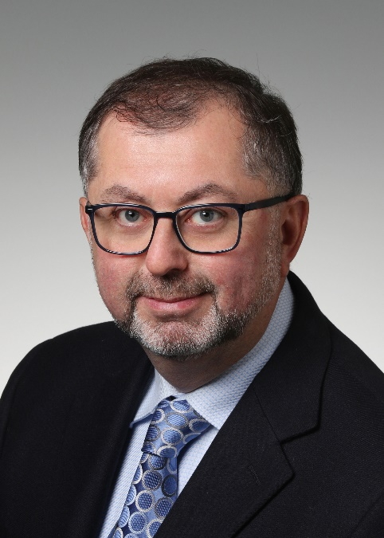
Dr. Halim Yanikomeroglu, Chancellor’s Professor, Carleton University, Canada
Areas of Research
Integrated Space/Stratospheric/Aerial/Terrestrial Network Architecture for 6G and Beyond
AI, Machine Learning, and Data Analytics for Wireless Networks
Real-time, dynamic, and personalized network slicing
Advanced PHY for 6G and Beyond
Power-domain & code-domain NOMA
Faster-than-Nyquist signaling
Intelligent reconfigurable surfaces (IRS)
Professional Accomplishments
Fellow of IEEE, Engineering Institute of Canada (EIC), Canadian Academy of Engineering (CAE), Asia-Pacific Artificial Intelligence Association (AAIA)
Distinguished Speaker, IEEE Communications Society
Distinguished Speaker, IEEE Vehicular Technology Society
Steering Committee Chair, IEEE Wireless Communications and Networking Conference
Recipient, 2018 IEEE ComSoc Wireless Communications Tech. Committee Recognition Award
Former Chair, IEEE ComSoc Technical Committee on Personal Communications
Principal Investigator, Carleton University Network 2030 Multidisciplinary Research Cluster
General Chair, IEEE VTC 2017-Fall Toronto & IEEE VTC 2010-Fall Ottawa
Tech. Program Chair, IEEE WCNC 2014 Istanbul, WCNC 2008 Las Vegas, WCNC 2004 Atlanta

