Slide 1
Low-Complexity Detection of M-ary PSK Faster-than-Nyquist Signaling
Ebrahim Bedeer*, Halim Yanikomeroglu**, Mohamed Hossam Ahmed***
*Ulster University, Belfast, UK
**Carleton University, Ottawa, ON, Canada
***Memorial University, St. John’s, NL, Canada
April 15, 2019

Slide 2
Agenda
Introduction
FTN Signaling System Model
Our FTN Signaling Contributions
Quasi-Optimal Detection (High SE)
Symbol-by-Symbol Detection (Low SE)
M-ary QAM Detection
M-ary PSK Detection
Conclusions

Slide 3
Introduction
Orthogonality is an advantage and a constraint.
Nyquist limit is more of a guideline than a rule.
Nyquist limit simplifies receive design by avoiding ISI.
Faster-than-Nyquist (FTN signaling) intentionally introduce ISI to improve SE.
Detection: Increased complexity

Slide 4
Introduction
FTN signaling concept exists at least since 1968 [Saltzberg-68].
FTN signaling term coined by Mazo in 1975 [Mazo-75].
Mazo Limit: FTN does not affect minimum distance of uncoded sinc binary transmission up to a certain range.
Mazo Limit: 1/0.802 → 25% faster than Nyquist
→ 25% in spectral efficiency.
Much faster Mazo limit: Possible, but with some SNR penalty.
Saltzberg B. Intersymbol interference error bounds with application to ideal bandlimited signaling. IEEE Transactions on Information Theory. July 1968; 14(4):563-8.
Mazo JE. Faster-than-Nyquist signaling. The Bell System Technical Journal. Oct. 1975; 54(8):1451-62.

Slide 5
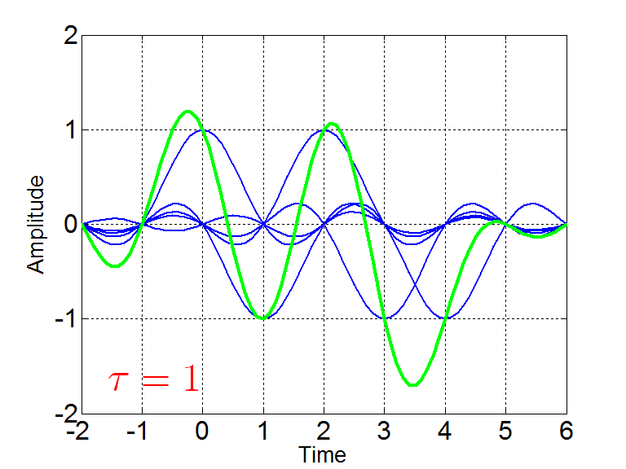
FTN Signaling Basic Idea

Slide 6
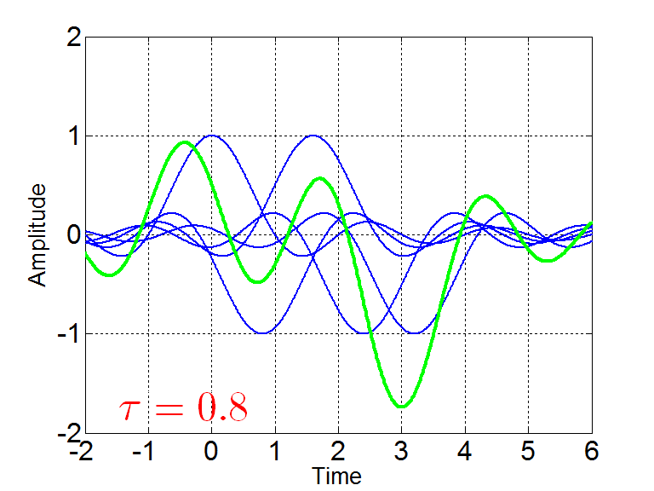
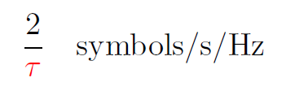
FTN Signaling Basic Idea

Slide 7
Extension of Mazo Limit
Other pulse shapes (root-raised cosine, Gaussian, …)
Non-binary transmission
Frequency domain

Slide 8
Our FTN Publications
Ebrahim Bedeer, Halim Yanikomeroglu, and Mohamed H. Ahmed, “Quasi-optimal sequence estimation of binary faster-than-Nyquist signaling”, IEEE ICC 2017, Paris, France.
Ebrahim Bedeer, Mohamed H. Ahmed, and Halim Yanikomeroglu, “A very low complexity successive symbol-by-symbol sequence estimator for binary faster-than-Nyquist signaling”, IEEE Access, March 2017.
Ebrahim Bedeer, Mohamed H. Ahmed, and Halim Yanikomeroglu, “Low-complexity detection of high-order QAM faster-than-Nyquist signaling”, IEEE Access, July 2017.
Ebrahim Bedeer, Halim Yanikomeroglu, and Mohamed H. Ahmed, “Low-Complexity Detection of M-ary PSK Faster-than-Nyquist Signaling”, IEEE WCNC 2019 Workshops, Marrakech, Morocco.

Slide 9
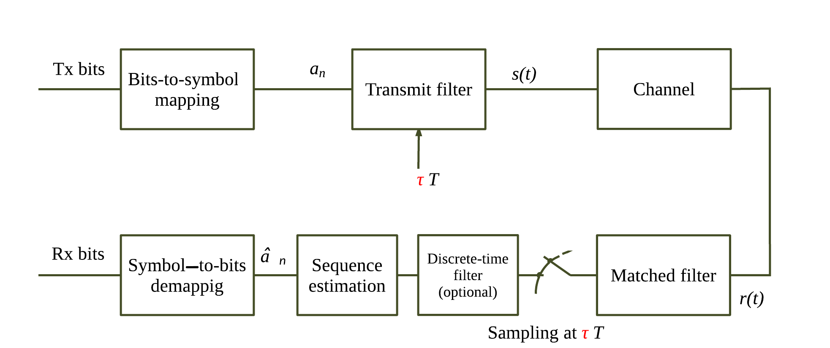
FTN Block Diagram

Slide 10
Our FTN Signaling Contributions
Quasi-Optimal Detection (High SE)
Ebrahim Bedeer, Halim Yanikomeroglu, and Mohamed H. Ahmed, “Quasi-optimal sequence estimation of binary faster-than-Nyquist signaling”, IEEE ICC 2017, Paris, France.

Slide 11
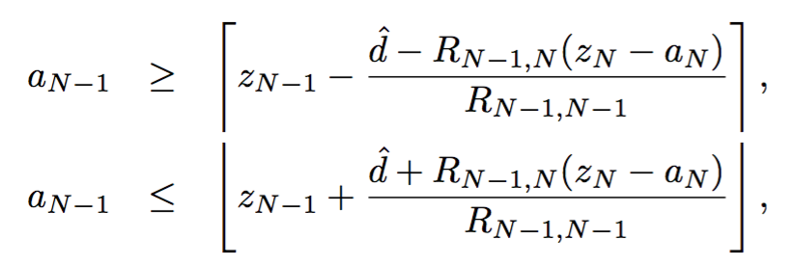
Modified Sphere Decoding (MSD)
Noise covariance matrix can be exploited to develop MSD.
Estimated data symbols can be found using MSD as

Slide 12
Simulation Results

Slide 13
Simulation Results

Slide 14
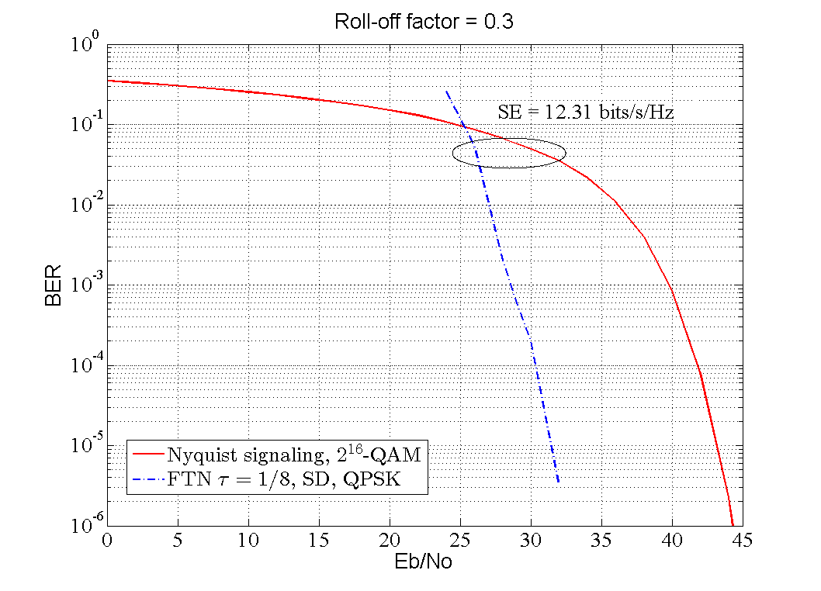
Simulation Results
Spectral Efficiency
SE= log2(M) x [1/(1+β)] x (1/τ) bits/s/Hz

Slide 15
Our FTN Signaling Contributions
Symbol-by-Symbol Detection (Low SE)
Ebrahim Bedeer, Mohamed H. Ahmed, and Halim Yanikomeroglu, “A very low complexity successive symbol-by-symbol sequence estimator for binary faster-than-Nyquist signaling”, IEEE Access, March 2017.

Slide 16
Successive Symbol-by-Symbol Sequence Estimation (SSSSE)
Received sample

Slide 17
Successive Symbol-by-Symbol Sequence Estimation (SSSSE)
Received sample
Perfect estimation condition for QPSK FTN signaling

Slide 18
Operating region of SSSSE

Slide 19
Successive Symbol-by-Symbol Sequence Estimation (SSSSE)
Received sample
Perfect estimation condition for QPSK FTN signaling
Estimated symbol

Slide 20
Successive Symbol-by-Symbol with go-back-K Sequence Estimation (SSSgbKSE)
Received sample
Estimated symbol

Slide 21
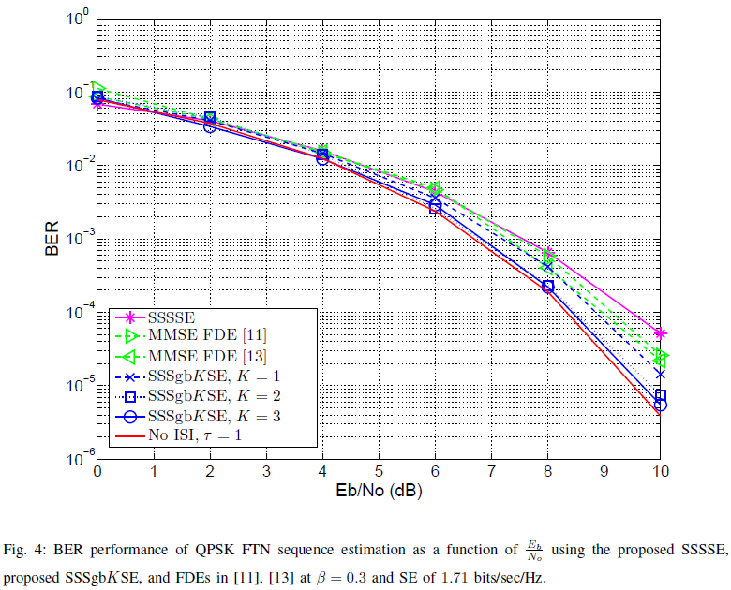
Simulation Results

Slide 22
Simulation Results

Slide 23
Our FTN Signaling Contributions
M-ary PSK Detection
Ebrahim Bedeer, Halim Yanikomeroglu, and Mohamed H. Ahmed, “Low-Complexity Detection of M-ary PSK Faster-than-Nyquist Signaling”, IEEE WCNC 2019 Workshops, Marrakech, Morocco.

Slide 24
FTN Detection Problem
Received sample
Received sampled signal in vector format
Received sampled signal after (optional) whitening filter

Slide 25
FTN Detection Problem
Received sampled signal
Maximum likelihood detection problem
Can be solved in polynomial time complexity using ideas from semidefinite relaxation and Gaussian randomization
NP-hard

Slide 26
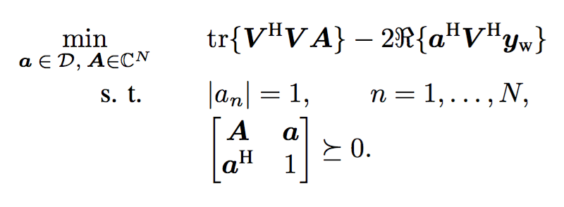
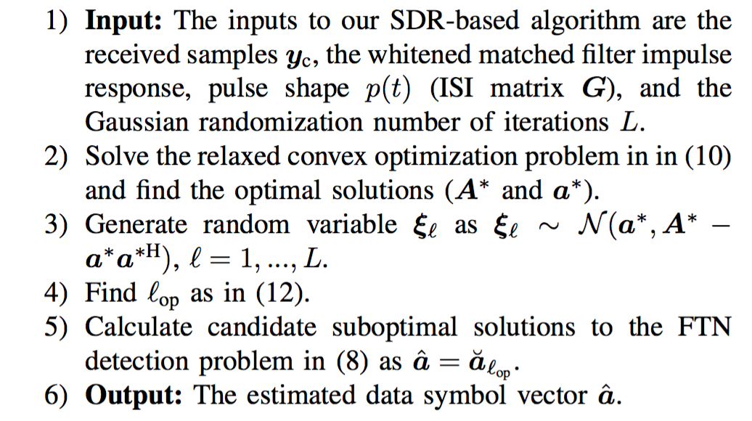
Proposed FTN Detection Scheme

Slide 27
Simulation Results
Spectral Efficiency
SE= log2(M) x [1/(1+β)] x (1/τ) bits/s/Hz
8-PSK
Roll-off factor: β = 0.3
Mazo limit: τ = 0.802
SE = 2.31 bits/s/Hz
17% increase in SE
→ excellent

Slide 28
Simulation Results
Spectral Efficiency
SE= log2(M) x [1/(1+β)] x (1/τ) bits/s/Hz
Roll-off factor: β = 0.5
Performance vs complexity tradeoff
Nyquist signaling
8-PSK
QPSK
QPSK, SE = 2 bits/s/Hz
J. B. Anderson and A. Prlja, “Turbo equalization and an M-BCJR algorithm for strongly narrowband intersymbol interference,” ISIT 2010.

Slide 29
Simulation Results

Slide 30
Conclusions
FTN signaling is promising to increase the SE.
Tradeoff between performance and complexity.
Gain of FTN increases at higher values of SE.
Channel coding?
AI / machine learning?

