Slide 1


Elham Kalantari*, Irem Bor-Yaliniz**, Abbas Yongacoglu*, and Halim Yanikomeroglu**
*School of Electrical Engineering and Computer Science, University of Ottawa, Canada
**Department of Systems and Computer Engineering, Carleton University, Canada
IEEE International Symposium on Personal, Indoor and Mobile Radio Communications
PIMRC 2017
User Association and Bandwidth Allocation for Terrestrial and Aerial Base Stations
with Backhaul Considerations
Outline
Introduction
System model
Proposed Algorithm
Performance evaluation
Conclusion
October 2017

Slide 2
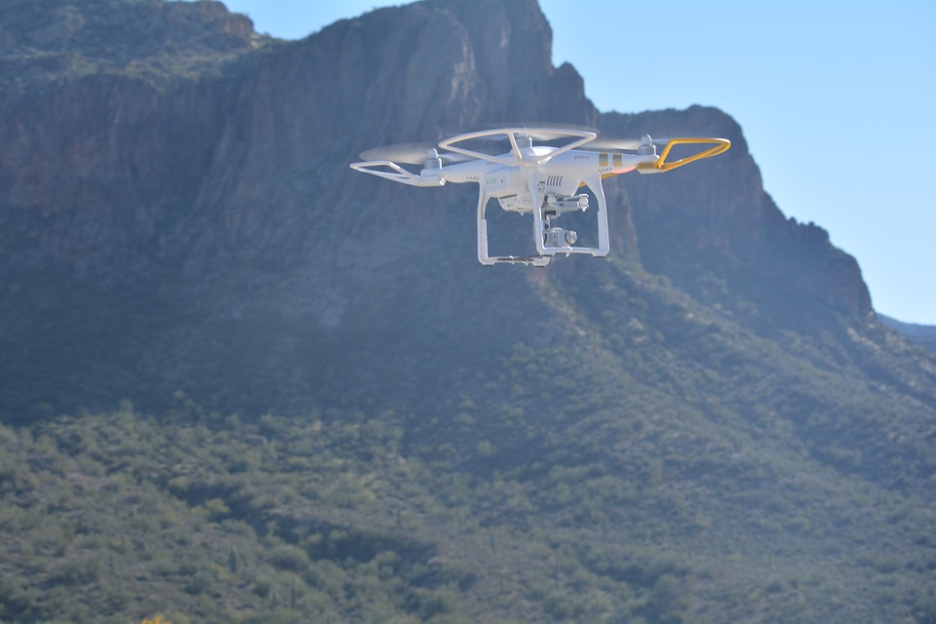
Outline
IEEE International Symposium on Personal, Indoor and Mobile Radio Communications
PIMRC 2017
Introduction
System model
Proposed Algorithm
Performance Evaluation
Conclusion
Outline
Introduction
System model
Proposed Algorithm
Performance evaluation
Conclusion

Slide 3
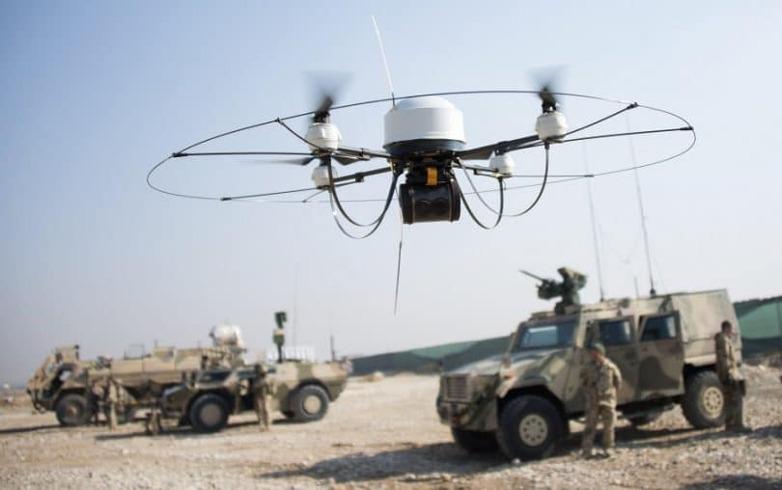
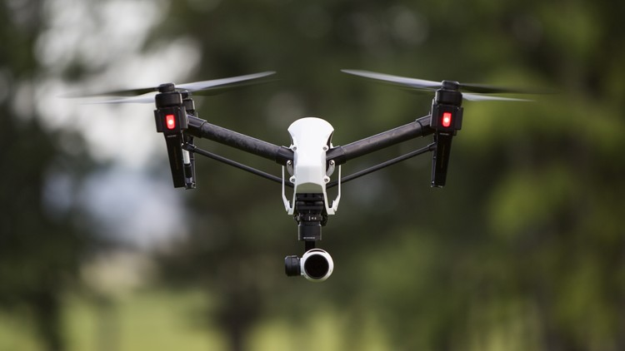
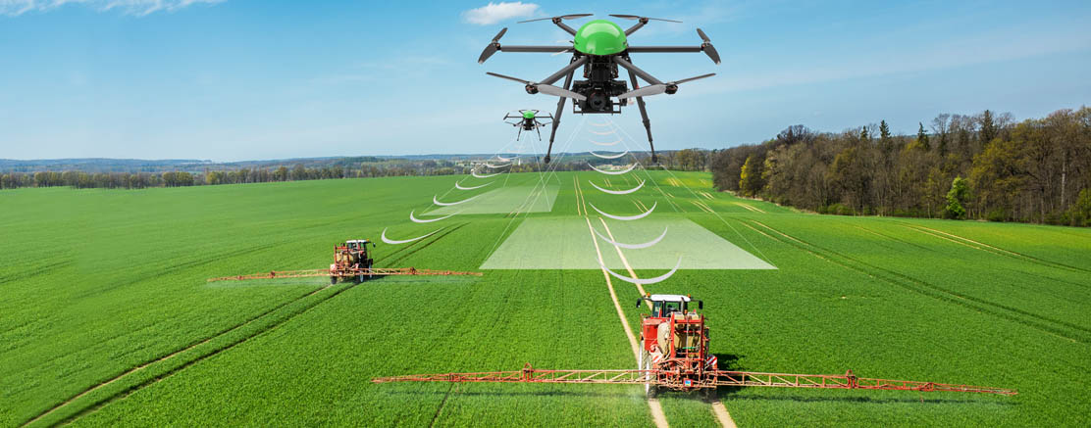

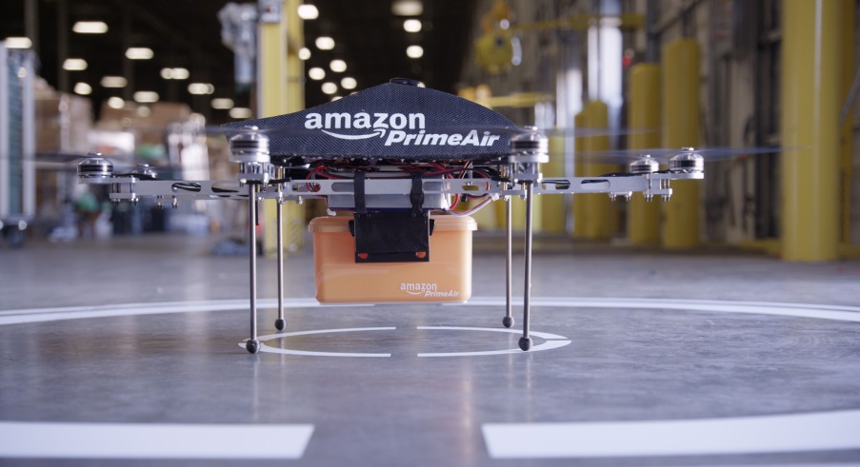
Different Applications of Drones
IEEE International Symposium on Personal, Indoor and Mobile Radio Communications
PIMRC 2017
Military
Outline
Introduction
System model
Proposed Algorithm
Performance evaluation
Conclusion
Agriculture
Aerial Photography
Product Delivery
Recreational Applications

Slide 4
Why Drone Base Stations?
IEEE International Symposium on Personal, Indoor and Mobile Radio Communications
PIMRC 2017
Terrestrial base stations’ locations is determined based on the long term average traffic.
However temporal and spatial variations in user densities and user application rates are expected to result in difficult-to-predict traffic patterns.
supply and demand mismatch.
To increase the agility and flexibility of the network, DRONES can be integrated into the wireless network as flying base stations.
➔ Bring supply wherever and whenever the demand is.
Outline
Introduction
System model
Proposed Algorithm
Performance evaluation
Conclusion

Slide 5
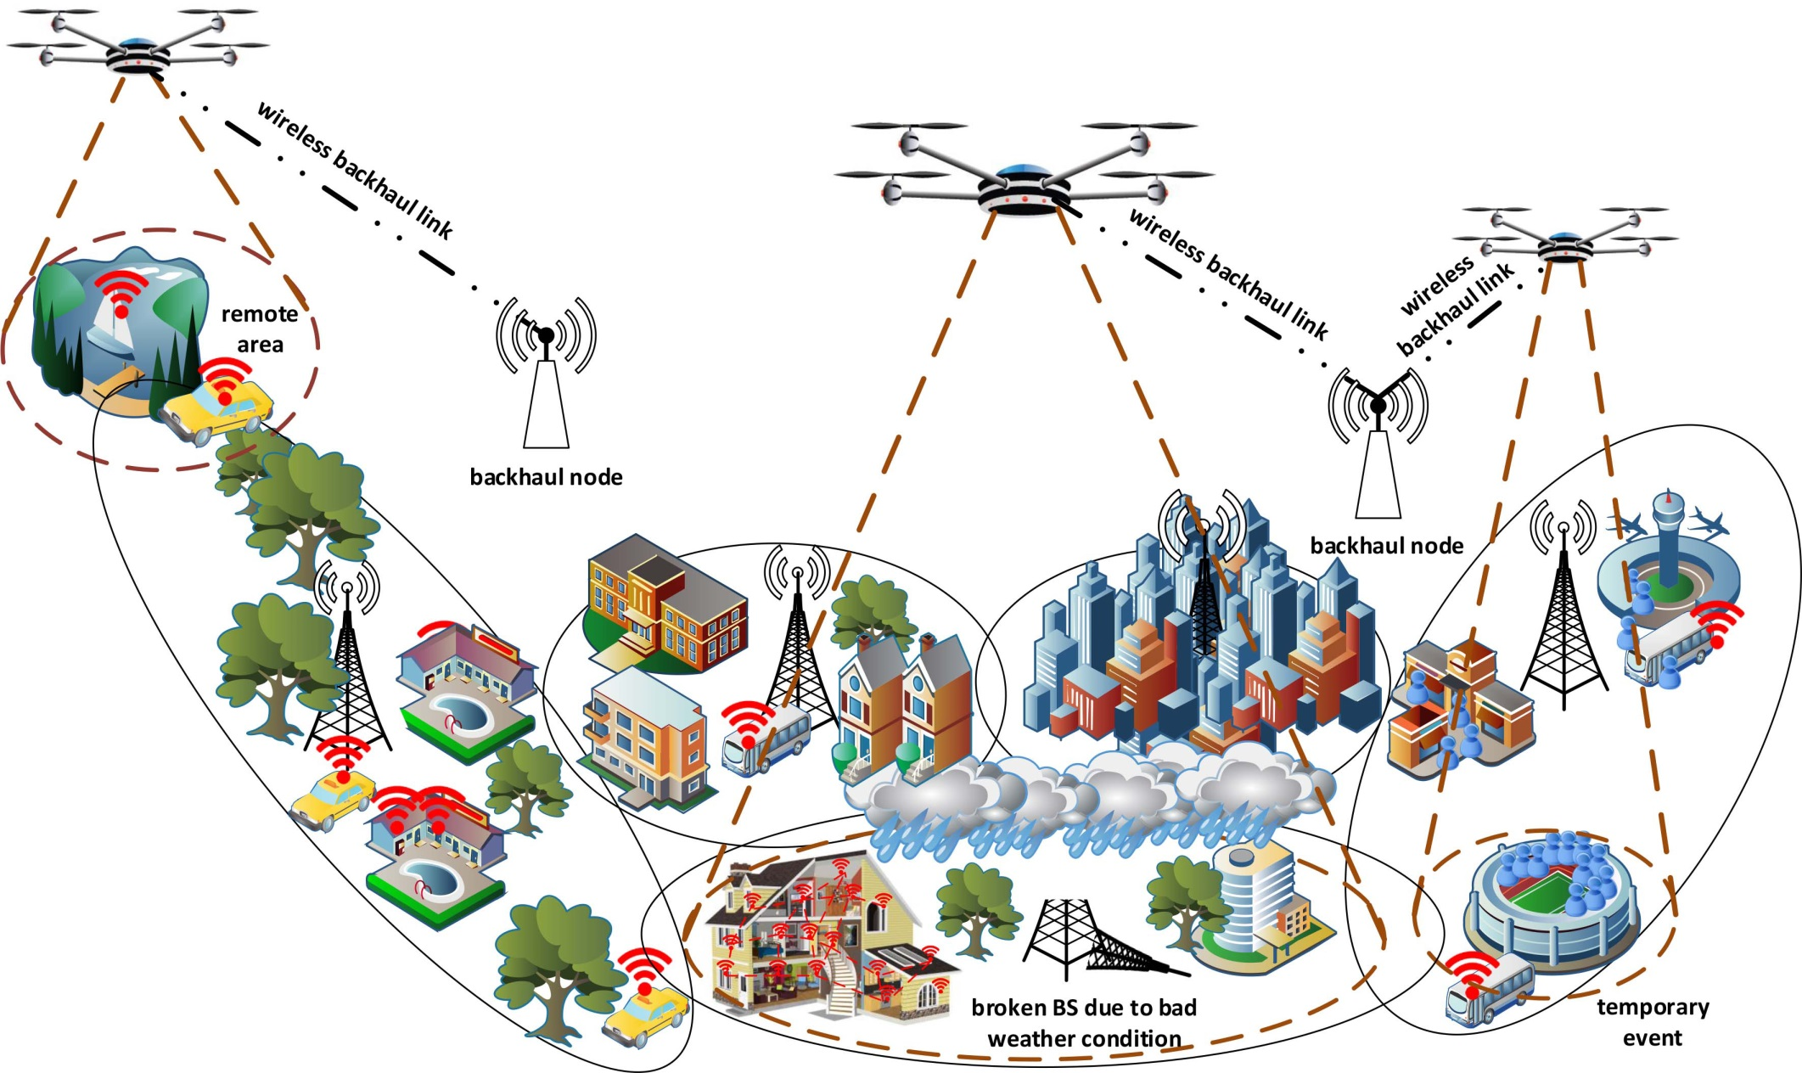
Various Use Cases for Integration of Drone-BSs in Cellular Networks
IEEE International Symposium on Personal, Indoor and Mobile Radio Communications
PIMRC 2017
Outline
Introduction
System model
Proposed Algorithm
Performance evaluation
Conclusion
- Temporary congestion issue
- Remote areas
- During aftermath of a disaster

Slide 6
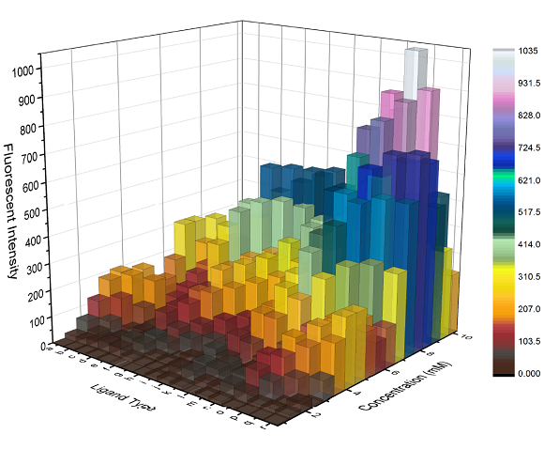
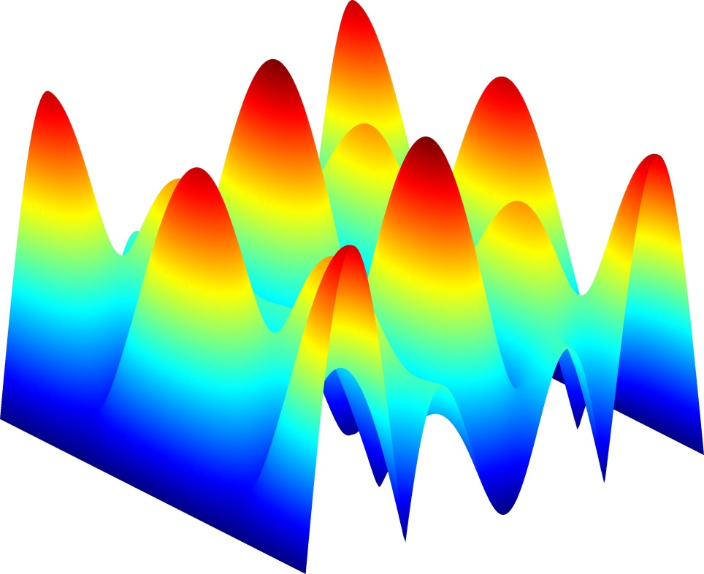
When Supply and Demand Do Not Match in Space and Time
IEEE International Symposium on Personal, Indoor and Mobile Radio Communications
PIMRC 2017
Outline
Introduction
System model
Proposed Algorithm
Performance evaluation
Conclusion
Can we store (in time) and/or transfer (in space) the supply?
If difficult, then more heterogeneous + more unpredictable → more problems

Slide 7
When Supply and Demand Do Not Match in Space and Time
IEEE International Symposium on Personal, Indoor and Mobile Radio Communications
PIMRC 2017
Outline
Introduction
System model
Proposed Algorithm
Performance evaluation
Conclusion
Can we store (in time) and/or transfer (in space) the supply?
If difficult, then more heterogeneous + more unpredictable → more problems
Ultra-Agile Infrastructure for Wireless Super-Connectivity

Slide 8
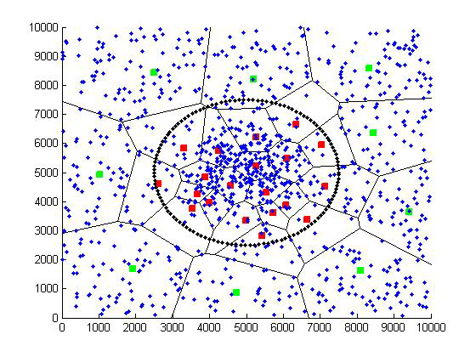
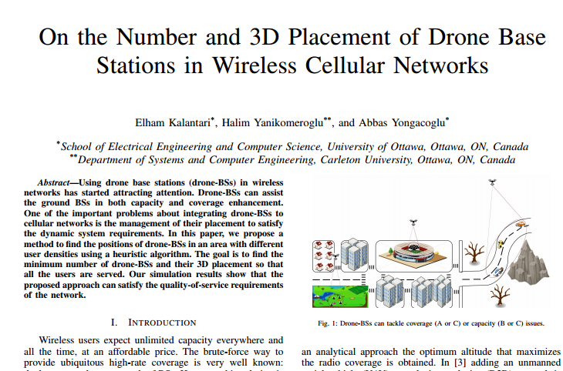
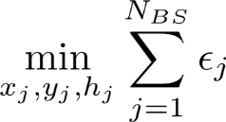
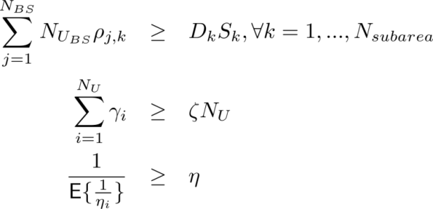
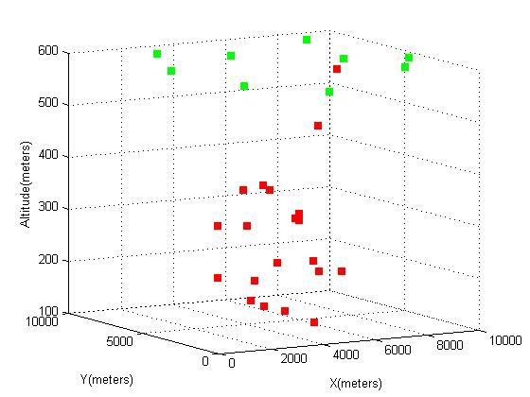
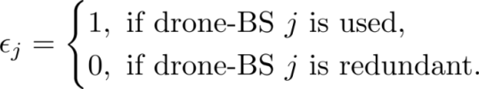
Previous work in VTC 2016
IEEE International Symposium on Personal, Indoor and Mobile Radio Communications
PIMRC 2017
Find the minimum number of drone-BSs and their 3D placement so that users with high data rates are served. *
Outline
Introduction
System model
Proposed Algorithm
Performance evaluation
Conclusion
Subject to:
Drone-BSs can change their altitudes in order to tackle coverage and capacity issues. A drone-BS decreases its altitude in a dense area to reduce interference to the users that are not served by it and increases its altitude to cover a large area in a low density region.
* Elham Kalantari, Halim Yanikomeroglu, and Abbas Yongacoglu, “On the number and 3D placement of drone base stations in wireless cellular networks”, IEEE Vehicular Technology Conference (VTC2016-Fall), 18–21 September 2016, Montreal, QC, Canada.

Slide 9
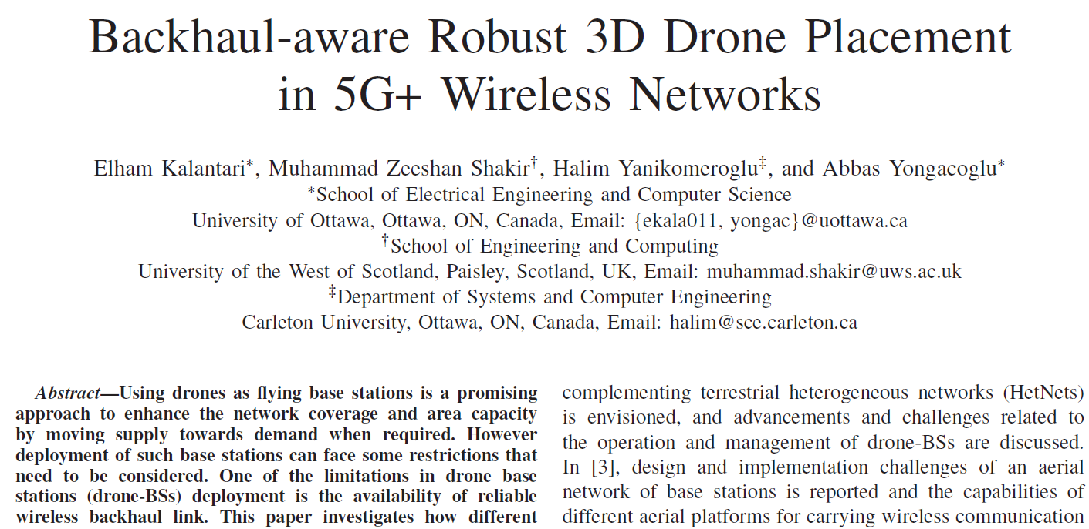
Previous work in ICC 2017
IEEE International Symposium on Personal, Indoor and Mobile Radio Communications
PIMRC 2017
Backhaul constraint is an important limitation in drone-BSs deployment.
A drone-BS should have a wireless backhaul; therefore, the peak data rate a drone-BS can support is limited and it may dramatically decrease due to inclement weather conditions especially if the link is based on the FSO or mmWave technology.
Outline
Introduction
System model
Proposed Algorithm
Performance evaluation
Conclusion
Find the maximum number of weighted users so that the bandwidth, backhaul, and coverage constraints are satisfied for different rate requirements in a clustered user distribution.*
* Elham Kalantari, Muhammad Zeeshan Shakir, Halim Yanikomeroglu, and Abbas Yongacoglu, “Backhaul-aware robust 3D drone placement in 5G+ wireless networks”, IEEE International Conference on Communications (ICC) 2017 – Workshop on Flexible Networks (FlexNets), 21 May 2017, Paris, France.

Slide 10
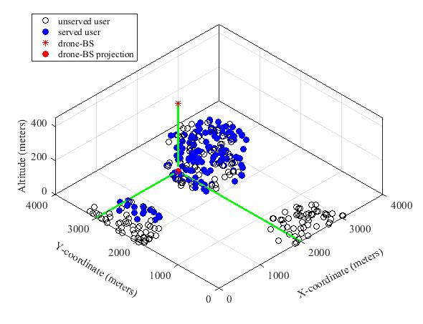
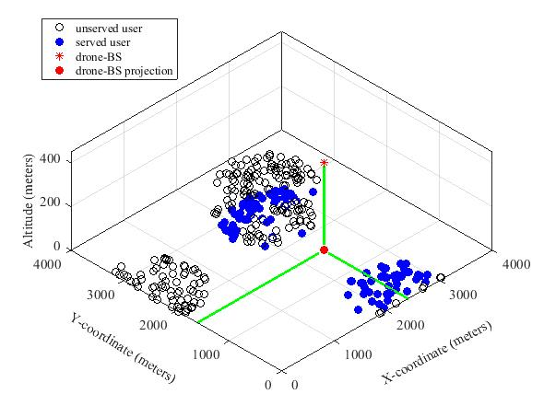
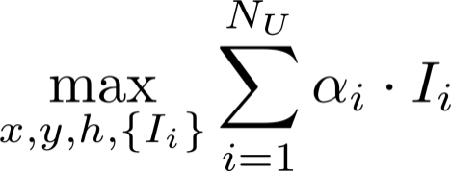
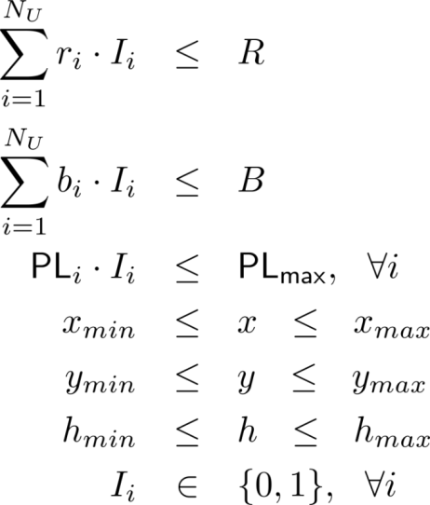
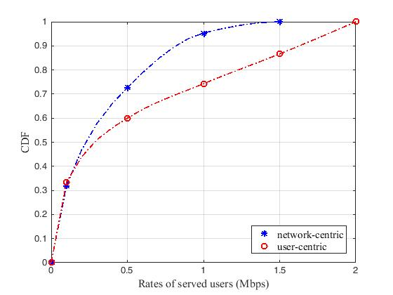
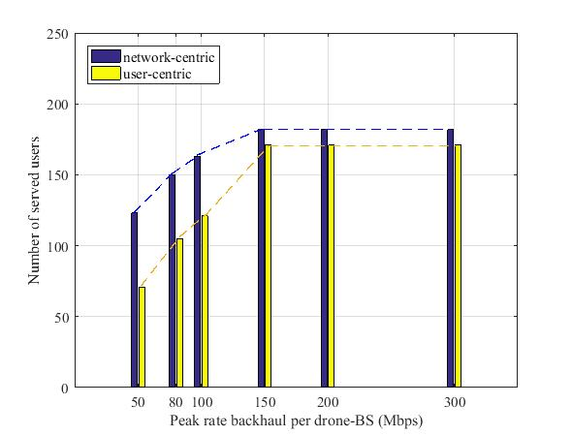
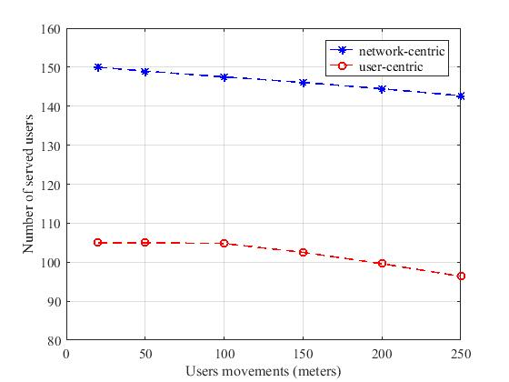
Previous work in ICC 2017
IEEE International Symposium on Personal, Indoor and Mobile Radio Communications
PIMRC 2017
Outline
Introduction
System model
Proposed Algorithm
Performance evaluation
Conclusion
Subject to:
network-centric
user-centric

Slide 11
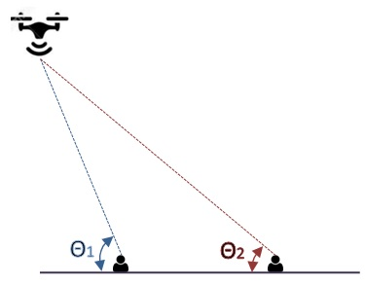




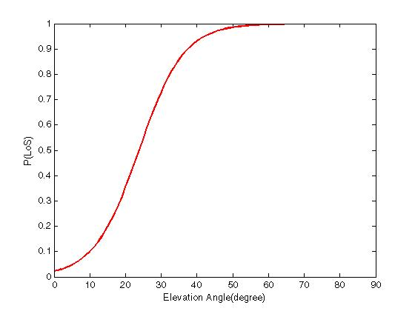
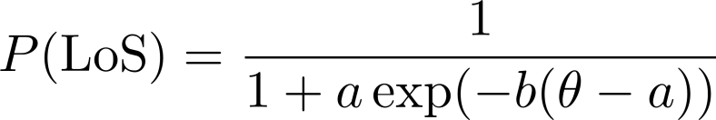
Air-to-Ground Channel Model
IEEE International Symposium on Personal, Indoor and Mobile Radio Communications
PIMRC 2017
Excessive pathloss due to LoS or NLoS channel between TX and RX
Outline
Introduction
System model
Proposed Algorithm
Performance evaluation
Conclusion
Probability of LoS:
P(LoS) increases as the elevation angle is increased.
- A. Al-Hourani, S. Kandeepan, and A. Jamalipour, “Modeling air-to-ground path loss for low altitude platforms in urban environments,” in IEEE Global Communications Conference (GLOBECOM), Dec 2014, pp. 2898–2904.
- A. Al-Hourani, S. Kandeepan, and S. Lardner, “Optimal LAP altitude for maximum coverage,” IEEE Wireless Communications Letters, vol. 3,no. 6, pp. 569–572, Dec 2014.

Slide 12
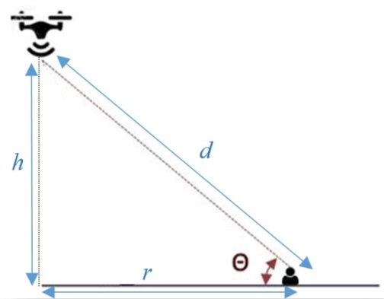
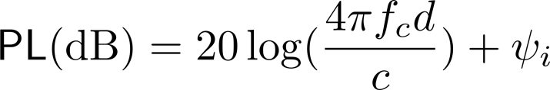
Air-to-Ground Channel Model
IEEE International Symposium on Personal, Indoor and Mobile Radio Communications
PIMRC 2017
Outline
Introduction
System model
Proposed Algorithm
Performance evaluation
Conclusion

Slide 13
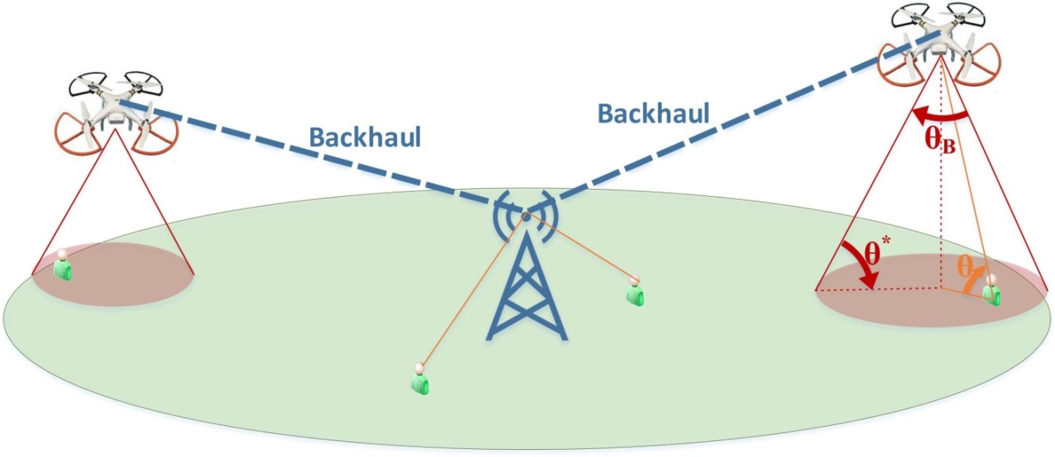
Problem Definition
IEEE International Symposium on Personal, Indoor and Mobile Radio Communications
PIMRC 2017
We assume downlink wireless HetNet including two tiers of BSs, an MBS and a number of DBSs.
Wireless Backhaul is not fixed unlike the previous work. In-band wireless backhaul is employed for DBSs and the MBS is utilized as a hub to connect DBSs to the network.
Outline
Introduction
System model
Proposed Algorithm
Performance evaluation
Conclusion
ITU classifications of 5G services:
Enhanced mobile broadband (eMBB),
Massive machine-type communications (mMTC),
Ultra reliable and low latency communications (uRLLC).
URLLC users with delay-sensitive applications co-exist with regular eMBB users.
The mobility of the DBSs and different types of users require that the following key issues are considered to provide wireless services efficiently:
Finding the locations of DBSs,
Determining the user-BS associations with consideration to user type,
Bandwidth allocation for access and backhaul links.

Slide 14
Bandwidth allocation
Backhaul spectrum
Dedicated backhaul
Shared backhaul with access side of drone-BS
Self-Interference
IEEE International Symposium on Personal, Indoor and Mobile Radio Communications
PIMRC 2017
The whole available bandwidth
Outline
Introduction
System model
Proposed Algorithm
Performance evaluation
Conclusion
α
1-α
Backhaul side of DBSs
Access side of DBSs and the MBS
To avoid self-interference, orthogonal frequency channels in the backhaul and access side of the DBSs is employed.
Bandwidth is shared between the access side of the MBS and DBSs.

Slide 15
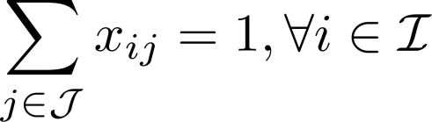
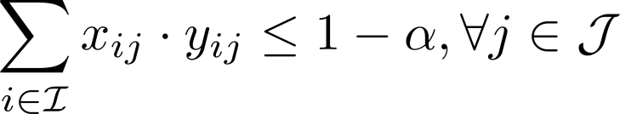
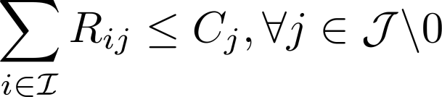
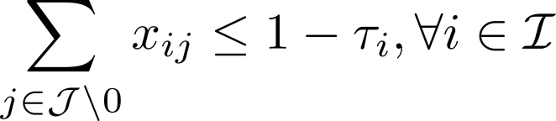

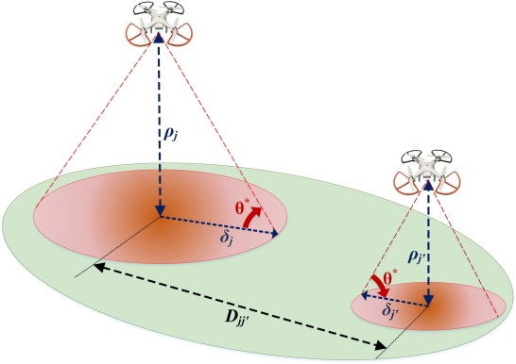
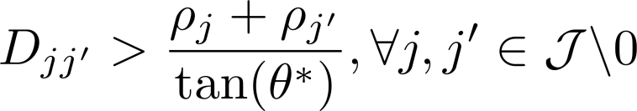
Problem Constraints
IEEE International Symposium on Personal, Indoor and Mobile Radio Communications
PIMRC 2017
Association with only one BS
Outline
Introduction
System model
Proposed Algorithm
Performance evaluation
Conclusion
Total available bandwidth
Backhaul constraint for DBSs
Delay-sensitive and delay-tolerant users
The DBS user should be in coverage footprint of the DBS
Minimum distance to avoid interference

Slide 16
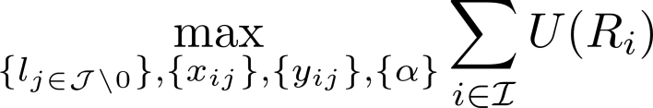

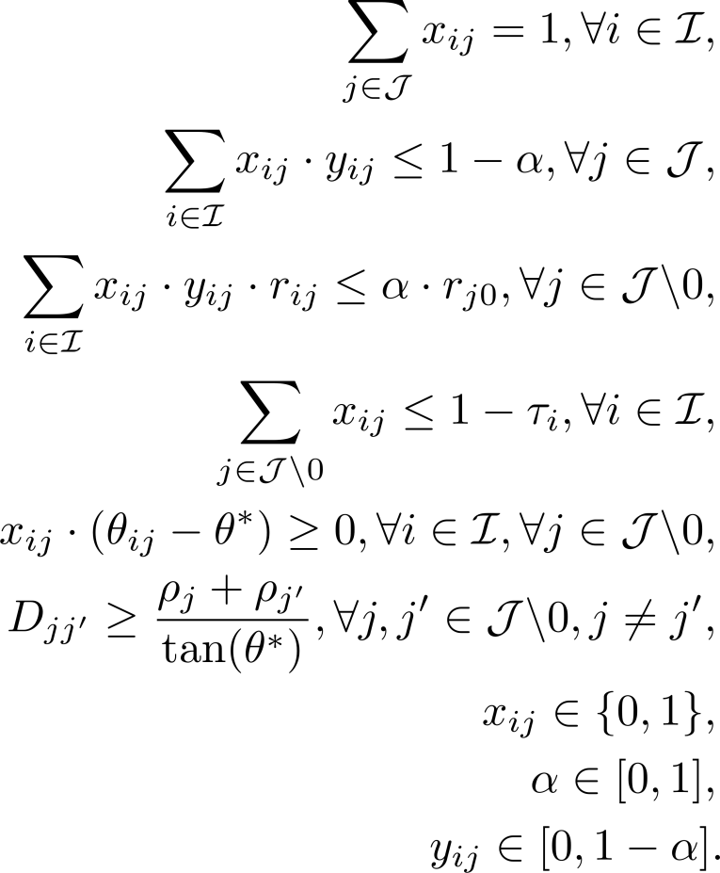

Problem Formulation
IEEE International Symposium on Personal, Indoor and Mobile Radio Communications
PIMRC 2017
Logarithmic utility function is assumed to consider fairness; therefore,
Outline
Introduction
System model
Proposed Algorithm
Performance evaluation
Conclusion
Subject to:
Equal resource allocation is the optimal allocation for the logarithmic utility; therefore,

Slide 17
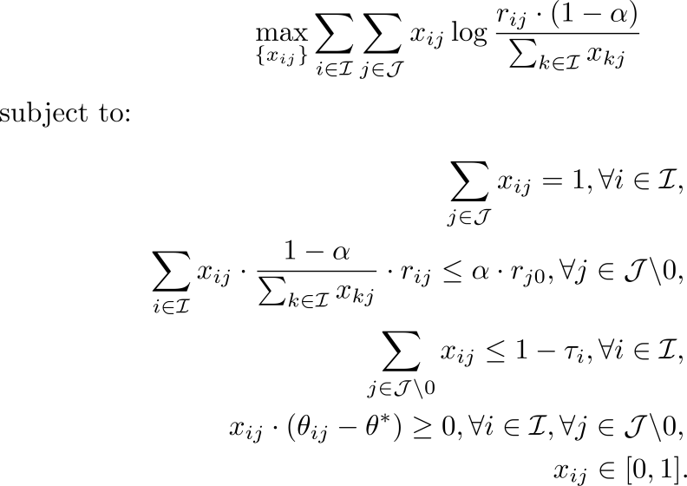
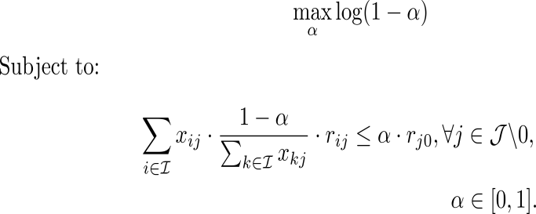

Proposed algorithm
IEEE International Symposium on Personal, Indoor and Mobile Radio Communications
PIMRC 2017
The procedure includes three main processes:
1- The user-BS association problem can be written as a convex sub problem for a fixed and locations of DBSs.
Outline
Introduction
System model
Proposed Algorithm
Performance evaluation
Conclusion
(a)
2- For fixed s (after rounding them), the convex master problem that finds can be solved.
(b)
3- Locations of DBSs are updated using PSO algorithm.
(c)

Slide 18
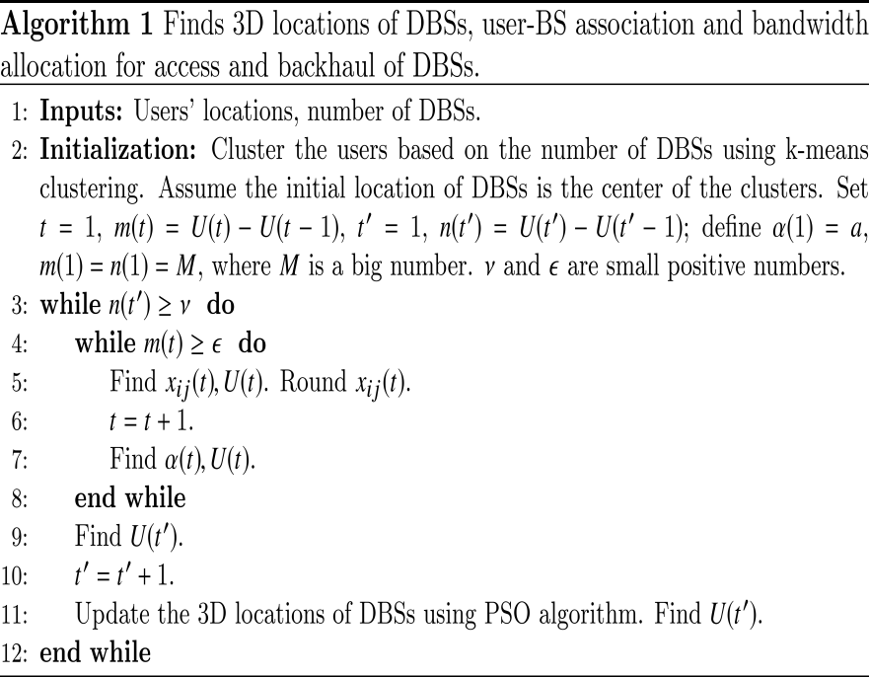
Flowchart for the proposed algorithm
IEEE International Symposium on Personal, Indoor and Mobile Radio Communications
PIMRC 2017
Start
Find initial placements for DBSs
Assume an initial value for
Outline
Introduction
System model
Proposed Algorithm
Performance evaluation
Conclusion
P.15 (c)
P.15 (a)
Find 3D locations of DBSs by PSO algorithm
Find the association indicators, round them, find the utility function
P.15 (b)
Update , update the utility function
Is convergence achieved?
No
No
Yes
Is convergence achieved?
Yes
End

Slide 19
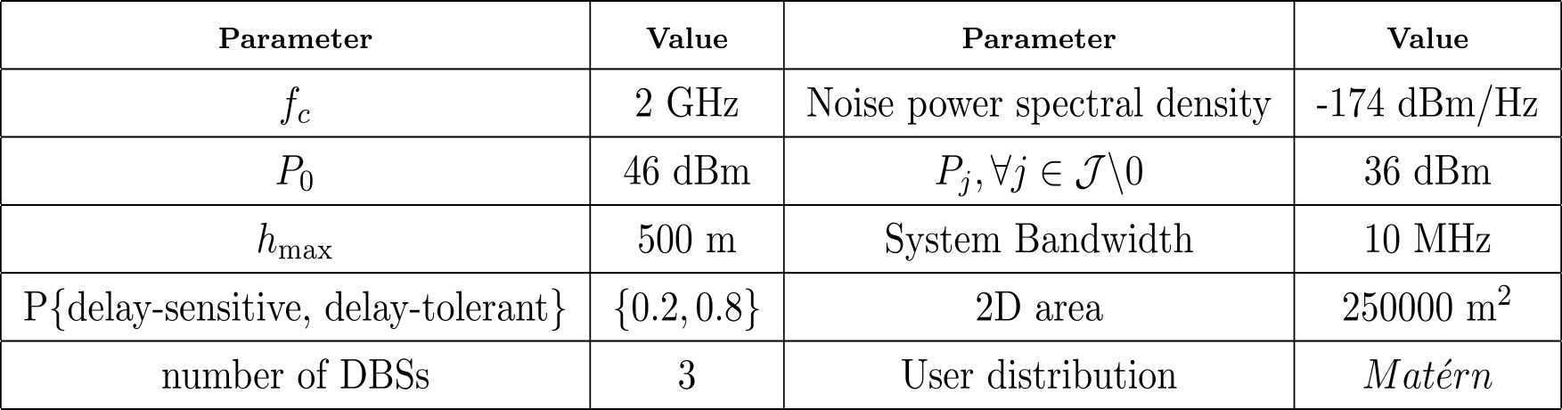

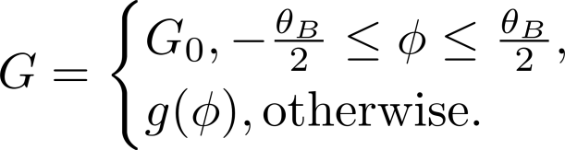

Simulation Assumptions
IEEE International Symposium on Personal, Indoor and Mobile Radio Communications
PIMRC 2017
Outline
Introduction
System model
Proposed Algorithm
Performance evaluation
Conclusion
Antenna gain for drone-BSs:

Slide 20
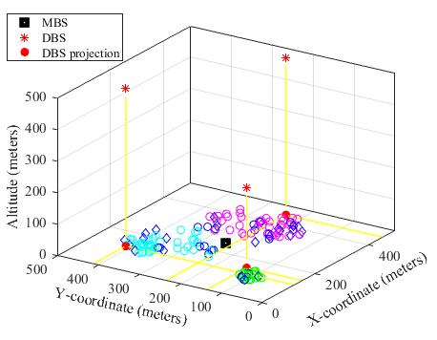
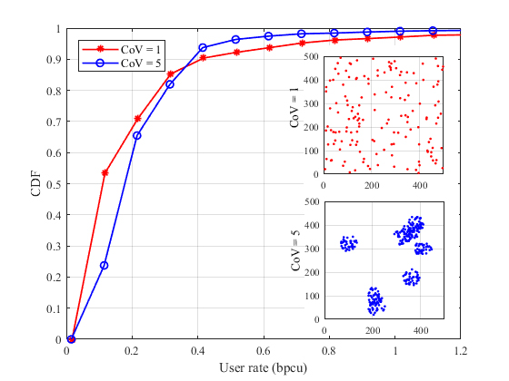

Simulation Results
IEEE International Symposium on Personal, Indoor and Mobile Radio Communications
PIMRC 2017
Outline
Introduction
System model
Proposed Algorithm
Performance evaluation
Conclusion
The heterogeneity of the users distribution is measured by the coefficient of variation (CoV) of the Voronoi area of the users.
In a more clustered distribution, the probability that each user receives a higher rate increases. This confirms that the proposed algorithm can increase the performance of the cellular network in terms of users’ satisfactions in more clustered distributions.

Slide 21
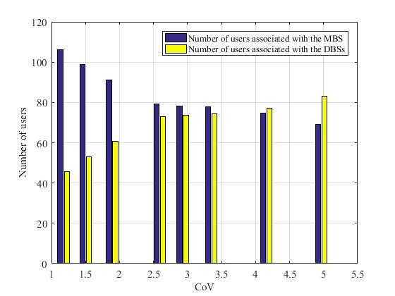
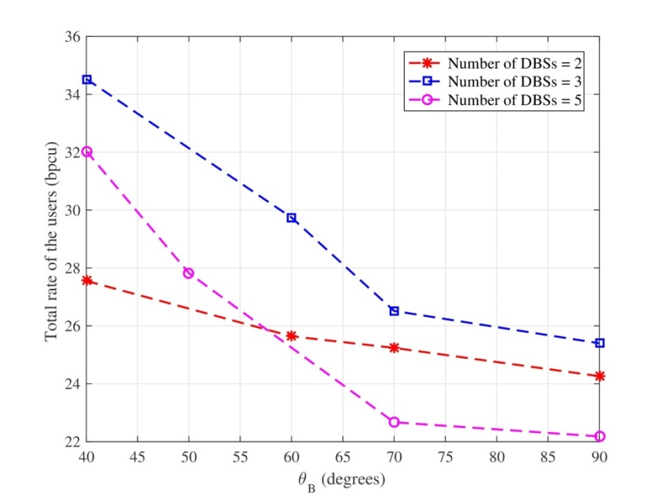
Simulation Results
IEEE International Symposium on Personal, Indoor and Mobile Radio Communications
PIMRC 2017
By increasing the CoV, more users could be associated with the DBSs which results in better load balancing in the system.
Outline
Introduction
System model
Proposed Algorithm
Performance evaluation
Conclusion
Increasing θB, increases the maximum possible coverage area. However, it also increases D, which means that to prevent overlapping, DBSs have to keep a larger distance between each other. Hence, the total capacity of users decreases, although the coverage radius increases with increasing θB.
The effect of θB becomes more severe as the number of utilized DBSs increases. Therefore, it is necessary to develop efficient interference cancellation methods for dense deployments of DBSs, since preventing overlaps between DBSs causes significant performance loss.

Slide 22
Conclusion
IEEE International Symposium on Personal, Indoor and Mobile Radio Communications
PIMRC 2017
Delay-sensitive users are associated with the MBS, while delay-tolerant users can be associated with either one of the BSs.
As all the DBSs share the same bandwidth, using directional antennas is proposed to relieve the effect of the interference.
User-BS association and wireless backhaul bandwidth allocation are found through a decomposition method and the locations of DBSs are updated using a PSO algorithm.
Further insights is obtained on the effects of CoV and halfpower beamwidth by simulations.
The results show that utilizing DBSs in cases where the users are clustered can increase total rate of the users associated with DBSs, despite depleting the resources.
In order to prevent interference, overlaps of coverage areas of different DBSs are not allowed. However, the half-power beamwidth should be chosen carefully for these scenarios, as the results show that increasing the beamwidth can decrease total rate by preventing DBSs to be deployed in beneficial locations.
Outline
Introduction
System model
Proposed Algorithm
Performance evaluation
Conclusion

Slide 23
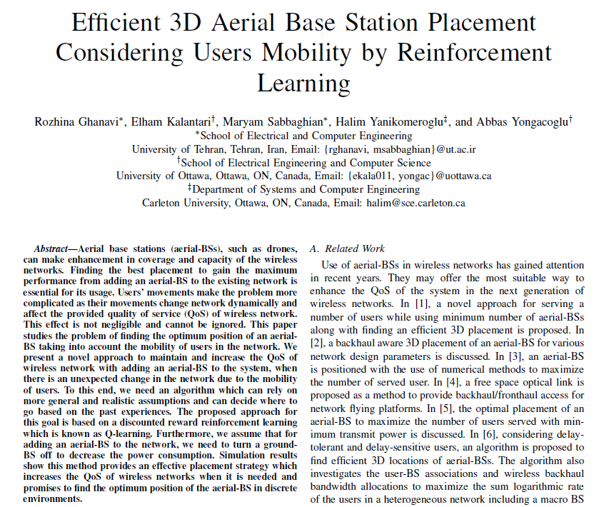
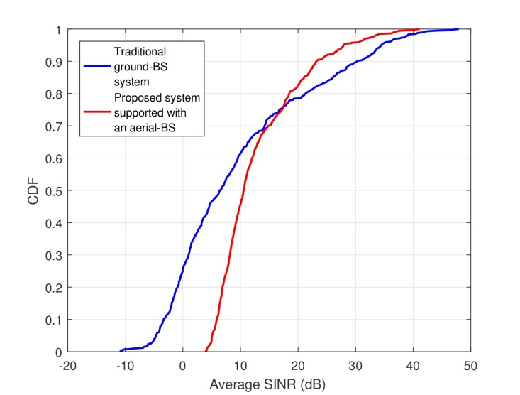
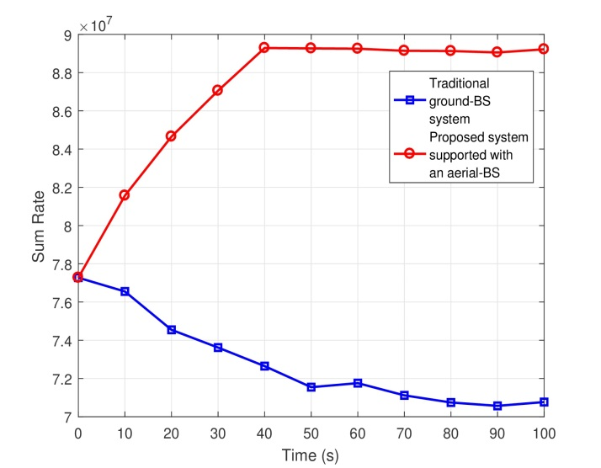
Under Review in WCNC 2018
IEEE International Symposium on Personal, Indoor and Mobile Radio Communications
PIMRC 2017
Find 3D location of a drone-BS while the users move base on Reinforcement learning method.
This method can bring much higher QoS to the network considering users’ movements.
After giving the agent sufficient time to learn the environment, the processing time to find the optimum position of the drone-BS becomes really low; therefore, it is a promising approach that can keep the agility and flexibility of the future wireless networks.
Outline
Introduction
System model
Proposed Algorithm
Performance evaluation
Conclusion

Slide 24
I. Bor-Yaliniz, HA. El-Keyi, Yanikomeroglu, “Spatial configuration of agile wireless networks with drone-BSs and user-iin-the-loop”, under review in IEEE Transactions on Wireless Communications, 2017.
I. Bor-Yaliniz, H. Yanikomeroglu, “The new frontier in RAN heterogeneity: Multi-tier drone-cells”, IEEE Communications Magazine, November 2016.
F. Lagum, I. Bor-Yaliniz, H. Yanikomeroglu, “Strategic densificationn with UAV-BSs for cellular networks”, under review in IEEE Wireless Communications Letters, 2017.
R. Ghanavi, E. Kalantari, M. Sabbaghian, H. Yanikomeroglu, A. Yongacoglu, “Efficient 3D aerial base station considering users mobility by reinforcement learning ”, u/r in IEEE WCNC 2018.
S. Andreev, V. Petrov, M. Dohler, H. Yanikomeroglu, “Future of ultra-dense networks beyond 5G: Harnessing heterogeneous moving cells”, under review in IEEE Communications Magazine, 2017.
M. Gapeyenko, I. Bor-Yaliniz, S. Andreev, H. Yanikomeroglu, Y. Koucheryavy, “Effect of blockage in deploying mmWave drone base stations for beyond-5G networks”, u/r in IEEE WCNC 2018.
I. Bor-Yaliniz, S.S. Szyszkowicz, H. Yanikomeroglu, "Environment aware drone-base-station placements in modern metropolitans”, under review in IEEE Wireless Communications Letters, 2017.
E. Kalantari, I. Bor-Yaliniz, A. Yongacoglu, H. Yanikomeroglu, “User association and bandwidth allocation for terrestrial and aerial base stations with backhaul considerations”, IEEE PIMRC 2017.
M. Alzenad, M.Z. Shakir, H. Yanikomeroglu, M.-S. Alouini, “FSO-based vertical backhaul/fronthaul framework for 5G+ wireless networks”, under review in IEEE Communications Magazine, 2017.
E. Kalantari, M.Z. Shakir, H. Yanikomeroglu, A. Yongacoglu, “Backhaul-aware robust 3D drone placement in 5G+ wireless networks”, IEEE ICC Workshops 2017.
M. Alzenad, A. El-Keyi, H. Yanikomeroglu, “3D placement of an unmanned aerial vehicle BS for maximum coverage of users with different QoS requirements”, IEEE Wireless Commun Letters, 2017.
E. Kalantari, H. Yanikomeroglu, A. Yongacoglu, “On the number and 3D placement of drone base stations in wireless cellular networks”, IEEE Vehicular Technology Conference (VTC2016-Fall).
M. Alzenad, A. El-Keyi, F. Lagum, H. Yanikomeroglu, “3D placement of unmanned aerial vehicle base station (UAV-BS) for energy-efficient maximal coverage”, IEEE Wireless Communications Letters, Aug 2017.
I. Bor Yaliniz, A. El-Keyi, H. Yanikomeroglu, “Efficient 3-D placement of an aerial base station in next generation cellular networks”, IEEE ICC 2016.
Notes:
Routing, subchannel scheduling, and power allocation are generally treated as separate problems.
They are mostly modeled using NLP to maximize either sum rate or minimum rate.
Although separation of problems simplifies modeling, it degrades network efficiency,
Low sum rate
Low minimum rate.

