Slide 1
Elham Kalantari*, Muhammad Zeeshan Shakir**, Halim Yanikomeroglu***, and Abbas Yongacoglu* *School of Electrical Engineering and Computer Science, University of Ottawa, ON, Canada **School of Engineering and Computing, University of the West of Scotland, Paisley, Scotland, UK ***Department of Systems and Computer Engineering, Carleton University, ON, Canada
IEEE International Conference on Communications
ICC 2017
Backhaul-aware Robust 3D Drone Placement
in 5G+ Wireless Networks
Outline
Introduction
System model
Optimization problem
Simulation results
Conclusion
May 2017

Slide 2
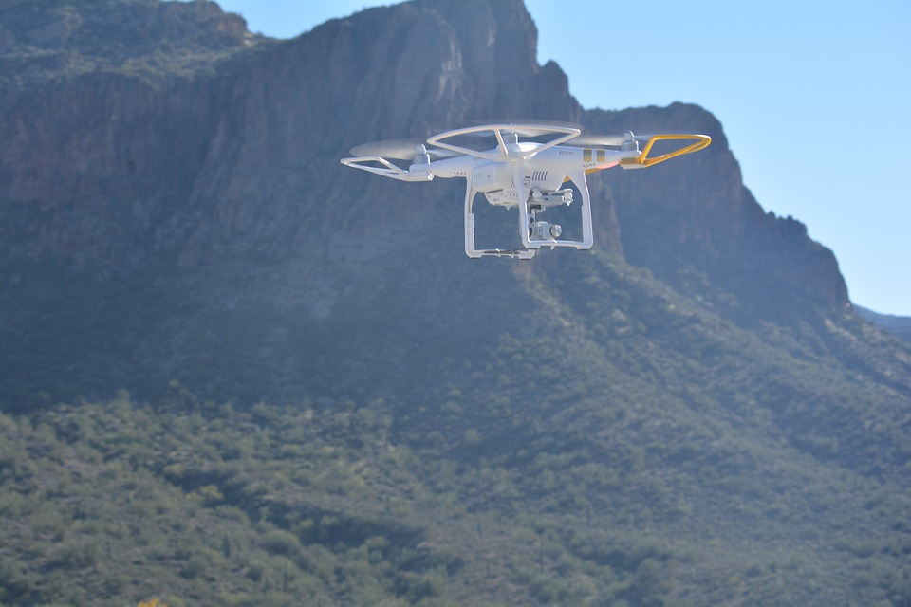
Outline
IEEE International Conference on Communications
ICC 2017
Introduction
System model
Optimization problem
Simulation results
Conclusion
Outline
Introduction
System model
Optimization problem
Simulation results
Conclusion

Slide 3
Why Drone Base Stations?
IEEE International Conference on Communications
ICC 2017
Terrestrial base stations’ locations is determined based on the long term average traffic.
However temporal and spatial variations in user densities and user application rates are expected to result in difficult-to-predict traffic patterns.
supply and demand mismatch.
How to satisfy the users who expect unlimited capacity everywhere and all the time?
Solution: deploy a very dense network of BSs.
Drawback: infeasible in terms of expenses, many of them are lightly loaded at a given time.
Outline
Introduction
System model
Optimization problem
Simulation results
Conclusion
Solution: Bring supply wherever and whenever the demand is by using drone base stations.

Slide 4
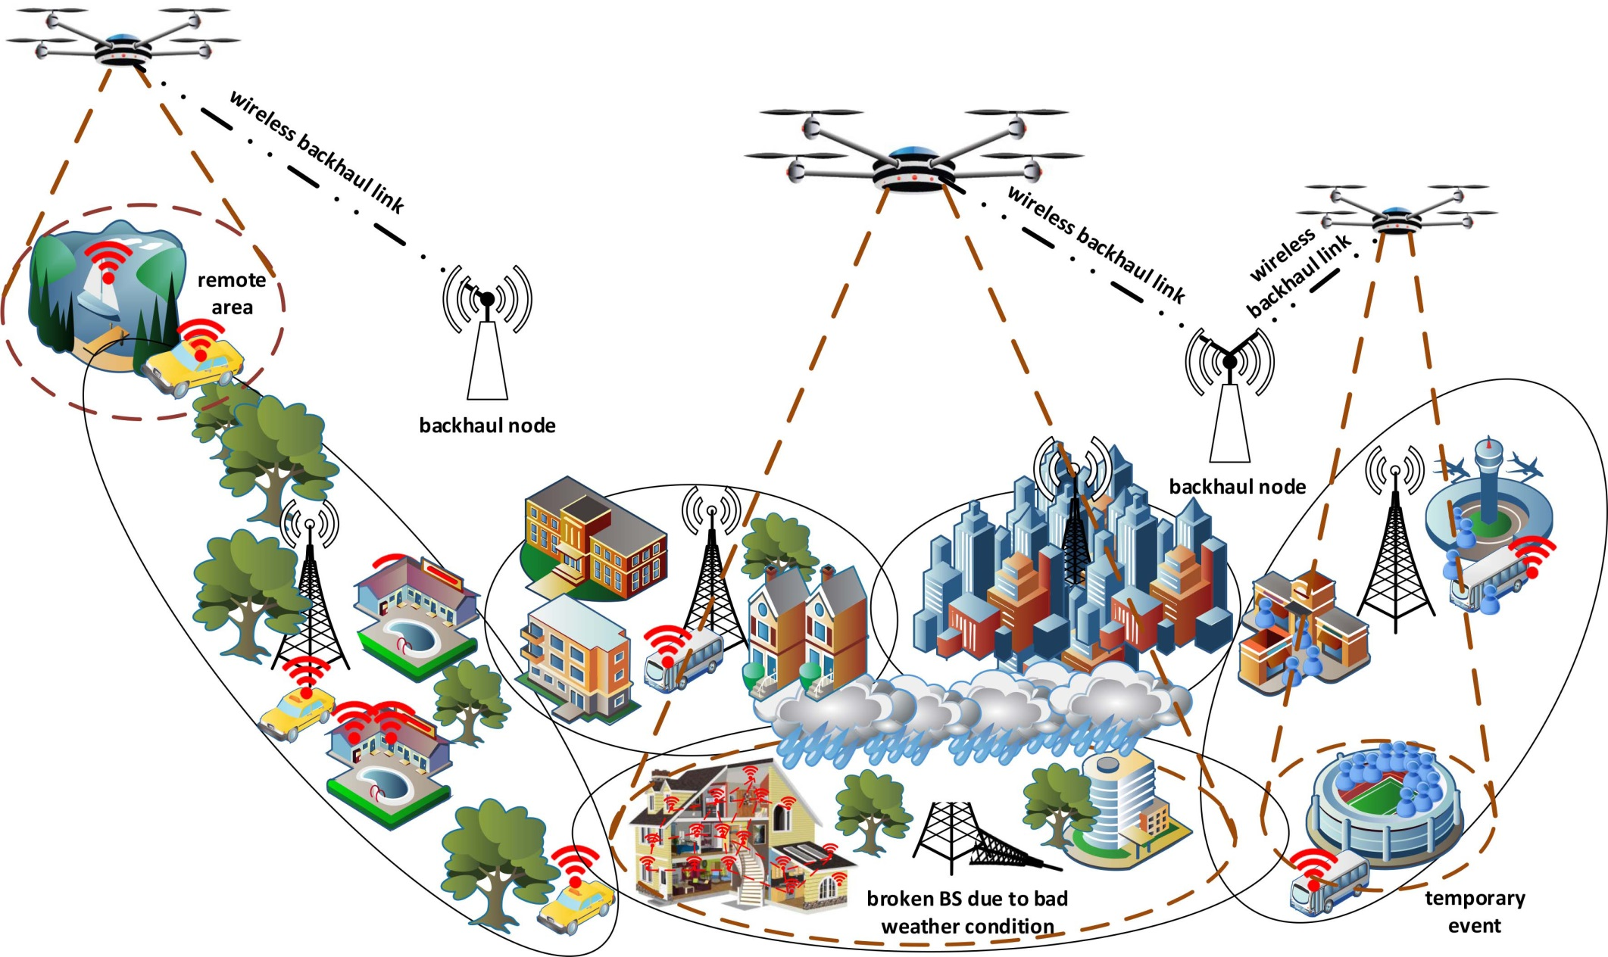
Various Use Cases for Integration of Drone-BSs in Cellular Networks
IEEE International Conference on Communications
ICC 2017
Outline
Introduction
System model
Optimization problem
Simulation results
Conclusion
- Temporary congestion issue
- Remote areas
- During aftermath of a disaster

Slide 5
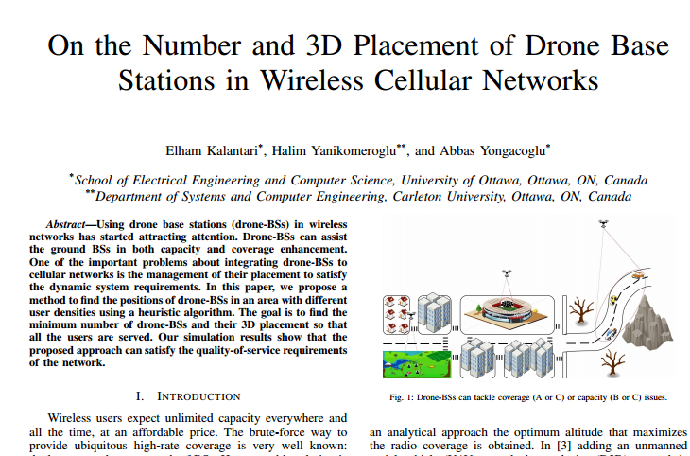
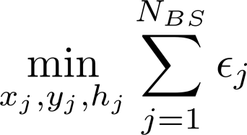
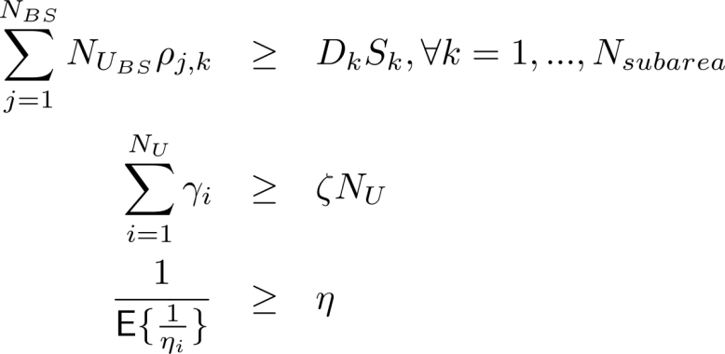
Previous work
IEEE International Conference on Communications
ICC 2017
Find the minimum number of drone-BSs and their 3D placement so that users with high data rates are served. *
Outline
Introduction
System model
Optimization problem
Simulation results
Conclusion
Subject to:
* Elham Kalantari, Halim Yanikomeroglu, and Abbas Yongacoglu, “On the number and 3D placement of drone base stations in wireless cellular networks”, IEEE Vehicular Technology Conference (VTC2016-Fall), 18–21 September 2016, Montreal, QC, Canada.

Slide 6
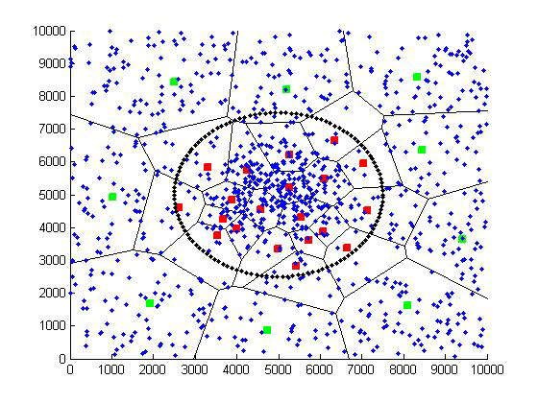
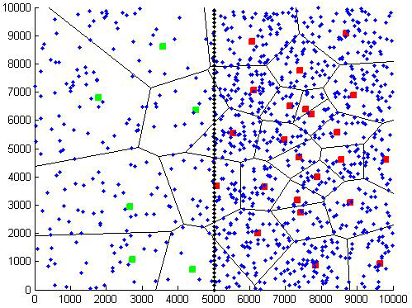
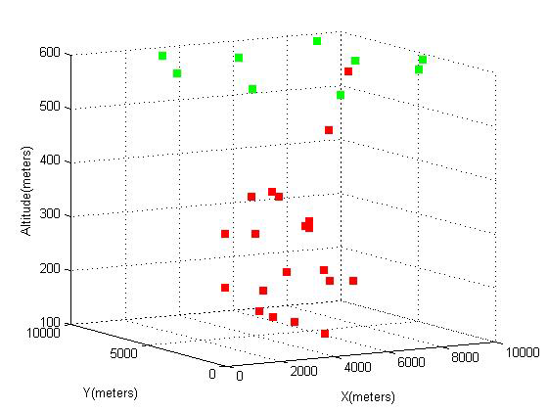
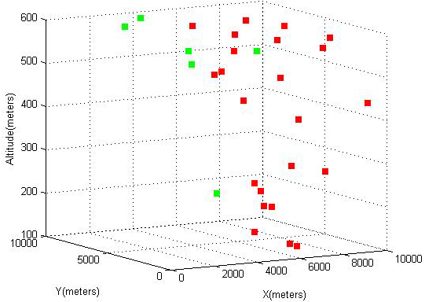
Previous work
IEEE International Conference on Communications
ICC 2017
Outline
Introduction
System model
Optimization problem
Simulation results
Conclusion
Number of drones are proportional with the user density of the area.
Drone-BSs can change their altitudes in order to tackle coverage and capacity issues. A drone-BS decreases its altitude in a dense area to reduce interference to the users that are not served by it and increases its altitude to cover a large area in a low density region.

Slide 7
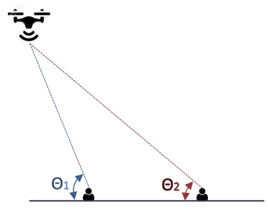
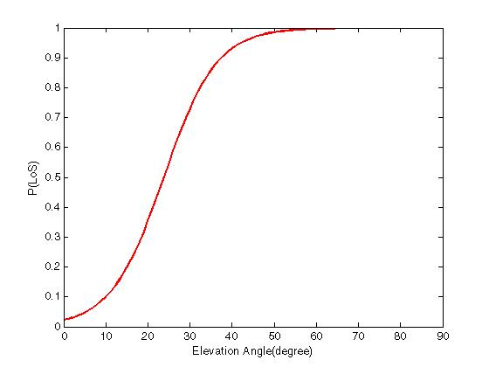
Air-to-Ground Channel Model
IEEE International Conference on Communications
ICC 2017
Excessive pathloss due to LoS or NLoS channel between TX and RX
Outline
Introduction
System model
Optimization problem
Simulation results
Conclusion
Probability of LoS:
P(LoS) increases as the elevation angle is increased.
- A. Al-Hourani, S. Kandeepan, and A. Jamalipour, “Modeling air-to-ground path loss for low altitude platforms in urban environments,” in IEEE Global Communications Conference (GLOBECOM), Dec 2014,pp. 2898–2904.
- A. Al-Hourani, S. Kandeepan, and S. Lardner, “Optimal LAP altitude for maximum coverage,” IEEE Wireless Communications Letters, vol. 3,no. 6, pp. 569–572, Dec 2014.

Slide 8
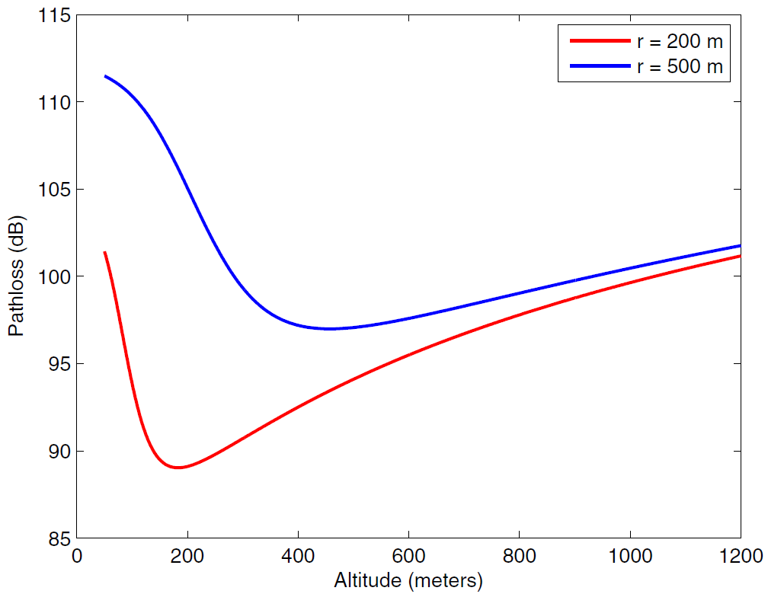
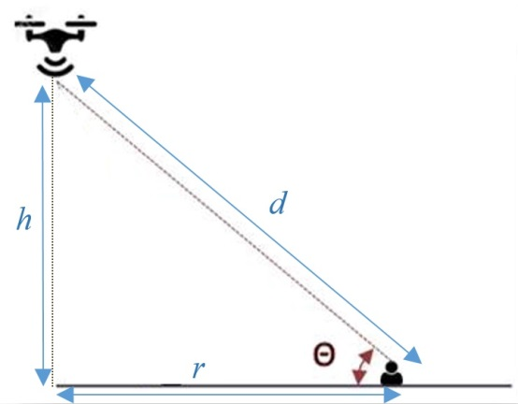
Air-to-Ground Channel Model
IEEE International Conference on Communications
ICC 2017
Free Space Pathloss
Outline
Introduction
System model
Optimization problem
Simulation results
Conclusion
LoS Loss
NLoS Loss
By increasing the altitude of a drone-BS, the pathloss first decreases and then increases.

Slide 9
Air-to-Ground Channel Model
IEEE International Conference on Communications
ICC 2017
Outline
Introduction
System model
Optimization problem
Simulation results
Conclusion
By increasing the altitude of a drone-BS, the pathloss first decreases and then increases.
In low altitudes, the probability of NLoS is much higher than LoS. By increasing the altitude, NLoS probability decreases and path loss will decrease, too.
The pathloss is also dependent on the distance between the transmitter and the receiver, so after a specific height, this factor dominates and by increasing the altitude, the pathloss will increase again.
Drone-BS: A new tier in multi-tier cellular networks (HetNets)

Slide 10
Optimization Problem
IEEE International Conference on Communications
ICC 2017
Backhaul constraint is an important limitation in drone-BSs deployment.
A drone-BS should have a wireless backhaul; therefore, the peak data rate a drone-BS can support is limited and it may dramatically decrease due to inclement weather conditions especially if the link is based on the FSO or mmWave technology.
It is important to consider the limitations and requirements of the wireless backhaul link as one of the constraints in designing and deploying drone-BSs in future 5G+ networks.
Here, we try to find the maximum number of weighted users so that the bandwidth, backhaul, and coverage constraints are satisfied for different rate requirements in a clustered user distribution.
Outline
Introduction
System model
Optimization problem
Simulation results
Conclusion

Slide 11
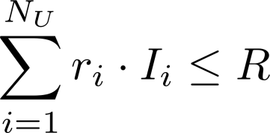
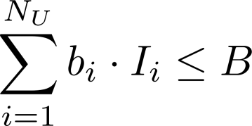
Problem constraints
IEEE International Conference on Communications
ICC 2017
Backhaul constraint
Outline
Introduction
System model
Optimization problem
Simulation results
Conclusion
Available spectrum constraint
Coverage constraint

Slide 12
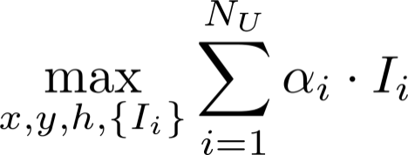
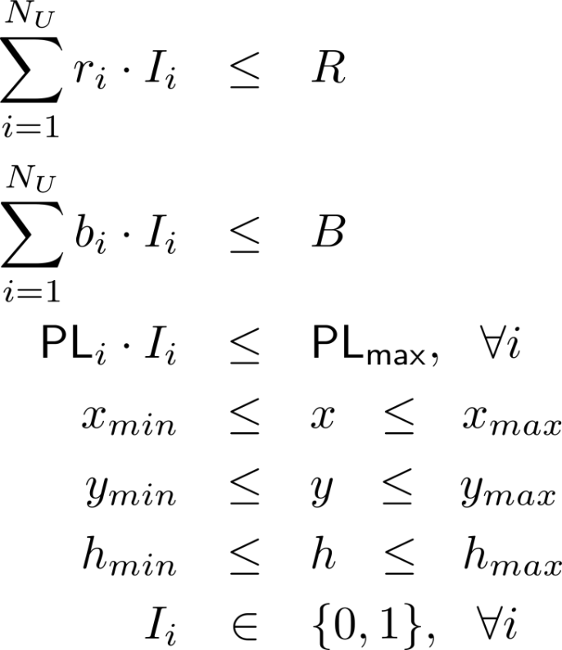
Optimization problem
IEEE International Conference on Communications
ICC 2017
Determined based on the system, whether it is network centric or user centric.
Outline
Introduction
System model
Optimization problem
Simulation results
Conclusion
Subject to:
Too complicated,
Use exhaustive search.

Slide 13
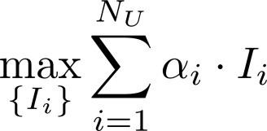
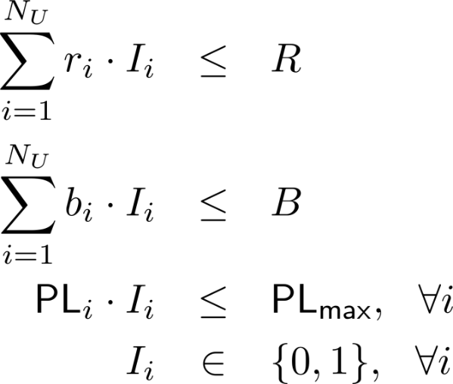
Optimization problem
IEEE International Conference on Communications
ICC 2017
In each candidate coordinates of the drone-BS, the problem can be transformed to a binary integer linear programming (BILP).
Outline
Introduction
System model
Optimization problem
Simulation results
Conclusion
Subject to:
Solve via Branch and Bound (B&B) method.

Slide 14
Network centric vs. user centric
IEEE International Conference on Communications
ICC 2017
Outline
Introduction
System model
Optimization problem
Simulation results
Conclusion
Network-centric:
User-centric: changes based on the priority of the users.
Different metrics to identify priority:
Sum-rate
Price differentiation
Signal strength
Content demand

Slide 15
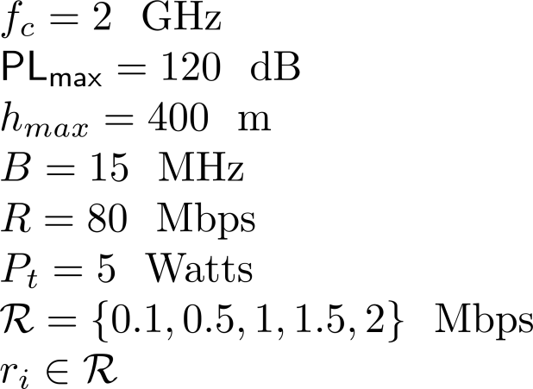
Simulation parameters
IEEE International Conference on Communications
ICC 2017
Outline
Introduction
System model
Optimization problem
Simulation results
Conclusion

Slide 16
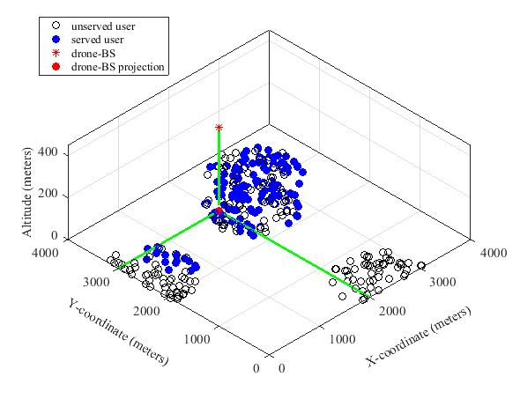
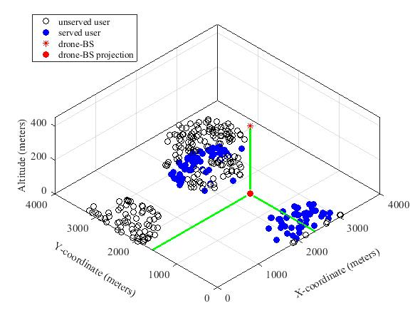
User Distribution and 3D Drone-BS Placement
IEEE International Conference on Communications
ICC 2017
Outline
Introduction
System model
Optimization problem
Simulation results
Conclusion
Network-centric
User-centric
In both approaches the drone-BS moves to the highest possible altitude to cover a larger area.
In the network-centric approach, more users are served compared to the user-centric approach.
There is a license fee related to spectrum usage that a service provider has to pay which is based on how much bandwidth per person is utilized over a geographical area. Therefore the network-centric approach may be a more favorable option for a service provider as it pays less for the spectrum usage.

Slide 17
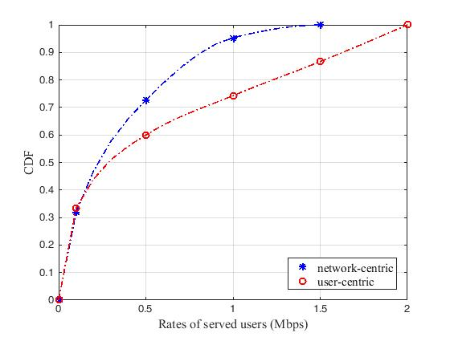
CDF Comparison for User-Centric and Network-Centric Approaches
IEEE International Conference on Communications
ICC 2017
More probable to serve users with lower rate requirement in network-centric approach.
Outline
Introduction
System model
Optimization problem
Simulation results
Conclusion
Higher number of total served users in this approach.

Slide 18
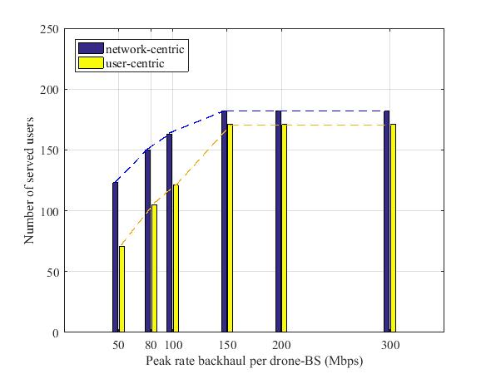
Backhaul Limitation
IEEE International Conference on Communications
ICC 2017
Dedicated Backhaul:
can be a FSO or mmWave link between access and core networks. Such links can provide very high backhaul capacity, but they are very sensitive to weather conditions; in foggy or rainy weather, the
peak rate may dramatically decrease.
In-band Backhaul:
Microwave backhaul can be deployed very quickly at a relatively low cost. By using RF for backhaul, the same spectrum is used in both the access and backhaul links, so it causes interference and the capacity of the backhaul connection is affected.
Outline
Introduction
System model
Optimization problem
Simulation results
Conclusion
Low backhaul rates can severely limit the number of served users.
By increasing the backhaul capacity, the number of served users is increased differently in two scenarios. It will stop increasing when the backhaul capacity is around 150 Mbps as there is no more spectrum resource in the access side of the drone-BS.

Slide 19
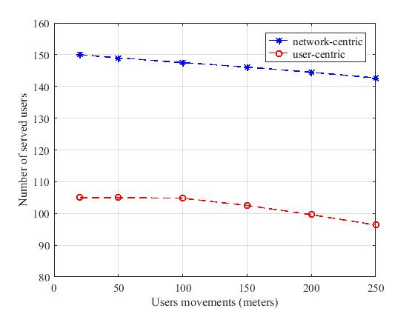
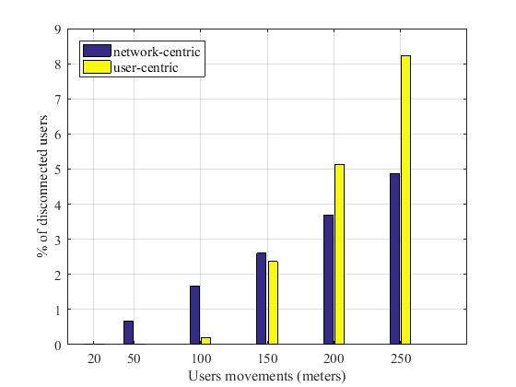
Robustness
IEEE International Conference on Communications
ICC 2017
Outline
Introduction
System model
Optimization problem
Simulation results
Conclusion
By increasing the movement distance, number of the served users will decrease, but this reduction is not significant.
Therefore, if a drone-BS flies to a predetermined good position, it is not required to change its place constantly due to users movements. This will result in savings in energy and reduction in complexity.

Slide 20
Conclusion
IEEE International Conference on Communications
ICC 2017
The optimal 3D placement of a drone-BS was found over an urban area with users having different rate requirements
The network-centric approach maximizes the total number of served users regardless of their required rates.
The user-centric approach maximizes their sum-rate.
Only a small percentage of the total served users would be in outage when the users move. It suggests the robustness of the proposed algorithm against the modest movement of users.
Outline
Introduction
System model
Optimization problem
Simulation results
Conclusion

Slide 21
IEEE International Conference on Communications
ICC 2017
Outline
Introduction
System model
Optimization problem
Simulation results
Conclusion
Thank you!

