Slide 1
Joint Backhaul and Access Optimization for Service-Segment Based VN Admission Control
Meisam Mirahsan, Carleton University, Ottawa, Canada
Hamid Farmanbar, Huawei Canada Research Centre, Ottawa, Canada
Halim Yanikomeroglu, Carleton University, Ottawa, Canada
ICC 2017, Paris, France, May 21-25, 2017

Slide 2
Virtual Network Admission Control
Single user admission control
Short term
Based on deterministic user locations
VN admission control
Long term
Based on user distribution probabilities
Other requirements include
QoS
Service function chains (SFC)
Such as encryption, aggregation, caching, …

Slide 3
Resource limitations
Access link limitations:
BS to UE wireless connection
Backhaul limitation:
Small cells deployed by customers
Service function nodes (SFN):
Limited processing powers

Slide 4
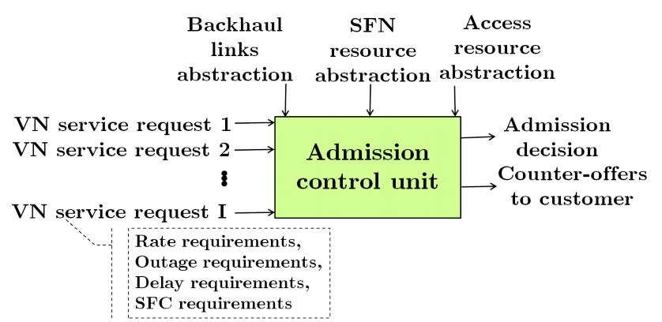
VN Admission Control Process

Slide 5
Contributions of the paper
A novel wireless VN admission control method is proposed which incorporates both the access limitations and backhaul limitations for general network topologies.
This problem is formulated as a joint convex optimization problem which is computationally tractable.
Service segments and SFC constraints are included in the problem both in the sense of service function orders and the resource requirements at each service function node.
A service-segment-based approach is put forth which is more scalable than its flow-segment-based counterpart.

Slide 6
Previous Works
Meisam Mirahsan, Gamini Senarath, Hamid Farmanbar, Ngoc Dao, and Halim Yanikomeroglu, “Admission control of wireless virtual networks in HetHetNets”, under review in IEEE Transactions on Vehicular Technology (submission: 22 Oct. 2016, 1st results: 26 March 2017,1st revision: 20 May 2017).
Meisam Mirahsan, Halim Yanikomeroglu, Gamini Senarath, and Ngoc-Dung Dao, “Analytic modeling of SIR in cellular networks with heterogeneous traffic”, IEEE Communications Letters, vol. 20, no. 8, pp. 1627-1630, August 2016.
Meisam Mirahsan, Rainer Schoenen, H. Yanikomeroglu, G. Senarath, Ngoc-Dung Dao, “User-in-the-loop for HetHetNets with backhaul capacity constraints”, IEEE Wireless Communications, Special Issue on Smart Backhauling and Fronthauling for 5G Networks, vol. 22, no. 5, pp. 50-57, Oct. 2015.
Meisam Mirahsan, Rainer Schoenen, and Halim Yanikomeroglu, “HetHetNets: Heterogeneous traffic distribution in heterogeneous wireless cellular networks”, IEEE Journal on Selected Areas in Communications, Special Issue on Recent Advances in Heterogeneous Cellular Networks, vol. 33, no. 10, pp. 2252-2265, October 2015.

Slide 7
System model
We consider the downlink of a cellular wireless network with general access and backhaul topologies.
A geographical region Q ⊂ R² (i.e., two dimensional plane) which is divided into small bins is assumed as the network layout that is served by a set of BSs B.
Each BS is characterized by its available bandwidth W_{k}.
We assume that demand arrivals for the ith VN service, v_{i} ∈ V, at location q in bin j, d_{ij}, are random variables that follow arbitrary distributions with mean λ_{ij} , where V is the set of VN services.
The backhaul network is modeled as a directional graph G(N,L), where N and L are the sets of nodes and links in the network, respectively.
Let L_{in}(n) and L_{out}(n) be the sets of links terminating and originating at node n ∈ N, respectively.

Slide 8
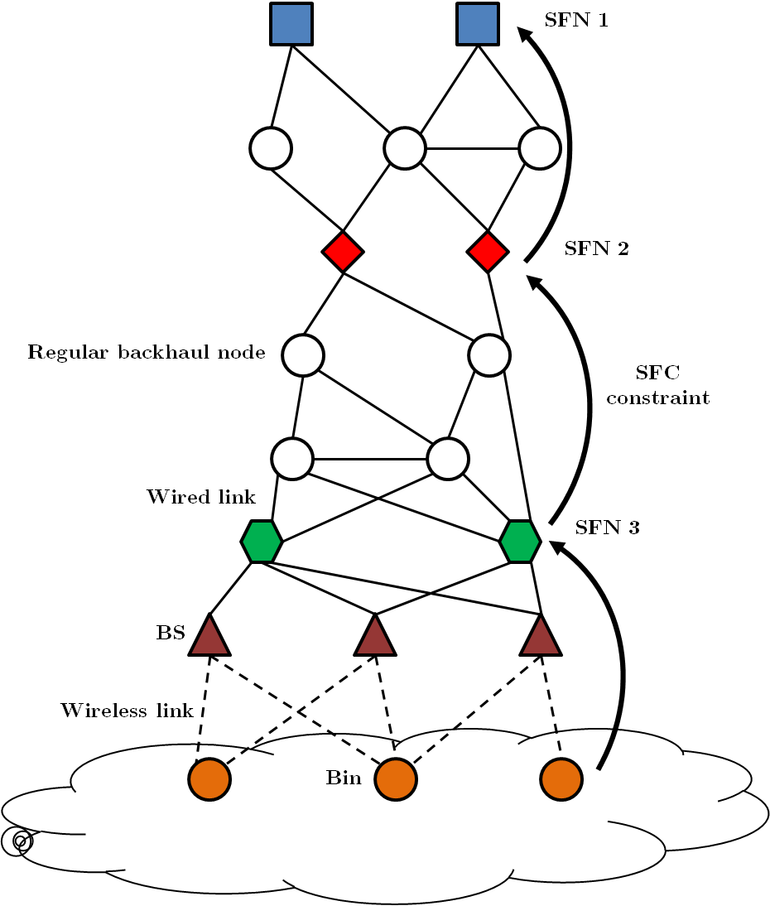
Network configuration

Slide 9
Flow segmentation
In order to address the flow traversal constraints, each flow is parsed according to its traversal constraints into multiple flow segments.

Slide 10
Flow-based VN admission control

Slide 11
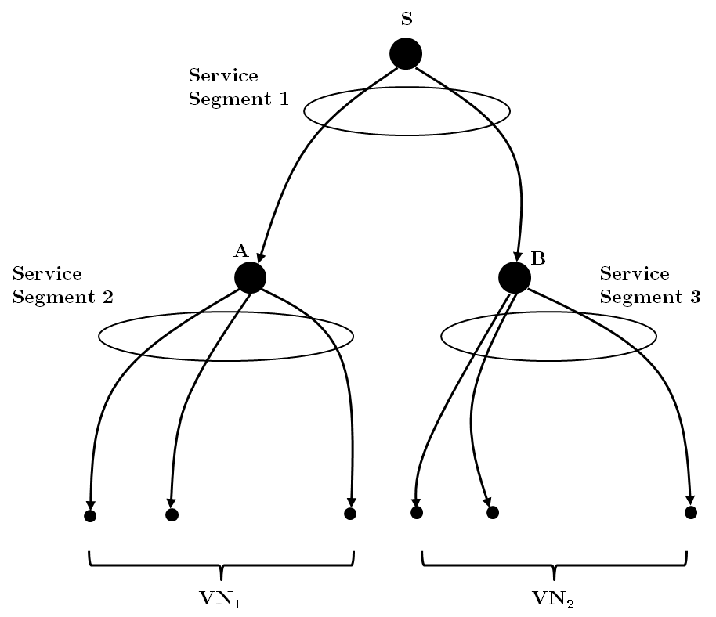
Service-based VN admission control
The flow-based approach does not scale with increasing number of flows or flow segments in terms of admission control algorithm complexity.
We parse flows according to their SFC requirements into flow segments.
A service segment is defined as a set of flow segments with common source node.

Slide 12
Service-based VN admission control

Slide 13
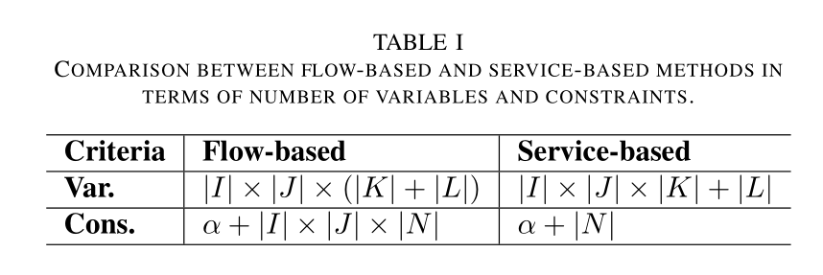
Service-based vs Flow-based

Slide 14
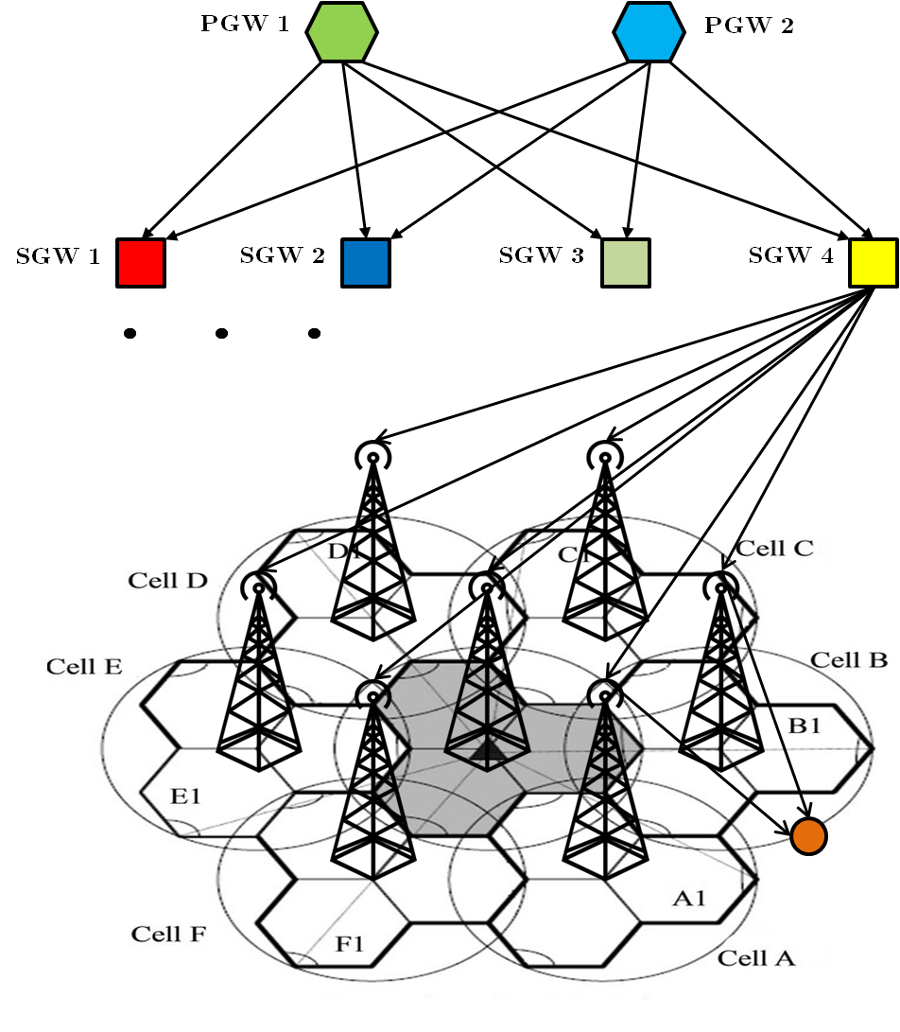
Simulation setup

Slide 15
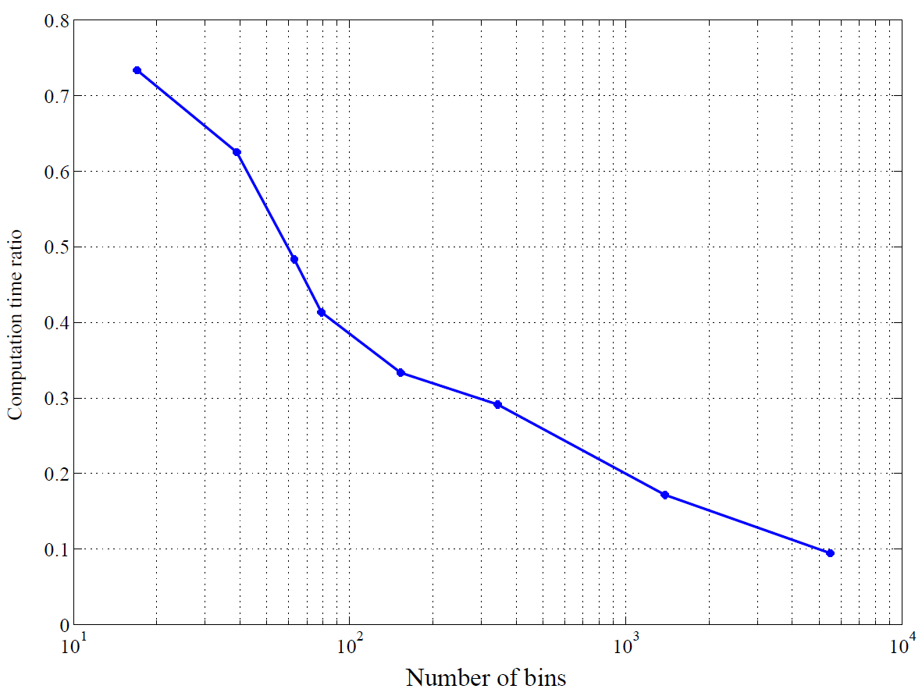
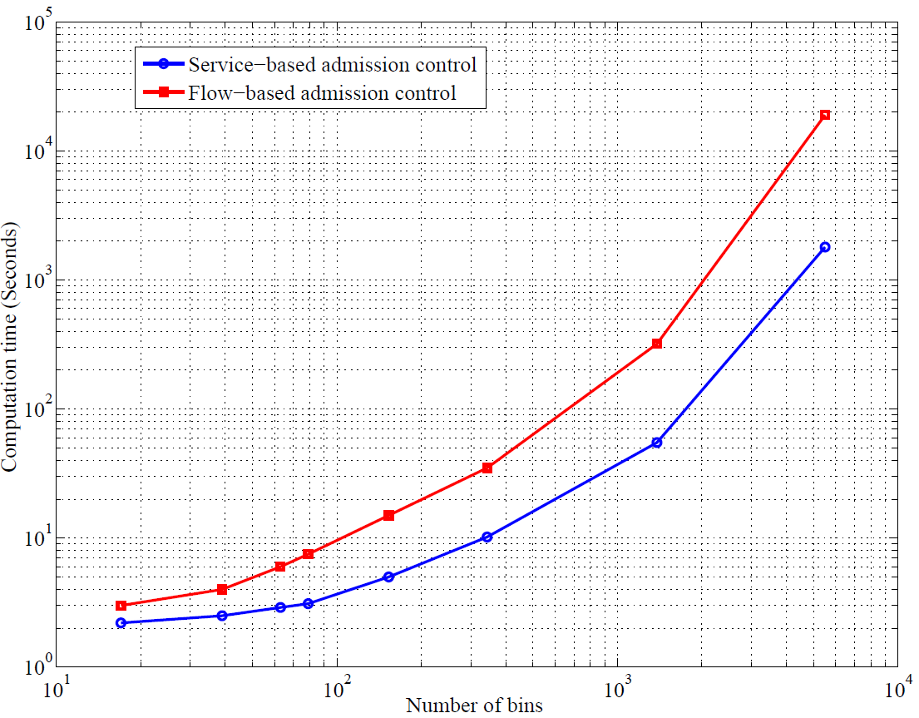
Simulation results

Slide 16
THANKS! Questions?

