Slide 1
Reduced Complexity Optimal Detection of Binary Faster-than-Nyquist Signaling
Ebrahim Bedeer*, Halim Yanikomeroglu*, and Mohamed Hossam Ahmed**
*Carleton University, Ottawa, ON, Canada
**Memorial Univeristy, St. John’s, NL, Canada
May 24th, 2017

Slide 2
Agenda
Introduction
System Model
Novel FTN Detection Schemes
Quasi-Optimal Detection (High SE)
Symbol-by-Symbol Detection (Low SE)
Conclusions

Slide 3
Introduction

Slide 4
Introduction
Nyquist limit is more of a guideline than a rule.
Nyquist limit simplifies receive design by avoiding ISI.
Faster-than-Nyquist (FTN signaling) intentionally introduce ISI to improve SE.
FTN signaling concept exists since 1968 [Saltzberg-68].
FTN signaling term coined by Mazo in 1975 [Mazo-75].
Mazo limit: FTN does not affect minimum distance of uncoded sinc binary transmission up to a certain range.
Saltzberg B. Intersymbol interference error bounds with application to ideal bandlimited signaling. IEEE Transactions on Information Theory. July 1968; 14(4):563-8.
Mazo JE. Faster-than-Nyquist signaling. The Bell System Technical Journal. 1975 Oct;54(8):1451-62.

Slide 5
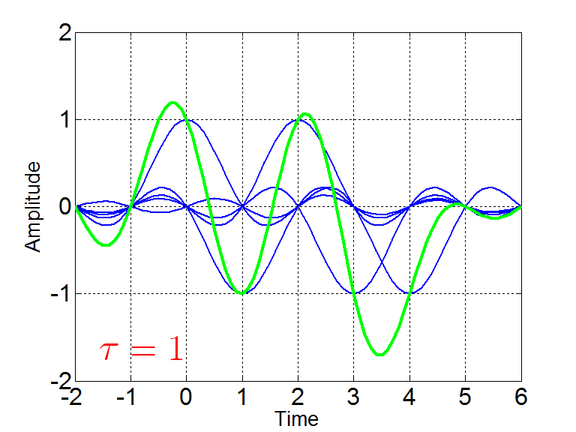
FTN Signaling Basic Idea

Slide 6
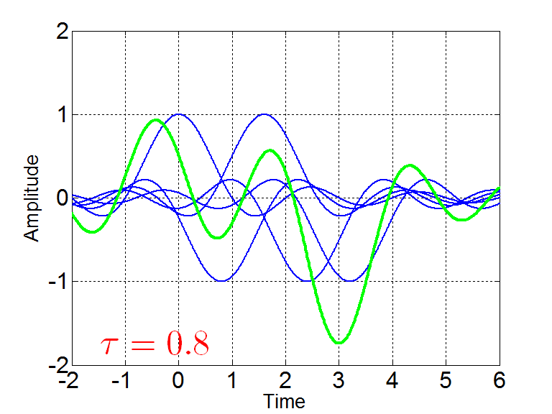
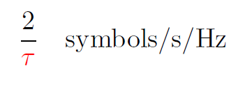
FTN Signaling Basic Idea

Slide 7
Extension of Mazo Limit
Other pulse shapes (root-raised cosine, Gaussian, …)
Non-binary transmission
Frequency domain

Slide 8
System Model

Slide 9
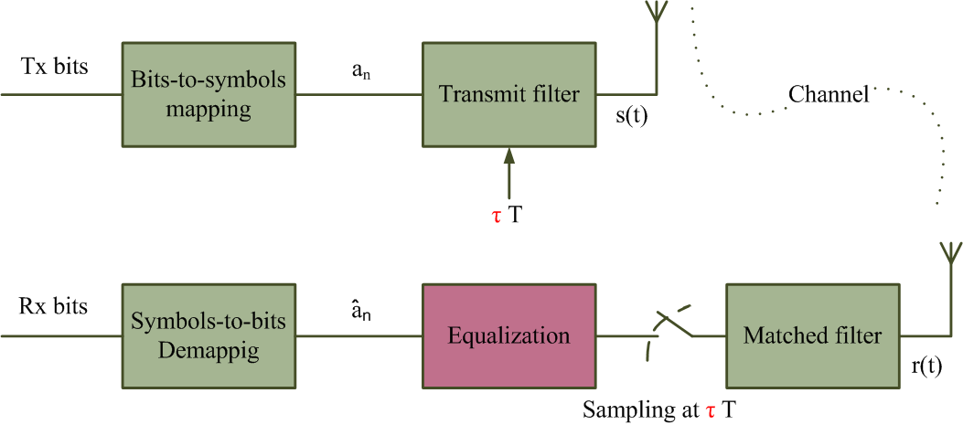
FTN Block Diagram

Slide 10
FTN Detection Problem
$y=G a+w$
$y$: received sample vector
$G$: ISI matrix
$a$: transmit data symbols
$w$: received noise samples (0, σ²$G$)
Detection Problem:
$\hat{a}=arg \min_{a∈D}{{ (G^{−1}y −a)}^{T}G(G^{−1}y −a)}$

Slide 11
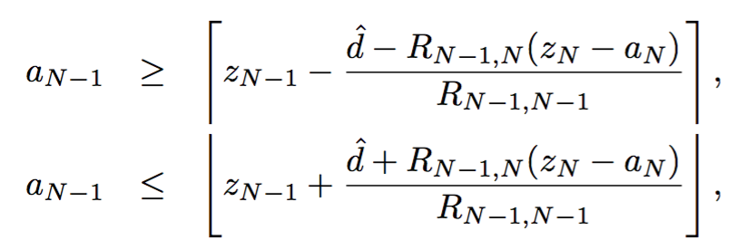
Modified Sphere Decoding (MSD)
Noise covariance matrix can be exploited to develop MSD.
Estimated data symbols can be found using MSD as

Slide 12
Simulation Results

Slide 13
Simulation Results

Slide 14
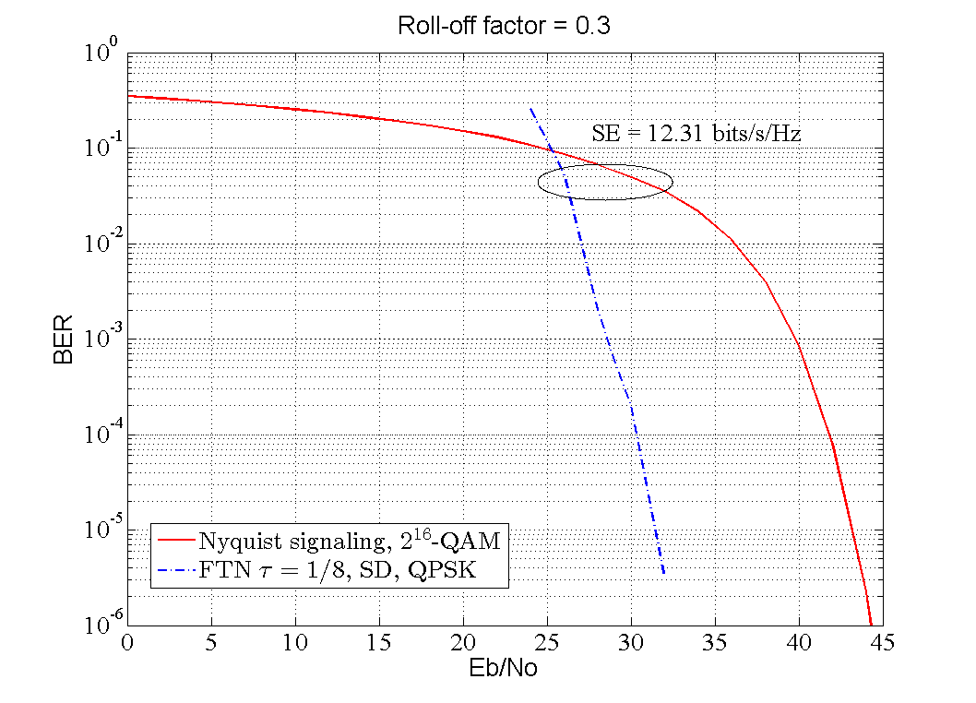
Simulation Results

Slide 15
Symbol-by-Symbol Detection of FTN Signaling
Ebrahim Bedeer, Mohamed Ahmed, and Halim Yanikomeroglu, “A very low complexity successive symbol-by-symbol sequence estimator for binary faster-than-Nyquist signaling”, accepted in IEEE Access, DOI: 10.1109/ACCESS.2017.2663762

Slide 16
Successive Symbol-by-Symbol Sequence Estimation (SSSSE)
Received sample

Slide 17
Successive Symbol-by-Symbol Sequence Estimation (SSSSE)
Received sample
Perfect estimation condition for QPSK FTN signaling

Slide 18
Operating region of SSSSE

Slide 19
Successive Symbol-by-Symbol Sequence Estimation (SSSSE)
Received sample
Perfect estimation condition for QPSK FTN signaling
Estimated symbol

Slide 20
Successive Symbol-by-Symbol with go-back-K Sequence Estimation (SSSgbKSE)
Received sample
Estimated symbol

Slide 21
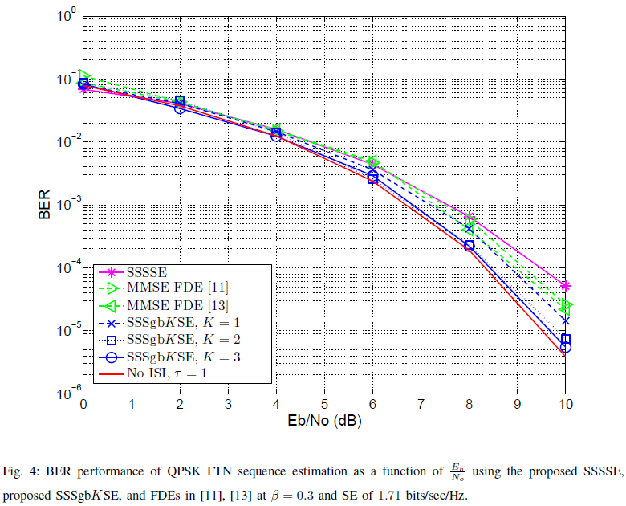
Simulation Results

Slide 22
Simulation Results

Slide 23
Conclusions

Slide 24
Conclusions
FTN signaling is promising to increase the SE
Tradeoff between performance and complexity
Gain of FTN increases at higher values of SE

