Slide 1
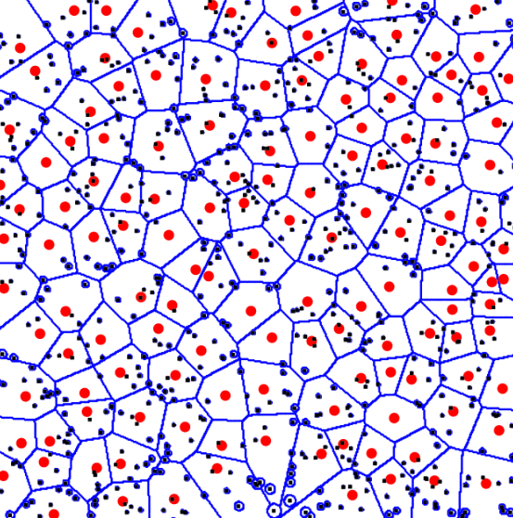
Outage in Large Wireless Networks with Spectrum Sharing under Rayleigh Fading
MASc. Defence
SYSC Dept., Carleton University
July 11, 2011
Arshdeep S. Kahlon, B.E.
Profs: Shalini Periyalwar and Halim Yanikomeroglu

Slide 2
Motivation
The number of wireless networks is expected to increase in the future.
Various spectrum sharing scenarios between primary network (PN) and secondary network (SN) have been proposed to increase the spectrum efficiency.
Focus has been on the effect of the SN deployment on the primary user (PU) services.
Conversely, SN should be designed to meet the specified constraint on the allowable degradation of PU services. It would be valuable to know the maximum spectrum sharing gains that can be achieved.

Slide 3
Outage at PU for Spectrum Sharing
In the absence of a SN, the outage probability at i ^{th} PR:
In the presence of SN, the outage probability at the PR:
In order to share the spectrum of a PU, SN needs to satisfy the specified additional outage constraint :
Initial unwanted signal set consisting of interference from PN and noise
Desired Signal
Initial outage
New unwanted signal set consisting of interference from SN, PN and noise
Additional outage

Slide 4
Importance of Point Processes
Large networks are characterized by the randomness in the number of nodes and their positions.
Network nodes can be modeled as points of a point process.
Poisson point process (PPP) or homogeneous Poisson point process (HPPP)
“Totally random”
Analytically tractable
Laplace transform of the distribution of the aggregate interference coming from the interferers distributed as HPPP is known.
Closed form PDF/CDF does not exist except for the case of path-loss exponent = 4 with infinite field-size.
In case of interactive point processes, Laplace transform is not known, so far.
Future spectrum sharing Wireless Networks
(Picture taken from J. Andrews Group at Texas University)

Slide 5
Literature Review and Our Work in Current Research
Single PU surrounded by SN
Overlaid PN and SN
Circular exclusion region (formed by using sensing mechanism) is unrealistic in presence of fading!
PN is already interference limited !
r₁
HPPP assumption for complex PN does not hold!
Infinite field size assumption (asymptotic) can lead to spectrum sharing opportunity loss!
Primary receiver
Secondary transmitters
Ghasemi ’08, Menon’08 , Vu ’09, Mordachev ’09, Aljuaid ’10,’11
Primary transmitters
Primary typical receiver
Secondary transmitters
Chandrasekhar ’09, Huang ’09, Yin ‘09 Lee ‘11
SN is distributed as an HPPP with or
without exclusion region around PR.
Interference from both PN and SN is
considered.
Distribution fit for SN interference
is done.
Both network nodes are distributed as HPPPs
with identical Tx-Rx pairs.
In Rayleigh fading environment, outage is derived in closed-form for infinite field of HPPP interferers (STs for single PU case and both PTs and STs for overlaid networks).

Slide 6
Thesis Goals and Contribution
Consideration of the interference from the SN as well as the PN for complex PNs (Ch 2 and Ch 3).
A simple, yet widely applicable, expression for the outage due to two independent unwanted signal sets is derived. This expression does not require the knowledge of the distribution of net unwanted signal from one of these sets; only the outage caused by this unwanted signal set is needed.
This result is applied in the spectrum sharing scenario to obtain the additional outage at the PR due to the deployment of SN, thus avoiding the complex task of characterizing interference coming from the PN.
Effect of the SN field size (Ch 2 and Ch 3).
A Closed-form expression for the outage at the PR due to the SN distributed over a finite sector field (includes the case of exclusion region) is derived.
Conversely, under the given outage constraint, the spectrum sharing opportunities are analyzed with respect to the SN field size.

Slide 7
Thesis Goals and Contribution (Cont.)
Spectrum sharing between overlaid cellular and ad hoc networks: uplink case (Ch 4).
The outage at the randomly, but not necessarily independently, distributed cellular receivers is analyzed in the uplink case, when an ad hoc network is overlaid on the cellular network.
Instead of presumably circular exclusion region, “soft” exclusion regions (formed by using a sensing mechanism) around the PRs are used to derive a tight upper bound on the outage .
The decision threshold (to decide whether to transmit or not) used by the secondary transmitters is optimized to maximize the spectrum sharing gains.

Slide 8
Outage Due to New Unwanted Signal Set
Does not require the knowledge of distribution of J; only initial outage ε₁ due to J is required.
Useful when the net unwanted signal from one of the unwanted signal sets is unknown or is difficult to characterize.
Additional outage is a decreasing function of the initial outage for some K .

Slide 9
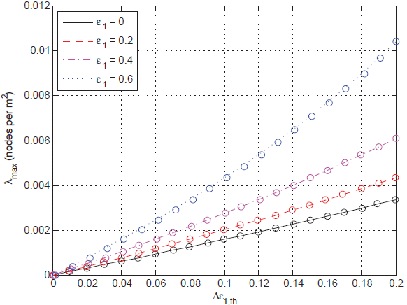
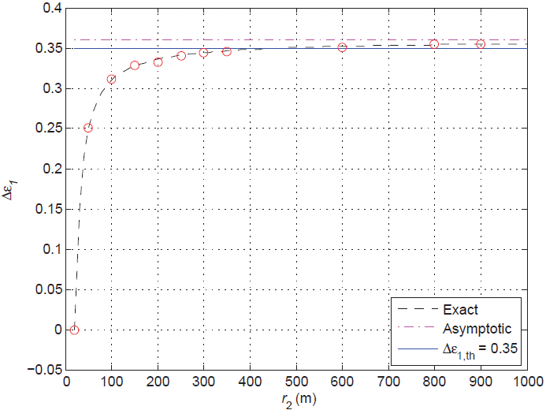
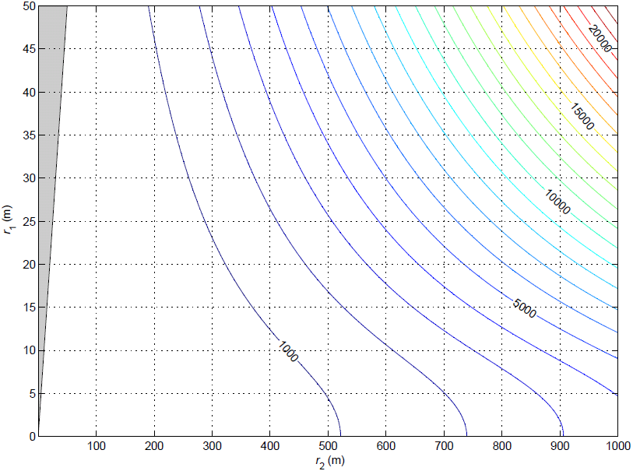
Deployment of a Finite Field Secondary Network around PR
Additional outage due to a SN distributed over a sector region is derived in a closed form expression.
Conversely, the spectrum sharing gains (density of STs) under given SN field size is analyzed.
The spectrum sharing opportunities are analyzed with respect to the field size and are shown to be significantly dependent on the exclusion region.
Conditions are obtained for which an infinite field size can or cannot lead to the loss of spectrum sharing opportunity.
θ
The spectrum sharing gains (maximum number of SN-TXs) are obtained for different spatial deployments.

Slide 10
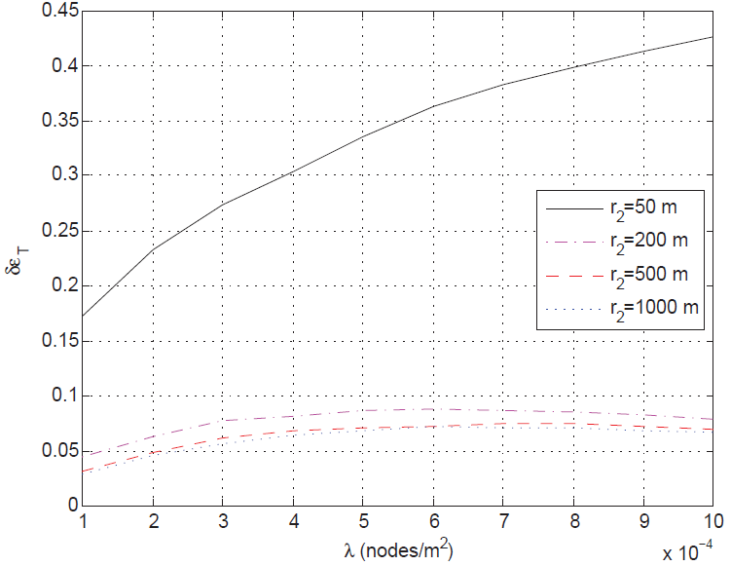
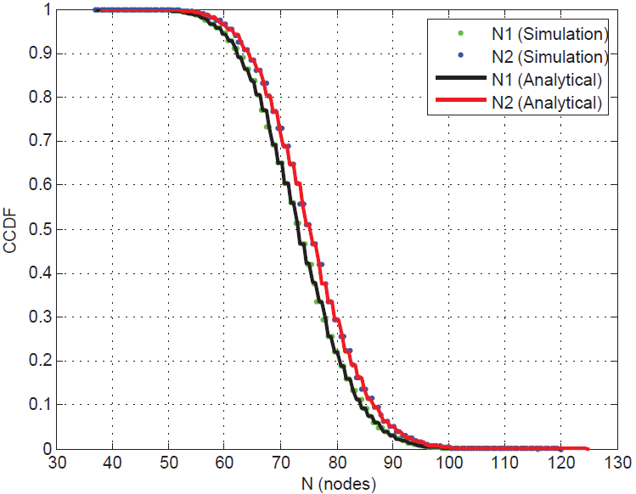
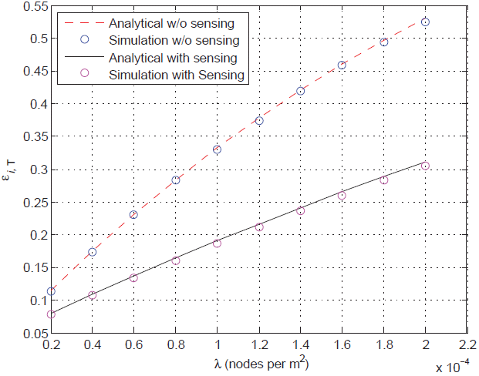
Spectrum Sharing between Cellular and Ad hoc Networks
Sensing mechanism is used rather than the presumably exact exclusion region
(physical boundary) to alleviate the significant effect of the nearby STs.
For the maximum spectrum
sharing gains, we optimize the
decision threshold (to decide
whether to transmit or not) used
by the STs.
We compare the soft exclusion region (formed
by considering fading on the sensing channel) and the
exact exclusion region (formed by not considering fading on the sensing channel).
Randomly but not necessarily independently distributed PRs: the uplink case

Slide 11
Concluding Remarks
Outage that any receiver experiences due to two independent unwanted signal sets, without the need for the knowledge of the distribution of the net unwanted signal from one of these sets, .
This result is applied in spectrum sharing scenario to study the outage at a receiver in the PN to avoid the complex task of characterizing PN interference.
We derived closed-form expressions for the outage at PR when the SN is distributed over a finite sector region. Conversely, under the given outage constraint, the spectrum sharing gains (in terms of average number of STs) are analyzed.
We also studied the uplink case of the cellular network overlaid by the ad hoc network where PN . Instead of presumably exact circular region, we use sensing mechanism to alleviate the significant effect of the nearby interfering transmissions .
Other than the networks sharing spectrum, the derived results are applicable to any set of interferers from the same network or other networks around any receiver of study.
This study provides the insights to the network operators on the feasibility of the spectrum sharing. Results derived here can be seen as lower bound on the maximum spectrum sharing gains.

Slide 12
Future Work
In the overlay scheme, there are always some active secondary users due to sensing errors or hardware inaccuracies. Those parameters incorporated under this framework for future work.
The effect of correlation between the sensing channel and the interference channel can be studied.
Instead of constant power of the ST, sensing or decision threshold can be related to the transmit power.
An interesting extension of this work is to model STs by Poisson cluster process (PCP). This can be the case of femtocells in a cellular network.

Slide 13
Thank You !

Slide 14
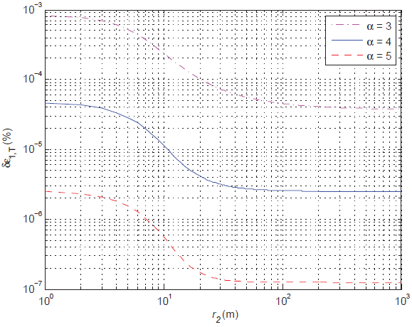
Percentage Increase in Outage when Unbounded Path-Loss Model is Used over Bounded Path-Loss Model

Slide 15
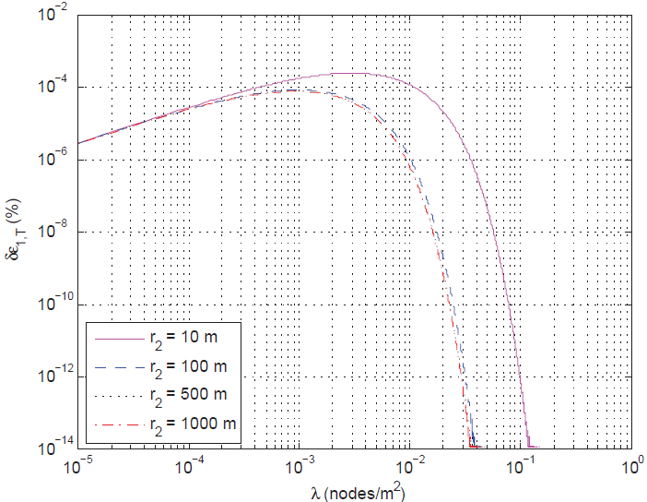
Percentage Increase in Outage when Unbounded Path-Loss Model is Used over Bounded Path-Loss Model

