Slide 1
Exponential Moving Average Q-Learning Algorithm
By
Mostafa D. Awheda
Howard M. Schwartz
Presented at the
2013 IEEE Symposium Series on Computational Intelligence
16 Tue -19 Fri April 2013, Singapore Grand Copthorne Waterfront Hotel

Slide 2
Outline
Objective.
The Matrix games.
The Stochastic Games.
The Multi-Agent learning Algorithms
- PGA-APP: Policy Gradient Ascent with Approximate Policy Prediction
- WPL: Weighted Policy
- WoLF-PHC: Win-or-Loss-Fast Policy-Hill Climbing
The EMA Q-Learning Algorithm
Simulation Results

Slide 3
Objective
To develop a multi-agent learning algorithm that will converge to the Nash Equilibrium in a wide variety of games.
The goal is to develop a learning algorithm that can provide a better convergence performance than the performance provided by the state-of-the-art multi-agent reinforcement learning (MARL) algorithms.

Slide 4
The Matrix Games
Matching Pennies Game
Dilemma Game
Nash equilibrium
(0.5,0.5)
Nash equilibrium
(0,1)

Slide 5
More Matrix Games
Shapley’s Game
Biased Game
Nash equilibrium
(1/3,1/3,1/3)
Nash equilibrium
(0.15,0.85) & (0.85,0.15)

Slide 6
More Matrix Games
Three-Player Matching Pennies Game
Player 1 gets a reward of one for matching player 2;
Player 2 gets a reward of one for matching player 3;
Player 3 gets a reward of one for not matching player 1;
Otherwise, players get zero rewards.

Slide 7
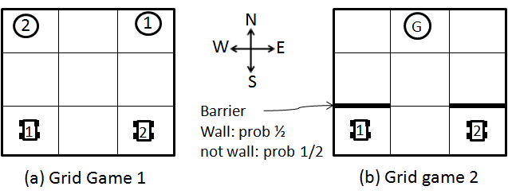
The Stochastic Games

Slide 8
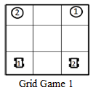
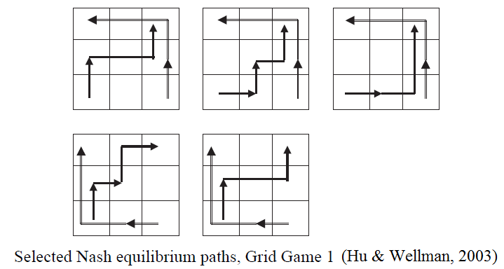
It is important to mention here that we are only concerned about the first movement of both players from the initial state. Therefore, the figures that will be shown later on will represent the probabilities of players’ actions at the initial state.
Notes:
It is important to mention here that we are only concern about the first movement of both players from the initial state. Therefore, the figures that will be shown later on will represent the probabilities of players’ actions at the initial state.

Slide 9
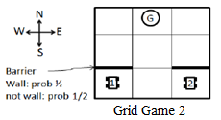
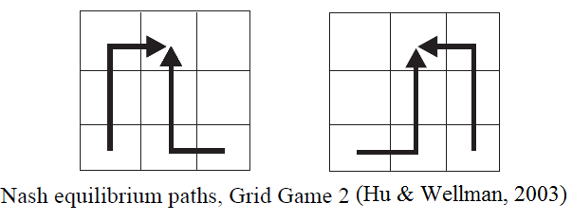
Notes:
It is important to mention here that we only concerned about the first movement of both players from the initial state. Therefore, the figures that will be shown later on will represent the probabilities of players’ actions at the initial state.

Slide 10
Gradient Ascent Methods
Gradient Ascent with Policy Prediction, Zhang and Lesser 2010

Slide 11
The Policy Gradient Ascent with Approximate Policy Prediction (PGA-APP) algorithm combines the basic gradient-ascent algorithm with the idea of the policy prediction. The key idea behind this algorithm is that a player adjusts its strategy in response to forecasted strategies of the other players, instead of their current ones. PGA-APP only requires an agent to observe its reward when choosing a given action. PGA-APP uses Q-learning to learn the expected value of each action in each state to estimate the partial derivative with respect to the current strategies.

Slide 12
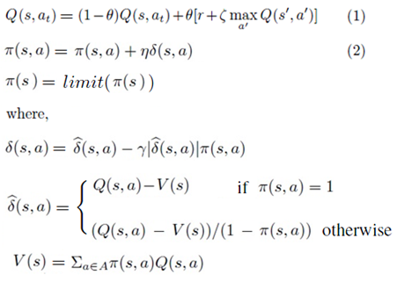
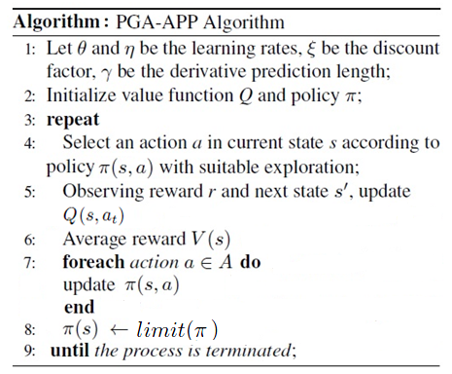
Policy Gradient Ascent with Approximate Policy Prediction (PGA-APP) Algorithm
Where the term represents the gradient
Notes:
The Policy Gradient Ascent with Approximate Policy Prediction (PGA-APP) algorithm combines the basic gradient-ascent algorithm with the idea of the policy prediction. The key idea behind this algorithm is that a player adjusts its strategy in response to forecasted strategies of the other players, instead of their current ones. PGA-APP only requires an agent to observe its reward when choosing a given action. PGA-APP uses Q-learning to learn the expected value of each action in each state to estimate the partial derivative with respect to the current strategies.

Slide 13
Weighted Policy Learner (WPL) Abdallah and Lesser 2008, AI Res.
The WPL algorithm was shown to converge to Nash equilibrium in benchmark two-player-two-action games as well as some larger games.
On the other hand, the algorithm that we are proposing uses the exponential moving average mechanism as a basis to update the policy of the learning agent. Our proposed algorithm also enables agents to converge to Nash equilibrium in a variety of matrix and stochastic games. It also outperforms state-of-the-art MARL algorithms in terms of the convergence to Nash equilibrium and speed of convergence.

Slide 14
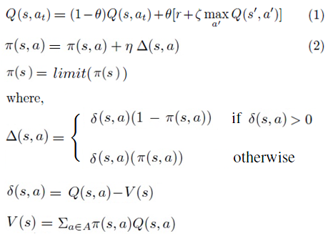
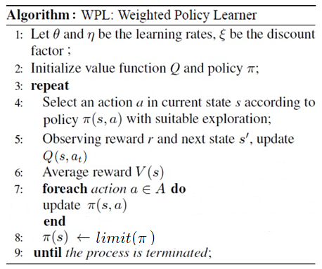
Weighted Policy Learner (WPL) Algorithm
Notes:
The Weighted Policy Learner (WPL) algorithm assumes that the value function of the game is known to all players, which is then used to update the learning policy based on gradient ascent. The WPL algorithm was shown to converge to Nash equilibrium in benchmark two-player-two-action games as well as some larger games.
On the other hand, the algorithm that we are proposing uses the exponential moving average mechanism as a basis to update the policy of the learning agent. Our proposed algorithm also enables agents to converge to Nash equilibrium in a variety of matrix and stochastic games. It also outperforms state-of-the-art MARL algorithms in terms of the convergence to Nash equilibrium and speed of convergence.

Slide 15
Win-or-Learn Fast Policy Hill Climbing (WoLF-PHC)
This is a gradient learning with a variable learning rate depending on whether the agent is winning or losing.
The Algorithm is:
Where,

Slide 16
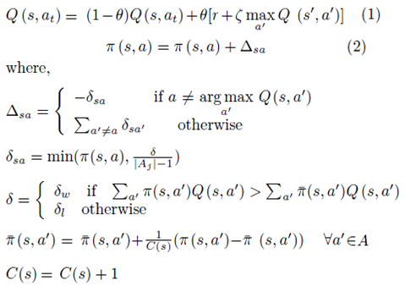
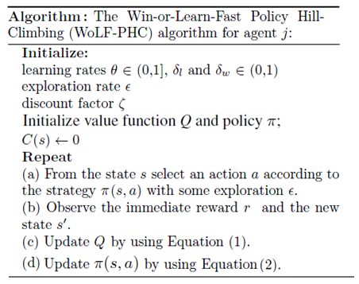
Win-or-Learn-Fast Policy Hill-Climbing (WoLF-PHC) Algorithm

Slide 17
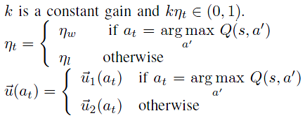
Exponential Moving Average Q-learning (EMA Q-learning) Algorithm
OR
Notes:
The proposed EMA Q-learning algorithm uses the exponential moving average mechanism as a basis to update the policy of the learning agent. This proposed algorithm enables the learning agents to converge to Nash equilibrium in a variety of matrix and stochastic games. It also outperforms state-of-the-art MARL algorithms in terms of the convergence to Nash equilibrium and speed of convergence.

Slide 18
Exponential Moving Average Q-learning (EMA Q-learning) Algorithm
The proposed EMA Q-learning algorithm uses the exponential moving average mechanism as a basis to update the policy of the learning agent. This proposed algorithm enables the learning agents to converge to Nash equilibrium in a variety of matrix and stochastic games. It also outperforms state-of-the-art MARL algorithms in terms of the convergence to Nash equilibrium and speed of convergence.

Slide 19
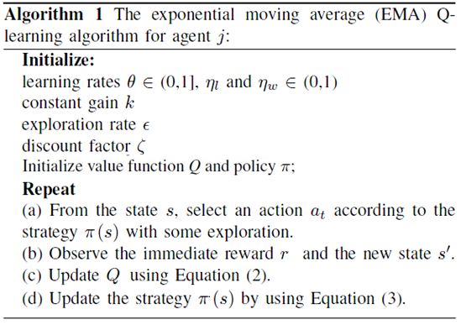
Exponential Moving Average Q-learning (EMA Q-learning) Algorithm (Cont…)

Slide 20
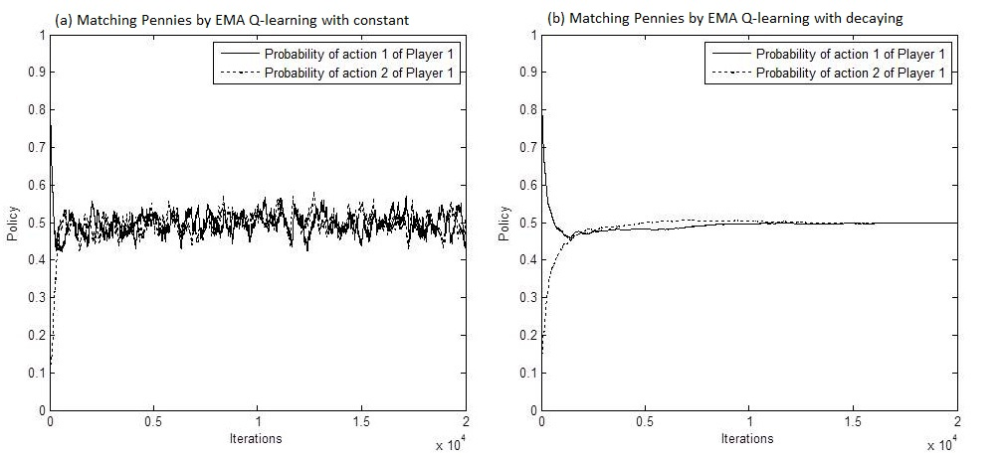
EMA Q-LEARNING ALGORITHM
Matching Pennies Game
Nash equilibrium
(0.5,0.5)
Notes:
When the optimal policy pi*(s,a) is a pure strategy, the EMA mechanism in the EMA Q-learning algorithm will enforce the strategy iterate pi(s,a) of the learning agent to converge to the optimal policy pi*(s; a). On the other hand, when the optimal policy pi*(s,a) is a mixed strategy, the EMA mechanism in the EMA Q-learning algorithm will enforce the strategy iterate pi(s,a) of the learning agent to oscillate around the optimal policy pi*(s,a). When time approaches infinity, the strategy iterate pi(s,a) converges to the optimal policy pi*(s,a).

Slide 21
EMA Q-Learning
When the optimal policy π*(s,a) is a pure strategy, the EMA mechanism in the EMA Q-learning algorithm will enforce the strategy iterate π(s,a) of the learning agent to converge to the optimal policy π*(s; a). On the other hand, when the optimal policy π*(s,a) is a mixed strategy, the EMA mechanism in the EMA Q-learning algorithm will enforce the strategy iterate π(s,a) of the learning agent to oscillate around the optimal policy p π*(s,a). When time approaches infinity, the strategy iterate π(s,a) converges to the optimal policy π*(s,a).

Slide 22
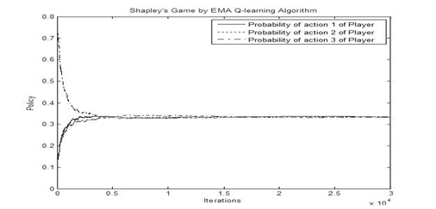
SIMULATION AND RESULTS
Shapley’s Game
Nash equilibrium
(1/3,1/3,1/3)
Notes:
These figures show the probability of choosing Player 1’s actions in the shapley’s game while learning with the EMA Q-learning, the PGA-APP, and the WPL algorithms. As shown in these figures, the players’ strategies successfully converge to Nash equilibrium in this game when learning with the EMA Q-learning, the PGA-APP, and the WPL algorithms.
NOTE:
1 - GIGA-WoLF algorithm doesn’t converge to Nash equilibrium in Shapley’s game.
2 - WoLF-IGA algorithm doesn’t converge to Nash equilibrium in Shapley’s game.
3 - IGA and GIGA were proved to converge in games with pure Nash equilibria. However, both algorithms fail to converge in games with mixed Nash equilibria.

Slide 23
Shapley’s Game

Slide 24
Shapley’s Game

Slide 25
Shapley’s Game Results
These figures show the probability of choosing Player 1’s actions in the shapley’s game while learning with the EMA Q-learning, the PGA-APP, and the WPL algorithms. As shown in these figures, the players’ strategies successfully converge to Nash equilibrium in this game when learning with the EMA Q-learning, the PGA-APP, and the WPL algorithms.
NOTE:
1 - GIGA-WoLF algorithm doesn’t converge to Nash equilibrium in Shapley’s game.
2 - WoLF-IGA algorithm doesn’t converge to Nash equilibrium in Shapley’s game.
3 - IGA and GIGA were proved to converge in games with pure Nash equilibria. However, both algorithms fail to converge in games with mixed Nash equilibria.

Slide 26
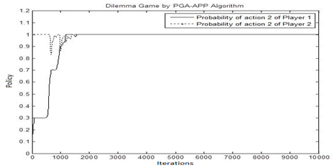
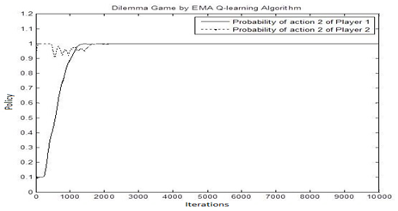
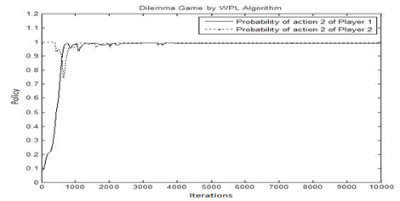
SIMULATION AND RESULTS
Dilemma Game
Nash equilibrium
(0,1)
Notes:
Some algorithms in this These figures show the probability of choosing the second action for both players in the dilemma game. The EMA Q-learning, the PGA-APP, and the WPL algorithms are shown. As shown in these figures, the players’ strategies successfully converge to Nash equilibrium in this game when learning with the EMA Q-learning, the PGA-APP, and the WPL algorithms.

Slide 27
Results of Dilemma Game
These figures show the probability of choosing the second action for both players in the dilemma game. The EMA Q-learning, the PGA-APP, and the WPL algorithms are shown. As shown in these figures, the players’ strategies successfully converge to Nash equilibrium in this game when learning with the EMA Q-learning, the PGA-APP, and the WPL algorithms.

Slide 28
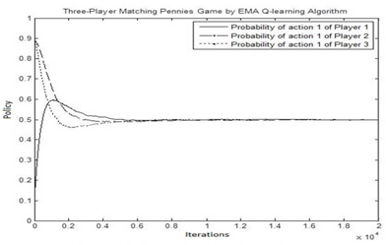
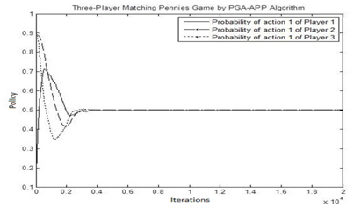
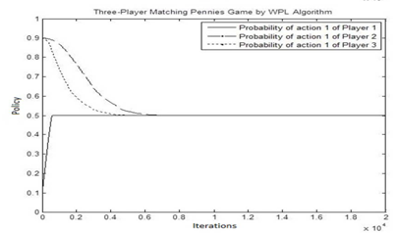
SIMULATION AND RESULTS
Three-Player Matching Pennies Game
Nash equilibrium
(0.5,0.5)
Notes:
These figures show the probability of choosing the first action for the three players in the three-player matching pennies game while learning with the EMA
Q-learning, the PGA-APP, and the WPL algorithms. As shown in these figures, the players’ strategies successfully converge to Nash equilibrium in this game when learning with the EMA Q-learning, the PGA-APP, and the WPL algorithms. It is important to mention here that the WPL algorithm successfully converges to Nash equilibrium in the three-player matching pennies game although it was presented to diverge in this game in (Zhang & Lesser, 2010).

Slide 29
Three Player Matching Pennies Game
These figures show the probability of choosing the first action for the three players in the three-player matching pennies game while learning with the EMA
Q-learning, the PGA-APP, and the WPL algorithms. As shown in these figures, the players’ strategies successfully converge to Nash equilibrium in this game when learning with the EMA Q-learning, the PGA-APP, and the WPL algorithms. It is important to mention here that the WPL algorithm successfully converges to Nash equilibrium in the three-player matching pennies game although it was presented to diverge in this game in (Zhang & Lesser, 2010).

Slide 30
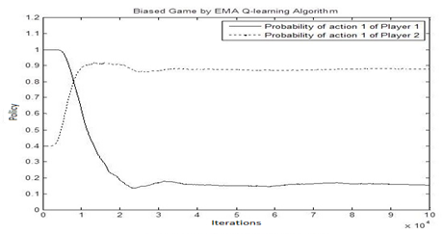
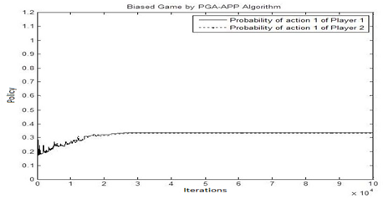
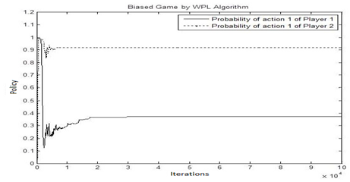
SIMULATION AND RESULTS
Biased Game
Nash equilibrium
(0.15,0.85) & (0.85,0.15)
Notes:
These figures show the probability of choosing the first action for both players in the biased game while learning with the EMA Q-learning, the PGA-APP, and the WPL algorithms. Recall that the biased game has two mixed Nash equilibria, (0.15,0.85) and (0.85,0.15). In this game, we see from the figures that both of the PGA-APP and the WPL algorithms fail to converge to a Nash equilibrium in the biased game; only the EMA Q-learning algorithm succeeds to converge to a Nash equilibrium in the biased game.

Slide 31
Biased Game Results
These figures show the probability of choosing the first action for both players in the biased game while learning with the EMA Q-learning, the PGA-APP, and the WPL algorithms. Recall that the biased game has two mixed Nash equilibria, (0.15,0.85) and (0.85,0.15). In this game, we see from the figures that both of the PGA-APP and the WPL algorithms fail to converge to a Nash equilibrium in the biased game; only the EMA Q-learning algorithm succeeds to converge to a Nash equilibrium in the biased game.

Slide 32
SIMULATION AND RESULTS

Slide 33
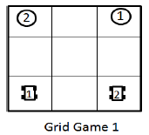
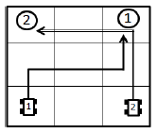
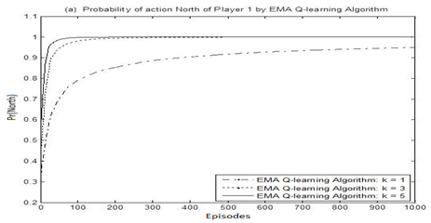
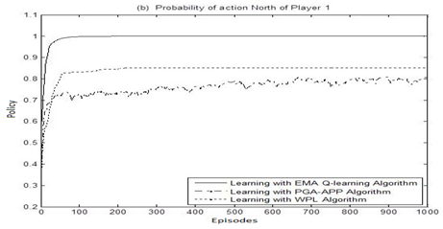
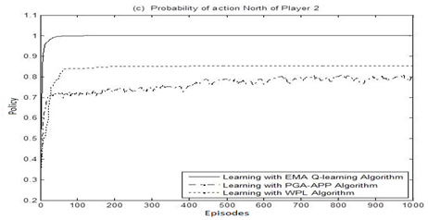
SIMULATION AND RESULTS
Notes:
Fig. (a) shows the probability of selecting action North by Player 1 at the initial state when learning with the EMA Q-learning algorithm with different values of the constant gain k. Fig (a) shows that Player 1’s speed of convergence to the optimal action (North) increases as the value of the constant gain k increases. Fig. (a) shows that the probability of selecting the optimal action North by Player 1 requires almost 80 episodes to converge to one when k=5 and 320 episodes when k=3. However, when k = 1, many more episodes are still required for the probability of selecting the action North to converge to one.
Fig. (b) and Fig. (c) show the probabilities of taking action North at the initial state by both players when learning with the EMA Q-learning, the PGA-APP, and the WPL algorithms. Fig. (b) and Fig. (c) show that the probabilities of taking action North by both players converge to the Nash equilibria (converge to one) when learning with the EMA Q-learning algorithm. However, the PGA-APP and the WPL algorithms fail to make the players’ strategies converge to the Nash equilibria.
These figures show that the EMA Q-learning algorithm outperforms the PGA-APP and the WPL algorithms in terms of the convergence to Nash equilibria. It also shows that the EMA Q-learning algorithm can converge to Nash equilibria with a small number of episodes by adjusting the value of the constant gain k. This will give the EMA Q-learning algorithm an empirical advantage over the PGA-APP and the WPL algorithms.

Slide 34
Results of Grid Game 1
Fig. (a) shows the probability of selecting action North by Player 1 at the initial state when learning with the EMA Q-learning algorithm with different values of the constant gain k. Fig (a) shows that Player 1’s speed of convergence to the optimal action (North) increases as the value of the constant gain k increases. Fig. (a) shows that the probability of selecting the optimal action North by Player 1 requires almost 80 episodes to converge to one when k=5 and 320 episodes when k=3. However, when k = 1, many more episodes are still required for the probability of selecting the action North to converge to one.
Fig. (b) and Fig. (c) show the probabilities of taking action North at the initial state by both players when learning with the EMA Q-learning, the PGA-APP, and the WPL algorithms. Fig. (b) and Fig. (c) show that the probabilities of taking action North by both players converge to the Nash equilibria (converge to one) when learning with the EMA Q-learning algorithm. However, the PGA-APP and the WPL algorithms fail to make the players’ strategies converge to the Nash equilibria.
These figures show that the EMA Q-learning algorithm outperforms the PGA-APP and the WPL algorithms in terms of the convergence to Nash equilibria. It also shows that the EMA Q-learning algorithm can converge to Nash equilibria with a small number of episodes by adjusting the value of the constant gain k. This will give the EMA Q-learning algorithm an empirical advantage over the PGA-APP and the WPL algorithms.

Slide 35
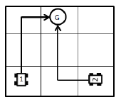
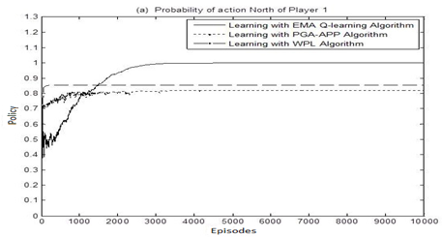
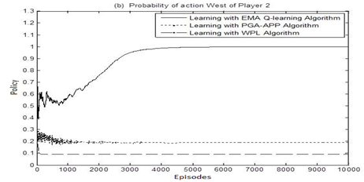
SIMULATION AND RESULTS
Notes:
Fig. (a) shows the probability of selecting action North by Player 1 when learning with the EMA Q-learning, the PGA-APP, and the WPL algorithms. Fig. (a) illustrates that the probability of selecting the action North by Player 1 successfully converges to one (Nash equilibrium) when Player 1 learns with the EMA Q-learning algorithm. However, the PGA-APP and the WPL algorithms fail to make Player 1 choose the action North with a probability of one. Fig. (b) shows the probability of selecting action West by Player 2 when learning with the EMA Q-learning, the PGA-APP, and the WPL algorithms. As can be seen from Fig. (b), the probability of selecting action West by Player 2 successfully converges to one (Nash equilibrium) when Player 2 learns with the EMA Q-learning algorithm. The PGA-APP and the WPL algorithms, on the other hand, fail to make Player 2 choose action West with a probability of one.
These figures show that the EMA Q-learning algorithm outperforms the PGA-APP and the WPL algorithms in terms of the convergence to Nash equilibria. This will give the EMA Q-learning algorithm an empirical advantage over the PGA-APP and the WPL algorithms.

Slide 36
Results of Grid Game 2
Fig. (a) shows the probability of selecting action North by Player 1 when learning with the EMA Q-learning, the PGA-APP, and the WPL algorithms. Fig. (a) illustrates that the probability of selecting the action North by Player 1 successfully converges to one (Nash equilibrium) when Player 1 learns with the EMA Q-learning algorithm. However, the PGA-APP and the WPL algorithms fail to make Player 1 choose the action North with a probability of one. Fig. (b) shows the probability of selecting action West by Player 2 when learning with the EMA Q-learning, the PGA-APP, and the WPL algorithms. As can be seen from Fig. (b), the probability of selecting action West by Player 2 successfully converges to one (Nash equilibrium) when Player 2 learns with the EMA Q-learning algorithm. The PGA-APP and the WPL algorithms, on the other hand, fail to make Player 2 choose action West with a probability of one.
These figures show that the EMA Q-learning algorithm outperforms the PGA-APP and the WPL algorithms in terms of the convergence to Nash equilibria. This will give the EMA Q-learning algorithm an empirical advantage over the PGA-APP and the WPL algorithms.

Slide 37
Conclusion
A new multi-agent policy iteration learning algorithm is proposed in this work. It uses the exponential moving average (EMA) estimation technique to update the players’ strategies.
This algorithm is applied to a variety of matrix and stochastic games.
The results also show that the EMA Q-learning algorithm outperforms the PGA-APP and the WPL algorithms in terms of the convergence to Nash equilibria.
Notes:
A new multi-agent policy iteration learning algorithm is proposed in this work. It uses the exponential moving average (EMA) estimation technique to update the players’ strategies. This policy iteration learning algorithm is called the EMA Q-learning algorithm. This algorithm is applied to a variety of matrix and stochastic games. The results show that the value of the constant gain k affects the speed of convergence of players’ strategies to Nash equilibria. The results also show that the EMA Q-learning algorithm outperforms the PGA-APP and the WPL algorithms in terms of the convergence to Nash equilibria. The results also show that the EMA Q-learning algorithm can converge to Nash equilibria with a small number of episodes by adjusting the value of the constant gain k. This will give the EMA Q-learning algorithm an empirical advantage over the PGA-APP and the WPL algorithms.

