Slide 1
Q(λ)-Learning Fuzzy Controller for the Homicidal Chauffeur Differential Game
Presented by: Prof. Howard M. Schwartz
Badr M. Al Faiya
Department of Systems and Computer Engineering,
Carleton University, Ottawa, Canada
20th Mediterranean Conference on Control and Automation - MED 2012
Barcelona, Spain

Slide 2
Outline
Why training the evader in pursuit-evasion differential game
Why Q-learning fuzzy inference system (QLFIS)
Objective
Previous Work
Problem statement
Proposed solutions
Training the evader in pursuit-evasion differential games using QLFIS
Conclusions

Slide 3
Why Training the Evader in Pursuit-Evasion Differential Game?
The work done in the literature neither trained the evader to escape nor considered the capture condition
The solution is available
evaluate the results
It can be used as a general problem for many other problems and real world applications
missile avoidance
collision avoidance (aircraft and mobile robots)
obstacle avoidance

Slide 4
Why Q-learning fuzzy inference system (QLFIS)
Fuzzy system
Alternative way to replace conventional control
Can deal with uncertainty in the environment
Does not require a mathematical model
Easy to modify rules using linguistic terms
In robotics applications, for example
Complexity of the environment makes it difficult to use pre-programmed robots

Slide 5
Why Q-learning fuzzy inference system (QLFIS)
Reinforcement Learning (RL)
Enables an agent (robot) to learn autonomously from its own experience by interacting with the real world (environment)
Learning can find solutions that cannot be found in advance
Environment or robot too complex
Problem not fully known beforehand

Slide 6
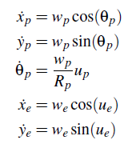
Homicidal Chauffeur Game
Homicidal Chauffeur Game
The pursuer is a car-like mobile robot
The evader (pedestrian) is a point
that can move in any direction instantaneously
Equations of motion for the mobile robots are
(1)

Slide 7
Objective
Design a highly maneuverable evader that can autonomously learn to escape from a pursuer in pursuit-evasion differential games

Slide 8
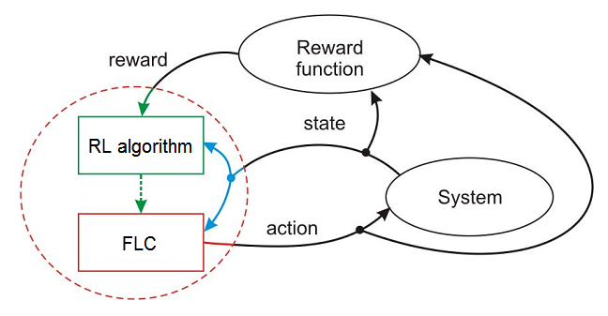
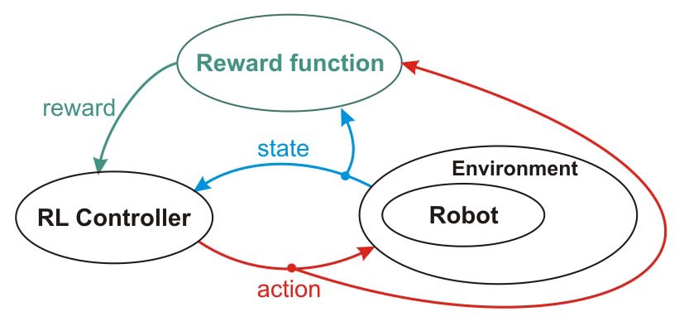
RL For Robot Control
The goal for the robot is to maximize the received rewards to find its best control actions
Design two fuzzy logic controllers that make a pursuer and an evader perform optimally
Fuzzy controller (FLC) is adapted by the RL algorithm
Learning by interacting with the system

Slide 9
Previous Work
An Experimental Adaptive Fuzzy Controller for Differential Games (S. Givigi and H. Schwartz, SMC 2009)
A robot is pursuing another robot moving along a straight line
Q(λ)-learning fuzzy logic controller for a multi-robot system(S. Desouky and H. Schwartz, SMC 2010)
Train the pursuer to capture the evader and minimize the time of capture

Slide 10
The Problem
Lack of studies on how the evader can learn its optimal strategy

Slide 11
Proposed Solutions
Add the distance and the angle difference as inputs to the FLC of the evader
The distance is critical for the evader when the pursuer approaches the evader to make a sharp turns to inter into Rp
Apply QLFIS algorithm to train both the pursuer and the evader simultaneously
Tune the input and the output parameters of the FLC

Slide 12
Proposed Solutions
Analyze the game for the evader
Investigate for the escape condition and the optimal solution
Set the parameters to meet the escape condition
(2)
(3)
(4)

Slide 13
Proposed Solutions
So this is the ideal, our goal is to see if the learning algorithm will converge to the known optimal solution and train the evader to escape

Slide 14
QLFIS Algorithm
ξ= [K c σ ] are the parameters to be tuned
Qt+1(st,at) =Qt(st,at)+ α δt (et)
δt = rt+1 +max Qt(st+1,a′) Qt(st,at)
Update rules:
ξFIS(t +1) = ξFIS(t) + η δt [∂Qt(st,ut)/∂ξFIS + λ γ et−1 ]
ξFLC(t +1) =ξFLC(t)+ ζ δt [(∂u(st,ut)/∂ξFLC) (un-u/ σn)]
⊤

Slide 15
Apply QLFIS Algorithm
Homicidal Chauffeur Game
Pursuer learns to capture the evader and minimize the time of capture
Evader learns to escape and maximize the time of capture, and learns the distance when to make sharp turns and avoid being captured

Slide 16
Results
We have set the game parameters such that it meets the escape condition given by Isaacs
In theory the evader should be able to escape
Fuzzy controller parameters initialization
The pursuer captures the evader before learning to see how long it takes for the evader to learn how to escape
The players are then trained by tuning the input and output parameters of the fuzzy controller using QLFIS algorithm.

Slide 17
Before Learning
Paths of the evader and the pursuer at the begining of learning

Slide 18
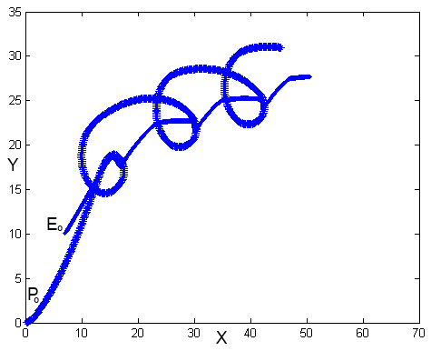
Homicidal Chauffeur Game After Learning
 | no. of episodes | Capture time Tc (sec)
After learning using QLFIS | 100 | 12.90
 | 500 | 25.10
 | 900 | escape ( >60 sec )

Slide 19
Conclusion
Reinforcement learning is used to train players in differential games.
The evader and the pursuer are trained by tuning the input and output parameters of a fuzzy controller using QLFIS algorithm.
We showed that the proposed technique trained the evader to escape from the pursuer after approximately 900 learning episodes

Slide 20
Thank you

