Slide 1
Big data classification using neural network
Classification example of TensorFlow Playground
Daijian Yang
Fan Wang
Dajun Zhang

Slide 2
Data classification

Slide 3
Data classification
Data classification may refer to:
Data classification (data management)
Data classification (business intelligence)
Data classification (machine learning), classification of data using machine learning algorithms
Assigning a level of sensitivity to classified information
In computer science, the data type of a piece of data
Our study focuses on Data classification of big data using deep learning algorithms.

Slide 4
Data classification
In machine learning and statistics, classification is the problem of identifying to which of a set of categories a new observation belongs, based on a training set of data containing observations whose category membership is known. Classification is an example of pattern recognition.
Classification is considered an instance of supervised learning, i.e. learning where a training set of correctly identified observations is available. The corresponding unsupervised procedure is known as clustering, and involves grouping data into categories based on some measure of inherent similarity or distance.
An algorithm that implements classification, especially in a concrete implementation, is known as a classifier. The term "classifier" sometimes also refers to the mathematical function, implemented by a classification algorithm, that maps input data to a category.

Slide 5
Big data classification using deep learning algorithm
Big Data: It is referred to the exponential growth and wide availability of digital data that is difficult or even impossible to be managed analyzed using conventional software tools and technologies.
Big data often processes many examples (inputs), large varieties of class types (outputs), and very high dimensionality (attributes).

Slide 6
Big data classification using deep learning algorithm
Deep Learning: Deep learning refers to machine learning techniques that use supervised and/or unsupervised strategies to automatically learn hierarchical representations in deep architectures for classification.
Deep Learning algorithms extract meaningful abstract representations of the raw data using a hierarchical multi-level learning approach.
Deep learning approach can be used in two well-established deep architectures: deep belief networks and convolutional neural networks.

Slide 7
neural network

Slide 8
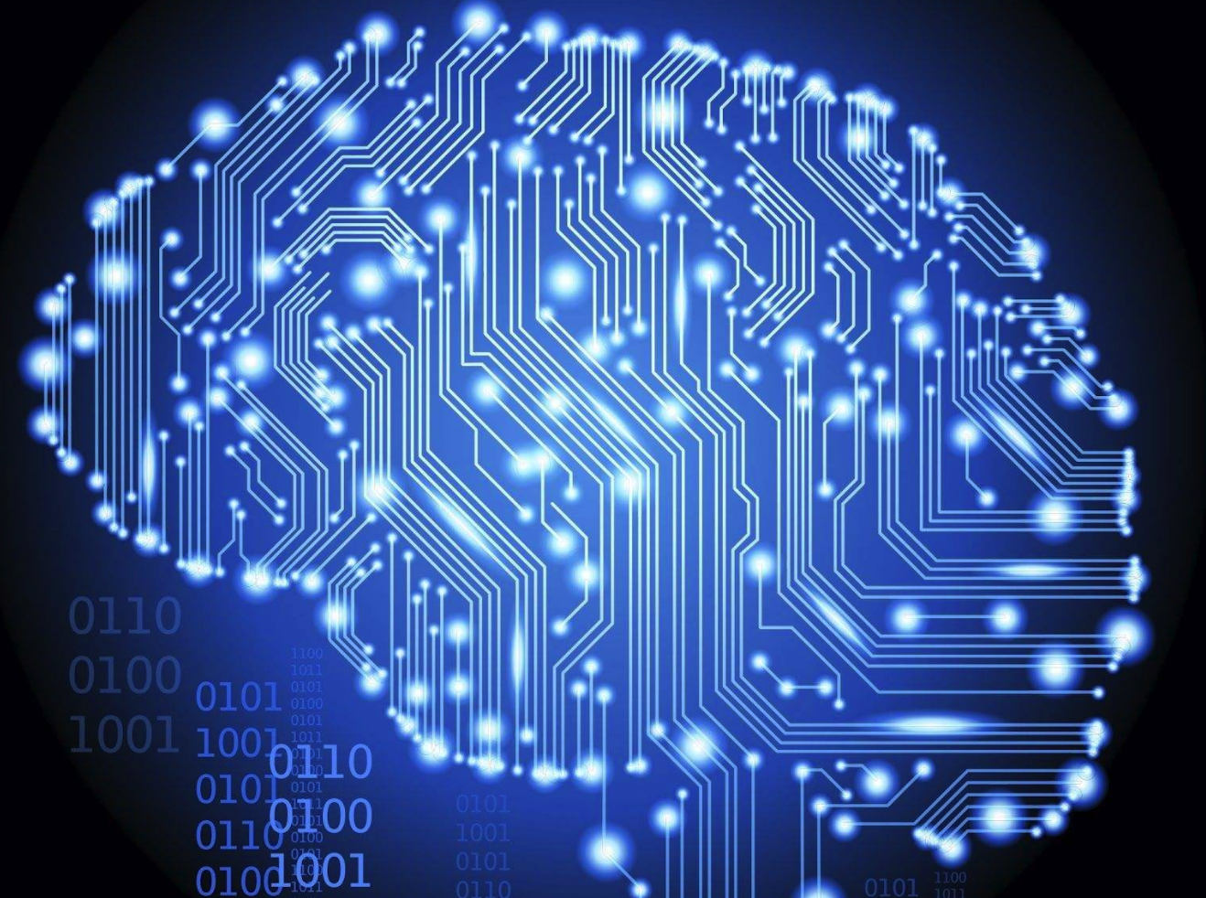
neural network
Neural networks is a computational approach which based on a large set of neurons, mimicking the way a biological brain solves problems with large clusters of biological neurons connected by axons.

Slide 9
The principle of neural network
Firstly, we will create a neural network and design learning algorithm.
Based on different purpose, we preparing different datasets to train the neural network.
After training stage, the neural network could complete different tasks automatically

Slide 10
Architecture of neural network
A neural network is composed of three types of layers: input layers, hidden layers and output layers
The layers which are not output layers are called hidden layers, the typical hidden layers consist of two components:
weights
Activation function

Slide 11
Simple architecture of NN

Slide 12
architecture of neuron

Slide 13
Self-adjustment process
Forward propagation stage:
Extracting a sample from the dataset and input X into NN
Calculating the actual output
Back propagation stage:
Calculating the difference between the actual output and ideal output
Using minimum error method to adjust the weighted matrix

Slide 14
TensorFlow Playground

Slide 15
What is TensorFlow Playground?
TensorFlow is Google Brain’s second-generation machine learning system.
“TensorFlow” means the “tensor” can flow in the neural network.
TensorFlow Playground is visual teaching platform that can help people to understand neural network intuitively (http://playground.tensorflow.org).

Slide 16
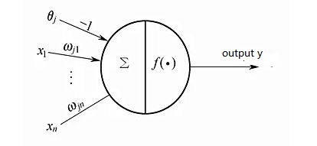
There are some issues that can help us to understand TensorFlow Playground quickly:
Activation function: activation function is used to activate the corresponding neuron. Fig. 1 shows the basic architecture of a neuron:
In TensorFlow Playground, there are four different activation function: ReLU, Tanh, Sigmoid and Linear.

Slide 17
2. In TensorFlow Playground, what is the training loss and testing loss?
Loss is the difference between the predicting output and expected output. The smaller loss means the more accurate the predicted model is. The TensorFlow Playground provides an intuitive view of Training Loss and Testing Loss after each iteration. Ideally, the model is becoming more accurate in a case that both losses gradually decrease. If Training Loss decreases and Testing Loss increases, the output may overfit.

Slide 18
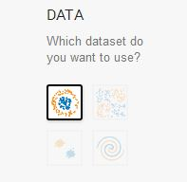
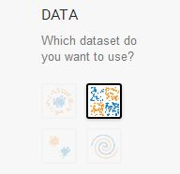
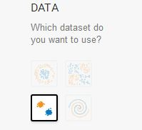
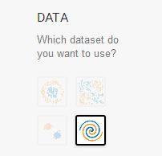
3. What problems can be solved through the TensorFlow Playground?
The platform can solve two types of problems:
Classification: The platform can create a model that successfully differentiates the orange and blue dots. TensorFlow Playground provides four different types of datasets (Circles, Exclusive or, Gaussian, and Spiral) in order to simulate the classification problem.
Regression: Continuous problems.

Slide 19
The Classification Example of MATLAB TensorFlow Playground
Fig. 2 shows the neural network architecture that uses the Exclusive or dataset in TensorFlow Playground. Each set of data is a group of points with different morphological distributions. Each point is born with two features: X₁ and X₂, which represents the location of the point. There are two types of points in our data: orange and blue. The goal of our neural network is to know where the points are orange and which points are blue by training.

Slide 20
The parameters of simulation in two platforms are shown in below:
Learning Rate | 0.03
Activation Function | Tanh
Regularization Rate | 0
Ratio of Training and Testing Data | 50%
Noise | 0
Batch Size | 10
Data Set | Exclusive or, Spiral

Slide 21
Fig. 3 shows the final output using Exclusive or dataset in TensorFlow platform. We can see that the loss functions are all converged in the figure, and the platform successfully divides the points into the corresponding regions.

