Slide 1
HIVE
A Warehousing Solution Over a MapReduce Framework
Presented By:
Anmoldeep Singh Arneja 101053427
Harmandeep Singh 101058953
Kanwarbir Singh 101060457
Gurshan Singh Hans 101059107
Manohar Deep Singh Gill 101055138

Slide 2
What is HIVE?
An alternative tool to deal with the Big Data rather than using traditional relational Database.
Data warehouse infrastructure tool to process structured data in Hadoop.
Summarize Big Data, and makes querying and analyzing easy.
Provides a simpler query model with less coding than MapReduce
The Hive Query Language (HQL) has similar semantics and functions as standard SQL in the relational database.

Slide 3
Features of HIVE
Familiar, fast, scalable, and extensible.
Stores schema in a database and processed data into HDFS.
Allows users to read data in arbitrary formats, using SerDes and Input/Output formats.
Supports user-defined functions, scripts, and a customized I/O format to extend its functionality.
Supports running on different computing frameworks.
Response time is typically much faster than other types of queries on the same type of huge datasets

Slide 4
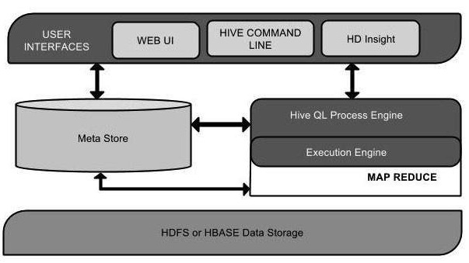
Architecture of HIVE

Slide 5
The following components are the main building blocks in Hive:
• Metastore – The component that stores the system catalog and metadata about tables, columns, partitions etc.
• Driver – The component that manages the lifecycle of a HiveQL statement as it moves through Hive. The driver also maintains a session handle and any session statistics.
• Query Compiler – The component that compiles HiveQL into a directed acyclic graph of map/reduce tasks.
• Execution Engine – The component that executes the tasks produced by the compiler in proper dependency order. The execution engine interacts with the underlying Hadoop instance.
• HiveServer – The component that provides a thrift interface and a JDBC/ODBC server and provides a way of integrating Hive with other applications.
• Clients components like the Command Line Interface (CLI), the web UI and JDBC/ODBC driver.
• Extensibility Interfaces which include the SerDe and ObjectInspector interfaces already described previously as well as the UDF(User Defined Function) and UDAF(User Defined Aggregate Function) interfaces that enable users to define their own custom functions.

Slide 6
HIVE TABLES
INTERNAL TABLES
EXTERNAL TABLES
First we have to create table and load the data i.e. data on schema.
Both data and schema will be removed if the table is dropped.
We use Internal table :
  When data is temporary
  Data is not needed after deletion
  If Hive is using the table data completely i.e. not allowing any external sources like pig, sqoop, mapreduce et-cetera to use the table.
In this case data is available on HDFS and table is created on HDFS data i.e. schema on data.
At the time of dropping the table, only schema will be dropped as data will be still available in the HDFS as before.
It also provides an option of creating multiple schemas for the data stored in HDFS instead of deleting the data everytime when schema updates.
We use external tables:
  When data is available in HDFS
  When files are being used outside of Hive

Slide 7
WHEN TO USE HIVE
If you have large (think terabytes/petabytes) datasets to query: Hive is designed specifically for analytics on large datasets and works well
for a range of complex queries. Hive is the most approachable way to quickly (relatively) query and inspect datasets already stored in Hadoop.
If extensibility is important: Hive has a range of user function APIs that can be used to build custom behavior in to the query engine.
Hive is not really ideal for Realtime data storage. But, with the add ons like Tez, Shark et-cetera Hive has become pretty amazing and a game changer in many enterprise divisions.
Thus it could be summarized that Hive is most suited for data warehouse applications, where
1) Relatively static data is analyzed
2) Fast response times are not required
3) When the data is not changing rapidly

Slide 8
Differentiating HIVE from PIG
HIVE | PIG
Best for structured Data | Best for semi structured data
Its used for reporting | Used for programming
Hive supports partitions | Pig doesn’t supports partitions
It can start an optional thrift based server | It cannot start an optional thrift based server
It defines tables beforehand (schema) and stores schema information in a database | PIG doesn't have a dedicated metadata of database
Language: Hive is Declarative | Language: PIG is a procedural data-flow language.
Debugging HIVE code in local is complex and time consuming. | PIG code can be debugged in Local

Slide 9
USAGE OF HIVE @Facebook
Types of Applications:
  Summarization
    Eg: Daily/Weekly aggregations of impression/click counts.
    Complex measurement of user engagement
  Ad hoc Analysis
    Eg: How many group admins broken down by state/country.
  Data Mining
    Eg: User engagement as a function of user attributes
  Spam Detection
    Anomalous patterns for Site Integrity
    Application API usage patterns
  Ad Optimization
Besides Facebook, Tata Consultancy Services & Netflix are among the list of approximately 1962 companies that work on Apache Hive.

Slide 10
Basic HIVE Commands
Create table:
create table <tablename>(text string) row format delimited
fields terminated by ‘\n’ stored as textfile;
Load data:
load data local inpath <SOURCE> overwrite into table <tablename>;
Show tables:
show tables;
Select statement:
select * from <tablename>;

Slide 11
Word Count Program
Enter Hive Command Line by typing hive in cmd.
Create table doc(text string) row format delimited fields terminated by ‘\n’ stored as textfile;
Load data local inpath <SOURCE> overwrite into table doc;
Select word,count(*) from doc LATERAL VIEW explode (split(text,‘ ‘)) temptable as word group by word order by word;

Slide 12
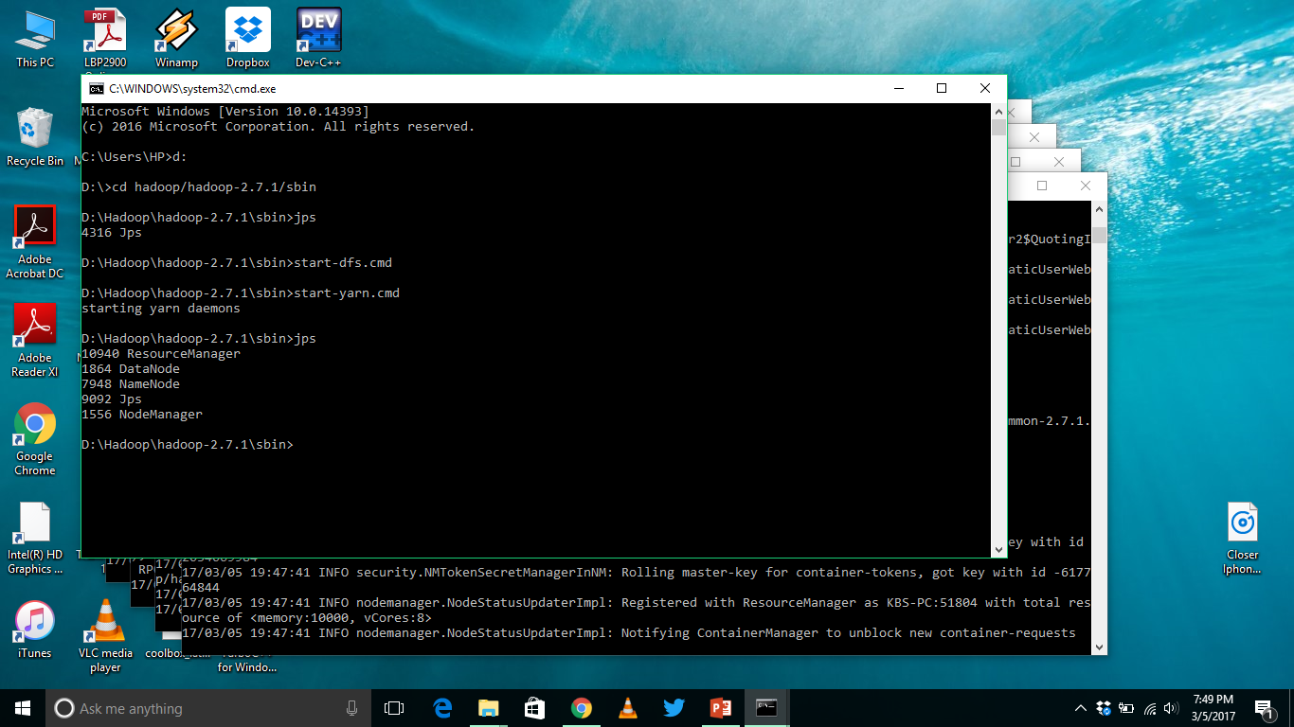
Screenshots (Windows 10)
Hadoop Initialization
Commands:
Start-dfs.cmd
Start-yarn.cmd

Slide 13
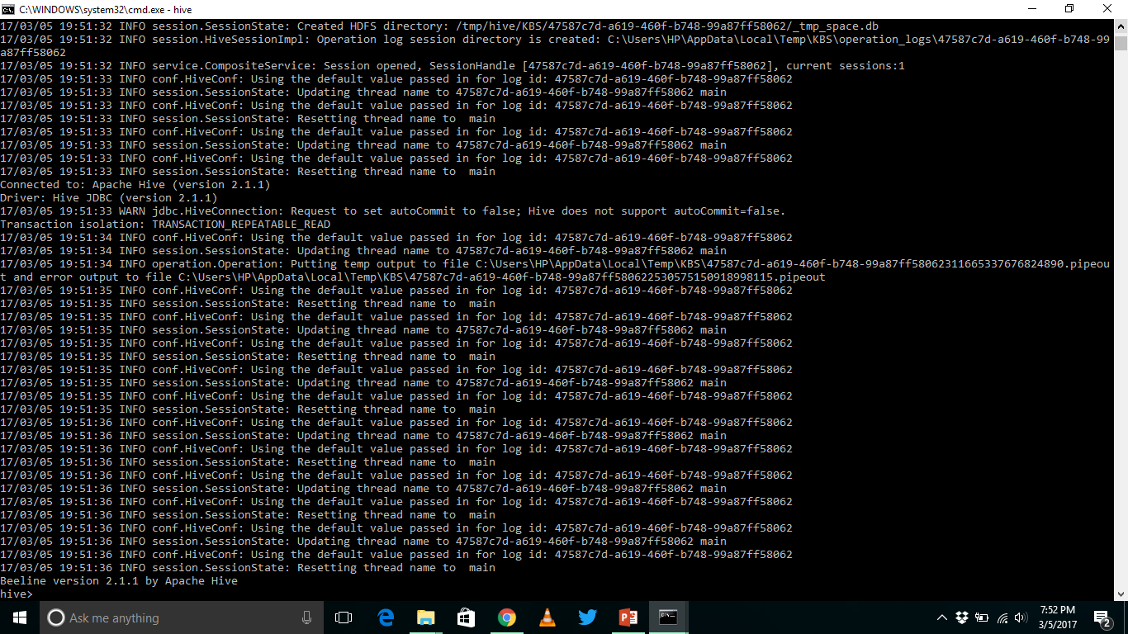
Screenshots (Windows 10)
Starting Hive Command Line
Commands:
hive

Slide 14
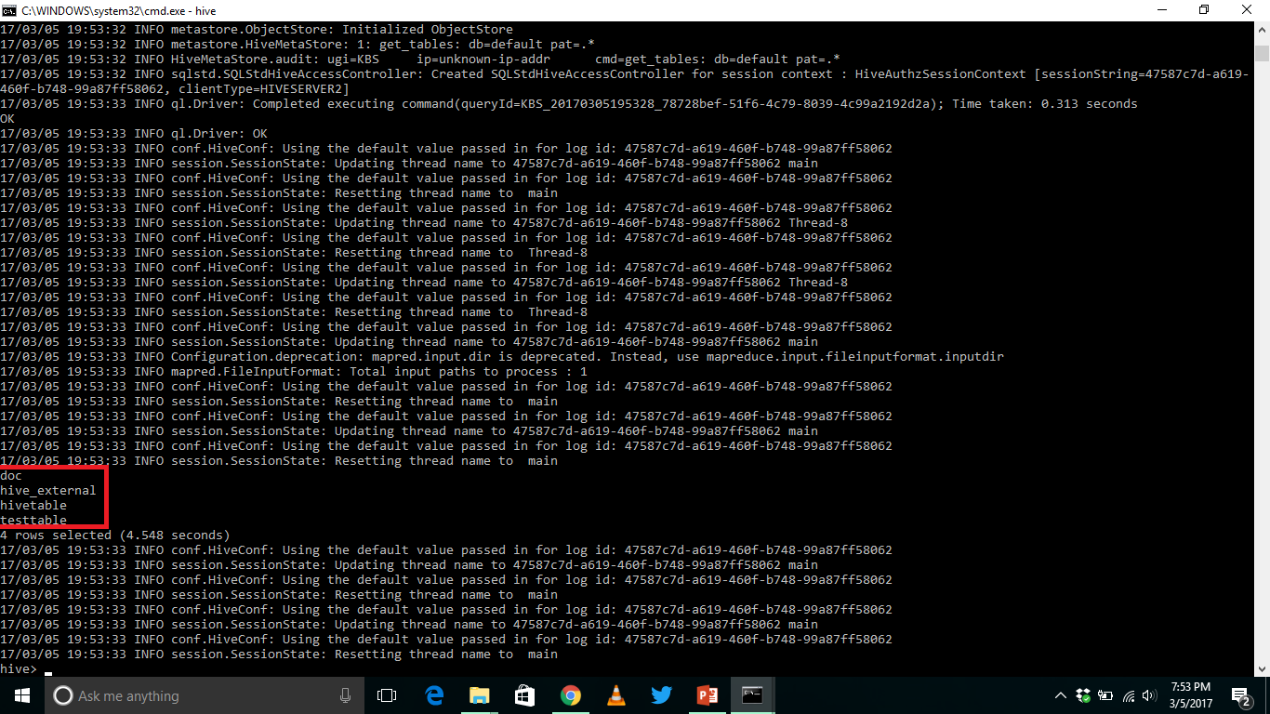
Screenshots (Windows 10)
Hive Commands:
Show tables;

Slide 15
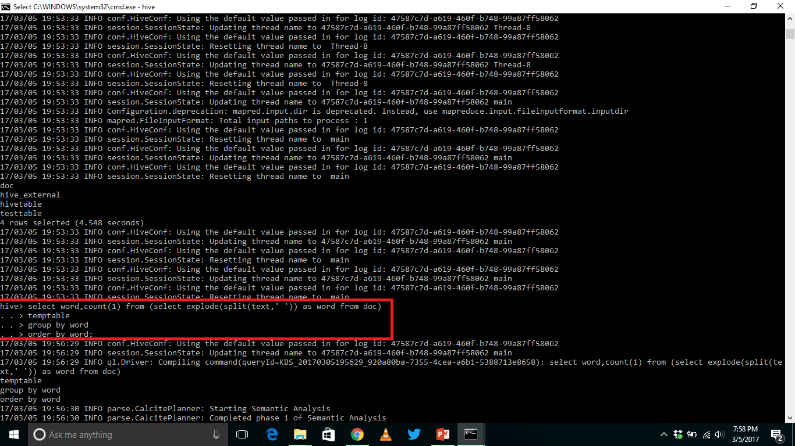
Screenshots (Windows 10)
Hive Commands:
Select statement
Group by
Order By
UDFs: explode, split

Slide 16
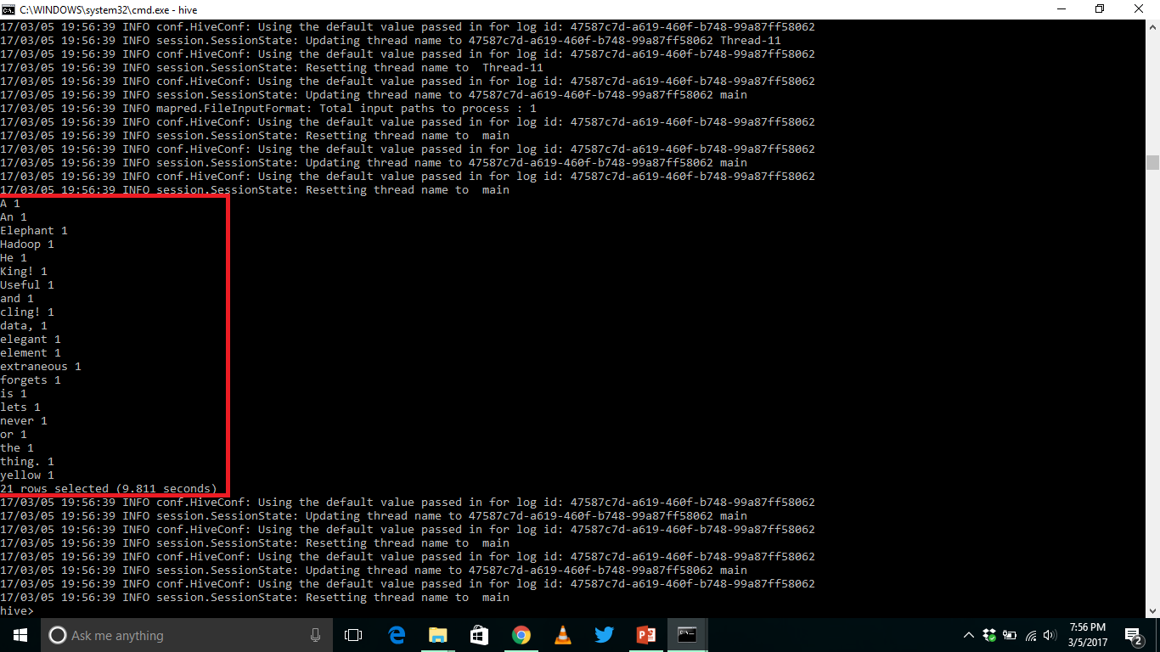
Screenshots (Windows 10)
Hive Commands:
Result of Word Count Program

Slide 17
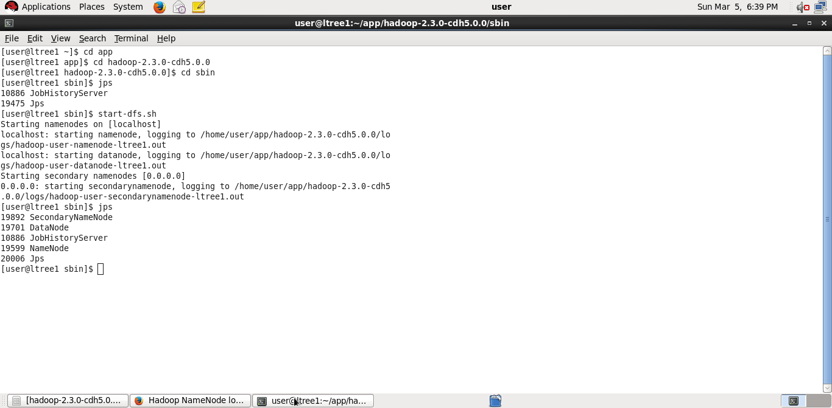
Screenshots (Linux)
Hadoop Initialization
Commands:
Start-dfs.sh
jps

Slide 18
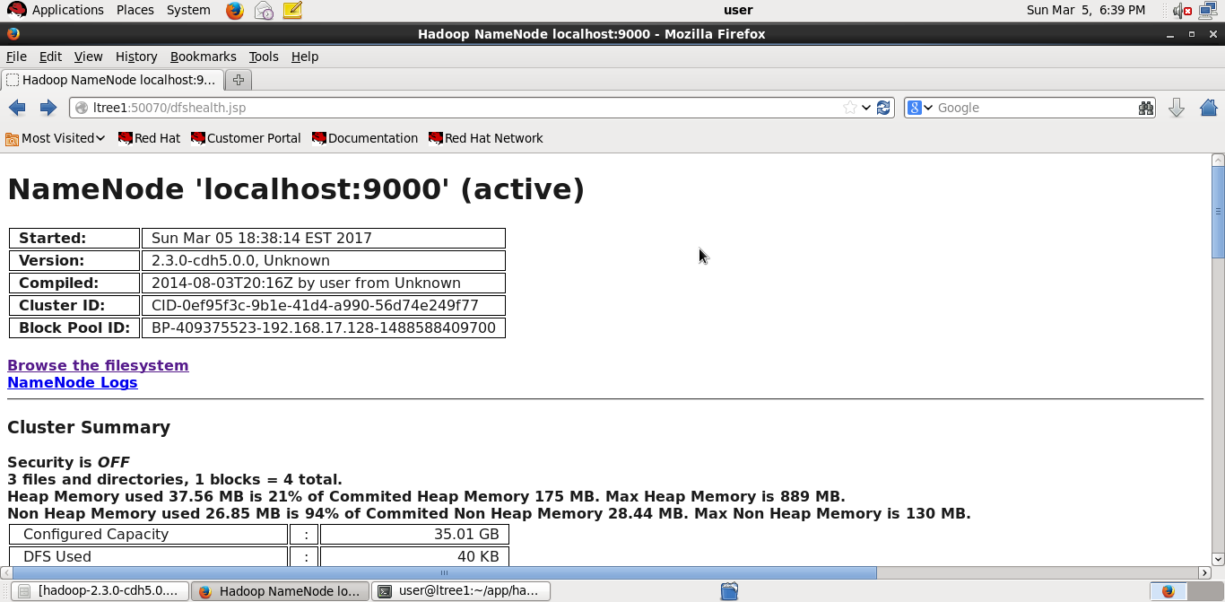
Screenshots (Linux)
NameNode Web UI

Slide 19
Benefits (HIVE):
It take very less time to write Hive Query compared to Map Reduce code. For example, the word count problem which takes around 50 lines of code can be written in 5 lines in Hive. So, you save time.
It was developed so that people who have SQL knowledge can write the Map Reduce Job. It supports many SQL Syntax which means that it is possible to integrate Hive with existing Business Intelligence tools. So, business Analyst, or non-java guys can also work on the large data sets. Similarly, the code which were earlier used in Relational data base system can be used in Hive (with changes). With Map Reducer, it is a separate exercise in itself.
It is very easy to write query involving joins (if there are few joins) in Hive. Comparing it with Map Reduce code, you have to do caching of data and do several operations to reach to the same point.
It has very low maintenance and is very simple to learn & use (low learning curve).

Slide 20
Drawbacks (HIVE):
You cannot do complicated operations using Hive. For example, when output of one job acts as input to the other job (SequenceFileFormat file) or writing query on an image file, Hive is not useful.
Hive is useful only if the data is structured. With unstructured data, Hive is not a good tool while with Map Reduce you can work on any kind of dataset.
Debugging code is very difficult in Hive as compared to pig in which code can be debugged in local .
Map Reduce is like machine code. So, you can do any analytical operation using Map Reduce programming and the disadvantage here is you are using SQL like queries and not purely SQL as per the data requested by the analyst you may have to write complex java programs also in hive.

Slide 21
HIVE 2 Incompatibilities
Required HADOOP 2.x, HADOOP 1.x is not supported.
JAVA 7&8 supported, JAVA 6 is not supported.
MapReduce is criticized, Tez or Spark is recommended instead.
Some configuration default changes.
  SQL standard authorization used by default
  Bucketing enforced by default

Slide 22
Future Work
MULTIPLE INTERFACES (JDBC)/ INTEGRATION WITH BI
COST BASED OPTIMIZATION
BETTER DATA LOCALITY.
DATA COMPRESSION
ADVANCED OPERATORS

Slide 23
Conclusion
It can be used for analytics and reporting.
It has similar syntax to SQL.
It provides a simpler query model with less coding.
Its response time is faster than other type of queries.
Hive supports user defined functions(UDFs), scripts and customized I/O format to extend its functionality.
There is a big community of practitioners and developers working on and using hive.

Slide 24
THANK YOU

