Slide 1
Every Good Graph Starts With
Presented to Prof: IMRAN AHMAD
By Nireesha Sudula (8840070)

Slide 2
Agenda…
RDBMS
Need for Graphs
5 W’s & H of Neo4J
Data Set
Conclusion
References

Slide 3
Where Does It Fit…

Slide 4
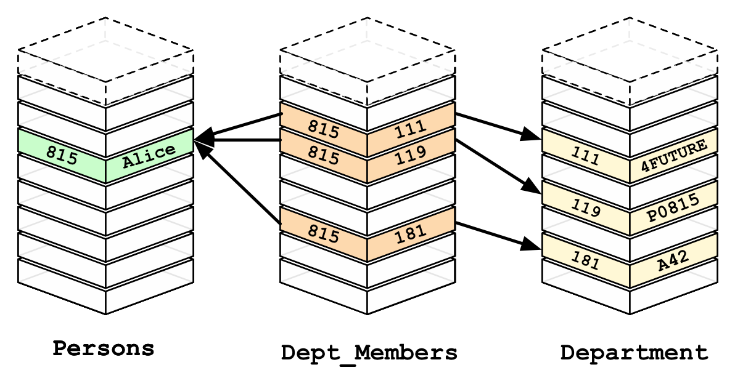
Relational Data BAseS
Traditional Relational Databases are Optimized for transactions, queries or searches.
Relational DBs are good for Static data which is well understood and structured involving discrete parts or minimal connectivity.
They cant handle Relationships well making inappropriate for real time.
Demerits:
Slow Development
Poor Performance
Low Scalability
Hard to maintain

Slide 5
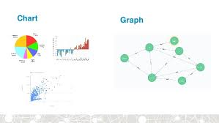
Need For Graphs???
Apart from the traditional relational DB, similar issues encountered with the NoSQL databases too.
The demerits mentioned earlier were resolved by the advent of the Graph Databases with below properties.
Intuitiveness -
Exact same data model as of data
Speed -
High speed is achieved by Index Free Adjacency
Agility -
Naturally adaptive model + Query Language for graph.

Slide 6
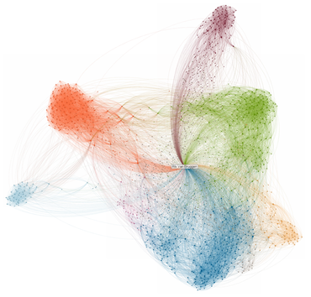
Neo4j… Reimagine your Data as a Graph
Neo4j is a highly scalable native graph database that leverages data relationships as first-class entities, helping enterprises build intelligent applications to meet today’s evolving data challenges.
This is an enterprise grade graph data base which enables you to
Model and store the data
Query Data Relationships
Seamlessly evolve applications

Slide 7
5 W’s???
World’s First and Best Graph Database
Highly Performant Read and Write Scalability, without Compromise
Fully Native Graph Storage & Processing - High Performance
Easier Than Ever to Learn
*************************************************************
Connected Data matters the most
*************************************************************
Fraud Detection
Graph based Search
Network & Id Operations
Real-Time Recommendation Engines
Master Data Management
Identity & Access Management

Slide 9
Architecture View Point...

Slide 10
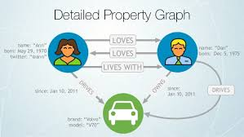
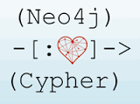
Data Modelling…
Neo4j is a graph database which uses the Property Graph Data Model of Native Graph Processing which has
Nodes-
Objects in the Graph
Relationships-
Relate nodes by Type and direction
Properties-
Named data values
Language- CQL

Slide 11
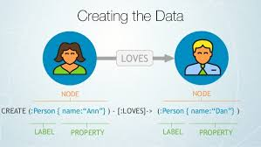
Cypher…
Cypher is the declarative Query language to graphs as SQL to the relational databases. Its key principles and capabilities are:
Create, update, and remove nodes, relationships, labels, and properties.
Pattern matching for nodes and relationship in the graph, to extract information or modify the data.
Manages indexes and constraints.
Basically it emphasizes on WHAT to find rather
HOW to find.

Slide 12
Comparisons…
FEATURES | RELATIONAL DATABASES | NEO4J | OTHER NOSQL DATABSES
Data Storage | Storage in fixed, pre-defined tables with rows and columns with connected data | Graph storage structure with index-free adjacency results. | No support for connected data at the database level.
Data Modelling | Database model must be developed with modelers and translated from a logical model to a physical one. | Flexible, "whiteboard-friendly" data model allows for fine-grained control of data architecture. | Data model not suitable for enterprise architectures as wide columns & document stores do not offer control
Query Language | SQL: Number of JOINs needed for connected data queries. | Cypher: A graph query language that provides the efficient way to describe relationship queries. | Query language varies, but no query constructs exist to express data relationships.
Data Center Efficiency | Server consolidation is possible but costly for scale up architecture. Scale out architecture is expensive in terms of purchase, energy use and management time. | Data and relationships are stored natively together with performance improving as complexity and scale grow. | Scale out architecture assumes ongoing access to more commodity hardware ignoring energy costs, network vulnerabilities

Slide 13
Dataset:
After extracting the CSV file, the data is imported into the Neo4J database using LOAD function.

Slide 14
Few keywords
ORDER BY
SKIP
SET
MERGE
UNWIND

Slide 15
Conclusion…
Neo4j was named "the most popular graph database" in Forrester's Market Overview on Graph Databases report.
Neo4j was also named a "champion" in a vendor landscape report on graph databases by Bloor Research.
InfoWorld's 2015 Technology of the Year
2015 SD Times 100 and the DBTA 100 2015.
“Neo4j is the clear market leader, as well as the recipient of numerous analyst, customer and community accolades. There's still massive growth left ahead of us, and we remain committed to the innovation and the evolution of our product.“
- Emil Eifrem, CEO of Neo Technology

Slide 16
References…
https://neo4j.com/
https://neo4j.com/graphgists/
http://neo4j.com/docs/cypher-refcard/3.1/
https://www.kaggle.com/nsharan/h-1b-visa
Considerations from Professor’ slides on Graph Databases

