Slide 1
NoSQL Database- Neo4j
PRESENTED BY:
JYOTSANA KARAN GOYAL PRINCY

Slide 2
CONTENTS
Introduction
What is NoSQL
About Neo4J
Cypher
Drivers
Conclusion
References

Slide 3
Data is expanding to include the increasing number of people and enterprises doing everything online connected to internet.

Slide 4
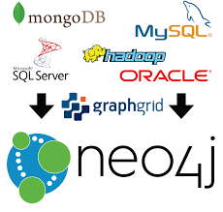
What is NoSQL
It means – “Not only SQL”
It has a flexible schema/schema less, often distributed, non-relational data storage systems.
They do not use the concept of joins.
Strength: Powerful data model , fast
Weakness: Sharding

Slide 5
What’s new ?
SQL
SQL databases are primarily called as Relational Databases (RDBMS).
SQL databases are table based databases.
SQL databases have predefined schema.
SQL databases uses “structured query language” for defining and manipulating the data.
SQL database examples: MySql, Oracle, Sqlite.
NoSQL
NoSQL database are primarily called as non-relational i.e. relational + others.
NoSQL databases are document based, key-value pairs, graph databases or wide-column stores.
NoSQL databases have dynamic schema for unstructured data.
In NoSQL database, queries are focused on collection of documents. Cipher is used in Neo4j.
NoSQL database examples: MongoDB, cassandra, Neo4j.

Slide 6
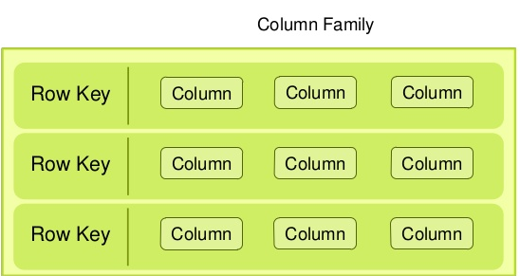
Flavors of NoSQL
Document
Graph

Slide 7
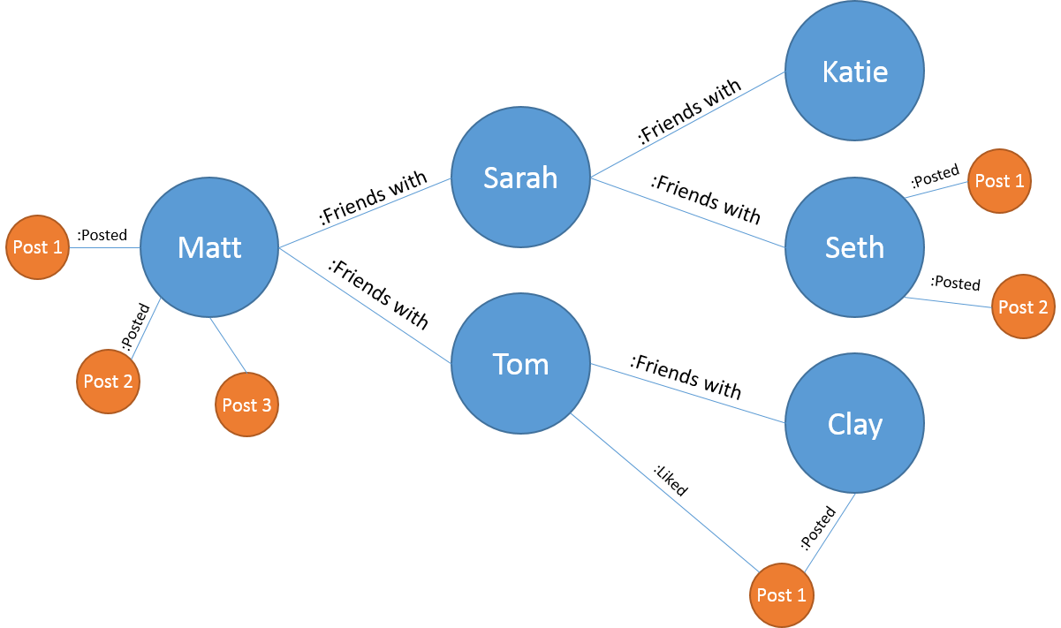
Neo4J
It’s a graph based database
Whiteboard friendly
Full ACID transactions
Fast management, storage and traversal of nodes and relationships
Schema optional
Supports rapid development
Designed for business critical and high performance operations

Slide 8
Since there is NoSQL, how do we query it?
Data access is programmatic:
Through JAVA API
-JVM languages have bindings to the same APIs
-JRuby, Jython, Clojure
-Cypher
Managing nodes and relationships
Indexing
Traversing
Path finding
Pattern matching

Slide 9
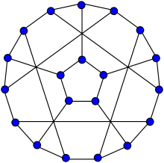
Property graph model
In Neo4J, we use a property graph model to represent information.
It consists of:
Nodes: Entities
Labels: Represent the role of node
Relationships: Connects two nodes
Properties: Which define a node or relationships

Slide 10
:GIRL
Name: “MARY”
Age:”25”
LIVES WITH
SISTER
:GIRL
Name: “ANNA”
Age: “20”
OWNS
FRIENDS
:BOY
Name: ”HARRY”
Age:”20”
TENANT
RENTS
:HOUSE
Location :”Ottawa”
Type: ”townhouse”

Slide 11
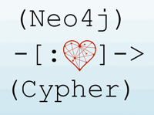
Cypher
It’s a declarative query language
-Allows you to declare a pattern of what you would like to be retrieved
Greater readability
Query optimizations
It is great for ad hoc querying, without having to write complex software routines to do so.
It matches patterns of nodes and relationships to extract information or modify data

Slide 12
Cypher Queries
CREATE:
It is a clause to create data
() used to indicate a node
p:person p is a variable, person is the label
{} to add properties to the node
CREATE
(p:person {name: “Anna”, from: “Ottawa”, Social: “Twitter”})

Slide 13
Cypher Queries
MATCH:
It is a clause to specify a pattern of nodes and relationships
(p:Person) a single node pattern with label ‘Person’ which will assign matches to the variable ‘p’
WHERE clause is used to constrain the results
p.name=“Anna” compares name property to the value “Anna”
RETURN clause is used to request particular results
MATCH (p:Person)-[:knows]-(q:Person)
where p.name=‘Anna’ AND q.name=’Mary’

Slide 14
Cypher Queries
INDEX
It is a redundant copy of information in DB for increase in efficiency of retrieval of data.
CREATE INDEX ON :Person(Karan)
MATCH (n:Person) WHERE n.name=$value
(Index can be directly used for equality comparison)
OR
MATCH (person:Person) WHERE person.name IN [‘Princy’, ‘Jyotsana’]
Return person

Slide 15
Cypher Queries
CONSTRAINTS
Neo4J helps to enforce data integrity with the help of constraints
Constraints can be applied to either nodes or relationships
Adding a unique property constraint will also add an index on that property
Example:
CREATE CONSTRAINT ON (cc.CreditCard) ASSERT cc.number IS UNIQUE

Slide 16
Statistics
STATISTICS
To produce an efficient plan for the query , Neo4j needs information about the DB, such as the schema – what indexes or constraints have been used?
Neo4j uses statistical information to optimize the execution plan :
The number of nodes with a certain label(example:person)
Selectivity per index
The number of relationships by type
The number of relationships by type, ending or starting from a node with a specific label

Slide 17
Statistics
How are Queries executed?
RULE :
Execution planner has rules to produce execution plans.
COST:
Execution planner uses the statistics service in Neo4j to assign cost to alternative plans and picks the cheapest one.
Execution query is broken into small pieces called operators:
Rows
Estimated rows
DbHits

Slide 18
DRIVERS
Neo4j drivers provide access to Neo4j for the application
A driver instance provides a sessions within which, transactions run statements to create and query data , define a schema and call procedures for monitoring and administration
Neo4j drivers use Bolt protocol for communication
Drivers exist for
.NET
Java
Javascript
Python

Slide 19
CONCLUSION
Neo4j is the most effective and intuitive way of working with data and it mimics the interconnectedness of the ideas in human mind.
High Performance: Goes even better, when data becomes more complex
Myriad solutions have been employed with Neo4j in fields like Fraud Detection, network and IT, Real time, social, access management.
Today all companies in the world are trying to do data driven business. For example,Walmart uses Neo4j to analyze each sale of product,what kind of items you like to buy and what products can be recommended.

Slide 20
REFERENCES
https://neo4j.com/
www.wikipedia.com
www.github.com
https://www.youtube.com/watch?v=NH6WoJHN4UA

Slide 21
OPEN FORUM ☺

