Slide 1
Neo4j: GRAPH DATABASE 27 March, 2017
Swati Hurde
8817756

Slide 2
Abstract
Neo4j, is the world’s leading graph database, helping businesses create new products and services and re-imagine existing ones, by bringing data
relationships to the fore.
Neo4j is a highly scalable, native graph database purpose-built to leverage not only data but also its relationships.
Neo4j's native graph storage and processing engine deliver constant, real-time performance, helping enterprises build intelligent applications to meet today’s evolving data challenges.

Slide 3
OUTLINE
What is Database
Relational Data Bases
Why NOSQL Data Bases
Types of NOSQL Data Bases
Neo4j and features
GRAPH Data Base
Graph Data Model
Basic Commands
Advantages
Applications
Project Outcome

Slide 4
DATA BASE
DATABASE: Any kind of organized collection of data. Not all databases require a management system. A database management system, then, can technically be referred to as a set of computer programs that manage the database.
Database management systems have been under development:
Relational database
NoSQL database

Slide 5
Relational Data base
Features:
Easy query language SQL
Schema based
Data Stored in rows and columns
Supports Exports data to various formats
Full acid: Atomicity, consistency, Isolation & durability
Drawbacks of Relational databases:
Can’t model or store data and relationship without complexity.
Performance degrades with no. of levels of relationships and data base sizes.
Adding new types of data and relationship requires redesign of schema increasing time to market.

Slide 6
NoSQL Data base
A mechanism for storage and retrieval of data other than the tabular relations used in relational databases.
Used in big data and real-time web applications.
Not only SQL" to emphasize that they may support SQL-like query languages.

Slide 7
Types: NoSQL data bases
Document Data Base: Stores data elements in document like structures. Ex: MongoDB
Graph Data Base: Stores data in form of nodes and relationships: NEO4J
Key value Data Base: Use a simple data model that pairs a unique key and its associated value in storing data elements. Ex: Dynamo DB
Wide column stores : Store data across tables that can have large no. of columns. Ex: Simple DB

Slide 8
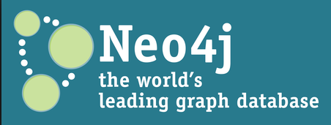
What is Neo4j & Salient features
Developed by Neo Technologies
Most Popular Graph Database
Implemented in Java
Open Source
Features:
Schema free: Data doesn’t have to adhere to any convention.
ACID: atomic, consistent, isolated and durable
Support for wide variety of languages.
High performance graph operations : traversing 1,000,000+ relationships /sec on commodity hardware.
Powerful and expressive query language: Cypher often requires 10x to 100x less code than SQL

Slide 9
Graph Data base
CHART
NEO4J
GRAPH: Connected Data
Pi Chart

Slide 10
Graph Data Model
Nodes: Objects in the graph that have name-value properties and can be labeled.
Relationships: It relate nodes by type and direction and can have name value properties.
Properties: Properties are named values where the name is a string.
Relationship: KNOWS
CREATE : Patient{name:‘John',Age:8 years})
-[:knows]->
CREATE : Doctor{name:‘Enny',Age:28years})

Slide 11
Basic Commands
CREATE (n {name: $value}) : Create a node with the given properties.
MATCH (n:Person)-[:KNOWS]->(m:Person)
MERGE (n:Person {name: $value}) : finds or creates a relationship between the nodes.
WHERE n.property <> $value
RETURN * : Return the value of all variables.
DETACH DELETE n : Delete a node and all relationships connected to it.
DELETE n, r : Delete a node and a relationship.
MERGE (n:Person {name: $value})
REMOVE n:Person : Remove a label from n

Slide 12
Advantages of neo4j
Easy to represent connected data
Very fast to retrieve / traversal / navigate connected data
Can represent semi structured data very easily
Cypher commands are human readable and easy to learn
Simple and powerful data model

Slide 13
Graph Thinking in practice
Fraud Detection in Banking
Social Networking Sites
Real time recommendations
Master data management
Graph based search
Network and IT operations
Identity and access management
Space Agencies

Slide 14
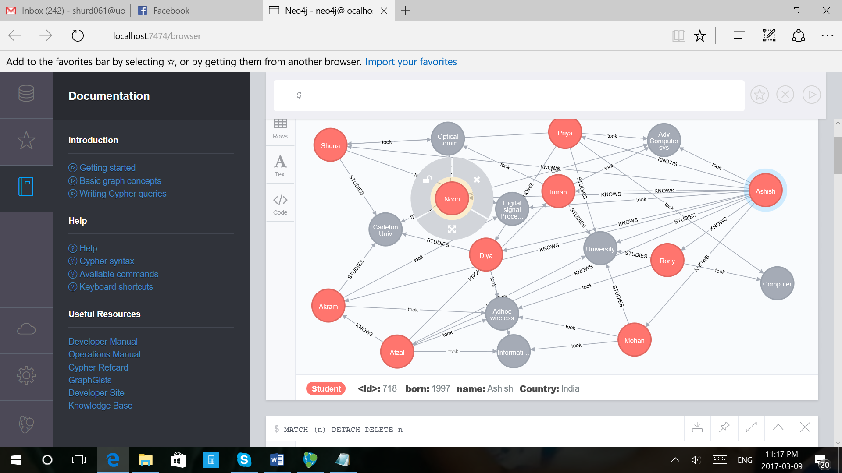
Project outcome
Establishing relationship between Students from India, Pakistan and Canada and Universities and Courses they are enrolled

