Slide 1
Real Time Analysis in Twitter
Avneet Behl
Jaya Priya Arya
Saifalikhan Pathan
Zaheenabanu Somani

Slide 2
Contents
Introduction
Proposed System
Implementation
Results and Analysis
Conclusion and Future Work
References

Slide 3
Introduction
In past source of news was ‘traditional media’ such as newspapers,magazines,television etc. but recently social media platforms like Twitter,facebook,Instagram have emerged as very important tool for spreading news well before traditional media can do
Social media not only gives quick updates but also people can start or indulge themselves in debates over some important topics(Example:US Elections 2016 ).
A trend on Twitter refers to a hashtag-driven topic that is immediately popular at a particular time.
These trending topics can be events such as political movements (USA election), entertainment (Academy Awards).
Notes:
Saif

Slide 4
What is twitter?
Twitter is an online news and social networking service where users post and interact with messages, "tweets," restricted to 140 characters. Twitter uses “hashtag” - a type of label or metadata tag used on social network and microblogging services which makes it easier for users to find messages with a specific theme or content.
Because tweets are sent out continuously, Twitter is a great way to figure out how people feel about current events.
Notes:
Saif

Slide 5
continued...
These trends or streams can give information and feedback about what people are thinking on a particular topic or where they are paying attention.
Here we are focusing on uncovering and analyzing real-time trends in Twitter. These trends can be used to discover emerging patterns in real time, which can be used for various applications.
Example: If a online news company(BBC.com) wants to get idea about what people are focusing at certain time when a particular event is going on real time analysis on social media can help them in various ways.

Slide 6
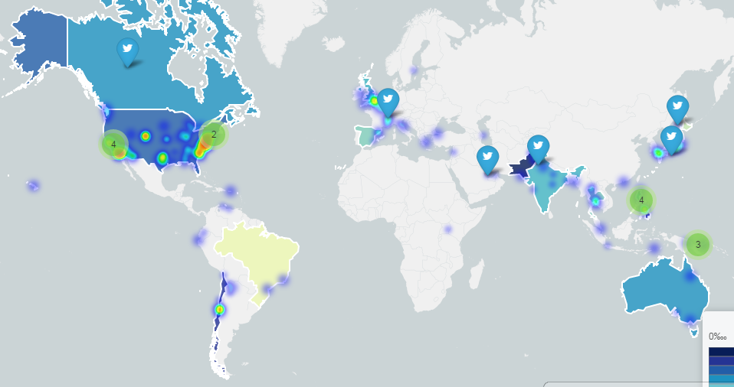
#Earthquake
Reference: Generated via Online Tableau software, www.tableau.com

Slide 7
Objective
To analyse the trends on twitter using the “hashtag”.
Real time analysis can be defined as the use of, or the capacity to use, available enterprise data and resources when needed. It consists of dynamic analysis and reporting, based on data entered into a system less than 60 seconds ago.
Social websites are one of the major driving forces for large data adoption.Public APIs provided by sites like twitter are useful source of data for analyzing and understanding popular trends.

Slide 8
Proposed System

Slide 9
Layout
We analysed the data of 50 tweets using keyword #Oscar and programmed a word cloud.
The size of a word in word cloud directly corresponds to its importance. The higher the frequency, the bigger the size.
Analysing data requires dataset, further demanding API (application program interface, set of tools or protocols to build software applications).
API of Twitter is an interface between the application just created and Rstudio. They are integrated by the packages and functions, they load tweets from twitter to RStudio.
Notes:
Avneet

Slide 10
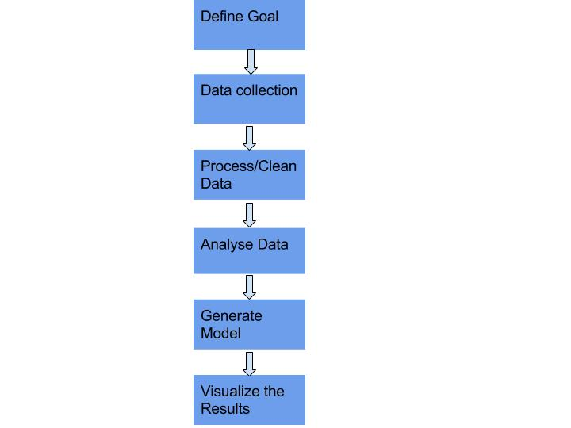
FLOWCHART
Analyse the trends on twitter
Collecting data using the twitter API
Remove punctuation, tolower, remove numbers,stopwords, Stemming
Tracing popular words
Generate the word Cloud
Display the word Cloud

Slide 11
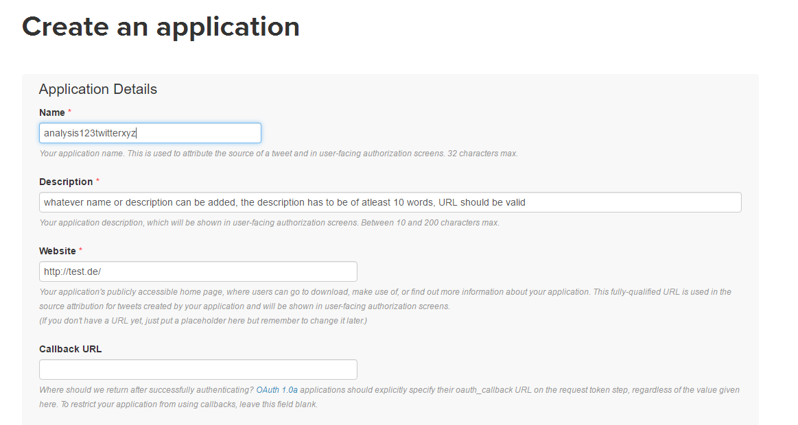
The process commences…………… Creating new application

Slide 12
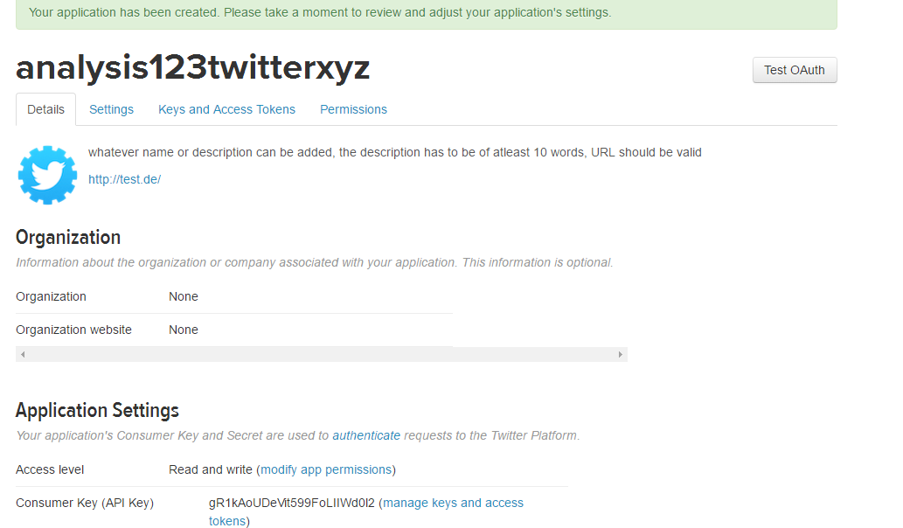
Redirected to a page OAuth setting of application just created
Leave it open in the background for use in later stages
OAUth - authentication protocol

Slide 13
Before proceeding further, make sure that newest version of twitteR package is installed.
Extract tweets and followers from twitter website using R and tweeteR packages.
It is followed by cleaning process employing tm package. It comprises of:
Removing punctuation
Converting all alphabets to lower case
Removing numbers
Remove stopwords (no significance in search queries, no specific definition, varies from purpose to purpose, may be short function words: the , is or lexical words, want etc )

Slide 14
This is followed by stemming
It is removal of inflected or derived words to their word stem, base or root form.
Many search engines treat words with the same stem as synonyms
The data is then analysed
Machine learning techniques monitors the number and score of tweets. The result is used to confirm text analysis of data set.
Based on this result, the model is generated and displayed (word cloud in this case)

Slide 15
Implementation

Slide 16
Implementation
We have implemented our project in Rstudio.
R is an open source programming language and software environment for statistical computing and graphics and data analysis.
Tools used: Twitter API, RStudio.
Notes:
Zaheena

Slide 17
Implementation
The data that we are using for analysis is completely unstructured text.
The machine learning algorithms work on numerical data that is in rows and columns.
So, we convert the text documents into rows and columns
Load libraries and update packages(tm, twitterR, wordCloud, devTools)
setup_twitter_oauth(api_key,api_secret,access_token,access_token_secret) #setup twitter authorization
dataframe <- do.call("rbind", lapply(rdmTweets, as.data.frame)); #convert tweets into dataframe
The collection of documents is called a Corpus
myDocuments <- Corpus(VectorSource(dataframe$text))

Slide 18
Implementation
Count the frequency of each word in each document.
Before that, clean the data(remove punctuations, stop words, convert to lowercase)
Stemming the data
myDocuments<-tm_map(myDocuments, stemDocument) #allows stemming of data i.e strip the words to their roots eg: playing, plays, played to play
TERM DOCUMENT MATRIX
The Term Document Matrix has a row for each term and a column for each document. The value is the count.
DTM<-TermDocumentMatrix(myDocuments)

Slide 19
Implementation
Count the words with the frequency of 10 or more and generate the cloud.
We did a twitter analysis on 26, February 2017 i.e Oscars 2017 night using the #Oscars after it was telecasted. We worked with 50 tweets in real time and generated a word cloud for the same.

Slide 20
Video
Notes:
Zaheena

Slide 21
Results and Analysis

Slide 22
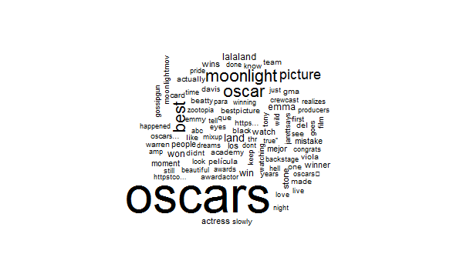
Result and Analysis
Notes:
Zaheena and Jaya

Slide 23
Results and Analysis
Through the real time analysis of twitter, one can understand the overall opinion of public behind a certain topic. Thus, it can be called as ‘Opinion Mining’ or ‘Sentiment Analysis’.
Briefly, the entire process of real time analysis has two parts:
Firstly, reading the data from twitter and writing it in a server called socket
Secondly, reading the data from socket and then analyzing the data on-the-fly.
Notes:
Jaya

Slide 24
Conclusion and Future Work

Slide 25
Conclusion
Likewise twitter and the real time analysis is a powerful tool for business, marketing, politics etc. which has a tendency to extract the result of current trends through feedback and decision making.
Merits:
Errors and frauds are detected
New competition strategies are observed
Cost saving
Notes:
Jaya

Slide 26
Conclusion
Demerits:
In open source tool Rstudio, we can extract only fixed number of maximum tweets (which is limited by twitter API)
Sometimes, the number of tweets recovered can be less than the number of tweets requested.
As characterization of tweets can be positive, negative or neutral, the real time analysis tool can be misleading sometimes.

Slide 27
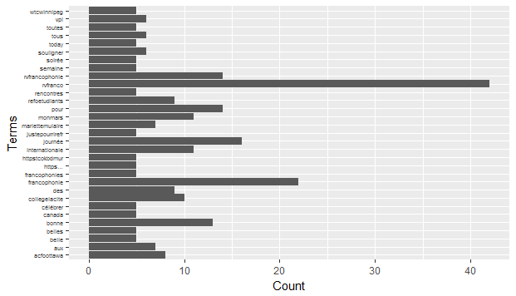
Analysing using bar chart
(Analysis on #RVFranco done on 21/03/2017)

Slide 28
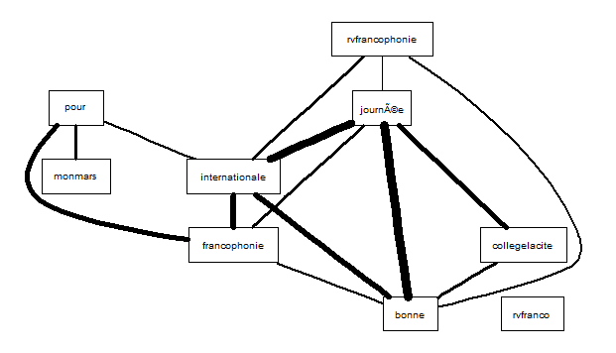
Finding Association with terms.
(Analysis on #RVFranco done on 21/03/2017)

Slide 29
Future Work
We will try to implement a cluster for this data.
For future data scientists are also working on a combination of tweets (or sentence) rather than a single tweet to garner the data.
Also, it can be implemented for Speech recognition instead of text.

Slide 30
References
[1] D. Ahmad and D. Alhayyan, "Discovering and Analyzing Important Real-Time Trends in Noisy Twitter Streams"
[2] Baqapuri, Afroze Ibrahim. Twitter Sentiment Analysis. 2012.
[3] Conclusion: Twitter and the Analysis of Social Phenomena,A Jungherr, Andreas, Analyzing Political Communication with Digital Trace Data: The Role of Twitter Messages in Social Science Research, 2015, Springer International Publishing, Cham, 10.1007/978-3-319-20319-5_8, http://dx.doi.org/10.1007/978-3-319-20319-5_8, 211-220
[4] Data Science Department(DATA5000), Carleton University
[5] Kaify Rais, Twitter Analysis, 2015

