Slide 1


Twitter Sentiment analysis Using Apache Spark
By:
Amandeep Kaur (101060350)
Deepesh Khaneja (101024610)
Khushboo Vyas (101059808)
Ranjit Singh Saini (101024552)

Slide 2
Outline
Introduction
Sentiment Analysis
Challenges in sentiment analysis
Framework
Apache Spark
Implementation
Conclusion

Slide 3
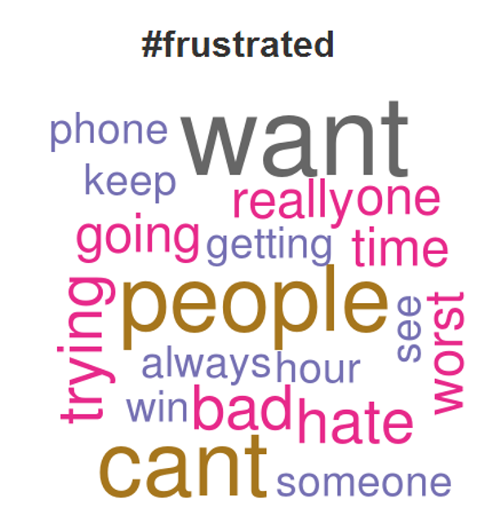


What is sentiment analysis?
1
Variety of Social Media Platforms and Blogs provide opportunities to express emotions.
2
Information has become vast and analysis can lead to several predictive results.
3
Sentiment Analysis is the classification of polarity of any word, sentence or document
4
uses Natural Language Processing(NLP) to extract, identify or to characterize the sentiment content.
5
Goal is to determine whether it is positive, negative or neutral.

Slide 4


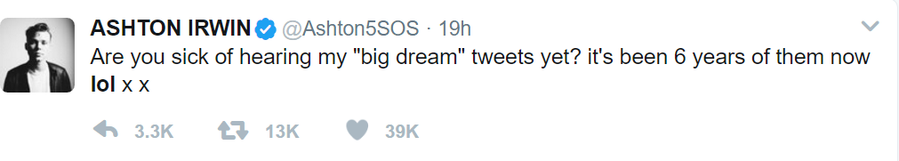


Challenges in sentiment analysis
1
Tweets are highly unstructured and non-grammatical
Tweets are highly unstructured and non-grammatical
slangs
emoticons
Has limit of Maximum of 140 characters
LOL
2
Extensive usage of slangs, acronyms and anti-social words
Extensive usage of slangs, acronyms and anti-social words
OMG
ROFL
IMHO
3
TBH
Out of Vocabulary Words
Out of Vocabulary Words
Words like Pleaseeeee, Noooo, Damnnnn

Slide 5

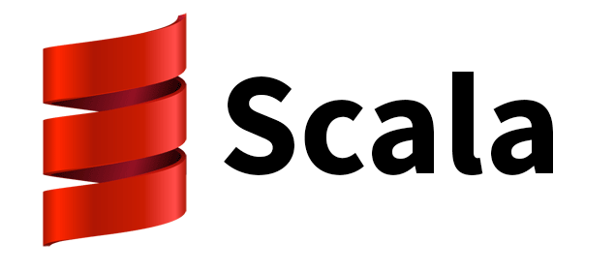

Technology Used
Apache Spark
A lightning fast cluster computing platform to retrieve streaming data and forwarding to storage system like HDFS, Database Server
High Level Functional and Object Oriented Programming
Intellij Idea
Integrated Development Environment to build, run and test code
Scala

Slide 6
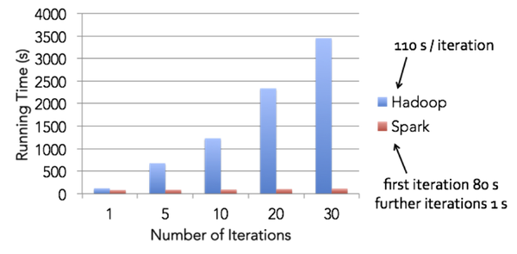
Apache Spark: Introduction
Fast and general engine for large-scale data processing.
Is open source, supports multiple languages and faster than on Apache Hadoop.
Main Features
Real Time Stream Processing: can handle real time streaming.
In-memory cluster computing: increases the processing speed of an application.
Advanced Analytics: It also supports SQL queries, Streaming data, Machine learning (ML), and Graph algorithms along with “map” and “reduce”.
Figure: Hadoop vs apache spark
By Cloudera.com

Slide 7
Apache Spark VS Hadoop

Slide 8
Apache Spark Framework
Scala
Python
Java
R
Programming
Library
Spark Core
Ml Lib
GraphX
Streaming
Spark Core
Engine
YARN
Mesos
Spark Scheduler
Management
Local
HDFS
S3
RDBMS
NOSQL
Storage

Slide 9

Spark Streaming
Spark Streaming is an extension of the core Spark API.
Data stream can be extracted from Various sources like Kafka, Twitter, HDFS to process
Processed Data can be pushed to filesystems like HDFS, Databases, Dashboards like Apache Zeppelin for various applications.
Kafka
HDFS
Flume
Databases
Twitter
HDFS/S3
Dashboards

Slide 10
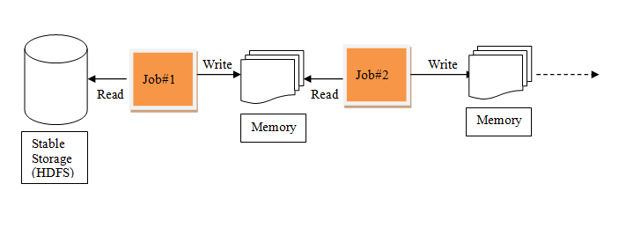
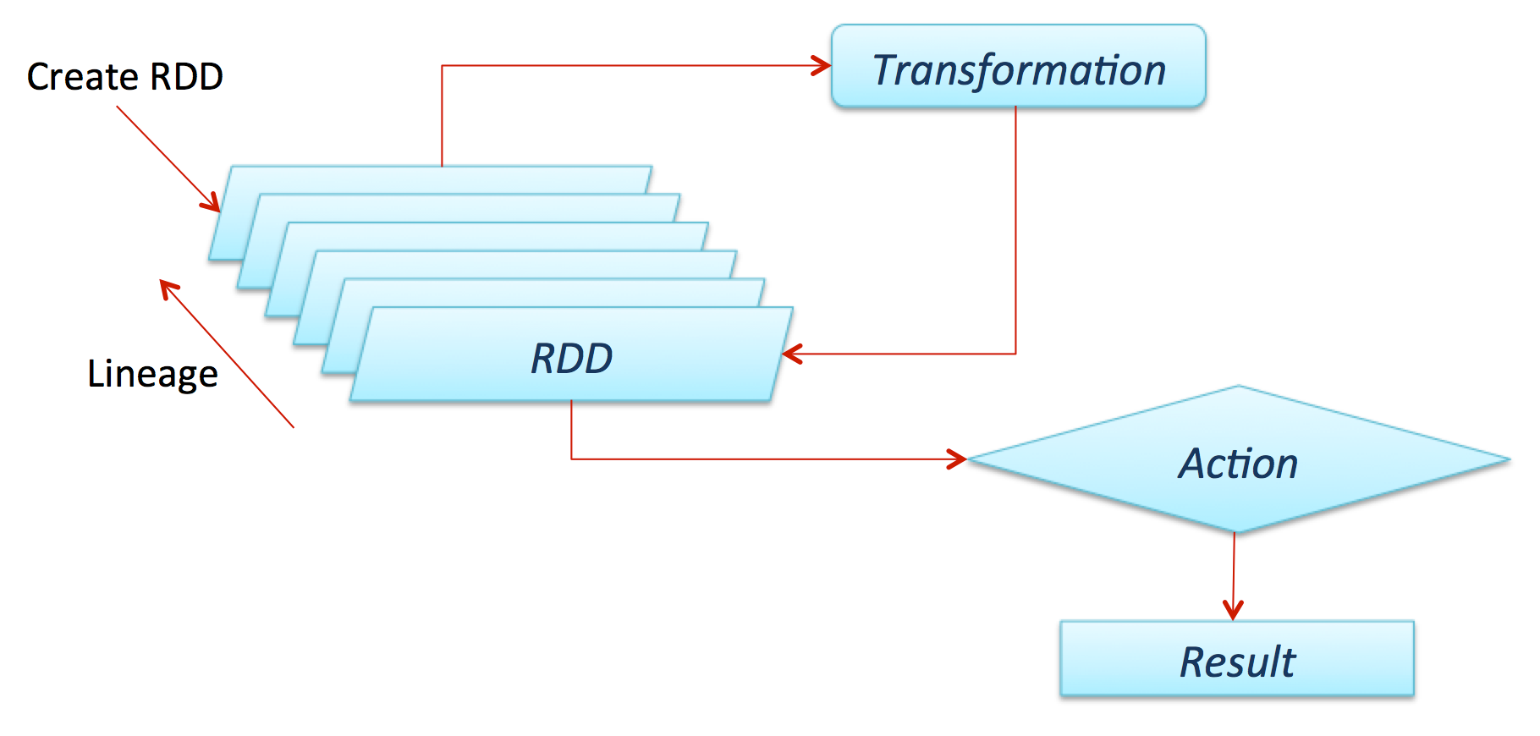
Resilient Distributed Dataset
RDDs support two kinds of operations:
Transformations - operations that return another RDD.
Actions - operations that trigger computation and return values.
RDD is basic Abstraction in Spark.
The main features of RDDs
Resilient: fault tolerant
Distributed : data resides on multiple nodes in a cluster.
Dataset : collection of partitioned data.
In-Memory, data inside RDD is stored in memory as much (size) and long (time) as possible.
Immutable it is read only & does not change once created , can only be transformed using transformations to new RDDs.
Parallel: process data in parallel.

Slide 11
Interactive and Iterative operations on RDD
Interactive Operations
If different queries are run on the same set of data repeatedly, this particular data can be kept in memory for better execution times.
Each transformed RDD may be recomputed each time you run an action on
Support for persisting RDDs on disk and memory. Spark will keep the elements around on the cluster for much faster access
Iterative Operations
Store intermediate results in a distributed memory instead of Stable storage (Disk)
Makes the system faster
Iteration 1
Iteration 2
Iteration n
HDFS
read
MR1
MR1
MR1
MR1
write
Read
Data on disk
Tuples(on Disk)
MR2
MR2
Distributed Memory
MR2
Distributed Memory
MR2
MR3
MR3
Input from stable
stage
MR3
MR3

Slide 12
DStream
Spark use Discretized Stream for real time processing.
Difference b/w real time & batch processing is the source of the data and the frequency at which the data is coming.
Is mainly a sequence of RDDs.
Batches of processed data
Batches of I/P data
Input data stream
Spark Streaming
Spark Engine
So, Dstream is nothing but batches of RDDs which is shown here.

Slide 13
How Streaming Works?
Receives Live input data streams and divides data into batches
Provides High level of Abstraction called DStream (Discretized Stream)
Records batches of processed data.
Receiver
RDD’s

Slide 14
Methodology : Our Project
Data Collection
Data Processing
Data Filtering
Feature Extraction
Classification Algorithm
Sentiment Analysis

Slide 15

Working
T1
T2
T3
T4
T5
Twitter Stream
Window
1
Tokenization
Tokenization
6
2
Pattern Analysis
Pattern Analysis
Stop Words Removal
Stop Words Removal
5
3
Term Document Matrix
Stemming
Term Document Matrix
Stemming
4
Filtering
Filtering

Slide 16
Data Collection
steps
oauth.consumerKey =xxxxxxxxxxxxxxxx
oauth.consumerSecret = x12221xxxxx
oauth.accessToken = x12221xxxxx
oauth.accessTokenSecret = x12221xxxxx
1. Twitter provides limited public API.
val keywords = scala.io.StdIn.readLine()
val filter= keywords.split(",")
val tweets: DStream[Status] =
TwitterUtils.createStream(streamingContext, None, filter)
2. User needs to fill his API credentials.
3. twitter4j library is used With Scala to Access Streaming Tweets.
Live Tweets can be filtered according to keywords like #trump, #SRK, #life using filter argument in create stream.

Slide 17
Data Preprocessing: Tokenization
Breaking a stream of text up into words, phrases, symbols, or other meaningful elements called tokens.
In our Project, the incoming live streams of tweets are converted into list of tokens or words.
Words are split after each space in the sentence.
Example – In unigram format : Consider one token
Tweet: What does Melania see in Donald Trump?
After tokenizing : {‘What’ , ‘does’, ‘Melania’, ‘see’ , ‘in’, ‘Donald’, ‘Trump’, ‘?’}
// Let's extract the words of each tweet
// We'll carry the tweet along in order to print it in the end
val textAndSentences: DStream[(TweetText, Sentence)] =
tweets.
map(_.getText).
map(tweetText => (tweetText, wordsOf(tweetText)))
def wordsOf(tweet: TweetText): Sentence =
tweet.split(" ")

Slide 18
Data Filtering: Stemming
Tokens are reduced to the root of word.
Helps to avoid the derived words having same meanings semantically.
Provided by Stanford CoreNLP library in scala.
Stemming has the disadvantage of discarding linguistic information.
Fish(root)
fish
fishing
fishes
Figure: example of stemming

Slide 19
Feature Extraction: TF-IDF Matrix
TF stands for term frequency and IDF stands for inverse Document Frequency.
A feature extraction method reflecting the importance of term in a document of corpus.
Computed Mathematically as
TF provides all the terms with highest frequencies in the document
T(t,D)= Number of times term t appears in a document/ Total number of documents D
IDF(t, D)= log( (|D| + 1) / DF(t,D) + 1)) ,
where DF(t, D) is the document frequency of term t in documents D
!!! But all terms are not relevant to the desired result.

Slide 20
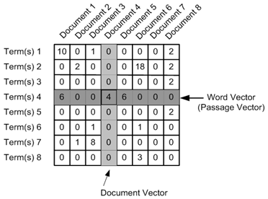
TF-IDF Continued..
IDF provides the relative importance of a term in all documents D. If it appears in all documents then it provides no significant information.
Based on the score of TF-IDF, set of keywords are chosen.
The weights of TF-IDF results reflect the importance of keyword from a chosen hashtag.

Slide 21
Classification Algorithm
Machine Learning
Several Machine Learning Based Classification algorithms are available using supervised or unsupervised learning Approach.
The supervised methods make use of a large number of labeled training documents.
The unsupervised methods are used when it is difficult to find these labeled training documents.
Supervised
Unsupervised
Classification
-Naïve Bayes
-Random Decision Forests
Regression
Liner
Logistic
Clustering
K-means
Dimensionality Reduction
-Principal component
-SVD

Slide 22
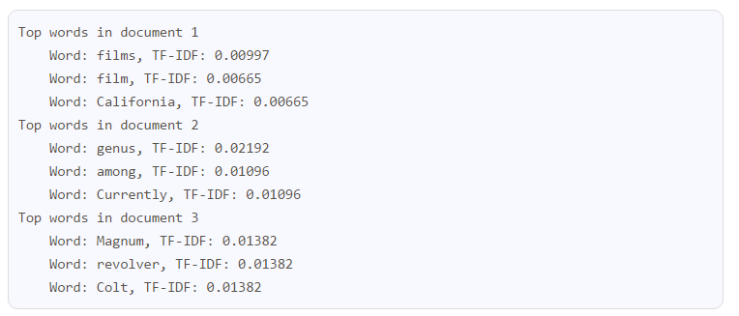
Pattern analysis
Conducted to find the most important keywords using the TF-IDF statistics.
The more the value of TF-IDF weight of a keyword, the more relevant it is to hashtag.
Words with high TF-IDF represents the current trends on twitter.

Slide 23
Sentiment Analysis
The other phase of the project is to analyze the sentiments in each tweet.
The tweets received after processing and filtering are given score.
The words in the tweets reflect the positive, negative or neutral sentiment.
Neutral tweets are skipped from final output.
// Compute the score of each sentence and keep only the non-neutral ones
val textAndNonNeutralScore: DStream[(TweetText, Int)] =
textAndMeaningfulSentences.
mapValues(sentence => computeScore(sentence, positiveWords.value, negativeWords.value)).
filter { case (_, score) => score != 0 }

Slide 24


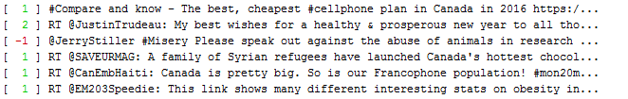
Output
Positive Tweet
Negative Tweet
On Inputting multiple particular Keywords like ‘Canada’ , ‘Toronto’, ‘Trump’
Output is the live stream of tweets associated with these keywords with sentiment score on its left.
We can see some false positives due to unsupervised learning approach.

Slide 25
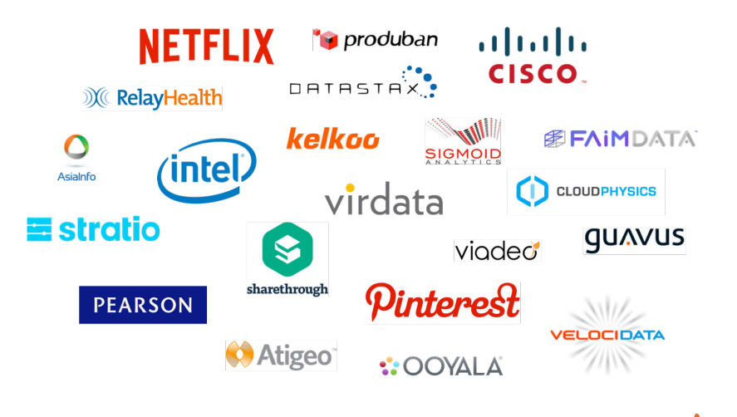
FUTURE WORK
Use of TF–IDF feature extraction to find the current Trends on Twitter
Classification and Prediction Model
Integrating with Dashboard to better visualize results
Used by major MNC’s

Slide 26
Conclusion
Apache Spark use is on rise because of its flexibility to both ingest real-time data and then perform analytics.
It provides various techniques to carryout sentiment analysis on Twitter data including knowledge based technique and machine learning techniques.
The project can be extended using sophisticated machine learning Algorithms to predict and classify data.

Slide 27
References
[1]E. Kouloumpis, T. Wilson, and J. D. Moore, “Twitter sentiment analysis: The good the bad and the omg!,” Icwsm, vol. 11, no. 538–541, p. 164, 2011.
[2] P. Mishra, R. Rajnish, and P. Kumar, “Sentiment analysis of Twitter data: Case study on digital India,” in Information Technology (InCITe)-The Next Generation IT Summit on the Theme-Internet of Things: Connect your Worlds, International Conference on, 2016, pp. 148–153.
[3] J. Ramteke, S. Shah, D. Godhia, and A. Shaikh, “Election result prediction using Twitter sentiment analysis,” in Inventive Computation Technologies (ICICT), International Conference on, 2016, vol. 1, pp. 1–5.
[4] Khalid N. Alhayyan, D. Imran Ahmed “Discovering and Analyzing Important Real-Time Trends in Noisy Twitter Streams”
[5] M. Frampton, Mastering Apache Spark: gain expertise in processing and storing data by using advanced tecniques with Apache Spark. Birmingham: Packt Publishing, 2015.

Slide 28

Thank You

