Slide 1
How to download, configure and run a MapReduce program in a Cloudera VM?
By
Chris immanuel, Heym Kumar, Sai janani, Susmitha

Slide 2
Overview
What is Big Data?
MapReduce
MapReduce Architecture
Why virtualize Hadoop?
VMware
Key features of VMware Server Virtualization
VMPlayer Configuration
Running the Wordcount Program

Slide 3
What is Big Data?
Big data is being generated around us at all times
Big data is arriving at an alarming velocity, volume and variety
To extract meaningful value from the big data, you need optimal processing power, analytics capability and skills
Big data uses the Mapreduce technique to process and analyse the data

Slide 4
MapReduce
Map Reduce is the abstraction behind Hadoop.
The unit of execution is the job
Job has input , output, Map function and Reduce function
Input and output have the key value pairs, where these two functions are provided by the developers.
There are 2 different types of job phases: Mapping phase and Reducing phase
In Mapping phase, map function is applied to Input data and an intermediate data is generated.
In Reducing phase, Reduce function is applied to intermediate data and final output is generated.

Slide 5
MapReduce Architecture

Slide 6
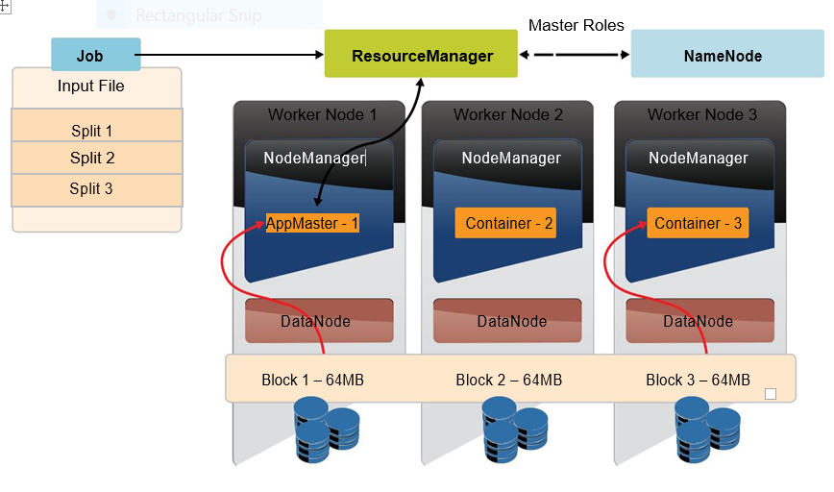
Why virtualize Hadoop?
Simplified Hadoop cluster configuration and provisioning.
Support Hadoop usage in existing virtualized datacenters.
Support multi-tenant environments.

Slide 7
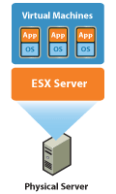
VMware
VMware is a subsidiary of Dell Technologies that provides cloud and virtualization software and services which is rapidly transforming the IT landscape and fundamentally changing the way that people compute.
With Virtualization it is possible to run multiple operating systems and multiple applications on the same SERVER at the same time, increasing the utilization and flexibility of hardware.

Slide 8
Key Features of VMware Server Virtualization
Partitioning:
Different OS can run on one physical machine
System resources can be divided between virtual machines
Isolation
Fault and security isolation on a hardware level
Extended resource control for constant performance.
Encapsulation
Complete status of a virtual machine can be stored in a file
Move and copy of a virtual machine is as easy as it is with files

Slide 9
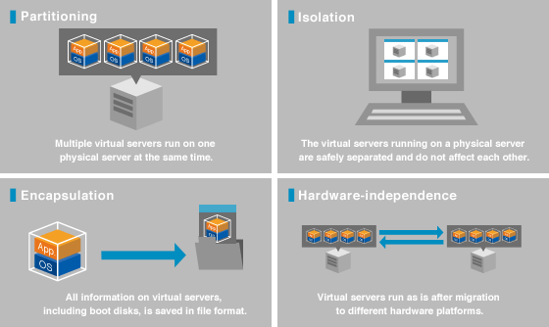

Slide 10
VMPlayer Configuration
VM player host system should have the following configuration
64-bit x86 CPU with 1.3 GHz or faster core speed.
Multiprocessor systems should be have 8 Gb RAM
The virtual machine we used is LINUX operating system
Running in 2 core processors
Occupying 3.5 Gb of memory
Hark disk is 40Gb

Slide 11
Running the Wordcount Program

Slide 12
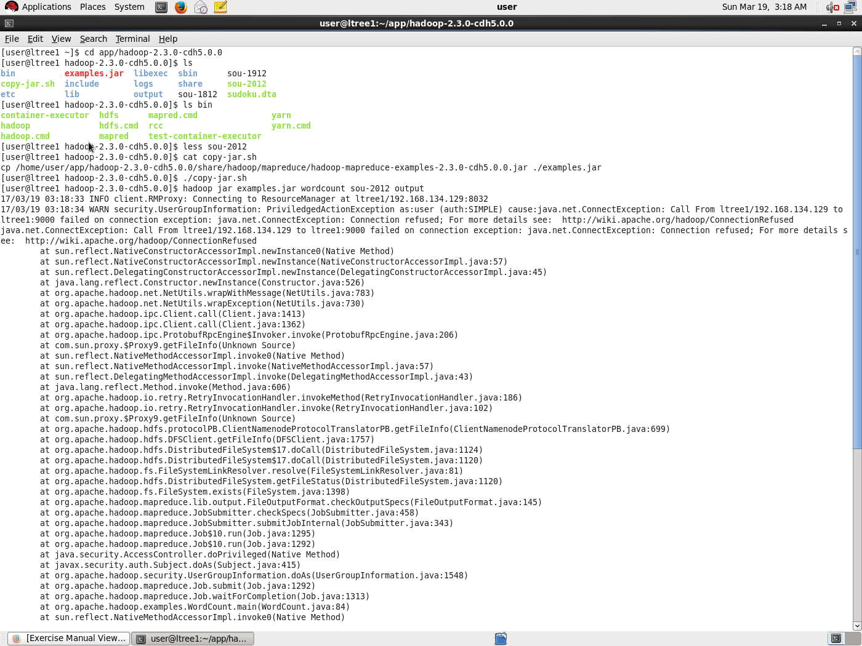

Slide 13
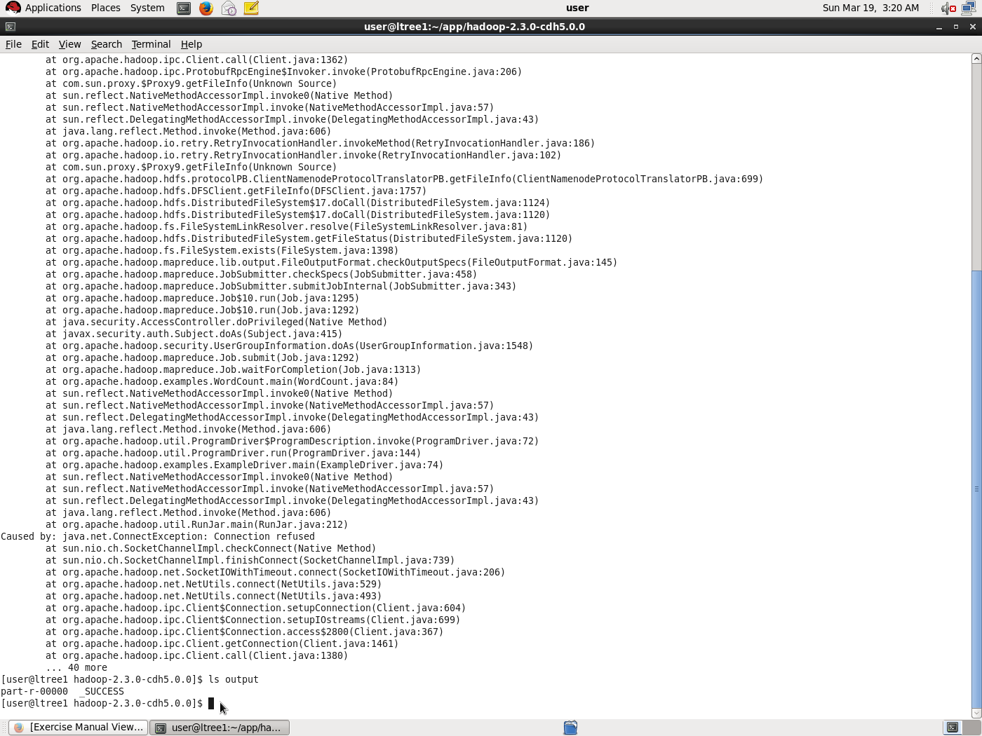

Slide 14
OUTPUT

Slide 15
Configuring HDFS to run in Pseudo-distributed mode

Slide 16
Configuring HDFS to run in Pseudo-distributed mode
To start the namenode use the command
start-dfs.sh
To see list of the nodes which are being executed we use the command
jps
To stop the HDFS we use the command
stop-dfs.sh

Slide 17
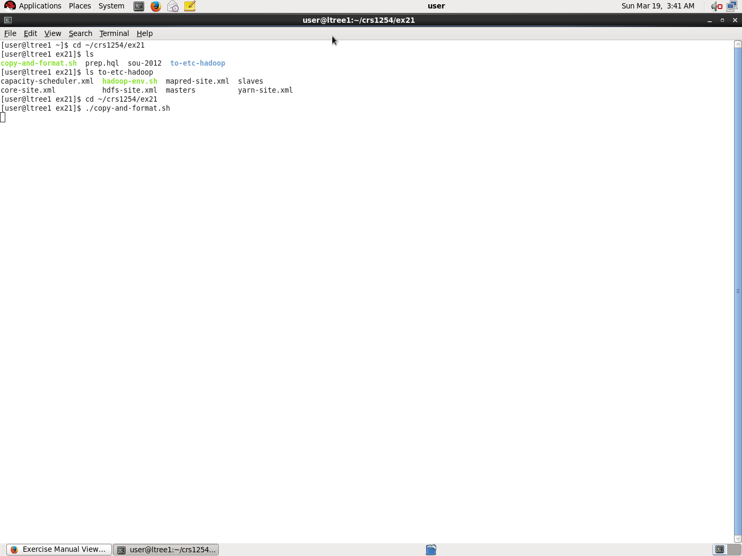

Slide 18
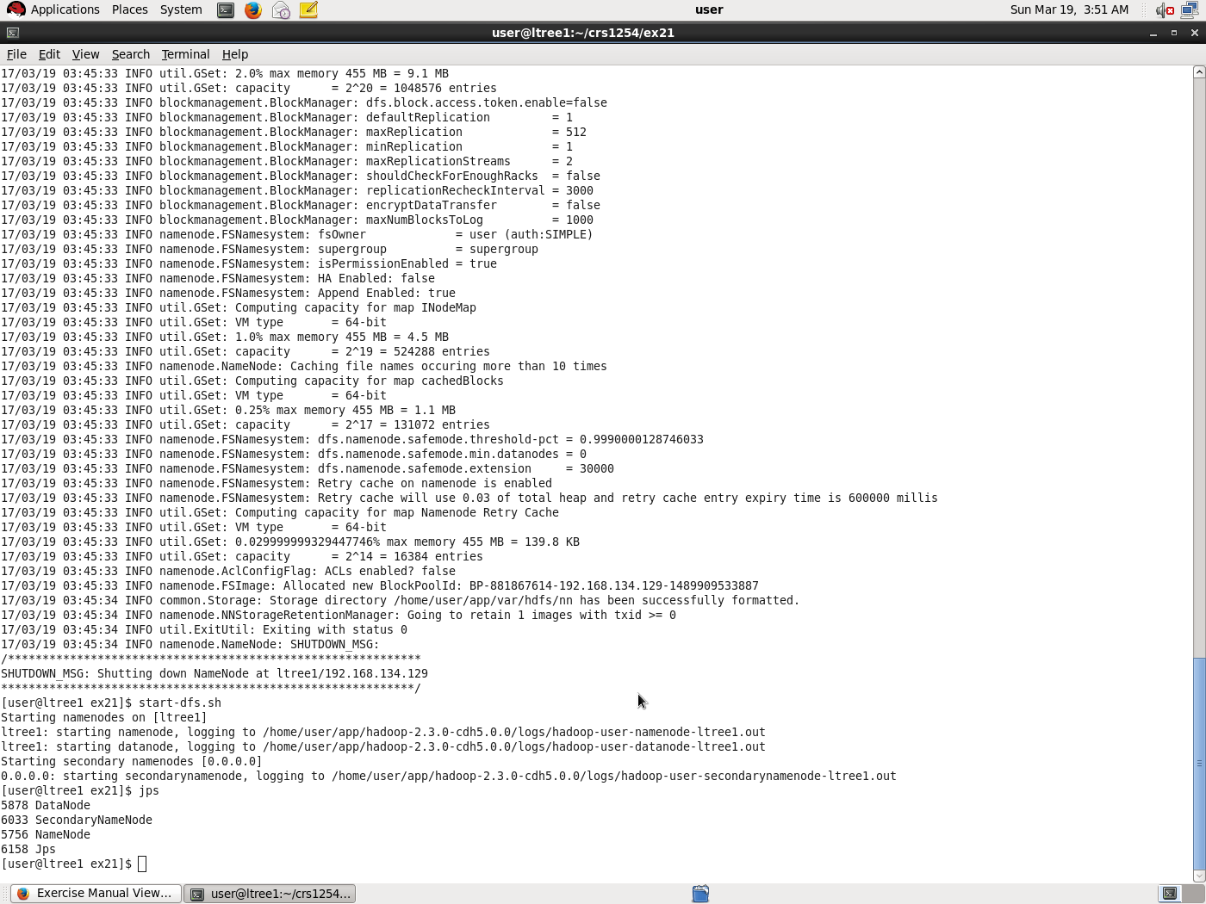

Slide 19
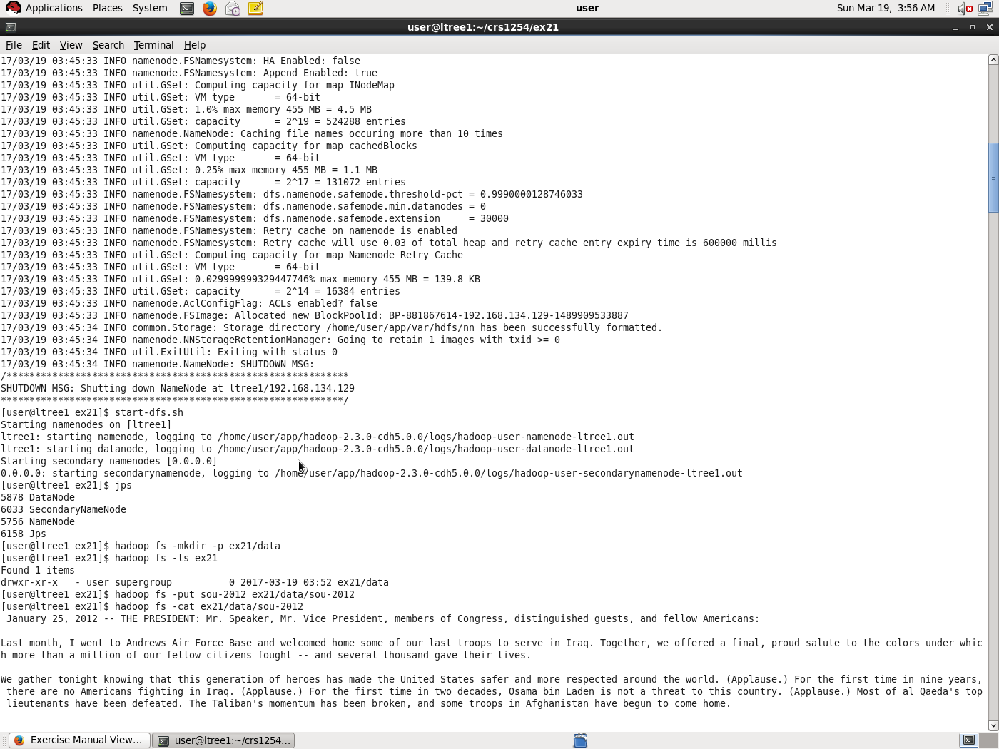

Slide 20
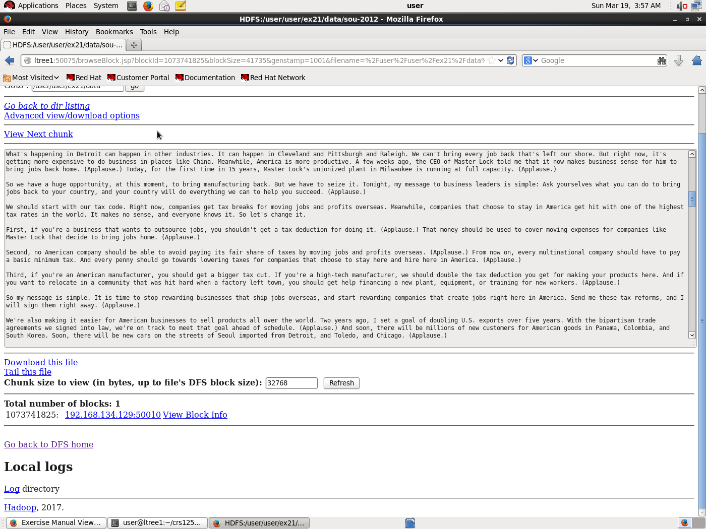

Slide 21
THANK YOU!

