Slide 1
How to download, configure and run a mapReduce program In a cloudera VM
Presented By:
Mehakdeep Singh
8868237
Amrit Singh Chaggar
8868228
Ranjodh Singh
8740179

Slide 2
Outline
Cloudera Introduction
Download and Configuration
MapReduce
Implementation

Slide 3
Cloudera - Introduction
Cloudera provides a powerful data platform that enables enterprises to manage their rapidly increasing volume and variety of data.
It provides products and solutions which enable:
To deploy and manage Apache Hadoop and related projects.
To manipulate and analyze your data
To keep that data secured and protected

Slide 4
Cloudera – Products and Tools
CDH
Cloudera Distribution Hadoop is open-source Apache Hadoop distribution and other related open-source projects, including Cloudera Impala and Cloudera Search.
Cloudera Manager
It is an end-to-end application for managing CDH clusters.
It automates the installation process and reduces the deployment time from weeks to minutes.
Cloudera Navigator
It is a fully integrated data management tool for the Hadoop platform.
Audit data access and verify access privileges

Slide 5
CDH
It is the complete, tested, and popular distribution of Apache Hadoop.
It provides:
Flexibility
Integration
Security
Scalability
High availability
QuickStarts for CDH 5.8
Cloudera QuickStart VM (Single Node Cluster) make it easy to quickly get hands on CDH for testing, demo and self learning purposes.
It includes a tutorial, sample data and scripts for getting started.

Slide 6
Download and Configuration
Prerequisites:
These 64-bit VMs require a 64-bit host OS and a virtualization product that can support a 64-bit guest OS.
To use a VMware VM, you must use a player compatible with WorkStation 8.x or higher:
Player 4.x or higher
Fusion 4.x or higher
The amount of RAM required by VM to run CDH 5 is 4+ GB.

Slide 7
Download and Configuration
Version used: VMware Workstation 12.5.3 Player for Windows 64-bit Operating Systems.
Download Link
https://my.vmware.com/en/web/vmware/free#desktop_end_user_computing/vmware_workstation_player/12_0
Cloudera version used is Quickstarts for CDH 5.8
Download Link
https://www.cloudera.com/downloads/quickstart_vms/5-8.html
NOTE: Make sure that Virtualization is enabled in BIOS settings in case of Windows.

Slide 8
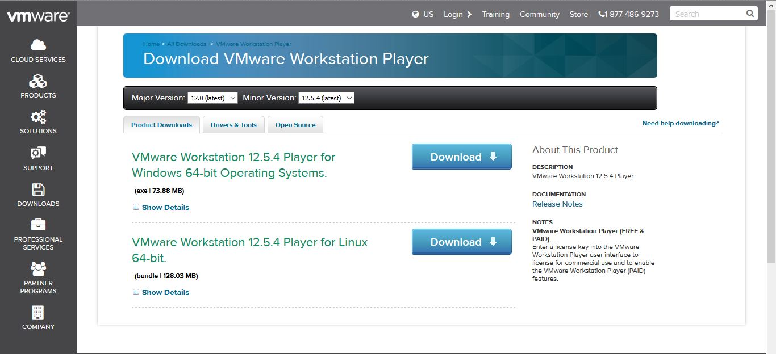
VMware Workstation 12.5.3 Player

Slide 9
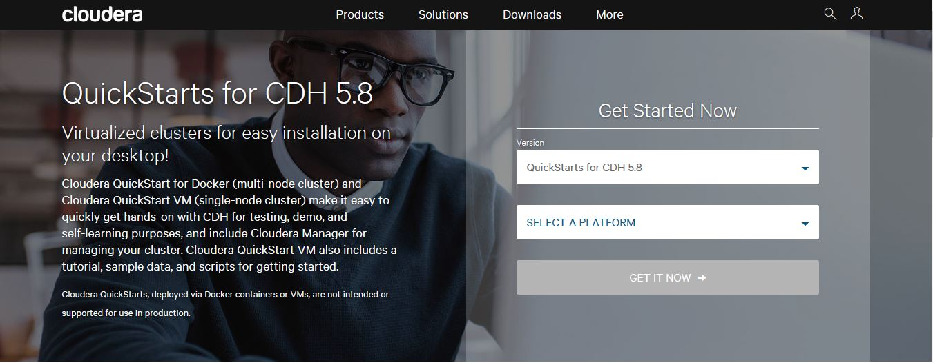
Cloudera VM Download Screen

Slide 10
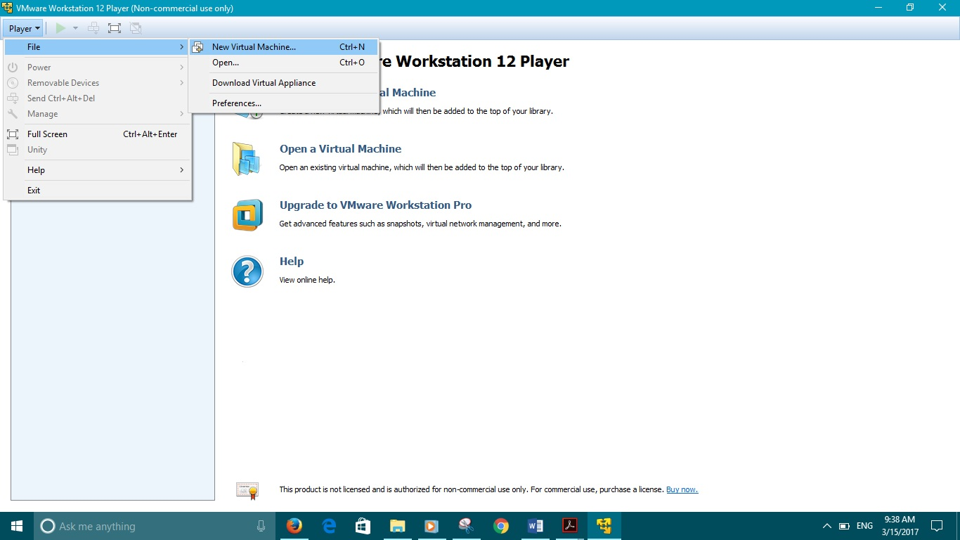
How to Setup and Configure

Slide 11
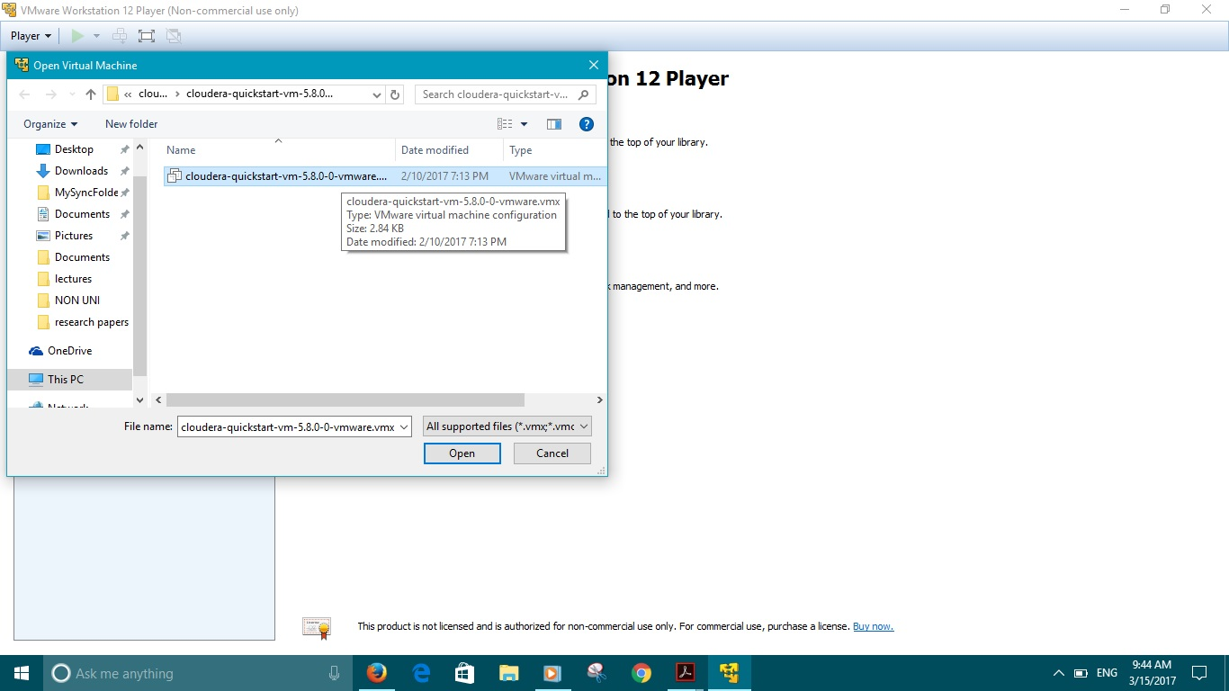

Slide 12
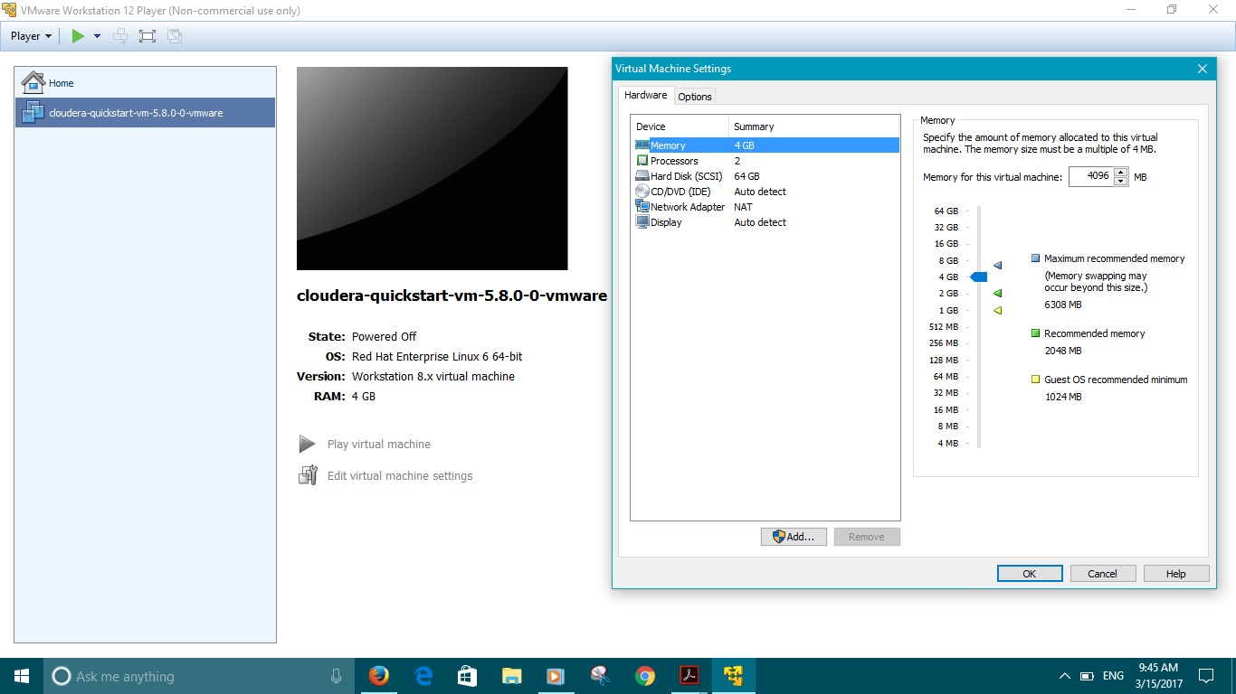

Slide 13
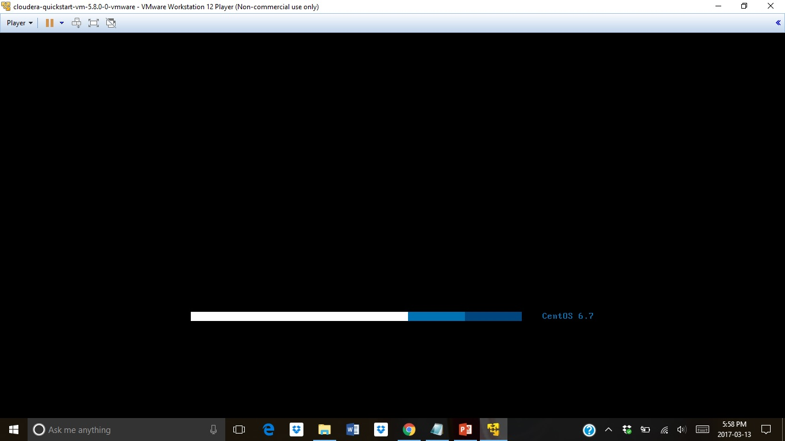

Slide 15
MapReduce
A MapReduce job splits a large data set into independent chunks and organizes them into key, value pairs for parallel processing. This parallel processing improves the speed and reliability of the cluster, returning solutions more quickly and with greater reliability.
The Map function divides the input into ranges by the InputFormat and creates a map task for each range in the input. The JobTracker distributes those tasks to the worker nodes. The output of each map task is partitioned into a group of key-value pairs for each reduce.
The Reduce function then collects the various results and combines them to answer the larger problem that the master node needs to solve. Each reduce pulls the relevant partition from the machines where the maps executed, then writes its output back into HDFS. Thus, the reduce is able to collect the data from all of the maps for the keys and combine them to solve the problem.

Slide 16
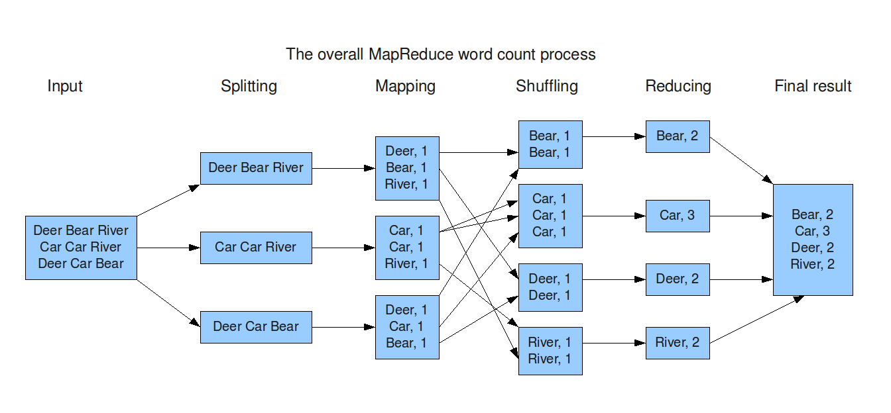
MapReduce Processing

Slide 17
How to run MapReduce program
1) Create the input and output locations in hdfs by using the following commands.
sudo su hdfs // to access hdfs. By default it is cloudera
Hadoop fs -mkdir /user/cloudera // creates folder cloudera within user folder
hadoop fs -chown cloudera /user/cloudera // changes ownership of user/cloudera to cloudera
exit // exits bash
hadoop fs -mkdir /user/cloudera/wordcount /user/cloudera/wordcount/input
This creates two folders. 1. wordcount in cloudera 2. input in wordcount

Slide 18
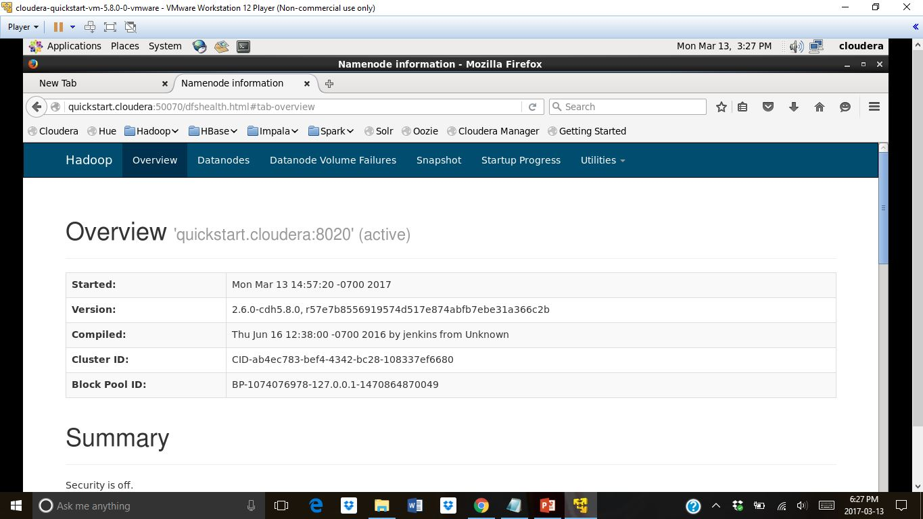

Slide 19
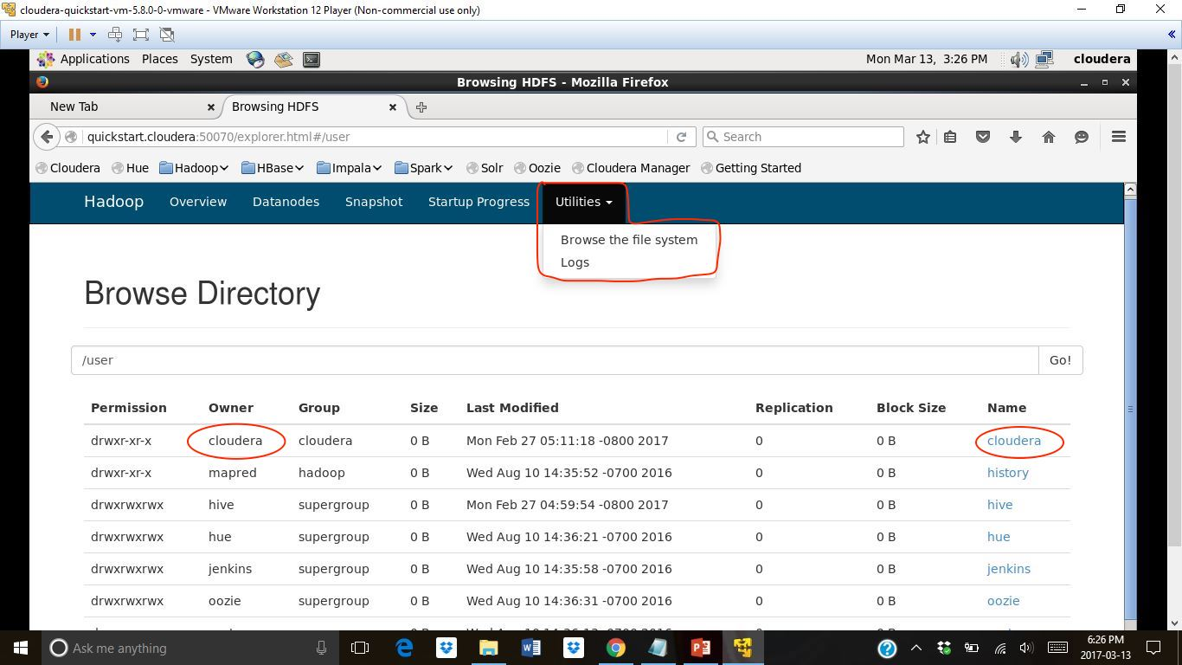

Slide 20
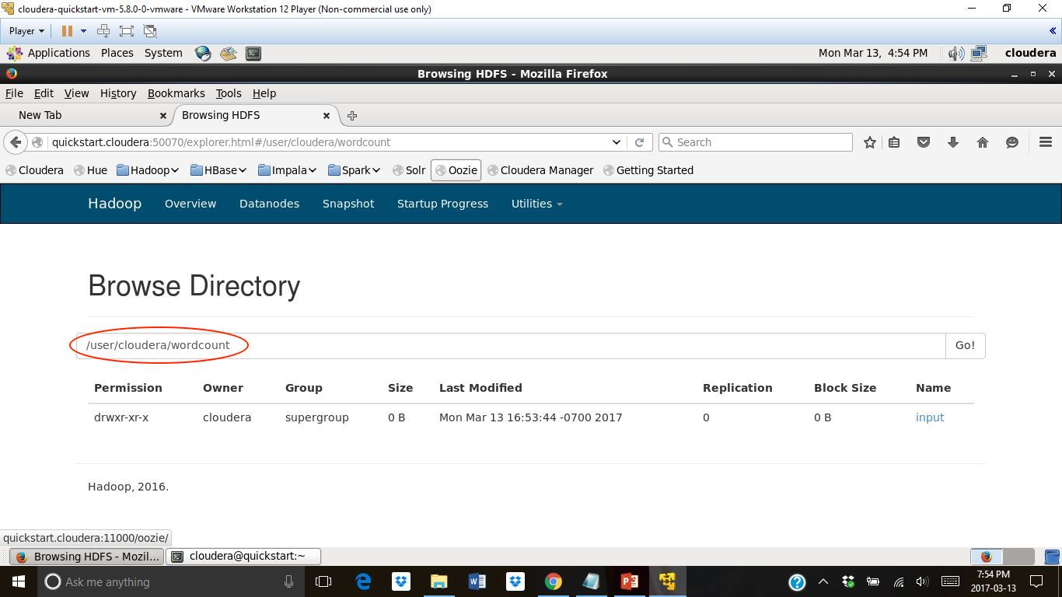

Slide 21
Next step is creating the input files
hadoop fs -put file* /user/cloudera/wordcount/input //to put the files from Local storage to HDFS
cd /usr/lib/hadoop-mapreduce/ // change the directory to /Hadoop- mapreduce. This folder contains some sample jar files including the one for Wordcount

Slide 22
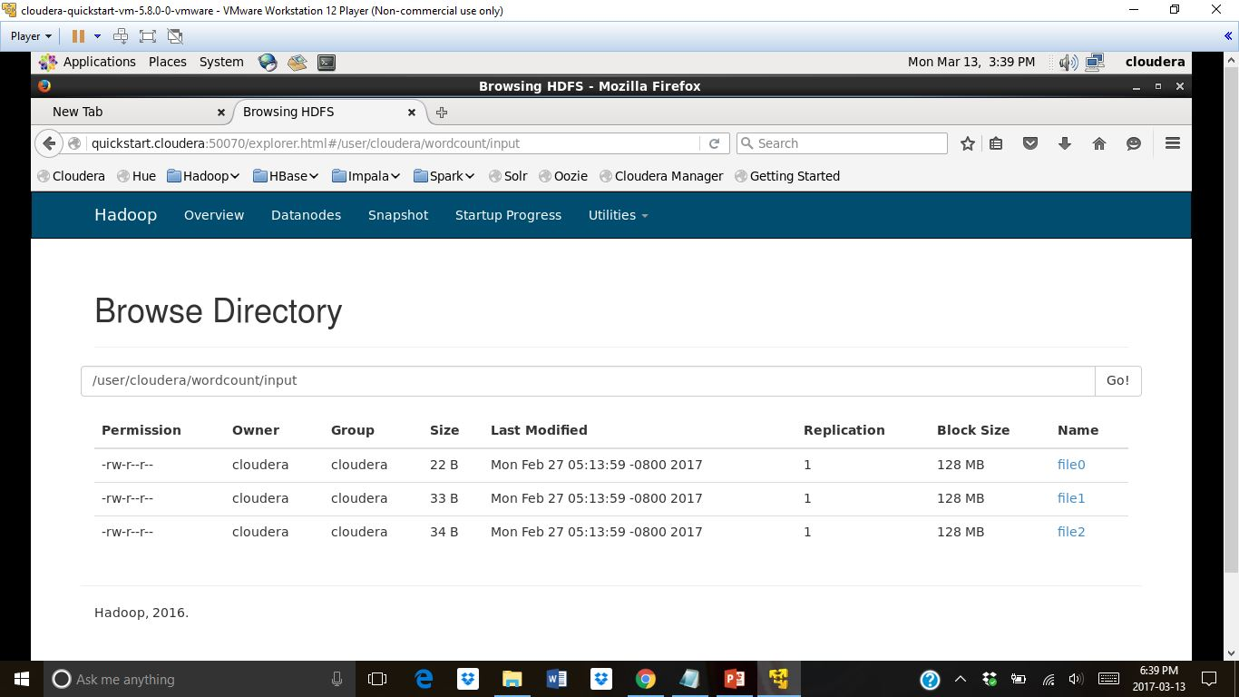

Slide 23
hadoop-mapreduce]$ hadoop jar hadoop-mapreduce-examples.jar wordcount /user/cloudera/wordcount/input /user/cloudera/wordcount/output/
This command is used to run jar file. The location of input files and output is specified. wordcount specifies that it is wordcount operation
Total input paths : 3 This is equal number of input files. (file0,file1,file2)

Slide 24
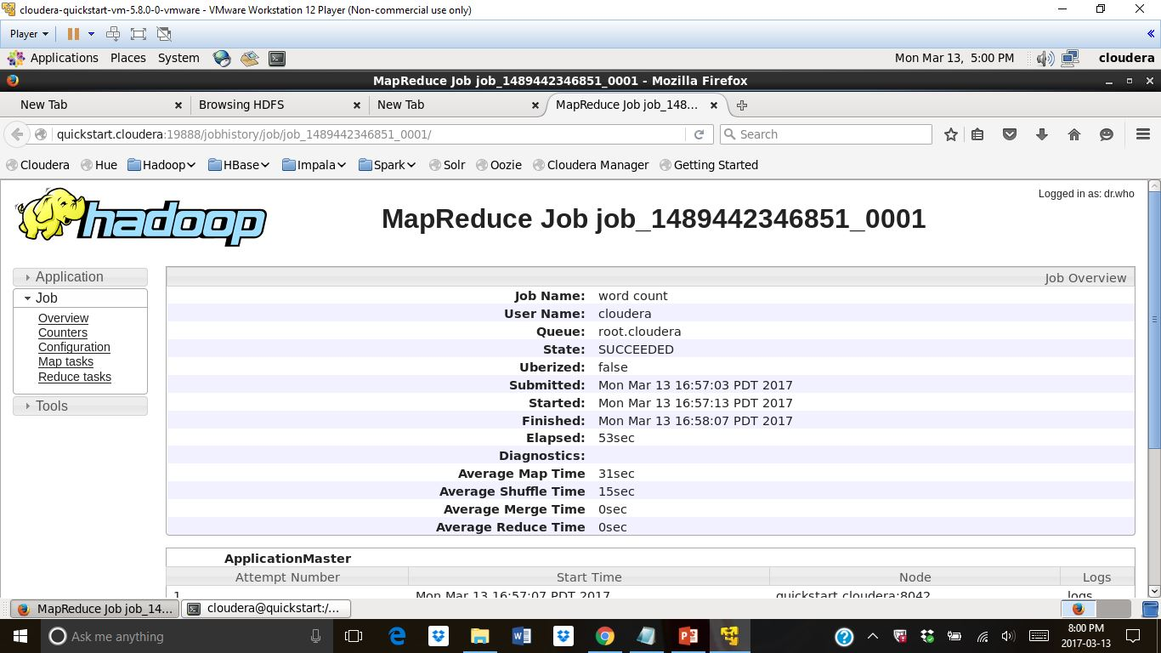

Slide 25
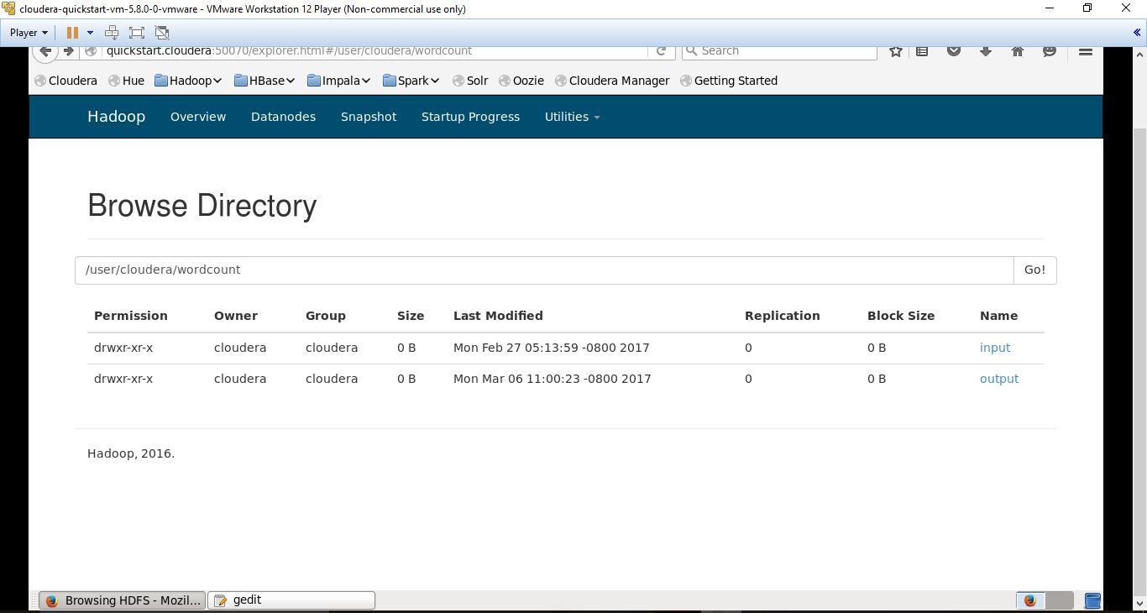

Slide 26
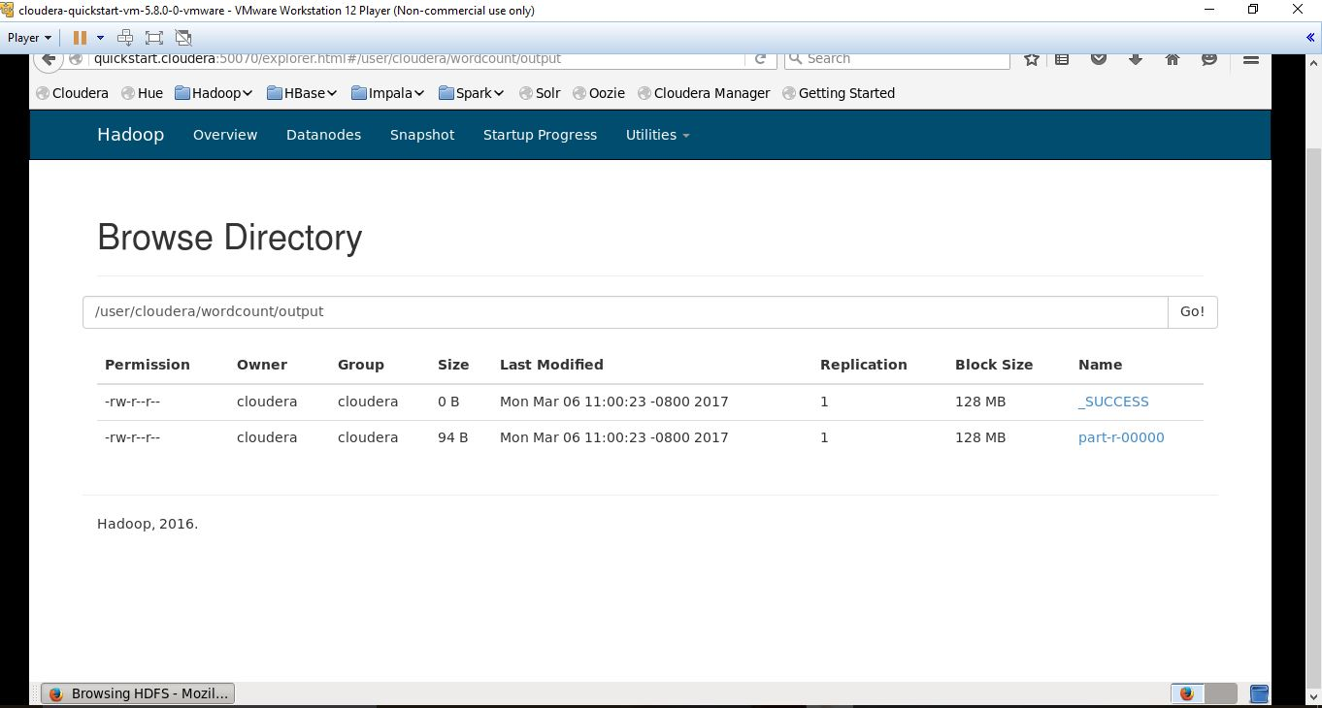

Slide 27
Checking the Output
Two ways : 1. thru’ terminal 2. from user interface
1. terminal
hadoop-mapreduce]$ hadoop fs –cat /user/cloudera/ wordcount /output /part-r-00000

Slide 28
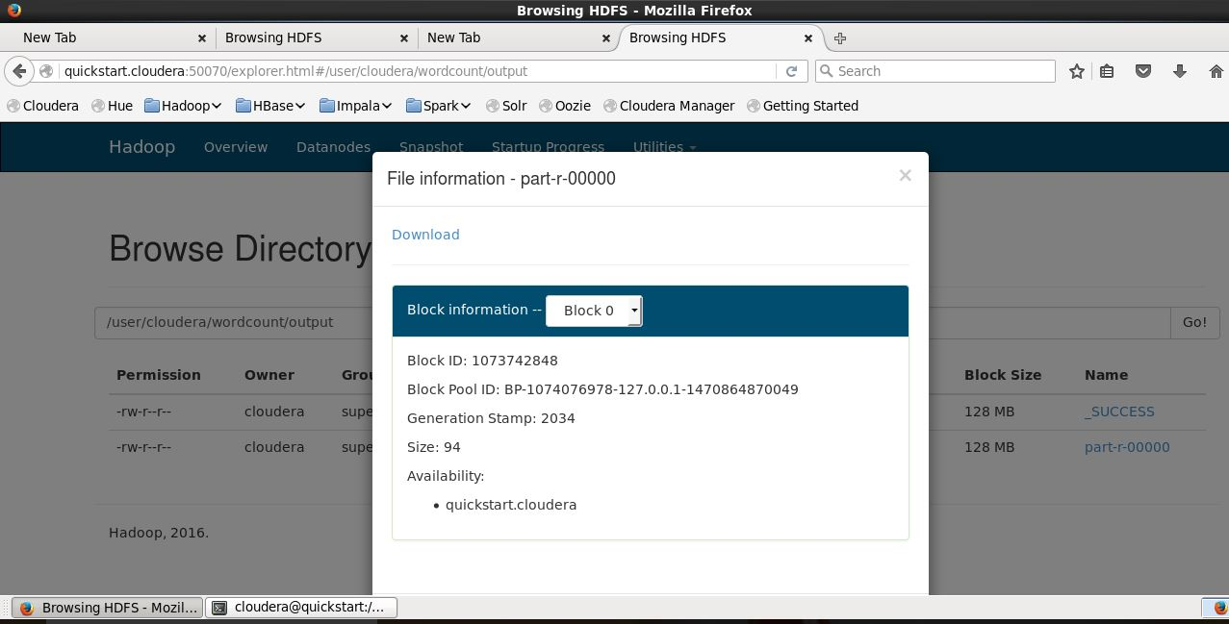
2. User Interface
Open firefox and From Hadoop>Utilities, select browse file system and move to user/cloudera/output and open file r00000

Slide 29
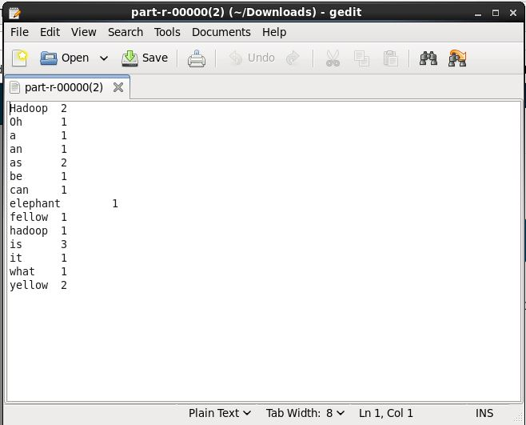
On opening the r00000 file we get the output

Slide 30
References
https://my.vmware.com/en/web/vmware/free#desktop_end_user_computing/vmware_workstation_player/12_0
https://www.cloudera.com/downloads/quickstart_vms/5-8.html
https://www.cloudera.com/documentation/enterprise/latest/topics/cloudera_quickstart_vm.html#xd_583c10bfdbd326ba-3ca24a24-13d80143249--7f9d
https://www.cloudera.com/documentation/other/tutorial/CDH5/topics/ht_usage.html

