Slide 1
How to Move High Volume Data to HDFS (APACHE SQOOP) Project Presentation SYSC 5807 - Advanced Topics in Computer Systems Professor Imran Ahmad, PhD
By,
Aesumon Sunny George (101030592)
Antony Anty Kannampilly (101053630)
Jipson Johnson (101028751)
Shagun Goel (101055437)

Slide 2
What is Covered
What is Sqoop
Why Sqoop
How Sqoop Works
Who Uses Sqoop
Importing and exporting data using Sqoop
Data Import in Hive and HBase with Sqoop
Conclusion
References

Slide 3
What is Sqoop?
Sqoop is a tool designed to transfer data between Hadoop and relational database servers
It moves High volume data to Hadoop HDFS
It is used to import data from relational databases such as MySQL, Oracle to Hadoop HDFS
It also exports data from Hadoop file system to relational databases
Transforms data in Hadoop with MapReduce or Hive

Slide 4
Why Sqoop?
SQL servers are already deployed and established worldwide
As Hadoop is making ways into enterprise, there was a need to move certain part of data from traditional SQL relational databases into Hadoop
Transferring data using scripts is inefficient and time consuming
Traditional DB already have reporting, data visualization applications built in enterprise .Bringing processed data from Hadoop to those applications is the need.

Slide 5
Cont…
From RDB to Hadoop :
Users must consider details like ensuring consistency of data, the consumption of production system resources, data preparation for provisioning downstream pipeline
Hadoop to RDB :
Directly accessing the data residing on eternal systems from within the map reduce applications complicates applications and exposes the production system to the risk of excessive load originating from cluster nodes

Slide 6
What Sqoop provides
Sqoop allows easy import and export of data from structured data stores
RD, Enterprise data warehouses and NoSQL systems
Provisions data from external system on to HDFS
Once data is moved ,populate tables in Hive and HBase
Sqoop integrates with Oozie, allowing you to schedule import and export tasks
Sqoop uses a connector based architecture which supports plugins that provide connectivity to new external systems

Slide 7
How Sqoop works

Slide 8
Cont…
Sqoop import tool imports individual tables from RDBMS to HDFS
Each row in a table is treated as a record in HDFS
All records are stored as text data in text files or as binary data in Avro and Sequence files
Sqoop export tool exports a set of files from HDFS back to an RDBMS
The files given as input to Sqoop contain records, which are called as rows in tables
Those are read and parsed into a set of records and delimited with user-specified delimiter

Slide 9
Who uses Sqoop?
Online Marketer Coupons.com uses Sqoop to exchange data between Hadoop and the IBM Netezza data warehouse appliance. The organization can query its databases and pipe the results into Hadoop using Sqoop
Education company The Apollo group also uses the software not only to extract data from databases but also to inject the results from Hadoop jobs back into relational databases
And countless other hadoop users use Sqoop to efficiently move their data

Slide 10
Sqoop Commands

Slide 11
Importing Data
Command
* $ sqoop import --connect jdbc:mysql://localhost/testdb \ --table TABLE_NAME --username USER_NAME --password PASSWORD
Import
* Subcommand
--connect & --username & --password
* Part of connection string
* A regular JDBC connec
--table
* Database table name

Slide 12
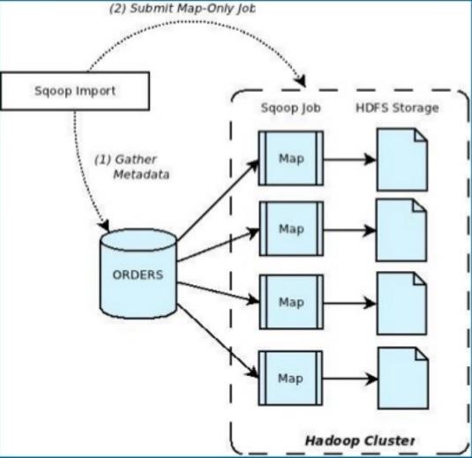
How Sqoop Import works
Step 1:
Sqoop introspects the database to gather the necessary metadata for the data being imported
Step 2:
A Map-only Hadoop job is submitted to cluster by Sqoop
The Map-only job performs data transfer using the metadata captured in Step 1

Slide 13
How Sqoop Import works
The imported data is saved in a directory HDFS based on the table being imported
User can specify any alternative directory where the files should be populated
By default these files contain comma delimited fields, with new lines separating different records
User can override the format in which data is copied over by explicitly specifying the field separator and record terminator characters

Slide 14
Importing Data into Hive
--hive-import
Appending above to Sqoop import command. Sqoop takes care of populating the Hive metastore with the appropriate metadata for the table and also invokes the necessary commands to load the table or partition
Using Hive import, Sqoop converts the data from the native datatypes within the external datastore into the corresponding types with Hive
Sqoop automatically chooses the native delimiter set used by Hive. If the data being imported has new line or other Hive delimiter characters in it, Sqoop allows you to remove such characters and get the data correctly populated for consumption in Hive
After the import get completed, user can operate table just like any other table in Hive

Slide 15
Importing Data into HBase
Sqoop can populate data in particular column family in HBase table
A column family is a NoSQL object that contains columns of related data
HBase table and column family setting is required in order to import table to HBase
Data imported to HBase is converted to their string representation and inserted as UTF-8 bytes

Slide 16
Importing Data into HBase
--hbase-create-table --hbase-table
$ sqoop import --connect jdbc:mysql://dataset_server/dbname \
--table table_name --username user_name --password password\
--hbase-create-table --hbase-table hbase_table_name --column- family DB_type_Setting
--hbase-create-table
Instructs Sqoop to create the Hbase table
--hbase-table
Specifies table name to use
--column-family
Specifies the column family name to use
For MySQL → mysql

Slide 17
Sqoop Connectors
Generic
These are the most basic ones that uses the JDBC interface for accessing metadata and transferring data.
Specialised
These are the custom Sqoop connectors that may or may not depend on JDBC e.g.; Netezza, Teradata, SQL Server, Oracle.

Slide 18
Exporting Data from Hadoop using Sqoop h
The export tool exports a set of files from HDFS back to an RDBMS
The target table must already exist in the database. The input files are read and parsed into a set of records according to the user-specified delimiters
export-dir -> The HDFS folder from where the data will be exported
$ sqoop export --connect jdbc:mysql://database_server/dbname \ --table target_table_name --username user_name --password \
--export-dir /home/cloudera/hivedb/testbl

Slide 19
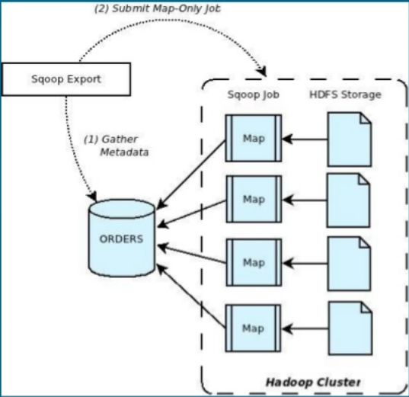
Exporting Data using Sqoop h
Step 1
Introspect the database for metadata
Step 2
Transfer the data
Sqoop divides the input dataset into splits
Sqoop uses individual map tasks to transfer the splits to the dataset
Each map task perform this transfer over many transactions in order to ensure optimal throughput and minimal resource utilization

Slide 20
Conclusion
The apache Sqoop tool is the most popular and efficient means to transfer high volume data into HDFS
The importing, exporting and manipulation of large volume data has become a necessity with the growing popularity of content based network architectures and Hadoop and apache scoop answers this
An implementation will be done showing how a large volume data from database will be transferred to HDFS, processed and returned back to the database.

Slide 21
References
https://sqoop.apache.org/docs/1.4.2/SqoopUserGuide.html#_literal_sqoop_export_literal
https://blogs.apache.org/sqoop/entry/apache_sqoop_overview
https://hive.apache.org/
http://hbase.apache.org/
https://www.tutorialspoint.com/sqoop/
https://en.wikipedia.org/wiki/Sqoop
https://hortonworks.com/apache/sqoop/

Slide 22
Thank You

