Slide 1
A NAMED DATA NETWORKING FLEXIBLE FRAMEWORK FOR MANAGEMENT COMMUNICATION
Authors:
Daneil Corjuo and Rui L. Aguiar
Ivan Vidal and Jamie Garcia-Reinoso
Presented by:
Gurpreet Singh Thind (7015428)
James Koksal (100716024)
Mohammed Sanaullah (100833946)
Patrick Khordoc (4275581)
Tarush Saul (6210487)

Slide 2
Outline
Introduction
Management Requirements
Management Architecture
Reliable And Secure Content Data Exchange
Evaluation & Validation
Results
Conclusion

Slide 3
INTRODUCTION
NDN
Interest Pkt.
Data Consumer Data Producer Data Pkt.
Interest packet Pending Interest Table (PIT) Forwarding Info. Base (FIB)
INTEREST DATA
Content Store (CS)
NDN node

Slide 4
Management Requirements in NDN
Use of “ Strategy Layer” for forwarding of packets [4]. Ability for FOB entries to address multiple interfaces.
Manageability aspects that allow network to control the reception of content by user.
Management procedures for Storage and Usable Trust.
Network input or intervention. No co-ordination between NDN node and network itself.
Limited to static rules or information collected by local node.

Slide 5
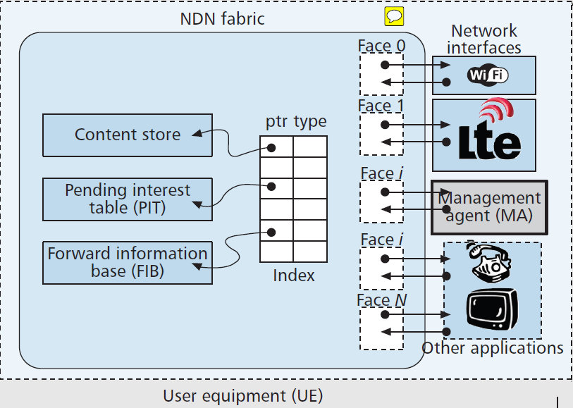
Management Framework
Management Agent:
Access and updates
NDN structures
Can interface with
local apps ( Eg: Info about QoS requirement for a video)
Can interface with lower layers of UE to obtain link info
Identifying available wireless networks
All above Info is used to guide management processes.

Slide 6
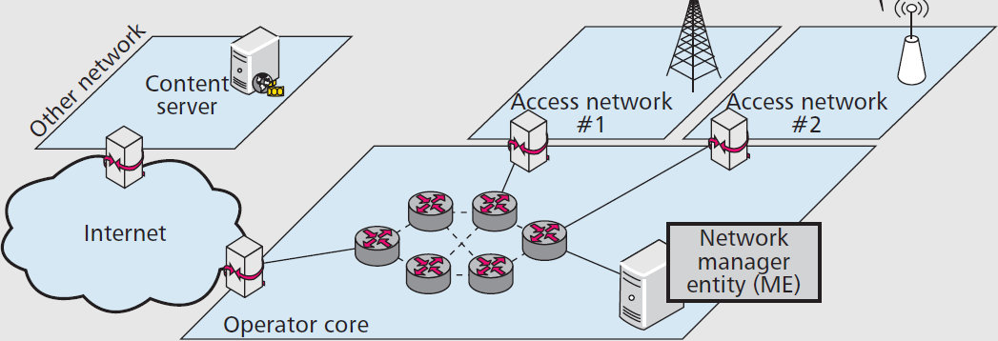
Management Framework (2)
Manager Entity:
Interacts with MA
for management
procedures
Triggered by diff mechanisms
Centralized or Distributed

Slide 7
Management Framework (3)

Slide 8
Support Procedures
Framework needs exchange of data using:
Asynchronous Exchange
Reliability
Security

Slide 9
Bootstrapping Procedure
Bootstrapping procedure used for
MA discovering an ME who can offer the appropriate management services
MA and ME agreeing on a security mechanism to encrypt management data

Slide 10
Bootstrapping Procedure
(1)
INTEREST/domain/management/mgmt-case/ME
MA
ME
DATA/domain/management/mgmt-case/ME
DATA: ME-id, supported security mechanisms, public key
(2)
INTEREST/domain/management/mgmt-case/ME/MA-id/Epk(security mechanism, Ks)
(3)
DATA/domain/management/mgmt-case/ME/MA-id/Epk(security-mechanism, Ks)
DATA: Ks received
(4)

Slide 11
BootStrapping Procedure (cont)
MA
ME
INTEREST/domain/management/mgmt-case/MA-id/EKs(test)
(5)
DATA/domain/management/mgmt-case/MA-id/EKs(security mechanism, Ks)
DATA: EKs(test’)
(6)

Slide 12
MA & ME Management Data Exchange
Case 1: MA pulls management data from ME
MA
ME
INTEREST/domain/management/mgmt-case/ME/MA-id/Eks(management content-name, seq-num)
(1)
DATA/domain/management/mgmt-case/ME/MA-id/Eks(content-name, seq-num)
DATA: Eks(management-data, seq-num)
(2)

Slide 13
MA & ME Management Data Exchange
Case 2: MA pushes management data to ME
ME
MA
INTEREST/domain/management/mgmt-case/ME/MA-publisher-id/seq-num
(1)
DATA/domain/management/mgmt-case/ME/MA-id/seq-num
DATA: seq-num accepted
(2)
INTEREST/domain/management/mgmt-case/MA-publisher-id/seq-num
(3)
DATA/domain/management/mgmt-case/MA-id/seq-num
DATA: Eks(management-data)
(4)

Slide 14
Evaluation
Validation
Using the face management to evaluate the feasibility of framework
Lets revisit the objective of the framework to have a better understanding of our evaluation and validation process
Utilizing the Virtual machines and virtual network to validate our objective
O
B
J
E
C
T
I
V
E
ME has the ability to know the topology and network condition surrounding PoA or UE
In our framework, ME is deployed in the network and the network has own policies and procedures
Based on the information ME can assist UE in the network discovery and selection procedures

Slide 15
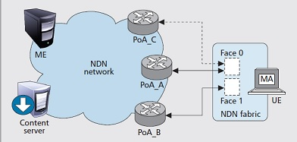
Forming the Test Bed:
Deployed in different Virtual machines
Connected to Virtual network
Uses CCNx software
Java API used for three applications:
NDN UE (featuring MA)
Content Server
ME
Bandwidth Constraint: 1Mbps (bidirectional) links to UE
Background traffic: Poisson distribution

Slide 16
In the validation scenario:
NDN UE (launched in either basic NDN mode and framework-managed mode)
Generates Interests periodically which matches a given prefix
Computes RTT of Interests/RTT exchange
Background traffic is generated using Poisson distribution
The framework (i.e. validation scenario) is tested three times to compare performance
Basic NDN with one probe per face
Basic NDN with five probes per face
NDN under framework-managed probe
Basic NDN mode | Framework managed
UE Sends regular packet Packet sent through all faces RTT per face is calculated Lowest RTT face is chosen till next probing or Interest times out Multiple Interest can be sent at a time | MA is involved in choosing faces Faces for management information is different than content retrieval so as to get better face for retrieval

Slide 17
Results

Slide 18
Results…

Slide 19
Results…
In the figure a) RTT in basic NDN with probing, 1 probe per face
Instantaneous RTT got from every interest sent from UE
Average RTT calculated instantaneous values in the last 5 sec and the current face used by the UE to send Interests
Between 0-40sec, may lead to choose any of the available faces, which may imply instability due to oscillations.
Between 80-120 and 120-160 sec (different traffic conditions), the decision may be wrong for example choosing a PoA with medium or high load
Increasing the number of Interests used in a single probing process may improve the performance, but with the cost of increasing the overhead and thus decreasing
Increased the number of interests per probing process to 5
In the figure b) RTT in NDN under a framework-managed mode.
Performance decreases between 80-120 sec (due to increasing traffic load → PoA_A
When happens ME sends message to MA, data coming from PoA_B
Between 120-160 sec, traffic load medium then ME tells MA detach PoA_A, attach PoA_C
Achieved a lower overhead due to more stable face selection
New PoA (120-160 sec), Average RTT reduce 14.78%
No need all interfaces be active always
De/Activating network interfaces is useful resource saving
The ME can decide which UEs attached to a saturated PoA should be moved to a different PoA

Slide 20
Results…

Slide 21
Conclusion…
Flexible and comprehensive management of NDN
Management procedures are taken care with the help of information available in the network, supplied by MA and utilized by ME, UE and MA to perform management
It has reliable, secure and asynchronous management structure
Enables easy interoperation with ICN

