Slide 1
Economic Incentives in Information- Centric Networking: Implications for Protocol Design and Public Policy
Group Members:
Muhammad Kamran Siddique
Adel M Shafiei
Khaleed Mohamed Abdel Fatah
Ahsan Ejaz
Turki Alghamdi
Raja Aamir Aurangzeb

Slide 2
Outline
Introduction
Assumptions
Model
Cache Deployment in Network
Conclusion
Study Limitations and Future Enhancements

Slide 3
Introduction
Aim of future Internet architecture is to deploy a widely distributed storage infrastructure within the network that facilitates delivery of content.
Basically, this is referred to as Information Centric Networking (ICN).
The main objective of ICN is to address some challenges of current Internet such as
lack of data persistence
Security
efficient in-network content
delivery support

Slide 4
Motivation
Failure of previous studies to evaluate the economic incentives of various stakeholders in order to deploy the required storage infrastructure
Policy issues, such as the effect of ICN on competition, network neutrality, and overall social welfare, have been largely ignored.

Slide 5
Assumptions
Both dedicated storage and content store are referred as cache.
Extra memory on board routers is referred as content stores.
Caches are integrated at network layer.
Unlike current TCP-IP model where caches are deployed at application layer.
Caches are deployed in existing network locations (e.g. edge routers, NAPs, and private peering points).

Slide 6
Network players

Slide 7
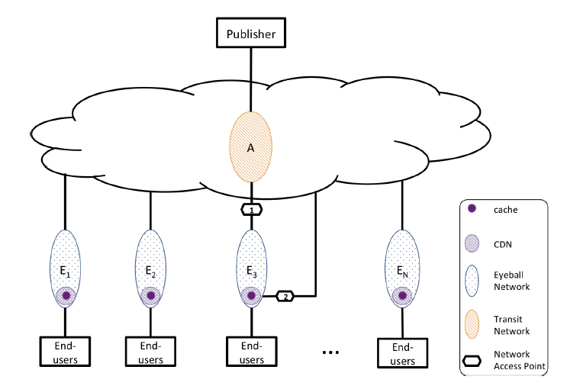
Network Model

Slide 8
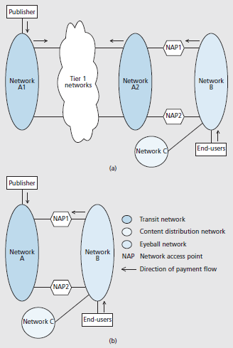
Network Model

Slide 9
Network Model
In the model in Fig. 1a, the publisher buys network access from a tier 2 network, which uses transit and peering relationships with other networks to reach the eyeball network.
In the model in Figure 1b, publishers buy network access from a tier 1 transit network that connects directly to eyeball networks.
In both models, publishers have the choice to buy caching services from only one of three types of network players namely transit networks (Networks A, A1 and A2), eyeball networks (Network B) and content distribution networks (Network C).
Content distribution networks locate their servers and caches directly within the eyeball network (e.g., Akamai) or outside the eyeball network (e.g., Limelight).

Slide 10
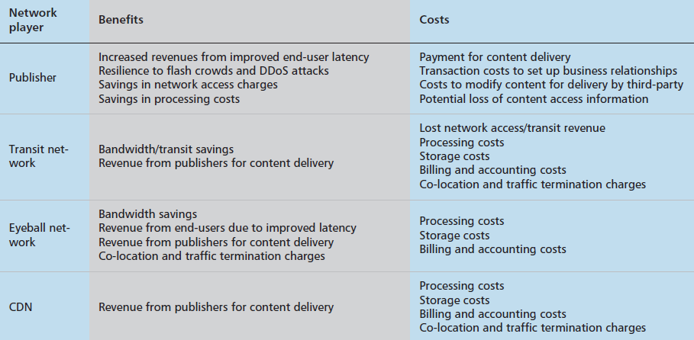
Benefits VS Costs
Network players choice in deployment of caches is based on a compromise between benefits and costs.

Slide 11
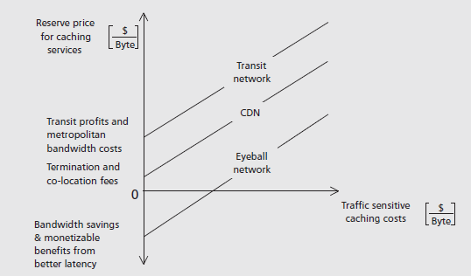
Prices for Different Network Players Caching Services

Slide 12
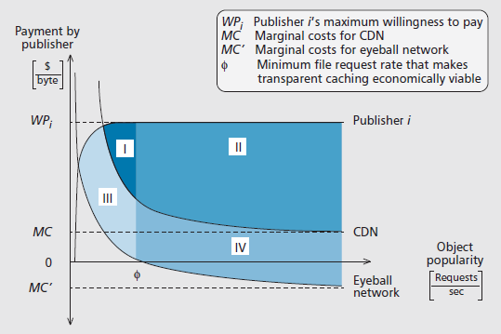
Viability of cache service

Slide 13
Cache Deployment Scenarios
The eyeball network appropriates the most benefits when it deploys its own caching infrastructure:
a) Eyeball network deploys transparent caches;
b) eyeball network deploys commercial caches;
c) eyeball network pays CDN to co-locate and terminate traffic; and
d) CDN pays eyeball network to co-locate and terminate traffic.

Slide 14
Implications of the Proposed ICN Architecture
Accounting, reporting and payment mechanism
ICN must incorporate features that make it easy to implement payment mechanisms to support caching-based business models.
payment mechanisms must provide disincentives for fraud.
Cache hit ratios
ICN design must emphasize cache performance in addition to primary concerns, such as efficient transport and security.
The trade-offs between cache hit ratios and access controls must be carefully studied in order to design ICN.

Slide 15
Conclusion
Economic incentives of different types of network players is evaluated to partake in an information-centric network.
Two deployment scenarios that maximize social welfare when a payment flow exists between the publisher and the caching service provider is presented.
In the first, eyeball networks provide the caching infrastructure through an entity that serves as a transaction broker between publishers and various networks.
In the second, eyeball networks pay third-party content distribution networks (CDNs) an amount, equivalent to the realized bandwidth and transit savings from caching, to deploy caches.

Slide 16
Study Limitations and Future Enhancements
ICN design must provide mechanisms to easily identify authorized intermediaries for files, in order to minimize duplication of efforts to provide caching infrastructure.
Some policy for the regulators should be defined in order to control the price, because eyeball networks can implement different pricing depending on CDN and CDN customers.

