Slide 1
Location vs. Identities in Internet Content: Applying Information-Centric Principles in Today’s Networks
Instructor: Assoc. Prof. Chung-Horng Lung
Group members : Qui Nguyen, Xiaolin Li,
Tianning Liang, Mohammad Tahooni

Slide 2
Agenda:
Main challenges: Content distribution
CDN-traditional approach.
ICN architectures: DONA,CCN, PSIRP, NetInf
ICN-HTTP
Q&A.

Slide 3
ICN represents the third revolution in telecommunication networks as we move from connecting wires (public switched telephone network [PSTN]) to connecting nodes (all-IP networks) to connecting information (ICN). Van Jacobson

Slide 4
Main challenges: content distribution
Internet has grown rapidly:
Traffic volume continuously increases.
While users’ demands: high performance, reduce response time.
Solutions:
Content distribution Network (CDN)
Caches.

Slide 5
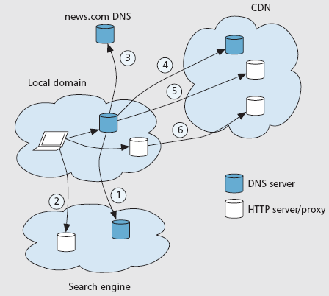
CDN-Traditional approach
(1,2): content lookup from search engine’s DNS

Slide 6
CDN-Traditional approach
(3): return desired result referring to URL that contains DNS name of requested content.

Slide 7
CDN-Traditional approach
(4): (CDN involved) DNS name might be an alias for a host located in the CDN provider network.

Slide 8
CDN-Traditional approach
(5,6): DNS redirects may be used to reach web server.

Slide 9
CDN-Traditional approach
This approach has a challenge about security.
Solution: TLS can be implemented. But…TLS prevents:
Caching.
Replication.

Slide 10
ICN architectures
Support content distribution by directly retrieved from appropriate source.
Aim to content-oriented security model.
secure binding b/w name and content vs. friendly name: human-readable, hierarchical form.
Clean-slate network design: replace entire TCP/IP by new architecture.
new packet header format.
packets addressed by location-independent identifiers.
Data-Oriented Network Architecture (DONA).
Content-Centric Networking (CCN) or Named Data Networking (DND).
Publish-Subscribe Internet Routing Paradigm (PSIRP) or Publish-Subscribe Internet Technology (PURSUIT).
Network of Information (NetInf).

Slide 11
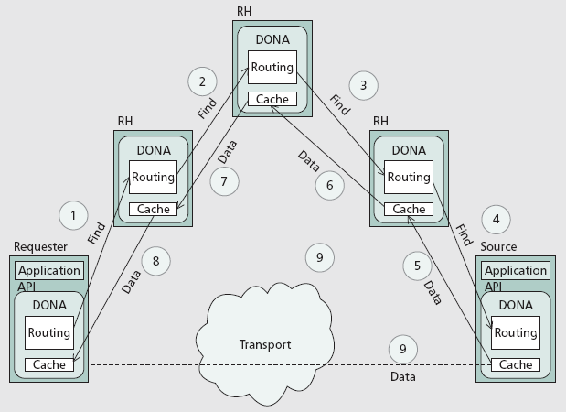
Data-Oriented Network Architecture (DONA).
DONA names:
a principal: self-certifying, hash of the public key.
a label: free-form identifier to distinguish objects that same principal
Secure but not human-readable, hierarchical name.

Slide 12
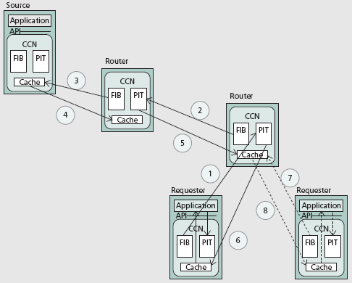
Content-Centric Networking (CCN)
CCN names:
traditional, hierarchical.
human-readable form: ~ web URL.
uniqueness by hierarchical organization: name-space divided into domain, sub-domain.

Slide 13
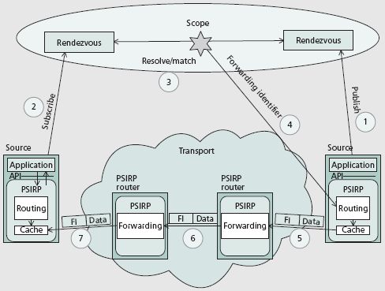
Publish-Subscribe Internet Routing Paradigm (PSIRP)
PSIRP names:
Rendezvous identifiers.
Scope identifiers.
Flat namespace: secure but non human-readable.

Slide 14
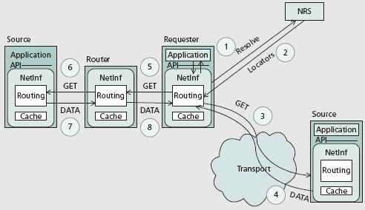
Network of Information (NetInf).
NetInf names:
Similar DONA names
Flat namespace: secure but non human-readable.

Slide 15
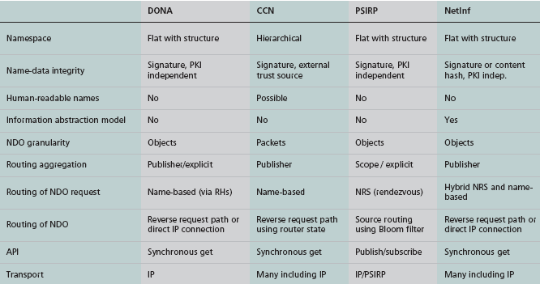
Summary ICN approaches.
ICN-clean slate:
Ideal for disseminating public content.
But…privacy issue, and less clear how efficiently a new information-centric architecture support: ssh, email…that have worked well with TCP/IP.
Should have a model that take advantages of ICN but still use existing TCP/IP?
.

Slide 16
Information-Centric HTTP.
Keep point-to-point service: w/o interrupting other services.
Take advantages of ICN
location independent content identifiers.
security.
Similar to ICN, to have secure feature need:
Binding b/w the name and the content so user can trust received content.
User perspective: the names must be friendly and readable.
...Can achieve both these requirements?
Naming content:
Secure identifiers are relevant for the network. Two approaches:
Use PK crypt to verify the content. But, routers need to know correct key: key in band, indicated by the request.
Hash the content : work well with immutable content, but has problem with mutable: content changes→ its identifier changes too.
Meaning are relevant to people:
Friendly name: ~ DNS name
Mapping from user –friendly label to secure network identifier.
Use search engine: list of URLs, sign its search results to prevent modification, even provide certificates.
DNS is an optional: DNSSEC could be applied to fetch a public key.
.

Slide 17
Information-Centric HTTP.
Location independent content identifiers.
Introduce self-certifying identifier: verify content matches the request
Implemented in http header.
Secure-name header: uniquely identifies contents, included in http request.
a self-certifying hash of a public key representing the owner (principal) of the content.
free-form label identifying a particular content item in the principal’s namespace.
ICN-HTTP proxies: overlay for info retrieval on top IP network.
Request routed based on secure name. So, proxy doesn’t need public IP address.
Proxies can exchange info, maintain active connections about neighbors.
Only caches data with correct signature.
Secure-name header is an optional.
Request includes secure name header <-> response : valid signature + PK compatible w signature, and secure name ,otherwise ignored.
Request doesn’t include secure name: traditional request by URL.→ no verified content.
Signature, Public key header.
.

Slide 18
Information-Centric HTTP.
Obtain the secure name
User never manipulates, sees secure name.
Http client user interface takes care secure name using labels.
Web link: URL + secure name
secure mode: secure name is used.
non-secure mode: URL is used.
Each click on web link: directly triggers a new http query routed thru ICN-HTTP proxies w/o additional resolution steps.
.
Optional URLs
Clear text description
User sees

Slide 19
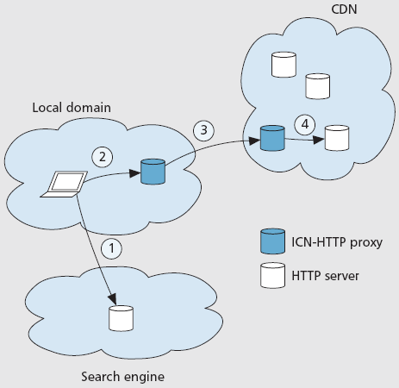
Information-Centric HTTP.
Deployment:
no DNS is needed.
Fewer separate protocol exchanges and interactions are needed.
Only one persistent connection per connected proxy is need: congestion control, local control loop.
.
Http request with secure name sent to the first ICN-HTTP proxy configured at client.
Request forwarded to CDN proxy.
Request passed on to server storing the requested data.
Browser performs queries, included secure names in the references.

Slide 20
Q?A

