Slide 1
Assignment 3 Advanced Network Routing Technologies (SYSC 5801), Carleton University, Ottawa -Prof. Lung A Survey of naming and Routing in Information-Centric Networks by Farooq , Fikirte, Avinaba, Shakil, Rabbibur & Masi

Slide 2
Introduction
Information Centric Network(ICN) : What is being exchanged, Not Who is exchanging (nodes).
Flow of packets from sender to receiver is based on “content of packet” not on the address of the packets.
Goal: Host-oriented Communication model to Content-oriented model for effective distribution of network.
CCN: Location Independent naming, In-Network Caching and Name based Routing.
Challenges: Secure, Persistent Naming, Name based Routing, Name resolution, Content Discrimination and Privacy.

Slide 3
CBCB
Content Broadcast and Content Based Routing

Slide 4
Combined Broadcast and Content Based Routing
CBCB is an application level overlay.
Its Publish/Subscribe Architecture
Publishers: Posts the content using messages.
Subscribers advertise their interest through Predicates.
Published messages are broadcasted over the network.
Nodes use the predicates to narrow down the branches of broadcast to ensure only the interested one gets the content.
Notes:
Predicate is a part of the sentence , Here in last point, Instead of broadcasting everywhere in the network, It will be sent only to those who are interested in it.

Slide 5
Naming
CBCB uses attribute value to name the contents.
Attribute values might be anything from name, type.
Ex: uwaterloo.ca/mfbari/srv_naming.pdf
Fig: Showing the new format of naming in the CBCB
Image Coutesy: “A Survey of Naming and Routing in Information-Centric Networks "by Md. Faizul Bari and at all, UWaterloo publishes in IEEE Communications Magazine • December 2012

Slide 6
Routing
CBCB routes the “published” messages from the source.
CBCB router implements two protocols
Broadcast Routing Protocol
Uses Network Topology.
Content-based Routing Protocol
Removes the branches from the broadcast topology in order to deliver the content to interested nodes only.
Routers – Content-based forwarding tables where interfaces are mapped with predicates (old : Interface to IP).
Routers- Forwards an incoming message to a specific interface if the predicate of the mapped interface is matching with message.

Slide 7
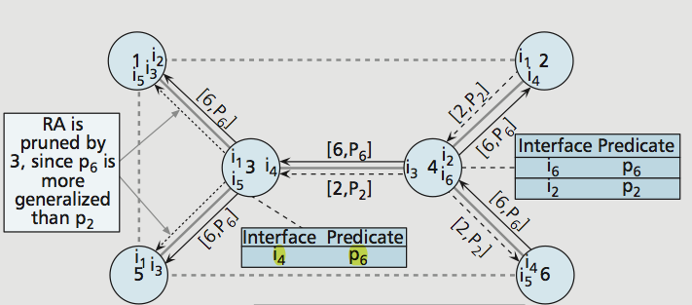
Routing. Contd
Construction of Routing tables with predicates,
Receiver Advertisements (RA)
Sender Request (SA)/ Update Replies (UR)
Routers periodically broadcasts their interests through RA.
Scene 1: When a new predicate come through an interface, The Router will update it and will send to other interfaces.
Scene 2: When a predicate already mapped to a specific interface comes, it will prune/stop sending to other interfaces.
Image Coutesy: “A Survey of Naming and Routing in Information-Centric Networks "by Md. Faizul Bari and at all, UWaterloo publishes in IEEE Communications Magazine • December 2012
Notes:
If a new predicate comes though an interface and if the node is interested, It will be updated

Slide 8
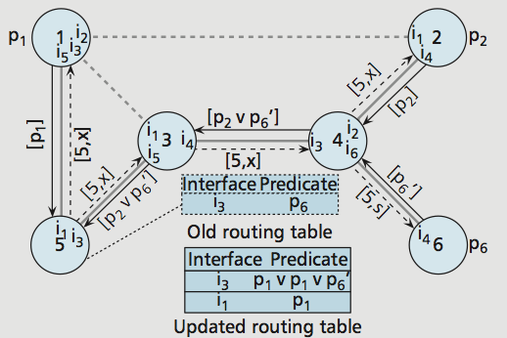
SR and UR
SR and UR – Used to update the Routing tables by pulling from other routers.
Router (5) broadcasts SR.
Receiving Routers sends UR.
Leaf Routers –Update with UR.
Non-Leaf Routers collects all UR > Add the CB-Address > Performs logical OR > Sends a finalized UR.
The original Router will update the Routing Table using the UR received.
Scalability : Analysis- 4x10⁵ BGP Routes for 3.8x10⁹ IPv4, Scaling factor is 10⁴
Google - 10¹² URL, so Scaling factor is 10⁷
Image Courtesy: “A Survey of Naming and Routing in Information-Centric Networks "by Md. Faizul Bari and at all, UWaterloo publishes in IEEE Communications Magazine • December 2012

Slide 9
DONA
Data Oriented Network Architecture

Slide 10
Naming :
Flat and Self Certifying Naming with Hierarchical organized
P:L - P is the cryptographic hash of the owner’s
public key , L is an owner assigned label
Verifying the public key actually belongs to the owner left to the receiver

Slide 11
Routing
RH- resolution Holder
Find P:L –locate the content
Register P:L – sets up necessary states in the RHs to route subsequent FIND messages effectively.
Register tables store (P: L,
next hop RH, distance)
-Uses Name based routing between the RHs but from RHs to requester Name resolution may be performed
-Deployed Incrementally

Slide 12
NetInf
Network of Information

Slide 13
Overview: - It is a part of the EU FP7 projects 4WARD and SAIL. Naming: a. It proposes using flat and self-certifying names similar to DONA b. Even here the names have two parts, P : L, where P is the hash of owner’s public key and L is a label chosen by the owner. c. To make a single owner use multiple private/public keys, it has proposed binding using the public/private key pair to the content instead of the owner.

Slide 14
Routing
It uses MDHT, a multilevel DHT-based name resolution service
IMDHT provides name-based anycast routing
It’s basically a topology embedded, multilevel, nested, hierarchical DHT
Three DHTs are nested in the access node (AN), point of presence (POP), and autonomous system (AS) levels.
Each of these DHTs run their own DHT algorithm, a
Intra-area routing is done according to the rules of the local DHT algorithms, however inter-area routing is done by finding node in the local DHT.

Slide 15
Registration process for any content
Host Tk registers content X at three different levels : AN, POP, and AS.
The AN stores two mappings : the first one says that content X belongs to host Tk, and the second one says that host Tk can be found at address k, which can be an IP address or a private address to access node C.
POP and AS level DHTs map the content X to access node C.

Slide 16
Name Resolution and Data Transmission Path for Content
Host T0 looking for content X
First will look up at its local AN
If it is not found, then at its local POP and after that at the AS level DHT
If the lookup is unsuccessful at the AS level, T0 will look up at the name in the Resolution Exchange (REX) system.
Aggregated bindings generated by the REX system are cached by the AS level DHT to reduce the load on REX system.

Slide 17
NDN
Named Data Network

Slide 18
Overview: - One of the four NSF FIA project - proposed to use content chunks as universal component of transport. It is clean slate design. Naming: a. Hierarchical naming with multiple components of arbitrary length b. User generated and user assigned name with only fixed component structure c. All name implicitly contain SHA(Secure Hash Algorithm)-256 digest, that ensures the uniqueness d. Authenticity and integrity is maintained by digitally signing content with ‘name-to-content’ mapping.

Slide 19
Routing
Two key messages:
Interest: client broadcasts ‘Interest’ over all available link for a content
Data: NDN node, that have the original or replicated copy of the content replies with ‘Data’
Messages are routed using route-by-name paradigm.
One-to-one mapping between ‘Interest’ and ‘Data’ to maintain strict flow balance.
Developing OSPF-N for generating and updating the routing table of named data.
Routing tables index next hope router against content name.
Needs to flood over the whole network for each new message.
Even after prefix aggregation and loop free forwarding scalability is still much lower than IP routing.

Slide 20
Routing contd..
Two key messages:
Interest: client broadcasts ‘Interest’ over all available link for a content
Data: NDN node, that have the original or replicated copy of the content replies with ‘Data’
Messages are routed using route-by-name paradigm.
One-to-one mapping between ‘Interest’ and ‘Data’ to maintain strict flow balance.
Developing OSPF-N for generating and updating the routing table of named data.
Routing tables index next hope router against content name.
Needs to flood over the whole network for each new message.
Even after prefix aggregation and loop free forwarding scalability is still much lower than IP routing.
Three tables are maintained at NDN nodes:
Forwarding Information Base(FIB): stores probable sources
Pending Interest Table (PIT): stores return path for possible Data message
Content Store(CS): caches Data

Slide 21
Public Subscribe Internet Technologies

Slide 22
Overview : - PSIRP is an EU FP7 Project. It is a publish-subscribe paradigm and a Clean slate design. - PURSUIT is the follow up project of PSIRP to develop Internet-scale deployable components Naming : a. Same naming scheme as DONA. b. Content names are called resource identifier (RIDs) c. Content persistence is ensured by data sources d. Scopes Identifier-Sid e. Scopes control access rights, authorization, reachability, availability etc. f. Content publication (publish)and content request (subscribe) are based on ‹Sid, RId›

Slide 23
Routing
PSIRP comprises four components: Rendezvous, Topology,
Routing and forwarding
Assumes Autonomous systems similar to current internet
Rendezvous network (RN) is responsible for locating the publications and scopes of its network. Advertise its scope to RIs. Matches data sources of publications with subscribers’ interests.
Topology nodes (TN) manages the topology and also works similar to BGP for inter-domain routing
Branching nodes (BNs)uses the information of TNs to route subscription messages from subscribers to data source. It also caches popular contents
Forwarding nodes (FNs) use Bloom filter based forwarding to send back a content to subscriber. Uses forwarding identifier (FIDs) in the bloom filter.
Need to store all the names in the network. Not so scalable like the others

Slide 24
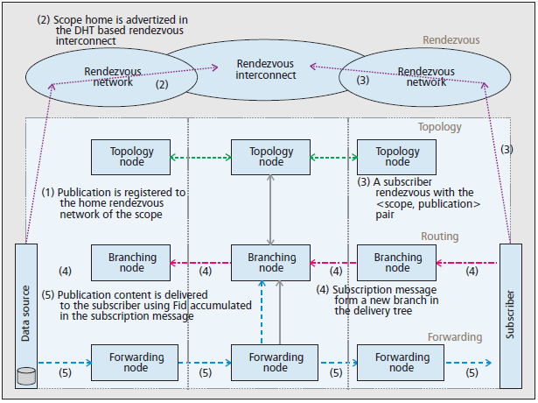

Slide 25
Naming Comparison
Human Friendly Names | Flat/Self Certifying
Can easily be remembered | Hard to be recognized
 | Globally unique, security ,authenticity binds to the name
Attribute Based & hierarchical

Slide 26
Routing Comparison
Name-based Routing | Name resolution
1.Request forwarding is performed directly based on the identifier (name) alone and some sort of state information is set-up along the way so that the content can travel back to the requester. | 1.content name is resolved to a single or a set of locators (e.g., IP address) 2.The request is routed to one of the locators using topology based shortest path routing (e.g., ISIS, OSPF).
Doesn’t guarantee discovery of content | Guarantee discovery of any content in the network
Update message overhead higher | Update message overhead lower
Maintain a mapping between names and network locations | Storage requirement for a name resolution system is higher

Slide 27
Conclusion
Survey content naming and routing mechanism for five ICN research project.
It Introduced several new methods for naming and routing such as
Naming :
Name structure
Self certification
Routing :
Content state
Discovery of closet copy
Resolution and retrieval locality
Discovery guarantee
Stability
Network level deployment
Security
With this method author provide and start point for new research at this area .
However, the scalability issue still remains!

Slide 28
Merci pour votre attention!!

