Slide 1
System Software
Operating Systems Multiprocessing
Notes:
There is no reference in the Murdocca text here.
Null, Chapter 8

Slide 2
Objectives
Services provided by an operating system
The process model
Process scheduling.
Security
Threaded programming
Database properties.

Slide 3
Operating System
Software that controls the execution of application programs and manages the processor’s resources.
Acts as an interface between the user of a program and computer hardware.
Masks the details of the hardware to application programs and provides a convenient interface for using the system.
Objectives:
Convenience
Efficient use of system resources
Ability to evolve

Slide 4
Typical O/S services
Human Interface
Layer of abstraction between user or application & hardware
3 standard interfaces: hardware, applications, users
Command line versus GUI
Process Management
Process : Independent program
Thread: Separate thread of control within Process
Smallest schedulable unit
Services: Creation, scheduling, synchronization
Resource Management
Resources: CPU, memory, I/O
Memory: Virtual Memory, Paging; I/O: Device Drivers
Security & Protection
All requests for resources pass through O/S
Notes:
Null, page 418
Human Interface: Neither user nor applications see the hardware directly.
Three views or interfaces (1) hardware developer 2) applications developers and 3) ordinary users
Process Management:
Threads share the same execution environment as their parent process, including its CPU registers and page table. Because of this, context switching among threads generates less overhead so they can occur much faster than a process context switch.
Combinations: one process with 1 thread, one process with >1 thread, >1 process each with 1 thread, >1 processes with >1 threads
Resource Mangement
Resources are expensive, so it is best if they are shared (eg. printer, physical memory)
CPU is handled by scheduler so that leaves memory and I/O
Security: As a resource and process manager, the O/S must ensure everything works fairly, correctly, and efficiently.

Slide 5
O/S History
Serial Processing
Batch Processing(50s):
Professional operators submit batch of jobs on behalf of users.
Resident monitor (a program) managed execution of each program in the batch in turn
Load job, Give control of computer to job, Resume control when job done.
Multiprogramming (60s):
Still batch, but several programs can be in memory concurrently
Maximizes CPU utilization; take advantage of I/O waits to switch between jobs
Time Sharing Systems (late 60s):
Extends multiprogramming to handle multiple interactive jobs
Processor’s time is shared among multiple users
Multiple users simultaneously access the system through terminals
If there are n users actively requesting service at one time, each user will only see on the average 1/n of the effective computer speed.
Notes:
Serial: Late 1940s to the mid-1950s: programmer directly interacted with the hardware; there was no operating system
Problems: Scheduling, Setup time, Users had access to computer in series
Batch: The first operating system (mid-50s): user had no access to the machine; instead users submitted a job (written on card or tape) to a computer operator and the computer operator placed a batch of several jobs on an input device. A special program, the monitor, manages the execution of each program in the batch. Each program is constructed to branch back to the monitor when it completes processing.
Resident monitor is in main memory and available for execution. The rest of the monitor consists of utilities that are loaded when needed
Multiprogramming: No interaction between users. Jobs were still remote, any I/O was with files, data.
But with sharing CPU, monitor was evolving into modern O/S at this point.
TSS: New problems for the OS: if multiple jobs are in memory, then they must be protected from interfering with each other by
The file system must be protected (multiple users…) The contention for resources, such as printers and storage devices, must be handled
Page 411: It is interesting to note the close correlation between advances in architecture and evolution of O/S. 1st generation computers (with vacuum tubes) were slow and didn’t need to handle multiple concurrent tasks. 2nd generation computers used transistors and were faster. Although CPU capacity had increased, it was still costly and had to be utilized to the maximum possible extent. Batch processing was introduced as a mean to keep the CPU busy. 3rd generation computers used integrated circuits, again more speed. Spooling of jobs could no longer keep the CPU busy, so timesharing was introduced. Virtual memory and multiprogramming demand more sophisticated programs than a simple monitor! 4th generation computers VLSI allowed the PERSONAL computing market to flousish … networks and distributed systems were an outgrowth. With circuitry now so small, there is room on the chip for circuits for managing pipelining, array processing and multiprocessing.

Slide 6
O/S Design Influences
A major operating system will evolve over time
Must adapt to hardware upgrades and new types of hardware.
Must offer new services, e.g. internet support
The need to change the OS on regular basis place requirements on its design
modular construction with clean interfaces between the modules
more than simply partitioning a program into subroutines: object oriented methodology
Event Driven: Performs tasks in response to commands, application programs, I/O devices, interrupts.

Slide 7
O/S Designs
Two main components
Kernel
System programs
Kernel
O/S core
Used by system programs (process manager, scheduler, resource manager)
Responsible: scheduling, synchronization, protection, memory, interrupts
Kernel Design
Microkernel
Monolithic kernel
Applications
Shared Libraries
System Calls
Kernel
Notes:
Microkernel: Provide rudimentary functionality and let other modules perform specific tasks
Lets many services to be restarted or reconfigured without restarting entire OS
Provide security because services running at user level have restricted access to system resources
Can be customized and ported more easily
BUT, additional communication between kernel and other module is necessary : slow and less efficient
Window 2000, QNX, Mach
Monolithic: All essential functionality in single process
Tend to be larger
Target for specific hardware
Interact directly with hardware, so more optimized
BUT not easily portable
Linux, MacOS, DOS

Slide 8
Process Model
Process model = systematic way of monitoring and controlling program execution
Multi-programming / time-sharing = Pseudo-parallelism
CPU switches from program to program
Switch when time slice (10s or 100s milli-sec pass) or when process does an I/O operation
A process is an executable program with:
associated data (variables, buffers…)
execution context: All information that CPU needs to execute process
content of the processor registers, program counter, etc.
Conceptually, each process has its own virtual CPU. In reality, the real CPU switches back and forth from process to process
O/S’s needs to manage the process:
priority of the process
the event (if any) after which the process is waiting
other data (that we will introduce later)
Notes:
All multiprogramming operating systems are built around the concept of the process.
Pseudo-Parallelism: Gives the appearance of concurrency; Users think they have the whole machine.

Slide 9
Process creation
Simple systems (e.g. the controller in a microwave oven): have all the processes that will ever be needed be present when the system comes up
General-purpose systems: create and terminate processes as needed during operation
When an OS is booted, several processes are created.
Some of these are foreground processes, that is processes that interact with human users and perform work form them.
Others are background processes (e.g. incoming mail), which are not associated with particular users, but instead have a specific function, also called daemons

Slide 10
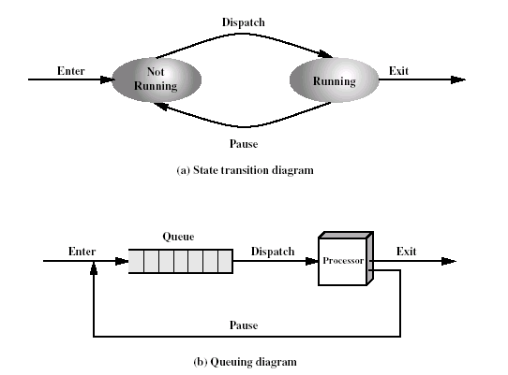
Two-state process model
Simplest model
A process is either being executed by a processor or not
Queue is FIFO
Each process in queue given a certain amount of time, in turn, to execute and then returned to queue.
If all processes were always to execute, then the queuing discipline would be effective.
Inadequate: some processes in the Not Running state are not ready to execute
Notes:
OS: controls the execution of processes; this includes determining an interleaving pattern for execution and allocating resources to processes.
Behavior that we would like the processes to exhibit
QUESTION Why would a processing that is not running not be ready to execute ? Waiting for I/O operation.

Slide 11
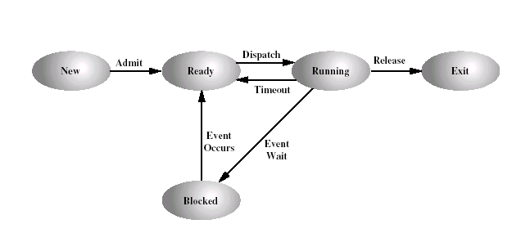
Five-state process model
Notes:
Soln: split the Not Running state into two states: Ready and Blocked

Slide 12
Process Control Block
Each process is represented in the OS by a :
Identifier: id
State: new, ready, etc.
Priority
PC
Memory pointers: start & end locations of the process
Context data: data present in registers; saved when the process leaves the ready state
I/O status info: outstanding I/O requests, a list of files, etc.
Accounting info: may be the amount of processor time and clock time used, etc.
Notes:
For each process in the system, the OS must maintain information indicating the state of the process and other information necessary for process execution.

Slide 13
When the OS (scheduler) accepts a new job for execution, it creates a blank process control block and places the associated process in the new state.
After the system has properly filled in the process control block, the process is transferred to the ready state

Slide 14
Context Switch
Notes:
The role of the O/S in a context switch

Slide 15
Process Scheduling
Notes:
Null: Page 417
Long term scheduling: O/S must determine which processes to admit to the system
requests for new processes
Short Term Scheduling: O/S must determine which process will be granted the CPU at any given instant
To perform short-term scheduling, the O/S maintains a list of ready processes so that it can distinguish between those that are waiting on resources and those that are ready to run. If a running process needs I/O or other resource, it voluntarily relinquishes the CPU and places itself in a waiting list.

Slide 17
Process Scheduling
Scheduler (kernel) is the lowest level of the operating system; key to the multiprogramming
Handles all the interrupts
Does process (context) switching
Handles interprocess communication
Rest of OS is on top of the scheduler (kernel) implemented as processes

Slide 18
Process Scheduling
To implement processes the OS maintains a process table
Examples of important information in the table:
Process management Memory management File Management
Registers Pointers to segments Root directory
Program counter Process id Working directory
Stack pointer Exit status File descriptors
Process start time .... ....
CPU time used
Message queue pointers

Slide 19
Process Scheduling
Criteria for scheduling
Fairness
Efficiency
Response time
Turnaround
Throughput
Three significant quantities
time spent in the system so far,
time spent in the execution so far, and
total service time required by the process (typically supplied by the user)

Slide 20
Relinquishing the CPU
Nonpreemptive: once a process is in the Running state, it continues to execute until (a) it terminates or (b) blocks itself to wait for I/O or some other service
Process must voluntarily give up CPU
Preemptive
Process is taken from the CPU by O/S.
Currently running process is interrupted and moved to the Ready state by the OS.
The decision to preempt may take place when a new process arrives, when an interrupt occurs that places a blocked process in the Ready state, or periodically based on a clock interrupt.
Time-sliced: If current time slice expires.
Priority-based: If a higher priority job is ready to run (vs. non-preemptive).
Notes:
Preemptive policy may incur greater overhead than nonpreemptive ones, but may provide better service to the total population of processes.

Slide 21
Scheduling Algorithms
Round robin (preemptive)
Define a time quantum, say x milliseconds
Preempt the current process every time quantum
Run the next ready to run process
When the interrupt occurs, the currently running process is placed in the Ready queue and the next ready job is selected on a first-come-first-served basis. This is also known as time slicing, because each process is given a slice of time before being preempted
The principal design issue: length of the time quantum.
Notes:
Round-robin is equitable and simple. Used extensively in timesharing systems.
Length of time slice: Small enough to make user feel like they are running continuously but large enough so that context switch time is not significant in relative size.

Slide 22
Scheduling methods
Shortest job first (SJF)
If you know how long programs will take to run, you can use this information to maximize throughput
Run the shortest job first!
Short process will jump to head of queue past longer jobs
Side Effect: Short process has effective high priority!
Preemptive or non-premptive:
Preemptive: Shortest Remaining Time First
Shortest job first also gives the minimum average response time
Difficulty: estimate the required processing time of each process
Risk: possibility of starvation for longer processes
Shortest remaining time: preempted version
Notes:
Null, page 418: SJF is provably the optimal scheduling algorithm. The main trouble is the first point: you have to know how long the job is. Systems that uses this algorithm use “guesstimates” of job run time, but heuristics are far from perfect and may reduce the maximum throughput.

Slide 23
Scheduling methods
First-come First Served (FCFS)
Non-preemptive: CPU relinquished when process terminates.
Easy to implement
Unsuitable for systems with multiple users
High variance in average time to get CPU
Other process could monopolize CPU
Priority
Process assign priority
Highest priority is selected from ready-queue
Use with
FCFS: Equal priority to all process at same priority!
SJF: Priority to shortest process at same priority
Suffers from starvation & indefinite blocking
Notes:
Finally, some operating systems offer a combination of scheduling approahces.
Premptive priority-based first-come first come.

Slide 24
Sample Scheduling
Traditional Unix scheduling: time-sharing ineractive environment
Multilevel feedback using round robin within each of the priority queues.
Use 1 second preemption. That is if a running process does not block or complete within 1 second, it is preempted.
Priority is based on process type and execution history. The priority is recomputed once per second, at which time a new scheduling decision is made.

Slide 25
Resource Management
Resources = {CPU, Memory, I/O}
CPU : Process Scheduler
Memory : Virtual Memory
O/S maintains memory page tables, transfers pages to/from disk, tracks free frames.
I/O
Usually expensive, therefore share
O/S mediates between simulataneous requests.
O/S provides services for file management (a layer above the disk driver)

Slide 26
Security & Protection
Protect concurrent processes from each other
Separate memory areas
Guard against infinite loops (starvation)
Protect O/S processes from all others
In multi-user, protect non-shared resources (eg. files)
Protection = {Virtual Machines, Subsystems, Partitions}

Slide 27
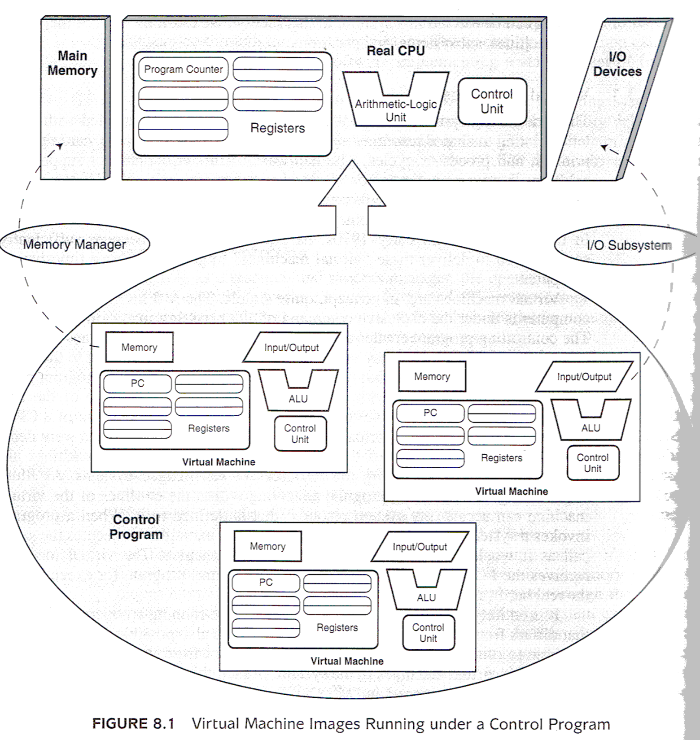
Virtual Machines
Null
Notes:
Null Figure 8.1, page 422
Kernel keeps control of “REAL” machine.
Presents each process with image resembling the hardware.
When a program invokes a system service to write data to a disk, it executes the same c all as it would if it were running on the real machine. But the virtual machine has passed the request onto the control program for execution on the real hardware.
Virtual machine can be running an operating system different from the kernel’s!
DOS command prompt
VM ware – Microsoft on Apple, and Apple on Microsoft.
So, Virtual Machines are one way for protecting processes from each other, and they also provide machine compatibility!

Slide 28
Subsystems
Define logically distinct environments that can be individually configured and managed
Virtual Machine Manager
File System Manager
Configuration Manager
Subsystem runs on top of kernel
Gain access to fundamental system resources (e.g. scheduler)
Notes:
Null, page 424
Each subsystem must be defined within the context of the controlling system.
Definition include: resource descriptors (eg. disk files), input and output queues, and other hardware components (printers)
Resources defined to a subsystem are not always seen directly by the underlying kernel, but are visible through the subsystem for which they are defined.
Resources defined to a subsystem may or may not be shareable among peer subsystems.
Subsystems assist in manging large, highly complex systems. Each subsystem is a discrete controllable entity, sysadmins can start and stop each one individually without disturbing the kernel or other subsystems. Each can be tuned individually by re-allocating resources (eg. adding more memory). If one process goes out of control, only the subsystem in which that process is running is affected.
- more manageable and more robust

Slide 29
SubSystems
Null

Slide 30
Partitions
Null
Notes:
In very large computer systems, we need even more segmentation for security and resource management.
A systems is broken into logical partitions (LPARs).
LPARs create distinct machines within one physical system with NOTHING IMPLICITLY shared between them.
The resources of one partition are no more accessible to another partition than if the partitions were running on physically separate systems.
If a system has two partitions A and B, partition A can read a file from partition B only if both partitions agree to establish a mutually shared resource (such as a pipe or messsage queue). Files can be copied between partitions only through the use of a file transfer protocol or special utility.
Partitions are useful to create sandboxes for user training and testing new programs. Sandboxes place strict limits on the accessibility of system resources. Processes running in one partition can never intentionally or inadvertently access data or processes resident in other partitions.
Partitions raise the level of security in a system by isolating resources from processes that are not entitled to use them.
Subsystems and partitions differ in HOW they define their resources but both are examples of layer system architectures.
Example: Eclipse and the Apache sandbox

Slide 31
Concurrency
What is concurrency?
Permit many activities to proceed in parallel
The activities synchronize and communicate at well defined points
Why concurrency?
Easier to describe a system using several independent cohesive activities than to have one monolithic coupled function
Link the activities using well-defined interaction mechanisms
Exploit multiple resources
Notes:
How can we time share between activities?
context switching
Examples of concurrent programming paradigms
Event-driven environments
Co-routines
Threads

Slide 32
Processes and threads
Processes embody two characteristics: resource ownership and scheduling/execution
In modern OSs: these two characteristics are treated independently
Thread (lightweight process): the unit of execution
Process (task): unit of resource ownership
Multithreading: ability of an OS to support multiple threads of execution within a single process
Multiple threads in the same process share the same address space
Example: WWW. For each image on a Web page, the browser must set up a separate connection to the page’s home site and request the image. By having multiple threads within the browser, many images can be requested at the same time

Slide 33
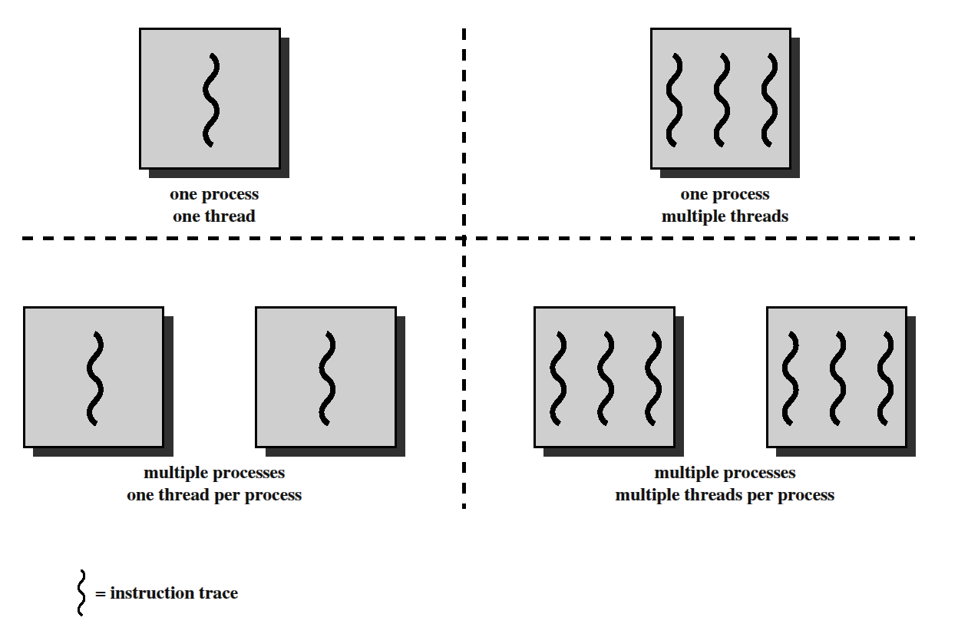

Slide 34
MS-DOS: single user process and a single thread
UNIX: multiple user processes but support only one thread per process
Java RTE: one process with multiple threads
W2K, Linux, Solaris: multiple processes, multiple threads
Multithreaded environment: a process is associated with
an address space that holds the process image and
Protected access to processors, other processes, files and I/O resources

Slide 35
Within a process: one or more threads each with the following:
Thread execution state
Saved thread context when not running
Execution stack
Some per-thread storage for local variables
Access to the memory and resources of its process shared with all other threads in that process
A separate thread table is needed, with one entry per thread.
Per-thread items: program counter (threads can be suspended and resumed), registers (must be saved during suspension) and state (running, ready, blocked)

Slide 36
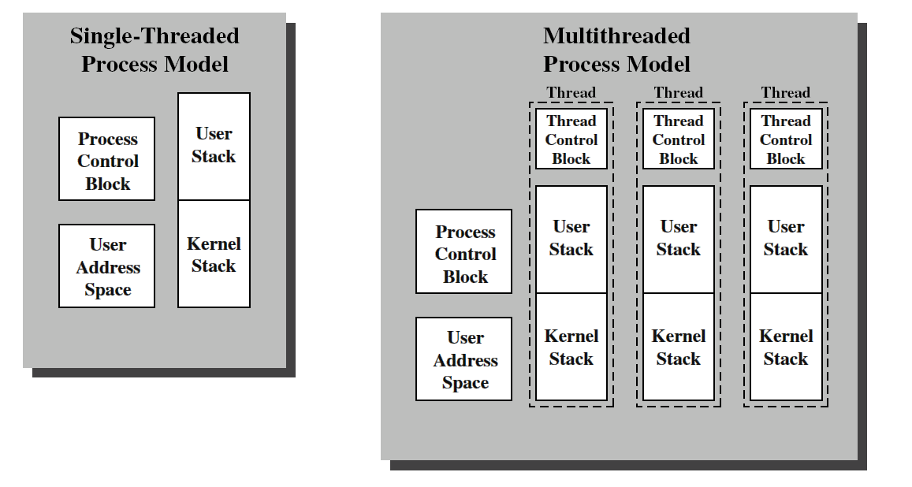
Single threaded and multithreaded process models
Notes:
Multi-threaded model:all of the threads share the state and resources of that process. They reside in the same address space and have access to the same data
When one thread alters a data item in memory, other threads see the results if and when they access that item

Slide 37
The key benefits of threads derive from the performance implications:
It takes far less time to create a new thread in an existing process than to create a brand-new process (Unix, factor of 10)
It takes less time to terminate a thread
It takes less time to switch between two threads within the same process
They also enhance communication efficiency between different programs
Thus, it is far more efficient to use a collection of threads rather than a collection of separate processes, if there is an application or function that should be implemented as a set of related units of execution

Slide 38
Threading Example
File server: As each new file request comes in, a new thread can be spawned for the file management program
Since a server will handle many requests, many threads will be created and destroyed in a short period.
If the server runs on a multiprocessor machine, then multiple threads within the same process can be executing simultaneously on different processors.

Slide 39
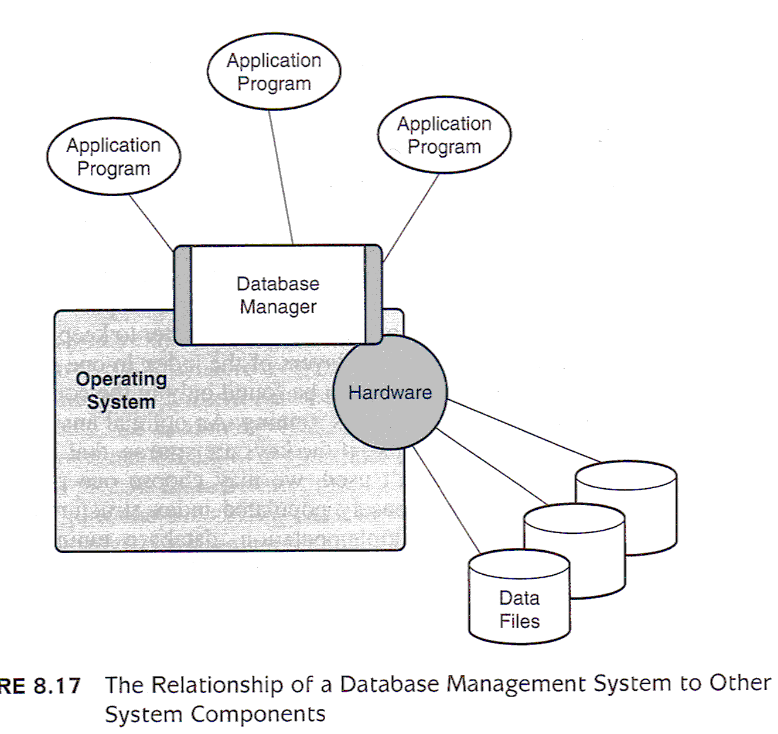
Database Software
Null
Notes:
We’ve been talking about coding, but what about databases.
See Null’s section in Chapter 8.6, page 445

Slide 40
ACID Properties of DBs
Atomicity
All updates related to the transaction are made; or none at all
Consistency
All updates obey the constraints of the data elements
Isolation
No transaction can interfere with another
Durability
Successful transactions are written to durable media ASAP

Slide 41
Race Conditions
Null
Notes:
Null, page 449
Suppose you make your month credit card payment and soon after mailing it, you go to a store and buy something with the card. Suppose at the same time that the sales clerk is swiping your plastic, a bank clerk is entering your payment into the bank’s database.
The clerk finishes his update before the sales clerk, leaving you with $300 unpaid balance.

Slide 42
Null
Notes:
Transaction managers and locks.
The bank clerk should get an exclusive lock on the record, released only after the updated balance is written back to disk.
The sales clerk will get a BUSY message.
When done, the transaction manager releases the bank’s lock and immediately places another for the sales clerk.
Risk: Anytime an entity is lock, there is potential for deadlock. Preventions for deadlock are possible but incur overhead
And transaction performance suffers. In general, deadlock prevention and detection is secondary to performance.
Deadlock rarely happens, performance is a factor in every transaction.

Slide 43
Next Lecture
Alternative Architectures
Murdocca, Chapter 10

