Slide 1
I/O Peripherals, Buses and Data Storage Systems
Murdocca Chapter 8
I/O Devices
I/O Programming : Interrupts
Bus Architectures
Notes:
Actually, this is one part of the Murdocca book that I think is particularly weak. It contains lots of examples of existing buses and I/O devices, but not on the theory or programming models. We’re going to be using other sources.
Null, page 207: Third major aspect of architecture: connections between a computer and the external world.
Abd-el-Barr, page 161: I/O plays a crucial role in any modern computer system. A clear understanding and appreciation of the fundamentals of I/O operations, devices and interfaces are of great importance.

Slide 2
Objectives
I/O devices (characteristics vs memory)
Accessing I/O devices (memory vs io mapped)
Programmed vs Interrupt I/O
Direct Memory Access (DMA)
Interrupt Processing
Bus Arbitration (Not OC Transpo labour issues!)

Slide 3
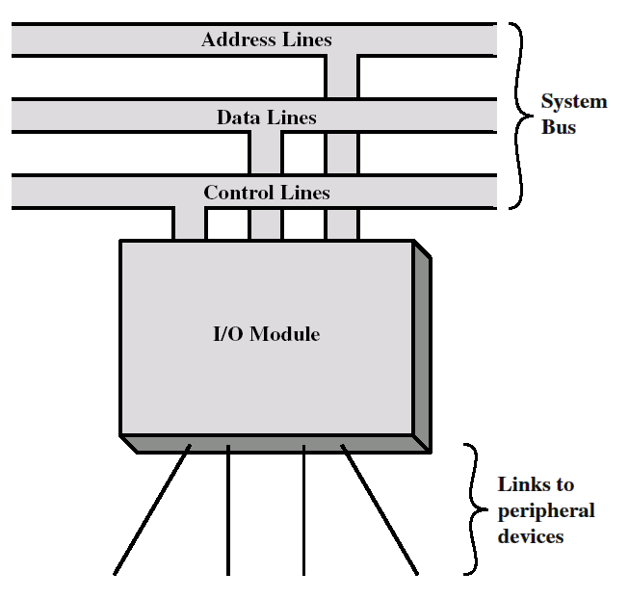
Input/Output
CPU
Memory
Notes:
Null, page 207: On most computers, the connection between a processor and memory uses the same basic paradigm as the connection between a processor and an I/O device
… ie. system bus.
First, some context (to explain what we mean by I/O):
I/O Module is on the System bus. Click Enter (show CPU and Memory): Same system bus as the CPU.
This implies it is on the same board as CPU and memory: Click Enter (show board)
This highlights what is meant by I/O Module
I/O Module is a hardware subsystem that takes care of moving data between the CPU/main memory and a particular device interface. The device interface electrically connects EXTERNAL I/O devices to the system bus (and therefore provides access to the CPU)
Although we’re sometimes careless in our speech : I/O Module = I/O Interface != I/O Device
… Null, , although they operate under control of a processor, I/O devices can interact directly with memory.
(This is referring to DMA and intelligent I/O processors)

Slide 4
Kinds of I/O Devices
Data Transfer
Human readable: suitable for communicating with the computer user (ASCII)
Machine-readable: suitable for communicating with the equipment (binary, digital)
Communication: suitable for communicating with remote devices
Exchange data with a remote device
Actuators: Control { + Data }
Sensors: Status { + Data }
Notes:
Human Readable: What most of you are thinking of : keyboard, mice, display.
Machine readable: Includes digital-to-analog and analog-to-digital: thermometers,
Communication: When we move into multiprocessor systems and/or networking.
TBD: Null, page 330
Control only: LEDs, speaker volume, start a disk spinning, turn off printer.
Status only: Window open/closed, alarm in security systems.

Slide 5
Typical I/O device data rates
Notes:
Key characteristic of I/O devices – that separates them from memory devices – is data transfer rates.
Memory chips are synchronized to the system bus.
I/O devices are NOT.

Slide 6
I/O Measures
Latency: Time required to perform a transfer
Throughput: Amount of data that can be transferred per unit time
Notes:
Comer, Page 213

Slide 7
I/O Modules
Data Transfer to/from external device to the processor
Ensure devices
Write: Ready for next data, or
Read: Host is ready to receive next data
Involves both command control & data
Data buffering
data coming from memory are sent to a module in a rapid burst. The data are buffered in the module and then sent to the peripheral device at its data rate
In the opposite direction, data are buffered so as not to tie up the memory in a slow transfer operation.
Data Error detection and reporting errors to the CPU
Mechanical and electrical malfunctions reported by the device (e.g., paper jam)
Unintentional changes to the bit pattern as it is transmitted from device to the module
Notes:
Roles/Functions of Typical I/O Modules :
Transfer of data from an external device to the processor might involve the following sequence of steps:
CPU interrogates the module to check the status of the attached device
Module returns the device status
If the device is operational and ready to transmit, CPU requests the transfer of data, by means of a command to the module
Module obtains a unit of data from the device
Data are transferred from the module to the CPU

Slide 8
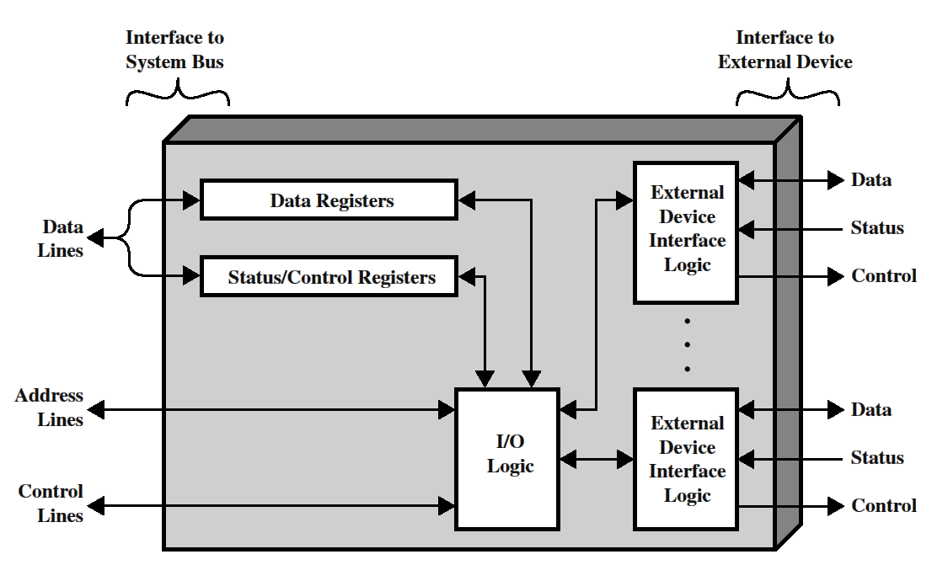
Block diagram of an I/O module
Programmer’s Model
Notes:
Click ENTER: Notice that there are two data arrows: One says Data and the other says Data Lines
Click ENTER: This represents the logical function of an I/O module: To connect an external device (with its own communication protocol) to the system bus (with its standard protocol made up of address/data lines and memory read/write cycles). Always look at I/O modules as two-sides, two faces
Click ENTER: Programmer’s model: Data, Status, Control. This is what we will be talking about. This is what we want to program. The exact collection will depend on the connect device (eg. >1 data port, no status, >1 control ). But the central question now: How do we access these registers: Next slide: I/O Addressing.

Slide 9
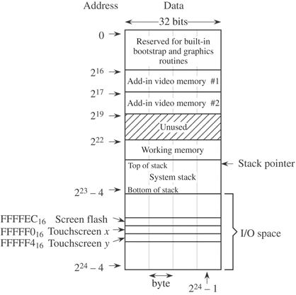
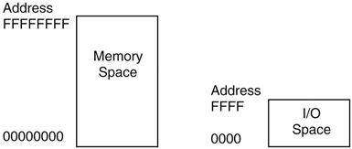
I/O Addressing Schemes
Memory mapped
I/O Mapped
(Shared, Isolated)
Murdocca, Figure 8-12
Murdocca, Figure 4-28
Notes:
In Chapter 8, Murdocca does not cover I/O addressing except in the case study. I/O addressing has also been mentioned on Page 97 and 137 both without a real explanation.
I/O Mapped
Murdocca, Page 317: As a bow to the small address space of early family members, all Intel processors have separate address spaces for memory and I/O access.
Consequence: Same address 0000 could be either memory or I/O
Consequence: To tell them apart, programmers were given different instructions: MOV for memory, IN and OUT for I/O
Memory has grown significantly, so more common these days are Memory Mapped
In the memory map, there are gaps; the memory map is not completely filled in with “real” memory. I/O devices are treated the same as memory (even though they are not the same, and do not behave the same – see polling example) and “ordinary” read and write instructions can be used for reading and writing devices.
Do you understand ? What with this separate / same instructions ? That’s the programmer’s perspective : amount of memory, and instructions. What about the hardware view ?
Next slide

Slide 10
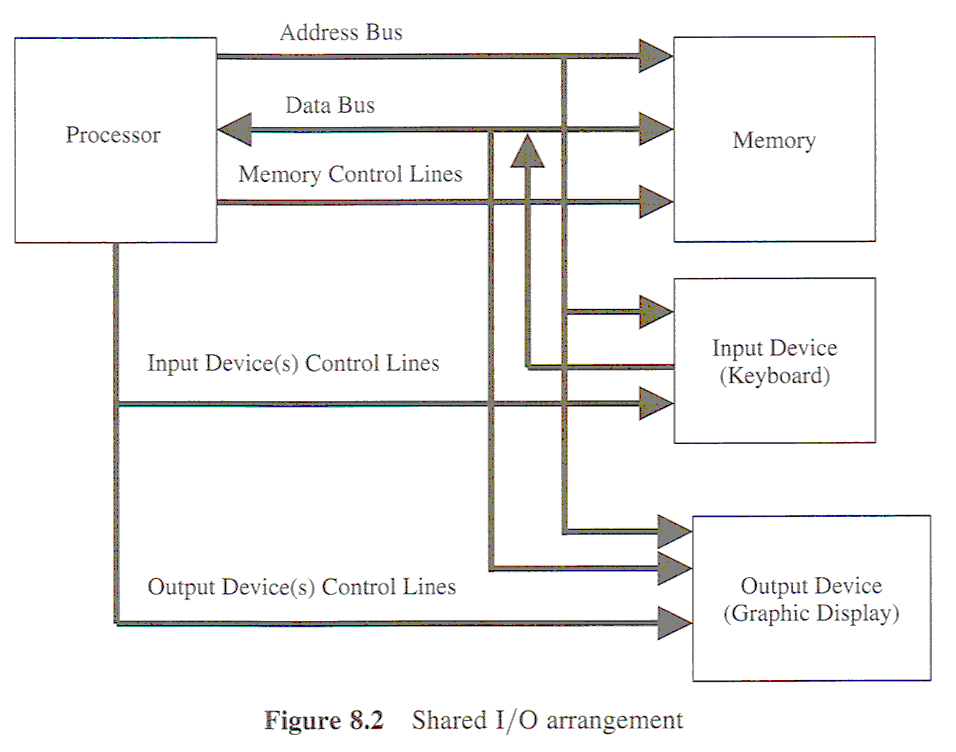
I/O Addressing Schemes
Abd-El_Barr
Notes:
Scan and copy Abd-el-Barr’s Figure 8.2 and Figure 8.3

Slide 11
I/O Addressing Schemes
Abd-El_Barr

Slide 12
I/O (Control) Protocols
Communication between CPU & I/O Device
operations:
Programmed I/O: CPU has to wait for completion of each I/O operation
Interrupt-driven I/O: CPU can execute code during I/O operation (uses interrupts)
Direct memory access (DMA) I/O: a block of data is transferred directly from/to memory without going through CPU
NB. Protocols must be programmed as routines that run under CPU control !
Notes:
Now that we can address our I/O module’s port registers, we have to figure out how to communicate with them : Protocol.
The issue again is the significant difference in data rates between the system bus and the I/O device.

Slide 13
Programmed I/O (Polling)
Summary: CPU (ie. program) repeatedly asks device whether operation has completed before CPU starts next operation.
H/W Requirement: Status Register
Read Sample
int *statusPtr = IO_ADDRESS;
while (*statusPtr != 0);
*data = READ_DATA;
Write Sample
while (*statusPtr != 0);
WRITE_DATA = *data;
What is operation completed (status) for Read? Write?
What if I use a faster CPU ?
Memory vs I/O Addressing!
If statusPtr was memory address, these would be infinite loops!
Notes:
Examples show tight polling loops, can also be looser.
Polling (Comer, page 241) :
Chief Advantage: Economics. Polling architectures do not contain sophisticated digital circuits, so these devices are inexpensive.
Chief Disadvantage: Computational overhead: Each step requires the PROCESSOR to interact with the I/O device.
To understand why polling is especially undesirable, we must recall the fundamental mismatch between I/O devices and computation: because they are electromechanical, I/O devices operate several orders of magnitude slower than a processor. And if a processor uses polling to control an I/O device, the amount of time the processor waits is FIXED and is independent of processor speed.
Because a typical processor is much faster than an I/O device, the speed of a system that uses polling depends ONLY on the speed of the I/O device; using a fast processor will not increase the rate at which I/O is performed; it will only increase the number of instructions that the processor will executing while waiting! The fast processor simply wastes more CPU cycles.

Slide 14
Interrupt-Driven I/O
Summary: Instead of wasting time polling, let the CPU continue other work while I/O device completes operation.
I/O device operates independently, once started.
I/O device informs CPU when operation completed.
H/W Requirement:
I/O Device: Interrupt Line/Pin (to inform CPU)
CPU : Interrupt Cycle (Interrupt Mechanism)
Sample Read:
void ReadISR ()
{ *data = READ_DATA; }
ISR=Interrupt Service Routine
void main (…)
{ Doing other work }
No checking of status!
Multiple Threads of Control
Notes:
Click ENTER: Introduce ISR
Click ENTER: We don’t need to check the status. The fact that this code is running, we KNOW the status is READY
Click ENTER: Coupled with an ISR is always the main() program, which allows the CPU to do other work. When interrupts happen, the CPU switches between the two.
Click ENTER: This is what we called : THREADs.

Slide 15
CPU Utilization Diagram
Depicts what CPU does as time progresses to the right
Let Work = { a, read, b, write }
Let a,b = 10 time units, read,write = 5 time units
Programmed I/O (Polling)
CPU consumed completely by main thread = {I/O + other work}
Interrupt-Driven I/O
CPU is used by ISR whenever the interrupt occurs.
a
P
R
b
P
W
time
P = poll …. until
a
R
a
b
W
b
time
Device
Interrupt signal
Context Switch Overhead
Notes:
Notice: … means variable time, depends ..
Notice: There are two a’s and two b’s, meaning that the work was interrupted and then returned to.
Question: Which one gets done faster in the diagram ? Why ? Interrupts, because useful work is done while device is busy. No waiting during polling.
Question: What is the overhead ?
Question: What if the polling time = 0 (immediately ready), which is faster : polling or interrupt ? Polling! Because interrupts always have overhead and in reality they also have some latency.
Comer, page 249: Interrupts were a revolution in computer architecture. Interrupt driven I/O automatically overlaps computation and I/O without requiring a programmer to take any special action. And interrupts adapt to any speed processor and I/O devices automatically.
A computer that uses interrupts is both easier to program and offer better I/O performance than a computer that uses polling.
Interrupts are the first stage towards moving towards SMART DEVICEs : An I/O device with more digital logic so that it can perform a series of operations on its own. It simply needs some mechanism (such as interrupts) to coordinate higher-level tasks with the CPU.
What’s a higher-level task: One easy example : word transfer versus block transfer.
Next slide …

Slide 16
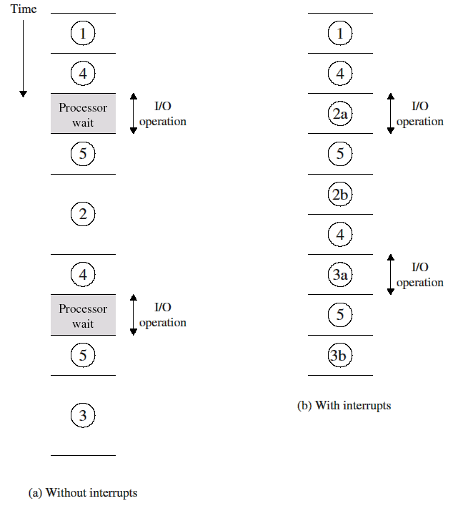
Program timing: short I/O wait

Slide 17
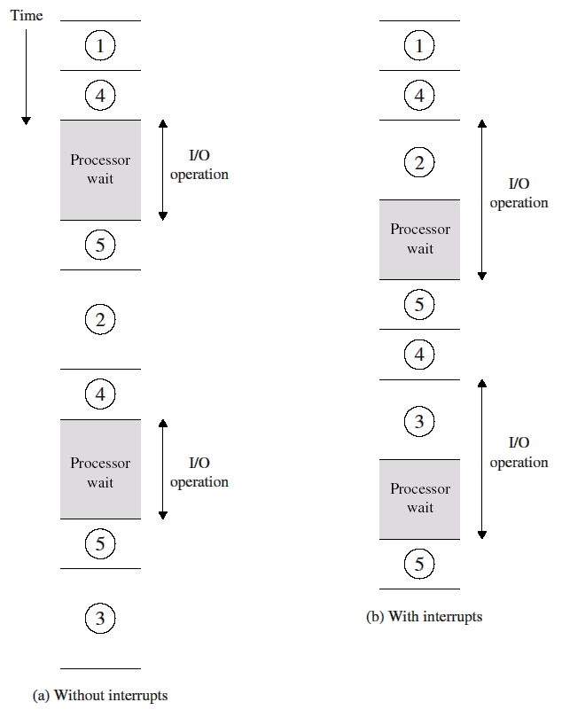
Program timing: long I/O wait

Slide 18
Direct Memory Access
Summary: A smart device transfers data between the device and memory without using the processor.
Shares the systems bus with the CPU
Characteristic of high speed, block-oriented I/O.
H/W Requirement:
Smart device (Embedded processor in I/O Device)
CPU: Control coordination (Interrupt)
Bus: Sharing mechanism
Typical Scenario:
1. DMA controller initiates data transfer = { address, word count}
2. Data is moved (increase address in memory, reduce count)
3. When word count = 0, DMA informs CPU by interrupt
4. CPU regains access to system bus.
Notes:
Have you noticed ? The Hardware is becoming more and more ($)

Slide 19
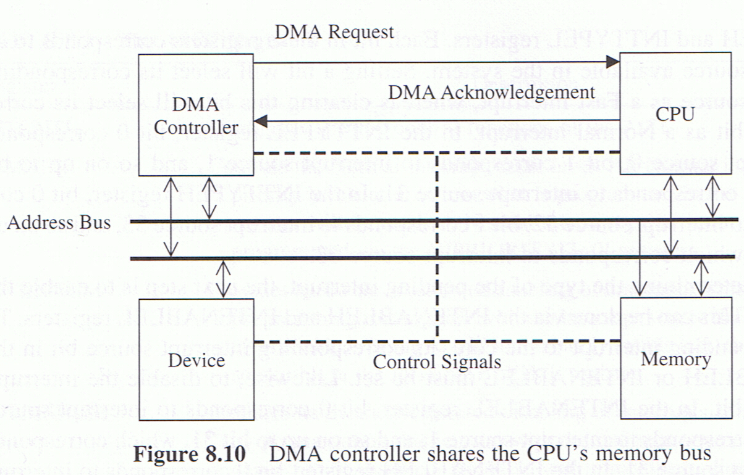
Direct Memory Access
Abd-el-Barr
Notes:
Comer: Page 251
Data can be transferred between the device and memory without using the processor
The device does not interrupt for each step of the operation (just the end)
Read Abd-el-Barr, page 176-177:
DMA channels

Slide 20
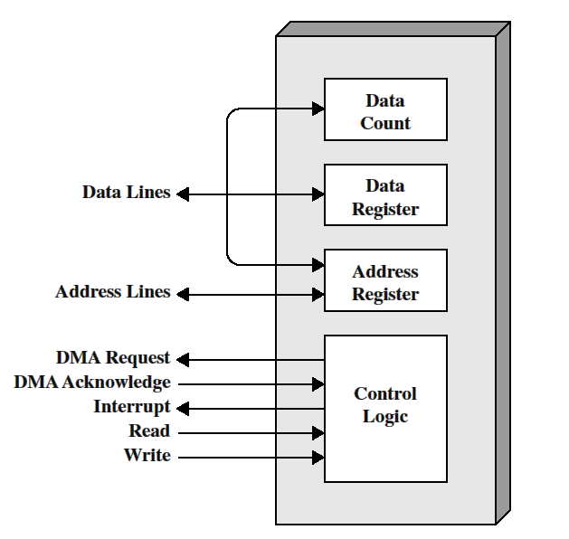
Typical DMA block diagram
DMA is capable of mimicking the CPU and indeed, taking control of the system
DMA module must use the bus only when the CPU does not need it, or it must force the CPU to suspend temporarily
The latter is more common and is referred to as cycle stealing

Slide 21
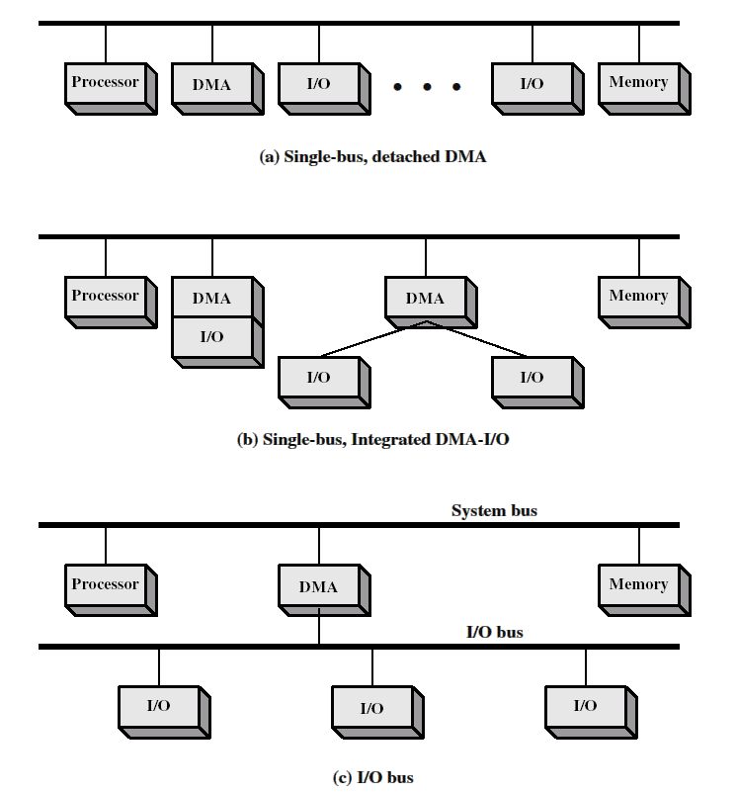
Notes:
TBD: Read Abd-el-Barr

Slide 22
Problem of the Day: DMA
Assertion: Using DMA does not guarantee high performance.
Example: Packet network.
Can you explain ?
Hint: Packets often arrive in bursts: with minimal time between.
Hint: What does the DMA do after a packet arrives ?
Hint: CPU must initialize DMA before DMA can operate independently
Hint: What is something the CPU must initialize for each read ?
Hint: What if there are multiple interrupts at the same time ?
Can you now solve ?
Notes:
Assumption: DMA device can do one operation at a time.
The DMA device must interrupt the processor after a packet arrives. During the interrupt, the processor must allocate a buffer to hold the next packet, and must start the device reading the (next) packet. This sequence of events must occur quickly (ie. before the next packet arrives). Unfortunately, if multiple devices attempt to interrupt simultaneously, the processor may not be able to service the network device interrupt in time to capture the next packet.

Slide 23
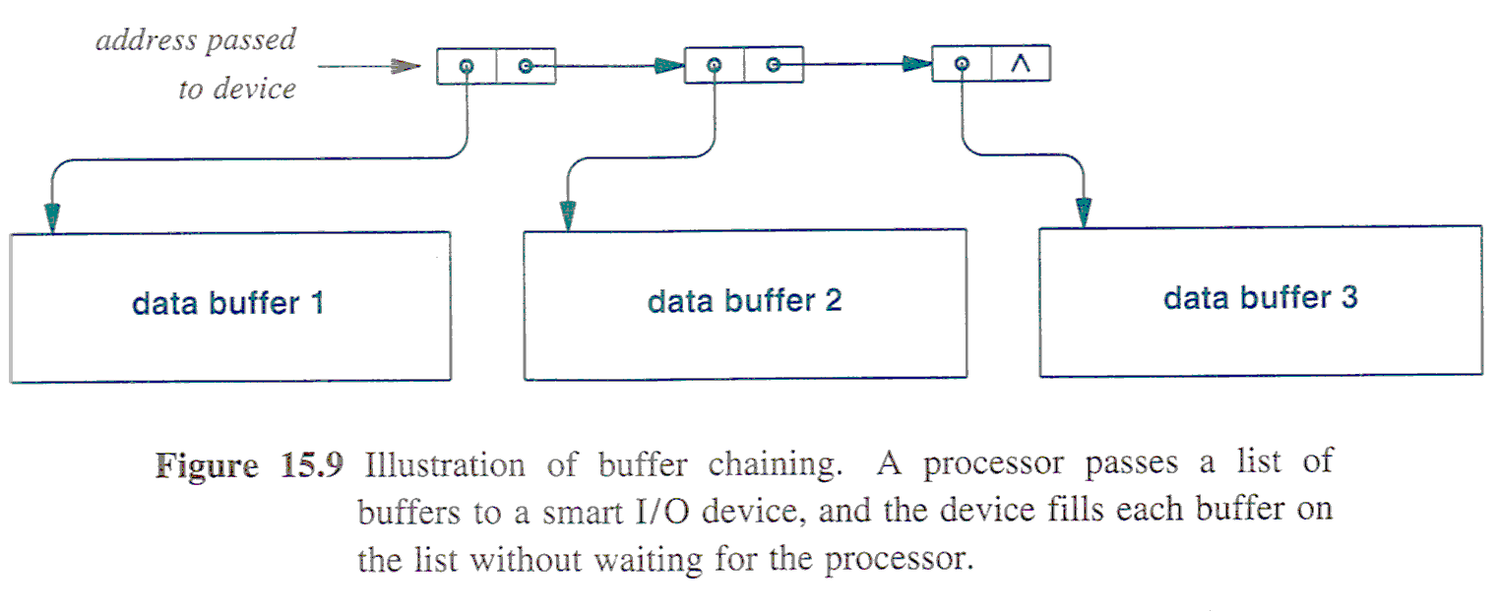
Problem of the Day : Buffer Chaining
CPU allocates >1 buffer in memory, as a linked list
CPU initializes DMA with list.
DMA fills each buffer without waiting for CPU
Comer
Notes:
Comer, Page 251
I assume that DMA still interrupts after each buffer is full, otherwise, the same problem happens when list if full!
Other uses for Buffer Chaining:
If the buffer size of the software < block size of DMA
On input (read), chained buffers allow DMA to divide a large data transfer into a set of smaller buffers: SCATTER READ
On output (write), chained buffers allow DMA to extract data from a set of small buffers and combine into one single block: GATHER WRITE
Operation Chaining ( instead of data chaining )
Buffer chaining handles situations where the same operation is repeated over many buffers (>1 read or >1 write, but not both)
If a DMA provides both read and write, in order to optimize performance, we need to start another operation as soon as the current operation completes. But how does the DMA know whether it is read or write. Do you have a solution ?
The buffers in the linked list specify a COMPLETE operation: as well as a buffer, it contain an operation (R or W) and any necessary parameters.
See Figure 15.10

Slide 24
Interrupts : The Full Story
Interrupt Classes:
Exceptions: generated by some condition in a program that occurs as a result of an instruction execution, such as arithmetic overflow, division by zero, attempt to execute an illegal instruction
Timer: generated by a timer within the CPU. This allows the OS to perform certain functions on a regular basis
I/O: generated by an I/O controller, to signal normal completion of an operation or to signal various error conditions
Hardware failure: generated by a hardware failure, such as power failure or memory parity error
Notes:
Interrupts are provided primarily as a way to improve CPU efficiency. Virtually, all computers provide a mechanism by which other modules (I/O, memory) may interrupt the normal processing of the CPU

Slide 25
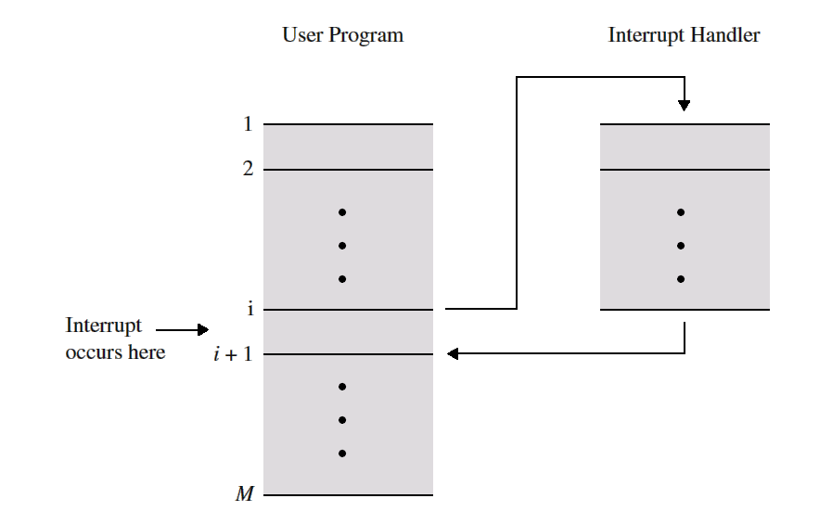
From User Program’s Point of View
Interrupt normal sequence of operation
When interrupt processing completed, execution resumes
Program does not have to contain any special code to accommodate interrupts; CPU and OS are responsible for this

Slide 26
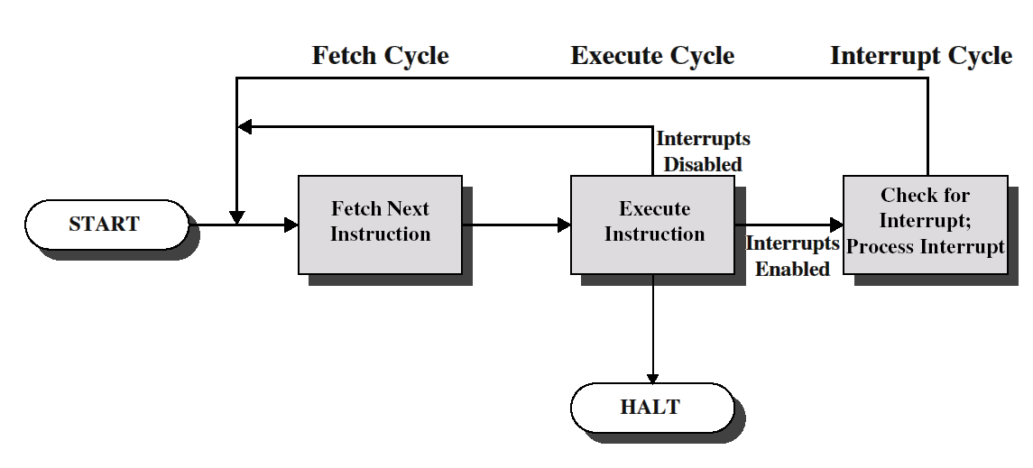
Interrupts and Instruction cycle
Notes:
Interrupt cycle: CPU checks to see if any interrupts have occurred, indicated by the presence of an interrupt signal. If no interrupts are pending, CPU proceeds to the fetch cycle, and fetches the next instruction
If an interrupt is pending: It “Processes the Interrupt”

Slide 27
Interrupt Processing
CPU suspends execution of the current program
Saves its context
Address of the next instruction to be executed (current contents of PC) and any other data
CPU sets the PC to the starting address of an ISR
CPU proceeds to the fetch cycle and fetches the first instruction in ISR which is generally a part of the OS
ISR typically determines the nature of the interrupt and performs whatever actions are needed.
It handles the interrupt
ISR = Interrupt Handler = Device Handler
For example, ISR determines which I/O module generated the interrupt and may branch to a program that will write more data out to that I/O module.
When ISR is completed, CPU can resume execution of the user program at the point of interruption

Slide 28
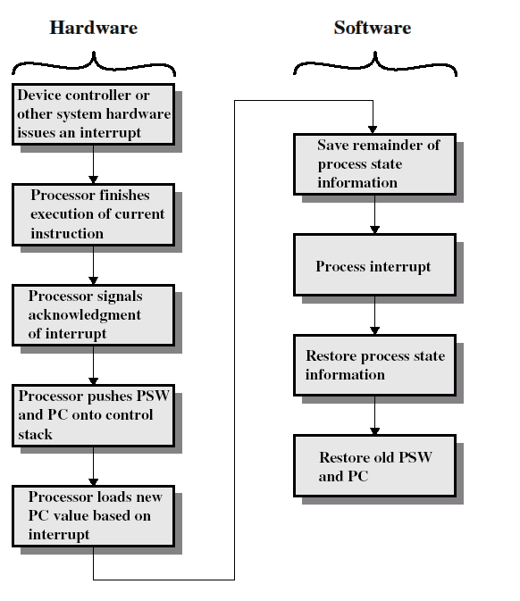
Simple Interrupt Processing

Slide 29
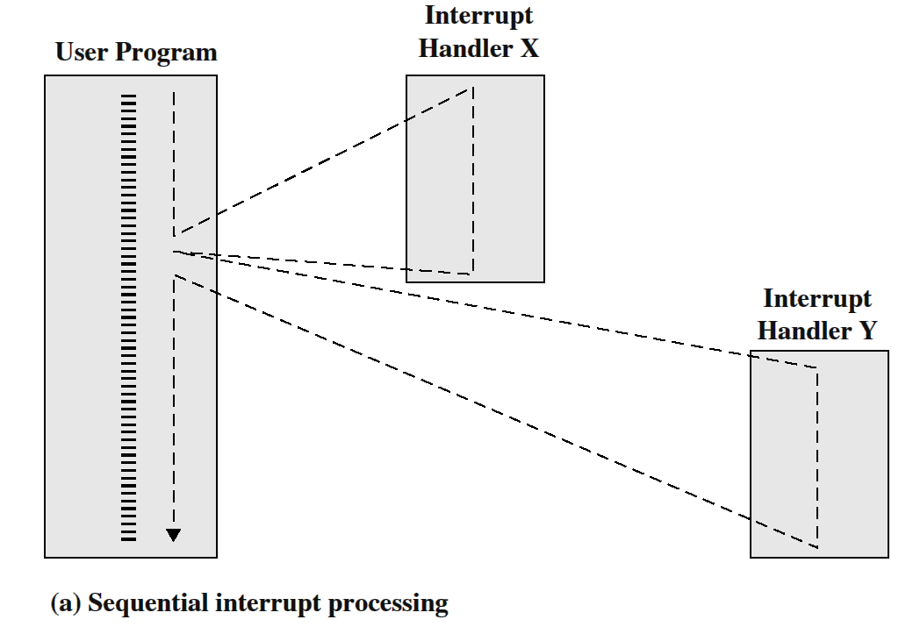
Multiple interrupts: sequential order
Disable interrupts during an interrupt
Interrupts remain pending until CPU enables interrupts
After the handler routine completes, CPU checks for additional interrupts pending

Slide 30
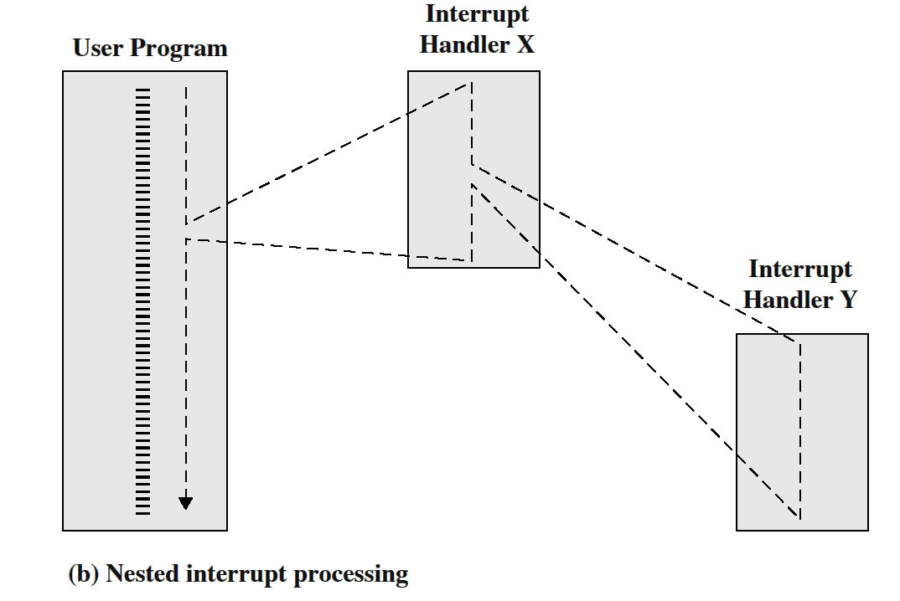
Multiple interrupts: priorities
Higher priority interrupts cause lower-priority ones to wait
Lower-priority interrupt handler is interrupted

Slide 31
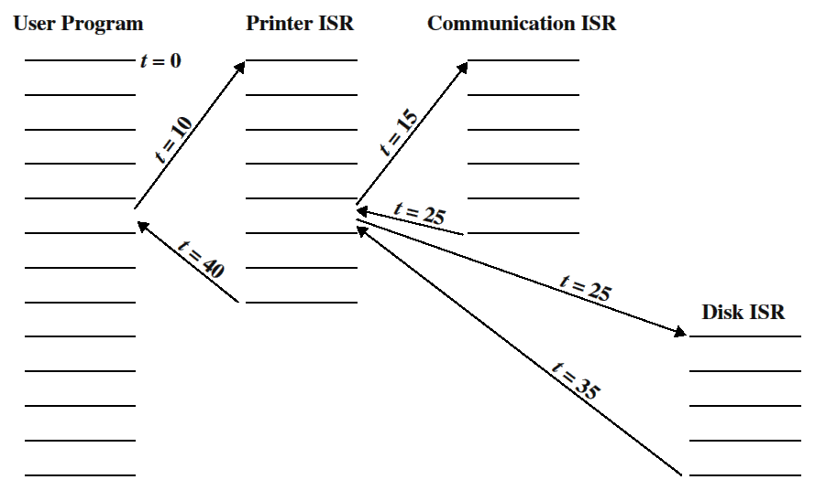
Example time sequence

Slide 32
Multiprogramming
When a program reads a value on an I/O device, it will need to wait for the I/O operation to complete
Interrupts are mostly effective when a single CPU is shared among several concurrently active processes
CPU can then switch to execute another program while a program waits for the result of the read operation (details later)

Slide 33
Consequences for Programmers
Synchronous Programming Paradigm (Polling)
Control passes through code sequentially from start to end
Programmer gives each step of the operation an I/O device performs
Asynchronous Programming Paradigm
Programmer writes code to handle events
Separate pieces of code (ISRs) to handle each event
Because events occur in any order, programmer cannot control sequence of events, meaning that programmer cannot control the sequence that the code is executed
In particular, with simultaneous events!
Notes:
Comer, Chapter 16! All of it!
Comer, page 263

Slide 34
Asynchrony and Mutual Exclusion
Page 264
Notes:
Comer, Chapter 16! All of it!
Comer, page 263

Slide 35
Device Drivers
Software that provides a high-level interface between an application program and an external hardware device.
Handles all low-level details of given device.
Provides device independence
Upper Half Invoked by Application Program
Shared Variables
Lower Half Invoked by Interrupts (ISR)
Comer, Figure 16.1
Notes:
Now, have any of you programmed hardware ? In general, I/O is hidden from the programmer. Instead of manipulation hardware devices such as disks and display screens, a programmer only uses abstractions such as files and windows.
Device Independence: Removes all hardware details from application programs and leaves them in the driver.
For example, because all applications that use a printer rely on the printer’s device driver, an application does not have detailed knowledge of the hardware built in. Consequently, changing a printer only requires changing the device driver, all applications remain unchanged. The device driver hides hardware details from applications; the driver encapsulates the hardware details.

Slide 36
The Runtime Library/Operating System Dichotomy
Device drivers are part of the operating system
Runtime I/O library is part of application
Intermediary that maintains device independence.
Application
printf(“Hello”)
RunTime Library
_printf()
{ Invoke appropriate device driver}
Application
System call
Device Driver
Operating System
Comer, Figure 16.6
Notes:
Runtime Libraries are part of the application, because they are LINKED with the application. They provide the interface to the Device Driver.
Device Drivers are part of the operating system – hardware!
Making a runtime library call is inexpensive, same as calling any library function – yours or pre-built – because it is code that is linked with your code.
Making a runtime I/O library call is expensive, because the runtime library function must make a SYSTEM CALL : a point of entry into the operating system.
Any system call is expensive because
The processor must change privilege mode because the operating system runs with greater privilege than an application
The processor must change the address space from the application’s virtual address space to the operating system’s address space.
The processor must copy data between the application’s address space and the operating system’s address space.
Conclusion: Writers of runtime libraries try to reduce the number of system calls, usually by transferring more data per system call.
Example: Print a document
Instead of printing byte-by-byte, print line by line
Redesign application to allocate enough memory to hold an entire page of the document, generate the page, and then make one system call to transfer the entire page to the device driver.
Now consider: Text editor or email composer, displaying character as user types. Should the application wait until the user enters an entire line or an entire screenful ??? No. It is NOT always possible to transfer more data per system call. Fortunately, such applications (text entry) is relatively SLOW, so optimization is not important.

Slide 37
Bus Architectures
Bus: Allows 2+ components to digitally transfer control signals or data
Uses:
Between components, within system
Between components, within chip
Types:
Standardized
Single-purpose
Notes:
Uses:
Within systems, implemented as parallel metal wires on a circuit board, or as a cable containing multiple wires between boards
Within chip, implemented as etches in silicon

Slide 38
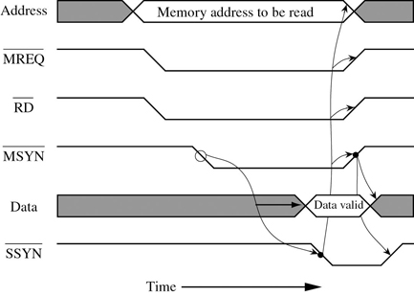
(A)Synchronous
Synchronous
Asynchronous
Murdocca, Figure 8-4
Murdocca, Figure 8-5
Notes:
Both are READS.
What’s the difference ?

Slide 39
Bus Arbitration
Although 2+ components can attach to a given bus, only one can transfer at a time
Wait for exclusive use of bus
Request, Grant
Perform transfer
Release bus
Release

Slide 40
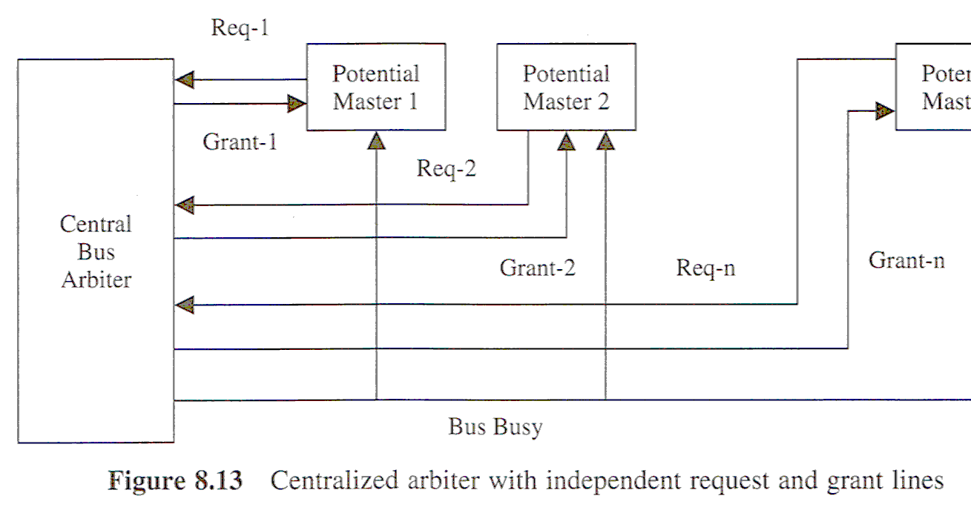
Bus Arbitration: Centralized (Master / Slave)
Abd-el-Barr
Notes:
Abd-el-Barr, Figure 8.13 and 8.14

Slide 41
Bus Arbitration: Decentralized
Abd-el-Barr

Slide 42
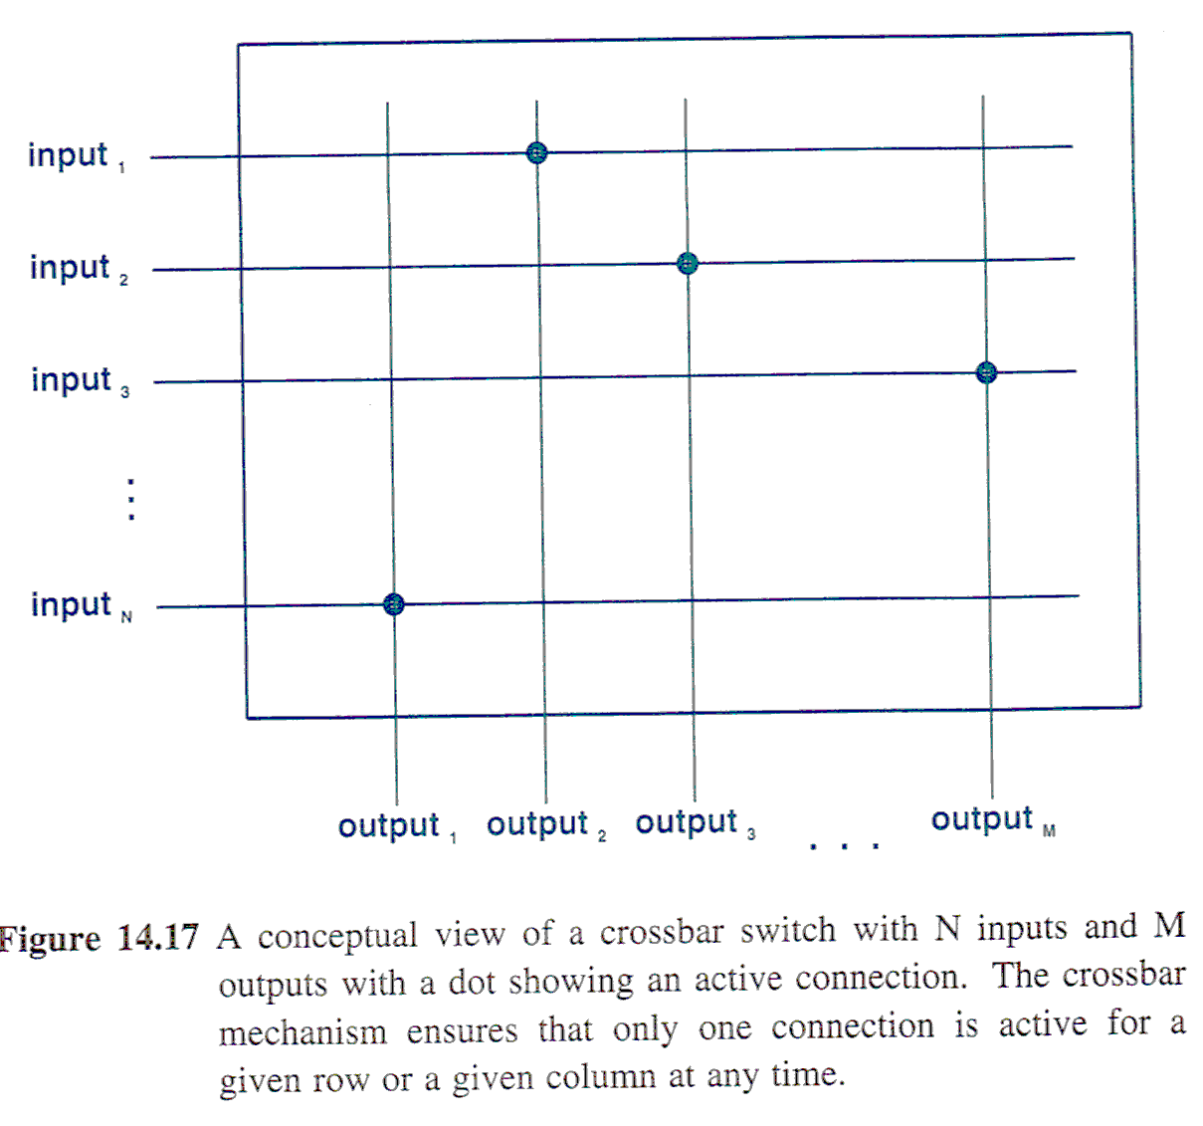
Thought of Day: Switching Fabrics
Comer
Notes:
Comer, page 234
Although a bus is fundamental to most computer systems, a bus has a disadvantage: can only perform one transfer at a time.
Even though >1 units can be attached, at most one pair of attached units can communicate
Three steps: 1) wait for exclusive use 2) perform transfer 3) release
Extensions: Each time they obtain bus, can transfer >1 byte of data (blocks)
But what we want is simultaneous transfers : switching fabrics.
Several forms: Slide shows just one.
Some designed for a few units, some for 100s or 1000s
Some restrict transfers so only a subset (some maximum) can initiate transfer at same time; other permit any number of simultaneous transfers.
Variation comes from different compromises of : higher performance (more concurrency) vs cost.
Shown is the crossbar: N inputs and M outputs allows N*M electronic units to EACH connect an input to an output.
At any one time, crossbar can turn on switches to connect PAIRS of inputs and outputs.
Can you see the cost?
Each line is a parallel data path composed of multiple wires
Each potential intersection requires an electronic switch : N*M switching components, each capable of switching a parallel connection.
In comparison, a bus only requires N+M (one to connect each input to each output)

Slide 43
Thought of Day: Bus Multiplexing
Comer,

Slide 44
Next Lecture
System Software

