Slide 1
Memory
Murdocca Chapter 7
Memory Design
Caching
Virtual Memory
Notes:
Null & Lobur, Chapter 8.4 Programming Tools
Comer, Chapter 9,10,11
Three major subtopics
Remember: Back in the ISA notes, we had a brief introduction: Address space, Alignment, Ordering (Endian)

Slide 2
Objectives
Memory types
Memory organization.
Virtual Memory.
Caching.
Performance!!

Slide 3
Memory Design
Design Aspects
Technology
Organization
Characteristics of Memory Technologies
Volatile or non volatile
Access: Random, sequential
Permanence: Read-write or read-only
Primary and Secondary
ROM and RAM dichotomy
Notes:
Comer, Chapter 9
Volatile if the contents of memory disappear when power is removed (eg. computer memory vs digital camera memory)
Access:
Random access mean any value can be accessed at any time.
Sequential (FIFO) has values that must be read from memory in same order they were inserted
Permanence: Is different than Volatility, characterized whether values can be extracted, updated or both.
Look at the ROM and RAM entries in Wikipedia (if necessary google)
Scroll down to Recent Developments and look at all the different kinds of memories.
Leave Primary and Secondary …. For introduction to memory hierarchy
What is EEPROM : First, it is non-volatile. But Electrically erasable PROM is an INTERMEDIATE form of permanence because it allows values to changed, but storing a value requires activation of special circuits and takes MUCH longer than reading a value. Thus it is used when nonvolatility is desired but values change infrequently.
FLASH is a variant of EEPROM used in digital cameras : It takes longer to store an image but the delay is not critical because it happens in less time than is required for a human to aim and focus the camera.
Question: What is ROM’s permanence used for ? Library subroutines for frequently used functions, Systems programs (BIOS), Function tables
Question: Is EEPROM permanent, volatile ? Flash ?
Aysegul’s notes: Programmable (once)
PROM: Read “mostly” ; Erasable Programmable (EPROM) Erased by UV
Electrically Erasable (EEPROM) Takes much longer to write than read
Flash memory Erase whole memory electrically

Slide 4
Main memory

Slide 5
Measures of Memory Technology
Density
Theory: Number memory cells per square area
Practice: Number bits represented on standard size chip
1 Meg chip ?
Latency
Simple: How fast can memory respond to requests
Actual: Access cost and update cost.
Controllers may need additional clock cycle(s) to reset hardware circuits before next operatio0n
Read cycle time, write cycle time : how quickly memory system can handle successive requests.
CPU
Controller
Physical Memory
Notes:
Comer, page 145 (Section 10.4)
1 Meg chip = a standard size chip that can hold 1 Meg bits
Higher density is usually desirable because it means more memory can be held in the same physical space.
However, higher density has disadvantages of increased power utilization and – with more electric current – more heat generation.
Density is related to size of transistors in underlying silicon technology: Moore’s law.
Some memory technologies take much longer to write values than to read them. Hence, access and update cost are too separate measures.
The difference can be dramatic, so any measure of memory performance must give two values.
But latency does not suffice as a measure of memory performance. Additional hardware known as memory controllers provide an interface between processor and the memory chips. It decodes addresses and sends control signals to the underlying memory. To minimize latency, the controller returns an answer as quickly as possible (ie. as soon as the memory responds). But, after it responds, a controller may need additionally clock cycles to reset hardware circuit and prepare for the next operation.
So to assess the memory performance, we need to measure how fast the system can perform a sequence of operations : cycle time.

Slide 6
Evaluation Parameters
Performance
Access time (latency): time to perform a read or write
Memory cycle time: consists of access time plus any additional time required before a second access can commence (eg. reset time) (ie. successive accesses)
Primarily applied to random-access memory (tRC,tWC)
Transfer rate: rate that data can be transferred in/out
http://www.kingston.com/tools/umg/umg03.asp
Cost
Actual Dollars
Physical Size (Density)
Power Use … Heat Dissipation
Dilemma ?
Faster access time, greater cost per bit
Greater capacity, smaller cost per bit
Greater capacity, slower access time
Notes:
Latency: OR is highlighted because read times are usually separated from write times, because for some technologies, they are vastly different.
The link is an interesting read by Kingston Technology, a memory chip distributor.
Latency is an insufficient measure and is supplemented by the memory cycle time which measures the time to perform SUCCESSIVE memory operations. Thus it includes (1) interface delay by the memory controller and (2) reset time that memory often needs between two operations to reset circuitry and perform setup.
Density: number of memory cells per square area of silicon, or in practical terms, number of bits that can be represented on a standard size chip. Higher density is good because more memory can be held in same physical space, but it also uses more power and with more electric current, generates more heat

Slide 7
Non-random-access memory
Average time to read/write N bits
Average access time
N Number of bits
R Transfer rate, bits per second
Notes:
Example for transfer time, but I don’t understand it.
TBD

Slide 8
Influences on Memory Design
Murdocca:
CPU speed doubled every 18 months for same price.
Memory quadrupled in size every 36 months for same price.
Memory speed increased at rate of < 10% per year.
Architectural solutions bridge growing gap between processor & memory speeds.
Integration
Locality of Reference
Temporal Locality
Spatial Locality
Sequential Locality
Instruction and Data
Von Neumann: Code ≈ Data
Separating instruction & data stores allows architects to select memory performance appropriate for each activity (Comer)
Harvard Architecture
CPU
CPU
ALU
+
cpt
=>
ALU
cpt
Blocks vs byte transfers
Notes:
Integration: We talked about this in an earlier lecture
Compare: CPU with FPU becomes CPU with on-chip FPU
Compare: GPU (General Purpose Unit) with Microcontroller : uCPU has on-chip A/D and on-chip Memory at the expense of simpler ALU (no floating point) and register set
Similarly, memory will be brought on chip as cache.
What is it about integration that makes it “better” : On chip means that proximity gives you faster access time, you’re on the same CPU bus, not the external SYSTEM bus, you’re connecting at the semi-conductor level, rather than with gold traces layered on a board with all the interference and crosstalk.
Locality
Temporal Locality: Recently accessed items tend to be accessed again in the near future
Spatial Locality: Accesses tend to be clustered in the address space (eg. arrays or loops)
Sequential Locality: Instructions tend to be accessed sequentially
Instruction and Data: It is ironic that the von Neumann model on which all conventional digital computers are built was innovative because it treated code the same as data: Stored Program Concept. Yet, experience has shown that the behaviour of each is different.
Instructions stores need higher performance than data stores:
High speed instructions are built to run on registers (no memory access)
An instruction is accessed on each iteration of the fetch-execute cycle → instruction stores experience more activity than data stores.
Harvard Architecture makes use of this by creating an instruction and a data cache.

Slide 9
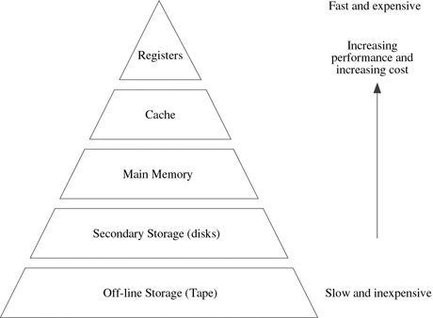
The Memory Hierarchy
Smaller, more expensive, faster memories are supplemented by larger, slower, cheaper memories.
Key: decreasing frequency of access
Type Access time $/MB Typical amt Typical $
Registers 0.5 ns High 2KB -
Cache 5-20 ns $80 2MB $160
Main memory 40-80ns $0.40 512MB $205
Disk memory 5 ms $0.005 40 GB $200

Slide 10
Memory Cell Technology
Circuit for 1 bit
Dynamic RAM: Even with power applied, capacitor dissipates charge.
External refresh circuitry must cyclically re-charge the cell to avoid data loss
Static RAM : As long as power is applied, flip-flop remains stable
write enable
write enable
input
D-Flip
Flop
Circuit
output
input
Transistor
Capacitor
Circuit
output
(Comer)
refresh
Notes:
Memory Technology: Physical makeup of the memory chip.
To begin, let’s look at one bit of RAM (random access, volatile).
Dynamic RAM is made with cells that store data as charge on capacitors. The presence or absence of charge in a capacitor is interpreted as 0 or 1. They require periodic charge refreshing to maintain data storage
Static RAM: binary values are stored using traditional flip-flops; will hold its data as long as power is supplied to it
TBD: See Page 251, prepare empty table and fill in during class
Question: Compare SRAM and DRAM
Both volatile: Power needed to preserve data
Dynamic cell : Simpler to build, smaller; More dense; Less expensive; Needs refresh; Larger memory units
Static cell : Faster, Cache

Slide 11
Synchronous DRAM (SDRAM)
Access is synchronized with an external clock
Address is presented to RAM
RAM finds data (CPU waits in conventional DRAM)
Since SDRAM moves data in time with system clock, CPU knows when data will be ready
CPU does not have to wait, it can do something else
Burst mode allows SDRAM to set up stream of data and fire it out in block
DDR-SDRAM sends data twice per clock cycle

Slide 12
RAMBus
Adopted by Intel for Pentium & Itanium
Main competitor to SDRAM
Vertical package – all pins on one side
Data exchange over 28 wires < cm long
Bus addresses up to 320 RDRAM chips at 1.6Gbps
Asynchronous block protocol
480ns access time
Then 1.6 Gbps

Slide 13
Memory Organization
Bus Width = Word Size
Architect: Performance improvement
A memory system of word size = K will have higher performance than another with word size < K.
Programmer: Memory transfer size
What word size should an architect use ?
Parallel Interface
Processor
Memory
Controller
Physical
Memory
…
(Figure 10.5 Comer)
Notes:
Organization is how individual cells are grouped together within a chip, and how chips are grouped together.
To understand the organization, we need an ACCESS PARADIGM. A memory controller provides the interface between the processor and the physical memory (made up of bits as shown before). To achieve high performance, memory systems use parallelism to simultaneously transfer one data bit at any time.
BUS = parallel connections.
We have two perspectives on the bus size: Architect and programmer
Memory transfer size = amount of data that can be read or written in a SINGLE operation
Question: What word size should an architect use ?
Because memory is used to store DATA, word size should accommodate common data types (integer, floating point )
Because memory is used to store INSTRUCTIONs, word size should accommodate FREQUENTLY USED instructions
Because parallel hardware takes space and adds to the economic costs, the work size should be a compromise between performance and various costs.
Bottom line: Design all parts of a computer system to work together.
If word size = 32, then standard integer and single-precision floating point will be 32.

Slide 14
Byte Addressing & Word Transfers
If architecture has word size = 32,
Memory is array of words
If programmer wants array of bytes, a mapping is required
Physical
Address
Physical
Address
32-bits
32-bits
0
Word 0
0
0 1 2 3
1
Word 1
1
4 5 6 7
2
Word 2
2
8 9 10 11
3
Word 3
3
12 13 14 15
4
Word 4
4
16 17 18 19
5
Word 5
5
20 21 22 23
Byte operations – in particular, writes – are expensive
(Figure 10.7 Comer)
Notes:
Comer, page 152
Question: What is the translation function ? B = byte address, W = corresponding word address, N = number of bytes per word.
Physical (word) address = B / N (ignore remainder)
Byte offset within a word O = remainder of B / N.
Question: Why is performance slow ? Because of the overhead of the computation.
Question: How can we improve it ? Division (or computing a remainder) is time consuming and requires extra logic in the ALU. To avoid computation, architects organize memory using powers of two. Above computations can be done by simply extracting bits (using shifts).
For N=2**2, the offset can be computer by extracting the two low-order bits, and the word address is everything but.
SUMMARY: Physical memory is organized into a set of M words that each contain N bytes; to make controller hardware efficient, M and N are each chosen to be powers of two.
Question: Who does the mapping ?
Memory controller (ie. a hardware solution)
Programmer (ie. a software solution) Wow, word size COULD have impact on your programs!
Question: Can you write this software to get the leftmost byte from a 32bit word ? ( w >> 24 ) & 0xFF

Slide 15
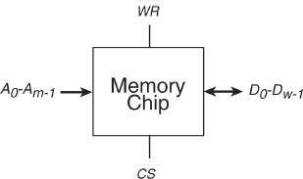
Memory Organization - Internal
Given a 16Mbit chip ( 16M x 1 bit cells), one possible implementation
cs
Word 0
A₀
A₁
…
A_{m-1}
Word 1
m-to-2^{m}
Decoder
Word 2
Word 3
…
m=10, w=16
Word 2^{m}-1
Pin Count (Fan in/out) ?
Footprint ?
D₀ .. D_{w-1}
Notes:
“Organization” is how individual cells are grouped together within a chip, and how chips are grouped together.
First we look at how multiple bits are combined inside a memory chip.
The first inclination is to implement as an array of words.
Ask: Does everyone know Decoders ? (See Appendix A of Murdocca)
For small m, this organization is fine. For large m, its implementation is ridiculous. The solution does not scale well.
Pin Count ? m + w + chip-select + R/W
Foot print … doesn’t scale well.
Original from Aysegul :
A bit per chip system has 16 lots of 1Mbit chip with bit 1 of each word in chip 1 and so on
Or is it internally organized as 2048 x 2048 x 4bit array
Reduces number of address pins
Is it 16M x 1 bit “words” ?
A bit per chip system has 16 lots of 1Mbit chip with bit 1 of each word in chip 1 and so on
Or is it internally organized as 2048 x 2048 x 4bit array
Reduces number of address pins
What is the difference ?
Why ?

Slide 16
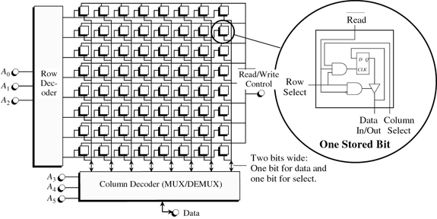
Memory Organization - Internal
A₀-A _{(m/2)-1}
Notes:
An alternate organization is 16M x 1 bit cell.
For Address Bus Width m = 10+4 = 14, and Data Bus Width w = 1 (That’s why there is only ONE Data line in the top figure)
See Comer, Page 254.
TBD
Pinout ? Time-multiplexed address lines.
Footprint ?
Access Time ?

Slide 17
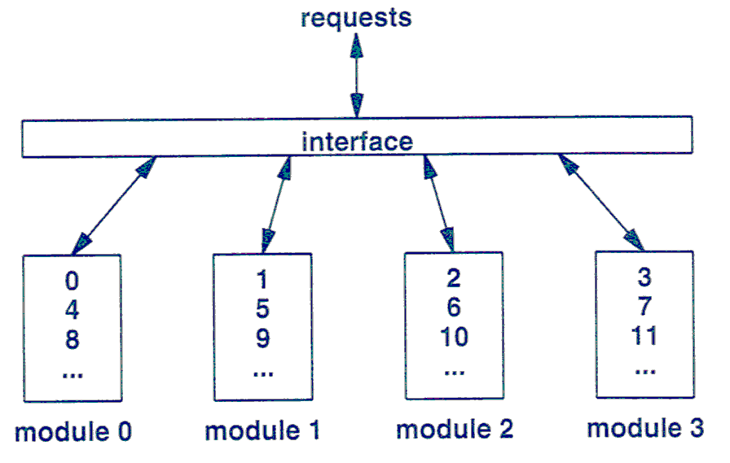
Memory Organization - External
Comer, Figure 10-11
Memory Banks and Interleaving
Notes:
Comer, page 158, Figure 10.11
When we talk about memory, we always assume 1 memory chip. That’s not true.
Parallelism is used for higher performance. The processor connects to multiple memory banks that each has its own controller. Higher performance comes from simultaneous operation : all banks can operate at the same time.
In some architectures, banks are transparent to the programmer : hardware automatically finds and exploits parallelism.
A CPU with horizontal microcode and parallel functional units can schedule access to multiple memory banks as independent operations.
In other architectures, the programmer is responsible for organizing the data into separate banks to achieve performance gains.
Interleaving: Spreads conseutive bytes of memory across separate physical memory modules.
Like banks, parallelism means more performance.
But interleaving is hidden from programmer: Programmers access contiguous bytes of memory (to fetch an integer) and the memory hardware automatically divides the request into the underlying memory modules.
N-way interleaving describes HOW the bytes are assigned to memory modules. This figure shows four-way interleaving.

Slide 18
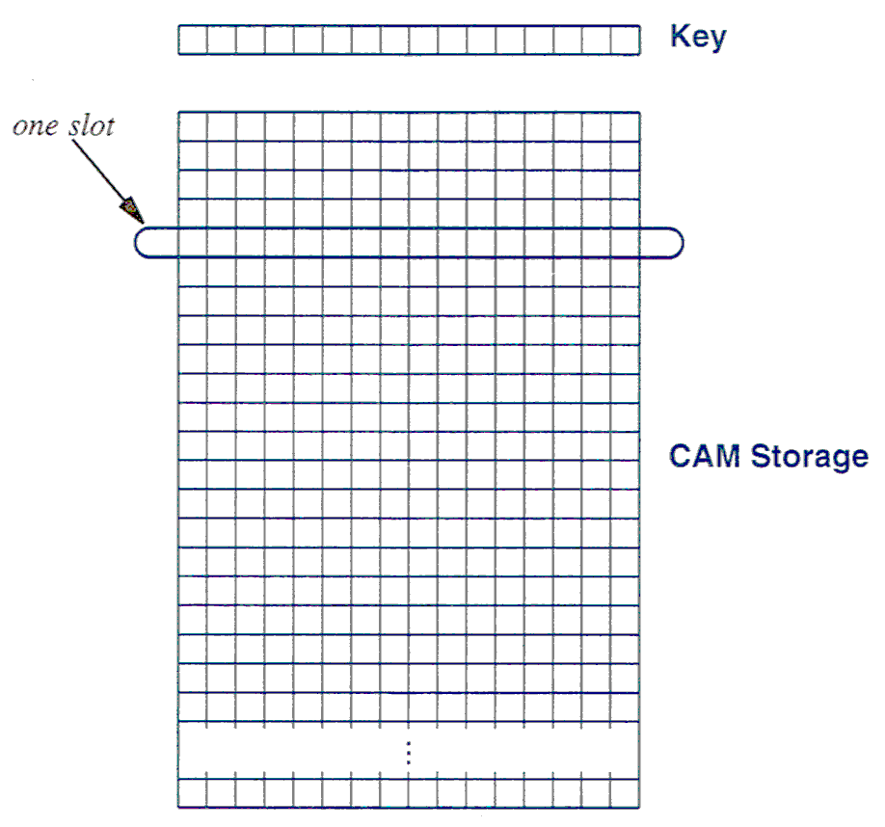
Content Addressable Memory
Figure 10-12
Comer
Notes:
Comer page 159
CAM does much more than merely store data items-it includes hardware for high-speed searching.
In order to understand (and not necessarily how it’s built) is to think of it as a 2-d array. Each row (used to store an item) is called a slot.
In each slot is the value being stored … as well as a key.
A search key is the same size as a slot in the CAM.
For the most basic form of a CAM, the search mechanism performs an exact match.
Different from a conventional processor, the CAM reports the results instantly. Because each slot in a CAM contains hardware that performs the comparison; All slots operate in parallel, so the search time does not depend on the number of slot.
Parallel hardware is always expensive. So, CAM is used only when lookup speeds is more important than cost.
A high speed Internet route : Each packet must be checked to determine whether other packets have arrived previously from the same source.

Slide 19
Virtual Memory
Definition (Comer): A mechanism that hides the details of the underlying memory to provide a more convenient memory environment
Creates an address space and a memory access scheme that overcome limitations of physical memory.
Example: Byte addressing
Memory Management Unit (MMU) : Intelligent controller that maps processor’s virtual address space into real/physical address spaces
Motivations
Homogeneous Integration of Software
Programming Convenience
Multiprogramming Support
Protection of Programs & Data
Processor
MMU
Physical
Controller
Physical
Controller
Physical
Memory
Physical
Memory
Notes:
Using Comer’s synopsis, Chapter 11
TBD: Motivations, on page 169

Slide 20
VM Implementation: Segments
Program is divided into variable-sized segments
Logical division of program
User (programmer) is aware of divisions
Only segments needed at time are loaded into memory; Others kept on secondary storage
When needed, operating system loads segment into unused area of memory
If none found, replaces a segment (TBD)
Pro: Extends logical memory size
Pro: Multiprocessing: Protection, Sharing
Con: Fragmentation
Truth: Segmentation is seldom used
Notes:
Pro: Allows programs to be altered and recompiled independently, without re-linking and re-loading ??
Removed this one because I’m not sure about it.
Logical division
eg. code, data, stack
eg. read-only to prevent changes, execute-only (to prevent copying)
Pro: Extends logical memory size by supporting multiple address spaces
Pro: Protection ???
Con: See next slide (taken from O/S notes)
Replacement Strategies ?

Slide 21
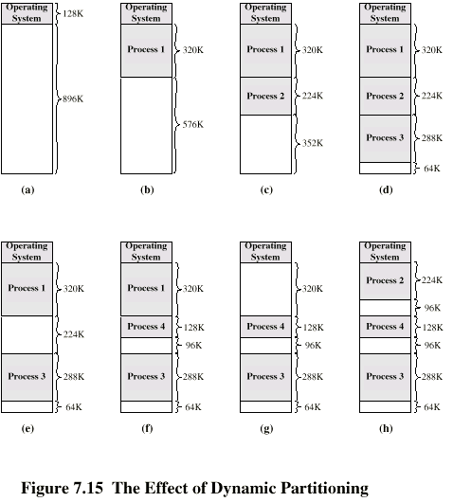
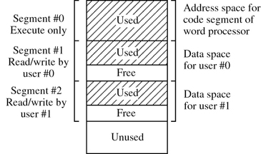
Segments
Sharing & Protection
Notes:
Pro: Null, page 314
Programs are no longer restricted by the amount of physical memory that is available. Virtual memory permits us to run individual programs whose virtual address space is larger than physical memory. In effect, this allows one process to share physical memory with itself. This makes it much easier to write programs because the programmer no longer has to worry about the physical address space limitations. Because each program requires less physical memory, virtual memory also permits us to run more programs at the same time. This allows us to share the machine among processes whose total address space sizes exceed the physical memory size, resulting in an increase in CPU utilization and system throughput.
Two examples of different kinds of sharing.

Slide 22
Question: How is the address translation done ? Same as paging ???
TBD

Slide 23
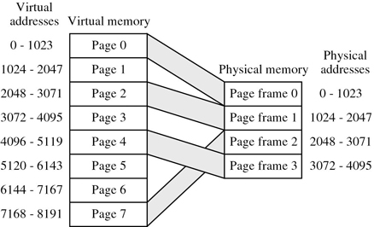
VM Implementation: Demand Paging
Program divided into fixed-sized pages; memory divided into same-sized page frames
Simple physical division of program
User (programmer) is unaware of divisions
Program’s pages kept in secondary storage until needed : Page Fault
Operating system loads page into free page frame
If none found, replaces a page
A process does not require contiguous page frames
Figure 7-31 Murdocca
Pro: Simple allocation & placement
Pro: Protection
Con: Internal Fragmentation
Notes:
BD: Fill in more from Murdocca.
Initially, page frames were 512 bytes or 1 K. Today’s processors use 4Kbytes
Do not require all pages of a process in memory; Bring in pages as required
Page fault : Hardware! Paging is a combined hardware/software solution:
Address translation and Generation of Page Faults is done in hardware
Loading of new pages is done in software (by operating system)
Replacement strategy? Research area, but typically based on recent history
Pro: Paging is easy to implement!
Pro: O/S can specify protection (this page belongs to User x and you can’t access it) and sharing (this page belong to User x but you can read it) on a per page basis.
TBD: Why is this useful … if programmer is unaware of the division ?
Internal Fragmentation: Because frames are fixed size, you don’t get the holes that are part of segments. But you do get the case where a page’s contents is small, but since pages are fixed-sized, the whole page frame is occupied. While occupied, other programs’ pages cannot be loaded.
Con…. More on the next page with the page frame table.
Null, page 313: Paging adds an extra memory reference when accessing data … because must address the page table!

Slide 24
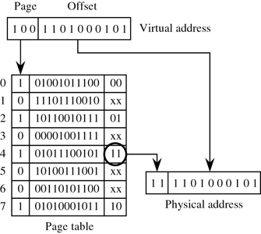
Page Table
Resident: Page is in memory
Resident Set: Set of all pages from an address space currently in memory.
Where is page table stored ?
Notes:
Operating System maintains list of free frames
A process does not require contiguous page frames
Use page table to keep track

Slide 27
Demand Paging: Summary
Good
Do not need all of a process in memory for it to run; Can swap in pages as required
So, can now run processes that are bigger than total memory available!
User/programmer sees much bigger memory - virtual memory
Bad
Too many processes in too little memory
Operating System spends all its time swapping
Little or no real work is done; Disk light is on all the time
Solutions
Good page replacement algorithms
Reduce number of processes running
Fit more memory

Slide 28
Combined Segment & Paging
Notes:
Each virtual address is 16-bit segment and 32-bit offset
2 bits of segment are protection mechanism
14 bits specify segment
Unsegmented virtual memory 2³² = 4Gbytes
Segmented 2⁴⁶=64 terabytes
Can be larger – depends on which process is active
Half (8K segments of 4Gbytes) is global
Half is local and distinct for each process

Slide 29
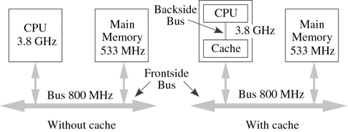
Cache Memory
CPU: Registers
Cache: SRAM
Main: DRAM
Cache is a copy of a portion of Main Memory
Cache Characteristics
Small
Active
Transparent
Automatic
Cache Performance:
Hit, Miss
Hit/Miss Ratio: Single/Multilevel
Murdocca, Figure 7-18
Notes:
Virtual Memory is about expanding memory, multiprocessing…
Caching is about addressing the Von Neumann’s bus bottleneck!
Cache is an intermediary : placed on the path between the CPU that makes the request and the memory that answers the request.
The cache is high speed temporary storage; it contains a copy of portions of main memory. If a word is not in the cache, a block of main memory, consisting of some fixed number of words, is read into the cache and then the word is delivered to the CPU.
When a block of data is fetched into the cache to satisfy a single memory reference, it is likely that future references will be to other words in the block (locality of reference).
Small Size is much smaller than needed for ENTIRE data set because of cost. Most are less than 10% of main memory, sometimes 1%
Active Must examine each request and decide how to respond
Transparent Cache is inserted without changes to requester(CPU) or to data store.
Automatic: Cache implementation has its own algorithm. It is an independent device.
Hit : request that can be satisfied without accessing underlying data store.
Hit Ratio: #hits / total number of requests.
Aside: Caching – in general terms – is an optimization technique used in both hardware and software (Web browsers caching pages; File readers reading whole file and then processing).

Slide 30
Multi-Level Caches
Adding more caches in a multi-level hierarchy can further improve performance
L1: Onboard the processor chip
L2: External to processor(off-chip)
L3: Built into physical memory
In best case: cost of accessing memory ≈ cost of accessing a register.
CPU
Cache
Cache
Main Memory
Notes:
Comer, page 192 and 196
Multi-level : More than one cache is used along the path from requestor to data store,

Slide 31
Cache/main-memory structure
Or Slot
Or Line
Address
Contents of Address
Notes:
OR Slot/Line : There are two terminologies in use! Confusing, huh!
One thing to note is that the cache actually stores both the block (the content) and the address of the block.
Why?
So when a request for the same address comes, cache can determine it is already there.
So if you have to replace this block, you know where to put back the block in main memory (because caching is also about writing!! … Later)
This is going to be a factor, because obviously storing a 32-bit or a 64-bit address reduces the effective capacity of your cache … it’s a waste of space!

Slide 32
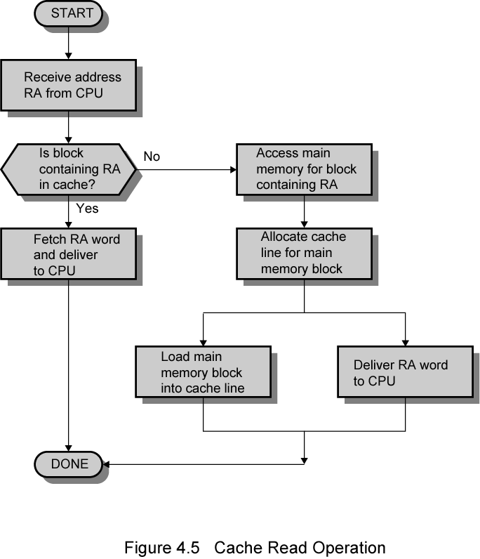
Cache Read
Start
Receive address RA from CPU
No
Is block containing RA in cache?
Access main memory for block containing RA
Cancel
Yes
Fetch RA word & deliver to CPU
Allocate cache line for main memory block
Load main memory block into cache line
Deliver RA word to CPU
Done
Performance Achieved By Parallelism
Notes:
Flowchart ? Do you know them ?
Caching is implemented in hardware
Note: Line versus Block terminology
Note: Block becomes word to CPU
Note: Parallelism on final action.
Go back to the flowchart : Implies very sequential behaviour. Too simplistic when we actually implement it because true performance gains come when we use parallelism. Click ENTER.
Comer, page 194: The cache simultaneously passes the request to the physical memory and searches for an answer locally. If it finds an answer locally, the cache must cancel the memory operation; else it must wait for the underlying memory operation to compelte. Furthermore, when the answer arrives, the cache uses parallelism (as it does on the left) to simultaneously save a local copy and transfer to the CPU.
- Parallelism makes the hardware complex! Caching does have a cost!
Note: What is RA ? Real Address? Relative Address ?? That’s a good question. Let’s answer it.

Slide 33
Virtual Memory + Caching
If we use both, is the cache between
processor and MMU ?
MMU and physical memory ?
Using virtual addresses
Fast: Cache can respond while MMU translates
L1 caches must use virtual addresses.
Address Ambiguity with Multiprogramming
Cache Flush
Disambiguating Identifier: Artificially long addresses
Using physical addresses
No Program ambiguity
Notes:
Comer, Page 198 : (From MMU) Cache comes “after” virtual memory mapping. It is also done at a different level. VM is a combination of hardware (for mapping and page faults) and software (operating system loading). Caching is all hardware, no software involved. (at least no “system software, maybe microcode!)
Another way of phrasing the question: Should a cache use virtual or physical addresses to identify an item?
On one hand,
using virtual addresses increases memory access speed because the cache can respond before the MMU translates the virtual address into a physical address
if the MMU is off-chip, an L1 cache MUST use virtual addresses.
On the other hand:
a cache that uses virtual addresses needs extra hardware that allows the cache to interact wit hthe VMS.
VMS usually supplies the same address range to each application program (0..n)
When O/S changes from one program to another, it must also change items in the cache because the new program uses the same addresses to refer to a new sett of values.
How can a cache resolve the ambiguity of two programs using same range of addresses
1) Cache FLUSH : Remove all values from cache (on each program switch)
2) Disambiguating identifier: Use extra bits to identify the address space. Processor contains an extra hardware register that contains an address space ID. Each running program gets a unique number. Whenever it is started, the O/S loads the application’s number into the address space ID register. The cache prepends the contents of the ID register onto the virtual address when it stores an item in the cache.
Processor create artificially longer addresses before passing an address to the cache.
For cache: No ambiguity anymore.

Slide 34
Cache Design
Cache size
Cost: Cache is expensive (faster is $$)
Rule of Thumb: Overall average cost per bit should be close to that of main memory alone and large enough so that overall average access time is close to that of cache alone.
Speed : More cache is faster (up to a point)
Block Size
Number of Caches
Mapping Function
Replacement Algorithm
Write Policy
Next slides
Notes:
First three: Talk about and then show next slide.
Last three: Will be covered in sequence in a set of slides.

Slide 35
Comparison of Cache Sizes
Notes:
Notice: Sometimes cache is getting smaller!
Notice: Pentium PC has two L1 caches: Instruction and Data (Harvard Architecture)

Slide 36
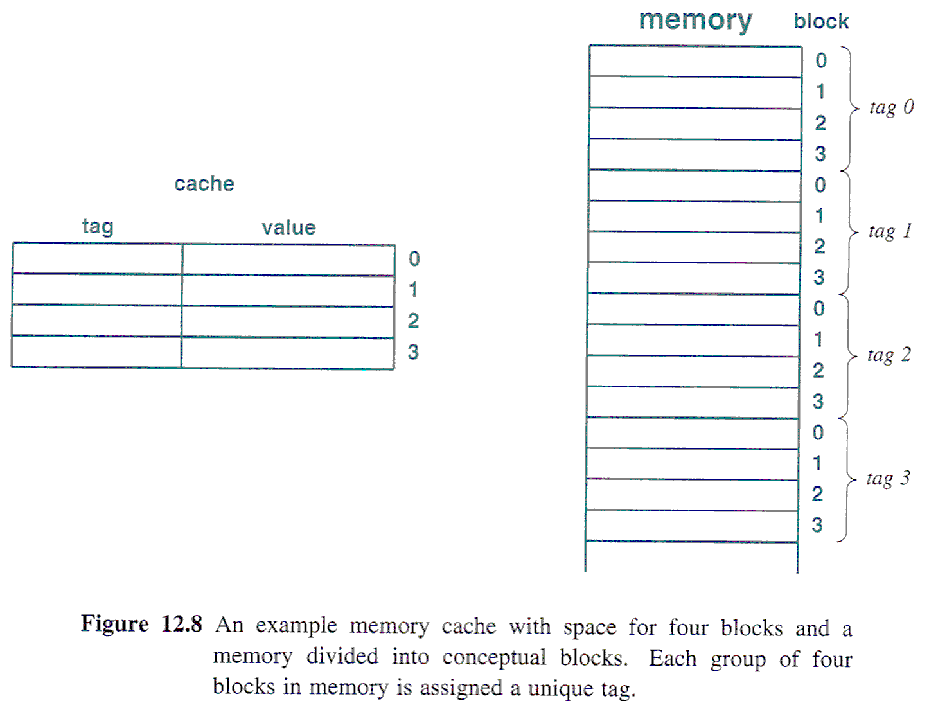
Mapping: Direct
Direct: Only memory block n can be placed in cache slot n
Tag s-r
Line or Slot r
Word w
Address
8 14 2
Notes:
Recall: Cache contains both data and the address of the data … but we want to minimize the address somehow
TBD: Rewrite to match new slide!
Let’s look at the memory address: Tag + Line + Word.
Word : A block of data is transferred between main and cache, but the CPU wants word access. This identifies the exact word inside a block. Will be part of any mapping function.
Tag and Line : Are variables in the direct mapping function.
Tag: Let’s look at a 4-digit word. If we mask out the 2 LSBits, what happens. What math operation is this equivalent to? Modulo! Tag is doing module math.
Question: Use the example to figure out what the parameters for the memory are:
Cache of 64KBytes
Cache block of 4 bytes i.e. cache is 16K (2¹⁴) lines of 4 bytes
16MBytes main memory
24 bit address (each byte directly accessible) (2²⁴=16M)
4M blocks of 4 bytes each
Summary:
Address length = (s + w) bits Number of addressable units = 2^{s+w} words or bytes
Block size = line size = 2^{w} words or bytes Number of blocks in main memory = 2^{s+ w}/2^{w} = 2^{s}
Number of lines in cache = m = 2^{r} Size of tag = (s – r) bits

Slide 37
Example

Slide 38
Mapping: Fully Associative
Associative: Any block can load into any line.
Notes:
A main memory block can load into any line of cache
Memory address is interpreted as tag and word where tag uniquely identifies block of memory
To determine whether a block is in the cache, every line’s tag is examined for a match
Discuss: What is the cost ?
TBD
Discuss: Let’s use the same system parameters as before (ie. 24 or 32 bit address). Find out which one?
Now we only have tag and word (not tag+line+word). What is the effect on block size ? On the number of blocks ? On the size of the compare ? On the amount of data that must now be stored in the cache (remember: Tag is stored and now tag is 22 bit tag stored with each 32 bit block of data!!!, if we use the same block size of 2 bits)
Same summary as in direct (Thought: Build a slide with a table, and fill in during class)
Address length = (s + w) bits
Number of addressable units = 2^{s+w} words or bytes
Block size = line size = 2^{w} words or bytes
Number of blocks in memory = 2^{s+ w}/2^{w} = 2^{s}
Number of lines in cache = undetermined
Size of tag = s bits

Slide 39
Associative mapping example

Slide 40
Mapping: Set Associative
Cache is divided into a number of v sets
Each set contains a number of k lines
A given block maps to any line in a given set
e.g. Block B can be in any line of set i
e.g. 2 lines per set
2 way associative mapping
A given block can be in one of 2 lines in only one set

Slide 41
Set Associative Mapping Example
13 bit set number: identifies a unique set of two lines within the cache.
Block number in main memory is modulo 2¹³
000000, 00A000, 00B000, 00C000 … map into the same cache set 0
For a read, the 13-bit set number is used to determine which set of two lines is to be examined, Both lines in the set are examined for a match with the tag number of the address to be accessed.

Slide 42
Two Way Set Associative Cache Organization

Slide 43
Set Associative Mapping Address Structure
Tag 9 bit
Word
2 bit
Set 13 bit
Use set field to determine cache set to look in
Compare tag field to see if we have a hit

Slide 44
Set Associative Mapping Summary
Address length = (s + w) bits
Number of addressable units = 2^{s+w} words or bytes
Block size = line size = 2^{w} words or bytes
Number of blocks in main memory = 2^s
Number of lines in set = k
Number of sets = v = 2^{d}
Number of lines in cache = kv = k * 2^{d}
Size of tag = (s – d) bits

Slide 45
Summary
Feature | Direct | Fully Assoc | Set Assoc
Address Length
#Addressable Units
Block Size
#Blocks
#Lines
Size of Tag
Notes:
Fill in during class, using information from each of the mappings.

Slide 46
Exercise: TLB
Translation Look-Aside Buffer
To speed up page table lookup
Stores most recent page lookup values in a page table CACHE
Each entry = virtual page number and corresponding frame number
Notes:
Null, page 310
Combining caching with VM!

Slide 47
Replacement Algorithms (1) Direct mapping
When a new block is brought into the cache, one of the existing blocks must be replaced
There is only one possible line for any particular block. No choice is possible
Each block only maps to one line
Replace that line

Slide 48
Replacement Algorithms (2) Associative & Set Associative
Hardware implemented algorithm (speed)
Least Recently used (LRU)
e.g. in two-way set associative
Which of the 2 block is LRU?
Replace that block in the set that has been in the cache longest with no reference to it.
2-way set associative: each line includes a USE bit, when a line is referenced, its USE bit is set to 1 and the USE bit of the other line is set to 0. When a new block is to be read into the set, the line whose USE bit 0 is used.
First in first out (FIFO)
Least frequently used
Random

Slide 49
Write Policy
Before a block that is resident in the cache can be replaced, it is necessary to consider whether it has been altered in the cache but not in main memory. If it has not, then the old block in the cache may be overwritten.
Must not overwrite a cache block unless main memory is up to date
Problems?

Slide 50
Write Policies
Write-Through
Simplest policy
All writes go to main memory as well as to the cache
Multiple CPUs can monitor main memory traffic to keep local (to CPU) cache up to date
Lots of memory traffic
Slows down writes
Updates initially made in cache only
Write Back
Update bit for cache slot is set when update occurs
If block is to be replaced, write to main memory only if update bit is set
Other caches get out of sync
I/O must access main memory through cache
N.B. 15% of memory references are writes

Slide 51
Problem : Cache coherence
In a bus organization in which more than one device (typically a CPU) has a cache and main memory shared
If data in one cache are altered, this invalidates not only the corresponding word in the main memory but also that same word in the other caches
Other caches might have invalid data.
Bus watching with write through: each cache controller monitors the address lines to detect write operations to memory
hardware transparency: additional hw is used to ensure that all updates to main memory via cache are reflected in all caches
Notes:
See Comer, Page 195

Slide 52
Problem
Solution
Processor on which feature first appears
External memory slower than the system bus.
Add external cache using faster memory technology.
386
Increased processor speed results in external bus becoming a bottleneck for cache access.
Move external cache on-chip, operating at the same speed as the processor.
486
Internal cache is rather small, due to limited space on chip
Add external L2 cache using faster technology than main memory
486
Contention occurs when both the Instruction Prefetcher and the Execution Unit simultaneously require access to the cache. In that case, the Prefetcher is stalled while the Execution Unit’s data access takes place.
Create separate data and instruction caches.
Pentium
Increased processor speed results in external bus becoming a bottleneck for L2 cache access.
Create separate back-side bus that runs at higher speed than the main (front-side) external bus. The BSB is dedicated to the L2 cache.
Pentium Pro
Move L2 cache on to the processor chip.
Pentium II
Some applications deal with massive databases and must have rapid access to large amounts of data. The on-chip caches are too small.
Add external L3 cache.
Pentium III
Move L3 cache on-chip.
Pentium 4

Slide 53
Case Study: Pentium II
Murdocca: The Intel Pentium processor is typical of modern processors in its memory configurations, with some unique features. Figure 7-44 shows a simplified diagram of the memory elements and data paths. There are two L1 caches—a 16 KB four-way set associative data, or D-cache, and an instruction, or I-cache, which holds up to 12K decoded instructions. This is also known as the trace cache and removes decoder latency from main execution loops. The L2 cache, which is known as the Advance Transfer Cache, is eight-way set associative, unified for data and instructions, and can be as large as 2 MB. The optional L3 cache, if present, is 2 MB in size. All caches (L1 data, trace, L2, and L3) reside on the same die as the processor.
The L1 line size is 64 bytes and the L2 line size is 128 bytes. The L2 cache is inclusive of the L1 cache, which means that the L1 cache is mirrored at all times. It thus takes two cycles (64 bytes/line × eight bits/byte / 256 bits/cycle = two cycles/line) to transfer a line into the L1 cache.
One of the amazing technological advances is that all of the caches are now resident on the same die, which was not practical just a few years ago. The Pentium Pro, released in the mid-1990s got as close as it could, with an on-die L1 cache (8 KB D-cache, 8 KB I-cache), and a 512 KB L2 cache on a separate die but mounted in the same package, with no L3 cache. (See the companion Web site for details on the Pentium II memory system.)
There is a separate TLB for the instruction and data caches, 128 entries in size and four-way set associative for the instruction TLB, and 64 entries in size and fully associative for the data TLB.
Notes:
Can you read this ?

Slide 54
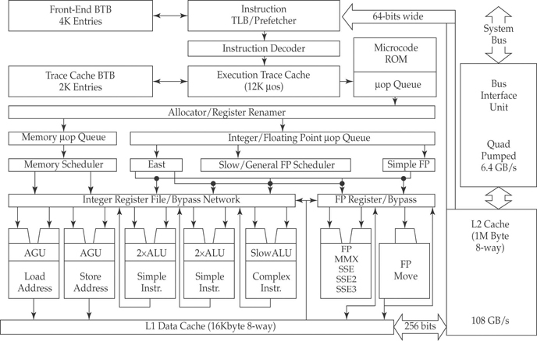

Slide 55
Pentium 4 Diagram (Simplified view)
Notes:
History
80386 – no on chip cache
80486 – 8k using 16 byte lines and four way set associative organization
Pentium (all versions) – two on chip L1 caches
Data & instructions
Pentium III – L3 cache added off chip
Pentium 4
L1 caches 8k bytes; 64 byte lines; four way set associative
L2 cache Feeding both L1 caches: 256k, 128 byte lines; 8 way set associative
L3 cache on chip
Fetch/Decode Unit
Fetches instructions from L2 cache; Decode into micro-ops; Store micro-ops in L1 cache
Out of order execution logic
Schedules micro-ops; Based on data dependence and resources; May speculatively execute
Execution units
Execute micro-ops; Data from L1 cache; Results in registers
Memory subsystem: L2 cache and systems bus

Slide 56
PowerPC G5
Notes:
601 – single 32kb 8 way set associative
603 – 16kb (2 x 8kb) two way set associative
604 – 32kb
620 – 64kb
G3 & G4
64kb L1 cache
8 way set associative
256k, 512k or 1M L2 cache
two way set associative
G5
32kB instruction cache
64kB data cache

Slide 57
Thought of the Day
Debate: Demand Paging is a form of caching.
Debate: Demand paging on a computer system with a small physical memory can perform almost as well as if the computer had a physical memory large enough for the entire virtual address space
Notes:
Comer, page 193:
Demand Paging can be viewed as a form of caching. In this case, main memory is the cache, and secondary memory is the data store. The VM page replacement policy becomes the cache line replacement policy.
A virtual address space can be much larger than physical memory (just like a cache is bigger than main memory)
Rule of Thumb: Cache size is selected so that average access rate approaches that of cache alone. …. Leads us to think that the performance of a demand paged virtual memory can approach the performance of physical memory.
Cache analysis shows that using demand paging on a computer system with a small physical memory can perform almost as well as if the computer had a physical memory large enough for the entire virtual address space!

Slide 58
Consequences for Programmers
Program Locality
Code contains loops
A Data item are usually referenced several times before the next
Suppose you must perform many operations on each elements of a large array …
How can you program “to the cache”
Notes:
Comer, page 203
Experience has shown that caching works wells for most computer programs.
Code tends to contain loops, which means the processor will repeatedly execute a small set of instructions before moving on to another set.
Programs tends to reference data items multiple times before moving onto a new data item.
Compilers that are aware of caching will optimize generated code to better use the cache.
Perform one operation at a time (iterate through the array many times)
Perform all operations on a single element of the array before moving to next (iterate through once)
The latter is preferable from the caching viewpoint because the element will remain in the cache.
A single iteration also works best for demand paging … EXPLAIN.

Slide 59
Case Study: Memory is for Data Only ?
Refer back to lecture on microcode.
FPGAs
Used to store ALU logic.
Thus you can reprogram your ALU by re-burning your memory!

Slide 60
Coding for Low Power
Project Subject …
http://citeseerx.ist.psu.edu/viewdoc/summary?doi=10.1.1.37.5745
http://csdl2.computer.org/persagen/DLAbsToc.jsp?resourcePath=/dl/mags/mi/&toc=comp/mags/mi/2004/03/m3toc.xml&DOI=10.1109/MM.2004.18
http://portal.acm.org/citation.cfm?id=1018022.1018180&coll=GUIDE&dl=

Slide 61
Next Lecture
Buses
Peripherals
Murdocca, Chapter 8

