Slide 1
Languages and the Machine
Murdocca Chapter 6
Notes:
Null & Lobur, Chapter 8.4 Programming Tools
Comer, Chapter 8 Assembly Languages & Programming Paradigm
Principles of Computer Organization & Assembly Language Using the JVM: Patrick Juola, Chapter 1
Abd-El-Barr, Chapter 3
Now for a software detour. We’ve been covering hardware, and we will be finishing this course with hardware, but this is an appropriate time to consider software – 1) the impact of hardware on software, 2) the impact of software on hardware. Again, the synergy between hardware and software.

Slide 2
Objectives
Understand how a program is transformed to machine language
Architectural influences on programming languages.
Assembly language programming (avoid!)
Linking.
Compilation.
Interpretation.

Slide 3
Programming Tools
Utilities to carry out the mechanical aspects of software creation (Null)
Library
.lib
.dll
Compiler
Assembler
Linker
Loader
.c
.cc
.java
.f
.asm
.obj
.exe
High Level
Language
Low Level
Language
(Derived from Figure 3.3 Abd-El-Barr)
Notes:
Utilities = = Another program that takes in one form of the program and translates or transforms it into another form.
What are the distinguishing characteristics of each form of program (write on board and don’t necessarily cover in this order, but make sure all these points are covered.)
Exe is a single complete program
There are no unresolved external references
Usually relocatable in application-level although not so in embedded systems where memory management is part of the developer’s responsibilities.
Obj is a MACHINE LANGUAGE PROGRAM for a given architecture that is made up of a collection of machine instructions represented in BINARY form.
Can contain EXTERNAL reference
ASM is the symbolic representation of the MACHINE program
Assembly instructions are a DIRECT MAPPING (1:1) of the binary code into a symbolic form that is easier for humans to read.
Thus the major task of an assembler is to translate the SYMBOLIC representations into their 1:1 binary equivalents.
The others are high level languages
Loader is coloured because it is part of the operating system, whereas the others are separate utilities.

Slide 4
High vs Low Level Languages
High Level Languages | Assembly Languages
Many:1 translation | 1:1 translation
Hardware independence | Hardware dependence
Application Orientation | Systems programming orientation
General-Purpose | Specific Purpose
Powerful Abstractions | Few Abstractions
What is the design motivation of a HLL ?
Is assembly programming really/still used ?
Notes:
From Comer, page 116
M:1 : Each statement corresponds to many machine instructions. (One if statement = 10 machine instructions)
Hardware In/Dependence: Intended for use with many computers, HLL do not specify any details of the underlying hardware. Programmers work without knowing/caring what kind of computer they are running on. Eg. Use floating point without knowing whether the ALU implements floating point directly or with a FPU coprocessor. With a LLL, a program created for one processor cannot be used with another type of processor.
Application/Systems Orientation: Application programming usually includes I/O facilities, complex data structions, complex code structures. Systems programming requires facilities for directly controlling the hardware
General/Special Purpose: General (like a general purpose computer versus a specialized one like a DSP) is not restricted to a specific task or a specific problem domain. Language contains standard features for creating programs for any arbitrary tasks. But, while it can do anything, it’s not expect at doing anything (ie. fast, memory). Special: Used in cases where extreme control or efficiency is required. Provides explict control of which values are stored in registers and exact order of instructions.
Abtractions: Bridge the SEMANTIC GAP, allowing programmer to express complex tasks succintly. Few abstractions mean there are no array, structures or procedures, strings or objects; everything must be built from scratch.
Design motivation of a HLL: Next slide. Ease of human understanding. Bridging the semantic gap. At a loss of efficiency!
Assemlby programming used when 1) writing device drivers for O/S 2) embedded and portable application where resources are very limited. For the most part, assembly language is a fantastic tool for actuallly learning … and coming to understand … computer organization.

Slide 5
Language Evaluation Criteria
Readability: ease programs can be read & understood
Writability: ease language can be used to create programs
Reliability: conformance to specifications (i.e., performs to its specifications)
Cost: the ultimate total cost
Null & Lobur
Notes:
A historical perspective, that is a broader view of the high/low dichotomy.
1950s and early 1960s: Simple applications; worry about machine efficiency
Late 1960s: People efficiency became important; readability, better control structures
structured programming
top-down design and step-wise refinement
Late 1970s: Process-oriented to data-oriented
data abstraction
Middle 1980s: Object-oriented programming
Data abstraction, inheritance, polymorphism
1990s .. : Web programming

Slide 6
Domain Influences on Languages
Scientific applications (Fortran)
Large number of floating point computations
Business applications (Cobol)
Produce reports, use decimal numbers and characters
Artificial intelligence (LISP)
Symbols rather than numbers manipulated
Systems programming (C)
Need efficiency because of continuous use
Web Software
markup (e.g., XHTML), scripting (e.g., PHP), general-purpose (e.g., Java)
Notes:
The application to which computers are used also impacts the design of a programming language.

Slide 7
Language Categories
Imperative
Central features are variables, assignment statements, and iteration. Examples: C, Pascal
Functional
Main means of making computations is by applying functions to given parameters. Examples: LISP, Scheme
Logic
Rule-based (rules are specified in no particular order). Example: Prolog
Object-oriented
Data abstraction, inheritance, late binding. Examples: Java, C++
Markup
New; not a programming per se, but used to specify the layout of information in Web documents. Examples: XHTML, XML
Notes:
The design of the language is a reflection of the underlying computer architecture, and as we’ve learned, the primary computer model is the von Neumann machine which is based on.
Data and programs stored in memory
Memory is separate from CPU
Instructions and data are piped from memory to CPU
Imperative languages, most dominant, because of von Neumann computers
Basis for imperative languages
Variables model memory cells
Assignment statements model piping
Iteration is efficient

Slide 8
Fortran
Fortran 0: 1954 - not implemented
Fortran I:1957
Designed for the new IBM 704, which had index registers and floating point hardware
Environment of development
Computers were small and unreliable
Applications were scientific
No programming methodology or tools
Machine efficiency was most important

Slide 9
Design process of Fortran
Impact of environment on design of Fortran I
No need for dynamic storage
Need good array handling and counting loops
No string handling, decimal arithmetic, or powerful input/output (commercial stuff)
Main features:
Names could have up to six characters
Post-test counting loop (DO)
Formatted I/O
User-defined subprograms
Three-way selection statement (arithmetic IF)
No data typing statements
Notes:
Control flow matched what the hardware at the time provided (thus, a bit bizarre).

Slide 10
No separate compilation
Compiler released in April 1957, after 18 worker-years of effort
Programs larger than 400 lines rarely compiled correctly, mainly due to poor reliability of 704
Code was very fast
Quickly became widely used

Slide 11
Fortran II: distributed in 1958
Independent compilation
Fixed the bugs
Fortran IV: evolved during 1960-62
Explicit type declarations
Logical selection statement
Subprogram names could be parameters
ANSI standard in 1966
Fortran77: became the new standard in 1978
Character string handling
Logical loop control statement
IF-THEN-ELSE statement

Slide 12
Fortran 90
Most significant changes from Fortran 77
Modules
Dynamic arrays
Pointers
Recursion
CASE statement
Parameter type checking

Slide 13
Functional Programming: LISP
AI research needed a language to
Process data in lists (rather than arrays)
Symbolic computation (rather than numeric)
Only two data types: atoms and lists
No need for variables or assignment
Control via recursion and conditional expressions
Still the dominant language for AI
COMMON LISP and Scheme are contemporary dialects of LISP

Slide 14
Computerizing Business Records: COBOL
First Design Meeting (Pentagon) - May 1959
Design goals
Must look like simple English
Must be easy to use, even if that means it will be less powerful
Must broaden the base of computer users
Must not be biased by current compiler problems
Contributions
First macro facility in a high-level language
Hierarchical data structures (records)
Nested selection statements
Long names (up to 30 characters), with hyphens
Separate data division

Slide 15
BASIC
Designed by Kemeny & Kurtz at Dartmouth
Design Goals:
Easy to learn and use for non-science students
Must be “pleasant and friendly”
Fast turnaround for homework
Free and private access
User time is more important than computer time
Current popular dialect: Visual BASIC

Slide 16
Pascal -1971
Designed for teaching structured programming
Small, simple, nothing really new
Largest impact on teaching programming
From mid-1970s until the late 1990s, it was the most widely used language for teaching programming

Slide 17
C - 1972
Designed for systems programming (at Bell Labs by Dennis Richie)
Evolved primarily from BCLP, B, but also ALGOL 68
Powerful set of operators, but poor type checking
Initially spread through UNIX
Many areas of application

Slide 18
Ada
Huge design effort, involving hundreds of people, much money, and about eight years
Named Ada after Augusta Ada Byron, known as being the first programmer
Contributions
Packages - support for data abstraction
Exception handling - elaborate
Generic program units
Concurrency - through the tasking model
Comments
Competitive design
Included all that was then known about software engineering and language design
First compilers were very difficult; the first really usable compiler came nearly five years after the language design was completed

Slide 19
Object oriented programming: Smalltalk
Developed at Xerox PARC, initially by Alan Kay, later by Adele Goldberg
First full implementation of an object-oriented language (data abstraction, inheritance, and dynamic type binding)
Pioneered the graphical user interface design
Promoted OOP

Slide 20
Combining Imperative and Object-Oriented Programming: C++
Developed at Bell Labs by Stroustrup in 1980
Evolved from C and SIMULA 67
Facilities for object-oriented programming, taken partially from SIMULA 67
Provides exception handling
A large and complex language, in part because it supports both procedural and OO programming
Rapidly grew in popularity, along with OOP
ANSI standard approved in November 1997
Microsoft’s version (released with .NET in 2002)

Slide 21
An Imperative-Based Object-Oriented Language: Java
Developed at Sun in the early 1990s
C and C++ were not satisfactory for embedded electronic devices
Based on C++
Significantly simplified (does not include struct, union, enum, pointer arithmetic, and half of the assignment coercions of C++)
Supports only OOP
Has references, but not pointers
Includes support for applets and a form of concurrency

Slide 22
Eliminated unsafe features of C++
Libraries for applets, GUIs, database access
Portable: Java Virtual Machine concept, JIT compilers
Widely used for WWW pages
Use for other areas increased faster than any other language

Slide 23
Assembly Programming
“Assembly language” does not refer to a single language; many assembly languages exists, one for each processor.
label: opcode operand1, operand2…
#operands ∝ CISC, RISC
Order of operands: Motorola vs Intel
Operands = {immediate, memory, register, indirect}
Registers ∝ processor architecture
Notes:
So, you have to learn a new assembly language whenever you have a new processor. However, they all share common features.

Slide 24
Assembly Process: Symbolic Translation & Address Binding
Assembly
Machine
Loader
Load x
Add y
Store z
Halt
X, DEC 35
Y, DEC -23
Z. HEX 0000
1+004
3+005
2+006
7000
0023
FFE9
0000
Address Contents
Address Contents
Binding of instruction and data to memory addresses can happen at compile time, load time, or execution time.
What can you say about the ISA ?
1254
3255
2256
7000
0023
FFE9
0000
400 1404
3405
2406
7000
0023
FFE9
0000
Notes:
Note: Simplified example where the program is one file (no linking phase)
Ultimately the machine code must be bound to specific addresses in order to execute, both for instructions and for data.
Most assemblers produce object code that is relocatable (See the translation from assembly to machine, with the + signs)
The loader (part of the O/S) will decide where to locate the code when you select it to run. Sometimes, it will run at address 250, sometimes at address 400. The loader performs the address calculation when it is copying your code into memory, and setting the PC to this address.
It is also possible that some are bound at compile time
Usually either with embedded systems (where memory is very restricted and there is no O/S) or for hardware dependent addresses, such as I/O ports, interrupt vectors (all things we will see)
Most rarely, addresses can be bound at execution time : The process image moves from one location to another while it is executing! Requires special hardware, and is used in virtual memory systems (coming up)
The + signs are just a visual aid. You won’t actually see a + sigin in the object code because object code are only 1 and 0. Instead, you will either have a special bit pattern that is a signal for the loader, or you will have header information at the front of the object file with instructions for the loader.
What can you say about the ISA? It is fixed width with each machine instruction taking up one word. An instruction opcode table would have Load=1xxx,Store = 2xxx, Add=3xxx and Halt=7000 (no operand).
Who does Symbolic Translation ? Assembler
Who does Address Binding ? Loader

Slide 25
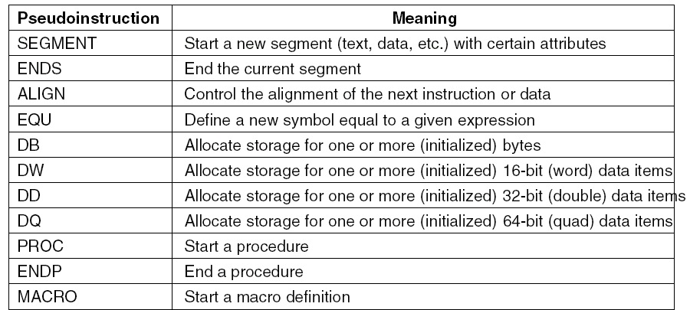
Pseudoinstructions Pentium 4

Slide 26
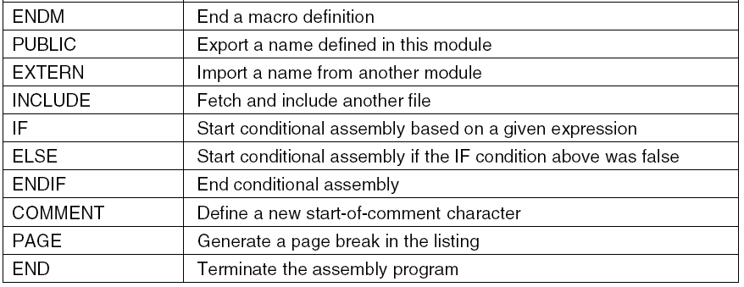
Pseudoinstructions (2)

Slide 27
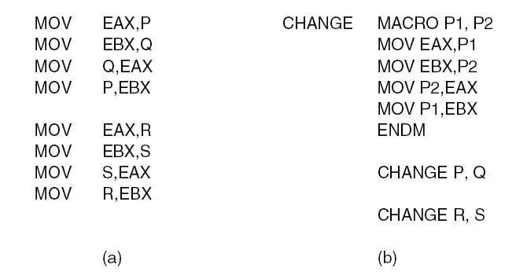
Macros
Nearly identical sequences of statements.
(a) Without a macro. (b) With a macro.
Notes:
Example shows Parameters. Macros don’t have to have parameters.

Slide 28
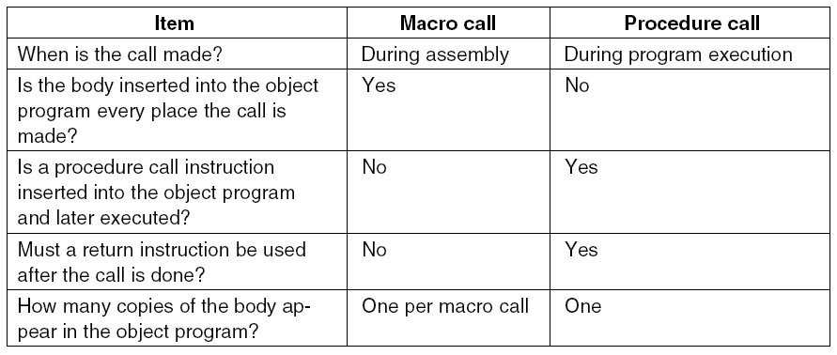
Macro

Slide 29
Assembler
A program that translates assembler symbols into binary.
Why are most assemblers two-pass ?
Forward references
Assemblers use 3 key data structures
Symbol Table : To be built
Opcode Table : Fixed, from manufacturer
ILC : Instruction Location Counter

Slide 30
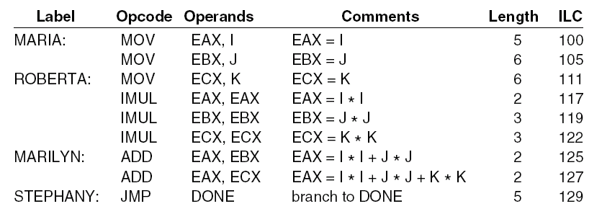
Two Pass Assemblers (1)
Excerpt of opcode table for Pentium 4

Slide 31
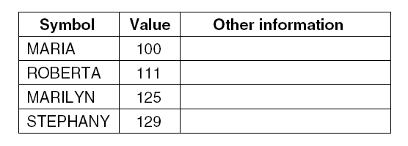
Two Pass Assemblers (2)
An excerpt symbol table for the program
Notes:
Question: What other entries belong here ? (Flip back to the code)
Where are entries for I,j,k?
Another column could be the data type (byte, word, proc)

Slide 32
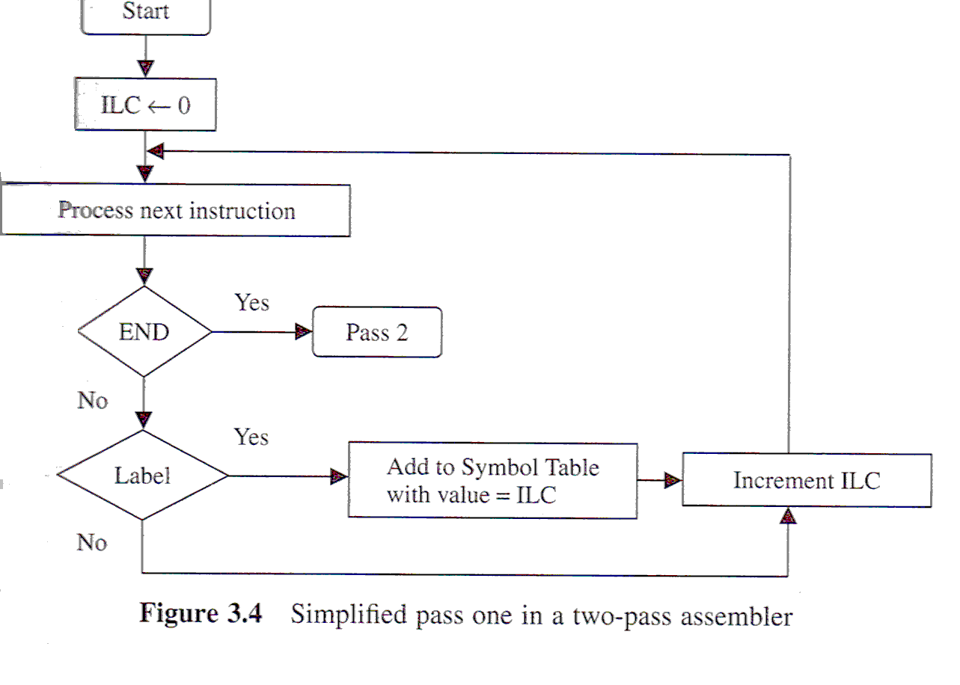
Two Pass Assembly – Pass 1
Purpose: Generate the symbol table
The instruction location counter (ILC) keeps track of the address where the instructions will be loaded in memory.

Slide 33
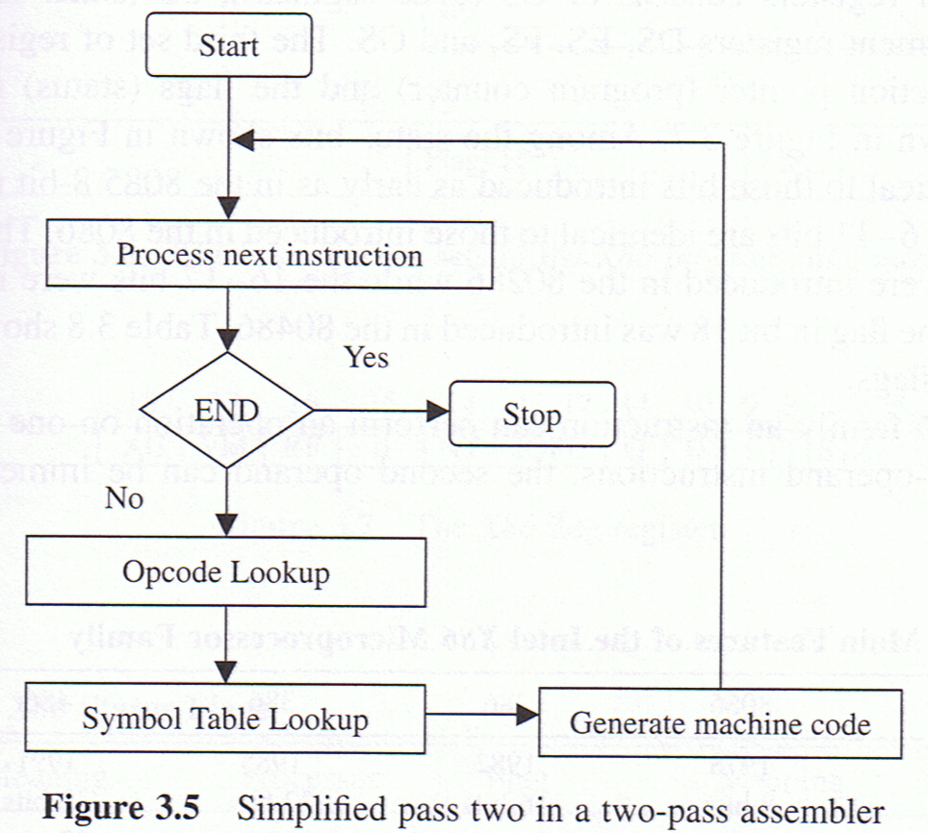
Two Pass Assembly – Pass 2
Purpose: Generate machine code

Slide 34
The Symbol Table
Notes:
Hash coding. (a) Symbols, values, and the hash codes derived from the symbols.
Symbol tables tend to grow with program size. For the efficiency of the assembler, although we envision the symbol table as a “table”, it is often implemented as a Hashtable (with associative searches)
In this example: Hash coding. (b) Eight-entry hash table with linked lists of symbols and values

Slide 35
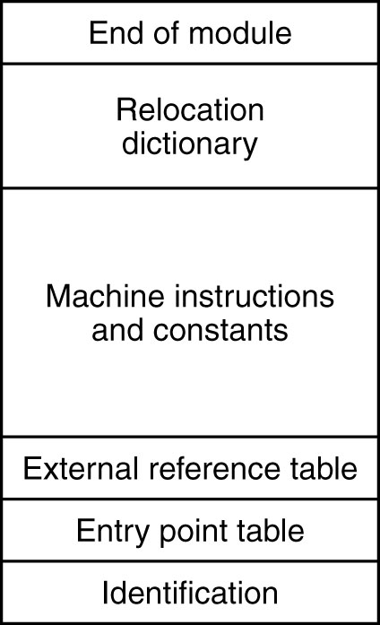
Structure of an Object Module
The internal structure of an object module produced by a translator.
Notes:
Final outcome of the assembler : An .obj object module. (We’re not talking OO Objects!)
See Page 211, Section 6.2.3, Murdocca.
End of module:
Relocation dictionary: Leave for last
Machine instructions and constants (the code!)
External reference table: Address of any global symbols defined in the module and exported by it; … and any global symbols that are referenced but not present in this module.
Entry Point Table: The address of the start symbol and library routes.
Identification: Pretty obvious. But also, the size of the contained data,code,stack segments
And lastly, relocation dictionary: Next slide:
Lead into next slide on linking :

Slide 36
Linker
Generation of single executable binary program from a collection of independently translated source with no unresolved external symbols
Notes:
Each module has its own address space, starting at 0.
The modules can be assembled/compiled from different HLL languages and assembly (But only one assembly, why ? Because must all be of same machine code)
When assembled/compiled,
each module cannot know if it has an address conflict
If it has an unresolved symbol, assumes that it is

Slide 37
Linking
Same object modules after linking and after relocation has been performed. Together they form an executable binary program, ready to run
Object modules after being positioned in binary image but before being relocated and linked.

Slide 38
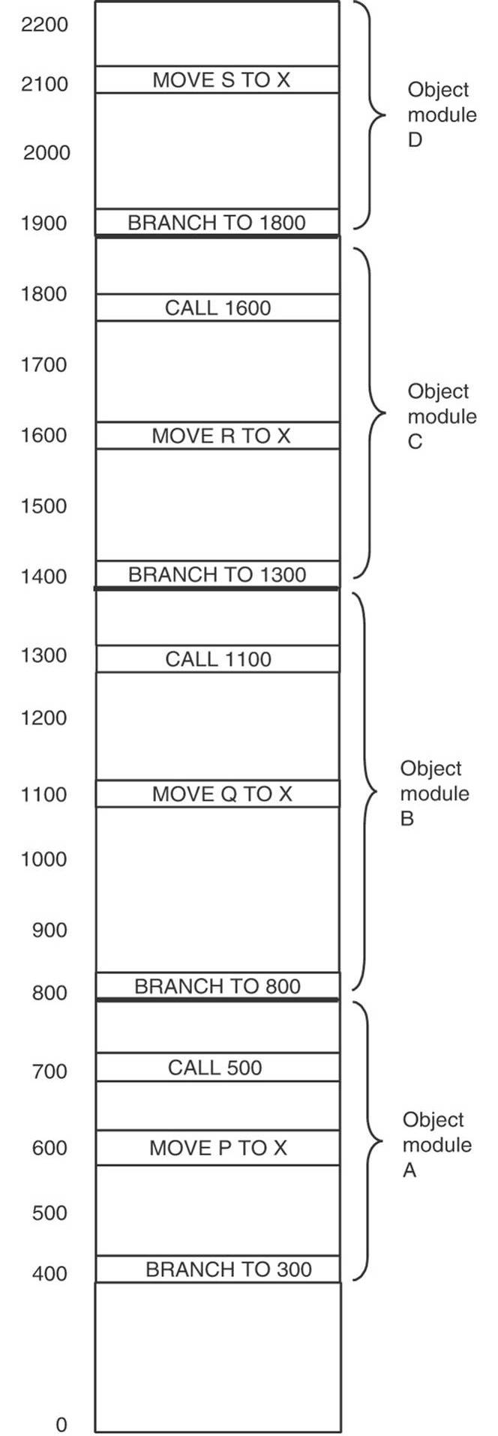
Binding Time and Dynamic Relocation
The relocated binary program moved up 300
addresses. Many instructions now refer to an
incorrect memory address.
Notes:
Don’t understand

Slide 39
Dynamic Linking in MULTICS (1)
Before EARTH is called.

Slide 40
Dynamic Linking in MULTICS (2)
After EARTH has been called and linked.

Slide 41
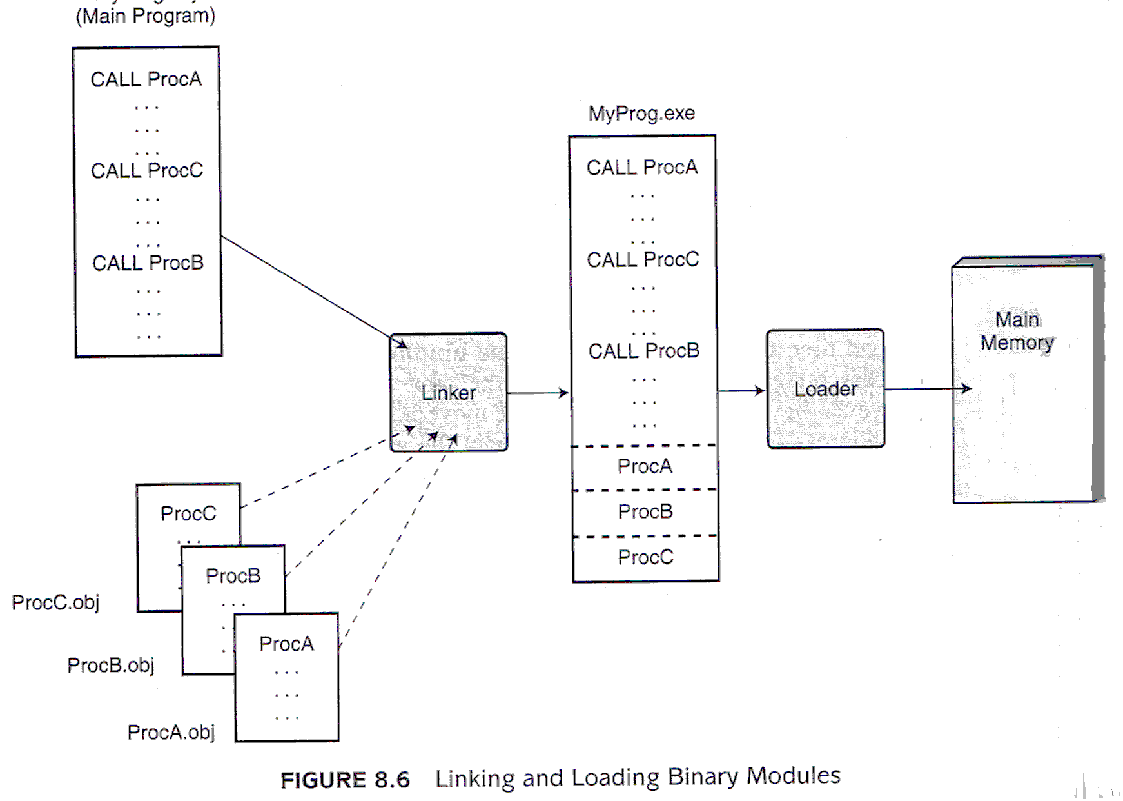
Static Linking
Null & Lobur
Notes:
Null, page 432
Question: What happens when two separate programs run, which both use Proc B ? Proc B is loaded twice into memory. Each program has its own separate copy ?

Slide 42
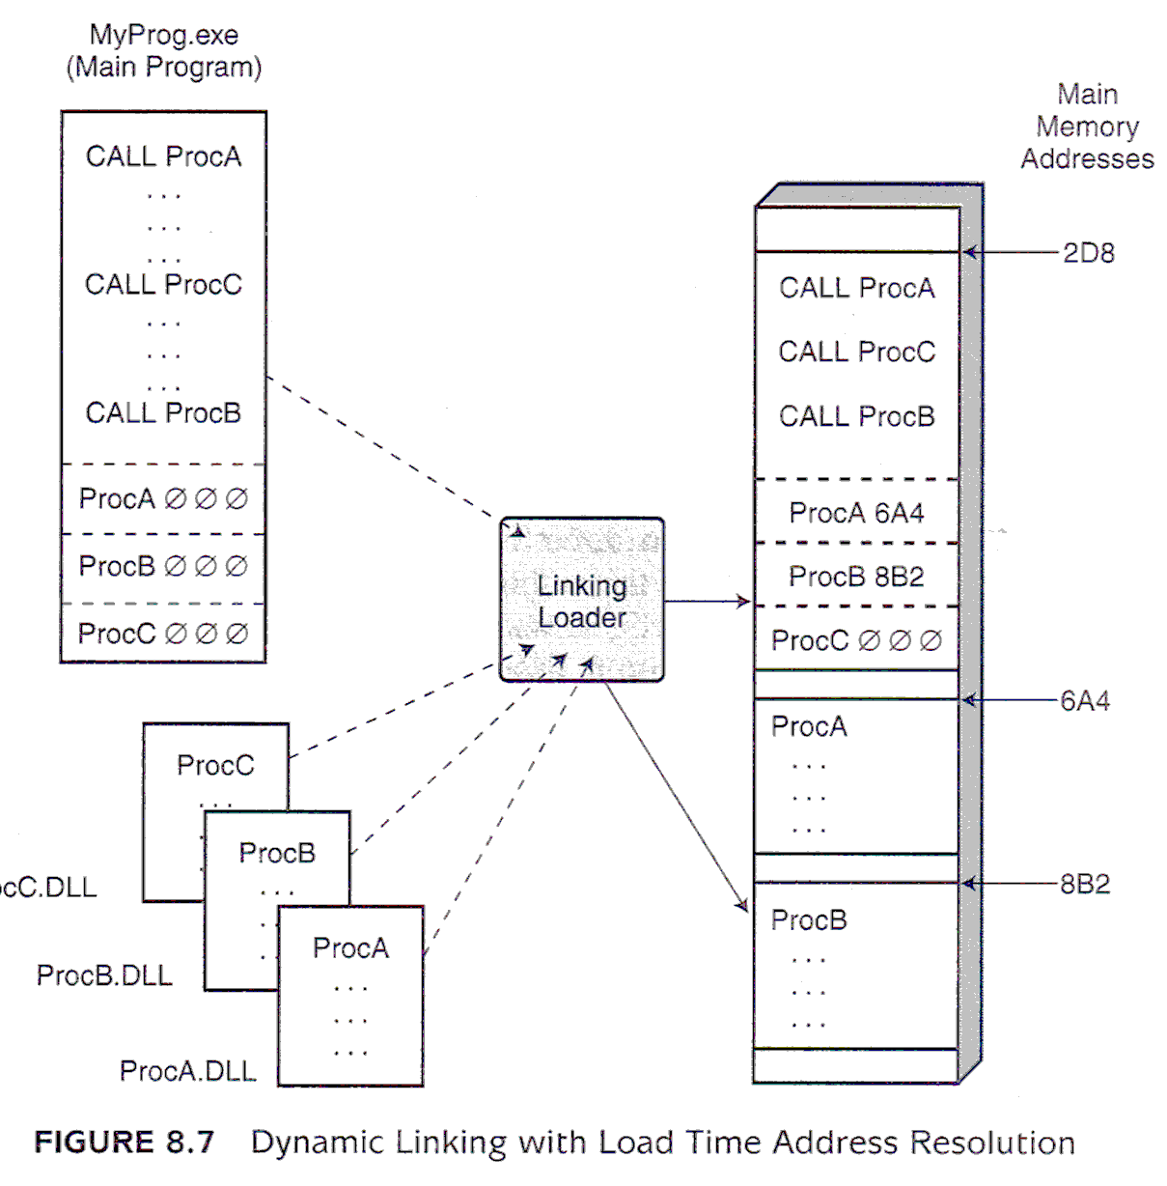
Dynamic Linking
Null & Lobur
Notes:
Null, page 432
Question: What happens when two separate programs run, which both use Proc B ? Proc B is loaded once into memory! All programs share same copy!
There are obvious advantages :
What is the disadvantage:

Slide 43
Dynamic Linking – Another view
Figure 7-19 Tanenbaum
User Process 1
User Process 2
DLL Header
A
B
C
D
Notes:
Here, we also see that DLL’s are shared among >1 process.

Slide 44
Compilers
Conceptually, compilers are the same as assemblers, but they have more responsibility
How to allocate variables to memory
Which sequence of instructions to use for each statement
Which values to keep in general purpose registers.
Which paradigm to follow for passing parameters to subroutines
Compilers have 1:m relationships
Can generate machine code for >1 architectures
Cross compilation
Can generate >1 code sequences for same if statement
Optimizations
HLL impose high overheads on compilers
The higher the language, the more machine instructions each program line typically generates.
Notes:
Last point: Null, page 435: Each generation of programming languages gets closer to how people think about problems and more distant from how machinery solves them. The key idea is to tell the computer what to do, not how to do it. The compiler figures it out.
But remember that compilers are just programs…
In making it simpler for the user, these HLL languages place substantial overhead on computer systems. Ultimately all instructions must be pushed down through the instruction hierarchy to the binary level.

Slide 45
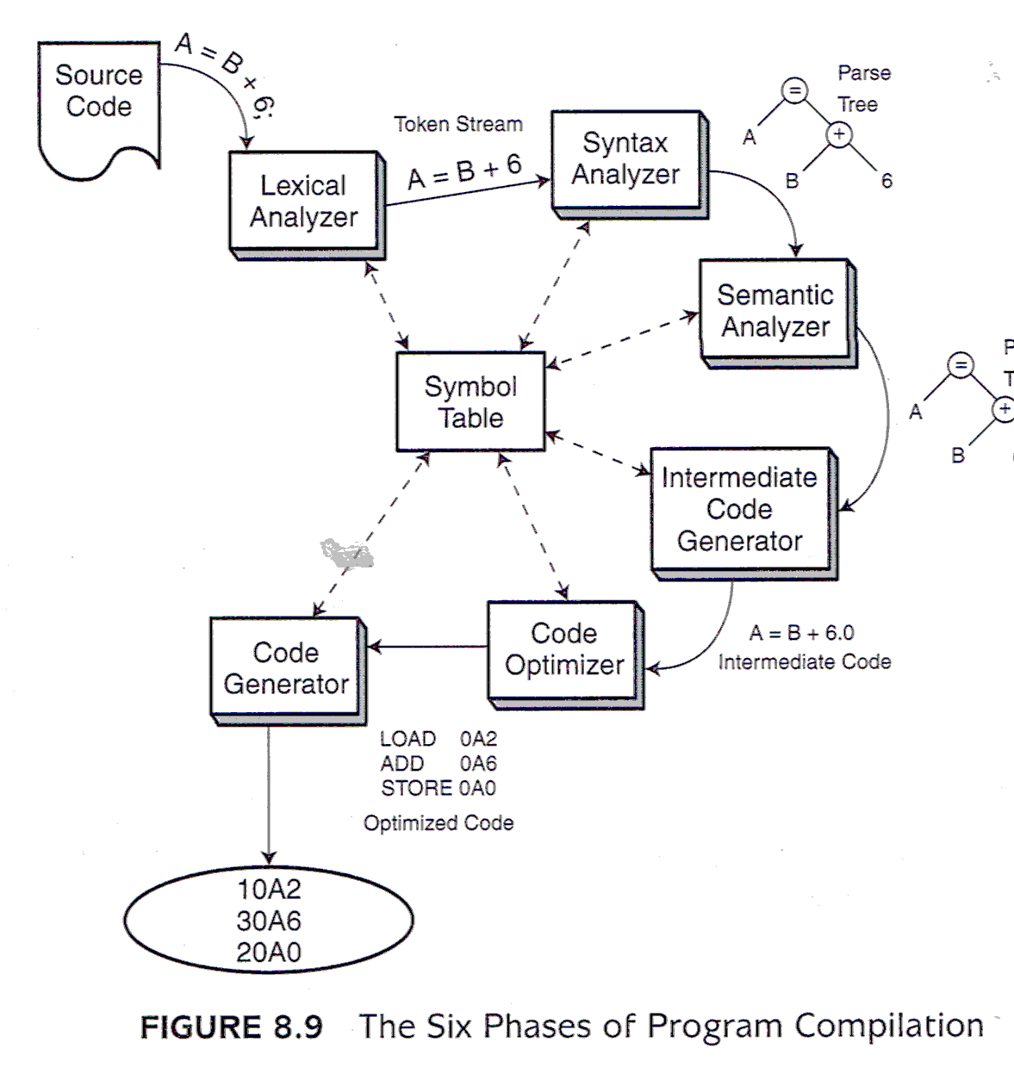
Null & Lobur
Notes:
1) lexical analysis(tokenizing): converts characters in the source program into lexical units.
Extract meaningful language primitives (tokens) from the text stream.
Reserved words: if, else, math operators and user variables.
Building the framework of the symbol table user-defined token with location and data type)
Error: 1DaysPay : Most languages don’t allow variables to start with numbers.
2) syntax analysis (parsing): transforms lexical units into parse trees which represent the syntactic structure of program
In-order traversal of parse tree usually gives the expression just parsed;
Checks symbol table for user-defined variables. Error if not present.
Checks syntax: A = B + 6 = D; Illegal
3) Semantics analysis: checks whether the operators identified in a parse tree are valid for the given data types.
Can you + B and 6. What if B is an object ? A string ?
In order words, it is a type checker.
Makes appropriate data type promotions (convert int to float, if possible)
1 + 2 + 3 are the analytic phases. Now it is time for SYNTHESIS.
4) Intermediate code generation: Creates pseudo-assembly usually with three-address code (even if the processor does not support it)
Question: What is the importance of this phase ? Portability
5) Code Optimizer: First, it is a translator from a 3-address code to legal assembly code for destination processor. Second, it looks for optimizations.
6) Machine code is generated (ie. Assembler!!)

Slide 46
Compilation of N=I+J
Pentium 4
Pentium 4
Motorola 680x0

Slide 47
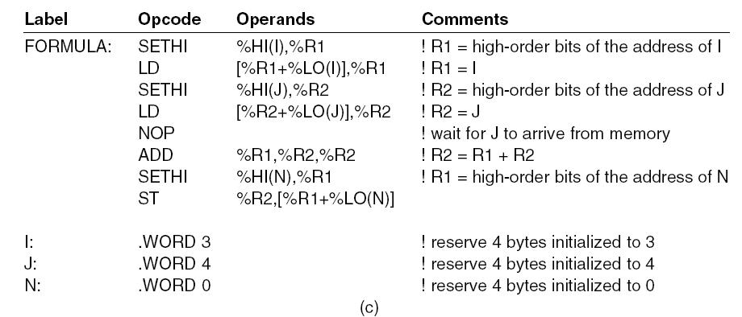
Computation of N=I+J
SPARC
Notes:
Don’t know the architecture. Is it a SPARC ?

Slide 48
C/C++ Code Generation
Each C statement mapped to one or more ASM instructions
Simple approach uses template for implementation of each C++ statement
General approach simplifies compiler
Leads to redundancies or inefficiencies
Assumption : All variables used are ints
xx= 3; ldd #3
std xx
z = xx + yy; ldd xx
addd yy
std z
array[1] = z; ldx #array
ldd z
std 2, x
Redundant
Note : Simplified array example
Notes:
What does separately compiled mean ?
- After x = 3, D contains x. Yet in the next statement, it loads D with x.
- No re-use of registers between C statements.
- One reason why C code will run slower than assembly code
- Why is it done ? Simplicity in the compiler (Think back to subroutines : Don’t worry about register because
it has made no assumption about their contents)
- Most compilers will have an optimization switch to look for this.
(1) Register optimization: try to “remember” how registers are used between statements avoid redundant save/load of values
(2) registers variables: allows programmer to “request” compiler to try to use processor registers for certain variables (instead of memory variables)
register variables are merely hints: compiler is free to ignore them as it sees fit
Example code : See optimization.c

Slide 49
Arrays and Pointers
int i[2]; i rmw 2
int *iptr; iptr rmw 1
...
*iptr++ = 7; ldd #7
ldx iptr
std 2,x+
char c[2]; c rmb 2
char *cptr; cptr rmw 1
...
*cptr++ = 9; ldab #9
ldx cptr
stab 1, x+
Notes:
Arrays and pointers are interchangeable in C but …
C still takes care of the address calculation adding 2 for an integer array and 1 for a byte array, etc.
At the end (before going to next slide) : What other use do we have pointers (addresses) ? Reference arguments !

Slide 50
Data Dependencies
Goal: Effective execution of ALU instructions in the execution core
Branch, load/store are “overhead”
Ideally, take no time to execute
Computation latency = Processing of ALU instructions
Given: ALU instructions operate registers
With binary instruction: 2 source registers, 1 destination
If “n” not available:
n = Function unit: Structural dependence
n = 1+ source register: true data dependence
n = dest. register: anti- and output false dependence
Notes:
Page 157 from Shen & Lipasti

Slide 51
False Data Dependences
Due to re-use of registers to store operand
Register recycling:
Static: Compiler
Dynamic: Superscalar (later)
Compiler Phase: Intermediate Code
Assumes unlimited registers
Each symbolic register is written once
Compiler Phase: Code Optimizer: Register allocation
Avoid moving data to memory only to reload later
Keep as many of temporary values in registers as possible
Register Re-use: Register is written with new value when old value is no longer needed.

Slide 52
Register Data Flow Technique
Register Definition: Writing to a register
Register Use: Reading a register
Live Range: Duration between definition & use
Techniques: Map nonoverlapping live ranges into same register, maximize register re-use
Each register is variable that can take on multiple values

Slide 53
Limitations
If instructions are executed sequentially, allocate registers so that live ranges that share the same register will never overlap
Superscalar: Out-of-order processing
Read & write operations can occur in different order than program order.
Out-of-order use can be permitted as long as all output dependences are enforced.
Requires semantic correctness checks.

Slide 54
Memory Layout of a C Program
file.c
file.asm
#include <stdio.h>
#include “mySubs.h”
int a;
void aSub() {
}
void main() {
}
.module
.area text
_main::
_aSub::
.area data
.area idata
.area bss
_a::
Memory
“ROM”
RAM
Notes:
Where are the ORG statements in a C program ? It’s done by the compiler based on the C syntax.
What are the “areas”
text = code (static information → goes to ROM)
data and idata work together = data that is initialised
data is the memory space allocation, idata is the actual initial value
bss = uninitialized data
(Performance reason : Only need to know amount of space, so it makes downloading faster
Notice : Naming convention : names are prepended with _ and followed by double :
bss = "Block Started by Symbol" Dennis Ritchie says: Actually the acronym (in the sense we took it up; it may have other credible etymologies) is "Block Started by Symbol." It was a pseudo-op in FAP (Fortran Assembly [-er?] Program), an assembler for the IBM 704-709-7090-7094 machines. It defined its label and set aside space for a given number of words. There was another pseudo-op, BES, "Block Ended by Symbol" that did the same except that the label was defined by the last assigned word + 1. (On these machines Fortran arrays were stored backwards in storage and were 1-origin.) The usage is reasonably appropriate, because just as with standard Unix loaders, the space assigned didn't have to be punched literally into the object deck but was represented by a count somewhere.

Slide 55
Different kinds of Data Areas
int a; // Global external in bss
int b = 1; // Init’d global external in data
static int c; // Static External in bss
// (only for this file)
static int d = 2; // Init’d static external in data
void anyFunction () { // Including main()
int e; // Automatic or Local in stack
int f = 3; // Automatic or Local in stack
static int g; // Persistent Local in bss but only // visible in function
static int h=5; // Init’d persistent Local in data // but only visible in function
}
Notes:
Example code : See MemoryMap.c
How do we know what data goes in what area ? We need to refresh some C syntax
Automatic / Local Variables : Defined within a function
Transient : Exist only during function call
External Variables : Defined outside of any function
Persistent, global data
Static has two meanings
For internal variables : Value persists between function call (therefore must be a global variable
For external variables : Available only to code in the same file

Slide 56
Language Interfacing
If they adhere to the same policies :
xxx programs can call yyy functions AND
yyy programs can call xxx functions
ICC function call policies :
Function/external variable names: prepended with underscore
Local variables allocated on stack.
First argument (arg[0]) passed in register D
If it is a byte: passed in LSB (B)
Remaining arguments, if any (arg[1]… arg[n]) passed on the stack
Pushed right to left
Return variables passed in register D (if a byte, in B)
Register X must be preserved but Y and D can be freely used
Notes:
Note : Ignoring long and float variables. They are handled completely different with space enough to handle them allocated on the stack.
Why ? D is being used to pass in arg[0]. It is assumed to be destructed.
Y because each C statement is separately compiled with a template (no optimization)
so it doesn’t matter if destroyed
X (…. lead onto next page) must be preserved because it is probably being used as frame pointer in calling routine.
TBD : void func (void) // ie. no parameter or return type. Does func() save D if it uses it ?

Slide 57
The ICC Stack Frame
Upon entry, stack allocated for every potential use
All stack operations are word oriented
Byte parameters: values in LSB (MSB cleared)
Local variables are treated as either byte or word, as declared.
X is used as a base pointer or frame pointer
For passing parameters
to any subroutine called
by this subroutine.
Max #arguments – 1
SP
X-2
outgoing parameters
internal/local variables
saved copy of X
arg[0] (saved copy of D)
return Address
arg[1]
…
arg[n]
X
X+2
X+4
X+6
X+8
Notes:
Outgoing parameters are for calls to other subroutines.
Seems to be an efficiency tactic: Stack is allocated ahead of time. Calls to subroutines means simply MOV’ing the parameter to the stack, rather than PUSHing onto the stack
example : LDD

Slide 58
C – ASM Interfacing
void func1 (char a, char b, int c, char *d, int e[]) {
char f;
int g = 3;
func2 (g, c);
}
void func2 (int x, int y);
Compiled to _func1::
SP
x-6
x-3
x-2
1 outgoing parameter
0x?? f (byte only)
g (word)
X
0x00 arg[0] = a
return address
0x00 Value of b
Value of c
Address of d
Address of e
X
x+3
x+4
x+7
x+8
x+A
x+C
Notes:
In the code :
Notice the different types of parameters: byte, word, value, reference.
e is an array and is passed automatically passed by reference.
Notice the internal variables: byte and word
Notice the nested subroutine call (How many parameters ? 2. Therefore max #args = 2 – 1 (in D) = 1)
In the stack frame :
Notice that all parameters are word whereas local variables are bytes or words
Notice the number of outgoing parameters
Notice the order of parameters
Notice how to access: parameters X+n (n = even) and local variables x-n (n=odd or even)

Slide 59
Creating the ICC Stack Frame
Caller: Standard call code
Subroutine: Standard entry and exit code
Caller
ldy #intArray
pshy
ldy #char1
pshy
ldd anInt
pshd
ldab char1
clra
pshd
ldab char2
clra
jsr _func1
leas 8, sp
Subroutine
_func1::
pshd ; Save arg[0]
pshx ; Save X
tfr s, x
leas –6, sp ; Allocate local
...
tfr x, s ; Deallocate local
pulx ; Restore X
leas 2,sp ; Get rid of arg[0]
rts
Notes:
Notice !
D is NOT restored ( leas 2, sp ) ( D represents arg[0] and it is a VALUE argument or an address)
When pushed onto the stack, it represents the local copy of the parameters (that can change)
X is restored
Y is neither saved nor restored.

Slide 60
Optimizing the Stack Frame
Most subroutine calls are nested inside another subroutine
Even main() is a subroutine
Parameters are MOV’d to outgoing portion of the stack
Caller (eg. main())
ldy #intArray
sty –outgoing, x
ldy #char1
sty –(outgoing+2), x
ldd anInt
std –(outgoing+4), x
ldab char1
clra
std –(outgoing+6), x
ldab char2
clra
jsr _func1
Subroutine
_func1::
pshd ; Save arg[0]
pshx ; Save X
tfr s, x
leas –6, sp ; Allocate local
. . .
tfr x, s ; Deallocate local
pulx ; Restore X
leas 2,sp ; Get rid of arg[0]
rts
Notes:
The “outgoing parameter” area of the calling subroutine becomes the “incoming parameter” area of the called subroutine!
Outgoing here is used to represent the offset to the bottom of the outgoing parameter area.
The actual value will depend on what ? The number of local variable in THIS caller subroutine
Notice : The stack does not need to be cleaned up after the JSR !!!

Slide 61
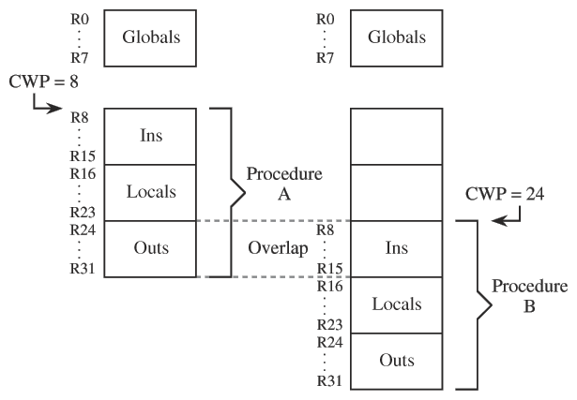
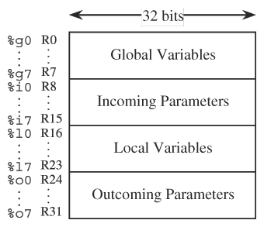
Case Study: Register Windows
Another solution? Optimizing compiler (remove procedure overhead so that object code is efficient but then source code is still encapsulated for future growth)
Notes:
My tour of the ICC compiler – with its optimization of the stack frame – is one response to the findings given in Murdocca.
Section 6.5 Quantitative Anaylyses of Program Execution
Most common instruction used is assignment.
(page 234) Typical programs spend much of their time dealing with procedure call-and-return overhead, which involves passing parameters on a stack located in main memory in traditional architectures.
Furthermore, the subroutines are typically nested, with calls often staying within a depth of 5, with the stack pointer SP moving within the same 8 words for 99% of the time!
In Software engineering, it is taught to always use accessors/mutators to access data, rather than directly. (Encapsulation)
ICC’s stack optimization is one solution; Register Windows is another (Murdocca, page 234)
The SPARC takes a different approach, called Register Windows. If you look at Figure 6-18, it’s actually very similar to ICC. The difference is that the active portion of the stack is not kept in memory but in registers!
Later: Could we say that the register window is just a form of caching!
Another example of synergy of software : Problems arise and then have to be accommodated by other pieces of the total solution, in this case, by utilities.

Slide 62
Interpreted Languages
Compilation is static execution
Slow translation, fast execution
Pure Interpretation is dynamic execution
Programs interpreted by another program known as an interpreter
Compile-and-execute on-the-fly
Easier implementation of programs (run-time errors can easily and immediately displayed)
Slower execution (10 to 100 times slower than compiled)
Often requires more space
Became rare on HLLs but significant comeback with some Web scripting languages (e.g., JavaScript)

Slide 64
Hybrid implementation systems
A compromise between compilers and pure interpreters
A HLL program is translated to an intermediate language that allows easy interpretation
Faster than pure interpretation
Examples
Perl programs are partially compiled to detect errors before interpretation
Initial implementations of Java were hybrid; the intermediate form, byte code, provides portability to any machine that has a byte code interpreter and a run-time system (together, these are called Java Virtual Machine)

Slide 66
Just-in-Time Implementation Systems
Initially translate programs to an intermediate language
Then compile intermediate language into machine code
Machine code version is kept for subsequent calls
JIT systems are widely used for Java programs

Slide 67
Preprocessors
Preprocessor macros (instructions) are commonly used to specify that code from another file is to be included
A preprocessor processes a program immediately before the program is compiled to expand embedded preprocessor macros
A well-known example: C preprocessor
expands #include, #define, and similar macros
Uses ?
Notes:
I use it for conditional compilation
Others use it for creating multiple OS versions (to handle portability issues

Slide 68
Coding for Low Power
http://citeseerx.ist.psu.edu/viewdoc/summary?doi=10.1.1.37.5745
http://csdl2.computer.org/persagen/DLAbsToc.jsp?resourcePath=/dl/mags/mi/&toc=comp/mags/mi/2004/03/m3toc.xml&DOI=10.1109/MM.2004.18
http://portal.acm.org/citation.cfm?id=1018022.1018180&coll=GUIDE&dl=
Notes:
A wonderful project topic!

Slide 69
Next Lecture
Memory Systems
Murdocca, Chapter 7

