Slide 1
MicroArchitecture
Murdocca, Chapter 5 (selected parts)
How to read Chapter 5
Notes:
Other sections Murdocca 6.5-6.9, 10.2-10.3

Slide 2
Objectives
How the control unit of the CPU works.
Microcode
Nanocode
Hardwired control.
Think RISC vs CISC…

Slide 3
MicroArchitecture - Defined
“A given ISA may be implemented with different microarchitectures. For example, the Intel Pentium ISA has been implemented in different ways, all of which support the same ISA. Not only Intel, but a number of competitors such as AMD and Cyrix have implemented Pentium ISAs. A certain microarchitecture might stress high instruction execution speed, while another stresses low power consumption and another, low processor cost. Being able to modify the microarchitecture while keeping the ISA unchanged means that processor vendors can take advantage of new IC and memory technology while affording the user upward compatibility for their software investment. Programs run unchanged on different processors as long as the processors implement the same ISA, regardless of the underlying microarchitectures.” , Murdocca, Chapter 5
Notes:
Here or later ???
Maybe: Brief intoduction here, full details in next lecture.
TBD: Fix up to match Comer, Murdocca and Null

Slide 4
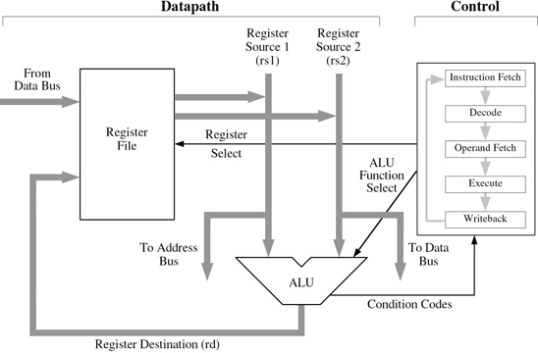
Data / Control Path
Figure 5-1, Murdocca
Notes:
The ISA is what the programmer uses to write programs.
But to execute the program, we need to also write a program, so-to-speak.
It is the microarchitecture that is responsible for making the fetch-execute cycle happen.
The microarchitecture fetches the next instruction to be executed, determines which instruction it is, fetches the operands, executes the instruction, stores the results, and then repeats.
The microarchitecture consists of a data section, which contains registers and an ALU, and a control section, as illustrated in Figure 5-1. The data section is also referred to as the datapath.
Microprogrammed control uses a a special-purpose microprogram, not visible to the user, to implement operations on the registers and on other parts of the machine.
Often, the microprogram contains many program steps that collectively implement a single ISA-level instruction.
Hardwired control units adopt the view that the steps to be taken to implement an operation comprise states in a finite state machine, and the design proceeds using conventional digital design methods (such as the methods covered in Appendix A).
In either case, the datapath remains largely unchanged, although there may be minor differences to support the differing forms of control.

Slide 5
Hardwired
Digital Logic directly connects the control lines to the actual machine instructions
Instructions divided into fields
Bits in field connect to input lines that drive digital logic components (flip-flops)
Notes:
Null, Page 214
Signals control the movement of bytes (which are actually signal patterns that we interpret as bytes) along the dtapath in a computer system.
Timing signals from the clock are ANDed using combinational logic circuits to raise and lower signals.

Slide 6
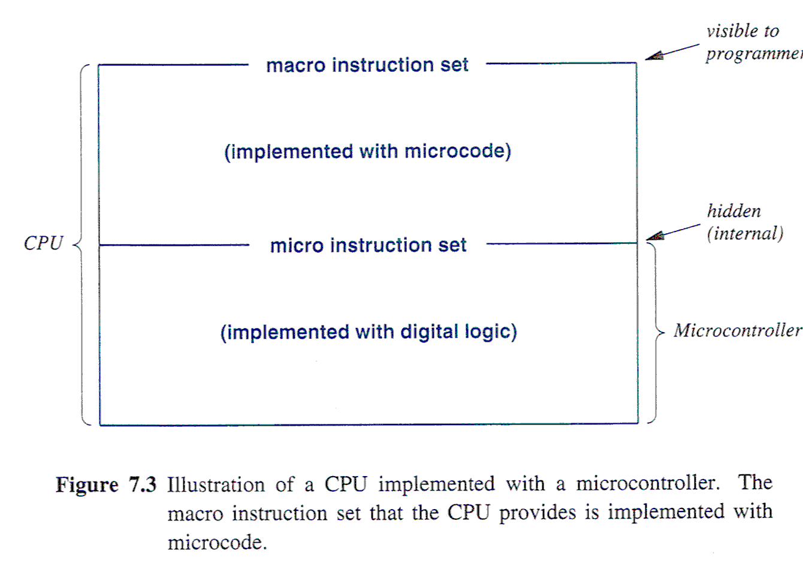
MicroProgrammed (Firmware)
Notes:
Comer, page 95-96, 100 ….
How do hardware engineers handle the complex of millions of transistors ?
Subroutines!
Macro processor / Micro processor/controller runs microcode
Notice: ON the right, you still have a layer of digital logic that implements the microinstructions.

Slide 7
MicroInstructions
Purpose: Interpret an assembly instruction
Stored Program Concept: Must be stored
Not in main memory; internal CPU store
Format: single word, fixed size, limited #

Slide 8
Sample Instruction
Set (ARC)
- 32 bit width

Slide 9
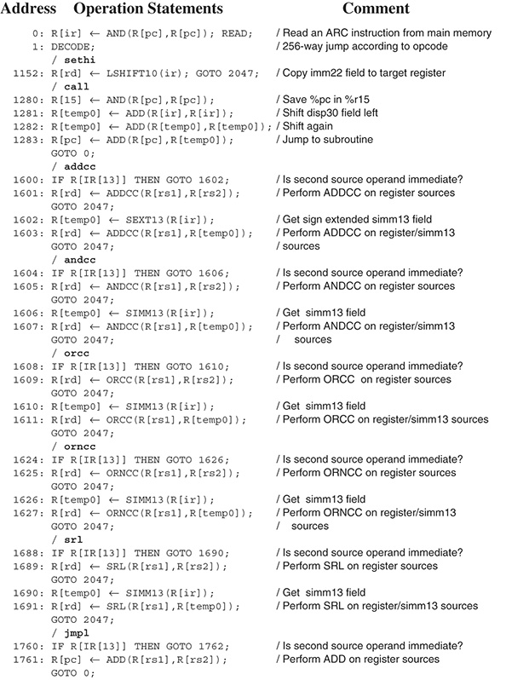
Notes:
Murdocca, Figure 5-15 (On two pages)
Use this to show:
Set of microinstructions is small = {READ, WRITE, DECODE, GOTO Register assignments, plus all the ORNCC, ORCC…)
In line 0: What is purpose of the AND ? To put the PC on the A bus (See Figure 5-10) without affecting the condition codes. AND is arbitrarily chosen as one instruction that will do this (The A bus is the internal address bus between the scratchpad (containing the programming registers) and the ALU, but which is also connected to the Address bus of the Main Memory interface)
Each instruction is 1 byte long. That’s a feature of microcode instructions: Fixed length.
This length determines the width of the (internal) microstore and is related to the (hardware) cost of implementing the firmware.
Go to next page, to show Address 2047 which increments the PC (hmmmm, after the instruction is executed ???)
Now, look for duplication, in order to introduce Nanoprogramming.

Slide 10
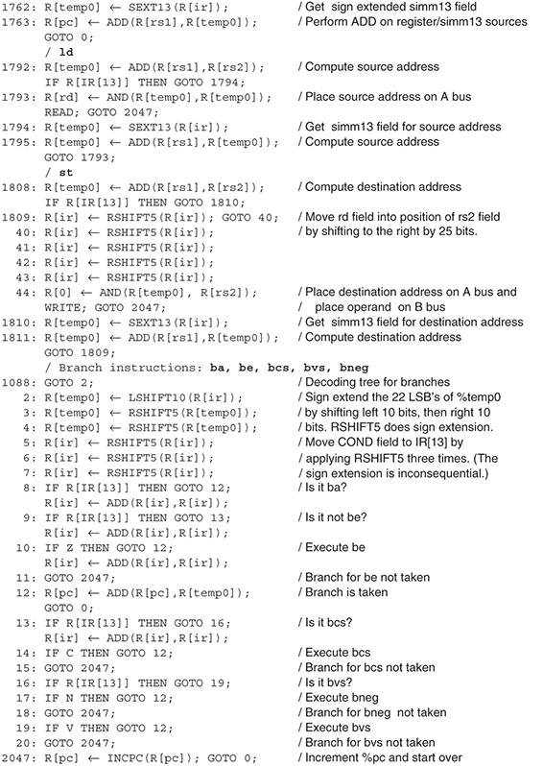

Slide 11
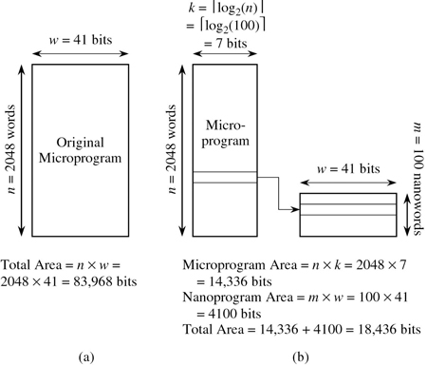
Nanoprogramming
Figure 5-19
Murdocca
Notes:
If the microstore is wide and has lots of the same words, then we can save microstore memory by placing one copy of each unique microword in a nanostore, and then use the microstore to index into the nanostore. For instance, in the microprogram shown in Figure 5-15, lines 1281 and 1282 are the same. Lines 3, 4, and 40-44 are the same, and there are a number of other microinstructions that recur, especially for the duplicated branch microcode and the duplicated illegal instruction microcode.
Figure 5-19a illustrates the space requirement for the original microstore ROM. There are n= 2048 words that are each 41 bits wide, giving an area complexity of 2048 × 41 = 83,968 bits. Suppose now that there are 100 unique microwords in the ROM (the microprogram in Figure 5-15 is only partially complete so we cannot measure the number of unique microwords directly). Figure 5-19b illustrates a configuration that uses a nanostore, in which an area savings can be realized if there are a number of bit patterns that recur in the original microcode sequence. The unique microwords (100 for this case) form a nanoprogram, which is stored in a ROM that is only 100 words deep by 41 bits wide.
The microprogram now indexes into the nanostore. The microprogram has the same number of microwords regardless of whether or not a nanostore is used, but when a nanostore is used, pointers into the nanostore are stored in the microstore rather than the wider 41-bit words. For this case, the microstore is now 2048 words deep by bits wide. The area complexity using a nanostore is then 100 × 41 + 2048 × 7 = 18,436 bits, which is a considerable savings in area over the original microcoded approach.
For small m and large n, where m is the length of the nanoprogram, we can realize a large savings in memory. This frees up area that can be applied in some other way, possibly to improve performance. However, instead of accessing only the microstore, we must now access the microstore first, followed by an access to the nanostore. The machine will thus run more slowly, but will fit into a smaller area.

Slide 12
Hardwired vs MicroProgrammed
Advantages (of MicroProgrammed)
Higher level of abstraction. Building microcode is less prone to errors than building hardware circuits.
Building microcode takes less time than building circuits
Changing microcode is easier than changing hardware circuits (new version can be created faster)
Disadvantages:
Microcode has more overhead than a hardware implementation (ie. slower)
Because it executes multiple micro instructions for each macro instruction, the microcontroller must run at much higher speed than the CPU.
Cost of a macroinstruction depends on the micro instruction set.
Notes:
Bottom line: Microprogrammed control units are less costly to manufacture and maintain.

Slide 13
shll register (micropogram)
shlr register
Notes:
Another example: From Reis’s book.
If microprogrammed using a simple barrel shifter: shll takes 3 microinstructions for 1 shift, but 3*15 = 45 for 15 shifts because we have to do a loop
NB. Simple barrel shifter uses just 1 control line (R or L) and the 16 data bits.
If hardwired (as shown – with 4 more control wire for the NUMBER of shifts)
Now, num (expressed as the lower 4 bits of the right operand) is passed directly as control lines and whether you’re shifting 1 bit or 15, it’s always 3 microinstructions.
Conclusion: Hardwired is faster but more expensive whereas microprogram is less expensive but slower.
A similar decision is with multiplication: MUL unit or repeated addition.

Slide 14
shll register, num (hardwired)
shlr register, num
Notes:
Another example: From Reis’s book.
If microprogrammed using a simple barrel shifter: shll takes 3 microinstructions for 1 shift, but 3*15 = 45 for 15 shifts because we have to do a loop
NB. Simple barrel shifter uses just 1 control line (R or L) and the 16 data bits.
If hardwired (as shown – with 4 more control wire for the NUMBER of shifts)
Now, num (expressed as the lower 4 bits of the right operand) is passed directly as control lines and whether you’re shifting 1 bit or 15, it’s always 3 microinstructions.
Conclusion: Hardwired is faster but more expensive whereas microprogram is less expensive but slower.
A similar decision is with multiplication: MUL unit or repeated addition.

Slide 15
Vertical Microcode
Model the microcontroller similar to conventional processor:
Instruction set = {load, store, add, branch..}
Except it needs
Access to ALU and general-purpose registers used by macro-instruction
Decode operand references & fetch values
Coordinate with hardware (ie. memory)
Example: RISC microcontroller inside CISC processor
Pros: Natural for programmer: Similar programming interface, similar semantics (one instruction at a time)
Cons: Difficult to implement for H/W engineer; slower
Notes:
Comer, page 103
What architecture should be used for a microcontroller (the part that runs the micro-instructions).
As programmers, we want to know to know the ISA for the microcontroller = {register set + instructions}
Example: The microcontroller used in a CISC processor can consist of a smaller, fast, RISC processor. This is a VERTICAL architecture.

Slide 16
Horizontal Microcode Reference: Comer, Chapter 7
Basis: Most macro instructions = >1 micro instructions
To execute macro instructions at K per second, microcontroller must execute micro instructions at n * K per second
All hardware aspects must be designed to operate at high speed (including memory)
Horizontal : Allows hardware to run faster, but is more difficult to program

Slide 17
Simple Horizontal Control Unit
…
Notes:
Some hardware background to understand: A simplistic CPU with just a few parts key to horizontal microcoding.
ALU expects operands to be placed in the storage units before an operation is performend and places the result in the two hardware units labeled result1 and 2 (Remember, multiplies provide results that are twice as big).
Register access provides a hardware interface to the general purpose registers.
Arrows denotes paths along which data can pass.
Each functional unit is controlled by a set of wires that contain commands. Although not shown, we can imagine control lines, depending on the type of unit.
ENTER For the result register, a single command line is needed: zero = stop interacting with other units; one = send current contents of result unit to data transfer mechanism.
ENTER For the operand registers, a single command line is needed: zero = stop interacting with other units; one = load current contents of result unit to data transfer mechanism.
ENTER For the ALU, several control lines are needed, depending on the number of instructions: 000 = ADD, 001 = Subtract.
ENTER:For the register access, several control lines are needed, depending on the number of registers; need two values for each register (to read register, to write register)

Slide 19
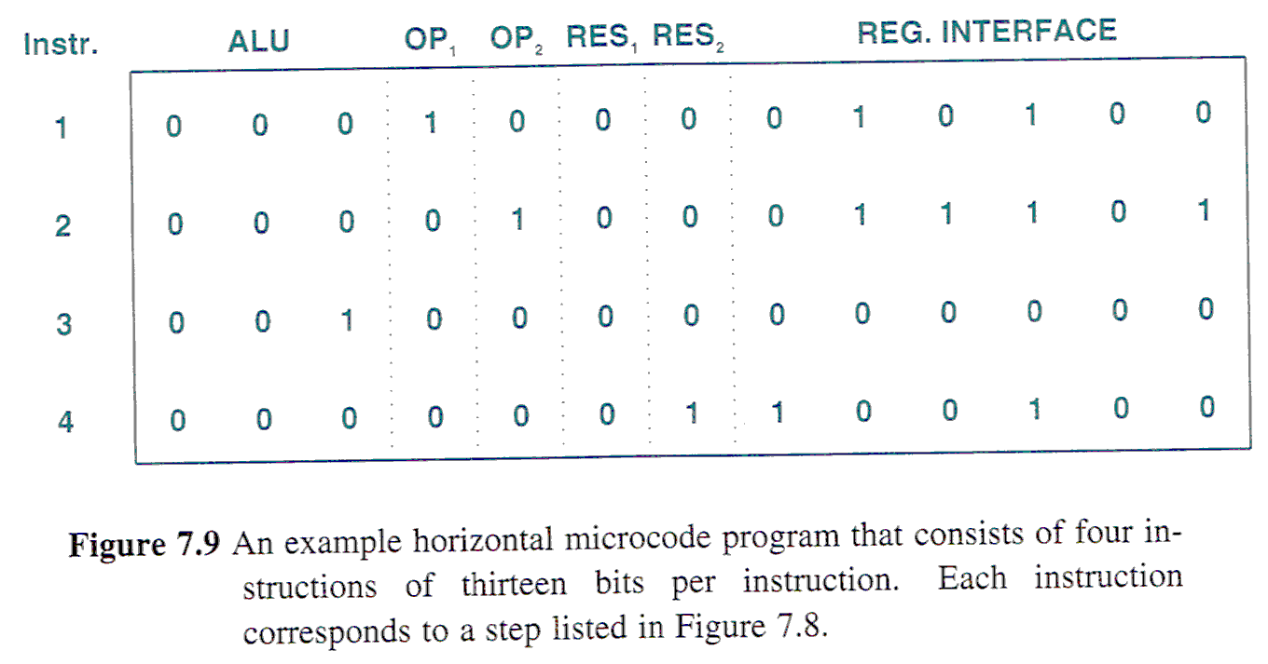
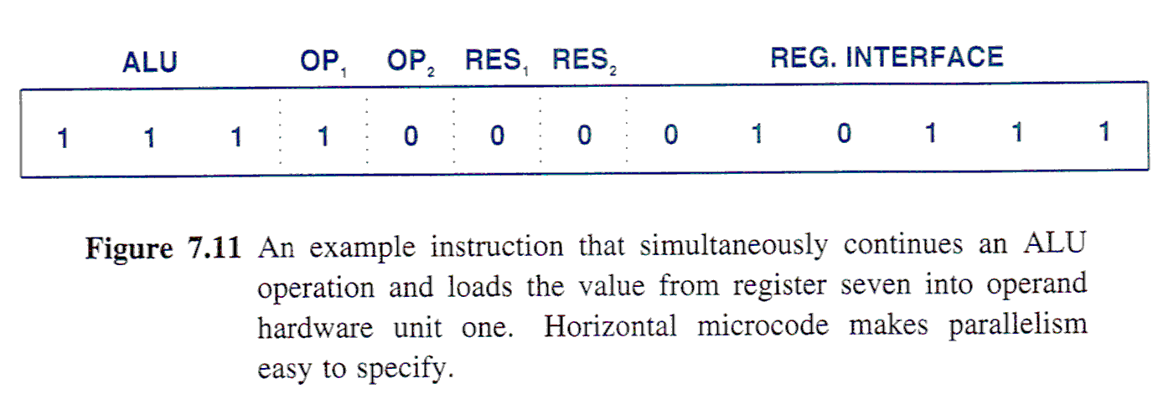
Horizontal Microinstruction
Notes:
Comer, Figure 7.7, 7.9 and 7.11
Each microcode instruction is a command to function units – when it executes an instruction, the hardware sends bits from the instruction to the functional units.
The bits specify which functional unit(S) operate when the instruction is executed.
The centre table demonstrates: R4 = R13 + R4
Get the idea?
But there is inherent parallelism here because the hardware contains units that operate independently. A programm can specify parallel operation because an instruction contain separate fields that each control ONE of the hardware units.
Because the operands remain unused after transferring to the ALU, we could insert an instruction that simultaneously move a new value into an operand unit while an ALU operation continues.!

Slide 20
Issues in Horizontal Microcode
Instruction Scheduling
CPU = {funtional units + intelligent controller}
Intelligent controller: Access >1 macro instruction at a time; look-ahead to find parallelism; schedule work to functional units
Out-of-order Execution
DIV R1, R3, R7
SUB R4, R4, R6
ADD R7, R1, R2
SHIFT R12, 5
Conditional Branches and Branch Prediction
Y = …;
if (Y > Z) doQ() else doR();
Notes:
Idea: An ALU operation can continue at same time as operand unit is loaded.
But how do you exploit that parallelism. Who codes that ? Horizontal Microcode is not intuitive for the programmer (or the programmer of the compiler!)
Out-of-Order Execution: What about the SEMANTICS of the instruction stream ?
In the example, operands overlap (R7 = destination, then R7 = source)
The macro instruction stream specifies sequential processing; an intelligent controller must accommodate this overlap:
Must balance maximizing parallel execution and preserving original (ie. sequential) semantics
Conditional Branches are WAIT points for the intelligent controller.
Branch Prediction: Based on measurements: Most code, the branch is taken 60% of time. Continue executing along that path and if wrong, undo results to the branch point
Follow both paths in parallel
Is this wasteful ? What else is it going to do ? WAIT ? Isn’t something better than nothing ?
(Speed is the imperative, not elegance)
Question: What’s the consequence for programmers ? If you know branch prediction is being used, arrange your code so that the most common cases take the branch. (Instead of if (y>z) code if (y<=Z)

Slide 21
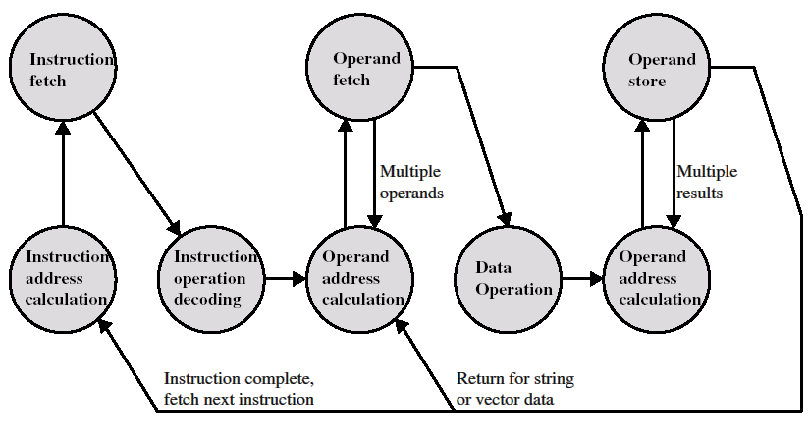
Instruction Processing
Notes:
We introduced the Instruction Execution Cycle, but we can break this down to show the processing sequence.
We teach the Fetch-Execute cycle as though it is a linear, sequential process, one after the other.
But it is actually a potential of parallelism. … Performance speedup!

Slide 22
Instruction-level parallelism

Slide 23
Superscalar architectures -1

Slide 24
Superscalar architectures-2

Slide 25
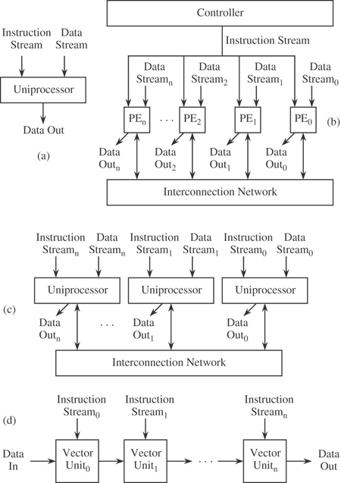
Processor-level parallelism-1
Notes:
Flynn taxonomy, Murdocca, Section 10.1

Slide 26
Processor-level parallelism - 2

Slide 27
Discussion
Difference between superscalar and parallel processing.
See Comer page 110 and page 280 - 283

Slide 28
Next Lecture
Chapter 6: Programming Languages and the Assembly Process

