Slide 1
Instruction Set Architecture (ISA)
Murdocca, Chapter 4
N.B. Case Study is Distributed Throughout Lecture.
Murdocca Text:: ARC (Sparc-based)
Lecture: Pentium (Intel)
Notes:
When presenting, unhide Slides 32,33,34,35 (Pentium instructions)

Slide 2
Objectives
Encoding of INSTRUCTIONS
Typical CPU registers.
CISC vs RISC.
Zero, one, two and three address machines – design tradeoffs.

Slide 3
ISA
ISA = {instruction set, internal storage}
= {instruction set, register set}
Typical Instruction Format
ADD X, Y Execution Semantics :
X = X + Y
Y = X + Y
opcode
operand
Intel
Motorola
0 0 0 0
0 0 0 0 0 0
0 0 0 0 0 1
Notes:
Internal storage versus register set : Most texts will say that an ISA is given by a CPU’s instruction set and its register set. In completely general and formal terms, it is really its internal storage architecture. It’s just that registers are so pervasively used, everyone forgets there are alternatives. We shall look at these alternatives in the next few slides.
But first let’s look at an instruction to introduce the terms : opcode and operand, and assembly versus machine, and execution semantics.
Question: Which execution semantics is correct ? Both are. Explain source and destination operands.
Question: If I show you this particular machine encoding of this particular instruction, what can you say about the opcode and operands.
ADD is associated with the opcode 0000. What if I want SUB ? Perhaps SUB = 0001
X must be a variable at location 0 and Y must be a variable at location 1
The ADD must be adding BYTEs, not WORDs (because X and Y are one address apart)
The address space of the memory must be 2**6 = 64 bytes long! Not very long
Here, you start to see the challenges of instruction set design: If every instruction contains addresses of operands, and addresses are 32 or 64 bits long (to handle the large amount of memory we have) then our instructions are going to start getting very long!
That in turn brings us back to the first point: internal storage versus register set …. Registers are a very efficient means of reducing addressing needs (among other things, like speed!)

Slide 4
Questions?
How many different instructions can we encode?
How many locations in memory can we encode?
How much memory is available?
How then do we access more?

Slide 5
Programmer’s Computer Model
Execution Unit:
Operands of arithmetic instructions cannot be (memory) variables; they must be from a limited number of special (internal) locations, called registers
Some registers interface to outside world via pins connected directly to special purpose bus interface registers within the processor
Notes:
Virtually all contemporary computer designs are based on the concepts developed by von Neumann. Same System Bus model as before, but with some internal components now shown. (Names shown are generic and will vary depending on the particular processor you are using, although the concepts are all the same)
Stored Program Concept: Data & instructions are stored in a read-write memory
Contents of memory are accessible by location (address) = { read, write }
Memory: Notice the addresses on the right side, showing memory as an array of Byte locations from 0 to n-1.
By convention: Width of memory cell is 1 byte (8 bits wide)
Data widths = 16,32, 64 …. Implemented as sequentially addressed cells
Execution occurs in a sequential version (unless explicitly modified)
Consequence: In the CPU, we see Execution Unit as well as PC, IR
I/O :
Notice the centrality of the CPU.
Notes on Execution Unit are concerned with registers INSIDE execution unit (Inside not shown). These programming registers differ from machine to machine, and are part of a machine’s ISA.

Slide 6
Instruction Execution Cycle
Fetch the next instruction from memory into the IR
Change the PC to point to the following instruction
Decode: Determine type of instruction just fetched
If the instruction uses a word in memory, determine where it is
Fetch the word(s), if needed, into a CPU register
Execute the instruction
Store the result in memory, if needed
Go to step 1 to begin executing the following instruction
Nickname: Fetch-Execute Cycle
Notice: When executing current instruction, PC is already pointing to next sequential instruction

Slide 7
Memory Organization & Addressing
Separation of address and data
Every memory cell has an address
Every memory cell has contents (data)
Address ≈ Pointer, Reference
Heart of dynamic memory allocation, stacks, arrays, heaps …..
Big/Little Endian
Data comes in 8 (byte), 16 (word), 32(doubleword), and 64 (quadword) bits
Multiple bytes stored in sequential addresses but in what order ?
Big Endian: MSbyte is located as lowest address (Motorola)
Little Endian: LSbyte is located at lowest address. (Intel)
Alignment
Many architectures (eg. Pentium) require words to be aligned on their natural boundaries
4-byte word may begin at address 0, 4, 8 etc. but not 1 or 2
8-byte word may begin at address 0, 8, 16, etc. but not 4 or 6
Notes:
Null & Lobur, page 186
A brief introducti
Intel 8086 and 8088: 16-bit machines
80286: also a 16-bit machine with the advantage of a larger address space
80386: 32-bit machine; all the subsequent machines have essentially the same 32-bit architecture as the 80386, called IA-32
Pentium II: memory divided into 16,834 segments
Every byte has its own address
Words are of 32 bits long stored in little-endian format
on to give background required for ISA, from the Programmer’s Perspective. Complete hardware details in a later lecture.

Slide 8
Memory Access Times
Memory access :
Most common operation; Potential performance bottleneck
Synchronized around system clock, or some sub-multiple of the system clock.
Clock = System Clock = CPU clock
Bus Clock: Usually much slower
e.g. CPUs in 100 MHz to 2 GHz range use 400MHz, 133MHz, 100MHz, or 66 MHz bus clocks (often, speed is selectable)
Goal: 1 memory cycle takes 1 bus cycle, but that means several clock cycles!
Notes:
A digression about performance (to help underpin coming discussion on ISA design: length of instructions)…
Comer, page 56
Null & Lobur, page 184
Memory access is one of the most common CPU activities. Memory access is definitely an operation synchronized around the system clock or some submultiple of the system clock. That is, reading a value from memory or writing a value to memory occurs no more often than once every clock cycle. Indeed, on many 80x86 processors, it takes several clock cycles to access a memory location. The memory access time is the number of clock cycles the system requires to access a memory location; this is an important value since longer memory access times result in lower performance..
Memory access time is the amount of time between a memory operation request (read or write) and the time the memory operation completes. Modern x86 CPUs are so much faster than memory that systems built around these CPUs often use a second clock, the bus clock, that is some sub-multiple of the CPU speed. For example, typical processors in the 100 MHz to 2 GHz range use 400MHz, 133MHz, 100MHz, or 66 MHz bus clocks (often, the bus speed is selectable on the CPU).

Slide 9
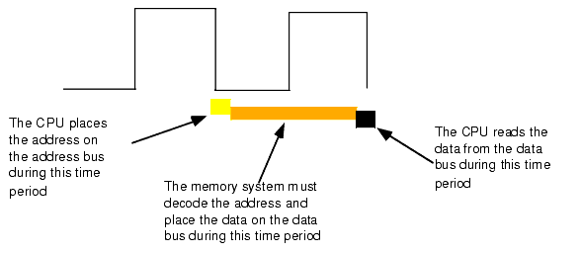
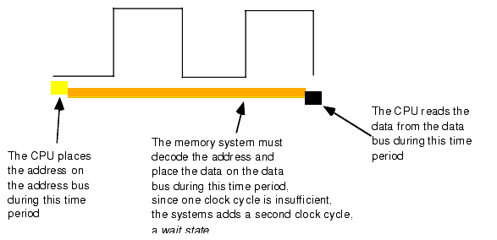
Memory Read Cycle
http://webster.cs.ucr.edu/AoA/Windows/HTML/SystemOrganizationa4.html
Notes:
Clock shown is Bus Clock!
When reading from memory, the memory access time is the amount of time from the point that the CPU places an address on the address bus and the CPU takes the data off the data bus. On typical x86 CPU with a one cycle memory access time, a read looks something like shown in Figure 1.11.Writing data to memory is similar (see Figure 1.12).
Note that the CPU doesn't wait for memory. The access time is specified by the bus clock frequency. If the memory subsystem doesn't work fast enough, the CPU will read garbage data on a memory read operation and will not properly store the data on a memory write operation. This will surely cause the system to fail.
Memory devices have various ratings, but the two major ones are capacity and speed (access time). Typical dynamic RAM (random access memory) devices have capacities of 512 (or more) megabytes and speeds of 0.25-100 ns. You can buy bigger or faster devices, but they are much more expensive. A typical 2 GHz Pentium system uses 2.5 ns (400 MHz) memory devices.
Wait just a second here! At 2 GHz the clock period is roughly 0.5 ns. How can a system designer get away with using 2.5 ns memory? The answer is wait states.
If cost-effective memory won't work with a fast processor, how do companies manage to sell fast PCs? One part of the answer is the wait state. For example, if you have a 2 GHz processor with a memory cycle time of 0.5 ns and you lose 2 ns to buffering and decoding, you'll need 2.5 ns memory. What if your system can only support 10 ns memory (i.e., a 100 MHz system bus)? Adding three wait states to extend the memory cycle to 10 ns (one bus clock cycle) will solve this problem.
Almost every general purpose CPU in existence provides a signal on the control bus to allow the insertion of wait states. Generally, the decoding circuitry asserts this line to delay one additional clock period, if necessary. This gives the memory sufficient access time, and the system works properly (see Figure 1.14).
Needless to say, from the system performance point of view, wait states are not a good thing. While the CPU is waiting for data from memory it cannot operate on that data. Adding a single wait state to a memory cycle on a typical CPU doubles the amount of time required to access the data. This, in turn, halves the speed of the memory access. Running with a wait state on every memory access is almost like cutting the processor clock frequency in half. You're going to get a lot less work done in the same amount of time.
However, we're not doomed to slow execution because of added wait states. There are several tricks hardware designers can play to achieve zero wait states most of the time. The most common of these is the use of cache (pronounced "cash") memory.

Slide 10
Memory Write Cycle
http://webster.cs.ucr.edu/AoA/Windows/HTML/SystemOrganizationa4.html

Slide 11
Instruction Rate
Fetch Instruction
Decode
Fetch Operands
Execute Instruction
Store Result
Fetch-execute cycle does not proceed at a fixed rate; time depends on operation being performed, clock speed, bus speed, and the ISA
Notes:
So what does this all mean for the instruction rate, given that instructions are stored in memory and must be fetched, operands must be fetched, results must be stored.
Comer, page 56
Null & Lobur, page 184

Slide 12
CPU Internal Storage
In execution unit, storage needed for operands while executing op
Stack architecture
Instructions and operands found on top of (memory) stack
Excellent for evaluation of expressions, good code density (HP calculators with Polish notation)
Generates high memory traffic; stack is execution bottleneck
Accumulator architecture
Accumulator is dedicated register all instructions use implicitly
Allows for very short instructions.
Generates high memory traffic
General Purpose Register architecture (GPR)
Set of registers used for multiple purposes (flexible)
Faster than memory; reduces memory traffic, easy for compilers to deal with.
Longer instructions; Uses expensive real-estate on chip, but with decreasing H/W costs …
Hence, ISA = {instruction set, programming registers}
Notes:
Remember:
Stored program concept → instruction is read into CPU to be executed
And CPU doesn’t add two memory variables in situ – the memory variables are brought into the CPU, added and returned.
Hence the need for internal storage of some form.
For more discussion on stack architectures, see Null & Lobur, page 249-252

Slide 13
Typical CPU Registers
Special-purpose registers: program counter (PC), stack pointer (SP), flag register.
Some available only in kernel mode (Used by OS)
Control caches, memory, I/O devices
General-purpose registers:
Hold key local variables
Non-programmable registers:
Internal registers for control and/or intermediate results
Instruction Register (IR)

Slide 14
Flag Register
Also called PSW (Program Status Word)
Kernel/user hybrid
Holds various miscellaneous bits that are needed by the CPU; the most important ones are the condition codes
N: set when the result was negative
Z: set when the result was zero
V: set when the result caused an overflow
A: set when there was a carry out of bit 3
C: set when there result caused a carry out of the leftmost bit
P: set when the result had even parity

Slide 15
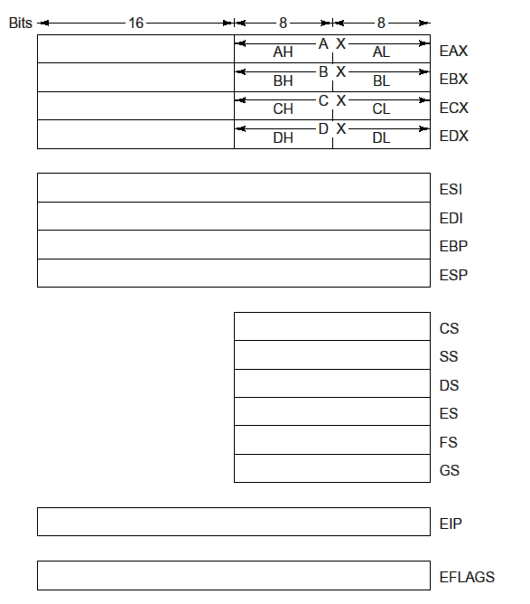
Pentium II’s primary registers
Notes:
EAX, EBX, ECX and EDX: general purpose registers (more or less)
EAX: main arithmetic register
EBX: holding pointers (memory addresses)
ECX: in looping
EDX: multiplication and division together with EAX it holds 64-bit products and dividends
Each of these registers:
Contain a 16-bit register in the low-order 16 bits and an 8-bit register in the low-order 8 bits; makes it easy to manipulate 16- and 8-bit quantities, respectively.

Slide 16
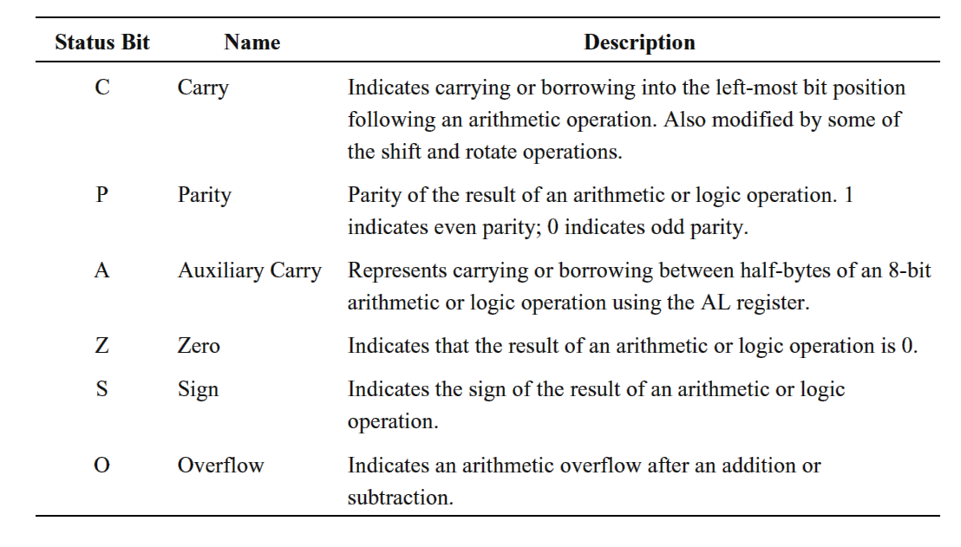
Pentium II Condition codes

Slide 17
Design Decisions for ISAs
ISA measurements
Amount of space required by program
Complexity of Instruction set (decoding & execution)
Length of instructions
Total number of instructions
Design Considerations
Long or short instructions
Fixed length versus variable length
Addressing modes
Register set design: How many? Uses ? General purpose or dedicated
Notes:
Null & Lobur, page 244

Slide 18
Example Design Issue
Maximum number of addresses one might need in an instruction?
Virtually all arithmetic and logic operations are either unary or binary
Unary: NOT INC DEC
Binary: ADD SUB MUL DIV AND OR
Maximum of two addresses to reference operands
Result must be stored, suggesting a third address
Yet …

Slide 19
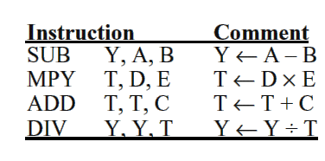
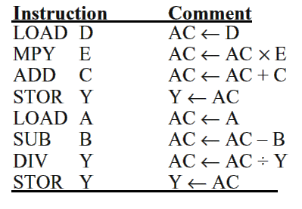
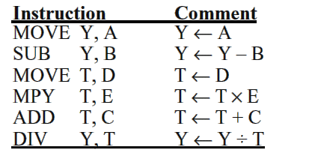
Program: Y=(A-B)/(C+DxE)
3-Address Instructions
1-Address Instructions
2-Address Instructions
Notes:
See Murdocca, page 129 for similar comparison.

Slide 20
Conclusion
Number of addresses per instruction is a basic design decision
Fewer addresses: more primitive instructions, a less complex CPU; more total instructions which in general results in longer execution times
Multiple addresses: allow the operations to be performed solely on registers

Slide 21
Fixed versus Variable Length
Should all instructions be same length ?
Addition operates on 2 operands; negation on 1 operand
Addition of 16 bit values; addition of 32 bit values
x = x + 1 x = x + 45,666
Variable-length: Space vs Speed
Optimal use of memory; all bits used
Complex hardware to fetch & decode
Fixed-length
Extra unused bits.
Simpler Fetch/Decode hardware
Higher CPU speed: No need to examine each opcode
Notes:
See Comer, page 63-64
TBD: Find similar contrasting example to show the execution difference of fixed versus variable.
Use as motivation of CISC versus RISC

Slide 22
Architectural Developments
ISA
To increase performance (Abd-El-Barr, El-Rewini)
CISC Complex Instruction Set Computer
Do more in one instruction
Programs have less instructions, less read/write
Instructions close “semantic gap”
Intel Pentium, Motorola 68000, IBM PowerPC
RISC Reduced Instruction Set Computer
Optimize architecture by speeding up those operation that are most frequently used while reducing the instruction complexities and the number of addressing modes.
Sun SPARC and MIPS
A recurring theme through this course
Notes:
Taken from Mostafa Abd-El-Barr and Hesham El-Revini: Fundamental of Computer Organization and Architecture
We want more performance. Two main prongs have been experienced, known as CISC and RISC
CISC
Sematic gap between instructions in a high-level language and those in the low-level machine language.
A single machine instruction to convert several binary coded decimals (BCD) numbers to binary
A single machine instruction to search a string for a character
A single machine instruction to compute the matrix inverse
At capabilities were added, manufacturers realized that it was increasingly difficult to support higher clock rates, because of the increased complexity of computations within a single clock period. Studies of code in the 1970 and 1980s show that 80% instructions are assignments, conditional branching (if) and procedure calls .. .and 50% of this 80% was assignment. So why spend so much time making complicated instructions when they are never used!
…. Hence, RISC
No one agrees which is best. But studies do indicate that RISC architectures would lead to faster execution of programs.
Yet, look at which processors are which ? Again, market influences technology!

Slide 23
CISC and RISC
Complex Instruction Set Computer
Large number of instructions (100’s)
Complicated instructions (cosine); variable execution time
Variable length, complex layouts
Reduced Instruction Set Computer
Simple instructions that are quick to execute; minimal set of primitive operations
Each instruction performs one operation (more fixed execution time)
Fixed length, simple layouts
All arithmetic operations performed between register (memory cannot be an operand)
Notes:
Maybe: Brief introduction here of a theme that you will start to see develop. Full details will evolve in coming lectures.
Comer, page 67
Null, page 224
Later: Murdocca, page 227 (Why CISC is coming back)
CISC are flexible and powerful, friendly to the programmer
RISC are fast and cheap
All instructions are directly executed by hardware
Maximize the rate at which instructions are issued
Instructions should be easy to decode
Only loads, stores should reference memory
Provide plenty of registers
See Comer, page 67-70

Slide 24
CISC vs RISC
Until late 70s: very complex instructions made possible with the interpreter.
Desire to simplify compilers and to improve performance
1980 VLSI CPU chip that did not use interpretation; RISC concept
Did not have to be backward compatible with existing products;
Simple instructions that could be issued quickly
Intel has been able to employ the same ideas in a CISC architecture.
Starting with the 486, the Intel CPUs contain a RISC core that executes the simplest (and typically most common) instructions in a single data path cycle, while interpreting the more complicated instructions in the usual CISC way.
Competitive performance while still allowing old sw run unmodified.
Notes:
Maybe: Brief introduction here of a theme that you will start to see develop. Full details will evolve in coming lectures.
TBD: Fix up to match Comer, Murdocca and Null

Slide 25
Principle of Orthogonality
Each instruction should perform a unique task without duplicating or overlapping the functionality of other instructions [Comer]
For the programmer:
Instructions are more easily understood
Do not need to choose between alternative
Notes:
A final design principle!
Read definition and the advantages for the programmer.
Then read Comers: This principle is one aspect of the aesthetics and elegance of the instruction set!
Yes, an architect considers how the ISA looks to the programmer, how well do instructions combine to perform common programming tasks? Are the instruction balanced (if it has right-shift, does it also have left-shift). Elegance is a subjective judgement and requires experience, although orthogonality is one measurable facet.
Comer, page 80
Now it is time to learn an ISA

Slide 26
Instruction Types
Data transfer
Most frequent
Register-register, memory-register (READ), register-memory (WRITE), input, output
Also must specify length of data
Arithmetic and Logic
Execution semantics always include effects on flags
Essentially defines capability of processor
Control (Sequencing)
Change default sequence in which instructions are executed
Used for decision making (if), loops (for/while), procedures
Instead of (address of ) data, instructions contain address of the next instruction to be executed.
Notes:
Number of opcodes varies from machine to machine
TBD: Find out Murdocca’s load/store, page 104

Slide 27
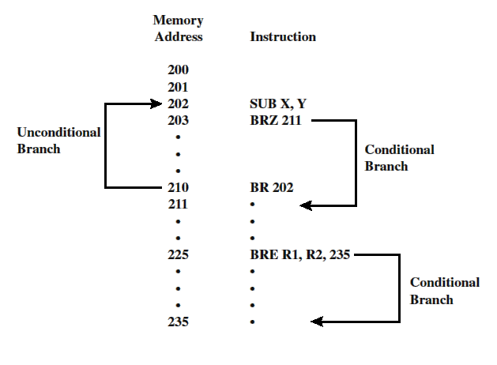
Branches/Jumps
Notes:
Conditional Jumps are predicated on the use of flags registers; that flag register was set by previous instruction which was probably an arithmetic/logic instructions.

Slide 28
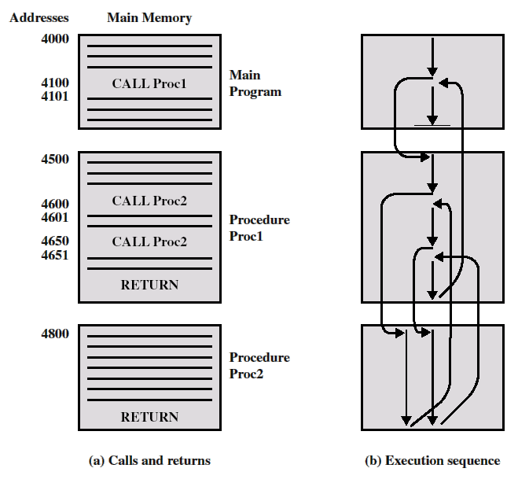
Nested Procedure Calls
Procedure ≈ Function, Method, Subroutine.
Self-contained program that is incorporated into a larger program
Libraries
At any point in the program, the procedure may be invoked, or called
Foundation of Modularity and reuse
Call instruction and a return instruction

Slide 29
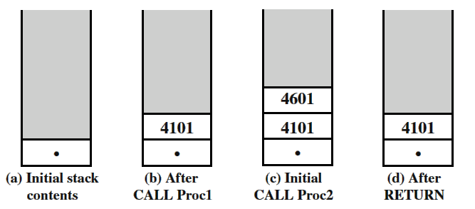
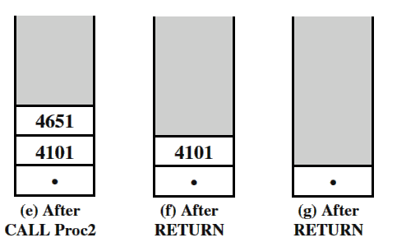
Use of stack for nested procedures

Slide 30
Subroutine Linkage
In addition to knowing how to return, a subroutine must be able to find its parameters
Registers
Fast but limited
Used in embedded, optimized
Data link area
Suffers from reentrancy problems
Stack Area
Notes:
Important to understand for
Compilers
Variable scope: local variables
Passing by reference, passing by value

Slide 31
Subroutine Linkage
Notes:
Photocopy onto an overhead and put this on projector while showing the stack frames on the next slides.

Slide 32
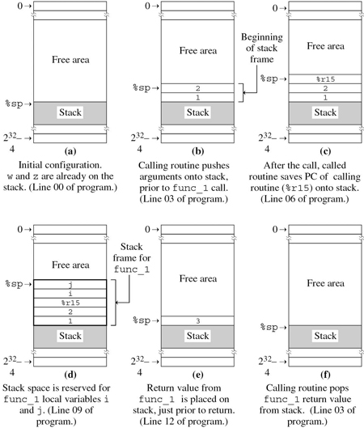
Subroutine Linkage – Using a Stack Frame

Slide 33
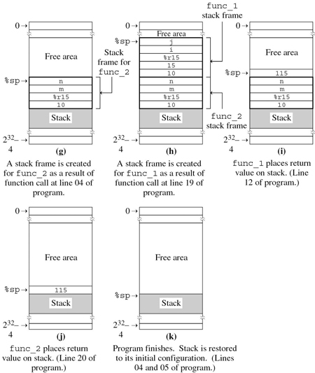
Subroutine Linkage – Using a Stack Frame

Slide 34
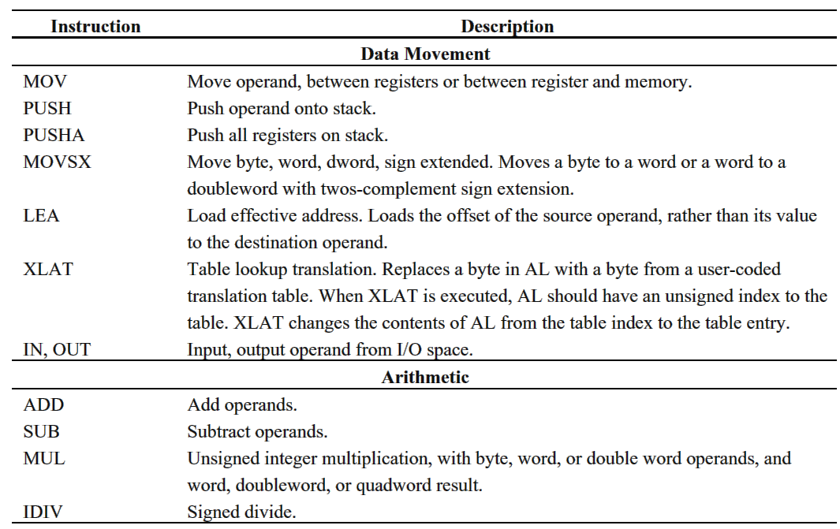
Pentium Operation Types

Slide 35
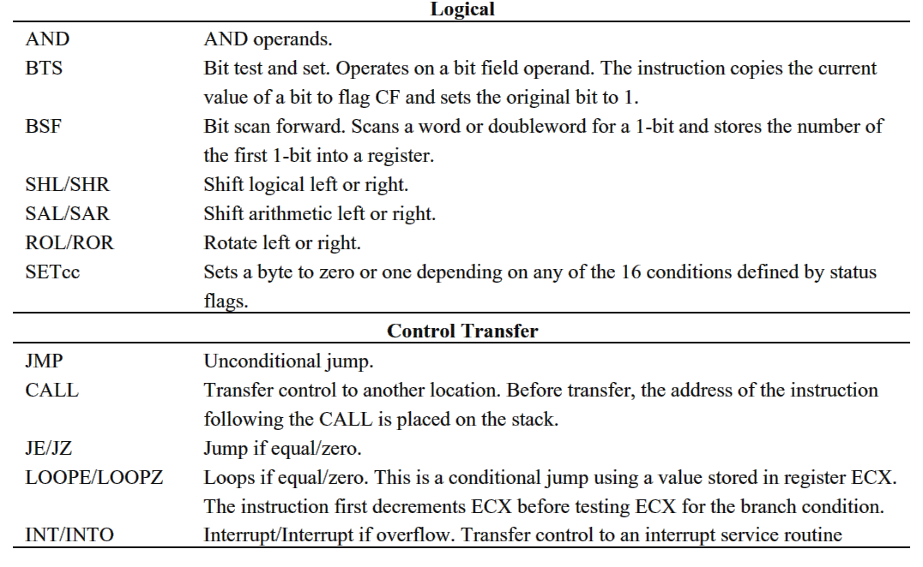

Slide 36
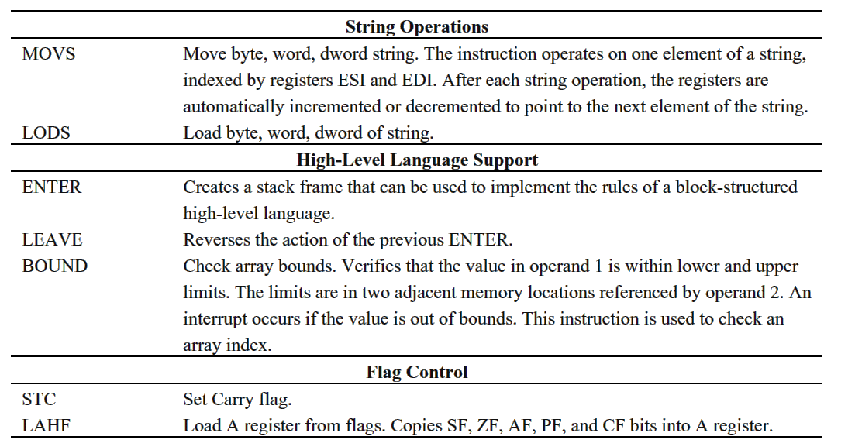

Slide 37
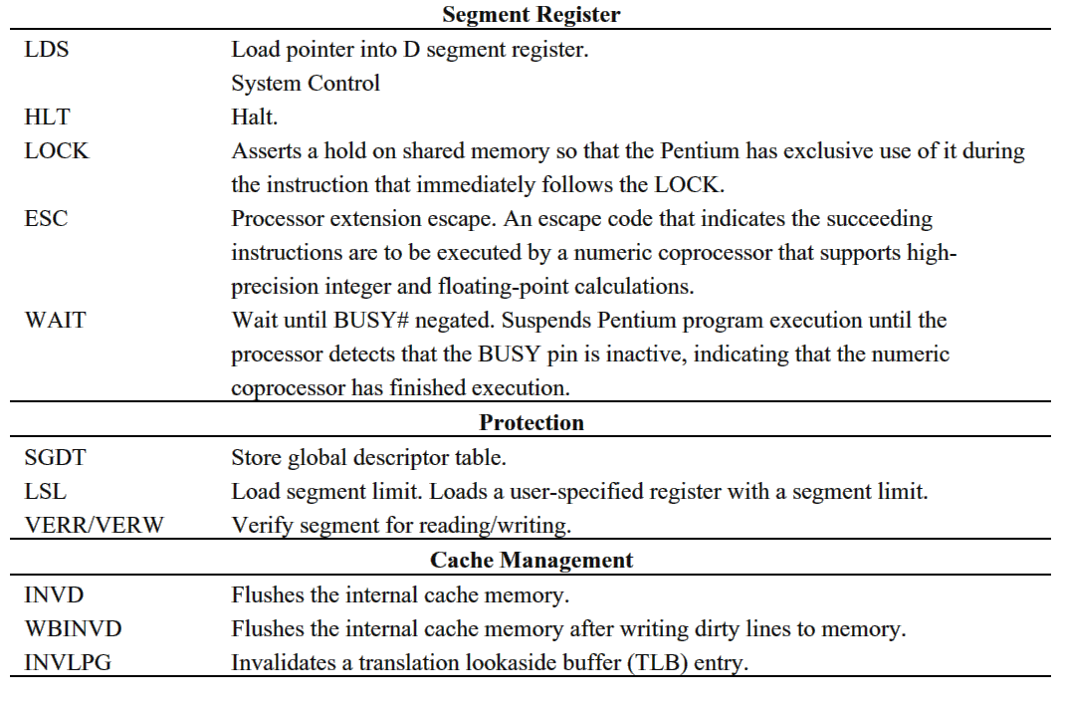

Slide 38
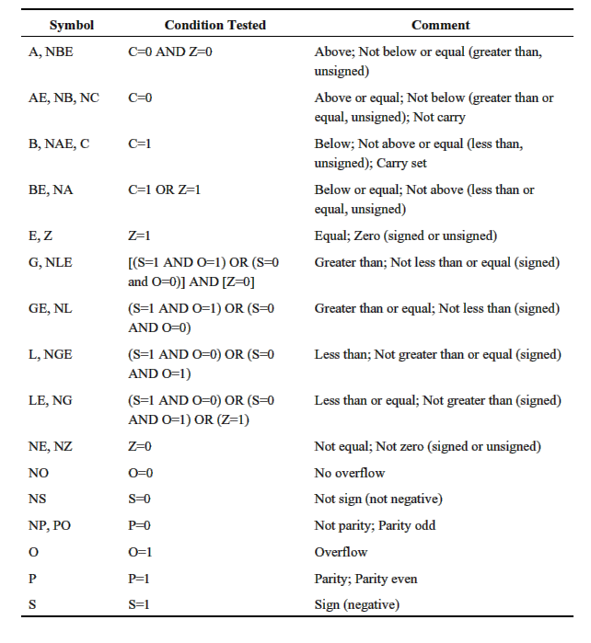
Pentium II conditions for conditional jump and SETcc

Slide 39
Addressing Modes
Every memory cell has an address and its contents
The contents can be data
… OR it can be another address!
Murdocca TABLE 4.11
Addressing Mode | Syntax | Meaning
Immediate | #K | K
Direct | K | M[K]
Indirect | (K) | M[M[K]]
Register Indirect | (Rn) | M[Rn]
Register Indexed | (Rm + Rn) | M[Rm + Rn]
Register Based | (Rm + X) | M[Rm + X]
Register Based Indexed | (Rm + Rn + X) | M[Rm + Rn + X]
Notes:
Immediate and direct are pretty fundamental and have been a part of all the samples given so far.
The rest are all variants of indirect addressing.
CLICK: Indirection is predicated on the separation of address and data for each memory cell.
CLICK: A memory cell can contain data – pure and simple and numerical in nature – or it can contain another address.
Addresses are data !!
Indirection is fundamental to pointers, dynamic allocation of heap memory, objects….
Indirection is also a principle that you will meet repeatedly in memory systems, with caching and with virtual memory
From the book ….
But I find the next slide more visually understandable.

Slide 40
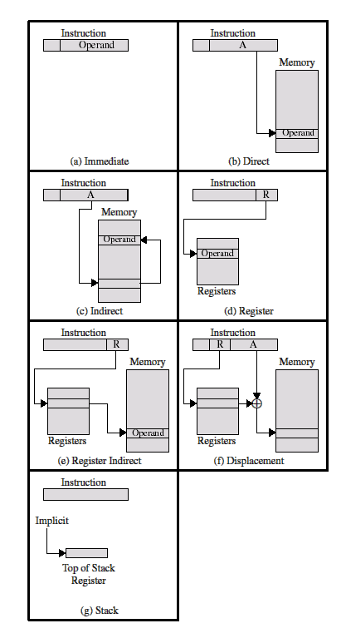
Addressing modes

Slide 41
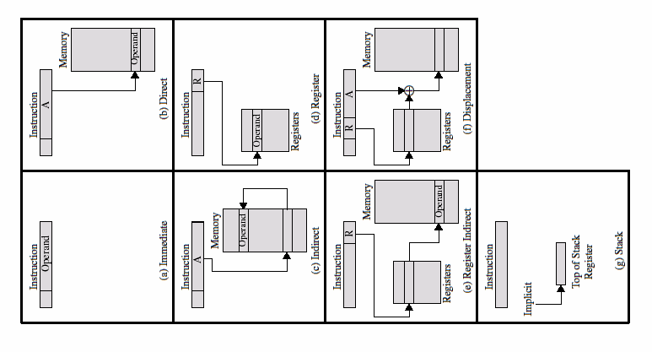
Addressing modes
Notes:
The full copy for those who want to print.

Slide 42
Generic AL program

Slide 43
Indexed addressing

Slide 44
Stack addressing
Items are appended to the top of the stack; at any given time the block is partially filled
Stack pointer is maintained in a register
Thus, references to stack locations in memory are in fact register indirect addresses
Stack mode addressing: implied addressing
Notes:
TBD ??

Slide 45
Pentium Addressing Mode Calculation

Slide 46
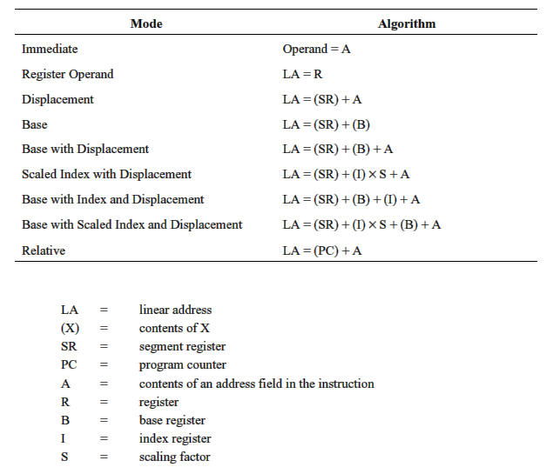
Pentium addressing modes
Notes:
Show quickly this slide and next, just to show that different processors have same concepts.

Slide 47
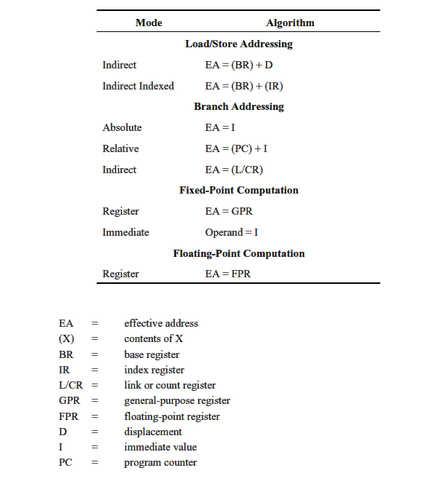
PowerPC addressing modes

Slide 48
Common instruction formats

Slide 49
Instruction formats
The layout of the bits of an instruction
Opcode
Implicitly or explicitly, zero or more operands
Each explicit operand is referenced using one of the addressing modes described previously
Key design issues:
Instruction length: memory size, memory organization, bus structure, CPU complexity and CPU speed
Allocation of bits: number of addressing modes, number of operands, number of registers, register versus memory, address range

Slide 50
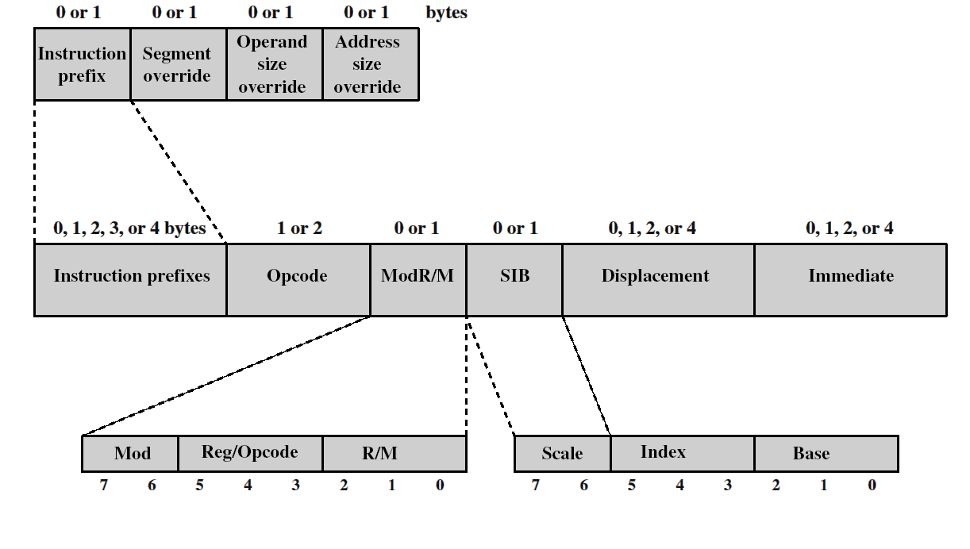
Pentium instruction formats
Highly complex and irregular; up to six variable-length fields, five of which are optional

Slide 51
Discussion
Murdocca, page 131: “While the program size and memory usage statistics calculated above are observed out of context from the larger programs in which they would be contained, they do show that having even one temporary storage register in the CPU can have a significant effect on program performance. In fact, the Intel Pentium processor, considered among the faster of the general-purpose CPUS, have only a single accumulator, though it has a number of special-purpose registers that support it. There are many other factors that affect real-world performance of an instruction set, such as the time an instruction takes to perform its function and the speed at which the processor runs”

Slide 52
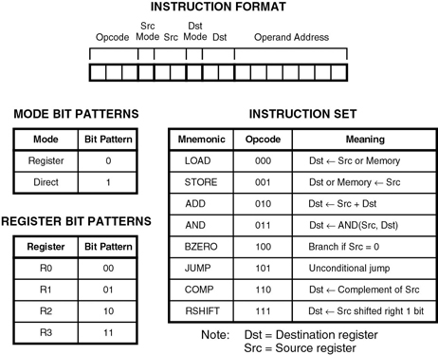
Discussion: Exercise 4.14
Notes:
A pocket pager contains a small processor with 27eight-bit words of memory. The ISA has four registers: R0, R1, R2, and R3. The instruction set is shown in Figure 4-36, as well as the bit patterns that correspond to each register, the instruction format, and the modes, which determine if the operand is a register (mode bit = 0) or the operand is a memory location (mode bit = 1). Either or both of the operands can be registers, but both operands cannot be memory locations. If the source or destination is a memory location, then the corresponding source or destination field in the instruction is not used, since the address field is used instead.
Write a program using object code (not assembly code) that swaps the contents of registers R0 and R1. You are free to use the other registers as necessary, but do not use memory. Use no more than four lines of code (fewer lines are possible). Place 0s in any positions where the value does not matter.
(b) Write a program using object code that swaps the contents of memory locations 12 and 13. As in part (a), you are free to use the other registers as necessary, but do not use other memory locations. Place 0s in any positions where the value does not matter.

Slide 53
Discussion: Exercise 4.14

Slide 54
The Von Neumann Bottleneck
“On a computer that follows the Von Neumann architecture, the time spent performing memory accesses can limit the overall performance. Architects use the term Von Neumann bottleneck to characterize the situation, and avoid the bottleneck with techniques such as restricting most operands to registers.” Comer, Essentials of Computer Architecture
Notes:
Comer, page 87
Operand addressing exposes the central weakness of Von Neumann : memory access can become a bottleneck. Because instructions are stored in memory, a processor must make at least one memory reference per instruction. If one of more operands specify items in memory, the processor must make additional memory references to fetch or store values. To optimize performance and avoid the bottleneck, operands must be taken from registers instead of memory.

Slide 55
Java Virtual Machine
javac MyProgram.java
java MyProgram
Java executable is byte-code
Machine code for the Java Virtual Machine (JVM)
“java” is an interpreter, a program that makes a machine (eg. PC) look like a JVM

Slide 56
Bytecode (and VMs)
Pros
Portability
Security: JVM places limits on what bytecode can do; protects host system
Cons: Slower than “native” code
Interpretation is overhead: software decoding of instruction
Each bytecode instruction = 10+ machine instructions on host machine
Dynamic linking
Verification (runtime checks of array bounds, invalid references (pointers)) protect host

Slide 57
Notes:
Four main parts
Execution engine: PC register and other implementation-dependent registers.
Question: PC register is 32 bits so what is the address range of a JVM? 4 gigabyte
Method area (or class area) contains information on each class program by the .class file
The method code for each class
The class data members.
Heap: contains objects. Whenever an object is created, an area for it is dynamically allocated in the heap. Contains the data fields, not the methods.
Periodically, a garbage collector runs to deallocate the storage for objects that are no longer referenced.
Stack:
Whenever a method is called, a FRAME for that method is pushed onto the top of the Java stack. The top frame is always for the currently executing method.
Each frame consists of 1) a local variable array and an operand stack (holding area for operands and return results)

Slide 58
Operand Stack (not the Java stack)
Java stack holds the stack frames
Example: iadd instruction
Pops two integers from operand stack
Adds
Pushes results back onto operand stack

Slide 59
JVM is a stack-oriented architecture
Each slot in operand stack & local variable array holds 4 bytes
All primitive types : byte, short, int, long, float, double, char)
byte & short are sign-extended
chars are zero-extended
double,long use 2 consecutive slots
Object and Array references

Slide 60
Bytecode Instruction Format
Most are 1 byte long. Opcode only
iconst_0
iconst_1
iconst_2
iconst_3
iconst_4
iconst_5

Slide 61
Bytecode Instruction Format
Multiple-byte instructions
2 byte:
bipush 6
3 byte
sipush operand
where -32768 <= operand <= +32768
Same for iadd, fadd, ladd, dadd

Slide 62
Sample Bytecode
iconst_3
bipush 6
Iadd
sipush 130
iadd
Notes:
Push 3
Push 6
Pop 6 and 3, and push result = 9
Push 130
Add 130 and 9, and push sum = 139

Slide 63
Method Invocation
Java stack holds the stack frames
Notes:
It creates a frame for the called method and pushed it onth the Java stack
It pops the arguments from the caller’s operand stack and places them in the called methods’s local variable array
If the called method is static, arguemnts are placed in the local variable array starting with 0
If the called method is instance, arguments are placed in local variable array at 1 and local variable 0 is the reference to the object that contains the called method.
Control is transferred to the called method.

Slide 64
Notes:
Code assumes variable sp points to the op of the operand stack
*sp or sp[0] access top item
*(sp+1) or sp[1] accesses item just below top
Code assumes variable ap points to first local variable in the local variable array
*ap accesses first variable, *(ap+1) accesses next
In fetch: only operand is fetched. Additional operands are fetched during the execute step.
but pc is increments so it points to the beginning of next instruction.
Decoding is done with a select, each case of which execute on instruction.

Slide 65
Why a Stack Architecture
Register-oriented architectures are faster
Minimizes time-consuming memory references
Stack-oriented architectures are slower
Operands on the stack … i.e. in memory
JVM is a virtual machine
Implemented as a program
Registers are represented by variables
Variables are in memory
“Register access” = = memory access

Slide 66
Why a Stack Architecture
So… register architecture has no performance benefit over stack architecture
And …
When operands are on a stack, don’t need extra fields in the instruction to say where operands are…
So, instructions are short
And performance is improved.

Slide 67
Next Lecture
Micro Architecture
Murdocca, Chapter 5: Datapath and Control

