Slide 1
Advanced Architectures
Parallel Architectures
Fall 2012
SYSC 5704: Elements of Computer Systems
1
Notes:
1
Comer, Chapter 17
Murdocca, Chapter 10

Slide 2
Objectives
Symmetric Multiprocessors.
Cache Coherence.
Cluster computers.
Non-Uniform Memory access Architectures.
Parallel Architectures.

Slide 3
Symmetric Multiprocessors
A stand alone computer with the following characteristics
Two or more similar processors of comparable capacity
Processors share same memory and I/O
Processors are connected by a bus or other internal connection
Memory access time is approximately the same for each processor
All processors share access to I/O
Either through same channels or different channels giving paths to same devices
All processors can perform the same functions (hence symmetric)
System controlled by integrated operating system
providing interaction between processors
Interaction at job, task, file and data element levels
Notes:
3

Slide 4
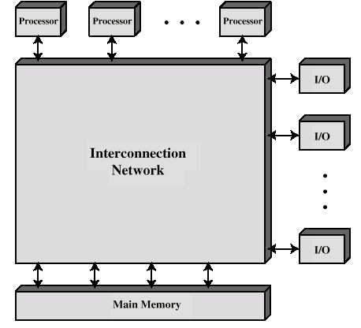
Block Diagram of Tightly Coupled Multiprocessor
Notes:
4

Slide 5
SMP Advantages
Performance
If some work can be done in parallel
Availability
Since all processors can perform the same functions, failure of a single processor does not halt the system
Incremental growth
User can enhance performance by adding additional processors
Scaling
Vendors can offer range of products based on number of processors
Notes:
5

Slide 6
Organization Classification
Time shared or common bus
Multiport memory
Central control unit
Notes:
6

Slide 7
Time Shared Bus
Simplest form
Structure and interface similar to single processor system
Following features provided
Addressing - distinguish modules on bus
Arbitration - any module can be temporary master
Time sharing - if one module has the bus, others must wait and may have to suspend
Now have multiple processors as well as multiple I/O modules
Notes:
7

Slide 8
Time Share Bus - Advantages
Advantages:
Simplicity
Flexibility
Reliability
Disadvantages:
Performance limited by bus cycle time
Each processor should have local cache
Reduce number of bus accesses
Leads to problems with cache coherence
Notes:
8

Slide 9
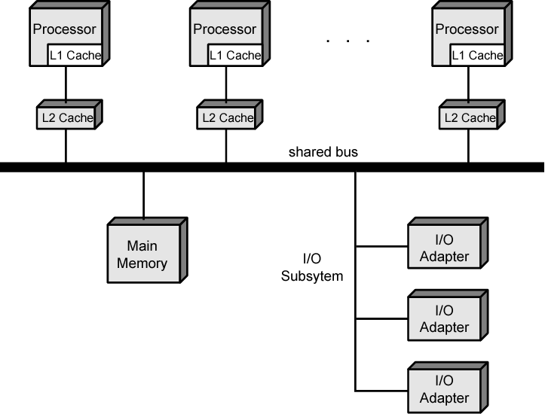
Symmetric Multiprocessor Organization

Slide 10
A Mainframe SMP IBM zSeries
Uniprocessor with one main memory card to a high-end system with 48 processors and 8 memory cards
Dual-core processor chip
Each includes two identical central processors (CPs)
CISC superscalar microprocessor
Mostly hardwired, some vertical microcode
256-kB L1 instruction cache and a 256-kB L1 data cache
L2 cache 32 MB
Clusters of five
Each cluster supports eight processors and access to entire main memory space
System control element (SCE)
Arbitrates system communication
Maintains cache coherence
Main store control (MSC)
Interconnect L2 caches and main memory
Memory card
Each 32 GB, Maximum 8 , total of 256 GB
Interconnect to MSC via synchronous memory interfaces (SMIs)
Memory bus adapter (MBA)
Interface to I/O channels, go directly to L2 cache

Slide 11
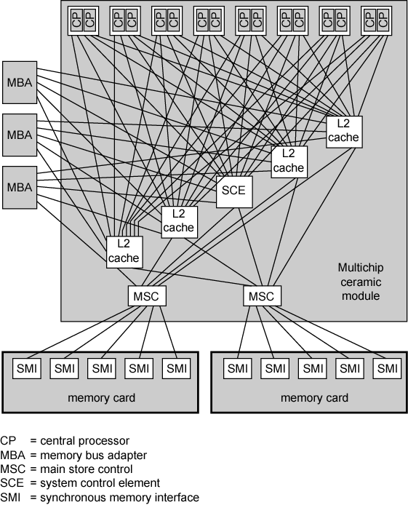
IBM z990 Multiprocessor Structure

Slide 12
Cache Coherence
Problem - multiple copies of same data in different caches
Can result in an inconsistent view of memory
Write back policy can lead to inconsistency
Write through can also give problems unless caches monitor memory traffic
Notes:
12

Slide 13
Software Solutions
Compiler and operating system deal with problem
Overhead transferred to compile time
Design complexity transferred from hardware to software
However, software tends to make conservative decisions
Inefficient cache utilization
Analyze code to determine safe periods for caching shared variables
Notes:
13

Slide 14
Hardware Solution
Cache coherence protocols
Dynamic recognition of potential problems
Run time
More efficient use of cache
Transparent to programmer
Two types:
Directory protocols
Snoopy protocols
Notes:
14

Slide 15
Directory Protocols
Collect and maintain information about copies of data in cache
Directory stored in main memory
Requests are checked against directory
Appropriate transfers are performed
Creates central bottleneck
Effective in large scale systems with complex interconnection schemes
Notes:
15

Slide 16
Snoopy Protocols
Distribute cache coherence responsibility among cache controllers
Cache recognizes that a line is shared
Updates announced to other caches
Suited to bus based multiprocessor
Increases bus traffic
Notes:
16

Slide 17
1) Write Update
Multiple readers and writers
Updated word is distributed to all other processors
Notes:
17

Slide 18
2) Write Invalidate
Multiple readers, one writer
When a write is required, all other caches of the line are invalidated
Writing processor then has exclusive (cheap) access until line required by another processor
Used in Pentium II and PowerPC systems
State of every line is marked as modified, exclusive, shared or invalid
MESI
Notes:
18

Slide 19
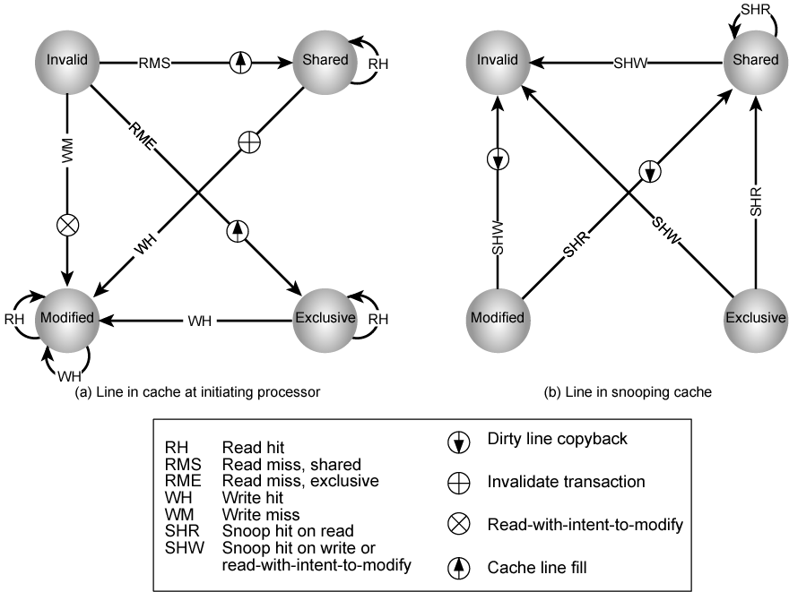
MESI State Transition Diagram
Notes:
19
Every cache line is marked with one of the four following states (coded in two additional bits):

Slide 20
Clusters
Alternative to SMP
A group of interconnected whole computers
Working together as unified resource
Illusion of being one machine
Each computer called a node
Benefits:
High availability
Server applications
Absolute or incremental scalability
Superior price/performance
Notes:
20

Slide 21
Parallelizing
Single application executing in parallel on a number of machines in cluster
Complier
Determines at compile time which parts can be executed in parallel
Split off for different computers
Application
Application written from scratch to be parallel
Message passing to move data between nodes
Hard to program
Parametric computing
If a problem is repeated execution of algorithm on different sets of data
e.g. simulation using different scenarios
Needs effective tools to organize and run

Slide 22
Cluster Configurations - Standby Server, No Shared Disk
Notes:
22

Slide 23
Cluster Configurations - Shared Disk
Notes:
23

Slide 24
Operating Systems Design Issues
Failure Management
High availability
Fault tolerant
Failover
Switching applications & data from failed system to alternative within cluster
Failback
Restoration of applications and data to original system
After problem is fixed
Load balancing
Incremental scalability
Automatically include new computers in scheduling
Middleware needs to recognise that processes may switch between machines

Slide 25
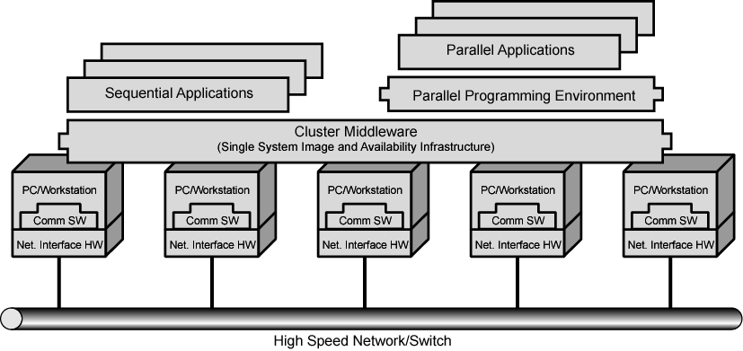
Cluster Computer Architecture

Slide 26
Cluster Middleware
Unified image to user
Single system image
Single point of entry
Single file hierarchy
Single control point
Single virtual networking
Single memory space
Single job management system
Single user interface
Single I/O space
Single process space
Checkpointing
Process migration

Slide 27
Cluster v. SMP
Both provide multiprocessor support to high demand applications.
Both available commercially
SMP for longer
SMP:
Easier to manage and control
Closer to single processor systems
Scheduling is main difference
Less physical space
Lower power consumption

Slide 28
Cluster v. SMP
Both provide multiprocessor support to high demand applications.
Both available commercially
SMP for longer
Clustering:
Superior incremental & absolute scalability
Superior availability
Redundancy

Slide 29
Nonuniform Memory Access (NUMA)
Alternative to SMP & clustering
SMP uses Uniform memory access
All processors have access to all parts of memory
Using load & store
Access time to all regions of memory is the same
Access time to memory for different processors same

Slide 30
Nonuniform Memory Access (NUMA)
Nonuniform memory access
All processors have access to all parts of memory
Using load & store
Access time of processor differs depending on region of memory
Different processors access different regions of memory at different speeds
Cache coherent NUMA
Cache coherence is maintained among the caches of the various processors
Significantly different from SMP and clusters

Slide 31
Motivation
SMP has practical limit to number of processors
Bus traffic limits to between 16 and 64 processors
In clusters each node has own memory
Apps do not see large global memory
Coherence maintained by software not hardware
NUMA retains SMP flavour while giving large scale multiprocessing
e.g. Silicon Graphics Origin NUMA 1024 MIPS R10000 processors
Objective is to maintain transparent system wide memory while permitting multiprocessor nodes, each with own bus or internal interconnection system

Slide 32
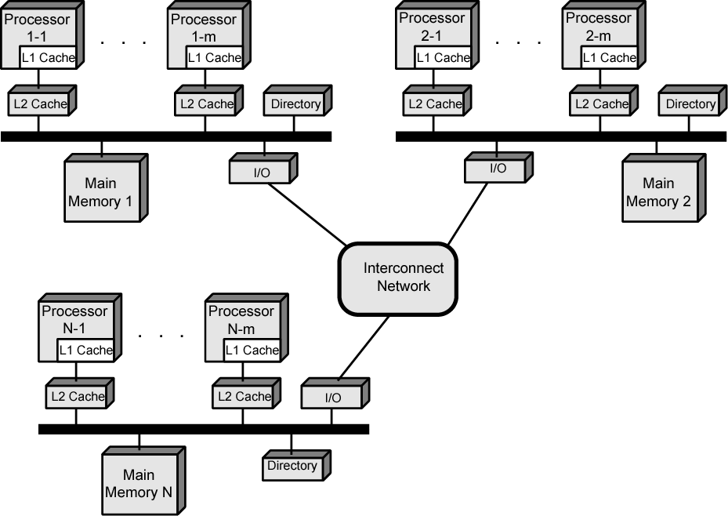
CC-NUMA Organization

Slide 33
CC-NUMA Operation
Memory request order:
L1 cache (local to processor)
L2 cache (local to processor)
Main memory (local to node)
Remote memory
Delivered to requesting (local to processor) cache
Automatic and transparent

Slide 34
CC-NUMA Operation
Each processor has own L1 and L2 cache
Each node has own main memory
Nodes connected by some networking facility
Each processor sees single addressable memory space

Slide 35
Memory Access Sequence
Each node maintains directory of location of portions of memory and cache status
e.g. node 2 processor 3 (P2-3) requests location 798 which is in memory of node 1
P2-3 issues read request on snoopy bus of node 2
Directory on node 2 recognises location is on node 1
(cont...)

Slide 36
Memory Access Sequence
Node 2 directory requests node 1’s directory
Node 1 directory requests contents of 798
Node 1 memory puts data on (node 1 local) bus
Node 1 directory gets data from (node 1 local) bus
Data transferred to node 2’s directory
Node 2 directory puts data on (node 2 local) bus
Data picked up, put in P2-3’s cache and delivered to processor

Slide 37
Cache Coherence
Node 1 directory keeps note that node 2 has copy of data
If data modified in cache, this is broadcast to other nodes
Local directories monitor and purge local cache if necessary
Local directory monitors changes to local data in remote caches and marks memory invalid until writeback
Local directory forces writeback if memory location requested by another processor

Slide 38
NUMA Pros & Cons
Effective performance at higher levels of parallelism than SMP
No major software changes
Performance can breakdown if too much access to remote memory
Can be avoided by:
L1 & L2 cache design reducing all memory access
Need good temporal locality of software
Good spatial locality of software
Virtual memory management moving pages to nodes that are using them most
Not transparent
Page allocation, process allocation and load balancing changes needed

Slide 39
What is Parallelism (Comer)
Microscopic: Present but not visible, within 1 component, or
Macroscopic: Spans <1 component, system parallelism.
Symmetric: Replicate identical elements, or
Asymmetric: Multiple elements working at same time, but doing differ things
Fine grain: At the level of individual instruction/data, or
Coarse Grain: At the level of programs/blocks of data
Implicit: Automatic, without programmer control, or
Explicit: Programmer controls each parallel unit
Fall 2012
SYSC 5704: Elements of Computer Systems
39
Notes:
The idea here is that parallelism is fundamental to computer organization and we’ve been using it already. So when we talk about parallel machines, what distinguishes it.
Microscopic: Buses are parallel, ALU units that perform bit-wise operations are parallel
Macroscopic: All multiple components to work together.
Multiple identical processors: dual processor PCs, one doing I/O and the other running apps
Multiple dissimilar processors: Coprocessors: graphics.
Symmetric:
Multiple identical processors: dual processor PCs, one doing I/O and the other running apps
Asymmetric:
Multiple dissimilar processors: Coprocessors: graphics.
Fine grain: Graphics processor that uses 16 units to simultaneouly update 16 bytes of an image
Coarse grain: The dual processor, one doing I/O and the other running apps (editing an email)
39

Slide 40
Parallel Architecture
Where parallelism is the central design feature
Where parallelism enables scaling
So distributed client/server is not necessarily a parallel architecture
Where there are >>1 processors, complete or in most part
Is Dual-Processor PC a parallel architecture?
Fall 2012
SYSC 5704: Elements of Computer Systems
40
Notes:
Question: Will depend on who you’re talking to, but in general, no. It’s for MASSIVELY parallel machines.
40

Slide 41
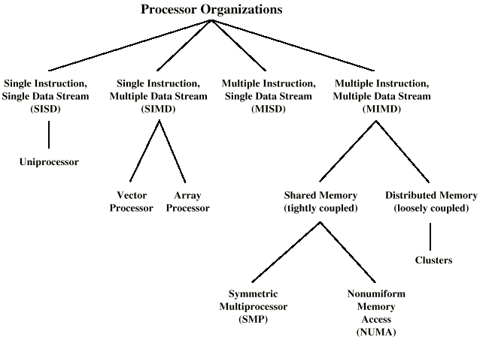
Flynn Taxonomy of Parallel Processor Architectures
Notes:
41

Slide 42
Flynn’s 1st-Level
SISD: Single instruction, single data stream
Single processor, single instruction stream, data stored in single memory
SIMD: Single instruction, multiple data stream
Single machine instruction controls simultaneous execution of >1 processing elements in “lockstep”
Each PE has own data memory so each instruction executed concurrently on different data
Notes:
42

Slide 43
Flynn’s 1st-Level (con’t)
MISD: Multiple instruction, single data stream
Sequence of data transmitted to set of processors
Each processor executes different instruction sequence
Never been implemented
MIMD: Multiple instruction, multiple data stream
Set of processors simultaneously execute different instruction sequences on different sets of data
Many sub-types … 2nd level
Many computers have >1 internal processing units, but MIMD is reserved for those where processors are explicit (visible to programmer)
Notes:
43

Slide 44
Flynn’s 2nd-Level:
Communication:
Mechanism for PEs to communicate with each other, memory and I/O devices.
Must be scalable
Coordination:
Mechanism for controlling processing.
Asymmetric: One unit is master; others are slaves
Distributed: PEs must be programmed to handle coordination.
Contention:
Concurrency leads to accessing resources at same time.
Reduces actual performance gained by parallelism
Notes:
44

Slide 45
Flynn’s 2nd level: Communication
Shared Memory: Tightly coupled
Communicate via shared data
Symmetric Multiprocessor (SMP)
Share single memory or pool via shared bus.
Memory access time to given area of memory is approximately the same for each processor
NUMA: Non-uniform memory access
Access times to different regions of memory may differ
Distributed Memory : Loosely coupled
Interconnection of independent uniprocessors (or SMPs)
Communicate via fixed path or network connections
NOW: Network of Workstations
COW: Cluster of Workstations
DCPC: Dedicated Cluster Parallel Computer
PoPC: Pile of PCs
Cluster Computing
Fall 2012
SYSC 5704: Elements of Computer Systems
45
Notes:
NOW: Collection of distributed workstations that works in parallel only while the nodes are not being used as regular workstations.
typically heterogenous units communicating over the Internet
users must enable connection to the network before joining in the parallel computation
used in building or corporate intranets.
COW: same as NOW but a single entity is in charge.
Nodes have common software
As a user, if you can access one node, you can access all nodes
DCPC: collection of workstations specifically collected to work on a set parallel computation
Common software, common file system, communicate by Internet, managed by single entity, but …. Not used for any other purpose.
PoPC : cluster of dedicated heterogeneous hardware used to build a parallel system out of mass marker commodities.
DCPC: has a few expensive machines
PoPC: has a lot of cheap machines.
45

Slide 46
Samples of Flynn’s Taxonomy
Notes:
46
Can you put a label on each one?
SISD
SIMD
MISD (Top-right) No such machine.
MIMD (Bottom-right) It’s distributed

Slide 47
Parallel Performance
Performance does not increase linearly as more processors are added.
Memory contention
Communication overhead
Works better on intensive computations
Most application are I/O bound!
Fall 2012
SYSC 5704: Elements of Computer Systems
47

Slide 48
Next Lecture
We’re done!
You’re on stage now!
Fall 2012
SYSC 5704: Elements of Computer Systems
48

Slide 49
Next Lecture
Writing programs to exploit the architecture.
Scheduling for power savings.
Assignment and course review.
Fall 2012
SYSC 5704: Elements of Computer Systems
49

