Slide 1
SYSC 5704
Elements of Computer Systems
Course Introduction
www.sce.carleton.ca/courses/sysc-5704
Notes:
Course Outline 1st.

Slide 2
Course Curriculum
Course Objective: Survey Course
Goal: Meet IEEE/ACM 2001 Computing Curricular (CC-2001)
  www.computer.org/education/cc2001
  http://www.computer.org/portal/cms_docs_ieeecs/ieeecs/education/cc2001/cc2001.pdf
IEEE Institute of Electrical and Electronics Engineers
ACM Association for Computing Machinery
Notes:
I want to assure that the topics I have chosen and the texts are those that meet the standard set by the IEEE and ACM.
Consequently, the course should provide you with a suitable background in order to meet some of your degree requirements.
Don’t tell them yet (let them read the Murdocca text) but there are online tests.
Graduate Record Examinations:
General Test: Measure veral reasoning, quantitative reasoning and critical thinking and analytical writing skills.
GRE Subject Test: Gauges undergraduate achievement in specific field of study.
http://www.ets.org/Media/Tests/GRE/pdf/CompSci.pdf

Slide 3
My Lecture Philosophy
Lecture
  Coverage of key or difficult topics, concepts, terms
  Exercises for discussion
  Case Study where applicable
You’re responsible for the whole chapter (unless otherwise indicated).
Ideally: Read before class the text
  Your 2nd time through the material

Slide 4
Project
Self-selected topic within the field
Use at least 3 references
  Either IEEE or ACM
  Interlibrary loan (RACER)
  If related, from a departmental member
  Please minimize WikiPedia references
    Use for context explanations. No source.
Presentation 15 minutes + 5 minutes questions
Paper: Following IEEE standards (See Webpage)
Encourage: Topic different from/tangential to thesis; should be new to you

Slide 5
Peer Review
Proposal
  >= 3 references
  Abstract
Paper
  4000 words, IEEE format
Presentation
Attendance is mandatory for these classes.

Slide 6
Meet & Greet
Please introduce yourself
  Name
  Degree or Special; Full or Part-time
    Degree: Program, Supervisor, How far along
  Background
  Interest

Slide 7
Elements of Computer Systems
Historical Overview

Slide 8
Computer Systems – Why ?
Performance :
  Program optimization and system tuning
Applications
  Compilers : Hardware dependence
  “Systems” : Peripheral support
  Embedded Computing : Resource constraints
Notes:
Computer scientists are usually more concerned with writing complex program algorithms than with designing computer hardware. But these algorithms eventually run on a computer and to understand whether an algorithm is feasible, how an algorithm will perform, you must be able to see that program from the computer’ point of view. You cannot optimize your program without understanding the computer. So performance – in the form of program optimization and system tuning – a key motivations for learning how computers work.
Other reasons are driven by different kinds of applications :
How can you write a compiler without knowing the environment within which the compiler will work.
How can you develop a distributed control systems made up of sensors and actuators, without knowing how peripherals provide input and output to your computer
How can you work within an embedded systems environment – such as robotics or cell phone – without knowing how to deal with the severe memory and power constraints present in this environments.

Slide 9
Standards Organizations
IEEE : Institute of Electrical and Electronics Engineers
ACM : Association of Computing Machinery
ITU : International Telecommunications Unit (formerly CCITT)
ISO : International Organization for Standardization.
  ANSI : American National Standards Institute
Notes:
IEEE : standards for computer components, signaling protocols, data representation
ITU : interoperability of telecommunications systems (telephone, telegraph, data communications)
ISO : is not an acronym but derives from the Greek word “isos” meaning equal.
Global standardization
Umbrella for the national groups, such as ANSI

Slide 10
Key Terms
Computer Organization: How does a computer work ?
  Physical aspects : Control signals, memory types
Computer Architecture: How do I design a computer ?
  Logical aspects as seen by programmer
  Structure and behaviour of the system
Notes:
The distinction between computer organization and computer architecture is not clear-cut. People hold different opinions. The division is not black-and-white. Actually neither can stand alone – they are related terms. But it helps to organize some of the topics coming up, and one of the goals of this course is to establish a working knowledge of the industry vocabulary.

Slide 11
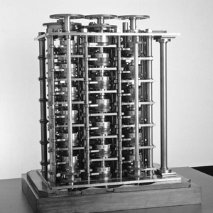
Computer History : Gen 0
Mechanical Computers: using dials, pegged cylinders, cogs, gears …
Blaise Pascal (1623-1662) : Calculating machine for taxes
  Mechanical Calculation: Add, subtract
Charles Babbage (1791-1871)
  Added mechanical control (ie. algorithm)
  Functions: input, store, calculate, control of operation, output
  Difference Engine Add/subtract tables of numbers for navigation
  Analytic Engine: Programmable general purpose computer
Figure 1-6 Murdocca
Notes:
References: Linda Null’s Book and Murdocca
The text begins the history in 25000 BC with tally ticks as well as the Chinese abacus.
I don’t want to go that far back but you should read the chapter. It’s interesting.
Pascal used mechanical calculation
Babbage combine mechanical calculation with mechanical control … where control implies a sequence of operations (not just one), in other words, an algorithm. However, it could run only one algorithm.
Difference Engine could perform addition and subtraction of large tables of numbers, to be used in navigational systems. It was never actually built.
Analytic Engine could also branch, and could be programmed using “punch cards”. Again, it was never built.
Why weren’t they built ? Because technology did not exist to build the numerous cogs, wheels and gears needed with the required tolerances.
None of these were actually built, yet they constitute the forerunners of our computers, in terms of functions : input, output, store, calculate, sequence control

Slide 12
Computer History – Gen 1
Vacuum Tubes (1945 – 1953)
Controversy:
Inventor of Electronic Digital Computer ?
  John Atanasof (1904-1995)
    Built first binary machine from vacuum tubes
    Solved only linear equations; not general purpose computer
  John Mauchly (1907-1980) and J. Presper Eckert (1929-1995)
    ENIAC (Electronic Numerical Integrator and Computer)
Notes:
Reference: Linda Null’s book.
There were many branches of history, but three names stand out.
Atanasof built the ABC (Atanasoff Berry Computer).
Mauchly and Eckert were two principal leads on the ENIAC project.
There was a lawsuit in 1988 as to who should get the patent and credit for the first electronic computer because although the ABC was limited in application, it did contain many of the same functional units as the ENIAC.

Slide 13
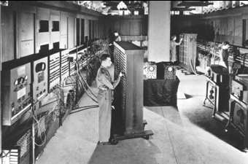
Computer History – Gen 1
“Where …. the ENIAC is equipped with 18,000 vacuum tubes and weights 30 tons, computers in the future may have 1,000 vacuum tubes and perhaps weigh just 1 ½ tons”, Popular Mechanics, March 1949
Notes:
The ENIAC is generally regarded as the first electronic (general-purpose) computer.
The ENIAC was built during (actually after) WWII for calculating ballistic trajectories. It shortened calculations from 20 hour to 30 seconds. The computer was born!
But :
Programming it and entering data was done through switches and pulling cables. Need some way to store the program.
The architecture was built on decimal arithmetic, with each digit represented by 10 vacuum tubes.
Vacuum tubes were large, full of heat, prone to blowout …
Now before we leave the ENIAC, it should be said (and it’s in the text) that another famous person originally worked on the ENIAC project but wasn’t part of the end result. Van Neumann. Hold onto that name for now.

Slide 14
Computer History: Gen 2
Transistors (1954 – 1965)
Bell Labs 1948 – John Bardeen, Walter Brattain, William Shockley (Nobel Prize)
  For televisions, radios … computers.
Less power, less room, more reliable
  Dawn of the computer industry : IBM, Digital Equipment Corp (DEC), Univac (now Unisys)
Example: DEC PDP-1 (1961) First minicomputer; 4096 words of 18-bit words, 200,000 instructions/sec; visual display = $120000.
Notes:
Last line: Obviously, computers were mostly owned by universities, governments and large businesses.

Slide 15
Computer History: Gen 3
Integrated Circuits (1965 – 1980)
  Integration : Putting more than one circuit on one (silicon) chip.
  Jack Kilby : invented microchip … on germanium
  Robert Noyce: did same … on silicon
Age of IBM : 7094, 1401 and System/360
  Time-sharing/Multiprogramming: >1 person using same computer at the same time
  Led to developments in operating systems.
  DEC focussed on greater accessibility : DEC’s PDP-8 and 11 were affordable to smaller businesses.
Notes:
Poor Kilby, he used the wrong material. Noyce did his six months after Kilby, but is credited with the explosion accompanying ICs.

Slide 16
Computer History: Gen 4
VLSI : Very Large Scale Integration
  SSI : 10 – 100 components per chip
  MSI : 100 – 1000
  LSI : 1000 – 10,000
  VLSI : 10,000+
Perspective: 1997’s ENIAC-on-a-chip
Notes:
From 1980, the level of integration simply increased.
In 1997, to commemorate the 50th anniversary of the ENIAC’s 1st appearance, a group of student at the University of Pennsylvania constructed a single-chip equivalent of the ENIAC. The 1800 square foot, 30 ton beast that required 174 kilowatts of power was reduced to a chip the size of a thumbnail.

Slide 17
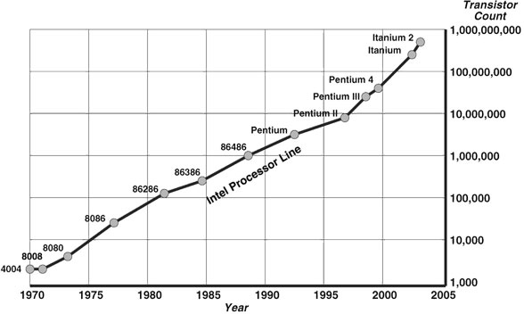
Moore’s Law
1965, Intel founder Gordon Moore: “The density of transistors in an integrated circuit will double every year”.
Figure 1-11 Murdocca
Notes:
Moore only intended this to last 10 years. It has held for almost 40 years although it is held that the number of transistors doubles every 18 months (60% increase in transistor count per year).
Many people believe it will hold into the 2010’s or 2020 at which time transistors will consist of few too atoms to be reliable. However advances in quantum computing may make it possible by then to store 1 bit using the spin of a single electron!!!
…. OR computers will shift to a radically new technology, fashioned around organic computing.
That will be Generation 5 … your lifetime!
But let’s review the present day …

Slide 18
Computer History: Gen 4
Moore’s law can be used in different ways:
  build increasingly powerful computers at constant price or
  build the same computer for less and less money every year.
Trends:
  1971: A microprocessor was born: IBM 4004 contained all of the components of a CPU on a single chip.
    Personal Computing: IBM PC
  Memory: Since 1978, semiconductor memory has been through 11 generations: 1K, 4K, 16K, 64K, 1M, 4M, 16M, 64M, 256M and 1Gbits on a single chip (1K=2^10; 1M=2^20; 1G=2^30)
  Embedded Computers: appliances, watches, bank cards.
    Pervasive computing
  Mainframes have evolved into enterprise servers
    Passed billion-instructions-per-second in late 1990’s
    Web servers : handle hundreds of thousands transactions per minute.
Notes:
The second way of Moore’s law is also known as Rock’s Law, proposed by an early Intel capitalist Arthur Rock.
Rock’s law is a corollary “ The cost of capital equipment to build semiconductors will double every four years”
From his point as a financier, he saw the price tag of new chip facilities escalate from 12000 in 1968 to 12 million in late 1990.
In 2005, the cost of building a new chip plant was nearing 3 billion.
At this rate, by 2035, not only will the size of a memory element be smaller than an atom, but it would also require the entire wealth of the world to build a single chip!
Ultimately, Moore’s and Rock’s law demonstrate one of the fundamental tensions in computer architectural design: cost, technological capability (eg. Babbage didn’t have the technology to build his gears) and function.
With the trends, note that integration allows us to support polar markets:
Personal computing versus enterprise computing. The 1980-2000 was marked by the distribution of computers to every desk. Everyone needs a computer. The challenge was to network. A current trend is to “CLOUD COMPUTING” where we return ESSENTIALLY to the mainframe, except now the mainframe is just “out there” (not owned by a company, but by a service provider)
Embedded versus enterprise computing: Systems are getting smaller and more pervasive. Systems are getting larger and more dominant (banking, aviation, government, WEATHER PREDICTION)

Slide 19
The Computer Spectrum
Type | Price | Example
Disposable | $.50 | Greeting card
Microcontroller | 5 | Watches, cars, appliances
Game Computer | $50 | Home video games
Personal Computer | $500 | Desktop or notebook
Server | $5000 | Network Server
Cluster of Workstations | $50-500K | Departmental minisupercomputer
Mainframe | $5 M | Batch data processing in a bank
Figure 1-9, Tannebaum, Structured Org, 5th Ed.
Notes:
From Tanenbaum
Server is really just a beefed up personal computer (from an architectural viewpoint) – faster, bigger, more disk space and possible faster network connection.
Mainframe: For the most part, they are not much faster than powerful servers, but they always have more I/O capacity and are often equipped with vast disk farms, often holding thousands of gigabytes of data. While expensive, they are often kept running due to the immense investment in software, data, operating procedures and personnel they represent.
So, mostly for legacy, although the Internet is breathing new life as they are being used for Internet servers that need massive number of e-commerce transactions per second : combination of high I/O rate and large databases match the mainframe’s suite of features.
What about supercomputers – the mainframe “cousin” that have super-fast CPUs. Now mostly replaced by clusters with very fast memory – memory is often the bottleneck and parallelism addresses the computational speed need.

Slide 20
Next Lecture
Murdocca: Read Chapter 1
Topic: Processor Model and Measuring Performance
Suggestion: Appendix A Digital Logic

Slide 21
Digital Logic
Combinational Logic
  Electronic implementation of boolean logic
  Translates a set of inputs into a set of outputs
  Logic Gates and Components
Sequential Logic
  Finite State Machines
  Translates an input and a current state into an output and a new state.

Slide 22
Logic Gates
http://www.play-hookey.com/digital/basic_gates.html
AND, OR, NOT, XOR
Binary Addition
Is a 1 always a one? Thresholds, Rise/Fall Times
Positive and Negative Logic
  Positive (Active High): High = 1 = True
  Negative (Active Low): Low = 0 = True

Slide 23
Digital Components
n:1 Multiplexers
  1:n Demultiplexers
n:m Decoders
  m:n Encoders

Slide 24
Sequential Logic
Flip-Flop: Maintains stable outputs even when inputs are inactive
  It remembers!
http://www.play-hookey.com/digital/basic_gates.html
  SR (Look at Basic RS NOR Latch)
  Clocked SR
  D latch : One memory cell (1 bit)

Slide 25
Central Processor Model

Slide 26
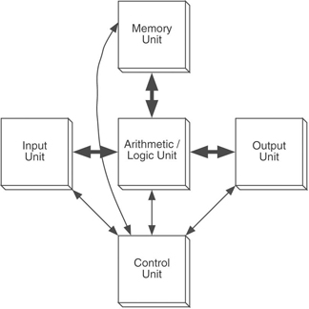
The VON Neumann Model
Stored Program Concept:
Memory contains both data and code
Execution Unit
Figure 1-13 Murdocca
Notes:
Review each part…
Systems: Mathematical foundation where a system (Laplace,Fourier,Z) transforms inputs into outputs.
Each program is a system transformation!
The execution of a stored program is the most important aspect of the von Neumann model. A program is stored in the computer's memory along with the data to be processed. Although we now take this for granted, prior to the development of the stored-program computer, programs were stored on external media, such as plugboards or punched cards or tape. In the stored-program computer the program can be manipulated as if it is data. This gave rise to compilers and operating systems, and makes possible the great versatility of the modern computer as we know it today.
Original model has evolved a bit …
Encapsulation of ALU and Control Unit
Unification of interfaces into single shared bus.
Together, they lead to the notion of a CENTRAL processing unit (served by memory and I/O)

Slide 27
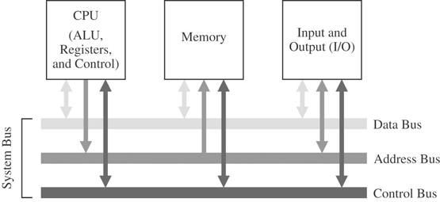
The System Bus Model
Figure 1-14 Murdocca
Notes:
Although the von Neumann model prevails in modern computers, it has been streamlined. Figure 1-14 shows the system bus model of a computer system. This model decomposes a computer system into three subunits: CPU, Memory, and Input/Output (I/O). This refinement of the von Neumann model combines the ALU and the control unit into one functional unit, the CPU. The input and output units are also combined into a single I/O unit.
AND the shared bus interface!
Buses are made up of collections of wires that are grouped by function.
Review : Address
Notice the direction: Data and Control are bidirectional, address is unidirectional
Shared between devices, so we need some way to coordinate.

Slide 28
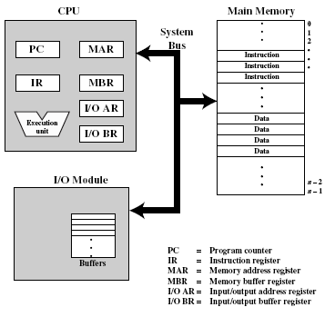
Programmer’s Computer Model
Execution Unit:
Operands of arithmetic instructions cannot be (memory) variables; they must be from a limited number of special (internal) locations, called registers
Some registers interface to outside world via pins connected directly to special purpose bus interface registers within the processor
Notes:
Virtually all contemporary computer designs are based on the concepts developed by von Neumann. Same System Bus model as before, but with some internal components now shown. (Names shown are generic and will vary depending on the particular processor you are using, although the concepts are all the same)
Stored Program Concept: Data & instructions are stored in a read-write memory
Contents of memory are accessible by location (address) = { read, write }
Memory: Notice the addresses on the right side, showing memory as an array of Byte locations from 0 to n-1.
By convention: Width of memory cell is 1 byte (8 bits wide)
Data widths = 16,32, 64 …. Implemented as sequentially addressed cells
Execution occurs in a sequential version (unless explicitly modified)
Consequence: In the CPU, we see Execution Unit as well as PC, IR
I/O :
Notice the centrality of the CPU.
Notes on Execution Unit are concerned with registers INSIDE execution unit (Inside not shown). These programming registers differ from machine to machine, and are part of a machine’s ISA.

Slide 29
(5 stage)
Instruction Execution Cycle
Instruction Fetch (IF): From memory into IR
  Change the PC to point to the following instruction
Instruction Decode(ID) : Determine type of instruction
Operand(s) Fetch (OF):
  If instruction uses word in memory, fetch into CPU register
Instruction Execution(EX)
Operand Store (OS): Put result in memory, if needed
Nickname: Fetch-Execute Cycle
Notice: When executing current instruction, PC is already pointing to next sequential instruction
Notes:
Page 53, Modern Processor Design (Shen & Lipasti)

Slide 30
Performance …
Simply: How fast to execute an instruction
Machine Cycle Time (CPU clock)
- All sequential logic is “clocked”
Memory Cycle Time
Memory Access Time
Instruction Execution Time
Instruction Cycle Time
Notes:
We are going to talk about measuring the performance of a processor.
These times are the components…
Machine Cycles – Remember the D flip-flop

Slide 31
Memory Organization & Addressing
Separation of address and data
  Every memory cell has an address
  Every memory cell has contents (data)
  Address ≈ Pointer, Reference
  Heart of dynamic memory allocation, stacks, arrays, heaps …..
Big/Little Endian
  Data comes in 8 (byte), 16 (word), 32(doubleword), and 64 (quadword) bits
  Multiple bytes stored in sequential addresses but in what order ?
  Big Endian: MSbyte is located as lowest address (Motorola)
  Little Endian: LSbyte is located at lowest address. (Intel)
Alignment
  Many architectures (eg. Pentium) require words to be aligned on their natural boundaries
    4-byte word may begin at address 0, 4, 8 etc. but not 1 or 2
    8-byte word may begin at address 0, 8, 16, etc. but not 4 or 6
Notes:
Null & Lobur, page 186
A brief introducti
Intel 8086 and 8088: 16-bit machines
80286: also a 16-bit machine with the advantage of a larger address space
80386: 32-bit machine; all the subsequent machines have essentially the same 32-bit architecture as the 80386, called IA-32
Pentium II: memory divided into 16,834 segments
Every byte has its own address
Words are of 32 bits long stored in little-endian format
on to give background required for ISA, from the Programmer’s Perspective. Complete hardware details in a later lecture.

Slide 32
Memory Access Times
Memory access :
  Most common operation; Potential performance bottleneck
  Synchronized around system clock, or some sub-multiple of the system clock.
Clock = System Clock = CPU clock
Bus Clock: Usually much slower
  e.g. CPUs in 100 MHz to 2 GHz range use 400MHz, 133MHz, 100MHz, or 66 MHz bus clocks (often, speed is selectable)
  Goal: 1 memory cycle takes 1 bus cycle, but that means several clock cycles!
Notes:
A digression about performance (to help underpin coming discussion on ISA design: length of instructions)…
Comer, page 56
Null & Lobur, page 184
Memory access is one of the most common CPU activities. Memory access is definitely an operation synchronized around the system clock or some submultiple of the system clock. That is, reading a value from memory or writing a value to memory occurs no more often than once every clock cycle. Indeed, on many 80x86 processors, it takes several clock cycles to access a memory location. The memory access time is the number of clock cycles the system requires to access a memory location; this is an important value since longer memory access times result in lower performance..
Memory access time is the amount of time between a memory operation request (read or write) and the time the memory operation completes. Modern x86 CPUs are so much faster than memory that systems built around these CPUs often use a second clock, the bus clock, that is some sub-multiple of the CPU speed. For example, typical processors in the 100 MHz to 2 GHz range use 400MHz, 133MHz, 100MHz, or 66 MHz bus clocks (often, the bus speed is selectable on the CPU).

Slide 33
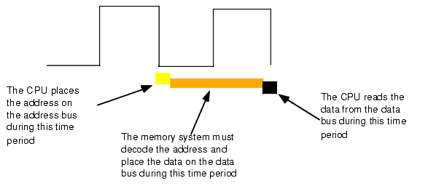
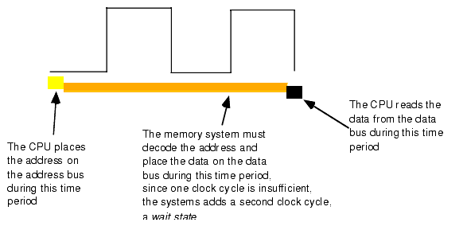
Memory Read Cycle
http://webster.cs.ucr.edu/AoA/Windows/HTML/SystemOrganizationa4.html
Notes:
Clock shown is Bus Clock!
When reading from memory, the memory access time is the amount of time from the point that the CPU places an address on the address bus and the CPU takes the data off the data bus. On typical x86 CPU with a one cycle memory access time, a read looks something like shown in Figure 1.11.Writing data to memory is similar (see Figure 1.12).
Note that the CPU doesn't wait for memory. The access time is specified by the bus clock frequency. If the memory subsystem doesn't work fast enough, the CPU will read garbage data on a memory read operation and will not properly store the data on a memory write operation. This will surely cause the system to fail.
Memory devices have various ratings, but the two major ones are capacity and speed (access time). Typical dynamic RAM (random access memory) devices have capacities of 512 (or more) megabytes and speeds of 0.25-100 ns. You can buy bigger or faster devices, but they are much more expensive. A typical 2 GHz Pentium system uses 2.5 ns (400 MHz) memory devices.
Wait just a second here! At 2 GHz the clock period is roughly 0.5 ns. How can a system designer get away with using 2.5 ns memory? The answer is wait states.
If cost-effective memory won't work with a fast processor, how do companies manage to sell fast PCs? One part of the answer is the wait state. For example, if you have a 2 GHz processor with a memory cycle time of 0.5 ns and you lose 2 ns to buffering and decoding, you'll need 2.5 ns memory. What if your system can only support 10 ns memory (i.e., a 100 MHz system bus)? Adding three wait states to extend the memory cycle to 10 ns (one bus clock cycle) will solve this problem.
Almost every general purpose CPU in existence provides a signal on the control bus to allow the insertion of wait states. Generally, the decoding circuitry asserts this line to delay one additional clock period, if necessary. This gives the memory sufficient access time, and the system works properly (see Figure 1.14).
Needless to say, from the system performance point of view, wait states are not a good thing. While the CPU is waiting for data from memory it cannot operate on that data. Adding a single wait state to a memory cycle on a typical CPU doubles the amount of time required to access the data. This, in turn, halves the speed of the memory access. Running with a wait state on every memory access is almost like cutting the processor clock frequency in half. You're going to get a lot less work done in the same amount of time.
However, we're not doomed to slow execution because of added wait states. There are several tricks hardware designers can play to achieve zero wait states most of the time. The most common of these is the use of cache (pronounced "cash") memory.

Slide 34
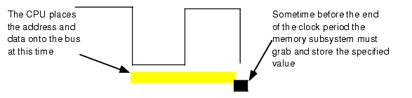
Memory Write Cycle
http://webster.cs.ucr.edu/AoA/Windows/HTML/SystemOrganizationa4.html

Slide 35
Instruction Rate
Fetch Instruction
Decode
Fetch Operands
Execute Instruction
Store Result
Fetch-execute cycle does not proceed at a fixed rate; time depends on operation being performed, clock speed, bus speed, and the ISA
Notes:
So what does this all mean for the instruction rate, given that instructions are stored in memory and must be fetched, operands must be fetched, results must be stored.
Comer, page 56
Null & Lobur, page 184

Slide 36
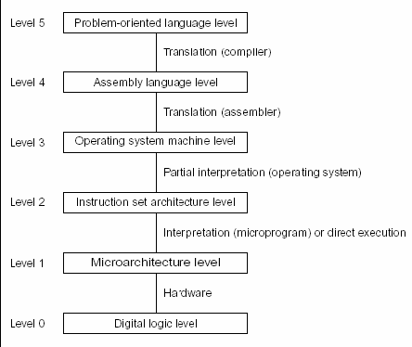
Machine Levels
Notes:
With millions of transistors making up a computer, we need to approach computers through abstract models.
Computer models are broken into levels – The book shows one breakdown which I’ll let you read about in the text. Here is another popular version. (Similar to Linda Null’s breakdown). In either case, the models at the top are high-level abstractions where you need to know nothing about how the computer works, only have to deal with your programming problem at hand. At the bottom is the actual transistors, and you only have to know all these details if you are an ASCI chip designer. However, ultimately any program run has to be transformed from the high level to the low level, passing through various tools and forms before actually becoming a voltage change in some transistor.
In this course, we are interested in touching on the key topics for Level 1 to 4, and maybe even get some insight into Level 0, depending on your interest and background.

Slide 37
Processor Models
Architecture:
  Functional behaviour of a processor
  Represented by the ISA
MicroArchitecture:
  Organization, Implementation
  Logical structure that performs the architecture
Realization:
  Physical structure that embodies the implementation
Notes:
Architectures: Sparc, IBM 360, DEV VAX, Motorla 68K, Power PC, Intel IA32
Interface to software as perceived by the compiler.
MicroArchitecture or Organization: Next Slide
Attributes: pipeline design, caches, … This is what I want to talk about
Realization: Different clock frequencies, cache memory capacity, bus interface, fabrication technology, packaging
- Attributes: die size, physical form factor, power, cooling, realability.

Slide 38
The Intel CPU Family
Notes:
This table summarizes some of the main developments of the Intel 80x86 family on which the IBM PC is based.
It demonstrates how speed, integration (#transistors), memory has increased, and on the side are some of the architectural advancements that we will be talking about (cache, pipelining).
Throughout all this, and really from the days of the ENIAC …. From one of the contributors of the ENIAC project … all electronic digital computers have been founded on the same architectural model : Next page ….

Slide 39
Trends
1980’s: Architectural or ISA optimizations
  An instruction set to support efficient implementations
  RISC versus CISC
1990’s: Microarchitectural optimizations
  Instruction Level Parallelism (fine-grained)
  Pipelining, Superscalar
2000’s: Thread-Level Parallelism (TLP), Memory Parallelism, Integration, Power
Notes:
Power: Macro-issues become micro issues.

Slide 40
Micro-Architectures
Non-pipelined – Von Neumann
  Sequential instruction execution cycle
(Scalar) Pipelined
  Parallelism in the instruction execution cycle with instruction pipeline
  Scalar: Fetch (and Issue) at most one instruction every machine cycle
Superscalar:
  Fetch and issue multiple instructions every machine cycle
  >1 execution unit, >1 pipeline

Slide 41
Instruction-Level Parallelism ILP
Uniprocessors, parallelism at functional unit level
Norm Jouppi (‘89) Classification Parameters
  Operation Latency (OL) : #machine cycles for execution of instruction
    Time when result is available for next instruction
  Machine Parallelism(MP): max # simultaneous instructions “in-flight”
  Issue Latency (IL): #machine cycles needed between issuing two consecutive instructions
  Issue Parallelism(IP) : Max # instructions issues in every machine cycle
Notes:
Issuing mean initiating new instruction into the pipeline

Slide 42
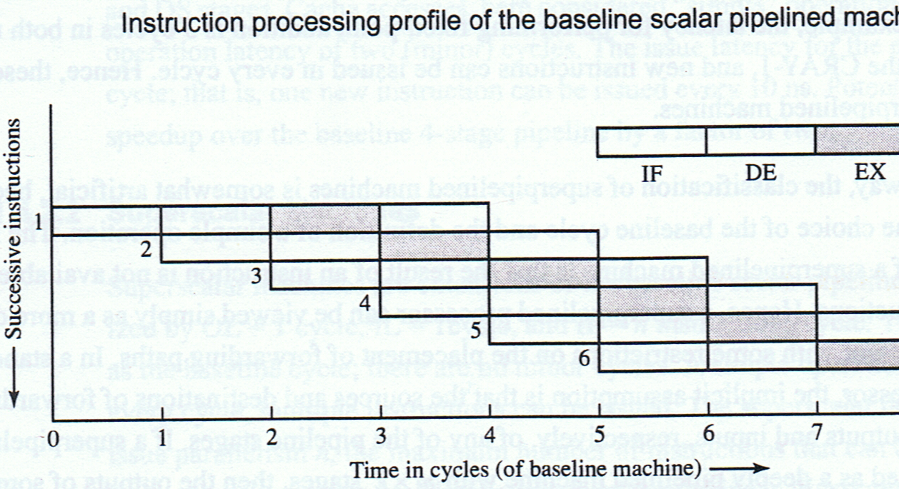
(Baseline) Scalar Pipeline
Hunt, Figure 1-9
Notes:
EX stage is used as a reference for the Operation Latency.
Where k = #stages in a pipeline.
OL = 1 cycle
IL = 1 cycle
MP is equal to the number of stages in the pipeline, here, MP = 4 ! How do you know??
IP is 1 instruction per cycle
All four parameters are static parameters of the machine and do not take into account the dynamic behaviour that depends on the program being executed.

Slide 43
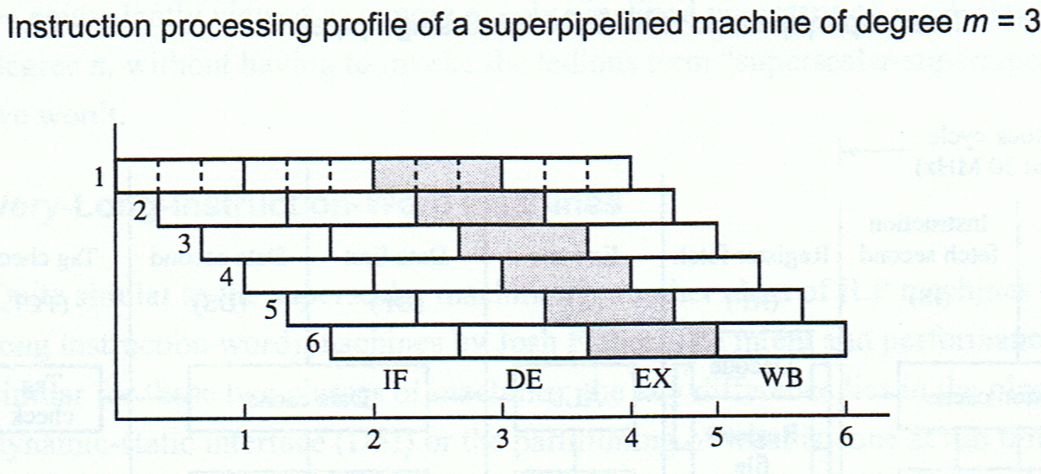
Superpipelined
Hunt, Figure 1-10
Notes:
See Hunt, page 30
Superpipeline – the degree of pipelining (the number of stages) is beyond that dictated by the operation latency of simple instructions.
- The execution of an instruction is itself divided down into stages (minor cycles) so that an instruction takes m minor cycles.
- Execution time > Machine cycle time
Under-pipeline = can’t feed instructions fast enough
Super-pipeline = pipeline issues instructions faster than they can be executed.
OL = 1 cycle but = m minor cycles
IL = 1 minor cycle.
IP = 1 instructor per minor cycle or m instructions per cycle
MP = m * k where k = number of stages in the pipeline.

Slide 44
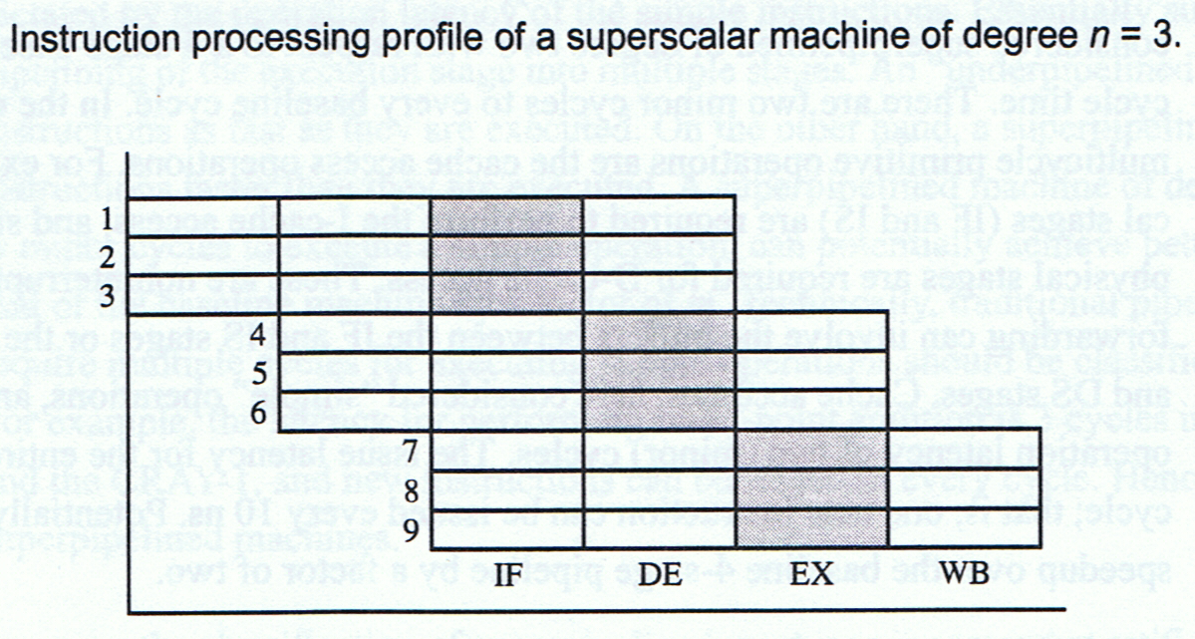
Superscalar
Hunt, Figure 1-11
Notes:
(No minor cycles)
OL = 1 cycle – Simple instruction executed in one cycle.
IL = 1 cycle –
IP = n instructions / cycle – Multiple instructions are issued per cycle
Superscaler degree = n = IP
Viewed as
- n pipelines
- a pipeline that is n times wider (being able to carry n instruction in each pipeline stage instead of one)
MP = n * k
Superscalar are implicitly pipelined, whereas pipelined are not necessarily superscalar.

Slide 45
Designing For Performance
Always a tradeoff between performance and cost
What is performance : Speed ?
  Increase CPU speed ? New circuits, more integration : closer circuits means faster switching.
  CPU’s raw potential will not be used unless it is fed a constant stream of work to do.
    Instruction Stream
    Memory – Processor Interface
    Input / Output Interface
Notes:
Instructions Stream: More elaborate techniques for feeding the monster? Branch prediction, data flow analysis, speculative execution
Interface between main memory and processor: Is responsible for carrying a constant flow of program instructions and data
Wider bus data paths, cache, higher-speed buses
IO Interface: Handling of IO: Caching and buffering, higher-speed interconnection buses, multiprocessor configurations

Slide 46
Architectural Developments
ISA
To increase performance (Abd-El-Barr, El-Rewini)
CISC Complex Instruction Set Computer
  Do more in one instruction
  Programs have less instructions, less read/write
  Instructions close “semantic gap”
  Intel Pentium, Motorola 68000, IBM PowerPC
RISC Reduced Instruction Set Computer
  Optimize architecture by speeding up those operation that are most frequently used while reducing the instruction complexities and the number of addressing modes.
  Sun SPARC and MIPS
A recurring theme through this course
Notes:
Taken from Mostafa Abd-El-Barr and Hesham El-Revini: Fundamental of Computer Organization and Architecture
We want more performance. Two main prongs have been experienced, known as CISC and RISC
CISC
Sematic gap between instructions in a high-level language and those in the low-level machine language.
A single machine instruction to convert several binary coded decimals (BCD) numbers to binary
A single machine instruction to search a string for a character
A single machine instruction to compute the matrix inverse
At capabilities were added, manufacturers realized that it was increasingly difficult to support higher clock rates, because of the increased complexity of computations within a single clock period. Studies of code in the 1970 and 1980s show that 80% instructions are assignments, conditional branching (if) and procedure calls .. .and 50% of this 80% was assignment. So why spend so much time making complicated instructions when they are never used!
…. Hence, RISC
No one agrees which is best. But studies do indicate that RISC architectures would lead to faster execution of programs.
Yet, look at which processors are which ? Again, market influences technology!

Slide 47
Performance Measures
Which Metric ?
  Single Program: Execution Time
  Multiprogramming: Throughput
Competing Demands
  Users want minimal execution time for their program
  Engineers want maximal throughput
Notes:
Detour from Murdocca (to help in assignments/promote discussion of DESIGNING FOR PERFORMANCE)
We will do a whole unit on Benchmarking later, but to begin, let’s at least introduce the notion of CPI.
From Abd-El_Barr, page 6.
Execution time: Actual time spent by the computer executing the program, including all system overheads, input, outputs…
This is what users are interested in.
Throughput: total amount of work done in a given time. Designers and system administrators are interested in this.
Question: Do the following changes to a computer system increase throughput, decrease response time, or both?
Replacing the processor in a computer with a faster version.
Both response time and throughput are improved
Adding additional processors to a system that uses multiple processors for separate tasks, i.e., net surfing
Only throughput increases
To begin, we are learning about single computer processor, so we will concern ourselves first with PROGRAM EXECUTION TIME.

Slide 48
Iron’ Law of Performance
1/Performance =
  Time / Program =
  Instructions / Program * Cycles/Instruction * Time/Cycle
Execution Time
How long to execute the program
Instruction Count
(dynamic)
CPI
(cycles per instruction)
(average)
Machine
cycle time
Notes:
How can we improve the performance?
Reduce instruction count – fewer instruction to execution, so execution time is less.
CPI is reduced, then on average each instruction will consume fewer machine cycles
Reduce cycle time, (faster clock), faster overall execution.
But the factors are not independent: Reducing one may increase the other!
- Read Modern Processor Design, page 12 and 13!
Short: Instruction count: RISC versus CISC

Slide 49
Program Execution Time
The operation of all instructions is synchronized with a clock
CPU time = CC * clock period T
= CC / clock frequency f
where
CC = number of clock cycles
T ≡ clock cycle time
f = 1 / T
Clock cycle time
time
Notes:
How does a user measure their PROGRAM EXECUTION TIME ?
One way is to physically measure the time it takes to execute (with a watch).
Problems ?
Accuracy of measuring clock
Assumption that wall-clock time = CPU time. When would this not be true ? When >1 program is running on a machine.
Usually want to compare or even forecast its relative performance on machines of different speeds (ie. frequencies)
2. So, for the user, the PROGRAM EXECUTION TIME or the CPU time is computed based on the clock cycles.
The obvious problem is to count the number of clock cycles in your program.
3. A more user-friendly measure of a program’s length is the number of instructions. Next page
Example: Our favorite program runs in 10 seconds on computer A, which has a 4 GHz clock. We are trying to help a computer designer build a computer, B, that will run this program in 6 seconds. The designer has determined that a substantial increase in the clock rate is possible, but this increase will affect the rest of the CPU design, causing machine B to require 1.2 times as many clock cycles as machine A for this program. What clock rate should we tell the designer to target? Pg 247

Slide 50
Program Execution Time
CC = nInstructions * CPI
Where
  CPI = average number of clock cycles per instruction
  CPI = Σ_{i=1}^{n} CPI_{i} * numOccurrences_{i}
  nInstructions
where CPI_{i} established by CPU manufacturer (benchmarking)
CPU time = nInstructions * CPI
Clock frequency f
CPI reflects organization and ISA of processor.
Instruction count reflects ISA and compiler technology used.
CPI and instruction count are interdependent
Notes:
Alternatively, you can compute the PROGRAM EXECUTION TIME as follows, using the more intuitive measure of #instructions.
CPI is the average number of clock cycles per instruction.
Average : Different instructions take different amounts of time. Multiplies and divides take much longer than additions. On CISC machines, a compare takes much less time than a string-compare instructions that compares two 80-character strings!
Average: The same instruction will take different amounts of time to execute! We’ll learn later about addressing modes, but essentially, adding a constant value to a variable is less expensive than adding two variables!
Average: Because different programs have different kinds of instruction mixes.
CPI depends on hardware implementation and instruction mix. Must be calculated for each program. We may calculate based on instruction counts OR based on relative instruction frequencies (Abd-El-Barr’s examples).
Example: Suppose we have two implementations of the same instruction set architecture. Machine A has a clock cycle time of 250 ps and a CPI of 2.0 for some program, and machine B has a clock cycle of 500 ps and a CPI of 1.2 for the same program. Which machine is fastest for this program, and by how much?

Slide 51
Example
Assume 3 types of instructions:
  Arithmetic (=,-,*,/) takes 4 cycles
  Conditional (if) takes 3 cycles
  I/O takes 5 cycles
Consider the following code segment:
cin > num1;
cin > num2;
num3 = num1 + num2;
if (num3 > 10)
cout << "yes";
else
cout << "no";
How many cycles to complete?
What's the average number of cycles per instruction?
Notes:
Example: CPI Calculation with Instruction Count
Assume Class A CPI=1, Class B CPI=2, Class C CPI=3
CPI = CPU Clock Cycles/Instruction Count
CPU Clock Cycles = Sum(CPIi * Counti)
Program requires 5 A, 3 B, 2 C instructions. What is the CPI?
# Cycles = 5*1 + 3*2 + 2*3 = 17
# Instructions = 5 + 3 + 2 = 10
CPI = 17 cycles/10 instructions = 1.7 cycles/instruction
Example: CPI Calculation with Relative Frequencies
Program uses 50% A, 30% B, 20% C instructions. What is the CPI?
.5 * 1 + .3 * 2 + .2 * 3 = 1.7
Why does this work?
CPI = CPU Clock Cycles/Instruction count
#Instructions * (.5 * 1 + .3 * 2 + .2 * 3 )
-----------------------------------------
#Instructions
How do we calculate execution time? Execution Time = Instruction Count * CPI * cycle time
OR
Instruction Count * CPI
-----------------------------
Clock Rate
How long would it take to execute a program with 100 * 106 instructions if CPI is 3 and clock rate is 500 Mhz?
Time = (Instructions / Program) * (# Cycles / Instruction) * (Seconds / Cycle)

Slide 52
For a given instruction set architecture, increases in CPU performance come from three sources:
Increases in clock rate
Improvements in processor organization that lower the CPI
Compiler enhancements that lower instruction count or generate lower average CPI
When comparing two machines, you must consider all three components of execution time.
Notes:
http://www.mines.edu/~crader/cs341/Chapter2.html
Last point: If some factors are identical, then comparison can be based on just non-identical factors.
Example
Machine 1and Machine 2 both have clock speeds of 500 MHz
On Machine 1, program P requires 100 * 106 instructions and has a CPI of 2.5
On Machine 2, program P requires 90 * 106 instructions and has a CPI of 3
Which machine is faster? By how much?

Slide 53
Program Execution Time
MIPS Million instructions per second
For given program, MIPS = nInstructions
        CPU time * 10⁶
        = f
CPI * 10⁶
Intent: A simple metric where higher means better
Ignores capabilities of instructions
Can vary inversely with performance
Notes:
Previously that CPU time = nInstructions * CPI / f
Rearranging nInstructions = CPU time * f / CPI.
Substituting in first form, you get second form.
Example: A program with 100 * 106 instructions executes in .4s. What is the MIPS?
Example: A program with CPI of 2 is run on a machine at 500 MHz. What is the MIPS?
Doesn't consider capabilities of instructions (so can't compare computers with different instruction sets)
Varies between programs on same computer ??
Can vary inversely with performance
Exec = #cycles/clock rate
Fewer cycles, less time - better
BUT instruction count/exec time may not be better
Use Example on Page 8 of Abd-El-Barr as example or on assignment ?

Slide 54
Amdahl’s Law
Overall speedup depends on both the speedup of a particular component and how much that component is used in the system.
Overall speedup S = 1
        (1-F) + F/s
F = fraction of work performed by faster component
s is the speedup of a single component
Notes:
Null, page 328
We’re always looking for speedup. With knowledge about architecture, we can make informed improvements
Yet, Performance is a global characteristic of the whole integrated computer system: How CPU works in conjunctions with Memory and I/O
Test Question: How do you find k ? Speedup k = New performance / old performance

Slide 55
Systems Engineering
Principle: Equivalence of Hardware and Software: Anything that can be done with software can also be done with hardware, and anything that can be done with hardware can also be done with software.
  Hardware implementations are almost always faster.
  Linda Null and Julia Lobur
Notes:
With the levels in the previous slide and in the hierarchy in the Murdocca text, there is a question: Which is hardware, which is software ?
We write a program in C or Java. What makes the algorithm run ? Another algorithm. And so on until you get down to the machine level… which is in fact an algorithm implemented as an electronic device (microcoded instructions). Programs can be written to do signal processing or you can buy a signal processing machine.
Examples : Microcode.

Slide 56
SW Iteration vs HW Replication
For operations that apply to a set of items:
  Software: Use iteration (eg. for loop)
    Principle: Avoid duplicate code (“smelly”)
  Hardware: Use replication
    Use multiple copies of same gate where each copy operates on one item.
    e.g. boolean AND of a 32-bit boolean value
    Iteration hardware is difficult and clumsy ($$)
    Increases performance dramatically : Parallelism!
Notes:
Taken from Douglas Comer: Essentials of Computer Architecture
And while we’re talking about the synergy between software and hardware in Systems engineering, let’s also introduce another theme that you should notice as we progress: Software iteration versus hardware replication
In software, we use iteration because the underlying system can only apply the operation at a time. A programmer must explicitly specify the number of items in the set and the order in which they are to be processes.
The for loop and arrays.
In hardware, the functional unit is replicated. For doing a boolean operation (such as AND, OR, NOT), there will be 32 AND gates, doing a parallel 1-bit AND on the 32 bits.
- Replication is a more elegant solution (even though it looks like you’re using more components) because iteration hardware requires extra hardware to select an individual item, move it into place, and move the result back
- Replication increases performance – instead of selecting and moving items about, replication allows multiple operations to be performed simultaneously. Replication is parallelism.
However, the previous principle applies: My experience at Intel with routers : Broadcast. They were going to build an hardware for loop for multicast addresses.

Slide 57
Next Lecture
Murdocca: Read 2 and 3
Data representations

