Slide 1
Adaptive Modulation and Coding
(Link Adaptation)
Halim Yanıkömeroğlu, PhD, PEng
Professor
Systems and Computer Engineering
Carleton University

Slide 2
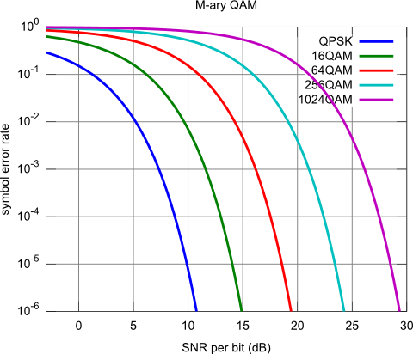
Reliability vs SNR
(uncoded)

Slide 3
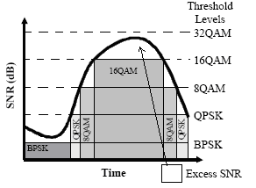
Fixed Modulation vs Adaptive Modulation

Slide 4
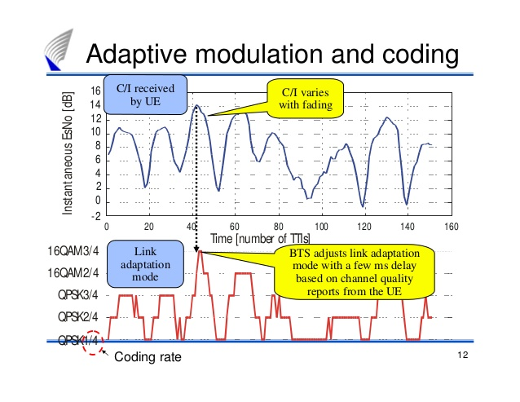
Channel-Adaptive Signalling
TTI: Transmission Time Interval
1 msec in LTE

Slide 5
Fixed Modulation vs Adaptive Modulation

Slide 6
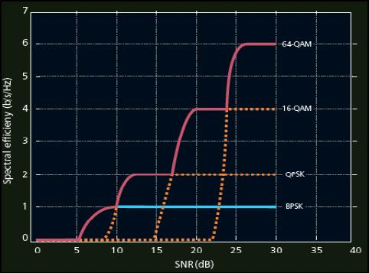
Throughput vs SNR in Link-Adaptive Systems

Slide 7
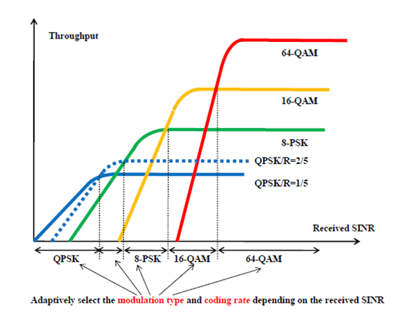
Throughput vs SNR in Link-Adaptive Systems

Slide 8
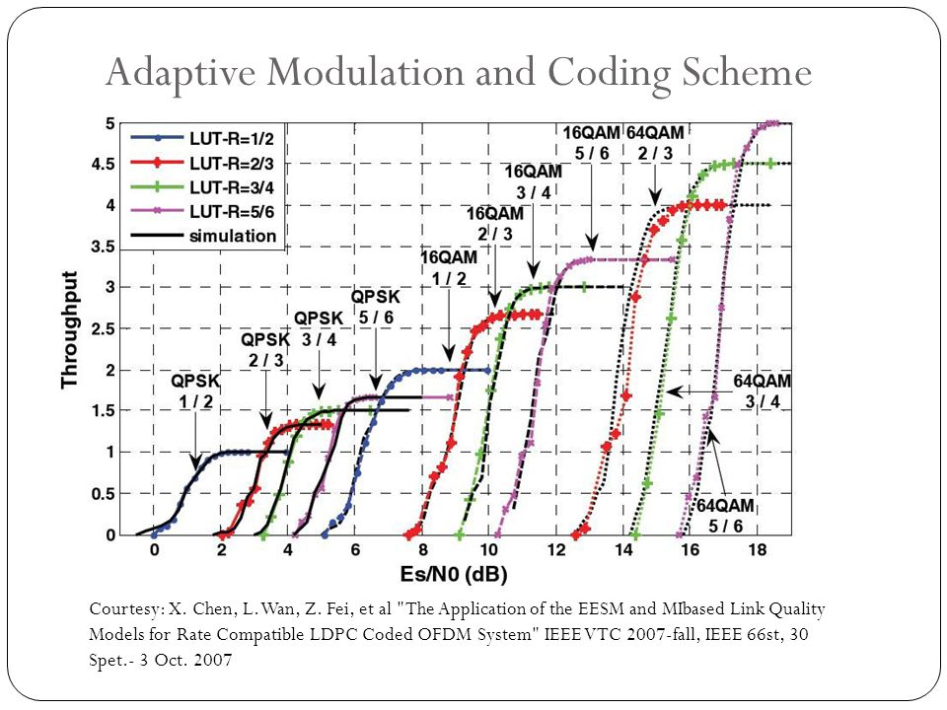
Throughput vs SNR in Link-Adaptive Systems

Slide 9
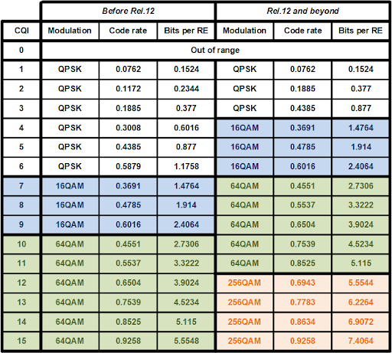
Ex: LTE
Feedback
CQI:
Channel
Quality
Indicator

Slide 10
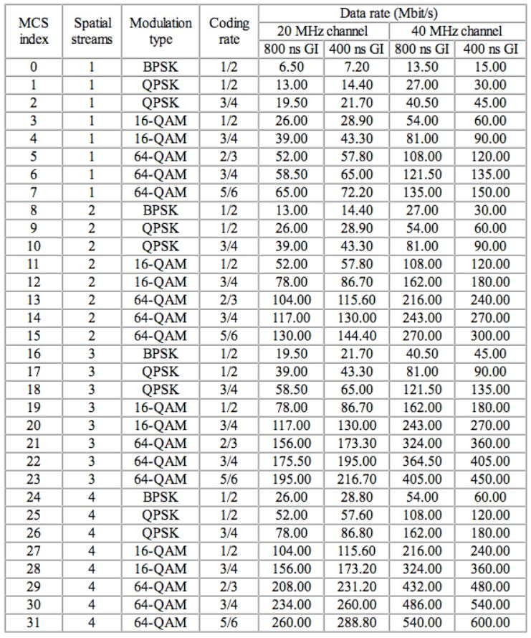
Ex: 802.11n

Slide 11
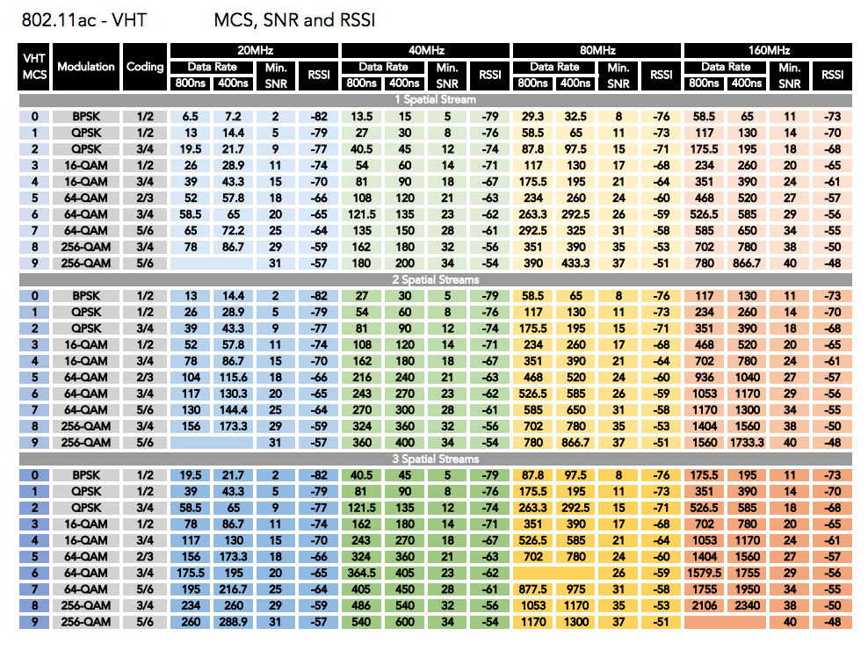
Ex: 802.11n

