Slide 1
DEVS modeling and simulation with CD++ / Cadmium
http://cell-devs.sce.carleton.ca/

Slide 2
Review of the DEVS formalism
Atomic: lowest level model, contains structural dynamics -- model level modularity
Coupled: composed of one or more atomic and/or coupled models -- hierarchical construction
Elements of an atomic model:
input ports
output ports
state variables
state transition functions
output function
time advance function
Elements of coupled model:
Components
Couplings
  Internal Couplings
  External Input Couplings
  External Output Couplings

Slide 3
CD++ (1997/98)
Basic tool following DEVS formalism.
Extension to include Cell-DEVS models.
High level specification language.

Slide 4
CD++
Independent simulation
mechanisms

Slide 5
CPU: header files
CD++
class CPU : public Atomic {
public:
.
.
.
protected:
Model &initFunction() ;
Model &externalFunction(const ExternalMessage&);
Model &internalFunction(const InternalMessage &);
Model &outputFunction(const InternalMessage&);
private:
int pid;
Port &in, &out ;
Distribution *distribution ;
};

Slide 6
CPU: coding example
CD++ - initFunction
Model &initFunction() {
this->passivate() ;
return *this ;
}
Passive state kept
while cpu waits for
new external events
in input ports.

Slide 7
CPU (Cont.)
CD++ - externalFunction
Model &externalFunction(const ExternalMessage &msg)
{
if( this->state() == passive )
{
this->pid = static_cast<int>(msg.value()) ;
Time t( fabs(this->distribution().get()) ) ;
this->holdIn(active, t) ;
}
return *this ;
}
Process Id stored. Schedule
internal transition at random
using the chosen distribution.

Slide 8
CPU (Cont.)
CD++ - internalFunction
Model &internalFunction( const InternalMessage & )
{
this->passivate() ;
return *this ;
}
Task processing finished.
Passivate waiting for the
following request.

Slide 9
CPU (Cont.)
CD++ - outputFunction
Model &outputFunction( const InternalMessage &msg )
{
this->sendOutput(msg.time(), this->out, this->pid);
return *this ;
}
Send Process Id and time
associated with end of
processing for the
present task.

Slide 10
CPU model testing
CD++ - Coupling specification
[top]
components : proc@CPU
in : in
out : out
Link : in in@proc
Link : out@proc out
[proc]
distribution : normal
mean : 2
deviation : 1
top
proc
in
out
in
out

Slide 11
Input events to test
CD++ - External event file (.EV)
Job Id
00:00:10:00 in 0
00:00:30:00 in 1
00:01:00:00 in 2
00:02:20:00 in 3
top
Input port used
proc
in
out
Hh:mm:ss:ms
in
out

Slide 12
Output file
CD++ - Output file
Job Id
00:00:11:348 out 0
00:00:33:485 out 1
00:01:00:328 out 2
00:02:21:094 out 3
Output Port
Hh:mm:ss:ms

Slide 13
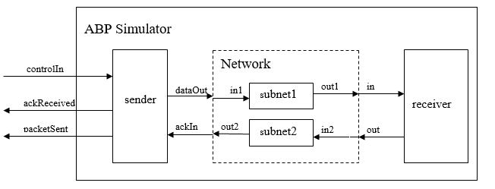

Slide 14
Subnet.hpp: headers
#ifndef _SUBNET_HPP__ // 2 models = name: illegal
#define _SUBNET_HPP__
#include <cadmium/modeling/ports.hpp>
// to define ports
#include <cadmium/modeling/message_bag.hpp>
// bags associated to ports
#include <limits> // include all libraries you need in your model
#include <assert.h>
#include <string>
#include <random>
#include "../data_structures/message.hpp“ // to define new messages (needed)
using namespace cadmium; // namespaces to reduce typing
using namespace std;

Slide 15
Subnet.hpp: headers
// Definition of 2 ports: in/out.
// They are defined in a struct, called Subnet_defs
// In this way we can use the same name (in, out) for different
// atomic models defined in the same model structure
struct Subnet_defs{
struct in : public in_port<Message_t> {};
struct out : public out_port<Message_t> {};
};
// The ports transfer message of typpe Message_t
// They use in_port and out_port
// Message_t defined in message.hpp uses 2 integers: packet and bit

Slide 16
Subnet.hpp: headers
// We use templates: we can choose different TIME representation
template<typename TIME>
class Subnet{ // This class defines the model
public: // Assign the ports defined above to class
using input_ports=tuple<typename Subnet_defs::in>;
using output_ports=tuple<typename Subnet_defs::out>;
// using: from now on we can call them input_ports/output_ports
struct state_type{ // ALL state variables defined here
bool transmitting; // to state if we’re transmitting
Message_t packet; // the packet transmitted
int index; // how many packets transmitted
};
state_type state; // the state variables

Slide 17
Subnet: constructor (initialization)
// default constructor: defines initial states
Subnet() {
state.transmitting = false; // not transmitting
state.index = 0; // no packet yet
}

Slide 18
Subnet: External Transition
// e, inputs (s: accesible from the class definition)
void external_transition(TIME e, typename
make_message_bags<input_ports>::type mbs) {
vector<Message_t> bag_port_in; // to store the input
// get the message in port in; save it
bag_port_in=get_messages<typenameSubnet_defs::in>(mbs);
state.index++; // one more message
if ((double)rand() / (double) RAND_MAX < 0.95){
state.packet = bag_port_in[0];
state.transmitting = true;
} else
state.transmitting = false; // packet lost
}

Slide 19
Subnet: Output function
// Uses a bag of outputs: output_ports
typename make_message_bags<output_ports>::type output() const {
// Declare the bag we will fill up
typename make_message_bags<output_ports>::type bags;
vector<Message_t> bag_port_out; // aux vector to build bag
bag_port_out.push_back(state.packet); // save the packet
// copy the auxiliary bag to the bag of the output port out
get_messages<typename Subnet_defs::out>(bags) = bag_port_out;
return bags;
}

Slide 20
Subnet: Time Advance Function
TIME time_advance() const {
TIME next_internal; // aux variable
if (state.transmitting)
next_internal = TIME("00:00:03:000");
else
next_internal = numeric_limits<TIME>::infinity();
return next_internal;
}

Slide 21
Subnet: Internal Transition
// The packet has been transmitted: wait for
// the next one
void internal_transition() {
state.transmitting = false;
}

Slide 22
Subnet: Time Advance Function
TIME time_advance() const {
TIME next_internal; // aux variable
if (state.transmitting)
next_internal = TIME("00:00:03:000");
else
next_internal = numeric_limits<TIME>::infinity();
return next_internal;
}

Slide 23
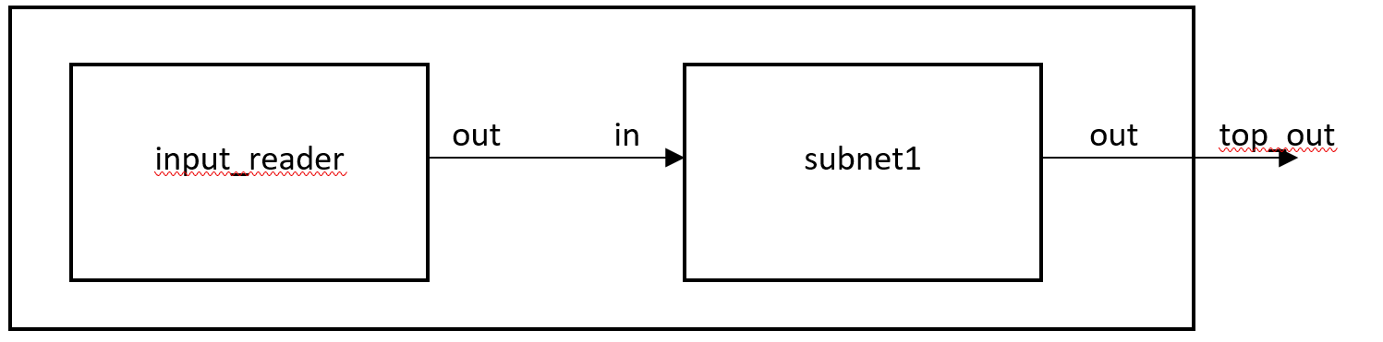
Subnet model testing
Cadmium - Coupling specification

Slide 24
Subnet: Internal Transition
//Cadmium Simulator headers
#include <cadmium/modeling/ports.hpp>
#include <cadmium/modeling/dynamic_model.hpp>
#include <cadmium/modeling/dynamic_coupled.hpp>
#include <cadmium/modeling/dynamic_model_translator.hpp>
#include <cadmium/engine/pdevs_dynamic_runner.hpp>
#include <cadmium/logger/common_loggers.hpp>
#include <NDTime.hpp> //Time class header
#include "../data_structures/message.hpp” //Messages structures
//Atomic model headers
#include "../atomics/subnet.hpp"
#include <cadmium/basic_model/pdevs/iestream.hpp> //Atomic model for inputs
#include <iostream> //C++ libraries
#include <string>
using namespace std;
using namespace cadmium;
using namespace cadmium::basic_models::pdevs;
using TIME = NDTime;

Slide 25
Coupled Model
// Define input/output ports for coupled model
struct top_out: public out_port<Message_t>{};
// Input Reader atomic model
template<typename T>
class InputReader_Message_t :
public iestream_input<Message_t, T> {
public:
InputReader_Message_t () = default;
InputReader_Message_t (const char* file_path) :
iestream_input<Message_t,T> (file_path) {}
};

Slide 26
Coupled Model
int main(){
const char * i_input_data = ”YOURTESTFILEHERE";
// Input Reader atomic model instantiation
shared_ptr<dynamic::modeling::model> input_reader;
input_reader = dynamic::translate::
make_dynamic_atomic_model
<InputReader_Message_t, TIME, const char*>
("input_reader", move(i_input_data));
// Subnet atomic model instantiation
shared_ptr<dynamic::modeling::model> subnet1;
subnet1 = dynamic::translate::
make_dynamic_atomic_model<Subnet, TIME>("subnet1");

Slide 27
Coupled Model
shared_ptr<dynamic::modeling::coupled<TIME>> TOP;
TOP = make_shared<dynamic::modeling::coupled<TIME>>(
"TOP", submodels_TOP, iports_TOP, oports_TOP,
eics_TOP, eocs_TOP, ics_TOP);
// Loggers
static ofstream out_messages(”output_messages.txt");
...
static ofstream out_state(".. output_state.txt");
...
using state = logger::logger<logger::logger_state, ...
// Runner
dynamic::engine::runner<NDTime, logger_top> r(TOP, {0});
r.run_until(NDTime("04:00:00:000"));
return 0;
}

Slide 28
Coupled Model
dynamic::modeling::Ports iports_TOP; // // X
iports_TOP = {};
dynamic::modeling::Ports oports_TOP; //Y
oports_TOP = {typeid(top_out)};
dynamic::modeling::Models submodels_TOP; // Mi
submodels_TOP = {input_reader, subnet1};
dynamic::modeling::EOCs eocs_TOP; // EOC
eocs_TOP = dynamic::translate::make_EOC
<Subnet_defs::out,top_out>("subnet1");
dynamic::modeling::ICs ics_TOP; // IC
ics_TOP = dynamic::translate::make_IC
<iestream_input_defs<Message_t>::out,Subnet_defs::in>
("input_reader","subnet1");

Slide 29
Input events to test
00:00:10 1 1
00:00:20 2 0
...
00:02:30 15 1
00:02:40 16 0
...
00:03:20 20 0

Slide 30
...
00:00:10:000
State for model input_reader is next time: 00:00:10:000
State for model subnet1 is index: 1 & transmitting: 1
00:00:13:000
State for model input_reader is next time: 00:00:10:000
State for model subnet1 is index: 1 & transmitting: 0
...
00:02:30:000
State for model input_reader is next time: 00:00:10:000
State for model subnet1 is index: 15 & transmitting: 0
00:02:40:000
State for model input_reader is next time: 00:00:10:000
State for model subnet1 is index: 16 & transmitting: 1
00:02:43:000
State for model input_reader is next time: 00:00:10:000
State for model subnet1 is index: 16 & transmitting: 0
...
00:03:20:000
State for model input_reader is next time: inf
State for model subnet1 is index: 20 & transmitting: 1
...

Slide 31
Simulation Results
...
00:00:10:000 [iestream_input_defs<Message_t>::out: {1 1}] generated by model input_reader
00:00:13:000 [Subnet_defs::out: {1 1}] generated by model subnet1
...
00:02:30:000 [iestream_input_defs<Message_t>::out: {15 1}] generated by model input_reader
00:02:40:000 [iestream_input_defs<Message_t>::out: {16 0}] generated by model input_reader
00:02:43:000 [Subnet_defs::out: {16 0}] generated by model subnet1
...
00:03:20:000 [iestream_input_defs<Message_t>::out: {20 0}] generated by model input_reader
00:03:23:000 [Subnet_defs::out: {20 0}] generated by model subnet1

