Slide 1
Discrete EVent Systems specificaton DEVS
Other Formalisms. Limitations. DEVS.

Slide 2


System dynamics Paradigms
Review
System Dynamics : A sequence of state transitions
Model : A set of rules for a state transition
System
X
S
Y
CVDS
DTDS
x(t)
DEDS
DDS
x(t)

Slide 3
CFSM for the ping-pong example
Review
player_A
player_B
Ball_B
Ball_A
Ball_A
Ball_A
D
A
D
A
Ball_B
Ball_B
Ball_A
Ball_B
Problem : player_A output: Ball_A. Transition ?
Ball_A
CFSM
A_A, B_D
A_D, B_A
Ball_B
Player_A δ : X × S → S
X_{A} = {Ball_A} ∪ {τ} τ: internal event
Ball_A
feedback
Ball_A
τ
A_A
A_D
A_A
A_D

Slide 4
Limitation of expressive power in FSM
Ex) ping-pong game
(i) what if “attack” takes 2 steps : one state generating an output and the other state with no output. State independent of any inputs.
(ii) what if we want to specify time to be spent for state A or D
A takes 0.1 sec.
D takes ? sec.
input event -> State transition
time modeling -> Infinity
No semantics for such sojourn time specification: logical time models.
player_A
player_A
Receiving state
R_B
A_A
Ball_A
Ball_B
τ
Ball_B
?
τ
A_A
A_D
Ball_A
A_A
replace
τ
R_B
A_D
Ball_A
Ball_B
A_A
τ
Ball_B

Slide 5
Solution: DEVS (Discrete EVent System specification) formalism
Internal transition & time advance function (defined):
introducing internal transition function δ_{int} : S → S
introducing time advance function ta : S → R⁺_{0,∞}
S
s,e
X
Y
A DEVS Model is one that can represent any system that produces a finite number of state transitions in a finite amount of time.

Slide 6
DEVS Modeling & Simulation Framework
DEVS = Discrete EVent System specification
Provides a sound formal M&S framework
Supports a full range of dynamic system representation capability
Supports hierarchical & modular model development
(Bernard P. Zeigler, 1976/84/90/00)

Slide 7
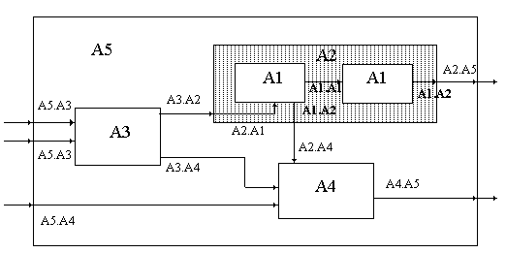
DEVS Formalism
Discrete-Event formalism: time advances using a continuous time base
Basic models can be coupled to build complex systems
Abstract simulation mechanism.
Atomic Models:
M = < X, S, Y, δ_{int}, δ_{ext}, λ, ta >
Coupled Models:
CM = < X, Y, D, {M_{i}}, {I_{i}}, {Z_{ij}}, select >

Slide 8
The DEVS Framework for M&S
Separates Modeling from Simulation
Derived from General Systems Theory (GST)
Includes Continuous and Discrete Time Systems
Provides well defined coupling of components
Supports
Hierarchical construction
Stand-alone testing
Repository reuse
Enables provably correct, efficient, event-based, and distributed simulation.

Slide 9
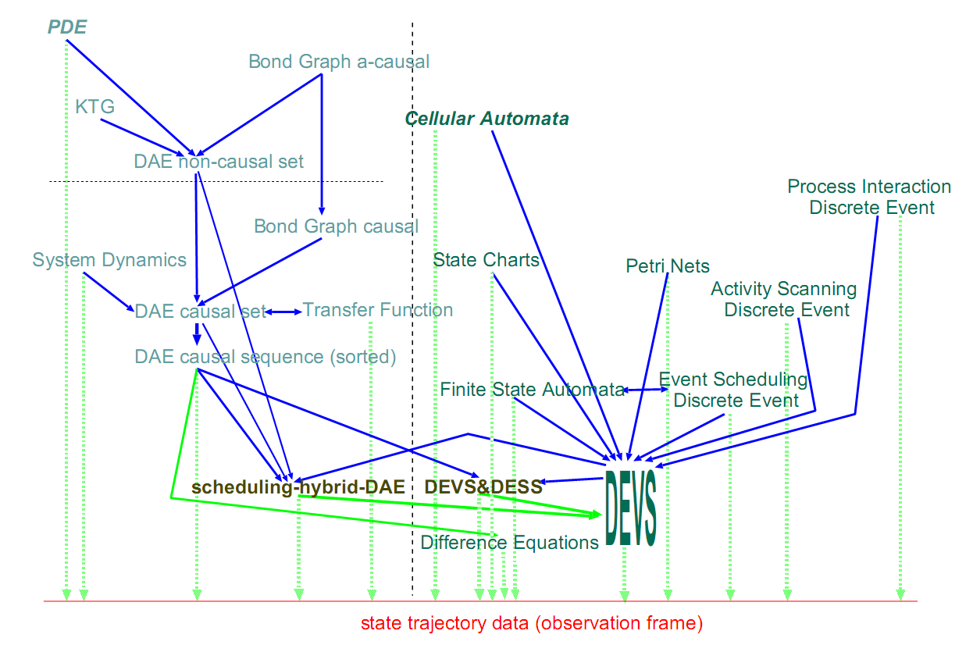
Formalism transformations
Continuous
Discrete
Formalism Space and Formalism Transformation Graph (FTG)
DEVS as a common denominator for Multi-formalism Hybrid Systems Modelling
Hans Vangheluwe
School of Computer Science, McGill University
Notes:
http://www.cs.mcgill.ca/~hv/publications/00.CACSD.multiform.pdf
Based on the mathematical relationship between the Sys-tem Dynamics and the ODE formalisms, translation of any model in the first formalism to a behaviourally equivalent model described in the second formalism is possible.
In Figure 2, a part of “formalism space” is depicted in the form of a Formalism Transformation Graph (FTG). The different formalisms are shown as nodes in the graph. The vertical striped line in the middle denotes the distinction between continuous models (on the left) and discrete models (on the right).
The well known difference equations formalism is often implicitly used in numerical simulators: ODEs are discretised by means of a suitable numerical scheme and the resulting difference equations are iteratively solved.
Suit- able refers to the nature of the equations as well as to the accuracy requirements.
-The arrows denote a homomorphic relationship “can be mapped onto”, implemented as a symbolic transformation between formalisms.
The vertical dotted lines denote the existence of a solver or simulation kernel which is capable of simulating a model, thus generating a trajectory.
A trajectory is really a model of the system in the data formalism (time/value tuples).
In a denotational sense, traversing the graph makes semantics of models in formalisms explicit: the meaning of a model/formalism is given by mapping it onto some known formalism. This procedure can be applied iteratively to reach any desired (reachable) level.
In an operational sense, a mapping describes how model interpretation can be achieved. If the “trajectory” formalism is the target of the mapping, model interpretation is model simulation.
Though a multi-step mapping may seem cumbersome, it can be perfectly and correctly performed by tools.
The advantage of this approach is that the introduction of a new formalism only requires the description of the mapping onto the nearest formalism as well as the implementation of a translator to the latter formalism.
It is often meaningful to introduce a new formalism for a specific application, encoding particular properties and constraints of the application. Often, translation involves some loss of information, though behaviour must obviously be conserved.
This loss may be a blessing in disguise as it entails a reduction in complexity, leading to an increase in (simulation) performance.
- Usually, the aim of multi-step mapping is to eventually reach the trajectory level.
Another major use for formalism transformation is the answering of particular questions about the system. Some questions can only be answered in the context of a particular formalism.
In case of a System Dynamics model for example, the visual inspection of the model can provide insight into influences. If the model is mapped onto a set of Algebraic and Ordinary Differential Equations, a dependency analysis may reveal algebraic dependency cycles not apparent at the System Dynamics level. At this same level, one may check whether parts of the model are linear. If so, these parts may be solved symbolically by means of computer algebra. Also, transformation to the Laplace domain (i.e., to a Transfer Function form) opens avenues to a plethora of techniques for stability analysis. Finally, the transformation, through numerical simulation to the data level allows for quantitative analysis of problems posed in initial value form.
Note how the larger the number of intermediate formalisms, the higher the possibility for optimization along the way. Above all, the traversal described above is the basis for the meaningful coupling of models described in different formalisms.

Slide 10
DEVS Atomic models
Atomic DEVS = < S , X , Y , δ_{int} , δ_{ext} , λ , ta >
X : external input event set
Y : external output event set
S : state set
δ_{int}: internal transition function
δ_{ext} : external transition function
λ : output function
ta : time advance function
S
s,e
X
Y

Slide 11
DEVS Atomic models
Notes:
2 min

Slide 12
DEVS Atomic models
X
S
ta
0 → e→ ta
Y
X
=
Set
of
input valu
es
Y
=
Set
of
output val
ues
S
=
Set
of
possible
states
⇒
δ
:
S
→
S
=
Internal
state
transitio
n
function
s’ = δ _{int} (s)
int
δ
:
S
×
ℜ
+
×
X
→
S
=
External
state
transitio
n
function
s’ = δ _{ext} (s,e,x)
ext
0
⇒
λ
:
S
→
Y
=
Output
function
t
:
S
→
ℜ
+
=
Time
advance
function
a
0
(
e
=
Elapsed
time
since
last
state
transitio
n)
Notes:
2 min

Slide 13
DEVS Atomic internal transition
S
s
s’
ta
s
(3)
s’
(4)
0 → e→ ta
y
Y
(2)
(5)
(1)
DEVS Atomic Model components:
X
=
Set
of
input valu
es
Y
=
Set
of
output val
ues
S
=
Set
of
possible
states
⇒
δ
:
S
→
S
=
Internal
state
transitio
n
function
s’ = δ _{int} (s)
int
δ
:
S
×
ℜ
+
×
X
→
S
=
External
state
transitio
n
function
ext
0
λ
:
S
→
Y
=
Output
function
t
:
S
→
ℜ
+
=
Time
advance
function
a
0
(
e
=
Elapsed
time
since
last
state
transitio
n)
Notes:
2 min

Slide 14
DEVS Atomic external transition
s’
X
x
S
s
(1)
(2)
ta
s’
e
(3)
0 → e→ ta
(4)
DEVS Atomic Model components:
X
=
Set
of
input valu
es
Y
=
Set
of
output val
ues
S
=
Set
of
possible
states
δ
:
S
→
S
=
Internal
state
transitio
n
function
int
δ
:
S
×
ℜ
+
×
X
→
S
=
External
state
transitio
n
function
s’ = δ _{ext} (s,e,x)
ext
0
⇒
λ
:
S
→
Y
=
Output
function
t
:
S
→
ℜ
+
=
Time
advance
function
a
0
(
e
=
Elapsed
time
since
last
state
transitio
n)
Notes:
2 min

Slide 15
Total State Set
Q = {q=(s,e) | s ∈ S , 0 ≤ e ≤ ta(s)}
e: elapsed time
s: current state
δ_{ext} : X * Q → S
s’ = δ_{ext}(s,q)
s’ = new state
Alternative notation
Not mandatory

Slide 16
Atomic model dynamics
External Event Transition Function: transforms a state and an input event into another state
(e.g., when receiving a faulty device put it into the queue to await its turn for repair.)
Internal Event Transition Function: transforms a state into another state after a time has elapsed
(e.g., given that there are 10 parts available and a broken part requiring 7 of them, after fixing the broken part, 3 parts will remain.)
Time Advance Function that maps a state into a duration
(e.g., how long it will take to a device once processing has started.)
Output Function that maps a state into an output
(e.g., when the number of parts available falls below a minimum number, issue an order to restock the part.)

Slide 17
Atomic model example
Ping-Pong
AMplayer_A =< X, Y, S, δ_{int} , δ_{ext} , λ, ta >
X = {Ball_B}
Y = {Ball_A}
S = {A, D}
δ_{int} (A) = D
δ_{ext} (Ball_B, D) = A
ta(A) = think_time
ta(D) = infinity
λ(A) = Ball_A
Ball_B
A
D
Ball_A
Ball_B

Slide 18
Atomic model example (pseudocode)
Processing Server
Atomic model: P
State variables:
sigma=inf; phase={passive}; job-id=none;
Parameters:
processing-time = 5;
__________________________________________
δ
ext (s,e,x) {
case
port
Fixed Delay
in
:
case
phase
compact expressions
passive
: save
job-id
hold in
busy
during
processing-time
busy
: continue
otherwise
: error
No queueing
No preemption
}
__________________________________________
δ
int (s) {
case phase
busy
: passivate
passive
: /* never happens */
}
__________________________________________
λ (
s) {
send
job-id
to the
out
port
}

Slide 19
Dynamic behavior of DEVS models
in
M
out
output
y₁=λ(s₂)
t
input
x₁
x₂
t
S
s₂=δ_{ext}(s₀,e,x₁)
s₂
s₁=δ_{int}(s₂)
s₁
s₀
Usually adopted convention
for sigma: “remaining time”
s₀
t
e
sigma
sigma=ta(s)
ta(s₁)
e
ta(s₂)
ta(s₀)
t
t2
t3
t0
t1
t2
t3

Slide 20
Atomic model example
Processing Server with queueing
Note: Usually sigma, e and phase are not explicitly annotated in function arguments. They are implicitly assumed to be always available.
In this context, ta(s)=sigma is assumed to be executed at the end of every δ_{ext} and δ_{int}

