Slide 1
Why building models?
Cannot experience on the real system of interest
Cost
Danger
The real system does not exist
Why using computer simulation?
Reduced cost of computers
Improved facilities of modern computers
Ease to use
Flexibility
Notes:
http://www.sce.carleton.ca/courses/sysc-5104/materials/private/

Slide 2
M&S Entities and Relations
Experimental Frame
Device for
executing model
Real World
Simulator
Data: Input/output
relation pairs
Conditions under which the system
is experimented with/observed
modeling
relation
simulation
relation
Model
Each entity can be formalized
as a Mathematical Dynamic
System
(mathematical manipulations
to prove system properties)
Structure generating behavior
claimed to represent real world

Slide 3
One system: many models
Model is valid to objective  correct answer to query
  c.f) Complete model never exists
One model: many implementations (simulations)
Q1 Q2 Q3 Q4
SYSTEM
Given system
Q1 Q2
Q3 Q4
Objective
MODEL1
MODEL2
many models
experiment1
experiment2

Slide 4
Systems, Models and Simulations
Processes. Classifications. Formalisms.

Slide 5
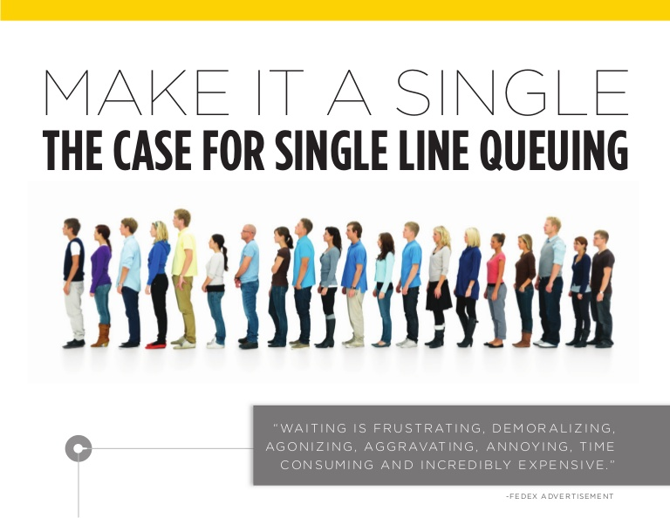
Modelling techniques classification
Example: waiting in a line for service
Conceptual Modelling: informal model
  Communicates the basic nature of the process
  Provides a vocabulary for the system (ambiguous)
  General description of the system to be modeled

Slide 6
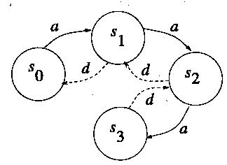
Declarative models
Based on
  evolution of the model represented as states (or events) over time = behavior of the entities under study
  Transitions between states (or events)
State-based declarative models
  Example:
  States = number of persons waiting in line
  Arcs = arrival of new customers/departure of serviced ones
Notes:
Fishwick: Models that permit dynamics to be encoded as state-to-
state or event-to-event transitions are declarative. The idea behind declarative modeling is to focus on the structure of the state (or event) from one time period to
the next
Declarative modeling: these techniques are focused on the evolution of the model represented
as states (which describe the behavior of the entities under study) and the transitions
between them. According to the particular focus of the technique, we can have state-based or event-based declarative models.
State-based declarative models, for instance, can be represented as a graph where the vertices represent the entities and the arcs represent the
state changes (transitions).
Figure 1.10 shows a state-based declarative model representing a portion of the system’s
specification, in which students arrive at or leave the classroom. At a certain point, we have
27 students in the lecture room and a temperature of 25°C. If a new student arrives, we will
have a total of 28 students and 25.05°C (this is an untimed model, so timing information is
not included). If a student leaves, we return to the previous state; if another student arrives,
we have 29 students and temperature will go up (25.1°C). We also show a state representing
that the heating has been turned off, which will reduce temperature in the classroom
accordingly.

Slide 7
Declarative models (cont.)
Event-based declarative models
Arcs = represent scheduling
Event relation: from arrival to departure of ith entity
Notes:
A taxonomy for simulation modeling based on programming language principles PAUL A. FISHWICK
Un d no puede ocurrir sin un a antes. Un a no necesita que haya un d antes.
Puede haber varios a consecutivos.
---
Wainer 2009:
Figure 1.11 shows an event-based declarative model for the classroom that represents the
same phenomena analyzed in Figure 1.10. If we schedule the arrival of a new student,
we will have one more student in the room and temperature will increase. The model
can receive more students while there is room available (q ≤ 85). At any moment, we can
schedule a student to leave (in this case, we will decrease temperature and the number of
students in the room). We need at least one student to schedule a student departure (q ≥ 1).
If we schedule the heat off event, temperature goes down 3°C.

Slide 8
Functional models
“Black box”
Input: signal defined over time
Output: depending on the internal function
Timing delays: discrete or continuous
  Example:
  Inputs = customers arriving
  Outputs = delayed output of the input customers
Notes:
A taxonomy for simulation modeling based on programming language principles PAUL A. FISHWICK

Slide 9
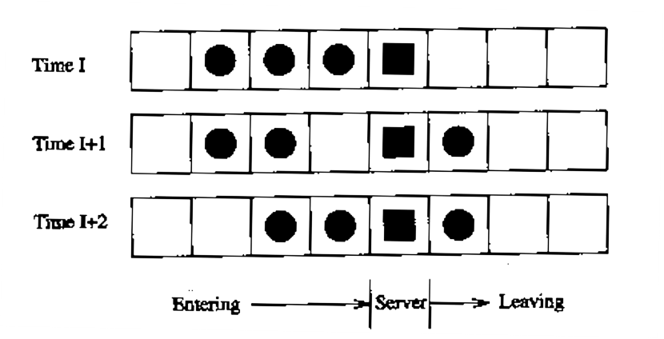
Spatial models
Space notions included
Relationship between time and space positions
  Example: customers moving through the server.
Notes:
A taxonomy for simulation modeling based on programming language principles PAUL A. FISHWICK

Slide 10
Modelling System Dynamics
Simulation models capture a systems’ dynamic behavior and
how it organizes itself over time
in response to imposed conditions and stimuli.
Such modeling is required in order to be able to predict how a system will react to external inputs and proposed structural changes.
Avoid approaches based in programming languages
In most cases their foundation are not rigorous
  resulting simulation software difficult to test, maintain, and verify
Changes in the language can produce serious effects in existing models
  their semantics are usually not formally defined.
Do not provide a method abstract enough to think about problems
  neither to solve or prove properties of the entities under study

Slide 11
Formal Modelling
Advantages of Formal Methods
  Correctness and completeness ⇒ Testing
  Communication means ⇒ Teamwork
Formalism
  Communication convention
  Specification in unambiguous manner
  Abstraction (representation) + manipulation of abstraction
  Formal specification -> Formal model

Slide 12
A Systems Dynamics classification
Classifying modelling techniques according to the system dynamics
System Dynamics: A sequence of State transitions
Model: A set of rules for a State transition
System
X
S
Y

Slide 13
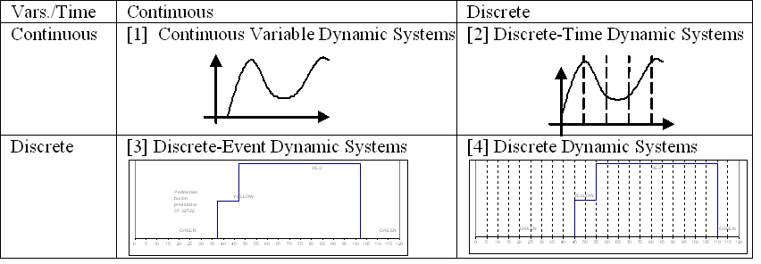
Classification
Vars./Time | Continuous | Discrete
Continuous | [1] DESS Partial Differential Equations Ordinary Differential Equations Bond Graphs Modelica Electrical circuits | [2] DTSS Difference Equations Finite Element Method Finite Differences Numerical methods (in general, any computing method for the continuous counterparts], like Runge-Kutta, Euler, DASSL and others.
Discrete | [3] DEVS DEVS Formalism Timed Petri Nets Timed Finite State Machines Event Graphs | [4] Automata Finite State Machines Finite State Automata Petri Nets Boolean Logic Markov Chains

Slide 14
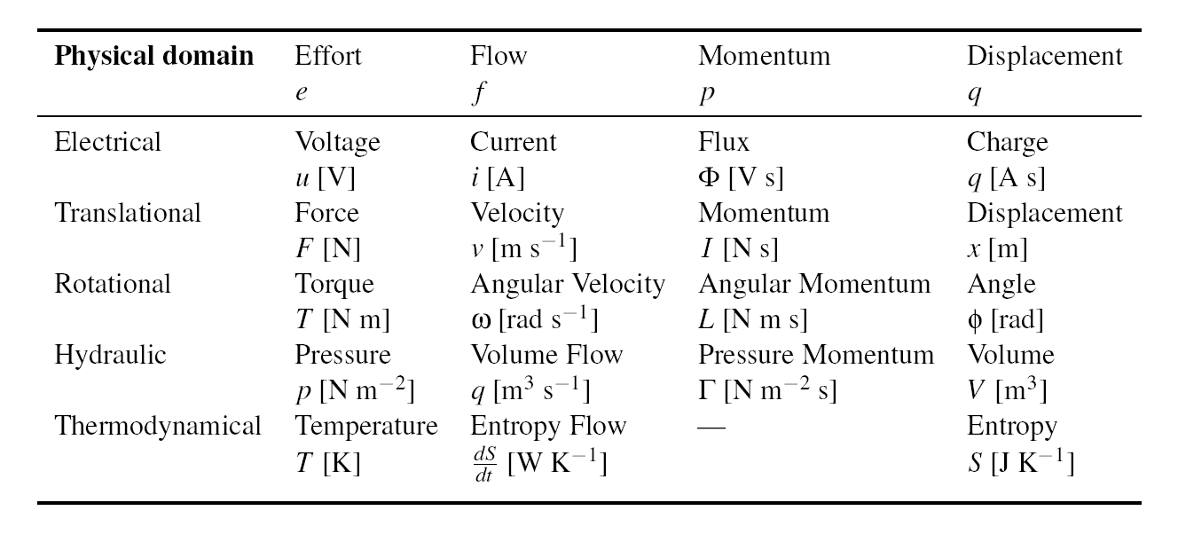
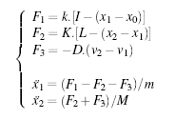
(DESS: Differential Equation Systems Specification)
Analogous ODE
system structure
Car suspension, Mechanical view.
Electrical analogy of car suspension.

Slide 15
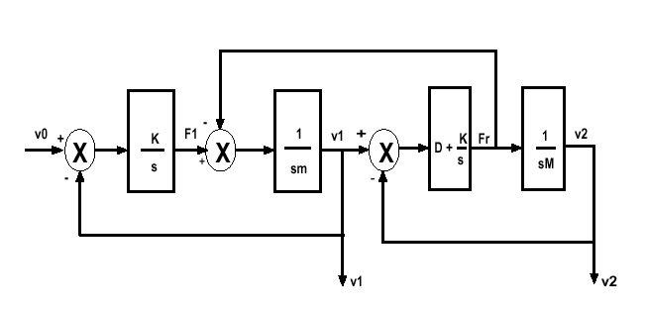
DESS
Transfer functions (block diagrams)

Slide 16
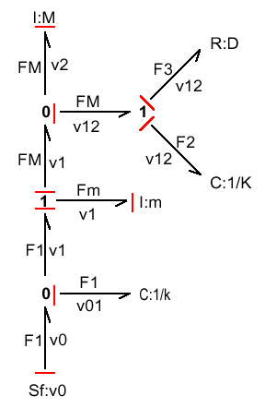
DESS
Bond Graphs
Also:
Forrester´s “System Dynamics”
Differential Algebraic Equations
Notes:
https://reference.wolfram.com/language/tutorial/NDSolveDAE.html

Slide 17
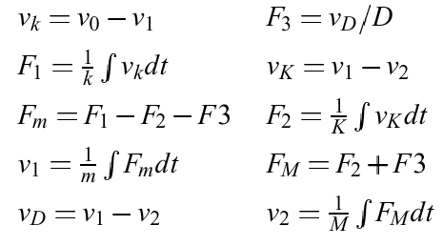
DESS
Differential equations
Numerical methods for Differential Equation solving:
Discrete Time/Continuous Variables systems.

Slide 18
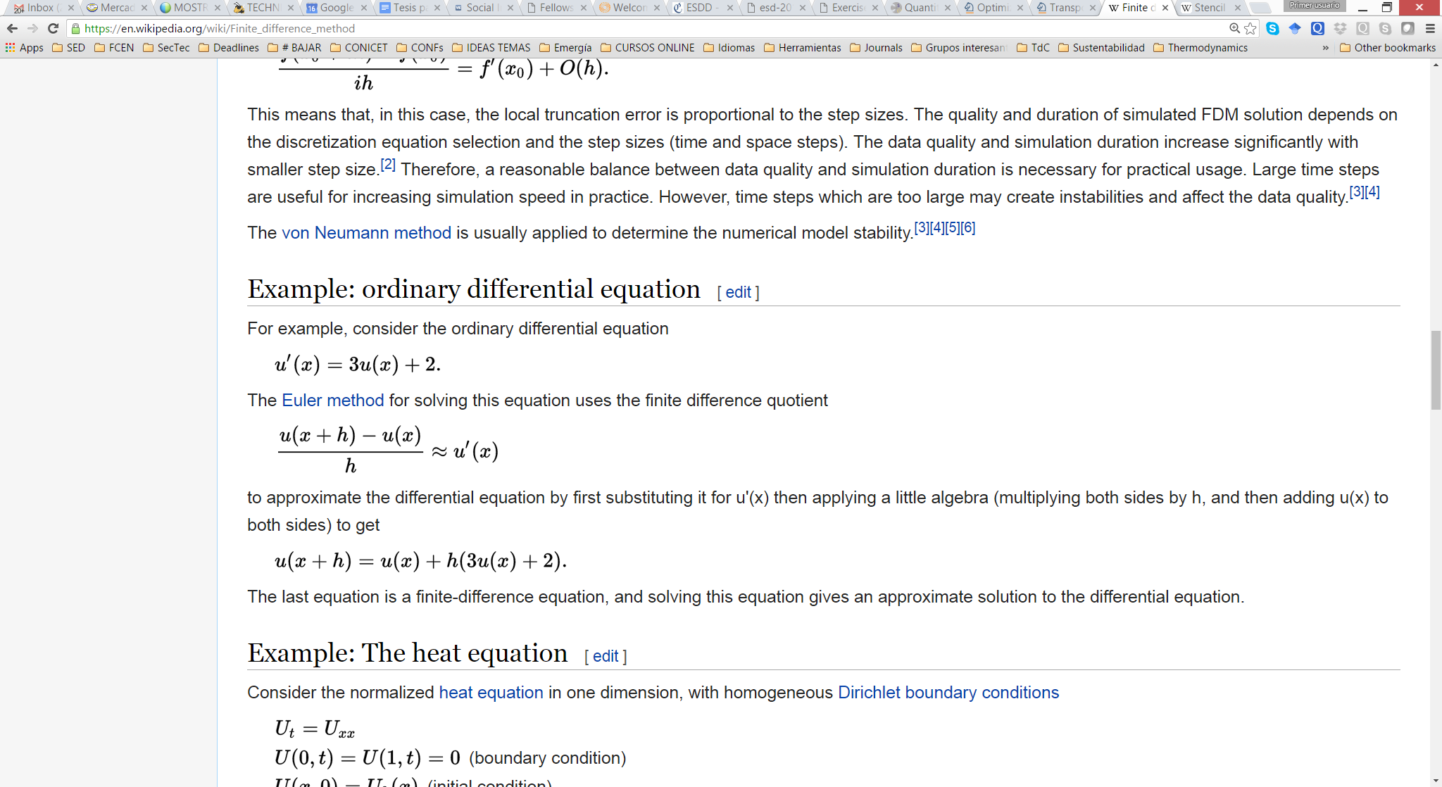
Discrete Time / Continuous Variable
(DTSS: Discrete Time Systems Specification)
Modeling Techniques:
Finite Difference Methods
  Also “Numerical Methods”, “Difference Equations”
  (Euler, Runge Kutta, DASSL, etc.)
  Dependent variable: u
  Independent variable: x
Differential equation:
Euler:
Difference equation:
Notes:
Stencil (PDEs)
https://en.wikipedia.org/wiki/Stencil_(numerical_analysis)
In mathematics, especially the areas of numerical analysis concentrating on the numerical solution of partial differential equations, a stencil is a geometric arrangement of a nodal group that relate to the point of interest by using a numerical approximation routine. Stencils are the basis for many algorithms to numerically solve partial differential equations (PDE). Two examples of stencils are the five-point stencil and the Crank–Nicolson method stencil.

Slide 19
Discrete Time / Discrete Variable (Automata)
Modeling Techniques:
Finite State Machines
Finite State Automata
Petri Nets
CSP (Communicating Sequential Processes)
CCS (Calculus of Communicating Systems)
LTS (Labelled Transition Systems)
Markov chains
Notes:
LTS:
http://www.cas.mcmaster.ca/~kahl/SE3BB4/2007/SE3B-2007-LTS1_4up.pdf
http://www.mcrl2.org/dev/user_manual/articles/lts.html

Slide 20
Discrete Variable / Continuous Time
(DEDS: Discrete Event Dynamic Systems)
Modeling Techniques:
Min-max algebra
Timed Finite State Machines
Timed Petri Nets
Generalized Semi-Markov Process (GSMP)
Timed automata
Timed graphs
Event graphs
Event scheduling
GPSS (simulation language)
DEVS formalism (Discrete EVent Systems specification)
DEVS contains all DEDS, being even more expressive.
Notes:
Ponemos DEVS como ejemplo más general del paradigma de modelos DVCT, porque los contiene a todos.
Fundamentalmente, DEVS no tiene la restricción de “Discrete Variable”, aunque esa es una restricción que reaparece en la etapa de simulación (por la finitud numérica represenatcional de las computadoras digitales).

Slide 21
Research efforts in DEDS modelling
Characteristic of DEDS (DTDS is a special case of DEDS)
  Human-made systems
  Naturally concurrent systems
  Not well-grounded mathematical formalism for modeling
  Difficulties in computer experimentation
  Non-linear
  No accurate analytic solution
  No transformation methods

Slide 22
Examples of Discrete Event Systems
Examples of Discrete Event System: Human-made system
  Multi-computer system
  Communication network
  Distributed control
  manufacturing system
  Games
  Traffic systems

Slide 23
Multiformalism
Complex system example
DAEs
GPSS
Differential
Algebraic
Equations
process interaction
discrete-event scheduling
system
…complexity lies in the diversity of the different components, both in abstraction level and
in formalism used.
Forrester’s
System Dynamics
Differential Equations
Hans Vangheluwe, 2008
Notes:
Complex systems are characterized, not only by a large number of components, but also by
the diversity of the components. For the analysis and design of such complex systems, it is no
longer sufficient to study the diverse components in isolation, using the specific formalisms these
components were modelled in. Rather, it is necessary to answer questions about properties (most
notably behaviour) of the whole system. To focus the attention, Figure 6 gives an example of a
complex system.
The complexity lies in the diversity of the different components, both in abstraction level and
in formalism used:
• A paper and pulp mill produces paper from trees with polluted water as a side-effect. This
system is modelled as a process interaction discrete-event scheduling system.
• A Waste Water Treatment Plant (WWTP) takes the polluted effluent from the mill and
purifies it. Some solid waste is taken to a landfill whereas the partially purified water
flows into a lake. This system is modelled using Differential Algebraic Equations (DAEs)
describing the biochemical reactions in the WWTP.
• A Fish Farm grows fish in the lake. Fish feed on algae which are highly sensitive to polluted
water. The water is also used for a tree plantation which supplies the paper mill. This
system is modelled using the System Dynamics formalism. The dotted feedback arrow
from the fish farm to the paper mill indicates the possible disastrous impact of poisoned
fish on the productivity of workers in the mill.

Slide 24
Multiformalism utility
Different Abstraction Levels of a Dynamic System
state
< Multilevel Abstraction in System Design >
Higher Abstraction Level
S/W
Real-time
program
Timed
DES
event₁
event₂
event₃
event₄
event₅
time
state
Concurrent
program
Untimed
DES
Sequential
program
Finite State
Automata
time
state
H/W
Diff. Eqn
FSM
time
state
time

Slide 25
Multiformalism utility
Hybrid Systems
Problematic for classic discrete Discrete Time methods. Among other reasons, due to the difficult/costly handling of Discrete Events.
Real Process,
Conceptual
Model.
Discrete-Event process,
State Chart.
(Juan de Lara, 2005)
Physical process,
Differential Equations.

Slide 26
Example: hierarchical control
Operator
Planning/scheduling
Strategic control
Event-based
control
Discrete Event
Controller
Supervisory control
Command
Discrete states
PID controller
analog/digital
Time-based
control
Actuation
Sensors
Plant
Continuous variables and time

