Slide 1
Previous experience
Background
Systems/Computer Engineering
  Computer Science
  Electronic/Electrical Engineering
  Industrial/Mechanical Engineering
  General Sciences: Mathematics, Chemistry, Physics, etc.
  Natural Sciences/Medicine
  Social Sciences
  Other?
Experience in the area
  Courses in Modelling and Simulation?
  DEVS? (Basic/Advanced)
  Parallel simulation (Basic/Advanced)
  Programming languages for discrete-event models (Basic/Advanced)
  None

Slide 2

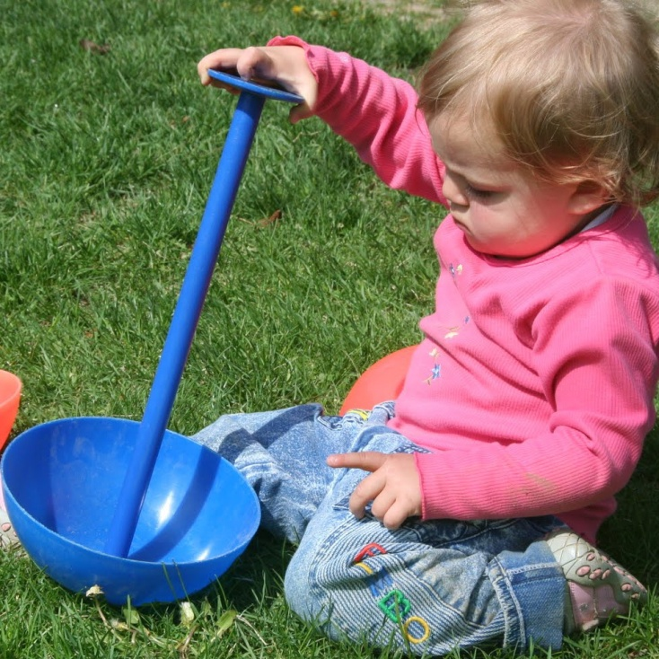
Problem Solving (Learning)
It’s in our nature. But how do we “learn”?

Slide 3

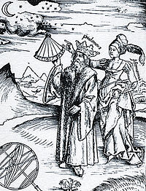

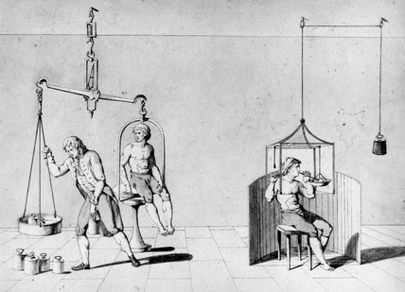
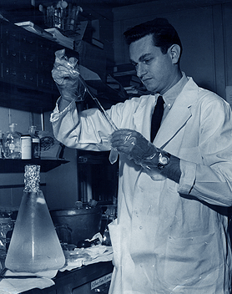
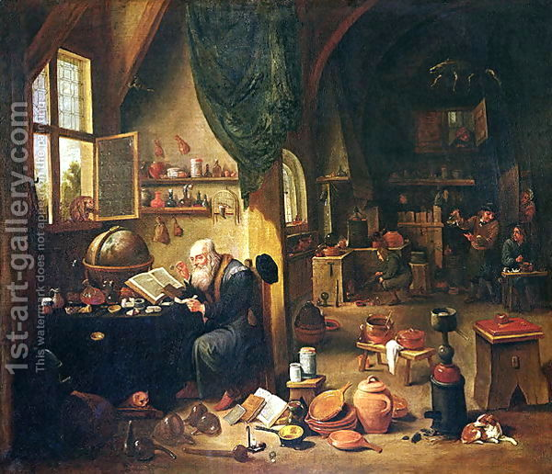
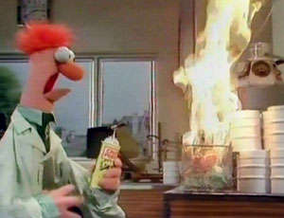
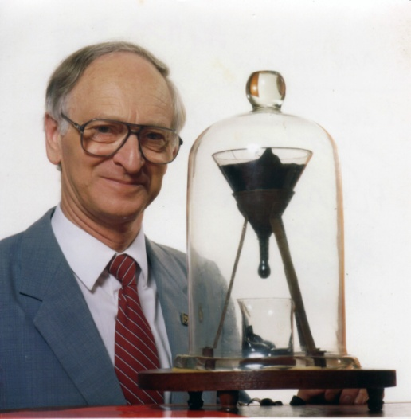
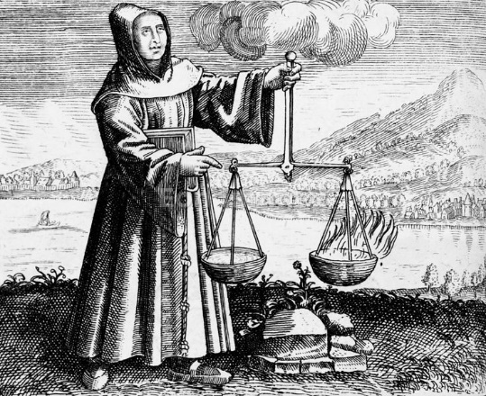
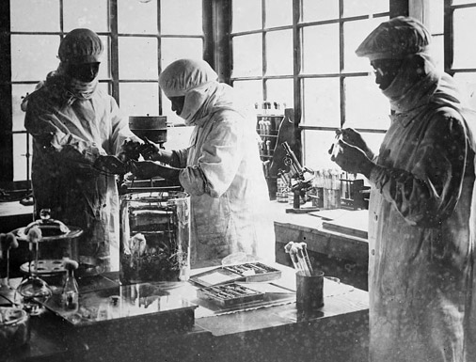
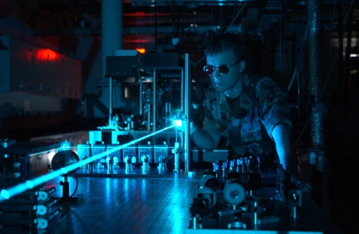
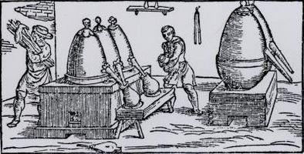
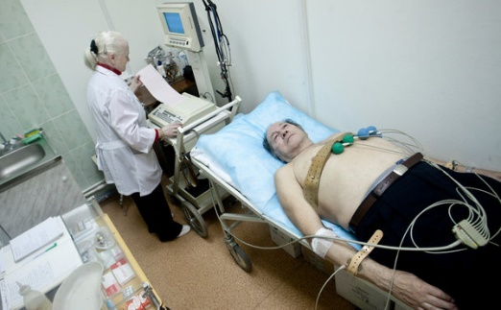
Experimentation

Slide 4
Experimentation
Experiment
Experimental Frame
Entity
Results
THERE ARE MANY LIMITS TO PURE EXPERIMENTATION

Slide 5

Experimentation
Experiment
Experimental Frame
Entity
Results
Experiments (DOCUMENT!)
- Are the seconds accurate? (device)
- Does it increment properly? (observation)
- Can you reset from any value?
- Does it restart?
- What happens when you press and hold the button?
- How long does it take to reset?
Assumptions
60 seconds max
Perfect first 12 s
Start: 0 or 1?
Other Posssible Experiments
- Smashing the button: mechanical
- Pressing the button too fast: mechanical
- Can you hurt yourself ? Safety , design

Slide 6
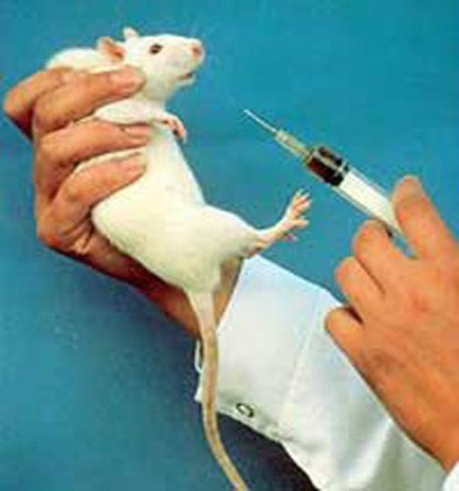
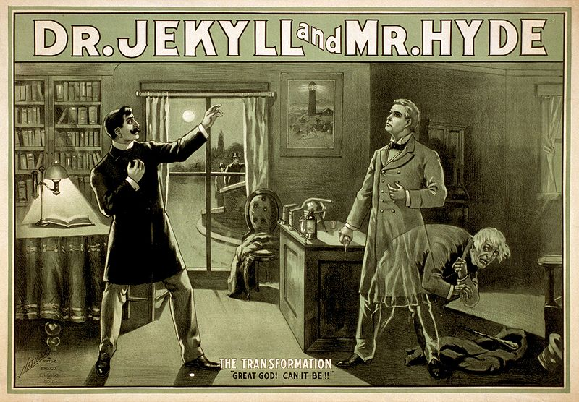
Ethics

Slide 7
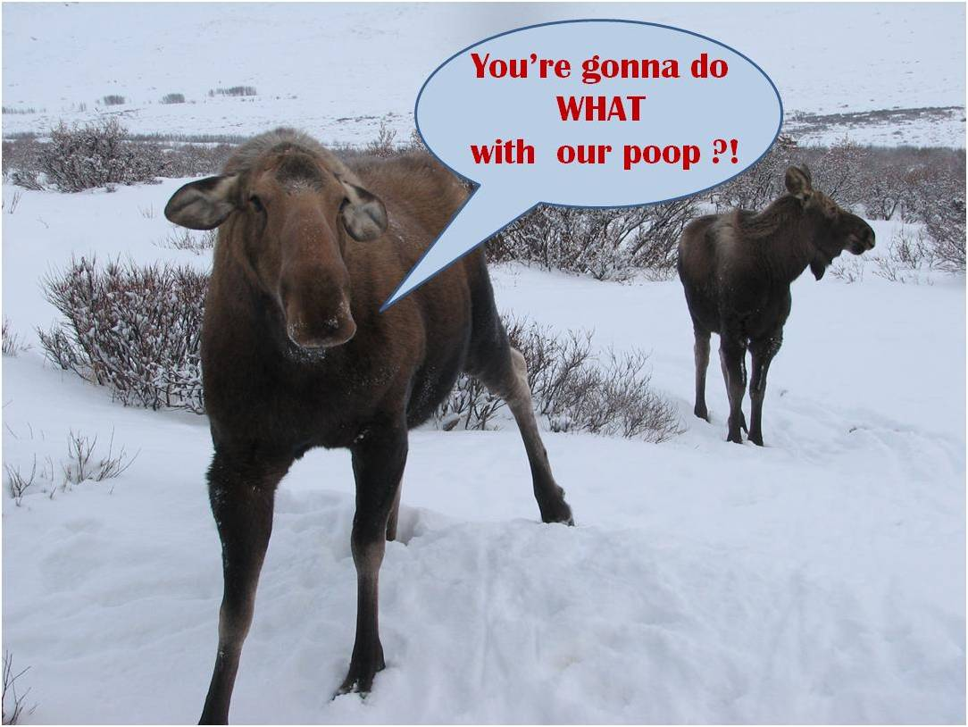
Risk/Danger

Slide 8
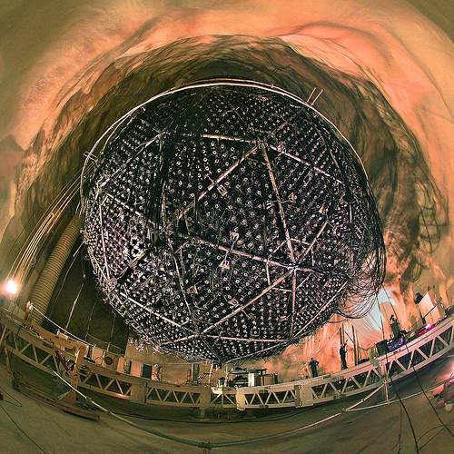
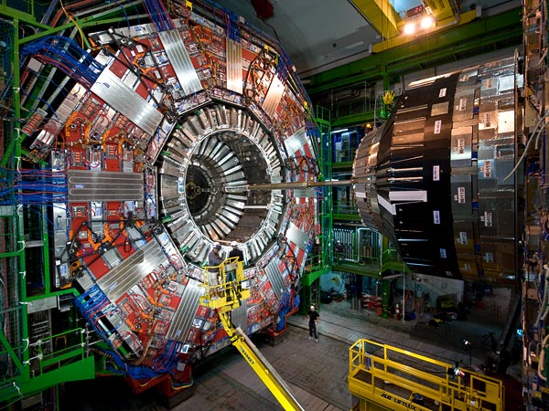
Cost ($$$$)

Slide 9

Combination of the above

Slide 10
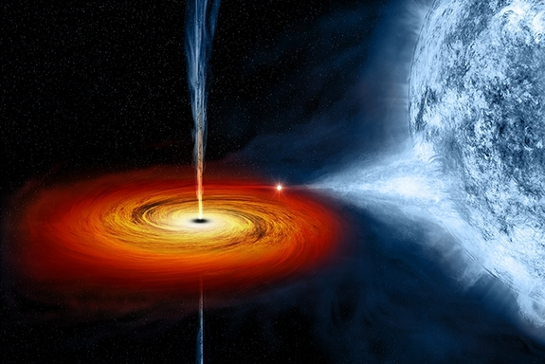

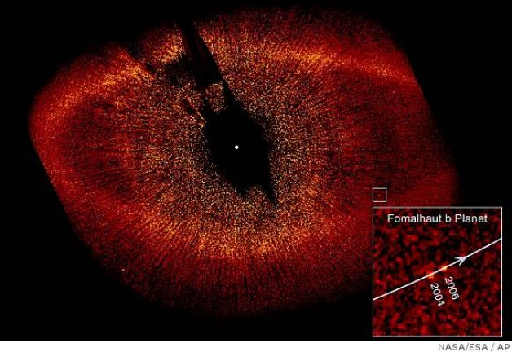
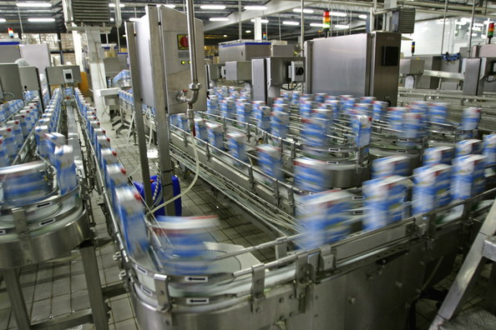
Cannot Experiment
Black Holes Subatomic Particles
Remote planets Manufacturing
plants
Remote
Planets
Manufacturing
plant

Slide 11
Modeling of Natural Systems
Analytical methods
(Fourier’s law for the conduction of heat
in a one-dimensional steady state
isotropic media)

Slide 12
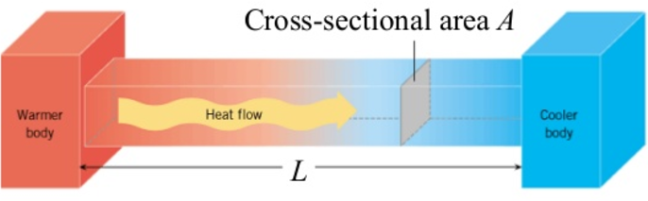
Analytical Modeling
Analytical:
  Symbolic
  General solutions to existing systems
  (under -often- broad experimental conditions)
  When available, the preferred way to go !
Problem solving through analytical modeling.
Experiment
Experimental Frame
Entity
Results
Equations
Query
Model's Exp. Frame
Model
Results
Fourier’s law for the
conduction of heat
in a one-dimensional
isotropic media:
q_{x}
x
Notes:
A'h-mosè Papyrus (1650 BC)
Archimedes (250 BC)
Newton-Leibniz (1700 AD)

Slide 13
Experimentation
Experiment
Experimental Frame
Entity
Results
Experiments (DOCUMENT!)
- Are the seconds accurate? (device)
- Does it increment properly? (observation)
- Can you reset from any value?
- Does it restart?
- What happens when you press and hold the button?
- How long does it take to reset?
Assumptions
60 seconds max
Perfect first 12 s
Start: 0 or 1?
Other Posssible Experiments
- Smashing the button: mechanical
- Pressing the button too fast: mechanical
- Can you hurt yourself ? Safety , design

Slide 14
Modeling
Experiment
Experimental Frame
Entity
Results
Equations
Query
Model's Exp. Frame
Model
Results
Other Posssible Experiments
Experiments
- Are the seconds accurate?
- Does it increment properly?
- Can you reset from any value?
- Does it restart?
Other Experiments within this Model/s Experimental Frame?
Assumptions
60 seconds max
Perfect first 12 s
Start: 0 or 1?

Slide 15
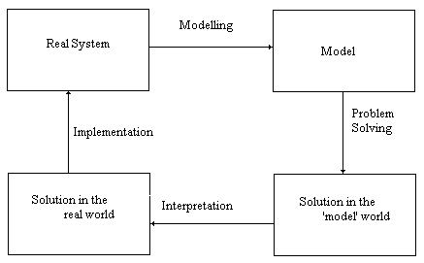
The problem analysis cycle

Slide 16
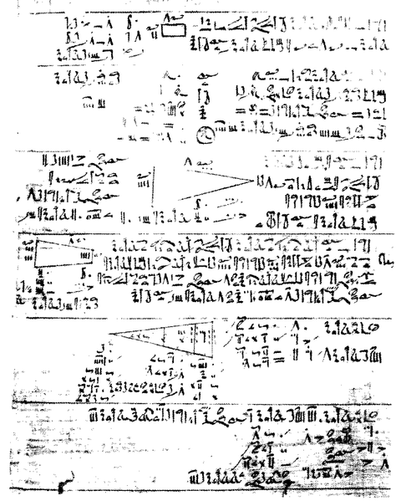

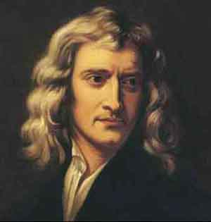
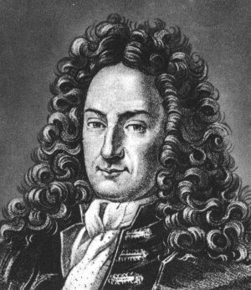
Analytical Modeling (1650 BC - ...)
Archimedes (250 BC)
A'h-mosè Papyrus (1650 BC) Newton-Leibniz (1700 AD)

Slide 17
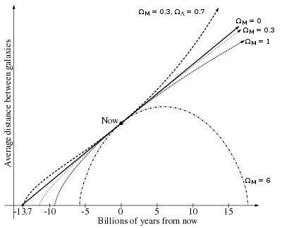
Defining the equations?
How is the Universe going to end?
  Impossible to define
  Impossible to solve
  Simplifications
  You end solving a different problem

Slide 18
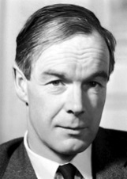
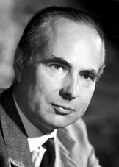
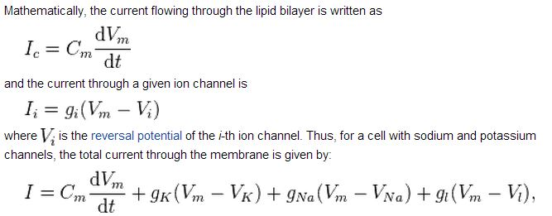
Solving Equations?
Hogdkin-Huxley
  Nobel Prize 1963

Slide 19
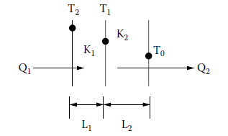
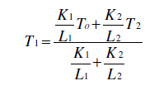
Problems with Analytical Modeling
Complexity: analytical solutions cannot be provided.
  Impossible to define
  Impossible to solve
  Simplifications needed
Numerical Methods
E.g.: Approximations of the Fourier equation:
(divide the surface of interest into small elements)

Slide 20
Numerical Approximation
Experiment
Experimental Frame
Entity
Results
Query
Model's Exp. Frame
Model
Computed Query
Approximation
Computation Exp. Frame
Compute
Approximate Results

Slide 21
Simulation
Experiment
Experimental Frame
Entity
Results
Query
Model's Exp. Frame
y(t)=x(t)+1
Computed Query
Approximation
Computation Exp. Frame
Compute
Approximate Results
Experiments
- Are the seconds accurate?
- Does it increment properly?
- Can you reset from any value?
- Does it restart?
Other Experiments within this Simulation’s Experimental Frame?
Assumptions
60 seconds max
Perfect first 12 s
Start: 0 or 1?

Slide 22
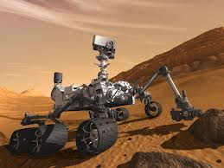

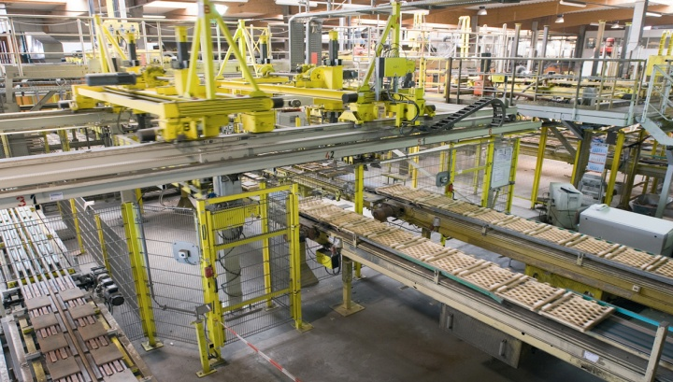
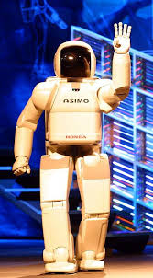

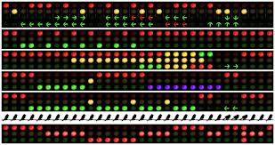
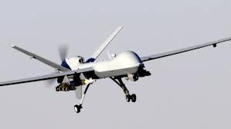
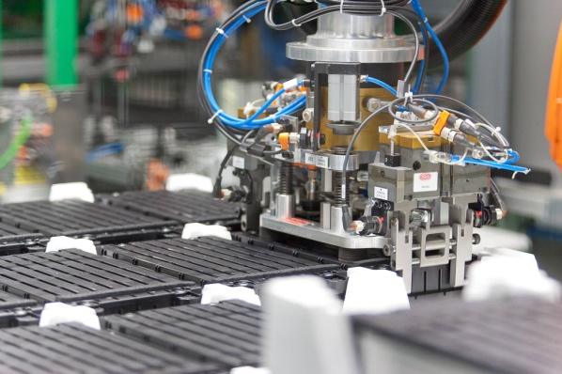
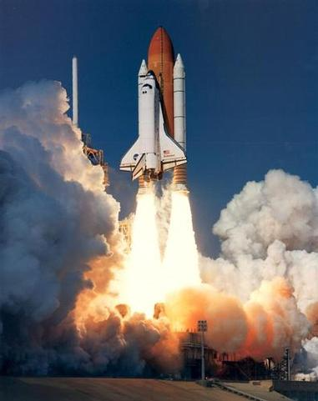
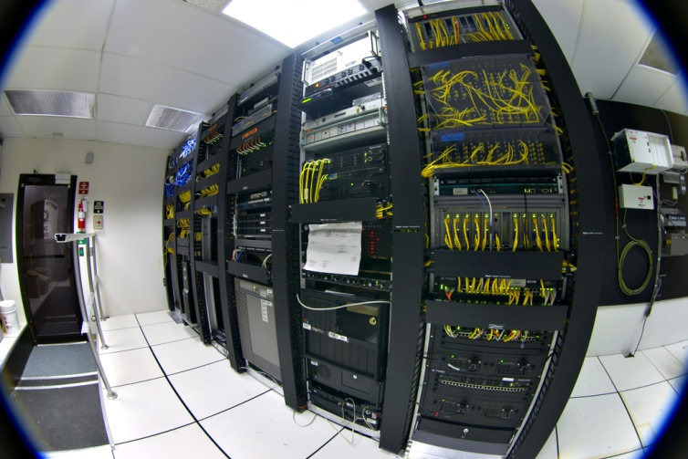

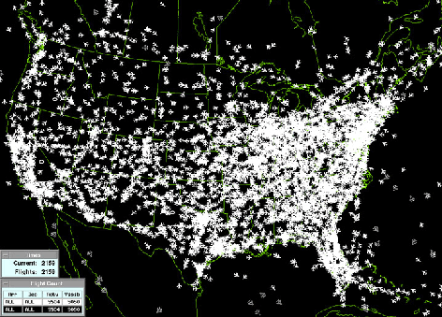
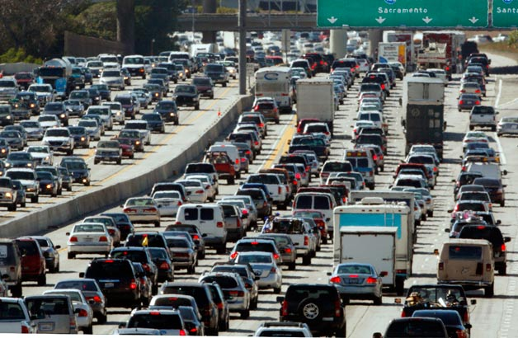
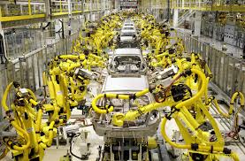
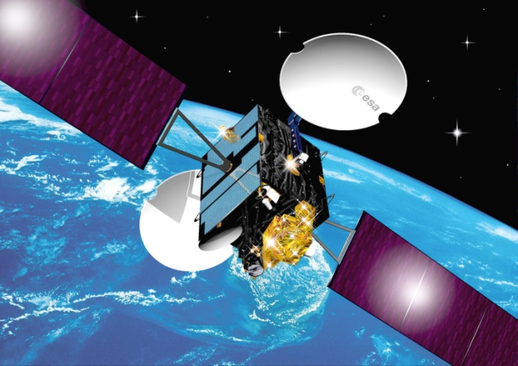

Slide 23
Artificial Systems Modeling
Complexity: analytical solutions cannot be provided.
Differential equations and approximations: inadequate tools

Slide 24
Modeling Artificial Systems
G
Y
R
G: 45s
Y:
10s
R:
55s

Slide 25
Automata Simulation
Experiment
Experimental Frame
Entity
Results
Query
Model's Exp. Frame
Model
G
Y
R
Computed Query
Approximation
Computation Exp. Frame
Compute
Approximate Results

Slide 26
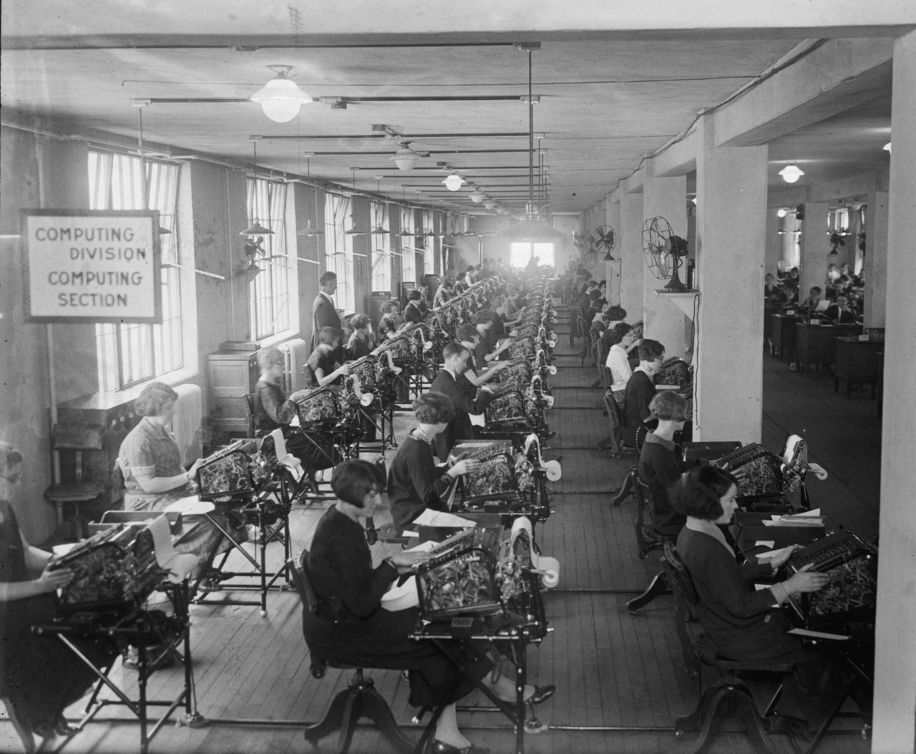
Would you prefer this option ?
November 24, 1924. Washington, D.C. "Bonus Bureau, Computing Division. Many clerks figure the amount of the bonus each veteran is entitled to."

Slide 27
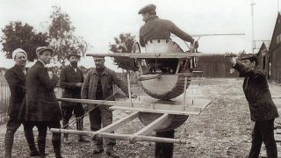
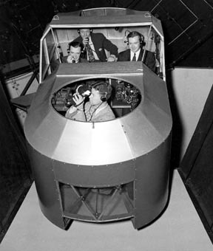
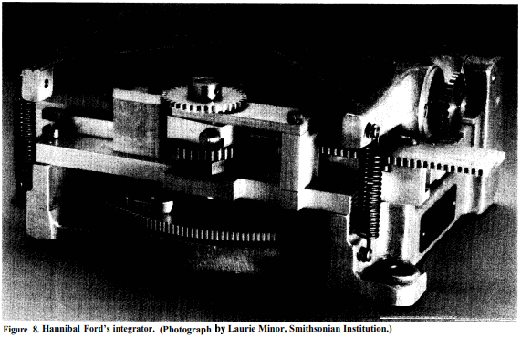
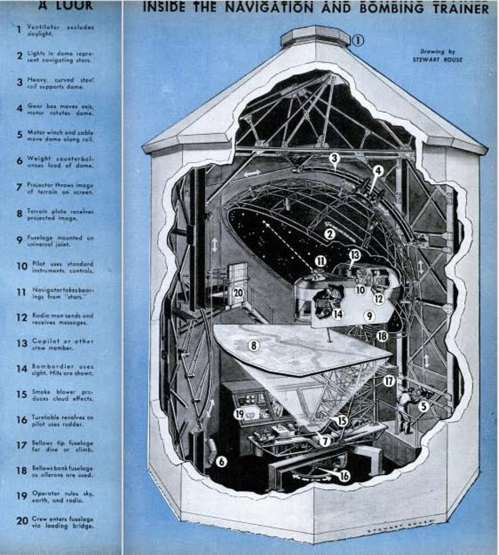
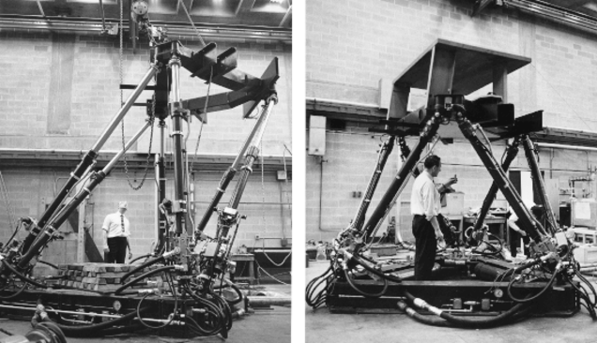

Slide 28
Along Came the Computer…
1950’s: simulation
  Particular solutions for a given problem
  Controlled experimentation
  Time compression
Mixed problems
  Solving numerical methods more efficiently
  Computing automata-based models
  Conducting a large number of experiments in a controlled fashion at a low cost

Slide 29
Problem Solving through Computation
Experiment
Experimental Frame
Entity
Results
Equations
Query
Model's
Exp. Frame
Model
Computed Query
Approximation
Computation Exp. Frame
Compute
Approximate Results
Opposite to:
Experiment
Experimental Frame
Entity
Results
single-use
Program
The model is mixed with the experiment and the software
Simulator
Results
Notes:
The source of many of these problems can be experienced by solving Exercise 1.2 or 1.5, and it is summarized in Figure 1.8: as most simulation languages were not derived from a formal modeling framework, the modeling phase, is actually skipped. We start by collecting data from experiments, and we build a piece of software (the simulator), trying to mimic the problem under study (skipping the intermediate modeling phase). Although this method is still useful in many cases, the result is a single-use program approach, which can have several problems (we will use Example 1.2 to discuss some of these problems):
What happens if we need to reuse the simulation in a different context (e.g., we want to reuse the traffic light controller simulation for a railway controller simulation)?
How can we reuse the experiments done to test the original model on a different one? How do we deal with changes?
If we decide to add a blinking green light for left turns (or a blinking red light for a failing controller), we need to modify the software application completely.
Where is the abstract model we can use to organize our ideas? How do we organize the creation of a new version of the simulator in which we need to study the intersection of six streets with two-way traffic? How do we validate the results? What do we do if we find errors in the simulation?
It is difficult to address these issues using the same simulation languages because the model is usually mixed with the experiment and the simulation software. For instance, in Example 1.2, the traffic light controller would be mixed with the generation of pedestrians arriving at the corner and the simulation routines that make time advance and decide what to do next. Even with a simple example like this one, reuse is complex—how can we reuse the control algorithm for the traffic light? Any changes would result in going through the code for the simulation and the experiment because there is no model to use in the verification process. Building a program from the experimental data, as in Figure 1.8, would result in having the original software discarded and a new simulator built from scratch for the next simulation project. Instead, using a model to organize our ideas can help to create a better product at a reduced cost. Although nonformal models (sometimes called conceptual models) can be of help in this task, a formal model like the automata in Figure 1.5 provides much better facilities for verification, reuse, modification and testing. It also provides the basis to define a process that would allow repetition of successful previous experiences, enable reuse, and introduce well-known software engineering practices in the creation of the simulation software.
With these goals in mind, different groups investigated the creation of formal discrete-event modeling techniques. Such formalisms provide a communication convention written in a mathematical language, which we can use as a guide to provide a nonambiguous specification of the system’s semantics [12,13]. Formalisms can be used to represent the entities under study formally, creating an abstract model and providing means for manipulating such abstraction, while being able to translate them into executable models. A formal model (i.e., one built using a formalism) provides a sound mechanism to specify the entity under study that can be formally verified. This improves error detection and reduces the development and verification time of the simulation software, enhancing the security and reducing the development costs of the simulation. Going back to Figure 1.3, if we can prove properties of the model before creating its computational version, we can improve the final product at a lower final cost. Simultaneously, a formal mechanism can disambiguate communication, enhancing teamwork by providing a sound notation for the model being constructed.

Slide 30
Building a Simulator
G: 45s
Y:
10s
R:
55s
- Artificial: Automata
- Physical/natural: Differential Equation approximation
- Special recipes are special purpose
time = 0; State = Green;
Repeat Forever {
if (State == Green AND (time mod 110) == 45) State = Yellow;
if (State == Yellow AND (time mod 110) == 55) State = Red;
if (State == Red AND (time mod 110) == 0) State = Green,
time = time + 5;
}
x(t)
x*(n)
5
t
Notes:
Special recipes are special purpose !
If we now use this model to create a simulator (for instance, an implementation of the timed
automata in Figure 1.5(b) using a C-like programming language), we obtain a program in the style
of the one introduced in Figure 1.6.
As we can see, we start at time 0 with a green light. The simulator evolves by checking the current
state and time and acting according to their values. For instance, after being 45 s in green, the
state changes to yellow; after 10 more units, it changes to red and then finally goes back to green.
Time is incremented on each cycle using time steps of 5 s (which is the greatest common divisor—
g.c.d.—of the three light periods—that is, the minimum value providing enough precision according
to the data collected in Figure 1.4).

Slide 31
Single-use Program Approach
Reuse of simulation software in a different context?
Reuse of experiments carried out?
Changes in the model?
Updates in the model?
Where is the abstract model to use to organize our thoughts?
How do we validate the results? What if we find errors?

Slide 32
Discrete-Event Dynamic Systems (DEDS)
Traffic lights + pedestrians

Slide 33
Modeling DEDS
How do we model the external sensory information?
If we need to combine this traffic light with others, how is the variable-timing behavior going to affect the combined automaton?
Which would be right timestep to be used?
What are the “differential equations” for this problem?
Lights for the whole city: explosion of states?

Slide 34
Modeling and Simulation of DEDS
SIMULA:
…find ways to conceptualize complex
real-world problems, and how to describe the heterogeneity of a system and its behavior.
Invention of Object-Orientation
(continued with Smalltalk)
Based on programming languages
  Difficult to test, maintain, verify.
Richard E. Nance, 1993
Notes:
Pensar en simulación de DEDS y en sistemas complejos dió nacimiento a OOP con Simula 67. Luego Smalltalk y C++
find ways to conceptualize complex
real-world problems, and how to describe the heterogeneity of a system and its behavior
A history of discrete event simulation programming languages
Full Text:PDFAuthor:Richard E. Nance
http://dl.acm.org/citation.cfm?id=155368
1993
Ever since he first started working with operations research back in 1952, Kristen Nygaard had been constantly concerned with ways to conceptualize complex real world systems. One of the major problems he encountered in this pursuit was how to describe the heterogeneity of a system and its operation.
http://staff.um.edu.mt/jskl1/simula.html
Paper: Compiling SIMULA, A Historical Study of Technogical Genesis
http://www.whoishostingthis.com/resources/simula-programming/
Simula a Smalltalk: https://www.cs.cmu.edu/~charlie/courses/15-214/2014-fall/slides/25-history-oo.pdf

Slide 35
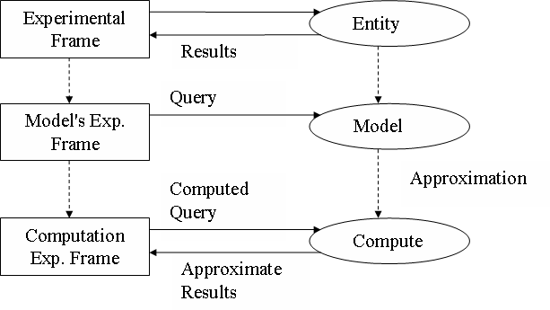
Building a Simulator
Experiment
Experiment
Experimental Frame
Entity
Results
Program
Simulator
Results

Slide 36
Discrete-Event M&S
Based on programming languages (difficult to test, maintain, verify).
Beginning ’70s: research on M&S methodologies.
Improvement of development task.
Focus in reuse, ease of modeling, development cost reductions.

Slide 37
Some definitions
Simulation is the reproduction of the dynamic behaviour of a real system with the goal of obtaining conclusions that can be applied back to the real system.
- Dynamic behaviour
- Real system
- Obtaining conclusions
Execution of a model by a computer system (algorithm -single processor or processor network-) capable to generate its behaviour

Slide 38
More Definitions
Behavior: specific form of data observable in a system over time within an experimental frame.
Experimental Frame: the conditions under which a system or a model are observed or experimented with.
- We do not reason but on MODELS.
- Problems cannot be solved on the real systems.
- Every problem is studied on abstract representations of the systems.
Problem solving for a System is related to an Experimental Frame in which the Behavior of a Model is analyzed.

Slide 39
Phases in a M&S study
Problem definition
Input/output data collection and analysis
Modelling
Implementation
Verification and validation
Experimentation
Experiment optimization
Output data analysis

Slide 41
Applications of M&S
Exploration: better understanding of a real system
Prediction: future behavior of a real system
Improvement: the system performance is enhanced, studying different alternatives
Conception: analysis of non-existing real systems
Applications to Natural/Artificial systems

Slide 42
M&S Entities and Relations
Data as Input/Output
relation pairs
Device for
executing models
Each entity can be formalized
as a Mathematical Dynamic system
Relations are represented
by homomorphisms or other
equivalences

Slide 43
Modelling/Simulation basic entities
3 Entities in Modeling/Simulation :
Real System, Model, Simulator
Experimental Frame
Real System
Model
Simulator
Validation
Verification
Data source
Scenario
(Instruction Set)
Interpretation
of Instructions
Signal
generator
Generator
Circuit
under test
Model
Oscilloscope
Acceptor
Voltmeter
Transducer
< Experiment Devices >
< Experimental Frame >

Slide 44


One system: many models
A model is valid to an objective
  Correct answer to given Queries
  Complete model never exists
  Many possible viewpoints of the same entity
    The Goedel-Escher-Bach cube.
Q1 Q2 Q3 Q4
SYSTEM
Given system
Objective
Q1 Q2
Q3 Q4
MODEL1
MODEL2
Many models
experiment1
experiment2
Notes:
http://www.ncl.ac.uk/kite/assets/downloads/
https://en.wikipedia.org/wiki/G%C3%B6del,_Escher,_Bach
1979 book by Douglas Hofstadter
What it means to communicate, how knowledge can be represented and stored, the methods and limitations of symbolic representation, and even the fundamental notion of "meaning" itself.

Slide 45
Verification, Validation and Accreditation
Verification: the process of verifying that the simulator of a model correctly generates its behaviour.
Validation: relation between a model, a system and an experimental frame.
- Answers the question of whether it is impossible to distinguish model from system in the experimental frame.
- Validity is affirmed if, as far as the experiments possible within the experimental frame, the behavior of the model and system agree within acceptable tolerance.
Accreditation: process of gaining approval for model use. Usually depends on prior verification and validation.

Slide 46
VV&A (cont)
Replicative validity: (weak criterion): validity is affirmed if, for all the experiments possible within the experimental frame, the trajectories of the model and system agree within acceptable tolerance.
Predictive validity: besides replicative validity of a model with respect to a system within an experimental frame, it is affirmed if, given the system
  it is possible to initialize the model to an internal state such that
  for the same input trajectory the model output trajectory predicts the system output trajectory within acceptable tolerance
Structural validity: besides predictive validity it requires that the model also mimics in step-by-step, component-by-component fashion the way in which the system does its internal transitions.

