Slide 1
Internet Technology
&
Cloud Computing Services
Overviews
Paul A. Kloppenburg, B.Eng., P.Eng.
UC Consultant Avaya CTO
613 595-9003
klopp@avaya.com
SYSC 4700, Telecommunications Engineering
April 3rd, 2018

Slide 2
Agenda
The Internet
  What is the Internet
  Brief history
Internet Protocols
  What is a Protocol?
  Open Systems Interconnections (OSI) reference model (1983)
  Data Protocols
  Application Protocols
  Control Management Protocols
  Internet Data Transfer Protocol Summary
  Protocol Summary
  Data Flow Summary
  Internet Protocol Addressing
Internet LAN Devices
Internet WAN Devices
Internet Applications
Internet Access
Future of the Internet
Clouding Computing Services Overview
Summary

Slide 3
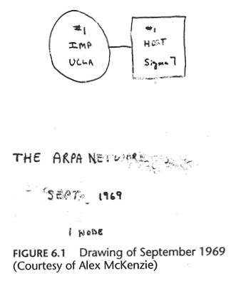
How the Internet began
UCLA Stanford
ARPA NET
ARPA (Advanced Research Project Agency)
Paul Baron “On Distributed Communications Networks” at RAND Corp.
Notes:
Distributed Communications Network=>Paul Baran as part of work done at the Research And Development (RAND) Corporation
http://en.wikipedia.org/wiki/Paul_Baran
A Complex Global web of thousands of networks some smaller; some larger. All these networks are connected with devices through various link medias. For most people they see and experience the Internet through their computer. Hobbes' Internet Timeline Copyright (c)1993-2000 by Robert H Zakon. Permission is granted for use of this document in whole or in part for non-commercial purposes as long as this Copyright notice and a link to this document, at the archive listed at the end, is included. A copy of the material the Timeline appears in is requested. For commercial uses, please contact the author first. Links to this document are welcome after e-mailing the author with the document URL where the link will appear. The author wishes to acknowledge the Internet Society for hosting this document, and the many Net folks who have contributed suggestions and helped with the author's genealogy search.
1950s
1957 USSR launches Sputnik, first artificial earth satellite. In response, US forms the Advanced Research Projects Agency (ARPA), the following year, within the Department of Defense (DoD) to establish US lead in science and technology applicable to the military (:amk:)
1960s
1961 Leonard Kleinrock, MIT: "Information Flow in Large Communication Nets" (July) First paper on packet-switching (PS) theory
1962
J.C.R. Licklider & W. Clark, MIT: "On-Line Man Computer Communication" (August)
Galactic Network concept encompassing distributed social interactions
1964
Paul Baran, RAND: "On Distributed Communications Networks"
Packet-switching networks; no single outage point
1965
ARPA sponsors study on "cooperative network of time-sharing computers"
TX-2 at MIT Lincoln Lab and AN/FSQ-32 at System Development Corporation (Santa Monica, CA) are directly linked (without packet switches) via a dedicated 1200bps phone line; Digital Equipment Corporation (DEC) computer at ARPA later added to form "The Experimental Network"
1966
Lawrence G. Roberts, MIT: "Towards a Cooperative Network of Time-Shared Computers" (October) First ARPANET plan
1967
ARPANET design discussions held by Larry Roberts at ARPA IPTO PI meeting in Ann Arbor, Michigan (April)
ACM Symposium on Operating Principles in Gatlinburg, Tennessee (October)
First design paper on ARPANET published by Larry Roberts: "Multiple Computer Networks and Intercomputer Communication
First meeting of the three independent packet network teams (RAND, NPL, ARPA)
National Physical Laboratory (NPL) in Middlesex, England develops NPL Data Network under Donald Watts Davies who coins the term packet. The NPL network, an experiment in packet-switching, used 768kbps lines
1968
PS-network presented to the Advanced Research Projects Agency (ARPA)
Request for proposals for ARPANET sent out in August; responses received in September
University of California Los Angeles (UCLA) awarded Network Measurement Center contract in October
Bolt Beranek and Newman, Inc. (BBN) awarded Packet Switch contract to build Interface Message Processors (IMPs)
US Senator Edward Kennedy sends a congratulatory telegram to BBN for its million-dollar ARPA contract to build the "Interfaith" Message Processor, and thanking them for their ecumenical efforts Network Working Group (NWG), headed by Steve Crocker, loosely organized to develop host level protocols for communication over the ARPANET. (:vgc:)
Tymnet built as part of Tymshare service (:vgc:)
1969
ARPANET commissioned by DoD for research into networking
Nodes are stood up as BBN builds each IMP [Honeywell DDP-516 mini computer with 12K of memory]; AT&T provides 50kbps lines
Node 1: UCLA (30 August, hooked up 2 September)
Function: Network Measurement Center
System,OS: SDS SIGMA 7, SEX
Diagram of the first host to IMP connection
Node 2: Stanford Research Institute (SRI) (1 October)
Network Information Center (NIC)
SDS940/Genie
Doug Engelbart's project on "Augmentation of Human Intellect"
Node 3: University of California Santa Barbara (UCSB) (1 November)
Culler-Fried Interactive Mathematics
IBM 360/75, OS/MVT
Node 4: University of Utah (December)
Graphics
DEC PDP-10, Tenex
Diagram of the 4-node ARPAnet
First Request for Comment (RFC): "Host Software" by Steve Crocker (7 April)
RFC 4: Network Timetable
First packets sent by Charley Kline at UCLA as he tried logging into SRI. The first attempt resulted in the system crashing as the letter G of LOGIN was entered. (October 29) [ Log entry ]
Univ of Michigan, Michigan State and Wayne State Univ establish X.25-based Merit network for students, faculty, alumni (:sw1:)
1970s
1970
First publication of the original ARPANET Host-Host protocol: C.S. Carr, S. Crocker, V.G. Cerf, "HOST-HOST Communication Protocol in the ARPA Network," in AFIPS Proceedings of SJCC (:vgc:)
First report on ARPANET at AFIPS: "Computer Network Development to Achieve Resource Sharing" (March)
ALOHAnet, the first packet radio network, developed by Norman Abramson, Univ of Hawaii, becomes operational (July) (:sk2:) connected to the ARPANET in 1972 ARPANET hosts start using Network Control Protocol (NCP), first host-to-host protocol. First cross-country link installed by AT&T between UCLA and BBN at 56kbps. This line is later replaced by another between BBN and RAND. A second line is added between MIT and Utah
1971
15 nodes (23 hosts): UCLA, SRI, UCSB, Univ of Utah, BBN, MIT, RAND, SDC, Harvard, Lincoln Lab, Stanford, UIU(C), CWRU, CMU, NASA/Ames BBN starts building IMPs using the cheaper Honeywell 316. IMPs however are limited to 4 host connections, and so BBN develops a terminal IMP (TIP) that supports up to 64 hosts (September). Ray Tomlinson of BBN invents email program to send messages across a distributed network. The original program was derived from two others: an intra-machine email program (SENDMSG) and an experimental file transfer program (CPYNET) (:amk:irh:)
1972
Ray Tomlinson (BBN) modifies email program for ARPANET where it becomes a quick hit. The @ sign was chosen from the punctuation keys on Tomlinson's Model 33 Teletype for its "at" meaning (March) Larry Roberts writes first email management program (RD) to list, selectively read, file, forward, and respond to messages (July)
International Conference on Computer Communications (ICCC) at the Washington D.C. Hilton with demonstration of ARPANET between 40 machines and the Terminal Interface Processor (TIP) organized by Bob Kahn. (October)
First computer-to-computer chat takes place at UCLA, and is repeated during ICCC, as psychotic PARRY (at Stanford) discusses its problems with the Doctor (at BBN). International Network Working Group (INWG) formed in October as a result of a meeting at ICCC identifying the need for a combined effort in advancing networking technologies. Vint Cerf appointed first Chair. By 1974, INWG became IFIP WG 6.1 (:vgc:) Louis Pouzin leads the French effort to build its own ARPANET - CYCLADES
RFC 318: Telnet specification
1973
First international connections to the ARPANET: University College of London (England) and NORSAR (Norway)
Bob Metcalfe's Harvard PhD Thesis outlines idea for Ethernet. The concept was tested on Xerox PARC's Alto computers, and the first Ethernet network called the Alto Aloha System (May) (:amk:) Bob Kahn poses Internet problem, starts internetting research program at ARPA. Vinton Cerf sketches gateway architecture in March on back of envelope in a San Francisco hotel lobby (:vgc:)
Cerf and Kahn present basic Internet ideas at INWG in September at Univ of Sussex, Brighton, UK (:vgc:)
RFC 454: File Transfer specification Network Voice Protocol (NVP) specification (RFC 741) and implementation enabling conference calls over ARPAnet. (:bb1:)
SRI (NIC) begins publishing ARPANET News in March; number of ARPANET users estimated at 2,000
ARPA study shows email composing 75% of all ARPANET traffic
Christmas Day Lockup - Harvard IMP hardware problem leads it to broadcast zero-length hops to any ARPANET destination, causing all other IMPs to send their traffic to Harvard (25 December)
RFC 527: ARPAWOCKY
RFC 602: The Stockings Were Hung by the Chimney with Care
1974
Vint Cerf and Bob Kahn publish "A Protocol for Packet Network Interconnection" which specified in detail the design of a Transmission Control Program (TCP). [IEEE Trans Comm] (:amk:)
BBN opens Telenet, the first public packet data service (a commercial version of ARPANET) (:sk2:)
1975
Operational management of Internet transferred to DCA (now DISA)
First ARPANET mailing list, MsgGroup, is created by Steve Walker. Einar Stefferud soon took over as moderator as the list was not automated at first. A science fiction list, SF-Lovers, was to become the most popular unofficial list in the early days. John Vittal develops MSG, the first all-inclusive email program providing replying, forwarding, and filing capabilities.
Satellite links cross two oceans (to Hawaii and UK) as the first TCP tests are run over them by Stanford, BBN, and UCL
"Jargon File", by Raphael Finkel at SAIL, first released (:esr:)
Shockwave Rider by John Brunner (:pds:)
1976
Elizabeth II, Queen of the United Kingdom sends out an email in February from the Royal Signals and Radar Establishment (RSRE) in Malvern
UUCP (Unix-to-Unix CoPy) developed at AT&T Bell Labs and distributed with UNIX one year later. Multiprocessing Pluribus IMPs are deployed
1977
THEORYNET created by Larry Landweber at Univ of Wisconsin providing electronic mail to over 100 researchers in computer science (using a locally developed email system over TELENET)
RFC 733: Mail specification
Tymshare spins out Tymnet under pressure from TELENET. Both go on to develop X.25 protocol standard for virtual circuit style packet switching (:vgc:) First demonstration of ARPANET/SF Bay Packet Radio Net/Atlantic SATNET operation of Internet protocols with BBN-supplied gateways in July (:vgc:)
1978
TCP split into TCP and IP (March)
RFC 748: TELNET RANDOMLY-LOSE Option
1979
Meeting between Univ of Wisconsin, DARPA, National Science Foundation (NSF), and computer scientists from many universities to establish a Computer Science Department research computer network (organized by Larry Landweber). USENET established using UUCP between Duke and UNC by Tom Truscott, Jim Ellis, and Steve Bellovin. All original groups were under net.* hierarchy.
First MUD, MUD1, by Richard Bartle and Roy Trubshaw at U of Essex
ARPA establishes the Internet Configuration Control Board (ICCB)
Packet Radio Network (PRNET) experiment starts with DARPA funding. Most communications take place between mobile vans. ARPANET connection via SRI. On April 12, Kevin MacKenzie emails the MsgGroup a suggestion of adding some emotion back into the dry text medium of email, such as -) for indicating a sentence was tongue-in-cheek. Though flamed by many at the time, emoticons became widely used
1980s
1980
ARPANET grinds to a complete halt on 27 October because of an accidentally-propagated status-message virus
First C/30-based IMP at BBN
1981
BITNET, the "Because It's Time NETwork"
Started as a cooperative network at the City University of New York, with the first connection to Yale (:feg:) Original acronym stood for 'There' instead of 'Time' in reference to the free NJE protocols provided with the IBM systems. Provides electronic mail and listserv servers to distribute information, as well as file transfers
CSNET (Computer Science NETwork) built by a collaboration of computer scientists and Univ of Delaware, Purdue Univ, Univ of Wisconsin, RAND. Corporation and BBN through seed money granted by NSF to provide networking services (especially email) to university scientists with no access to ARPANET. CSNET later becomes known as the Computer and Science Network. (:amk,lhl:)
C/30 IMPs predominate the network; first C/30 TIP at SAC
Minitel (Teletel) is deployed across France by France Telecom.
True Names by Vernor Vinge (:pds:)
RFC 801: NCP/TCP Transition Plan
1982
Norway leaves network to become an Internet connection via TCP/IP over SATNET; UCL does the same
DCA and ARPA establish the Transmission Control Protocol (TCP) and Internet Protocol (IP), as the protocol suite, commonly known as TCP/IP, for ARPANET. (:vgc:) This leads to one of the first definitions of an "internet" as a connected set of networks, specifically those using TCP/IP, and "Internet" as connected TCP/IP internets.
DoD declares TCP/IP suite to be standard for DoD (:vgc:)
EUnet (European UNIX Network) is created by EUUG to provide email and USENET services. (:glg:) original connections between the Netherlands, Denmark, Sweden, and UK
Exterior Gateway Protocol (RFC 827) specification. EGP is used for gateways between networks.
1983
Name server developed at Univ of Wisconsin, no longer requiring users to know the exact path to other systems. Cutover from NCP to TCP/IP (1 January) No more Honeywell or Pluribus IMPs; TIPs replaced by TACs (terminal access controller)
Stuttgart and Korea get connected
Movement Information Net (MINET) started early in the year in Europe, connected to Internet in Sept CSNET / ARPANET gateway put in place
ARPANET split into ARPANET and MILNET; the latter became integrated with the Defense Data Network created the previous year. 68 of the 113 existing nodes went to MILNET
Desktop workstations come into being, many with Berkeley UNIX (4.2 BSD) which includes IP networking software (:mpc:)
Networking needs switch from having a single, large time sharing computer connected to the Internet at each site, to instead connecting entire local networks
Internet Activities Board (IAB) established, replacing ICCB
EARN (European Academic and Research Network) established. Very similar to the way BITNET works with a gateway funded by IBM
FidoNet developed by Tom Jennings
1984
Domain Name System (DNS) introduced
Number of hosts breaks 1,000
JUNET (Japan Unix Network) established using UUCP
JANET (Joint Academic Network) established in the UK using the Coloured Book protocols; previously SERCnet
Moderated newsgroups introduced on USENET (mod.*)
Neuromancer by William Gibson
Canada begins a one-year effort to network its universities. The NetNorth Network is connected to BITNET in Ithaca from Toronto (:kf1:)
Kremvax message announcing USSR connectivity to USENET
1985
Whole Earth 'Lectronic Link (WELL) started
Information Sciences Institute (ISI) at USC is given responsibility for DNS root management by DCA, and SRI for DNS NIC registrations
Symbolics.com is assigned on 15 March to become the first registered domain. Other firsts: cmu.edu, purdue.edu, rice.edu, ucla.edu (April); css.gov (June);
mitre.org, .uk (July)
100 years to the day of the last spike being driven on the cross-Canada railroad, the last Canadian university is connected to NetNorth in a one year effort tohave coast-to-coast connectivity. (:kf1:)
RFC 968: 'Twas the Night Before Start-up
1986
NSFNET created (backbone speed of 56Kbps)
NSF establishes 5 super-computing centers to provide high-computing power for all (JVNC@Princeton, PSC@Pittsburgh, SDSC@UCSD, NCSA@UIUC, Theory Center@Cornell). This allows an explosion of connections, especially from universities.
NSF-funded SDSCNET, JVNCNET, SURANET, and NYSERNET operational (:sw1:)
Internet Engineering Task Force (IETF) and Internet Research Task Force (IRTF) comes into existence under the IAB. First IETF meeting held in January at
Linkabit in San Diego
The first Freenet (Cleveland) comes on-line 16 July under the auspices of the Society for Public Access Computing (SoPAC). Later Freenet program management assumed by the National Public Telecomputing Network (NPTN) in 1989 (:sk2,rab:)
Network News Transfer Protocol (NNTP) designed to enhance Usenet news performance over TCP/IP.
Mail Exchanger (MX) records developed by Craig Partridge allow non-IP network hosts to have domain addresses.
The great USENET name change; moderated newsgroups changed in 1987.
BARRNET (Bay Area Regional Research Network) established using high speed links. Operational in 1987.
New England gets cut off from the Net as AT&T suffers a fiber optics cable break between Newark/NJ and White Plains/NY. Yes, all seven New England
ARPANET trunk lines were in the one severed cable. Outage took place between 1:11 and 12:11 EST on 12 December
1987
NSF signs a cooperative agreement to manage the NSFNET backbone with Merit Network, Inc. (IBM and MCI involvement was through an agreement with Merit). Merit, IBM, and MCI later founded ANS.
UUNET is founded with Usenix funds to provide commercial UUCP and Usenet access. Originally an experiment by Rick Adams and Mike O'Dell
First TCP/IP Interoperability Conference (March), name changed in 1988 to INTEROP
Email link established between Germany and China using CSNET protocols, with the first message from China sent on 20 September. (:wz1:)
1000th RFC: "Request For Comments reference guide"
Number of hosts breaks 10,000
Number of BITNET hosts breaks 1,000
1988
2 November - Internet worm burrows through the Net, affecting ~6,000 of the 60,000 hosts on the Internet (:ph1:)
CERT (Computer Emergency Response Team) formed by DARPA in response to the needs exhibited during the Morris worm incident. The worm is the only advisory issued this year.
DoD chooses to adopt OSI and sees use of TCP/IP as an interim. US Government OSI Profile (GOSIP) defines the set of protocols to be supported by
Government purchased products (:gck:)
Los Nettos network created with no federal funding, instead supported by regional members (founding: Caltech, TIS, UCLA, USC, ISI).
NSFNET backbone upgraded to T1 (1.544Mbps)
CERFnet (California Education and Research Federation network) founded by Susan Estrada.
Internet Assigned Numbers Authority (IANA) established in December with Jon Postel as its Director. Postel was also the RFC Editor and US Domain registrar for many years.
Internet Relay Chat (IRC) developed by Jarkko Oikarinen (:zby:)
First Canadian regionals join NSFNET: ONet via Cornell, RISQ via Princeton, BCnet via Univ of Washington (:ec1:)
FidoNet gets connected to the Net, enabling the exchange of email and news (:tp1:)
The first multicast tunnel is established between Stanford and BBN in the Summer of 1988.
Countries connecting to NSFNET: Canada (CA), Denmark (DK), Finland (FI), France (FR), Iceland (IS), Norway (NO), Sweden (SE)
1989
Number of hosts breaks 100,000
RIPE (Reseaux IP Europeens) formed (by European service providers) to ensure the necessary administrative and technical coordination to allow the operation of the pan-European IP Network. (:glg:)
First relays between a commercial electronic mail carrier and the Internet: MCI Mail through the Corporation for the National Research Initiative (CNRI), and
Compuserve through Ohio State Univ (:jg1,ph1:)
Corporation for Research and Education Networking (CREN) is formed by merging CSNET into BITNET (August)
AARNET - Australian Academic Research Network - set up by AVCC and CSIRO; introduced into service the following year (:gmc:)
First link between Australia and NSFNET via Hawaii on 23 June
Cuckoo's Egg by Clifford Stoll tells the real-life tale of a German cracker group who infiltrated numerous US facilities
UCLA sponsors the Act One symposium to celebrate ARPANET's 20th anniversary and its decomissioning (August)
RFC 1121: Act One - The Poems
RFC 1097: TELNET SUBLIMINAL-MESSAGE Option
Countries connecting to NSFNET: Australia (AU), Germany (DE), Israel (IL), Italy (IT), Japan (JP), Mexico (MX), Netherlands (NL), New Zealand (NZ),
Puerto Rico (PR), United Kingdom (UK)
1990
ARPANET ceases to exist
Electronic Frontier Foundation (EFF) is founded by Mitch Kapor
Archie released by Peter Deutsch, Alan Emtage, and Bill Heelan at McGill
Hytelnet released by Peter Scott (Univ of Saskatchewan)
The World comes on-line (world.std.com), becoming the first commercial provider of Internet dial-up access
ISO Development Environment (ISODE) developed to provide an approach for OSI migration for the DoD. ISODE software allows OSI application to operate over TCP/IP (:gck:)
CA*net formed by 10 regional networks as national Canadian backbone with direct connection to NSFNET (:ec1:)
The first remotely operated machine to be hooked up to the Internet, the Internet Toaster by John Romkey, (controlled via SNMP) makes its debut at Interop.
Pictures: Internode, Invisible
RFC 1149: A Standard for the Transmission of IP Datagrams on Avian Carriers
RFC 1178: Choosing a Name for Your Computer
Countries connecting to NSFNET: Argentina (AR), Austria (AT), Belgium (BE), Brazil (BR), Chile (CL), Greece (GR), India (IN), Ireland (IE), Korea (KR),
Spain (ES), Switzerland (CH)
1991
First connection takes place between Brazil, by Fapesp, and the Internet at 9600 baud.
Commercial Internet eXchange (CIX) Association, Inc. formed by General Atomics (CERFnet), Performance Systems International, Inc. (PSInet), and
UUNET Technologies, Inc. (AlterNet), after NSF lifts restrictions on the commercial use of the Net (March) (:glg:)
Wide Area Information Servers (WAIS), invented by Brewster Kahle, released by Thinking Machines Corporation
Gopher released by Paul Lindner and Mark P. McCahill from the Univ of Minnesota
World-Wide Web (WWW) released by CERN; Tim Berners-Lee developer (:pb1:)
PGP (Pretty Good Privacy) released by Philip Zimmerman (:ad1:)
US High Performance Computing Act (Gore 1) establishes the National Research and Education Network (NREN)
NSFNET backbone upgraded to T3 (44.736Mbps)
NSFNET traffic passes 1 trillion bytes/month and 10 billion packets/month
Defense Data Network NIC contract awarded by DISA to Government Systems Inc. who takes over from SRI in May
Start of JANET IP Service (JIPS) which signalled the changeover from Coloured Book software to TCP/IP within the UK academic network. IP was initially 'tunneled' within X.25. (:gst:)
RFC 1216: Gigabit Network Economics and Paradigm Shifts
RFC 1217: Memo from the Consortium for Slow Commotion Research (CSCR)
Countries connecting to NSFNET: Croatia (HR), Czech Republic (CZ), Hong Kong (HK), Hungary (HU), Poland (PL), Portugal (PT), Singapore (SG), South
Africa (ZA), Taiwan (TW), Tunisia (TN)
1992
Internet Society (ISOC) is chartered (January)
IAB reconstituted as the Internet Architecture Board and becomes part of the Internet Society
Number of hosts breaks 1,000,000
First MBONE audio multicast (March) and video multicast (November)
RIPE Network Coordination Center (NCC) created in April to provide address registration and coordination services to the European Internet community
(:dk1:)
Veronica, a gopherspace search tool, is released by Univ of Nevada
World Bank comes on-line
The term "surfing the Internet" is coined by Jean Armour Polly (:jap:)
Zen and the Art of the Internet is published by Brendan Kehoe (:jap:)
Internet Hunt started by Rick Gates
RFC 1300: Remembrances of Things Past
RFC 1313: Today's Programming for KRFC AM 1313 - Internet Talk Radio
Countries connecting to NSFNET: Antarctica (AQ), Cameroon (CM), Cyprus (CY), Ecuador (EC), Estonia (EE), Kuwait (KW), Latvia (LV), Luxembourg
(LU), Malaysia (MY), Slovakia (SK), Slovenia (SI), Thailand (TH), Venezuela (VE)
1993
InterNIC created by NSF to provide specific Internet services: (:sc1:)
directory and database services (AT&T)
registration services (Network Solutions Inc.)
information services (General Atomics/CERFnet)
US White House comes on-line (http://www.whitehouse.gov/):
President Bill Clinton: president@whitehouse.gov
Vice-President Al Gore: vice-president@whitehouse.gov
Worms of a new kind find their way around the Net - WWW Worms (W4), joined by Spiders, Wanderers, Crawlers, and Snakes ...
Internet Talk Radio begins broadcasting (:sk2:)
United Nations (UN) comes on-line (:vgc:)
US National Information Infrastructure Act
Businesses and media begin taking notice of the Internet
InterCon International KK (IIKK) provides Japan's first commercial Internet connection in September. TWICS, though an IIKK leased line, begins offering
dial-up accounts the following month (:tb1:)
Mosaic takes the Internet by storm; WWW proliferates at a 341,634% annual growth rate of service traffic. Gopher's growth is 997%.
RFC 1437: The Extension of MIME Content-Types to a New Medium
RFC 1438: IETF Statements of Boredom (SOBs)
Countries connecting to NSFNET: Bulgaria (BG), Costa Rica (CR), Egypt (EG), Fiji (FJ), Ghana (GH), Guam (GU), Indonesia (ID), Kazakhstan (KZ), Kenya
(KE), Liechtenstein (LI), Peru (PE), Romania (RO), Russian Federation (RU), Turkey (TR), Ukraine (UA), UAE (AE), US Virgin Islands (VI)
1994
ARPANET/Internet celebrates 25th anniversary
Communities begin to be wired up directly to the Internet (Lexington and Cambridge, Mass., USA)
US Senate and House provide information servers
Shopping malls arrive on the Internet
First cyberstation, RT-FM, broadcasts from Interop in Las Vegas
The National Institute for Standards and Technology (NIST) suggests that GOSIP should incorporate TCP/IP and drop the "OSI-only" requirement (:gck:)
Arizona law firm of Canter & Siegel "spams" the Internet with email advertising green card lottery services; Net citizens flame back
NSFNET traffic passes 10 trillion bytes/month
Yes, it's true - you can now order pizza from the Hut online
WWW edges out telnet to become 2nd most popular service on the Net (behind ftp-data) based on % of packets and bytes traffic distribution on NSFNET
Japanese Prime Minister on-line (http://www.kantei.go.jp/)
UK's HM Treasury on-line (http://www.hm-treasury.gov.uk/)
New Zealand's Info Tech Prime Minister on-line (http://www.govt.nz/)
First Virtual, the first cyberbank, open up for business
Radio stations start rockin' (rebroadcasting) round the clock on the Net: WXYC at Univ of NC, KJHK at Univ of KS-Lawrence, KUGS at Western WA Univ
Trans-European Research and Education Network Association (TERENA) is formed by the merger of RARE and EARN, with representatives from 38
countries as well as CERN and ECMWF. TERENA's aim is to "promote and participate in the development of a high quality international information and
telecommunications infrastructure for the benefit of research and education" (October)
After noticing that many network software vendors used domain.com in their documentation examples, Bill Woodcock and Jon Postel register the domain.
Sure enough, after looking at the domain access logs, it was evident that many users were using the example domain in configuring their applications.
RFC 1605: SONET to Sonnet Translation
RFC 1606: A Historical Perspective On The Usage Of IP Version 9
RFC 1607: A VIEW FROM THE 21ST CENTURY
Countries connecting to NSFNET: Algeria (DZ), Armenia (AM), Bermuda (BM), Burkina Faso (BF), China (CN), Colombia (CO), Jamaica (JM), Jordan
(JO), Lebanon (LB), Lithuania (LT), Macao (MO), Morocco (MA), New Caledonia (NC), Nicaragua (NI), Niger (NE), Panama (PA), Philippines (PH),
Senegal (SN), Sri Lanka (LK), Swaziland (SZ), Uruguay (UY), Uzbekistan (UZ)
Top 10 Domains by Host #: com, edu, uk, gov, de, ca, mil, au, org, net
1995
NSFNET reverts back to a research network. Main US backbone traffic now routed through interconnected network providers
The new NSFNET is born as NSF establishes the very high speed Backbone Network Service (vBNS) linking super-computing centers: NCAR, NCSA,
SDSC, CTC, PSC
Hong Kong police disconnect all but 1 of the colony's Internet providers in search of a hacker. 10,000 people are left without Net access. (:api:)
Sun launches JAVA on May 23
RealAudio, an audio streaming technology, lets the Net hear in near real-time
Radio HK, the first commercial 24 hr., Internet-only radio station starts broadcasting
WWW surpasses ftp-data in March as the service with greatest traffic on NSFNet based on packet count, and in April based on byte count
Traditional online dial-up systems (Compuserve, America Online, Prodigy) begin to provide Internet access
Thousands in Minneapolis-St. Paul (USA) lose Net access after transients start a bonfire under a bridge at the Univ of MN causing fiber-optic cables to melt
(30 July)
A number of Net related companies go public, with Netscape leading the pack with the 3rd largest ever NASDAQ IPO share value (9 August)
Registration of domain names is no longer free. Beginning 14 September, a $50 annual fee has been imposed, which up until now was subsidized by NSF. NSF
continues to pay for .edu registration, and on an interim basis for .gov
The Vatican comes on-line (http://www.vatican.va/)
The Canadian Government comes on-line (http://canada.gc.ca/)
The first official Internet wiretap was successful in helping the Secret Service and Drug Enforcement Agency (DEA) apprehend three individuals who were
illegally manufacturing and selling cell phone cloning equipment and electronic devices
Operation Home Front connects, for the first time, soldiers in the field with their families back home via the Internet.
Richard White becomes the first person to be declared a munition, under the USA's arms export control laws, because of an RSA file security encryption
program tattooed on his arm (:wired496:)
RFC 1882: The 12-Days of Technology Before Christmas
Country domains registered: Ethiopia (ET), Cote d'Ivoire (CI), Cook Islands (CK) Cayman Islands (KY), Anguilla (AI), Gibraltar (GI), Vatican (VA), Kiribati
(KI), Kyrgyzstan (KG), Madagascar (MG), Mauritius (MU), Micronesia (FM), Monaco (MC), Mongolia (MN), Nepal (NP), Nigeria (NG), Western Samoa
(WS), San Marino (SM), Tanzania (TZ), Tonga (TO), Uganda (UG), Vanuatu (VU)
Top 10 Domains by Host #: com, edu, net, gov, mil, org, de, uk, ca, au
Technologies of the Year: WWW, Search engines
Emerging Technologies: Mobile code (JAVA, JAVAscript), Virtual environments (VRML), Collaborative tools
Hacks of the Year: The Spot (Jun 12), Hackers Movie Page (12 Aug)
1996
Internet phones catch the attention of US telecommunication companies who ask the US Congress to ban the technology (which has been around for years)
Malaysian Prime Minister Mahathir Mohamad, PLO Leader Yasser Arafat, and Phillipine President Fidel Ramos meet for ten minutes in an online interactive
chat session on 17 January.
The controversial US Communications Decency Act (CDA) becomes law in the US in order to prohibit distribution of indecent materials over the Net. A few
months later a three-judge panel imposes an injunction against its enforcement. Supreme Court unanimously rules most of it unconstitutional in 1997.
9,272 organizations find themselves unlisted after the InterNIC drops their name service as a result of not having paid their domain name fee
Various ISPs suffer extended service outages, bringing into question whether they will be able to handle the growing number of users. AOL (19 hours),
Netcom (13 hours), AT&T WorldNet (28 hours - email only)
Domain name tv.com sold to CNET for US$15,000
New York's Public Access Networks Corp (PANIX) is shut down after repeated SYN attacks by a cracker using methods outlined in a hacker magazine (2600)
MCI upgrades Internet backbone adding ~13,000 ports, bringing the effective speed from 155Mbps to 622Mbps.
The Internet Ad Hoc Committee announces plans to add 7 new generic Top Level Domains (gTLD): .firm, .store, .web, .arts, .rec, .info, .nom. The IAHC
plan also calls for a competing group of domain registrars worldwide.
A malicious cancelbot is released on USENET wiping out more than 25,000 messages
The WWW browser war, fought primarily between Netscape and Microsoft, has rushed in a new age in software development, whereby new releases are
made quarterly with the help of Internet users eager to test upcoming (beta) versions.
RFC 1925: The Twelve Networking Truths
Restrictions on Internet use around the world:
China: requires users and ISPs to register with the police
Germany: cuts off access to some newsgroups carried on Compuserve
Saudi Arabia: confines Internet access to universities and hospitals
Singapore: requires political and religious content providers to register with the state
New Zealand: classifies computer disks as "publications" that can be censored and seized source: Human Rights Watch
Country domains registered: Qatar (QA), Central frican Republic (CF), Oman (OM), Norfolk Island (NF), Tuvalu (TV), French Polynesia (PF), Syria (SY),
Aruba (AW), Cambodia (KH), French Guiana (GF), Eritrea (ER), Cape Verde (CV), Burundi (BI), Benin (BJ) Bosnia-Herzegovina (BA), Andorra (AD),
Guadeloupe (GP), Guernsey (GG), Isle of Man (IM), Jersey (JE), Lao (LA), Maldives (MV), Marshall Islands (MH), Mauritania (MR), Northern Mariana
Islands (MP), Rwanda (RW), Togo (TG), Yemen (YE), Zaire (ZR)
Top 10 Domains by Host #: com, edu, net, uk, de, jp, us, mil, ca, au
Hacks of the Year: US Dept of Justice (17 Aug), CIA (19 Sep), Air Force (29 Dec), UK Labour Party (6 Dec), NASA DDCSOL - USAFE - US Air Force
(30 Dec)
Technologies of the Year: Search engines, JAVA, Internet Phone
Emerging Technologies: Virtual environments (VRML), Collaborative tools, Internet appliance (Network Computer)
1997
2000th RFC: "Internet Official Protocol Standards"
71,618 mailing lists registered at Liszt, a mailing list directory
The American Registry for Internet Numbers (ARIN) is established to handle administration and registration of IP numbers to the geographical areas currently
handled by Network Solutions (InterNIC), starting March 1998.
CA*net II launched in June to provide Canada's next generation Internet using ATM/SONET
In protest of the DNS monopoly, AlterNIC's owner, Eugene Kashpureff, hacks DNS so users going to www.internic.net end up at www.alternic.net
Domain name business.com sold for US$150,000
Early in the morning of 17 July, human error at Network Solutions causes the DNS table for .com and .net domains to become corrupted, making millions of
systems unreachable.
Longest hostname registered with InterNIC: CHALLENGER.MED.SYNAPSE.UAH.UALBERTA.CA
101,803 Name Servers in whois database
RFC 2100: The Naming of Hosts
Country domains registered: Falkland Islands (FK), East Timor (TP), R of Congo (CG), Christmas Island (CX), Gambia (GM), Guinea-Bissau (GW), Haiti
(HT), Iraq (IQ), Libya (LY), Malawi (MW), Martinique (MQ), Montserrat (MS), Myanmar (MM), French Reunion Island (RE), Seychelles (SC), Sierra
Leone (SL), Somalia (SO), Sudan (SD), Tajikistan (TJ), Turkmenistan (TM), Turks and Caicos Islands (TC), British Virgin Islands (VG), Heard and
McDonald Islands (HM), French Southern Territories (TF), British Indian Ocean Territory (IO), Svalbard and Jan Mayen Islands (SJ), St Pierre and Miquelon
(PM), St Helena (SH), South Georgia/Sandwich Islands (GS), Sao Tome and Principe (ST), Ascension Island (AC), US Minor Outlying Islands (UM),
Mayotte (YT), Wallis and Futuna Islands (WF), Tokelau Islands (TK), Chad Republic (TD), Afghanistan (AF), Cocos Island (CC), Bouvet Island (BV),
Liberia (LR), American Samoa (AS), Niue (NU), Equatorial New Guinea (GQ), Bhutan (BT), Pitcairn Island (PN), Palau (PW), DR of Congo (CD)
Top 10 Domains by Host #: com, edu, net, jp, uk, de, us, au, ca, mil
Hacks of the Year: Indonesian Govt (19 Jan, 10 Feb, 24 Apr, 30 Jun, 22 Nov), NASA (5 Mar), UK Conservative Party (27 Apr), Spice Girls (14 Nov)
Technologies of the Year: Push, Multicasting
Emerging Technologies: Push, Streaming Media [:twc:]
1998
Hobbes' Internet Timeline is released as RFC 2235 & FYI 32
US Depart of Commerce (DoC) releases the Green Paper outlining its plan to privatize DNS on 30 January. This is followed up by a White Paper on June 5
La Fête de l'Internet, a country-wide Internet fest, is held in France 20-21 March
Web size estimates range between 275 (Digital) and 320 (NEC) million pages for 1Q
Companies flock to the Turkmenistan NIC in order to register their name under the .tm domain, the English abbreviation for trademark
Internet users get to be judges in a performance by 12 world champion ice skaters on 27 March, marking the first time a television sport show's outcome is
determined by its viewers.
Network Solutions registers its 2 millionth domain on 4 May
Electronic postal stamps become a reality, with the US Postal Service allowing stamps to be purchased and downloaded for printing from the Web.
Canada kicks off CA*net 3, the first national optical internet
Compaq pays US$3.3million for altavista.com
CDA II and a ban on Net taxes are signed into US law (21 October)
ABCNews.com accidentally posts test US election returns one day early (2 November)
Indian ISP market is deregulated in November causing a rush for ISP operation licenses
US DoC enters into an agreement with the Internet Corporation for Assigned Numbers (ICANN) to establish a process for transitioning DNS from US
Government management to industry (25 November)
San Francisco sites without off-city mirrors go offline as the city blacks out on 8 December
Chinese government puts Lin Hai on trial for "inciting the overthrow of state power" for providing 30,000 email addresses to a US Internet magazine
(December) [ He is later sentenced to two years in jail ]
French Internet users give up their access on 13 December to boycott France Telecom's local phone charges (which are in addition to the ISP charge)
Open source software comes of age
RFC 2321: RITA -- The Reliable Internetwork Troubleshooting Agent
RFC 2322: Management of IP numbers by peg-dhcp
RFC 2323: IETF Identification and Security Guidelines
RFC 2324: Hyper Text Coffee Pot Control Protocol (HTCPCP/1.0)
Country domains registered: Nauru (NR), Comoros (KM)
Bandwidth Generators: Winter Olympics (Feb), World Cup (Jun-Jul), Starr Report (11 Sep), Glenn space launch
Top 10 Domains by Host #: com, net, edu, mil, jp, us, uk ,de, ca, au
Hacks of the Year: US Dept of Commerce (20 Feb), New York Times (13 Sep), China Society for Human Rights Studies (26 Oct), UNICEF (7 Jan)
Technologies of the Year: E-Commerce, E-Auctions, Portals
Emerging Technologies: E-Trade, XML, Intrusion Detection
1999
Internet access becomes available to the Saudi Arabian (.sa) public in January
vBNS sets up an OC48 link between CalREN South and North using Juniper M40 routers
First Internet Bank of Indiana, the first full-service bank available only on the Net, opens for business on 22 February
IBM becomes the first Corporate partner to be approved for Internet2 access
European Parliament proposes banning the caching of Web pages by ISPs
The Internet Fiesta kicks off in March across Europe, building on the success of La Fête de l'Internet held in 1998
US State Court rules that domain names are property that may be garnished
MCI/Worldcom, the vBNS provider for NSF, begins upgrading the US backbone to 2.5GBps
A forged Web page made to look like a Bloomberg financial news story raised shares of a small technology company by 31% on 7 April.
ICANN announces the five testbed registrars for the competitive Shared Registry System on 21 April: AOL, CORE, France Telecom/Oléane, Melbourne IT,
Register.com. 29 additional post-testbed registrars are also selected on 21 April, followed by 8 on 25 May, 15 on 6 July, and so on for a total of 98 by year's
end. The testbed, originally scheduled to last until 24 June, is extended until 10 September, and then 30 November. The first registrar to come online is
Register.com on 7 June
First large-scale Cyberwar takes place simultaneously with the war in Serbia/Kosovo
Abilene, the Internet2 network, reaches across the Atlantic and connects to NORDUnet and SURFnet
The Web becomes the focal point of British politics as a list of MI6 agents is released on a UK Web site. Though forced to remove the list from the site, it
was too late as the list had already been replicated across the Net. (15 May)
Activists Net-wide target the world's financial centers on 18 June, timed to coincide with the G8 Summit. Little actual impact is reported.
MCI/Worldcom launches vBNS+, a commercialized version of vBNS targeted at smaller educational and research institutions
Somalia gets its first ISP - Olympic Computer (Sep)
ISOC approves the formation of the Internet Societal Task Force (ISTF). Vint Cerf serves as first chair
Free computers are all the rage (as long as you sign a long term contract for Net service)
.ps is registered to Palestine (11 Oct)
vBNS reaches 101 connections
business.com is sold for US$7.5million (it was purchased in 1997 for US$150,000 (30 Nov)
RFC 2549: IP over Avian Carriers with Quality of Service
RFC 2550: Y10K and Beyond
RFC 2551: The Roman Standards Process -- Revision III
RFC 2555: 30 Years of RFCs
RFC 2626: The Internet and the Millennium Problem (Year 2000)
Top 10 TLDs by Host #: com, net, edu, jp, uk, mil, us, de, ca, au
Hacks of the Year: Star Wars (8 Jan), .tp (Jan), USIA (23 Jan), E-Bay (13 Mar), US Senate (27 May), NSI (2 Jul), Paraguay Gov't (20 Jul), AntiOnline (5
Aug), Microsoft (26 Oct), UK Railtrack (31 Dec)
Technologies of the Year: E-Trade, Online Banking, MP3
Emerging Technologies: Net-Cell Phones, Thin Computing, Embedded Computing
Viruses of the Year: Melissa (March), ExploreZip (June)
2000
The US timekeeper (USNO) and a few other time services around the world report the new year as 19100 on 1 Jan
Growth
Internet | Networks | WWW | USENET | Security
*** see Note below ***
Hosts = a computer system with registered ip address (an A record)
Networks = registered class A/B/C addresses
Domains = registered domain name (with name server record)
Note: A more accurate survey mechanism was developed in 1/98; new and
some corrected numbers are shown below. For further info, see
Sources section.
Date Hosts | Date Hosts | Date Hosts
----- ----------- + ----- ----------- + ----- -----------
01/95 5,846,000 | 01/97 21,819,000
Worldwide Networks Growth: (I)nternet (B)ITNET (U)UCP (F)IDONET (O)SI
____# Countries____ ____# Countries____
Date I B U F O Date I B U F O
----- --- --- --- --- --- ----- --- --- --- --- ---
09/91 31 47 79 49 02/94 62 51 125 88 31
12/91 33 46 78 53 07/94 75 52 129 89 31
02/92 38 46 92 63 11/94 81 51 133 95 --
04/92 40 47 90 66 25 02/95 86 48 141 98 --
08/92 49 46 89 67 26 06/95 96 47 144 99 --
01/93 50 50 101 72 31 06/96 134 -- 146 108 --
04/93 56 51 107 79 31 07/97 171 -- 147 108 --
08/93 59 51 117 84 31
Figure: Worldwide Networks Growth
Sites = # of web servers (one host may have multiple sites by
using different domains or port numbers)
Figure: WWW Growth
Hobbes' Internet Timeline FAQ
How do I get Hobbes' Internet Timeline?
The Timeline is archived at http://www.isoc.org/zakon/Internet/History/HIT.html. Should you only have email access, you can learn how to request this
document and access the rest of the Internet by sending an email to one of the following addresses.
mail-server@rtfm.mit.edu (Americas) with the following line in the body of the message:
send usenet/news.answers/internet-services/access-via-email
mailbase@mailbase.ac.uk (elsewhere) with the following line in the body of the message: send lis-iis e-access-inet.txt
Why don't you list the Number of Internet users?
This is too controversial, and relatively inaccurate, an issue which the author does not want to get flamed or spammed for. His guess would be between
1 (himself) and 6 billion (but then again, one never knows if you're a dog on the Net).
Is the Timeline available in other languages or editions?
Chinese (Big5) by Tony Mao
Chinese (GB) by Guo Li
German by Michael Kaul
Japanese by Katsunori Tanaka (RFC/FYI translation)
Spanish by Pablo Ibarrolaza & Monica Piazza
Apple Newton by Paul Filmer
If you are interested in translating to another language or format, email me first
Can I re-print the Timeline or use parts of it for ... ?
Drop me an email. The answer is most likely (though don't assume) 'yes' for non-profit use, and 'maybe' for for-profit; but to be sure you are not going to break any copyright laws, drop me an email and wait for a reply. Also, please note that I get a bunch of requests with improperly formatted return email addresses. If you don't hear from me in a week (typical turn around is < 1 hour), check your header and email again. BTW, don't forget to tell me who you are and your affiliation.
What do you do when not updating the Timeline?
You can find me discussing issues in the cognitive sciences, particularly philosophy, language, and learning. Playing with gizmos ranging from iButtons
and Java rings to robots and biometrics. Sailing my 6 foot remote controlled yatch. Or performing my duties as Chief Technology Officer at an Internet
Startup.
Peddie (Ala Viva!), CWRU (North Side), Amici (PHP OH-EP), Colégio Andrews (Rio), Gordonstoun
E-mail me if you know

Slide 4



Brief History of the Internet
Initial concept of the Internet was very simple (1960s):
    No central Authority
    Assume the network is unreliable at all times vs. the global telephone network
    Data is divided into packets which can go anyway as long as they get to the final destination
    No matter the level of destruction the Internet would survive
Initial growth
    By the end 1969 ARPANET was formed with 4 nodes; the first installation at UCLA
    Scientists/researches could now share computing power
    By 1972 there was 37 nodes (LIFE WAS GOOD and there was a surprise benefit?)
    NEW USES…..Sharing of personal/professional information took off
    Internet growth was very RAPID!!!!
    The basic language needed to join was TCP/IP
Internet of today was born
    ARPANET involvement started to decline but the rest of the Internet grew
    By 1983 the military broke off to form their own network MILNET but the Internet growth continued
    Control of the Internet was given to the National Science Foundation (NSF) 1986
    As computing power increased so to did the Internet and so to the Internet value to people
    In 1995 NSF officially gave control of the Internet to commercial entities (NAPs) and ceased funding
    Internet growth has exponentially grown into the new millennium
THE BIG Iof the 90s
~3.88 BIILLION Users
as of
March, 2018
COLD WAR
“7.7 Billion People on the Earth”
Notes:
Global Internet users has exceeded 3,424,971,237 Billion users by end of July 2016
A Brief History of the Internet
In the 40s and 50s, computers were dedicated devices. IBM tailored the mainframe computers to each corporation. Corporations had no interest or need to exchange information with each other. Ford Motor Company had a computer that could handle automobile manufacturing cost tracking and American Airlines had a computer (SABER) that could handle airline reservations and billing. (Incidentally, SABER was an adaptation of the NORAD military computer system for tracking Soviet bombers to deliver nuclear weapons, which is similar to tracking airliners to deliver passengers. This happened because one of the IBM engineers who built the NORAD computer system was named Smith. He was sitting in an American Airlines plane next to another guy who was also named Smith and who was also the president of American Airlines. It was a long flight and by the time they got off the airplane, they had invented SABER. So you can see that Ford's computers were really different from airline computers.)
Anyway. In 1969, the US Department of Defense's nuclear weapons researchers began linking their computers to exchange research data and other information. This first, primitive network was called ARPANET. They developed a data standard called TCP/IP (Transmission Control Protocol/Internet Protocol) so that data could be translated between different types of computers and networks over different types of transmission systems, including telephone lines, radio, laser beam, satellites, and so on. In 1985, the National Science Foundation (NSF) created six supercomputer centers around the US. To give researchers access to these supercomputers, the NSF built the NSFNET network to link university and corporate researchers to these supercomputers. The network used a 56 kbps line: state of the art at the time. Today, a 56 kbps modem costs about $85. The university students used NSFNET for e-mail and Usenet newsgroups.
In 1987, the NSF created the NSFNET backbone with a 1.544 mbps T-1 line. It linked 170 networks. IBM, MCI, and Merit co-operated to build a 24-hour operations center. In 1988, the IBM, MCI, and Merit team built the first T-3 backbone. In 1990, the IBM, MCI, and Merit team was spun off into Advanced Network and Services (ANS) which installed the first 45 mbps backbone. Within two years, some 3,500 networks were connected through the NSFNET backbone. In 1993, Sprint, MCI and other companies were building backbones. The NSF got out of the backbone business and began building NAP (Network Access Points) which were the connections between backbones. In April 1995, the NSF backbone was shut down. Backbones are now built and operated by private companies, such as Sprint, MCI, and so on.
This information has been updated with latest data from the Spring 1999 CommerceNet/Nielsen Internet Demographic Survey. The projected growth has been adjusted to reflect this new data. As of 1999, there are 92.2 million Internet users over the age of 16 in US/Canada. Since 1997, we see a 59% increase in Internet users.

Slide 5
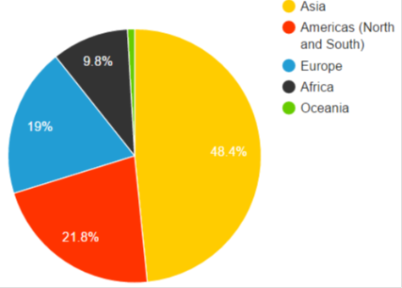
World Internet Users Population
3.88 Billion Internet
Users
Notes:
The world total Internet Users was 3,878,827,000 as of March 24th, 2018.
http://www.internetlivestats.com/internet-users/
http://www.internetlivestats.com/

Slide 6
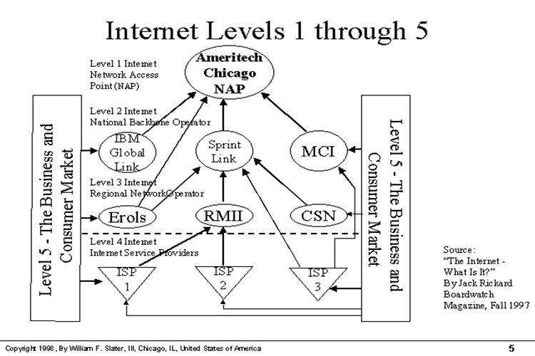
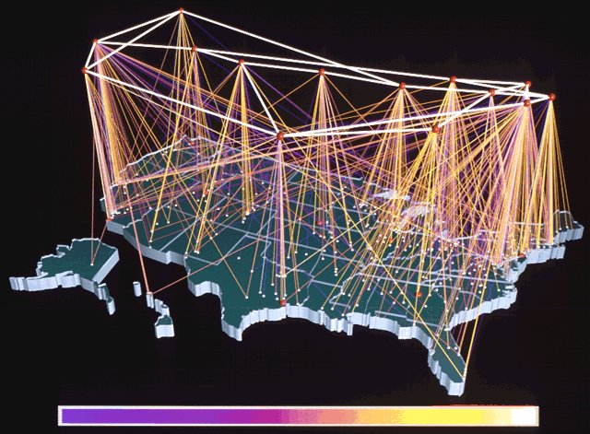
What is the Internet?
A Complex Global web of thousands of networks some smaller; some larger
All these networks are connected with devices through various link medias
For most people they see and experience the Internet through their computer, tablet or smartphone
(Level 1) NAP
(Network Access Point)
(Chicago, San Francisco, Washington DC., New Jersey, Miami)
(Level 2) NSP
(Network Service Provider Backbone)
(AT&T, Verizon, MCI, Tele2, Tata Communications)
(Level 3) Regional ISPs
(Commercial/Governmental)
(AT&T WorldNet, IBM Global Network, Netcom, UUNet)
(Level 4) (Local ISPs)
(Sympatico, Allstream, Rogers, etc.)
(Level 5) Consumer and Business Network/Connections
ISP
Regional
ISP
National
Service
Provider
Chicago
NAP
DS3
DS3
LA
NAP
DS3
Dallas
NSP
DS3
ISP
NSP
DS3
NSP
ISP
Notes:
An Explanation of the Internet
The Internet is made up of networks that are linked with each other. There are some 3,500 major networks. Most universities, large companies, and the various departments of national and state governments have networks. Many of these networks are local (cities) or regional (such as states). There are also ISPs (Internet Service Provider, such as Netcom or AOL), which are commercial networks to which anyone may subscribe for service. ISPs may be in office towers with dozens of computer engineers and millions of dollars of equipment. An ISP may also be a kid with a Windows 95 computer in the closet.
Ford Motor Company link their network sites all over the USA by using a high-capacity line that is called a backbone. Backbones are measured by their transfer capacity in Mbps (million bits per second.) A T-1 backbone line can carry 1.5 Mbps (1.5 million bits per second.) A T-3 backbone carries 45 Mbps. There are also backbones based on fiber optical cable (OC). The OC-3 carries 155 Mbps and the OC-12 carries 622 Mbps.
Despite what people say about thick pipes, these are thin cables, about the thickness of your phone line. Other backbones are based on satellite links.
Satellites are cheap since they can project to an entire continent (for example, India or South America.) (Bill Gates and Craig McCaw, the boy
billionaires, are building Teledesic which will use 80 satellites to offer planetwide access via cell phones at ISDN speed.)
To illustrate the backbone speeds, a home computer usually has a 33.6 kbps modem that can transmit 33,600 bits per second. A T-1 line is about 45 times faster; a T-3 is line about 1,300 times faster. To illustrate this: a 16 MB file (roughly an 8,000 page book) takes 90 minutes to transfer on a 33.6 modem, two minutes on a T-1, and four seconds on a T-3.
In September 1997, there are 31 backbones in the USA, run by MCI, Sprint, ATT, etc. This number is growing fast. Qwest is opening an OC-12 optical cable backbone in late 1998 that will have more capacity than all present backbones. It will be able to transmit the Library of Congress (twenty million books) in several minutes.
These 31 backbones interlink with each other at eleven Network Access Points (NAPs). These NAPS are the hubs of the Internet. The NAP is somewhat like a train switching station where a train arrives at Kansas City and the first ten wagons are routed towards Chicago, the next five are sent to Dallas, and the last 7 are sent to Denver. NAPs route millions of bits per second. Silicon Valley has four NAPs (one of which is named Mae West). Other NAPs are in Philadelphia (one), Chicago (two NAPs), Washington DC (two NAPs), Dallas, Houston, and Los Angeles. Many of the backbones often share the same buildings in many cities so the engineers have linked their backbones with each other slightly unofficially. Thus there are hundreds of NAPs.
Backbones have access points in large cities. The Internet Service Providers (ISPs) are smaller network services that link up to those 31 backbones. They tap into the flow of information from the backbones and distribute to yet smaller customers, such as home subscribers. ATT WorldNet, when it started in 1996, was merely access to BBN Planet's network which in turn ran on MCI's backbone. The users paid ATT for the right to use BBN Planet. Microsoft Network (MSN), Earthlink, etc., are ISPs with local banks of modems, leased T-3s and T-1s. Some ISPs are regional, others are nationwide.
What's the difference between America Online (AOL) and Larry's ISP? Not much. Both offer a connection to the Internet. Once you've passed
through their access point, you have equal access to any other computer on the net. You can create your own nationwide ISP without owning a single modem or computer: you just lease access to other ISPs and then sell that access.
To illustrate this: five kids have a local LAN (Local Area Network) by linking their home computers together with cables. One of the kids has an
Internet account with a local ISP, so they can send e-mail to the rest of the Internet. That local ISP is actually two guys with a Pentium in a closet, a leased line, and a hundred subscribers. That local ISP connects to a city-wide ISP which connects to a regional ISP which connects to the backbone.
The backbone carries the e-mail across the country and delivers it to a NAP, where it is routed onto another backbone, where it goes to a regional ISP, who delivers it to a local ISP, which delivers it to another kid's computer across the street.
So you're wondering: what exactly is the Internet? Internet means Inter-connected Net-works. There is no single thing called The Internet. It's made up of eleven hubs (NAPs), thirty-one backbones, seventeen thousand ISPs, 200,000 networks, 1.3 million domain names, and some 40 million users. It's doubling every six months. It's expected to reach 150 million users by the year 2,000 and 500 million users by 2010.
The Internet is totally different from any other kind of business. The more there is, the more valuable it becomes. The more it's sold, the more
there is and thus yet more can be sold. Anyone who buys it can then sell yet more. The more middlemen in the game, the cheaper it becomes to the end user. Whereas most companies are extremely happy to see 10% yearly growth, it's perfectly normal for Internet companies to grow at 100% per year. Some grow at 5,000% per year.
Who owns the Internet? Nobody. Different companies own the different networks. But the interconnection is not owned by anyone. Companies
and governments choose to connect themselves to the net or not.
What is the web? The web is just one of the transfer protocols (called HTTP, or Hypertext Transfer Protocol) on the Internet. The Internet also has other protocols such as SMTP (for email), ftp, telnet, and more.
What is an IP Number and DNS? Each device (a computer, a printer, etc.) that is connected to the Internet has a unique identification number,
which is like a telephone number. The number is called the IP number (Internet Protocol Number). For example, my web site is 209.24.47.8. In addition to this, there are also Domain Names. In the same way that telephone numbers can be 1-800-FLOWERS, the IP number can have a
name associated to it, such as andreas.com. It's easier for people to remember the name.
This means that there has to be a database of IP numbers and Domain Names. There's an organization called the Internic where one can register a domain name. The Internic maintains this database. This is the DNS (Domain Name Server).
There are static and dynamic IP addresses. A static IP address doesn't change. My machine's IP number is 209.24.47.8 and it's always there,
so it's a static address. When you start up your computer and connect to the web, your ISP or university has a pool of IP numbers. It assigns the next available number to you temporarily. During your connection, your machine has that IP address, so during your session, your machine is part of the Internet. When you disconnect, that number is released and it goes back into the pool for the next user. Therefore you have a
dynamic IP address.
To illustrate: When you want to see a picture of my cat, you click www.andreas.com/willy and your browser sends an email to the DNS which
looks up andreas.com. The DNS sees that andreas.com is a machine with the IP address 209.24.47.8. Your email is sent to my machine where
a program called a daemon looks up the image file. My daemon looks at your email request, which contains your machine's dynamic IP address, so it sends the image off into the net, addressed to your dynamic IP address. Your browser receives the image and renders it onto your screen. Willy shows up.
Who controls the Internet? Nobody. The only agreement is that everyone shall use a set of standards for data compatibility called Internet
Protocol (IP). Anyone can put anything on their server: data, pictures, or programs, and it's up to others whether they use it or not.
Can one censor the Internet? Via the Internet, you can reach any computer anywhere. It is just as easy to connect to a computer in Singapore or next door. A local government can forbid something, but the local users can place their web sites on computers in other countries where it is permitted and other local users can visit those web sites. There's nothing that the local government can do about that.
By the way, just because a domain name may be catfood.uk, it doesn't mean that the computer is actually in the UK. Again, that's just a domain name and the IP number can be anywhere.

Slide 7


What’s a Protocol?
Hello
Yo!!! DUDE!!!
Informally, conversation rules
  Hello
  Yo!!! DUDE!!!
  HEY
  Take care
  You too
More formally, allowable messages, responses
  never Goodbye - Hello
  Between computers for example
  a formal description of message formats and the rules two or more machines must follow to exchange those messages
HEY
Take Care
You too
time
Notes:
In computing, a protocol is a set of rules which is used by computers to communicate with each other across a network. A protocol is a convention or standard that controls or enables the connection, communication, and data transfer between computing endpoints. ...
In the field of telecommunications, a communications protocol is the set of standard rules for data representation, signaling, authentication and error detection required to send information over a communications channel. ...

Slide 8
OSI Data Communications Reference Model (1988)
Layer 7
Layer 6
Layer 5
Layer 4
Layer 3
Layer 2
Layer 1
Application
Presentation
Session
Transport
Network
Link
Physical
}
Upper layers:
Application service provider
Transport service user
Data protocols
}
Lower layers:
Transport service provider
Transmission protocols
“Protocol Stack”
(ISO) Greek isos, meaning "equal"
Open Systems Interconnection (OSI)
Notes:
The OSI Reference Model
Modern computer networks are designed in a highly structured way. To reduce their design complexity, most networks are organized as a series of layers, each one built upon its predecessor.
The OSI Reference Model is based on a proposal developed by the International Standards Organization (ISO). The model is called ISO OSI (Open systems Interconnection) Reference Model because it deals with connecting open systems - that is, systems that are open for communication with other systems.
The OSI model has seven layers. The principles that were applied to arrive at the seven layers are as follows:
1. A layer should be created where a different level of abstraction is needed.
2. Each layer should perform a well defined function.
3. The function of each layer should be chosen with an eye toward defining internationally standardized protocols.
4. The layer boundaries should be chosen to minimize the information flow across the interfaces.
5. The number of layers should be large enough that distinct functions need not be thrown together in the same layer out of necessity, and small enough that the architecture does not become unwieldy.
===========================================================
The seven layer Open System Interconnection (OSI) model is the reference structure for all data communication systems. All exiting data communication systems are compared to OSI model, one way of the other.
It was International Standards Organization (ISO) who had developed the OSI model in the early 1980’s.
Understanding data communication starts with the understanding of the OSI model, which is also called the 7-layer protocol stack.
Each layer has a specific set of functions it performs. It expects a set of services / functions from the layer below, and provides a set of services / functions to the layer immediately above it
There are protocols operating at each layer, communicating with similar OSI stack at the other end..
Physical Layer: Defines the physical characteristics of the interface, such as mechanical components and connectors, electrical aspects, and functional aspects.
Data Link Layer: Defines the rules for sending and receiving information across a physical connection between two systems. Its main function is to divide the data stream into frames and send them across the physical link.
Network Layer: Ensures that packet of information reaches its destination when traveling across multiple point-to-point links; manages multiple data link connections
Transport Layer: Provides high level of control for moving information between end-systems in a communication session
Session Layer: Coordinates the exchange of information between systems by using conversational techniques or dialogs.
Presentation Layer: Defines how to present the information.
Application Layer: Used for a range of applications that employs the underlying layers

Slide 9
OSI <-> Internet Applications/Protocols
Layer 7
Layer 6
Layer 5
Layer 4
Layer 3
Layer 2
Layer 1
Telnet, FTP, HTTP, SNMP, SIP
TCP, UDP
IP, ICMP, Routing Protocols, Openflow
ATM, Frame Relay, PPPoE, Openflow, etc.
10/100/1000BT Ethernet, SONET, 802.11, etc.
Application
Presentation
Session
Transport
Network
Link
Physical
Notes:
The architecture envisages a never-ending set of Standards in the Physical Layer, perhaps involving additional Standards right up to (but not beyond) the Network Layer as signaling and switching technology advances. OSI standardization will never be complete in these layers. Equally, in the Application Layer, we expect to see an ever-increasing set of ASE Standards as new applications are proposed for standardization. Again, OSI standardization will never be complete in this layer. In the middle layers of application-independent and technology-independent standardization (Network Service, Transport Layer, Session Layer, and Presentation Layer - the heart of OSI), the standardization work is largely complete now, with only minor changes and extensions likely in the future.
There is no doubt that the OSI architecture is richer and more complicated than any other protocol architecture. It may be illuminating to compare the de facto architecture of another major suite of protocol specifications with the architecture of OSI. The suite we compare with is that of the USA Department of Defense (DoD) Advanced Research Projects Agency (DARPA) Internet Community better known as TCP/IP.
There is no formal document specifying the architecture of the TCP/IP-related (Internet) specifications, so there can be different views by different authors on the de facto architecture, and particularly on its relationship to the OSI architecture. The following treatment would probably be accepted by most workers, however. The Internet became widely known and talked about in the early to mid 1990s. It is a world-wide collection of interlinked (hence the Inter) wide-area networks, with associated local area networks. In the 1970s it was better known as the Arpanet, when it was the first network to establish the viability of wide-area computer communication. It later became known as the Darpanet communication. It later became known as the Darpanet term the Internet is preferred today. Up to the mid-1990s it was largely a research, military and educational network, with a very limited and restricted amount of commercial traffic over it. This situation changed dramatically in the mid-1990s with the growth of interest in the provision of World-Wide Web pages. (Whilst all the early TCP/IP protocols have equivalent or better OSI equivalents, there is no OSI equivalent for the protocol underlying the World-Wide Web, although the markup language used to author pages (HTML - Hyper-Text Markup Language) is based on an ISO Standard (SGML - Standard Generalized Markup Language).
Communication over the Internet is characterized by the use of Transmission Control Protocol (TCP) and Internet Protocol (IP), but particularly the latter, with a variety of other protocols on top. All the protocols in the suite are generally collectively known as "the TCP/IP protocols" (even if they do not actually use TCP), or more accurately as "the Internet protocols".

Slide 10
Data Encapsulation
Addition of header and possibly trailer
  Down = encapsulate
  Up = decapsulate
Host Program
Host Program
Pgm Data
Layer 4
Layer 4
L4
Pgm Data
Layer 3
Layer 3
L3
L4
Pgm Data
Layer 2
Layer 2
L2
L3
L4
Pgm Data
Layer 1
Layer 1
L1
L2
L3
L4
Pgm Data
encapsulate
decapsulate

Slide 11
Data Protocols =>Internet Protocol (IP)
Purpose
  global data addressability
  network-type independence
    ethernet to frame relay
    leased-line to ATM
IP Header
IP Payload (data)
0 1 2 3
0 1 2 3 4 5 6 7 8 9 0 1 2 3 4 5 6 7 8 9 0 1 2 3 4 5 6 7 8 9 0 1
+-+-+-+-+-+-+-+-+-+-+-+-+-+-+-+-+-+-+-+-+-+-+-+-+-+-+-+-+-+-+-+-+
|Version| IHL |Type of Service| Total Length |
+-+-+-+-+-+-+-+-+-+-+-+-+-+-+-+-+-+-+-+-+-+-+-+-+-+-+-+-+-+-+-+-+
| Identification |Flags| Fragment Offset |
+-+-+-+-+-+-+-+-+-+-+-+-+-+-+-+-+-+-+-+-+-+-+-+-+-+-+-+-+-+-+-+-+
| Time to Live | Protocol | Header Checksum |
+-+-+-+-+-+-+-+-+-+-+-+-+-+-+-+-+-+-+-+-+-+-+-+-+-+-+-+-+-+-+-+-+
| Source Address |
+-+-+-+-+-+-+-+-+-+-+-+-+-+-+-+-+-+-+-+-+-+-+-+-+-+-+-+-+-+-+-+-+
| Destination Address |
+-+-+-+-+-+-+-+-+-+-+-+-+-+-+-+-+-+-+-+-+-+-+-+-+-+-+-+-+-+-+-+-+
| Options | Padding |
+-+-+-+-+-+-+-+-+-+-+-+-+-+-+-+-+-+-+-+-+-+-+-+-+-+-+-+-+-+-+-+-+
IP Header fields
  Version
  Header Length
  Service Type (TOS)
  Total Length
  Fragmentation Stuff (identification, flags, fragment offset)
  Time to Live (TTL)
  Protocol (of the layer above)
  Source, Destination Addresses
  IP Options
  Padding
Notes:
The Internet Protocol (IP) is the method or protocol by which data is sent from one computer to another on the Internet. Each computer (known as a host) on the Internet has at least one address that uniquely identifies it from all other computers on the Internet. When you send or receive data (for example, an e-mail note or a Web page), the message gets divided into little chunks called packets. Each of these packets contains both the sender's Internet address and the receiver's address. Any packet is sent first to a gateway computer that understands a small part of the Internet. The gateway computer reads the destination address and forwards the packet to an adjacent gateway that in turn reads the destination address and so forth across the Internet until one gateway recognizes the packet as belonging to a computer within its immediate neighborhood or domain. That gateway then forwards the packet directly to the computer whose address is specified.
Because a message is divided into a number of packets, each packet can, if necessary, be sent by a different route across the Internet. Packets can arrive in a different order than the order they were sent in. The Internet Protocol just delivers them. It's up to another protocol, the Transmission Control Protocol (TCP) to put them back in the right order. IP is a connectionless protocol, which means that there is no established connection between the end points that are communicating. Each packet that travels through the Internet is treated as an independent unit of data without any relation to any other unit of data. (The reason the packets do get put in the right order is because of TCP, the connection-oriented protocol that keeps track of the packet sequence in a message.) In the Open Systems Interconnection (OSI) communication model, IP is in layer 3, the Networking Layer.
The most widely used version of IP today is Internet Protocol Version 4 (IPv4). However, IP Version 6 (IPv6) is also beginning to be supported. IPv6 provides for much longer addresses and therefore for the possibility of many more Internet users. IPv6 includes the capabilities of IPv4 and any server that can support IPv6 packets can also support IPv4 packets.

Slide 12
Data Protocols =>User Datagram Protocol (UDP)
Purpose
  a host interface has one IP address
  multiple host applications may be sending and receiving
  UDP provides multiplexing to different applications on a single host using a single IP address
IP Header
UDP Header
UDP Payload (data)
0 7 8 15 16 23 24 31
+--------+--------+--------+--------+
| Source | Destination |
| Port | Port |
+--------+--------+--------+--------+
| | |
| Length | Checksum |
+--------+--------+--------+--------+
|
| data octets ...
+---------------- ...
UDP Header
  UDP Source Port
  UDP Destination Port
  UDP Message Length
  UDP Checksum
Significant to host, not network
Unreliable - no acknowledgment, retransmission
Connectionless
Notes:
UDP (User Datagram Protocol) is a communications method (protocol) that offers a limited amount of service when messages are exchanged between computers in a network that uses the Internet Protocol (IP). UDP is an alternative to the Transmission Control Protocol (TCP) and, together with IP, is sometimes referred to as UDP/IP. Like the Transmission Control Protocol, UDP uses the Internet Protocol to actually get a data unit (called a datagram) from one computer to another. Unlike TCP, however, UDP does not provide the service of dividing a message into packets (datagrams) and reassembling it at the other end. Specifically, UDP doesn't provide sequencing of the packets that the data arrives in. This means that the application program that uses UDP must be able to make sure that the entire message has arrived and is in the right order. Network applications that want to save processing time because they have very small data units to exchange (and therefore very little message reassembling to do) may prefer UDP to TCP. The Trivial File Transfer Protocol (TFTP) uses UDP instead of TCP.
UDP provides two services not provided by the IP layer. It provides port numbers to help distinguish different user requests and, optionally, a checksum capability to verify that the data arrived intact.
In the Open Systems Interconnection (OSI) communication model, UDP, like TCP, is in layer 4, the Transport Layer.

Slide 13
Data Protocols =>Transmission Control Protocol (TCP)
Purpose
  reliable data transmission
  workhorse - lots of other good things
Mechanism
  send message, retain copy, start timer
  analyze received message
  acknowledge received message
  resend if message not acknowledged
IP Data Payload
IP Header
TCP Header
TCP Payload (data)
0 1 2 3
0 1 2 3 4 5 6 7 8 9 0 1 2 3 4 5 6 7 8 9 0 1 2 3 4 5 6 7 8 9 0 1
+-+-+-+-+-+-+-+-+-+-+-+-+-+-+-+-+-+-+-+-+-+-+-+-+-+-+-+-+-+-+-+-+
| Source Port | Destination Port |
+-+-+-+-+-+-+-+-+-+-+-+-+-+-+-+-+-+-+-+-+-+-+-+-+-+-+-+-+-+-+-+-+
| Sequence Number |
+-+-+-+-+-+-+-+-+-+-+-+-+-+-+-+-+-+-+-+-+-+-+-+-+-+-+-+-+-+-+-+-+
| Acknowledgment Number |
+-+-+-+-+-+-+-+-+-+-+-+-+-+-+-+-+-+-+-+-+-+-+-+-+-+-+-+-+-+-+-+-+
| Data | |U|A|P|R|S|F| |
| Offset| Reserved |R|C|S|S|Y|I| Window |
| | |G|K|H|T|N|N| |
+-+-+-+-+-+-+-+-+-+-+-+-+-+-+-+-+-+-+-+-+-+-+-+-+-+-+-+-+-+-+-+-+
| Checksum | Urgent Pointer |
+-+-+-+-+-+-+-+-+-+-+-+-+-+-+-+-+-+-+-+-+-+-+-+-+-+-+-+-+-+-+-+-+
| Options | Padding |
+-+-+-+-+-+-+-+-+-+-+-+-+-+-+-+-+-+-+-+-+-+-+-+-+-+-+-+-+-+-+-+-+
| data |
+-+-+-+-+-+-+-+-+-+-+-+-+-+-+-+-+-+-+-+-+-+-+-+-+-+-+-+-+-+-+-+-+
Connection Oriented Protocol
TCP Header
  Source port
  Destination port
  Sequence number
  Acknowledgment number
  Header length
  (Reserved)
  Code bits (flags)
  Window size
  Checksum
  Urgent pointer
  Options
  Padding
Notes:
TCP (Transmission Control Protocol) is a method (protocol) used along with the Internet Protocol (IP) to send data in the form of message units between computers over the Internet. While IP takes care of handling the actual delivery of the data, TCP takes care of keeping track of the individual units of data (called packets) that a message is divided into for efficient routing through the Internet.
For example, when an HTML file is sent to you from a Web server, the Transmission Control Protocol (TCP) program layer in that server divides the file into one or more packets, numbers the packets, and then forwards them individually to the IP program layer. Although each packet has the same destination IP address, it may get routed differently through the network. At the other end (the client program in your computer), TCP reassembles the individual packets and waits until they have arrived to forward them to you as a single file.
TCP is known as a connection-oriented protocol, which means that a connection is established and maintained until such time as the message or messages to be exchanged by the application programs at each end have been exchanged. TCP is responsible for ensuring that a message is divided into the packets that IP manages and for reassembling the packets back into the complete message at the other end. In the Open Systems Interconnection (OSI) communication model, TCP is in layer 4, the Transport Layer.

Slide 14
TCP Relationship (Connection Sequence)
Initiation Data Transfer Termination
Client
Server
Either
Other
Either
Other
SYN
Data
FIN
Data
SYN/ACK
Data
ACK
ACK
ACK
ACK
ACK
FIN
ACK

Slide 15
File Transfer Protocol (FTP)
User's
I/O
Device
Purpose
  file transfer
  control independent of machine type
Client
System
Format
FTP
Client
FTP
Commands/Replies
Data
Connection
TCP ‘connections’ for control, data
Well-known ports (21, 20) at server
Dynamically assigned ports at client
Multiple sessions possible
Interactive control, e.g. ls, get, put
Format specification, e.g. ASCII, binary
Authentication
  user_id/password or anonymous
Server listens
On Port 21
Server sends
On Port 20
FTP
application
Notes:
FTP (File Transfer Protocol), a standard Internet protocol, is the simplest way to exchange files between computers on the Internet. Like the Hypertext Transfer Protocol (HTTP), which transfers displayable Web pages and related files, and the Simple Mail Transfer Protocol (SMTP), which transfers e-mail, FTP is an application protocol that uses the Internet's TCP/IP protocols. FTP is commonly used to transfer Web page
files from their creator to the computer that acts as their server for everyone on the Internet. It's also commonly used to download programs and other files to your computer from other servers.
As a user, you can use FTP with a simple command line interface (for example, from the Windows MS-DOS Prompt window) or with a commercial program that offers a graphical user interface. Your Web browser can also make FTP requests to download programs you select from a Web page. Using FTP, you can also update (delete, rename, move, and copy) files at a server. You need to log on to an FTP server. However, publicly available files are easily accessed using anonymous FTP.
Basic FTP support is usually provided as part of a suite of programs that come with TCP/IP. However, any FTP client program with a graphical user interface usually must be downloaded from the company that makes it.

Slide 16


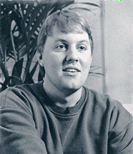
HyperText Transfer Protocol (HTTP)
Purpose – Web Browsing
Domain Name Server directory
Server
User
Client
DNS
IP Network
IT Maintenance
Person
Father of World Wide Web (WWW)
Tim Berners - Lee was the driving force behind the development of the WWW
He wrote the first WWW client and the first WWW server and defined standards
such as URL, HyperText Makeup Language (HTML) and HTTP
Marc Andreessen developed first browser called Mosaic (1993)
which evolved into Netscape
Notes:
Dark Web…. https://en.wikipedia.org/wiki/Dark_web
The Hypertext Transfer Protocol (HTTP) is the set of rules for exchanging files (text, graphic images, sound, video, and other multimedia files) on the World Wide Web. Relative to the TCP/IP suite of protocols (which are the basis for information exchange on the Internet), HTTP is an application protocol. Essential concepts that are part of HTTP include (as its name implies) the idea that files can contain references to other files whose selection will elicit additional transfer requests. Any Web server machine contains, in addition to the HTML and other files it can serve, an HTTP daemon, a program that is designed to wait for HTTP requests and handle them when they arrive. Your Web browser is an HTTP client, sending requests to server machines. When the browser user enters file requests by either "opening" a Web file (typing in a Uniform Resource Locator or URL) or clicking on a hypertext link, the browser builds an HTTP request and sends it to the Internet Protocol address indicated by the URL. The HTTP daemon in the destination server machine receives the request and, after any necessary processing, the requested file is returned. The latest version of HTTP is HTTP 1.1.
HTML (Hypertext Markup Language) is the set of "markup" symbols or codes inserted in a file intended for display on a World Wide Web browser. The markup tells the Web browser how to display a Web page's words and images for the user. The individual markup codes are referred to as elements (but many people also refer to them as tags).
HTML is a standard recommended by the World Wide Web Consortium (W3C) and adhered to by the major browsers, Microsoft's Internet Explorer and Netscape's Navigator, which also provide some additional non-standard codes. HTML5 is a language for structuring and presenting content for the World Wide Web, and is a core technology of the Internet originally proposed by Opera Software. It is the fifth revision of the HTML standard (created in 1990 and standardized as HTML4 as of 1997) and as of March 2012[update] is still under development. Its core aims have been to improve the language with support for the latest multimedia while keeping it easily readable by humans and consistently understood by computers and devices (web browsers, parsers, etc.). HTML5 is intended to subsume not only HTML 4, but XHTML 1 and DOM Level 2 HTML as well.
HTML5 overview - http://en.wikipedia.org/wiki/HTML5
WEB Real Time Communications WebRTC overview - http://en.wikipedia.org/wiki/WebRTC

Slide 17
(Domain Name Space)
Domain Name Service (DNS)
Root
com
edu
gov
mil
net
org
arpa
abcinc
acme
corp
ddn
in-addr
la
tor
ny
pine
cedar
maple
oak
palm
A message to an individual could be ”smith@pine.ny.corp.com”
where the domain name is pine.ny.corp.com <=> IP address 155.138.18.5
Notes:
A domain name locates an organization or other entity on the Internet. For example, the domain name www.totalbaseball.com locates an Internet address for "totalbaseball.com" at Internet point 199.0.0.2 and a particular host server named "www". The "com" part of the domain name reflects the purpose of the organization or entity (in this example, "commercial") and is called the top-level domain name. The "totalbaseball" part of the domain name defines the organization or entity and together with the top-level is called the second-level domain name. The second-level domain name maps to and can be thought of as the "readable" version of the Internet address.
A third level can be defined to identify a particular host server at the Internet address. In our example, "www" is the name of the server that handles Internet requests. (A second server might be called "www2".) A third level of domain name is not required. For example, the fully-qualified domain name could have been "totalbaseball.com" and the server assumed.
Subdomain levels can be used. For example, you could have "www.nyyankees.totalbaseball.com". Together, "www.totalbaseball.com" constitutes a fully-qualified domain name.
Second-level domain names must be unique on the Internet and registered with one of the ICANN-accredited registrars for the COM, NET, and ORG top-level domains. Where appropriate, a top-level domain name can be geographic. (Currently, most non-U.S. domain names use a top-level domain name based on the country the server is in.) To register a U. S. geographic domain name or a domain name under a country code, see an appropriate registrar.
On the Web, the domain name is that part of the Uniform Resource Locator or URL that tells a domain name server using the DNS (domain name system) whether and where to forward a request for a Web page. The domain name is mapped to an IP address (which represents a physical point on the Internet).
More than one domain name can be mapped to the same Internet address. This allows multiple individuals, businesses, and organizations to have separate Internet identities while sharing the same Internet server.
To see the Internet Protocol address for a domain name, use ping.
It may be worth noting that the domain name system contains an even higher level of domain than the top-level domain. The highest level is the root domain, which would be represented by a single dot (just as in many hierarchical file systems, a root directory is represented by a "/" ) if it were ever used. If the dot for the root domain were shown in the URL, it would be to the right of the top-level domain name. However, the dot is assumed to be there, but never shown.
What is arguably the most valuable three-letter dot-com domain name on the internet? Sex.com was sold for a reported 12 million US by a San Diego website developer named Gary Kremen. The buyer was and you can guess a company that wants to be the marketing-leading adult entertainment destination. It has been estimated that there are 246 million domain names worldwide at the end of April 2013.
http://royal.pingdom.com/2013/01/16/internet-2012-in-numbers/

Slide 18
Protocol Summary
FTP
DNS
SNMP
Telnet
BOOTP
20
21
160
161
67
68
SMTP
23
53
53
TFTP
25
TCP
(Ports)
UDP
(Ports)
69
6
17
ICMP
IP
(Protocol)
1
ARP
RARP
Ethernet
(Type)
Notes:
Version (always set to the value 4, which is the current version of IP)
IP Header Length (number of 32 -bit words forming the header, usually five)
Type of Service, now known as Differentiated Services Code Point (DSCP) (usually set to 0, but may indicate particular Quality of Service needs from the network, the DSCP defines one of a set of class of service)
Size of Datagram (in bytes, this is the combined length of the header and the data)
Identification ( 16-bit number which together with the source address uniquely identifies this packet - used during reassembly of fragmented datagrams)
Flags (a sequence of three flags (one of the 4 bits is unused) used to control whether routers are allowed to fragment a packet (i.e. the Don't Fragment, DF, flag), and to indicate the parts of a packet to the receiver)
Fragmentation Offset (a byte count from the start of the original sent packet, set by any router which performs IP router fragmentation)
Time To Live (Number of hops /links which the packet may be routed over, decremented by most routers - used to prevent accidental routing loops)
Protocol (Service Access Point (SAP) which indicates the type of transport packet being carried (e.g. 1 = ICMP; 2= IGMP; 6 = TCP; 17= UDP).
Header Checksum (A 2's complement checksum inserted by the sender and updated whenever the packet header is modified by a router - Used to detect processing errors introduced into the packet inside a router or bridge where the packet is not protected by a link layer cyclic redundancy check. Packets with an invalid checksum are discarded by all nodes in an IP network)
Source Address (the IP address of the original sender of the packet)
Destination Address (the IP address of the final destination of the packet)
Options (not normally used, but when used the IP header length will be > 5 32-bit words to indicate the size of the options field)

Slide 19
Internet Protocol Addressing (IPv4)
IP Address
  Unique Device (Host Address)
  IPv4 is a 32 bit address of binary 1s or 0s
Subnet Mask
  Identifies which portion of IP Address is the Network ID and which portion is the Host ID
  Address Classes:
    Class A (1st Octet 1-127) Network ID Host ID/Networks
    Network.Host.Host.Host 126 16,777,214
    Class B (1st Octet 128-191)
    Network.Network.Host.Host 16,384 65,534
    Class C (1st Octet 192-223)
    Network.Network.Network.Host 2, 097, 152 254
Default Gateway
  IP address of the router on the same physical segment
        152.107.102.7 (IP Address) (32 bit Class B IPv4 Address)
        255.255.0.0 (Subnet Mask)
        152.107.102.1 (Default Gateway)
Note: =>99.5% of Class A, B and C addresses are public
=>0.5% are private addresses I.e. 192.168.10.1
*Note: IPv6 (128 Bit Address) and Classless Inter-Domain Routing (CIDR) is not covered
Notes:
Value of IP addresses - https://www.networkworld.com/article/2228854/microsoft-subnet/microsoft-pays-nortel--7-5-million-for-ipv4-addresses.html
Private versus Public Addressing
There are two types of IP addresses, only one of which can be used on the Internet. These two types are private and public addresses. If you have ever worked at an organization that has internal telephone extensions and external telephone numbers, you are already familiar with the concept.
Public IP addresses are globally recognized and assigned by the InterNIC. The information for the IP address is entered into the Internet’s global routing tables and can be accessed from any other valid IP address on the Internet. Thus, 99.5 percent of class A, B, and C IP addresses are public addresses. Public IPs should be used for all servers and network hardware that will be used from or by the Internet. For example, a Web server must have a public IP address.
Private IP addresses are part of the IP addressing scheme but are globally recognized. If a host has an Internet connection and is using a private IP address, it cannot use Internet-based services because routes to private IP networks are not entered into the global routing tables. Private IP networks are 10.0.0.0 255.0.0.0, 172.16.0.0 255.255.0.0, and 192.168.00 255.255.0.0. Half of one percent of class A, B, and C IP addresses are private addresses.
Private addresses are used for very different tasks than public addresses. Private addresses are often used for isolated, IP-based networks that will not be connected to the public Internet. The InterNIC encourages the use of private addresses for these situations because it reduces the waste of public IP addresses.
Private IPs can be used within organizations that have outgoing Internet connectivity, as well. There are two common methods for connecting networks with private numbering schemes to the public Internet. The first is to use an application-layer proxy.

Slide 20
Internet Routing Protocols
Purpose: Exchange Reachability and Topology
  Reachability: This address is located here
  Topology: There is a 10 Mbit/s link between me and him
Dynamically learn and react to new or failed links & devices
  Not (usually) sensitive to load
Opposite static routes which are explicitly defined and not learned
Autonomous Systems (AS) = set of routers and networks under the same administration
  No theoretical limit to the size of the AS
Two categories
  Intra-Domain Routing Protocols - Interior Gateway Protocols (IGP)
    Routing Information Protocol (RIP) version (1 (RFC 1058) & 2(RFC 1388))
    Open Shortest Path First (OSPF) (RFC 1583)
    Intermediate System to Intermediate System (IS-IS) (RFC 1142)
  Inter-Domain Routing Protocols
  Exterior Gateway Protocol (EGP)
  Border Gateway Protocol (BGP) 4…replacing EGP
Notes:
Intra-Domain Routing Protocols (Interior Gateway Protocols (IGP))
Routing Information Protocol (RIP) version (1 (RFC 1058) & 2(RFC 1388))
Metric is a hop count
The most commonly used interior protocol.
Route with the lowest metric as the best route.
Open Shortest Path First (OSPF) (RFC 1583)
Link-state protocol.
Better suited than RIP for complex networks with many routers.
Provides equal cost multipath routing
Intermediate System to Intermediate System (IS-IS) (RFC 1142)
Link-state interior gateway protocol (IGP)
Developed for routing ISO/CLNP (International Organization for Standardization/Connectionless Network Protocol) packets
Intra-Domain routing protocols are used to exchange reachability information within an autonomous system (AS)
Routing Information Protocol (RIP) version (1 (RFC 1058) & 2(RFC 1388))
The most commonly used interior protocol. RIP selects the route with the lowest metric as the best route. The metric is a hop count representing the number of gateways through which data must pass in order to reach its destination
Open Shortest Path First (OSPF) (RFC 1583)
It is a link-state protocol. OSPF is better suited than RIP for complex networks with many routers. OSPF provides equal cost multipath routing
Intermediate System to Intermediate System (IS-IS)
It is a link state interior gateway protocol (IGP) originally developed for routing ISO/CLNP (International Organization for Standardization/Connectionless Network Protocol) packets
The longest path that RIP accepts is 15 hops. If the metric is greater than 15, a destination is considered unreachable. RIP assumes that the best route is the one that uses the fewest gateways, i.e. the shortest path, not taking into account congestion or delay on route. Distant based opposed to link-state based routing protocol.
The routing protocols allow routers to exchange reachability information. So it is much easier to introduce a new connection between two networks, new routers, or even whole new networks. (Just think of the co-ordination required for office splits, area code splits, or new IXCs). However, that lack of need for central control has perhaps led to a paucity of control tools for when they are needed.
Routing protocols are broadly classified as either ‘distance vector’ or ‘link state’, each with their own advantages/proponents and disadvantages/detractors. BGP (see next page) is a distance vector protocol, while OSPF is link state.
(Exterior Gateway Protocols (EGP)
Inter-Domain Routing Protocols RFC (827), (904)
Exterior protocols are used to exchange routing information between autonomous systems
Exterior protocols are only required when an autonomous system must exchange routing information with another autonomous system
Exterior Border Gateway Protocol (BGP) 4
Border Gateway Protocol 4 is replacing EGP as the exterior protocol of choice
BGP exchanges reachability information between autonomous systems, but provides more capabilities than EGP
BGP uses path attributes to provide more information about each route as an aid in selecting the best route
Exterior Gateway Protocol (EGP) (RFC (827) & (904))
Routers within an autonomous system run an interior routing protocol like RIP. Only those gateways that connect an autonomous system to another autonomous system need to run an exterior routing protocol. Originally EGP reachability information was passed into ARPANET/MILNET "core" gateways where the best routes were chosen and passed back out to all connected autonomous systems. As the Internet moved toward a less hierarchical architecture, EGP, an exterior routing protocol which assumes a hierarchical structure, became less effective.
Border Gateway Protocol (BGP) 4
The Border Gateway Protocol (BGP) is the protocol backing the core routing decisions on the Internet. It maintains a table of IP networks or 'prefixes' which designate network reach-ability among autonomous systems (AS). It is described as a path vector protocol. BGP does not use traditional Interior Gateway Protocol (IGP) metrics, but makes routing decisions based on path, network policies and/or rule-sets. For this reason, it is more appropriately termed a reach-ability protocol rather than routing protocol.
BGP was created to replace the Exterior Gateway Protocol (EGP) protocol to allow fully decentralized routing in order to transition from the core ARPAnet model to a decentralized system that included the NSFNET backbone and its associated regional networks. This allowed the Internet to become a truly decentralized system. Since 1994, version four of the BGP has been in use on the Internet. All previous versions are now obsolete. The major enhancement in version 4 was support of Classless Inter-Domain Routing and use of route aggregation to decrease the size of routing tables. Since January 2006, version 4 is codified in RFC 4271, which went through more than 20 drafts based on the earlier RFC 1771 version 4. RFC 4271 version corrected a number of errors, clarified ambiguities and brought the RFC much closer to industry practices.
Most Internet service providers must use BGP to establish routing between one another (especially if they are multi-homed). Therefore, even though most Internet users do not use it directly, BGP is one of the most important protocols of the Internet.

Slide 21
Internet Routing Protocols (cont’d)
Distance-Vector (DV): (Bellman-Ford)
  ‘how far away’ via each ‘next hop’
  So different knowledge in each router i.e. RIP, RIP VII, EGP
Link State (SPF): (Shortest Path First, Dijkstra)
  All routers and links within an autonomous system
  Same information in each router i.e. OSPF, IS-IS
Path Vector (PV) (RFC 1322):
  Exchanging network reachability between autonomous systems
  Augments the advertisement of reachable destinations with information
  that describes various properties of the paths to these destinations.
  BGP4
Protocol
Type
Algorithm
Metric
Convergence
Standard
Complexity
RIP OSPF IS-IS EGP BGP4
IGP IGP IGP EGP EGP
DV SPF SPF DV PV
Hop Count Arbitrary Arbitrary Policy Policy
Slow Fast Fast Slow Fast
IETF IETF ISO History IETF
Simple Complex Complex Simple Complex

Slide 22
Internet Local Area Network (LAN) Devices
7
APPLICATION
6
PRESENTATION
5
SESSION
4
TRANSPORT
3
NETWORK
Routers
Switches
2
DATA LINK
Bridges
1
PHYSICAL
Modems
Repeaters/Hubs

Slide 23
Modems (Wireless, Wireline, Cable, etc.)
Wireless Provider
Direct connection to NAP or via ISP “hierarchy”
ISP B
NAP/MAE
NAP/MAE
Switch
Global Internet
WireLine
Telco/ Carrier
ISP A
NAP/MAE
Cable Operator
ISP C
MOdulate DEModulate (MODEM)
Notes:
Single LAN segments are specified to be of a maximum length generally restricting them to a single building or even floor. To expand them, particularly within a building, devices called bridges were invented to transfer data from one LAN segment to another. By watching the source MAC addresses on the frames they saw on each segment, they could tell when a frame they received belonged:
on the same segment they got in, in which case they could just drop it,
on another segment they knew about, so they just sent it out that one, or
was a broadcast frame, so they had to send it on all segments.
Historically, bridges were invented before routers (see next page). So when manufacturers ‘re-invented’ devices that had lots of ports at very high speed, but were logically bridges, they marketed them using the term ‘switches’ to emphasize the high speed. But there is still no connection, let alone signaling, so I still prefer to call them multi-port bridges. Because of the flat address space, and in particular to minimize the impact of (intentional or unintentional) broadcast traffic, bridges typically serve networks of under a thousand stations within a single campus.
A modem modulates outgoing digital signals from a computer or other digital device to analog signals for a conventional copper twisted-pair telephone line and demodulates the incoming analog signal and converts it to a digital signal for the digital device.
In recent years, the 2400 bps modem that could carry e-mail has become obsolete. 14.4 Kbps and 28.8 Kbps modems were temporary landing places on the way to the much higher bandwidth devices and carriers of tomorrow. From early 1998, most new personal computers came with 56 Kbps modems. By comparison, using a digital ISDN adapter instead of a conventional modem, the same telephone wire can now carry up to 128 Kbps. With Digital Subscriber Line (DSL) systems, now being deployed in a number of communities, bandwidth on twisted-pair can be in the megabit rate.

Slide 24
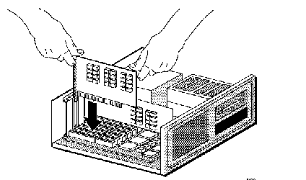
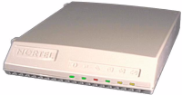
Repeaters/Hubs
NIC
Network Interface Card
NICs: Network Interface Cards
  Put into PC, if not already included
  May include separate processor
  Hardware defined Media Access Control (MAC) Address 006038:302206
Repeaters/Hubs
  ‘Patch panel’ where the signals are repeated from/to all stations
  May include management (monitoring) processor
  Also known as repeater, Multi-station Access Unit, ...
Cable, Connectors, Terminators
Ethernet Hubs
Or
Repeaters
Notes:
In general, a hub is the central part of a wheel where the spokes come together. The term is familiar to frequent fliers who travel through airport "hubs" to make connecting flights from one point to another. In data communications, a hub is a place of convergence where data arrives from one or more directions and is forwarded out in one or more other directions. A hub usually includes a switch of some kind. (And a product that is called a "switch" could usually be considered a hub as well.) The distinction seems to be that the hub is the place where data comes together and the switch is what determines how and where data is forwarded from the place where data comes together. Regarded in its switching aspects, a hub can also include a router.
In describing network topologies, a hub topology consists of a backbone (main circuit) to which a number of outgoing lines can be attached ("dropped"), each providing one or more connection ports for devices to attach to. For Internet users not connected to a local area network, this is the general topology used by your access provider. Other common network topologies are the bus network and the ring network. (Either of these could possibly feed into a hub network, using a bridge.)
As a network product, a hub may include a group of modem cards for dial-in users, a gateway card for connections to a local area network (for example, an Ethernet or a Token Ring), and a connection to a T-1 line (the main line in this example).
The common Ethernet hub simply broadcasts each message it receives to every one of its ports. Each Ethernet device also has to wait for its turn to ‘talk’ to the hub, increasing the likelihood of message collisions; therefore, real-time operation is jeopardized and determinism is difficult.

Slide 25
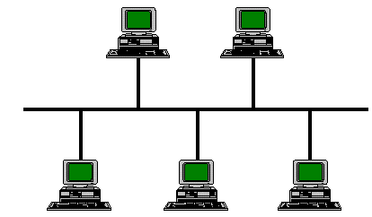
Bridges
  Extend a LAN further than wiring limits would allow
    Any frame on one side goes out the other (obsolete)
  ‘Learning’ bridges learn which stations are on which side, only repeat what is necessary
    Use source and destination MAC addresses
    48-bits, IEEE ‘universally administered’ or locally administered.
  Multiport bridges are commonly (incorrectly) called switches
    Recent extensive sales to move from shared to dedicated bandwidth, and mix 10/100/1000 Mbit/s
  Flat address space, single ‘broadcast’ domain
Bridge
Notes:
Single LAN segments are specified to be of a maximum length generally restricting them to a single building or even floor. To expand them, particularly within a building, devices called bridges were invented to transfer data from one LAN segment to another. By watching the source MAC addresses on the frames they saw on each segment, they could tell when a frame they received belonged: on the same segment they got in, in which case they could just drop it, on another segment they knew about, so they just sent it out that one, or was a broadcast frame, so they had to send it on all segments.
Historically, bridges were invented before routers (see next page). So when manufacturers ‘re-invented’ devices that had lots of ports at very high speed, but were logically bridges, they marketed them using the term ‘switches’ to emphasize the high speed. But there is still no connection, let alone signaling, so I still prefer to call them multi-port bridges. Because of the flat address space, and in particular to minimize the impact of (intentional or unintentional) broadcast traffic, bridges typically serve networks of under a thousand stations within a single campus.
In telecommunications networks, a bridge is a product that connects a local area network (LAN) to another local area network that uses the same protocol (for example, Ethernet or Token Ring). You can envision a bridge as being a device that decides whether a message from you to someone else is going to the local area network in your building or to someone on the local area network in the building across the street. A bridge examines each message on a LAN, "passing" those known to be within the same LAN, and forwarding those known to be on the other interconnected LAN (or LANs).
In bridging networks, computer or node addresses have no specific relationship to location. For this reason, messages are sent out to every address on the network and accepted only by the intended destination node. Bridges learn which addresses are on which network and develop a learning table so that subsequent messages can be forwarded to the right network.
Bridging networks are generally always interconnected local area networks since broadcasting every message to all possible destinations would flood a larger network with unnecessary traffic. For this reason, routing networks such as the Internet use a scheme that assigns addresses to nodes so that a message or packet can be forwarded only in one general direction rather than forwarded in all directions.
A bridge works at the data-link (physical network) level of a network, copying a data frame from one network to the next network along the communications path.
A bridge is sometimes combined with a router in a product called a brouter.

Slide 26
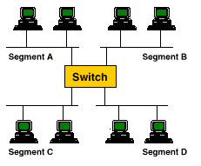
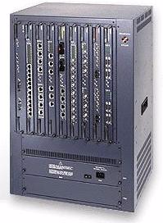
Ethernet Switches (Hardware Switching)
OSI Layer 2 and 3 switches
Hardware ASIC based switching ==> FAST Data Packet Flow
High-density Ethernet connectivity
“Route (Software Switch) when you must Hardware Switch when you can”
Notes:
Switching Technologies
You can see that a switch has the potential to radically change the way nodes communicate with each other. But you may be wondering what makes it different from a router. Switches usually work at Layer 2 (Data or Data link) of the OSI Reference Model, using MAC addresses, while routers work at Layer 3 (Network) with Layer 3 addresses (IP, IPX or Appletalk, depending on which Layer 3 protocols are being used).
The algorithm that switches use to decide how to forward packets is different from the algorithms used by routers to forward packets. One of these differences in the algorithms between switches and routers is how broadcasts are handled. On any network, the concept of a broadcast packet is vital to the operability of a network. Whenever a device needs to send out information but doesn't know who it should send it to, it sends out a broadcast. For example, every time a new computer or other device comes on to the network, it sends out a broadcast packet to announce its presence. The other nodes (such as a domain server) can add the computer to their browser list (kind of like an address directory) and communicate directly with that computer from that point on. Broadcasts are used any time a device needs to make an announcement to the rest of the network or is unsure of who the recipient of the information should be.
A hub or a switch will pass along any broadcast packets they receive to all the other segments in the broadcast domain, but a router will not. Think about our four-way intersection again: All of the traffic passed through the intersection no matter where it was going. Now imagine that this intersection is at an international border. To pass through the intersection, you must provide the border guard with the specific address that you are going to. If you don't have a specific destination, then the guard will not let you pass. A router works like this. Without the specific address of another device, it will not let the data packet through. This is a good thing for keeping networks separate from each other, but not so good when you want to talk between different parts of the same network. This is where switches come in.
LAN switches rely on packet-switching. The switch establishes a connection between two segments just long enough to send the current packet. Incoming packets (part of an Ethernet frame) are saved to a temporary memory area (buffer); the MAC address contained in the frame's header is read and then compared to a list of addresses maintained in the switch's lookup table. In an Ethernet-based LAN, an Ethernet frame contains a normal packet as the payload of the frame, with a special header that includes the MAC address information for the source and destination of the packet.
Packet-based switches use one of three methods for routing traffic:
Cut-through
Store-and-forward
Fragment-free
Cut-through switches read the MAC address as soon as a packet is detected by the switch. After storing the 6 bytes that make up the address information, they immediately begin sending the packet to the destination node, even as the rest of the packet is coming into the switch.
A switch using store-and-forward will save the entire packet to the buffer and check it for CRC errors or other problems before sending. If the packet has an error, it is discarded. Otherwise, the switch looks up the MAC address and sends the packet on to the destination node. Many switches combine the two methods, using cut-through until a certain error level is reached and then changing over to store-and-forward. Very few switches are strictly cut-through, since this provides no error correction.
A less common method is fragment-free. It works like cut-through except that it stores the first 64 bytes of the packet before sending it on. The reason for this is that most errors, and all collisions, occur during the initial 64 bytes of a packet.
LAN switches vary in their physical design. Currently, there are three popular configurations in use:
Shared memory - This type of switch stores all incoming packets in a common memory buffer shared by all the switch ports (input/output connections), then sends them out via the correct port for the destination node.
Matrix - This type of switch has an internal grid with the input ports and the output ports crossing each other. When a packet is detected on an input port, the MAC address is compared to the lookup table to find the appropriate output port. The switch then makes a connection on the grid where these two ports intersect.
Bus architecture - Instead of a grid, an internal transmission path (common bus) is shared by all of the ports using TDMA. A switch based on this configuration has a dedicated memory buffer for each port, as well as an ASIC to control the internal bus access.

Slide 27
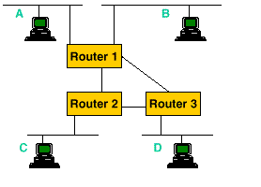
Routers (Software Switching)
OSI layer 2, 3 and 4
Use a ‘network’ address with ‘geographic’ significance
Many different network address formats and network protocols most ‘locally administered’, except IP
End system network addresses must be on right router port
Provides geographic significance that makes routing ‘scalable’ but introduces ‘moves and changes’ and ‘mobile user’ problems
Notes:
The work horses of internetworking, routers are used to:
Segment a LAN into multiple distinct address domains for traffic isolation (bridges extend broadcast domains across separate collision domains) interconnect separate broadcast domains so devices are addressed by ‘layer 3’ addresses, commonly called network addresses connect different types of LANs, serial lines, and layer 2 networks, translating the differences amongst the frame encapsulations used on each distinct layer 2 network (e.g., Ethernet & TRN), filter traffic for security, or to minimize geographic scope e.g., isolate printer names to a building determine the fastest way to reach another network address through a network of routers run a routing protocol with peer routers to exchange reachability information maintain a routing table of information thus learned prune the routing table into a forwarding table containing only ‘best’ routes actually forward packets based upon their network layer address using the forwarding table above
On the Internet, a router is a device or, in some cases, software in a computer, that determines the next network point to which a packet should be forwarded toward its destination. The router is connected to at least two networks and decides which way to send each information packet based on its current understanding of the state of the networks it is connected to. A router is located at any juncture of networks or gateway, including each Internet point-of-presence. A router is often included as part of a network switch.
A router creates or maintains a table of the available routes and their conditions and uses this information along with distance and cost algorithms to determine the best route for a given packet. Typically, a packet may travel through a number of network points with routers before arriving at its destination. An edge router is a router that interfaces with an asynchronous transfer mode (ATM) network. A brouter is a network bridge combined with a router.
The router is the only device that sees every message sent by any computer on either of the company's networks. When an animator sends a huge file to another animator, the router looks at the recipient's address and keeps the traffic on the animator's network. When an animator, on the other hand, sends a message to the bookkeeper asking about an expense-account check, then the router sees the recipient's address and forwards the message between the two networks.
One of the tools a router uses to decide where a packet should go is a configuration table. A configuration table is a collection of information, including:
Information on which connections lead to particular groups of addresses
Priorities for connections to be used
Rules for handling both routine and special cases of traffic
A configuration table can be as simple as a half-dozen lines in the smallest routers, but can grow to massive size and complexity in the very large routers that handle the bulk of Internet messages.
A router, then, has two separate but related jobs:
The router ensures that information doesn't go where it's not needed. This is crucial for keeping large volumes of data from clogging the connections of "innocent bystanders."
The router makes sure that information does make it to the intended destination.
In performing these two jobs, a router is extremely useful in dealing with two separate computer networks. It joins the two networks, passing information from one to the other and, in some cases, performing translations of various protocols between the two networks. It also protects the networks from one another, preventing the traffic on one from unnecessarily spilling over to the other. As the number of networks attached to one another grows, the configuration table for handling traffic among them grows, and the processing power of the router is increased. Regardless of how many networks are attached, though, the basic operation and function of the router remains the same. Since the Internet is one huge network made up of tens of thousands of smaller networks, its use of routers is an absolute necessity.

Slide 28
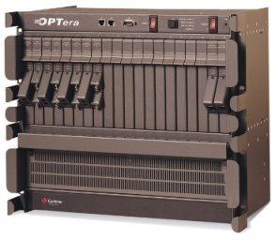
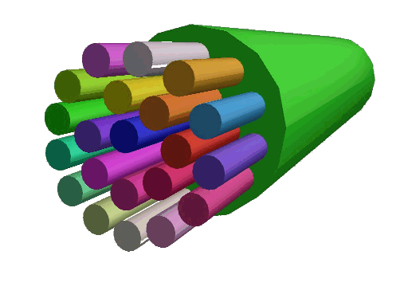

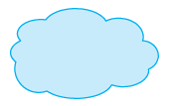

Internet Wide Area Network (WAN) Devices
Software Defined
Networking
Frame Relay
Switches
Optical
Switches
ATM/Ethernet
Switches
Broadband
Gateway
Frame Relay
Network
Optical
Network
ISP
Network
Customer
Premise
DSLAM
ATM/Ethernet
Network
Access
Router
PPPoE Session
Routed IP
Notes:
https://www.lifewire.com/cloud-computing-software-defined-networking-3473522

Slide 29


Internet Applications
Electronic Mail: ken.hayward@sce.carleton.ca
  Originally textual messages, worldwide availability
World Wide Web: http://www.carleton.ca
Instant Messaging (IM)
Multi-player games
Music & Video Streaming
Newsgroups
VoIP
Blogs (~450M)
YouTube (5B views/day)
WhatsApp (1.5B Active users)
Facebook (2.19B users)
Twitter (3.32B registered users)
Internet of Things (IoT)
Gartner predicts 500 smart devices per home 2022
Predicted Market value of 10Trillion dollars by 2025
2.8 Million
Viewings
*YouTube
}
Social
Media
Notes:
https://datafloq.com/read/how-big-will-the-internet-of-things-be/523
https://en.wikipedia.org/wiki/Internet_of_Things
http://www.internetlivestats.com/
Hair wig Out
http://en.wikipedia.org/wiki/Bride_Has_Massive_Hair_Wig_Out
As of 16 February 2011 there were over 156 million public blogs in existence
As of March 2013, Facebook has more than 1.06 Billion active monthly users
As of 2013 Twitter has more than 500 million users
Lots of applications, commonly available on lots of platforms. The World Wide Web browsers (Netscape, Internet Explorer) are the latest rage, but many are familiar with FTP/Fetch, Telnet/TN3270.… A technical definition of the World Wide Web is: all the resources and users on the Internet that are using the Hypertext Transfer Protocol (HTTP).
A broader definition comes from the organization that Web inventor Tim Berners-Lee helped found, the World Wide Web Consortium (W3C):
"The World Wide Web is the universe of network-accessible information, an embodiment of human knowledge.“
X Internet:
Executed Internet=>Napster, change existing web experience to something more interactive. Data and applications downloaded at the same time. Arguably will change the face of the internet as we know it.
Extended Internet=>RFID chips imbedded on business products and devices. As well as people for tracking, identification, etc.

Slide 30

Internet Access Types
Access
Applications
WWW
E-commerce
IP Telephony/Fax
Electronic Mail
Real Audio/Video
Distance Learning
Video on Demand
Remote Surveillance
Medical Imaging
VPN
Intranets
Extranets
Videoconferencing
Multicasting
Web Hosting
Ethernet PN
.
.
.
56kB
Users
ISDN
Households
ASDL
G. Lite
IDSL
HDSL
Businesses
VDSL
DOCSIS
Leased Lines
3G/4G/5G Wireless Lines
Notes:
DSL
There are several types of DSL (Digital Subscriber Line), including ADSL, which provides different upload and download speeds and is most popular with consumers, and SDSL, which provides the same speed in both directions and is most popular with businesses. However, this new technology is not yet available in many parts of the country. Furthermore, the speed you’re able to get depends on your distance from the telephone company’s local office and other factors. Because of these limitations, BizBuyer does not currently offer DSL.
ISDN
ISDN (Integrated Services Digital Network) provides fast access to the Internet relative to standard dial-up access, but is slower and less scalable than the other technologies mentioned here. In addition, ISDN is not actually a true dedicated connection – it is not always on. You are assessed per-minute charges for the time you spend connected to the Internet, which can add up. For these reasons, the popularity of ISDN is waning, and it is not currently available through BizBuyer.

Slide 31
Future of the Internet (IPv6)
IPv6: 128 bit addresses, flow labels, security, more ‘plug and play’
Estimated that one will be able to assign 1,000 addresses to every square meter of space in the world with IPv6 addressing or
IPv6 extends IPv4’s theoretical limit of 4.3 billion addresses to 340 trillion, trillion, trillion
Some benefits of IPv6:
More Efficient Routing
More Efficient Packet Processing
Directed Data Flows
Simplified Network Configuration
Support of New Services
Security
Notes:
With the growth of the Internet exceeding the original capabilities to provide network addresses, and some would argue even host addresses, the Internet Engineering Task Force defined Internet Protocol Version 6. Its definition is essentially complete, but it has not yet been proven in the marketplace. The Reservation Protocol was defined to be the signaling protocol for the Internet. It has a strong multicast bias. However, there is a lack of deployment experience, and general skepticism re widespread applicability There is a strong sentiment amongst many in the Internet community that they are in the process of supplanting the existing voice and video networks.
IPv6 has been built from the ground up with security in mind
Benefits of IPv6:
More Efficient Routing
IPv6 reduces the size of routing tables and makes routing more efficient and hierarchical. IPv6 allows ISPs to aggregate the prefixes of their customers' networks into a single prefix and announce this one prefix to the IPv6 Internet. In addition, in IPv6 networks, fragmentation is handled by the source device, rather than the router, using a protocol for discovery of the path's maximum transmission unit (MTU).
More Efficient Packet Processing
IPv6's simplified packet header makes packet processing more efficient. Compared with IPv4, IPv6 contains no IP-level checksum, so the checksum does not need to be recalculated at every router hop. Getting rid of the IP-level checksum was possible because most link-layer technologies already contain checksum and error-control capabilities. In addition, most transport layers, which handle end-to-end connectivity, have a checksum that enables error detection.
Directed Data Flows
IPv6 supports multicast rather than broadcast. Multicast allows bandwidth-intensive packet flows (like multimedia streams) to be sent to multiple destinations simultaneously, saving network bandwidth. Disinterested hosts no longer must process broadcast packets. In addition, the IPv6 header has a new field, named Flow Label, that can identify packets belonging to the same flow.
Simplified Network Configuration
Address auto-configuration (address assignment) is built in to IPv6. A router will send the prefix of the local link in its router advertisements. A host can generate its own IP address by appending its link-layer (MAC) address, converted into Extended Universal Identifier (EUI) 64-bit format, to the 64 bits of the local link prefix.
Support For New Services
By eliminating Network Address Translation (NAT), true end-to-end connectivity at the IP layer is restored, enabling new and valuable services. Peer-to-peer networks are easier to create and maintain, and services such as VoIP and Quality of Service (QoS) become more robust.
Security
IPSec, which provides confidentiality, authentication and data integrity, is baked into in IPv6. Because of their potential to carry malware, IPv4 ICMP packets are often blocked by corporate firewalls, but ICMPv6, the implementation of the Internet Control Message Protocol for IPv6, may be permitted because IPSec can be applied to the ICMPv6 packets.

Slide 32
Internet2
8.8 Terabits of capacity - new 100 Gigabit Ethernet Technology
Notes:
http://noc.net.internet2.edu/i2network/maps-documentation/maps.html
The second generation of the Internet, developed by a consortium of more than 200 universities, private companies and the U.S. government. It was not developed for commercial use or to replace the Internet, but is the reincarnation of it, intended primarily for research. Whereas the Internet was first designed to exchange text, Internet2 is designed for full-motion video and 3D animations.
Originally named UCAID (University Corporation for Advanced Internet Development), Internet2 spawned the high-speed Abilene backbone plus other backbone works
40G and 100G Ethernet vs. SONET
Today, some Telco gear already supports 40 Gig in Sonet OC-768. According to Communications Industry Researchers, 40 G and 100G Ethernet are expected to kill off use of SONET by 2016, and SONET will probably stop at OC-768.4
Internet2 mission:
Develop and deploy advanced network applications and technologies, accelerating the creation of tomorrow’s Internet.
Internet2 Goals:
Enable new generation of applications
Re-create leading edge R&E network capability
Transfer technology and experience to the global production Internet
Internet2 Universities
206 University Members, January 2005
Internet2 universities are recreating the partnerships that fostered the Internet in its infancy
Industry
Government
International
With the growth of the Internet exceeding the original capabilities to provide network addresses, and some would argue even host addresses, the Internet Engineering Task Force defined Internet Protocol Version 6. Its definition is essentially complete, but it has not yet been proven in the marketplace. The Reservation Protocol was defined to be the signaling protocol for the Internet. It has a strong multicast bias. However, there is a lack of deployment experience, and general skepticism re widespread applicability There is a strong sentiment amongst many in the Internet community that they are in the process of supplanting the existing voice and video networks. To meet the requirements of Internet2 applications and developers, there must be advanced-services support both within the campus and among the gigaPoPs. Within the campus, there will be many ways to tackle this requirement, and we do not propose to enumerate them here. Among the gigaPoPs, the wide area interconnect service must support differentiated Quality of Service as well as highly reliable, high-capacity transport. Since these capabilities are not yet available in the commodity backbone Internet, a special purpose inter-gigaPoP interconnect network will be established by the Collective Entity. We expect that initially this interconnect will be provided by the NSF vBNS. Over time, however, vBNS connectivity will be augmented with other interconnection pathways to give Internet2 a redundant and comprehensive set of connections. The gigaPoP concept can greatly increase market competition among Internet service providers and help ensure cost-effective Internet2 services over the long run. It might become a common way for end-user networks to acquire a wide variety of communications services, from basic Internet transport through caching and content provision Internet2 has four major technical components: applications that require Internet2-level services, such as those the Applications working group has outlined, and the equipment end users need to run the applications (denoted by solid-colored screens in Figure 1); campus networks connecting gigaPoPs to end users in their labs, classrooms, or offices (solid clouds); gigaPoPs consolidating and managing traffic from campus networks (striped clouds); and finally Internet2 interconnections among the gigaPoPs (dotted cloud) Industry's top analysts in Boston on November 21, leading telecom analyst group Ryan Hankin Kent (RHK) released a new Internet study that forecasts a 300-fold bandwidth boom over the coming decade. This boom, according to the study, will be driven by high-speed Internet access, disruptive technologies, and new applications.
Internet2 is a testing-ground network for universities to work together and develop advanced Internet technologies such as telemedicine, digital libraries and virtual laboratories.
Requiring state-of-the-art infrastructure, Internet2 universities are connected to the Abilene network backbone, which uses regional network aggregation points called gigaPoPs, high-speed Sonet facilities, and IP-over-Sonet routers. Abilene supports transfer rates between 2.4 gigabits per second and 9.6 gigabits per second.
With over 140 members, Internet2 currently has 30 gigaPoPs, about 150 HPC s, two backbones, and around 1500 routes.
In October of 1996, 34 US research universities began working on Internet2, and in September of 1997, the University Corporation for Advanced Internet Development (UCAID) was created to give an organizational body to the project.
2000
vBNS begins upgrade to OC-48 POS Backbone
Multi-protocol Label Switching (MPLS) deployed across vBNS - First known MPLS deployment in the US
Constrained Shortest Path First (CSPF) configured in combination with primary and secondary physically diverse label switched paths (LSPs), resulting in a technically superior backbone in speed, performance and restoration over any ATM-centric technology
Commercial offering of vBNS+ begins
Trials of VoIP technology conducted
* Patented high performance (>100 Mbps) multicast test deployed and activated
Content Distribution platforms (Cacheflows) added to network
Prototype OC12MON developed for POS
* SLA established promising 0.001% Packet loss and 100% availability
Active performance system refined to IPERF based measurements
vBNS+ releases an RFI (request for information) document detailing MCI's requirements for a next-generation QoS and multicast -capable edge router
Advanced test suite developed to include documented regression testing applied to all new router code releases for both unicast and multicast testing
In 2011 Internet2 has received a $62.5 million federal stimulus grant from the National Telecommunications and Information Administration's Broadband Technology Opportunities Program (BTOP). The total project value is approximately $97M. The grant is funding a dramatic expansion of the Internet2 Network footprint and capacity. The upgraded network will have an unprecedented 8.8 Terabits of capacity and use brand new 100 Gigabit Ethernet technology. The Internet2 Network is the first national network to deploy 100 GigE waves on its entire footprint, and will become the most sophisticated research and education platform in the world.
The upgraded network will be capable of supporting connectivity for all of the approximately 200,000 U.S. community anchor institutions (CAIs) as mandated by the grant, enabling CAIs to provide their communities with telemedicine, distance learning and other advanced applications not possible with consumer-grade Internet services, improving and creating new economic opportunities across the U.S. The enormous capacity can also be easily partitioned, enabling simultaneous support of logical networks for such diverse needs as GENI and national interconnect of public safety wireless networks.
The first phase of the project, from New York and Washington to Sunnyvale and Chicago to Atlanta, will be completed in summer, 2011

Slide 33
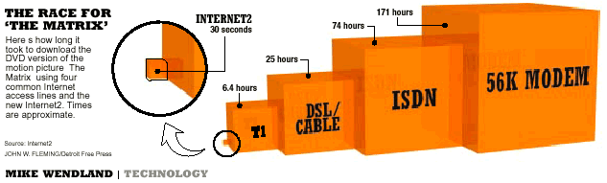
Download of “The Matrix” DVD
(Comparison of the Internet2 Land Speed Record)
Backbones 10 Gbps to 100 Gbps capacity today
GigaPoPs provide regional high-performance aggregation points
Local campus networks provide 100/1000 Mbps to the desktop
Current 2006 record stands at 4 seconds
Notes:
http://www.guinnessworldrecords.com/world-records/internet2-land-speed-record
Download of “The Matrix” DVD
(Comparison of the Internet2 Land Speed Record, Current Record 2006)
Single Stream Class: 272,400 terabit-meters per second by a team consisting of members from the University of Tokyo, the WIDE Project, NTT Communications, and others accomplished by transferring 20.42 terabytes of data across 30,000 kilometers of network in about 300 minutes at an average rate of 9.08 gigabits per second.
Researchers aren't the only ones excited about blazing data speeds. This record speed of 6.63Gbps is equivalent to transferring a full-length DVD movie in four seconds.

Slide 34
Internet Development Spiral
Commercialization
Privatization
Today’s Internet
Internet2
Research and
Development
Partnerships
Source: Ivan Moura Campos
Notes:
This spiral represents one way of looking at the development of the Internet. As the Internet moved from a research project to a commercial service, a set of partnerships fostered its development. During this process, the Internet grew in a number of ways: size, complexity, bandwidth, etc. Internet2 is forming the partnerships needed for technologies in a second cycle of innovation make their way into the commercial Internet.

Slide 35
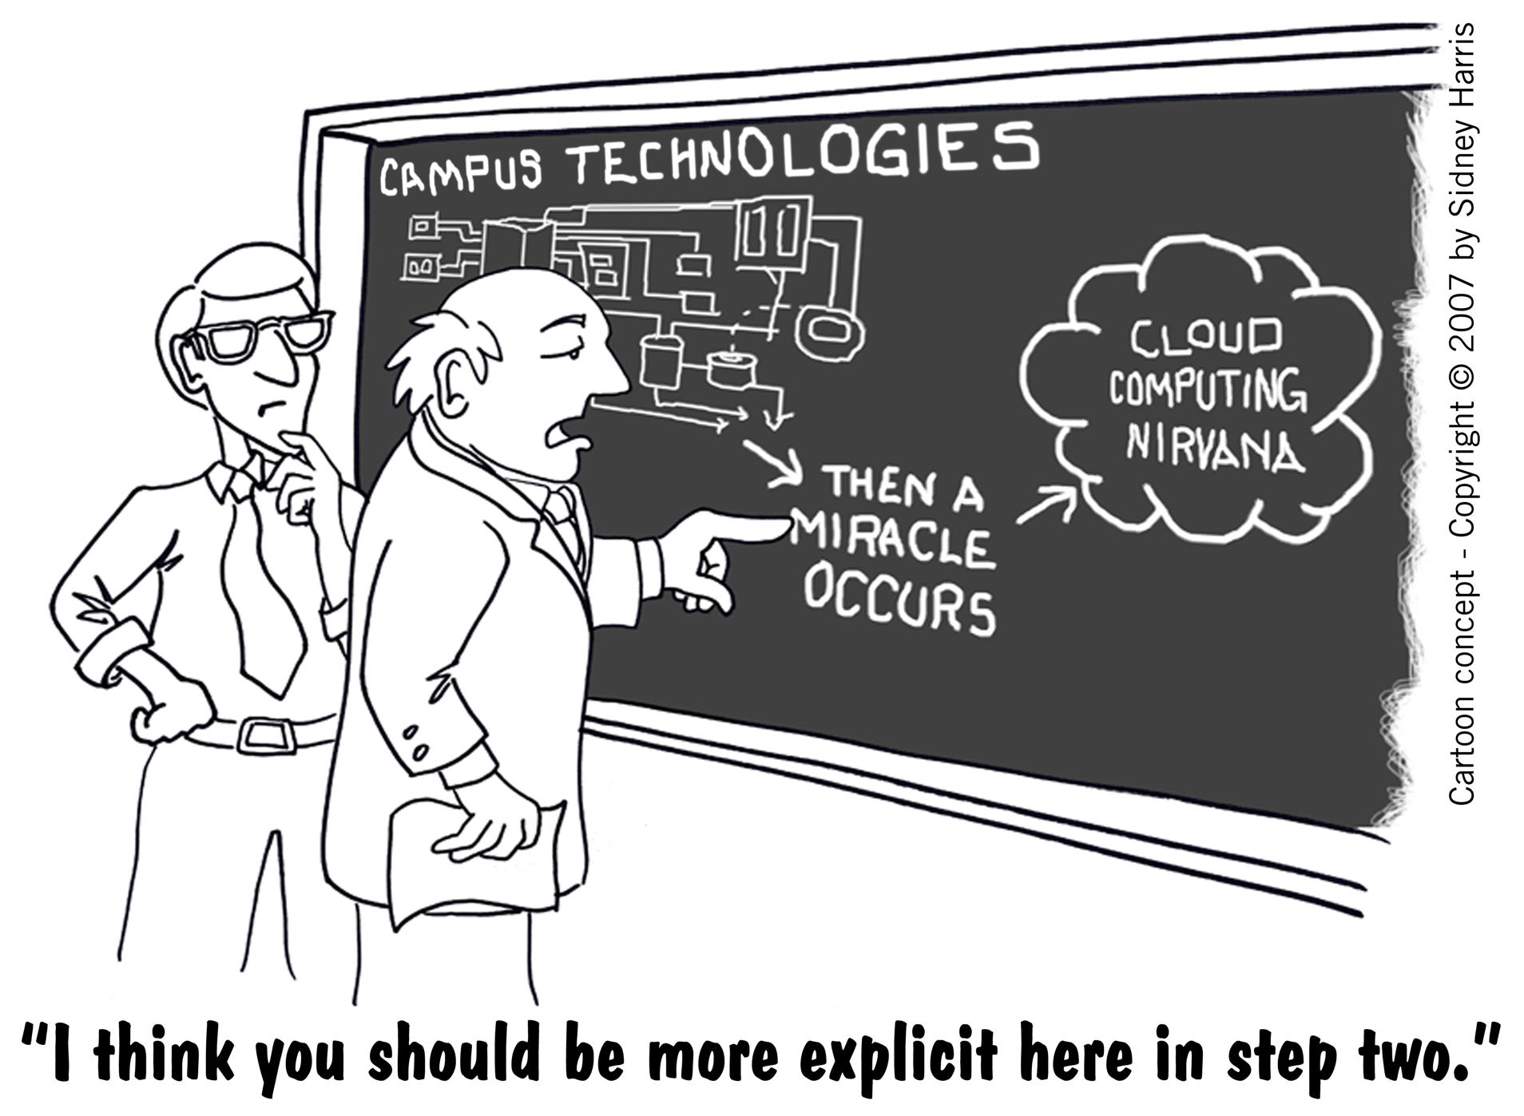
Cloud Computing Services Overview

Slide 36
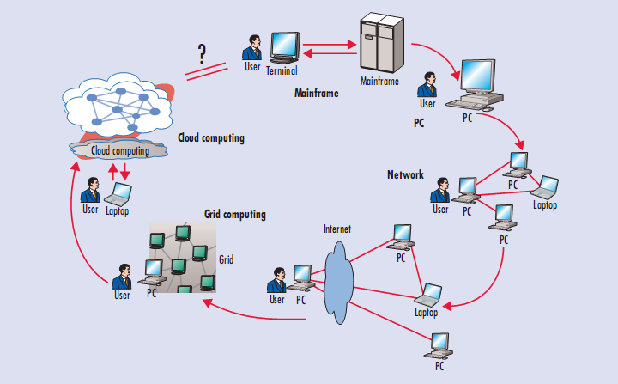
Computing Paradigm Shift Towards the Cloud
Notes:
Not just computing has gone to the cloud but in fact communications as well as many other services are trending towards this paradigm

Slide 37
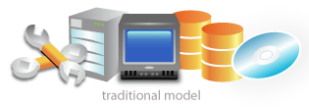

Conventional vs. Cloud Computing Services
Conventional
Cloud Computing Services
Manually Provisioned
Dedicated Hardware
Fixed Capacity
Pay for Capacity
Capital & Operational Expenses
Managed via Sys-admins
Self-provisioned
Shared Hardware
Elastic Capacity
Pay for Use
Operational Expenses
Managed via APIs
Notes:
This is true for telecommunications and the changes that are occurring

Slide 38
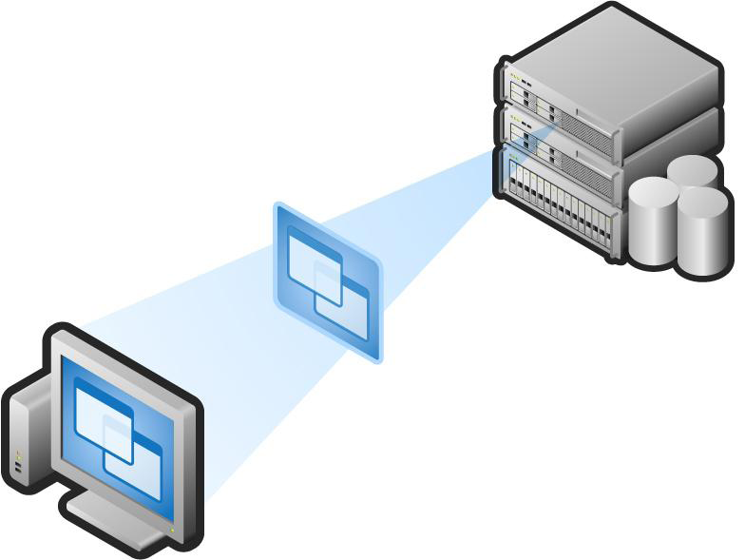
Virtual Machines (VM)
VM technology allows multiple virtual machines to run on a single physical machine.
Data Center
Virtual Desktop Infrastructure
(VDI)
Servers
App
App
App
App
App
Xen
Guest OS
(Linux)
Guest OS
(NetBSD)
Guest OS
(Windows)
VMWare
Virtual
Desktop
VM
VM
VM
Virtual Machine Monitor (VMM) / Hypervisor
UML
Thin Client
Denali
Hardware
Virtual Stacks
etc.
Notes:
When everything can be a Thin Client, the leap to a virtualized desktop infrastructure becomes feasible
Syncing becomes obsolete when you access the same “desktop” on every device
Pristine image every time you log in
Companies are slowly embracing VDI now
Moving beyond pilots into real deployments
Still too confusing and costly, but getting better
Advantages of virtual machines:
Run operating systems where the physical hardware is unavailable,
Easier to create new machines, backup machines, etc.,
Software testing using “clean” installs of operating systems and software,
Emulate more machines than are physically available,
Timeshare lightly loaded systems on one host,
Debug problems (suspend and resume the problem machine),
Easy migration of virtual machines (shutdown needed or not).
Run legacy systems!
Background
This vast processing power is made possible though distributed, large-scale cluster computing often in concert with server virtualization software, like Xen, and parallel processing.
Cloud computing can be contrasted with the traditional desktop computing model, where the resources of a single desktop, computer are used to complete tasks, and an expansion of the client/server model.
To paraphrase Sun Microsystems' famous adage, in cloud computing the network becomes the supercomputer.
Cloud computing is often used to sort through enormous amounts of data.
In fact, Google has an initial edge in cloud computing precisely because of its need to produce instant, accurate results for millions of incoming search inquires every day, parsing through the terabytes of Internet data cached on its servers

Slide 39
Deﬁning Cloud Computing Services - (Good Luck)
Industry Views
Software-as-a-Service (SaaS)
      “My Customer Resource Management (CRM) system is out on the Internet!”
Grids vs. Clouds
      Shared Virtual Resources
      Batch Jobs vs. Online Applications
Network Diagrams
      A service is “on a cloud somewhere”
  Analysts Views
“A pool of abstracted, highly scalable, and managed compute infrastructure capable of hosting end-customer applications and billed by consumption”
  “Is Cloud Computing Ready for The Enterprise?” Forrester Research, Inc
“Cloud Computing Services are an emerging approach to shared infrastructure in which large pools of systems are linked together to provide IT services.”
– IBM press release on “Blue Cloud”
“…a hosted infrastructure model that delivers abstracted IT resources over the Internet”
– Thomas Weisel Partners LLC from “Into the Clouds: Leveraging Data Centers and the Road to Cloud Computing”
Notes:
https://www.infoworld.com/article/2683784/cloud-computing/what-is-cloud-computing.html
There is no unique and standard definition out there!!!

Slide 40
What is Cloud Computing Services?
National Institute of Standards and Technology (NIST) Definition:
“Cloud Computing Services are a model for enabling convenient, on-demand network access to a shared pool of configurable computing resources that can be rapidly provisioned and released with minimal management effort or service provider interaction. This cloud model promotes availability and is composed of
4 Deployment Models
3 Service Models
5 Essential Characteristics”
Notes:
National Institute of Standards and Technology (NIST)
http://www.nist.gov/index.html
Essential Characteristics:
On-demand self-service. A consumer can unilaterally provision computing capabilities, such as server time and network storage, as needed automatically without requiring human interaction with each service’s provider.
Broad network access. Capabilities are available over the network and accessed through standard mechanisms that promote use by heterogeneous thin or thick client platforms (e.g., mobile phones, laptops, and PDAs).
Resource pooling. The provider’s computing resources are pooled to serve multiple consumers using a multi-tenant model, with different physical and virtual resources dynamically assigned and reassigned according to consumer demand. There is a sense of location independence in that the customer generally has no control or knowledge over the exact location of the provided resources but may be able to specify location at a higher level of abstraction (e.g., country, state, or datacenter). Examples of resources include storage, processing, memory, network bandwidth, and virtual machines.
Rapid elasticity. Capabilities can be rapidly and elastically provisioned, in some cases automatically, to quickly scale out and rapidly released to quickly scale in. To the consumer, the capabilities available for provisioning often appear to be unlimited and can be purchased in any quantity at any time.
Measured Service. Cloud systems automatically control and optimize resource use by leveraging a metering capability at some level of abstraction appropriate to the type of service (e.g., storage, processing, bandwidth, and active user accounts). Resource usage can be monitored, controlled, and reported providing transparency for both the provider and consumer of the utilized service.
Service Models:
Cloud Software as a Service (SaaS). The capability provided to the consumer is to use the provider’s applications running on a cloud infrastructure. The applications are accessible from various client devices through a thin client interface such as a web browser (e.g., web-based email). The consumer does not manage or control the underlying cloud infrastructure including network, servers, operating systems, storage, or even individual application capabilities, with the possible exception of limited user-specific application configuration settings.
Cloud Platform as a Service (PaaS). The capability provided to the consumer is to deploy onto the cloud infrastructure consumer-created or acquired applications created using programming languages and tools supported by the provider. The consumer does not manage or control the underlying cloud infrastructure including network, servers, operating systems, or storage, but has control over the deployed applications and possibly application hosting environment configurations.
Cloud Infrastructure as a Service (IaaS). The capability provided to the consumer is to provision processing, storage, networks, and other fundamental computing resources where the consumer is able to deploy and run arbitrary software, which can include operating systems and applications. The consumer does not manage or control the underlying cloud infrastructure but has control over operating systems, storage, deployed applications, and possibly limited control of select networking components (e.g., host firewalls).
Deployment Models:
Private cloud. The cloud infrastructure is operated solely for an organization. It may be managed by the organization or a third party and may exist on premise or off premise.
Community cloud. The cloud infrastructure is shared by several organizations and supports a specific community that has shared concerns (e.g., mission, security requirements, policy, and compliance considerations). It may be managed by the organizations or a third party and may exist on premise or off premise.
Public cloud. The cloud infrastructure is made available to the general public or a large industry group and is owned by an organization selling cloud services.
Hybrid cloud. The cloud infrastructure is a composition of two or more clouds (private, community, or public) that remain unique entities but are bound together by standardized or proprietary technology that enables data and application portability (e.g., cloud bursting for load-balancing between clouds).
Note: Cloud software takes full advantage of the cloud paradigm by being service oriented with a focus on statelessness, low coupling, modularity, and semantic interoperability.
Wikipedia definition of cloud computing:
"Cloud computing is the delivery of computing as a service rather than a product, whereby shared resources, software and information are provided to computers and other devices as a utility (like the electricity grid) over a network (typically the Internet)."

Slide 41
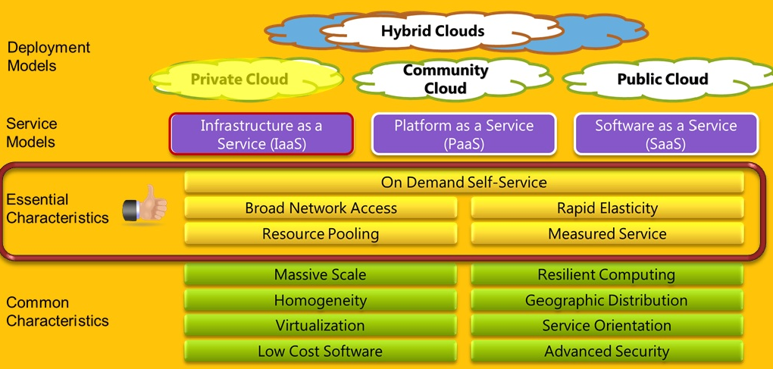
NIST Cloud Computing Reference Architecture
Notes:
http://csrc.nist.gov/groups/SNS/cloud-computing/cloud-computing-v26.ppt
The term "cloud" is used as a metaphor for the Internet, based on the cloud drawing used in the past to represent the telephone network, and later to depict the Internet in computer network diagrams as an abstraction of the underlying infrastructure it represents.

Slide 42
NIST - Five Essential Cloud Characteristics
Shared / Pooled Resources
Broad Network Access
On-Demand Self- Service
Scalable and Elastic
Metered by Use

Slide 43
1. NIST - Shared / Pooled Resources
Resources are drawn from a common pool
Common resources build economies of scale
Common infrastructure runs at high efficiency
Notes:
Resource pooling. The provider’s computing resources are pooled to serve multiple consumers using a multi-tenant model, with different physical and virtual resources dynamically assigned and reassigned according to consumer demand. There is a sense of location independence in that the customer generally has no control or knowledge over the exact location of the provided resources but may be able to specify location at a higher level of abstraction (e.g., country, state, or datacenter). Examples of resources include storage, processing, memory, network bandwidth, and virtual machines.

Slide 44

2. NIST - Broad Network Access
Open standards and APIs
Almost always IP, HTTP, and REST Web Services
Available from anywhere with an internet & private connection
Promote use by heterogeneous thin or thick client platforms (ie. Mobile phones, laptops, PDAs, Tablets, etc,)
Notes:
Broad Network Access. Capabilities are available over the network and accessed through standard mechanisms that promote use by heterogeneous thin or thick client platforms (e.g., mobile phones, laptops, and PDAs).
Private and public network access to cloud resources
Representational State Transfer (REST) web services and Service Oriented Architectures (SOA)
Representational State Transfer (REST) is a style of software architecture for distributed hypermedia systems such as the World Wide Web

Slide 45


3. NIST - On Demand Self - Service
“Turn off the lights” = turn off servers you aren’t using
  Ex: Turn off development and test environments
Pay for only what you use
No need to buy in advance
Zero Capital Outlay
Services accessed through a self-serve web interface
No contracts
The “no-need-to-know” in terms of the underlying details of infrastructure, applications interface with the infrastructure via the APIs.
Completely automated
Near real-time delivery (seconds or minutes)
Notes:
Pay-per-use:
You pay for cloud services only when you use them, either for the short term (for example, for CPU time) or for a longer duration (for example, for cloud-based storage or vault services).
On demand:
Because you invoke cloud services only when you need them, they are not permanent parts of your IT infrastructure—a significant advantage for cloud use as opposed to internal IT services. With cloud services there is no need to have dedicated resources waiting to be used, as is the case with internal services.

Slide 46

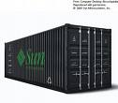

4. NIST – Scalability & Elastic
Control your infrastructure with your app
Nothing to purchase and take delivery on
Resources dynamically-allocated between users
Fully automated
Additional resources dynamically-released when needed
Zero Down Time – Resiliency
Multi-tenancy – Several customers share infrastructure
Notes:
Cloud computing gives you the ability to expand and reduce resources according to your specific service requirement. For example, you may need a large number of server resources for the duration of a specific task. You can then release these server resources after you complete your task.
Resiliency:
The resiliency of a cloud service offering can completely isolate the failure of server and storage resources from cloud users. Work is migrated to a different physical resource in the cloud with or without user awareness and intervention.
Workload movement:
This characteristic is related to resiliency and cost considerations. Here, cloud-computing providers can migrate workloads across servers—both inside the data center and across data centers (even in a different geographic area). This migration might be necessitated by cost (less expensive to run a workload in a data center in another country based on time of day or power requirements) or efficiency considerations (for example, network bandwidth). A third reason could be regulatory considerations for certain types of workloads.
Multi-Tenancy:
Public cloud services providers often can host the cloud services for multiple users within the same infrastructure. Server and storage isolation may be physical or virtual—depending upon the specific user requirements.

Slide 47
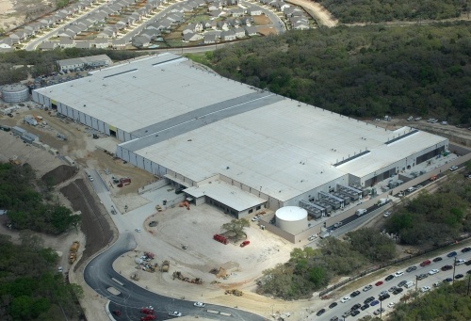
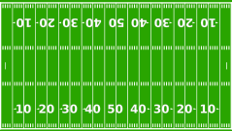

4. NIST – Scalability & Elastic, cont’d
Range in size from “edge” facilities to megascale.
Economies of scale:
  Approximate costs for a small size center (1K servers) and a larger, 100K server center.
Technology | Cost in small-sized Data Center | Cost in Large Data Center | Ratio
Network | $95 per Mbps/ Month | $13 per Mbps/ month | 7.1
Storage | $2.20 per GB/ Month | $0.40 per GB/ month | 5.7
Administration | ~140 servers/ Administrator | >1000 Servers/ Administrator | 7.1
Each MS data center is
12 times
the size of a football field
Microsoft has
1 Million Servers Globally for
Cloud Services .ie xBOX
Notes:
http://www.datacenterknowledge.com/special-report-the-worlds-largest-data-centers/largest-data-centers-io-data-centers-microsoft
https://storageservers.wordpress.com/2013/07/17/facts-and-stats-of-worlds-largest-data-centers/
Google – Million plus servers globally
Facebook
Amazon
Cloud computing systems are BIG
One Microsoft data center is 12x the size of a football field
Entirely packed with “containers” full of computers
A single system like this may have more horsepower than all the worlds supercomputers combined!
Deploy infrastructure with a mouse or API
No cabling, screwdrivers, racking, unboxing, buying
Middle of the night
Do it yourself remotely from anywhere anytime

Slide 48


5. NIST - Metered by Use
Services are metered, like a utility
Users pay only for services used
Services can be cancelled at any time
Notes:
Measured Service. Cloud systems automatically control and optimize resource use by leveraging a metering capability at some level of abstraction appropriate to the type of service (e.g., storage, processing, bandwidth, and active user accounts). Resource usage can be monitored, controlled, and reported providing transparency for both the provider and consumer of the utilized service.

Slide 49
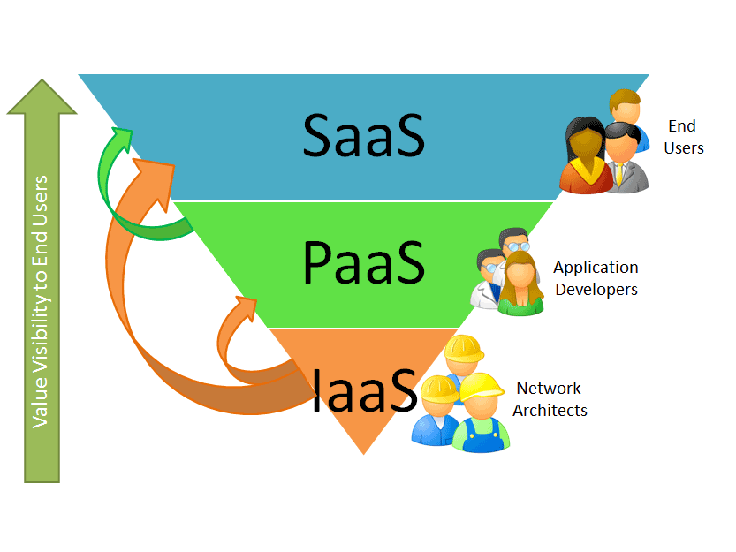
NIST - Service Delivery Models
Notes:
Almost like OSI Reference Model.
SaaS: Software as a Service
Consumer uses provider’s applications running on provider's cloud infrastructure
Delivery of computer infrastructure (typically a platform virtualization environment) as a service
PaaS: Platform as a Service
Consumer can create custom applications using programming tools supported by the provider and deploy them onto the provider's cloud infrastructure
Delivery of computing platform & solution stack as a service
IaaS: Infrastructure as a Service
Consumer can provision computing resources within provider's infrastructure upon which they can deploy and run arbitrary software, including OS and applications
Software deployment model whereby a provider licenses an application to customers for use as a service on demand

Slide 50
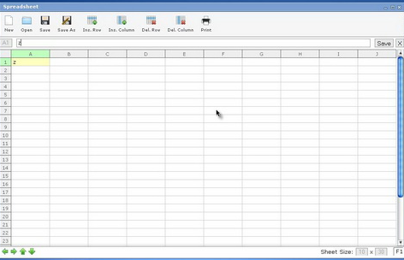



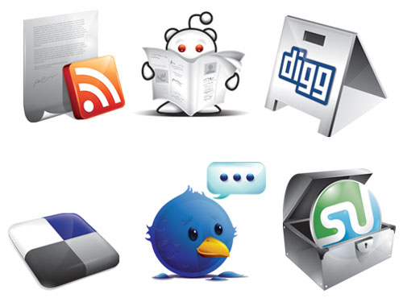





NIST - Software as a Service (SaaS)
Software delivery model
  Increasingly popular with SMEs
  No hardware or software to manage
  Service delivered through a browser
Examples
  CRM
  Financial Planning
  Human Resources
  Word processing
  Web-based E-mail
  Messaging Applications
Productivity Tools (word processing, spreadsheet, etc.)
Web 2.0 Content and Social Media (Blogs, Wikis, Networking
Messaging/Alert Management (Email, IM, RSS, Web Accessible Voicemail)
Payment Services (Permits, Taxes, etc.)
Notes:
Simple examples of SaaS are the “free” email (also called web-based email) systems offered on the Internet such as Microsoft Hotmail, G-mail, and Yahoo Mail.
CRM Customer Relationship Management
Software as a service (SaaS): A SaaS application runs entirely in the cloud (that is, on servers at an internet-accessible service provider). The on-premises client is typically a browser or some other simple client.
SaaS Application Services
Users in most enterprises today rely on both purchased and home-grown applications. As these applications expose their services to remote software, they become part of the on-premises platform.
Similarly, SaaS applications today frequently expose services that can be accessed by on-premises applications or by other cloud applications.
Salesforce.com’s CRM application, for example, makes available a variety of services that can be used to integrate its functions with on-premises applications.
As organizations begin to create their own SaaS applications running on a cloud foundation, those applications will also expose services.
Just as packaged and custom on-premises applications today are part of the on-premises platform, the services exposed by packaged and custom SaaS applications are becoming part of the cloud platform
Software as a Service
Consider the case of an enterprise with its set of software licenses for the various applications it uses. These applications could be in human resources, finance, or customer relationship management, to name a few. Instead of obtaining desktop and server licenses for software products it uses, an enterprise can obtain the same functions through a hosted service from a provider through a network connection. The interface to the software is usually through a web browser.
SaaS saves the complexity of software installation, maintenance, upgrades, and patches (for example, for security fixes) for the IT team within the enterprise, because the software is now managed centrally at the SaaS provider's facilities.
The SaaS provider can provide this service to multiple customers and enterprises, resulting in a multitenant model.
The pricing of such a SaaS service is typically on a per-user basis for a fixed bandwidth and storage.
Monitoring application-delivery performance is the responsibility of the SaaS provider.
SaaS is generally used to refer to business software rather than consumer software, falls under Web 2.0!
Gov-Apps, Internet Services
Blogging/Surveys/Twitter, Social Networking
Information/Knowledge Sharing (Wiki)
Communication (e-mail), Collaboration (e-meeting)
Productivity Tools (office)

Slide 51
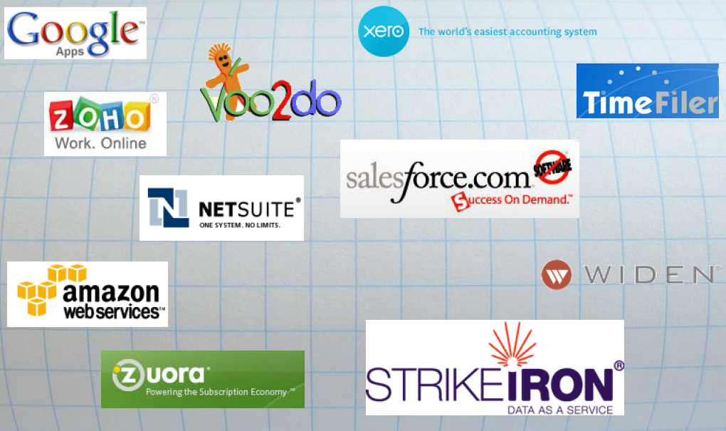
NIST (SaaS) – Commercial Examples
Notes:
Amazon Web Services (AWS)
Amazon Web Services logo Amazon Web Services (AWS) is a collection of remote computing services (also called web services) that together make up a cloud computing platform, offered over the Internet by Amazon.com. The most central and well-known of these services are Amazon EC2 and Amazon S3.
Launched in July 2002[citation needed], Amazon Web Services provide online services for other web sites or client-side applications. Most of these services are not exposed directly to end users, but instead offer functionality that other developers can use. In June 2007, Amazon claimed that more than 330,000 developers had signed up to use Amazon Web Services
Amazon.com provides its Web Services portal and in particular Amazon Elastic Cloud Computing service (aka Amazon EC2) as a truly on demand, as needed computing power and web infrastructure solution. Of course, most of Amazon’s clientele for Amazon EC2 are businesses that do not want to spend the resources to build out expensive servers until they have the revenue necessary to warrant such actions.
http://www.saas-showplace.com/home.html
MS Live/ExchangeLabs, IBM,
Google Apps; Salesforce.com
Quicken Online, Zoho, Cisco
Online software sales still account for only a paltry $9.5 billion of the overall $284 billion software market, but SaaS sales are growing at a pace of 40% compared to just 3.4% in the industry overall.

Slide 52
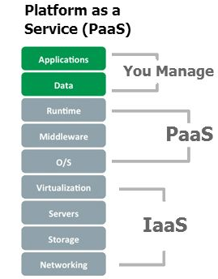
NIST - Platform as a Service (PaaS)
Delivery Model
  Provides a software platform on which developers can build their own applications and host them
  Provides middleware-style services such as database and component services for use by applications
  Applications do not need to worry about the scalability of the underlying platform
  Fundamentally it acts as “Middleware” between IaaS and SaaS services
Examples
  Google AppEngine
  Amazon EC2 WaveMaker
  Database tools & software
Notes:
PaaS is a common reference to the layer of cloud technology architecture that contains all application infrastructure services, which are also known as "middleware" in other contexts. It is the middle layer of the software stack "in the cloud" intermediating between the underlying system infrastructure (operating systems, networks, virtualization, storage, etc.) and overlaying application software.
Examples of PaaS solutions today include:
AppEngine from Google: based on Python and Java
Force.com from SalesForce: based on the SalesForce SaaS infrastructure and Apex language
Bungee Connect: visual development studio based on Java
LongJump: based on Java/Eclipse
WaveMaker: visual development studio based on Java and hosted on Amazon EC2
Faster to market. Custom applications were developed and deployed in 76% less time and required 76% - 85% fewer developer hours;
!"Lower cost. Companies were able to reduce their three year TCO by 54%, saving $560,000 per application;
!"Higher quality. Users of the custom applications built on the Force.com platform reduced Annual Downtime by 97% and 60% less time dealing with the service desk;
!"Better performance. The combination of the first three benefits contributed to better business performance and generated an additional $3.9 million in annual revenue for each firm.
Platform as a Service (PaaS) provides a software platform on which users can build their own applications and host them on the PaaS provider's infrastructure.
The software platform is used as a development framework to build, debug, and deploy applications.
It often provides middleware-style services such as database and component services for use by applications.
PaaS is a true cloud model in that applications do not need to worry about the scalability of the underlying platform (hardware and software). When enterprises write their application to run over the PaaS provider's software platform, the elasticity and scalability is guaranteed transparently by the PaaS platform.
The platforms offered by PaaS vendors like Google (with its App-Engine) or Force.com (the PaaS offering from Salesforce.com) require the applications to follow their own Application Programming Interface (API) and be written in a specific language.
PaaS sees the most success with new applications being developed specifically for the cloud.
Monit­oring application-delivery performance is the responsibility of the PaaS provider.
Pricing for PaaS can be on a per-application developer license and on a hosted-seats basis.
Note that PaaS has a greater degree of user control than SaaS.
Cloud platforms: A cloud platform provides cloud-based services for creating applications. Rather than building their own custom foundation, for example, the creators of a new SaaS application could instead build on a cloud platform. The direct users of a cloud platform are developers, not end users.
The Cloud Platform
Understanding cloud platforms requires some agreement on what the word “platform” means in this context. One broad way to think about it is to view a platform as any software that provides developer accessible services for creating applications.
Whether it’s on-premises or in the cloud, an application platform can be thought of as comprising three parts:
A foundation: Nearly every application uses some platform software on the machine it runs on. This typically includes various support functions, such as standard libraries and storage, and a base operating system.
A group of infrastructure services: such as remote storage services, integration services, an identity service.
A set of application services: service-oriented functions that are accessible to new applications.
Application Development, Data, Workflow, etc.
Security Services (Single Sign-On, Authentication, etc.)
Database Management
Directory Services

Slide 53
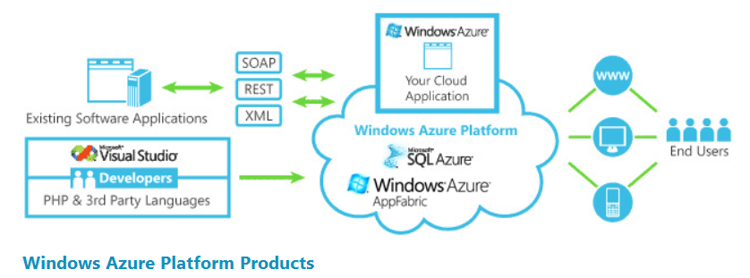



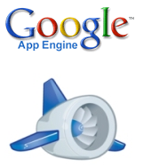


NIST – (PaaS) Commercial Examples
Notes:
Microsoft Azure /ˈæʒər/ is a cloud computing service created by Microsoft for building, deploying, and managing applications and services through a global network of Microsoft-managed data centers.
Google App Engine, Mosso,
Force.com, Engine Yard,
Heroku, AWS: S3

Slide 54
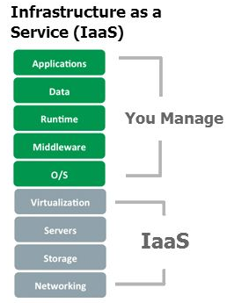
NIST Infrastructure as a Service (IaaS)
Computer infrastructure delivery model
  Access to computer infrastructure stack:
    Typically a platform virtualization environment
    Full OS access
    Hosted Firewalls
    Hosted Routers
    Load balancing
    Server and Data storage
Examples
  Amazon Elastic Computer Cloud (EC2)
  Rackspace
  Netflix – Uses Amazon Cloud Services
NaaS
Notes:
From Wikipedia, the free encyclopedia
(Redirected from Amazon EC2)
Jump to: navigation, search
Amazon Elastic Compute Cloud (EC2) is a central part of Amazon.com's cloud computing platform, Amazon Web Services (AWS). EC2 allows users to rent virtual computers on which to run their own computer applications. EC2 allows scalable deployment of applications by providing a web service through which a user can boot an Amazon Machine Image to create a virtual machine, which Amazon calls an "instance", containing any software desired.
Cloud infrastructure services, also known as "Infrastructure as a Service (IaaS)", delivers computer infrastructure - typically a platform virtualization environment - as a service. Rather than purchasing servers, software, data-center space or network equipment, clients instead buy those resources as a fully outsourced service. Suppliers typically bill such services on a utility computing basis and amount of resources consumed (and therefore the cost) will typically reflect the level of activity. IaaS evolved from virtual private server offerings.
Sometimes called Utility computing
Infrastructure as a Service
An IaaS provider offers you "raw" computing, storage, and network infrastructure so that you can load your own software, including operating systems and applications, on to this infrastructure.
This scenario is equivalent to a hosting provider provisioning physical servers and storage and letting you install your own OS, web services, and database applications over the provisioned machines.
IaaS offers you the greatest degree of control of the three models.
You need to know the resource requirements for your specific application to exploit IaaS well.
Scaling and elasticity are your—not the provider's—responsibility.
Amazon uses virtualization as a critical underpinning of its EC2 service.
Pricing for the IaaS can be on a usage or subscription basis. CPU time, storage space, and network bandwidth (related to data movement) are some of the resources that can be billed on a usage basis.
Servers
Networks, Security, Mainframes, Servers, StorHosting Services
The capability provided to the consumer is to provision processing, storage, networks, and other fundamental computing resources where the consumer is able to deploy and run arbitrary software, which can include operating systems and applications. The consumer does not manage or control the underlying cloud infrastructure but has control over operating systems, storage, deployed applications, and possibly limited control of select networking components (e.g., host firewalls).

Slide 55





NIST - (IaaS) Commercial Examples
Amazon
  Infrastructure web services
    EC2 (Elastic Compute Cloud) - now with Windows (99.95% availability!)
    S3 (Simple Storage Service)
    SimpleDB
    SQS (Simple Queue Service)
  Payments and Billing
  On-demand workforce
  Search (Alexa)
  Fulfillment web service
Rackspace
  Mosso
  JungleDisk
  SliceHost
Notes:
3Tera, SliceHost, Flexiscale
AWS: EC2
How Big is Amazon’s EC2?
Big. 158,000 servers. It has been independently confirmed this with at least two sources close to EC2….hosted services like Netflix and Instagram
GoGrid, RightScale, Linode
Amazon is arguably the first major proponent of Infrastructure as a Service (IaaS) through its Elastic Computing Cloud (EC2) service.
Amazon lets you rent servers with a certain CPU speed, memory, and disk capacity along with the OS and applications that you need to have installed on them.
Storage
Amazon S3, Dell, Apple, ...

Slide 56
NIST - Service Delivery Models Summary
Notes:
https://www.quora.com/Is-Amazon-EC2-IaaS-or-PaaS

Slide 57




NIST - Cloud Deployment Models
Internal (private) cloud - Example Intel’s internal network
  The cloud infrastructure is operated within the consumer’s organization.
  The cloud provider is responsible only for the infrastructure and not for the control.
  This setup is equivalent to a section of a shared data center being partitioned for use by a specific customer.
Community cloud - Example OPTUM
  The cloud infrastructure is jointly owned by several organizations and supports a specific community that has shared concerns (e.g., mission, security requirements, policy, and compliance considerations).
Public cloud – Example IBM Blue Cloud
  The cloud infrastructure is owned by an organization selling cloud services to the general public or to a large industry group.
  Both the infrastructure and control of these clouds is with the service provider.
  Data centers are external to the users of the service.
Hybrid cloud – Example rackspace
  The cloud infrastructure is a composition of two or more clouds (internal, community, or public) that remain unique entities but are bound together by standardized or proprietary technology that enables data and application portability.
Notes:
(Internet) Private cloud
Douglas Parkhill first described the concept of a "private computer utility" in his 1966 book The Challenge of the Computer Utility. The idea was based upon direct comparison with other industries (e.g. the electricity industry) and the extensive use of hybrid supply models to balance and mitigate risks.
Private cloud and internal cloud have been described as neologisms, however the concepts themselves pre-date the term cloud by 40 years. Even within modern utility industries, hybrid models still exist despite the formation of reasonably well-functioning markets and the ability to combine multiple providers.
Some vendors have used the terms to describe offerings that emulate cloud computing on private networks. These (typically virtualization automation) products offer the ability to host applications or virtual machines in a company's own set of hosts. These provide the benefits of utility computing -shared hardware costs, the ability to recover from failure, and the ability to scale up or down depending upon demand.
Private clouds have attracted criticism because users "still have to buy, build, and manage them" and thus do not benefit from lower up-front capital costs and less hands-on management,^{[52]} essentially "[lacking] the economic model that makes cloud computing such an intriguing concept".^{[54]} ^{[55]} Enterprise IT organizations use their own private cloud(s) for mission critical and other operational systems to protect critical infrastructures. ^{[56]}
Community cloud
A community cloud may be established where several organizations have similar requirements and seek to share infrastructure so as to realize some of the benefits of cloud computing. With the costs spread over fewer users than a public cloud (but more than a single tenant) this option is more expensive but may offer a higher level of privacy, security and/or policy compliance. Examples of community cloud include Google's "Gov Cloud".^{[47]}
Public cloud
Public cloud or external cloud describes cloud computing in the traditional mainstream sense, whereby resources are dynamically provisioned on a fine-grained, self-service basis over the Internet, via web applications/web services, from an off-site third-party provider who bills on a fine-grained utility computing basis.^{[26]}
Hybrid cloud and hybrid IT delivery
The main responsibility of the IT department is to deliver services to the business. With the proliferation of cloud computing (both private and public) and the fact that IT departments must also deliver services via traditional, in-house methods, the newest catch-phrase has become “hybrid cloud computing.”^{[48]} Hybrid cloud is also called hybrid delivery by the major vendors including HP, IBM, Oracle and VMware who offer technology to manage the complexity in managing the performance, security and privacy concerns that results from the mixed delivery methods of IT services.^{[49]}
A hybrid storage cloud uses a combination of public and private storage clouds. Hybrid storage clouds are often useful for archiving and backup functions, allowing local data to be replicated to a public cloud.^{[50]}
Another perspective on deploying a web application in the cloud is using Hybrid Web Hosting, where the hosting infrastructure is a mix between cloud hosting and managed dedicated servers - this is most commonly achieved as part of a web cluster in which some of the nodes are running on real physical hardware and some are running on cloud server instances.^{[citation needed]}
Combined cloud
Two clouds that have been joined together are more correctly called a "combined cloud". A combined cloud environment consisting of multiple internal and/or external providers^{[51]} "will be typical for most enterprises".^{[52]} By integrating multiple cloud services users may be able to ease the transition to public cloud services while avoiding issues such as PCI compliance.^{[53]}
Citizen Cloud – Cloud as defined by user access and perspective (not hosting location or data owner)
Federal Civilian Cloud (i.e. non-DoD/Intel) – Cloud services provided within a established Federal cloud environment with government/commercial providers, managed by one agency, subscribed to many other agencies. Specific attributes may include greater compliance with Federal policy and agency specific cloud services. Additionally, greater interoperability amongst cloud services in the Federal Cloud. Leverages TIC.
National Security Cloud – Managed by a DOD / Intel agency, with government/commercial providers. Traditional national security requirements and applications are provisioned within this cloud environment. Leverages TIC MTIPS providers.
Federal, State, & Local Government Cloud – Cloud services provided to facilitate enhanced government services, public safety, interoperability, and business operations amongst all American government Agencies

Slide 58
Disadvantages of Cloud Computing Services
Requires a constant Internet or network connection
Does not work well with low-speed connections
Stored data might not be secure and/or lost
Interoperability & Federation between clouds
Regulatory Compliance
Data ownership and location
Complex Service Level Agreements (SLA)s
Notes:
Requires a constant Internet connection:
Cloud computing is impossible if you cannot connect to the Internet.
Since you use the Internet to connect to both your applications and documents, if you do not have an Internet connection you cannot access anything, even your own documents.
A dead Internet connection means no work and in areas where Internet connections are few or inherently unreliable, this could be a deal-breaker.
Does not work well with low-speed connections:
Similarly, a low-speed Internet connection, such as that found with dial-up services, makes cloud computing painful at best and often impossible.
Web-based applications require a lot of bandwidth to download, as do large documents.
If you are labouring with a low-speed dial-up connection, it might take seemingly forever just to change from page to page in a document, let alone to launch a feature-rich cloud service.
In other words, cloud computing is not for the broadband-impaired!
When you are offline, cloud computing simply does not work.
Can be slow:
Even with a fast connection, web-based applications can sometimes be slower than accessing a similar software program on your desktop PC.
Everything about the program, from the interface to the current document, has to be sent back and forth from your computer to the computers in the cloud.
If the cloud servers happen to be backed up at that moment, or if the Internet is having a slow day, you would not get the instantaneous access you might expect from desktop applications.
Features might be limited:
This situation is bound to change, but today many web-based applications simply are not as full-featured as their desktop-based applications.
For example, you can do a lot more with Microsoft PowerPoint than with Google Presentation's web-based offering.
The basics are similar, but the cloud application lacks many of PowerPoint's advanced features.
If you are a power user, you might not want to leap into cloud computing just yet.
Stored data might not be secure:
With cloud computing, all your data is stored on the cloud.
The questions is How secure is the cloud?
Can unauthorized users gain access to your confidential data?
Cloud computing companies say that data is secure, but it is too early to be completely sure of that.
Only time will tell if your data is secure in the cloud.
Stored data can be lost:
Theoretically, data stored in the cloud is safe, replicated across multiple machines.
But on the off chance that your data goes missing, you have no physical or local backup.
Put simply, relying on the cloud puts you at risk if the cloud lets you down.
Interoperability
Each cloud systems uses different protocols and different APIs… so it may not be possible to run applications between cloud based systems.
Amazon has created its own DB system (not SQL 92), and workflow system (many popular workflow systems out there) – so your normal applications will have to be adapted to execute on these platforms.

Slide 59
Advantages of Cloud Computing Services
Lower cost of ownership TCO - Consumption based
Reduce infrastructure management responsibility
Allow for unexpected resource loads
Faster application rollout
High Demand Applications (CPU/Storage)
Geographically dispersed user base
Cheap to experiment
Resource Sharing more efficient (Multi-Tenanted)
Instant Software Updates
Accessibility = Any time, Any place, Any device
Notes:
Cost Savings
Organizations can reduce or eliminate IT capital expenditures and reduce ongoing operating expenditures by paying only for the services they use and, potentially, by reducing the size of their IT staffs.
Ease of Implementation
Without the need to purchase hardware, software licenses, or implementation services, an organization can implement cloud computing rapidly.
Flexibility
Cloud computing offers more flexibility (often called “elasticity”) in matching IT resources to business functions than past computing methods. It can also increase mobility of staff by allowing them to access business information and applications from a wider range of locations and/or devices.
Scalability
Organizations using cloud computing need not scramble to secure additional hardware and software when user loads increase, but can instead add and subtract capacity as the network load dictates.
Access to Top-End IT Capabilities
Particularly for smaller organizations, cloud computing can allow access to hardware, software, and IT staff of a caliber far beyond that which they can attract and/or afford for themselves.
Redeployment of IT Staff
By reducing or doing away with constant server updates and other computing issues, and eliminating expenditures of time and money on application development, organizations may be able to concentrate at least some of their IT staff on higher-value tasks.
Focusing on Core Competencies
Arguably, the ability to run data centers and to develop and manage software applications is not necessarily a core competency of most organizations. Cloud computing may make it much easier to reduce or shed these functions, allowing organizations to concentrate their efforts on issues central to their business such as (in government) the development of policy and design and delivery of public services.
Sustainability
The poor energy efficiency of most existing data centers, due to substandard design or inefficient asset utilization, is now understood to be environmentally and economically unsustainable. Cloud service providers, through leveraging economies of scale and their capacity to managing computing assets more efficiently, can consume far less energy and other resources than traditional data center operators.
Benefits of Cloud Computing
IT resources provided as a service
Compute, storage, databases, queues
Clouds leverage economies of scale of commodity hardware
Cheap storage, high bandwidth networks & multicore processors
Geographically distributed data centers
Cost & management
Economies of scale, “out-sourced” resource management
Reduced Time to deployment
Ease of assembly, works “out of the box”
Scaling
On demand provisioning, co-locate data and compute
Reliability
Massive, redundant, shared resources

Slide 60
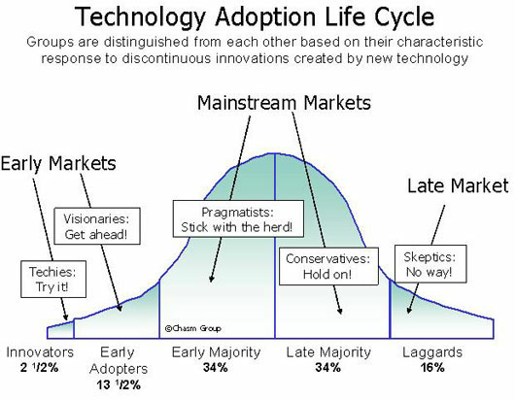

Cloud Computing Services Are “Crossing the Chasm”
Source: The Chasm Group
Notes:
Geoffrey Moore's book, “Crossing the Chasm”
Many of us have spent years explaining to customers why our various versions of Platform as a Service (PaaS) are their best alternative for customization and deployment of business software applications. Logically, there is little reason not to choose a PaaS as the core architecture for your businesses software. However while there has been adoption, it hasn't occurred at the pace which it probably should given the magnitude of the value proposition. This of course is the quandary called "the adoption cycle" that receives a lot of attention from authors and analysts alike.
Basically, the adoption cycle distinguishes early adopters, middle adopters and late adopters, and put's them all on a bell curve. In technology, it is widely thought that there is a very large gap between the early adopters and the middle adopters, and for a company to actually overcome that gap is often referred to as "crossing the chasm". Crossing the chasm is a mission critical endeavor because it is the difference between success and failure for a disruptive technology...you either cross it, or you die.
There's something happening in the market place today that is going to push PaaS across the chasm, and it's going to happen quicker then most of us probably thought. It's not a sudden influx of end-user customers, like most of us planned/hoped for. In fact, if you look at the earlier marketing efforts of most of the high profile platforms, you will see that their messages were targeted straight at the end user. However, if you look at the marketing efforts of the surviving PaaS companies today, you will see a common change in messaging towards a wholly new direction. They ("we" actually) aren't doing it because of theories...theorizing is what led us to chase what may arguably have been the wrong market, the late adopters whom we have no real power to influence. We are shifting our focus because there is a lot of activity taking place; real deals are being cut, and at an increasing pace.
The ideas in Moore's book have been floating around in my head for several months now. The book succinctly puts into words what have only been abstract ideas in my head. I've never been involved before with a product, icloud, much less an industry, cloud computing, that would be classified as disruptive. It's fascinating for me to be involved in this technological revolution.
A year and a half ago, IDC Exchange, conducted a survey with 244 companies about their use of, and views about, IT Cloud Services. Frank Gens, an employee at IDC Exchange, wrote on September 29th about how he expected IT cloud services within the "next three years" to expand from Early Adopters to the Early Majority. He felt that that would be the "critical time to develop strong cloud offerings" in order to "play a leadership role in bringing customers...across the chasm."
Based on his hypothesis, we have 1 1/2 years left to successfully cross the chasm within cloud computing.
How successful has the industry been so far? Do you think the cloud computing chasm can be crossed within this time frame? What will it take for the cloud computing industry to survive this "leap of faith" by the consumer?

Slide 61
Fundamental Market transitions are happening now!
Adoption/Usage/revenue
Email Messages (not spam)
Smartphones & mobile tablet & BIG Data/IoT
Microsoft Revenue
Email Users
PCs and laptops
iPhone Revenue
SMS Messages
SMS or Social Media Users
Time

Slide 62
Cloud Computing Services Summary
“Cloud Computing Services are an emerging area that affects IT infrastructure, network services, and applications.”
NIST is driving SaaS, PaaS, and IaaS towards standards
Some of the benefits are:
  Cost, Scalability, Flexibility, Mobility, Convergence
Security is one the major concern about cloud application
Virtualization of the desktop (VDI) and Data Centers are accelerating
Existing communications are becoming multi-modal sessions
  SIP, SOA, E-IMS, Web 2.0, etc.
The Internet will play a key part in Clouding Computing Services and Communications
Notes:
When you embark on a discussion of “the cloud” you know that you are simultaneously dealing with a great movement of anticipation and an associated great surround of ambiguity.
Our point of view is based on the following:
The pursuit of cloud models, of which there will be many, will result in transitions
These transitions suggest that some elements will be premise based and some cloud based and timing will vary based on situation
Hence hybrid premises/cloud models will exist for the better part of a decade
In fact – studies show that the vast majority of enterprises , 80% will choose a hybrid cloud / on prem approach (Source Wainhouse).
The goal here is Universal collaboration –by delivering on-demand collaboration and customer service capabilities — voice, data, video and messaging, but also presence, context, location, applications and multivendor integration to any user, on any device in any enterprise.
IDC believes that the rise of Cloud computing is one of the most transformative developments in how information technology services are created, delivered, and accessed, in the last 20 years. Cloud computing stands alongside milestones like the commercialization of the Internet in the 1990's, the advent of Java in 1995, and the growth and standardization of the world wide Web (URLs, browsers, HTTP), as a transformative advance in how we understand and consume information technology. Pervasive system availability and connectivity, a characteristic of the Internet and Web, is largely responsible for establishing the foundation for Cloud computing.

Slide 63
Q & A

Slide 64
References
Hobbes' Internet Timeline v4.1
  http://www.isoc.org/guest/zakon/Internet/History/HIT.html
A Little History of the World Wide Web
  :http//www.w3.org/History.html
Nerds 2.0.1: A Brief History Of The Internet
  http://www.pbs.org/cringely/
Internet accessible
  http://www.ietf.org
    Internet Engineering Task Force: IP standards body
Boardwatch’s (ISP World) Complete ISP Directory:
  http://www.boardwatch.com/
Books
  Perlman, R; Interconnections: Bridges & Routers; Addison Wesley; ISBN 0-201-56332-0
  Comer, D; Internetworking with TCP/IP; Prentice Hall; ISBN 0-13-216987-8
  Huitema, C; Routing in the Internet; Prentice Hall; ISBN 0-13-132192-7
  Stevens, W. Richard, TCP/IP Illustrated, Volume 3: TCP for Transactions, HTTP, NNTP, and the Unix Domain protocols, Addison-Wesley, 1966
  Comer, Douglas E., Internetworking with TCP/IP, Vol 1:, Principles, Protocols and Architecture, Third Edition, Prentice-Hall, 1995.
  T. Sridhar, "Cloud Computing: A Primer, Part 1: Models and Technologies," The Internet Protocol Journal, Volume 12, No. 3, September 2009.
  Carolyn Purcell, “Cloud Computing in the Public Sector”. January 26, 2010
  John Keagy, “Cloud Computing”
  Books
  The following uses examples from Kevin Jackson, Leading Cloud evangelist , CloudComputingJournal http://cloudcomputing.sys-con.com/ recent blog publications to illustrate the point. http://www.xmind.net/share/_embed/kvjacksn/cloud-computing-training/
Soft Copy of slides or questions
  E-mail Paul Kloppenburg at klopp@avaya.com

Slide 65
Back-Up

Slide 66
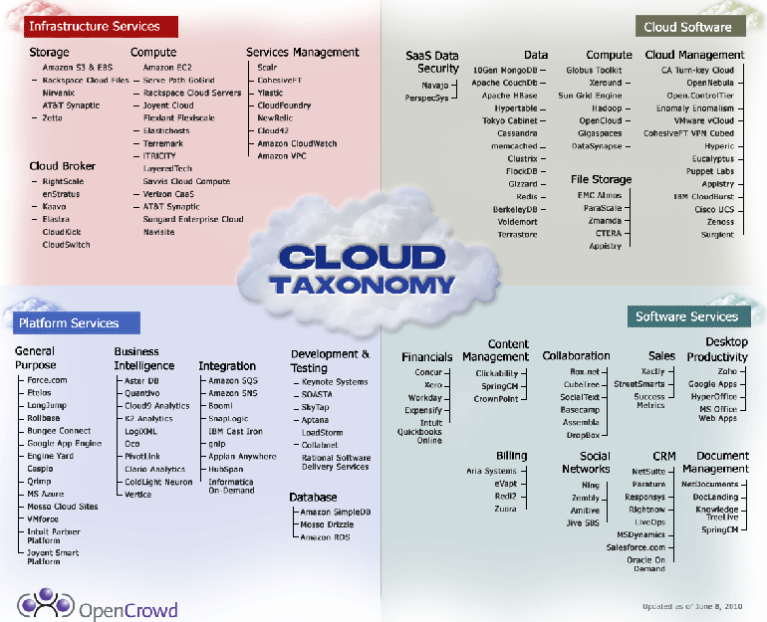
Cloud Computing Commercial Taxonomy
Notes:
http://www.opencrowd.com/assets/images/views/views_cloud-tax-lrg.png

Slide 67
Other Cloud Definitions
“Cloud computing is an emerging approach to shared infrastructure in which large pools of systems are linked together to provide IT services.”
– IBM press release on “Blue Cloud”
“…a hosted infrastructure model that delivers abstracted IT resources over the Internet”
– Thomas Weisel Partners LLC from “Into the Clouds: Leveraging Data Centers and the Road to Cloud Computing”
“Cloud computing describes a systems architecture. Period. This particular architecture assumes nothing about the physical location, internal composition or ownership of its component parts.”
– James Urquhart blog post

Slide 68
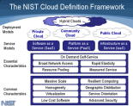
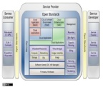
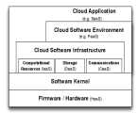
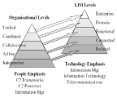
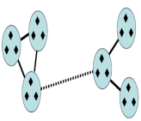
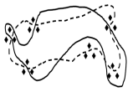
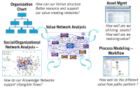
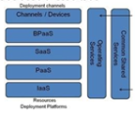



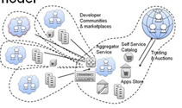




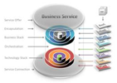
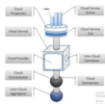
Scope of what I’m focusing on..
I am just looking at one model view of Cloud Architecture for business users.
But will talk about the scope of models for different stakeholders to put in context
Industry
NIST, Google UCs ,UC-SB
System of Systems Interoperability SOSi
Levels of System interoperability
LiSi
System of Systems
SOSI and LiSi stacks DoD, NATO, C-M
Value Network Analysis..
Ideas
A Cloud User Notation

Slide 69
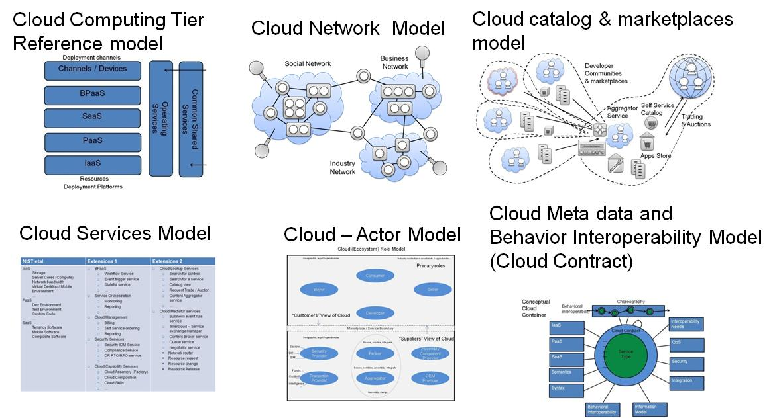
What a Cloud Computing Reference Architecture CCRA might contain ?

Slide 70
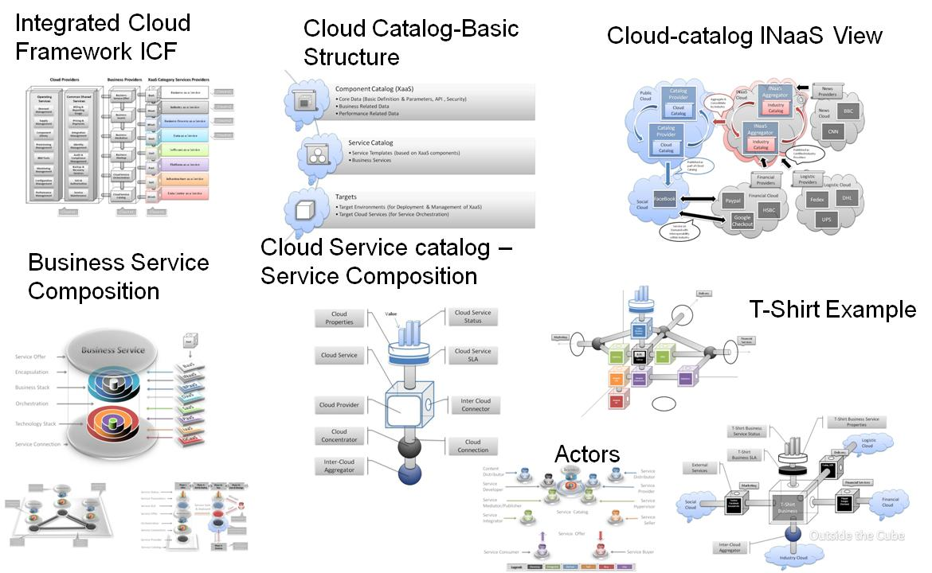
What a Cloud Computing Reference Architecture CCRA might contain ?

Slide 71
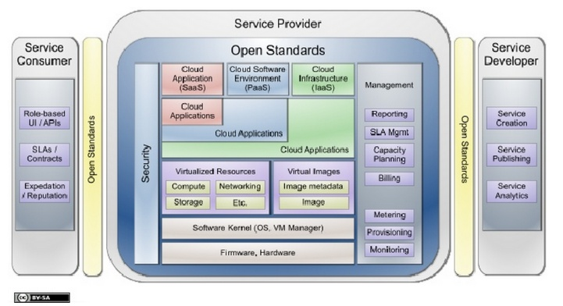
Google Hosted Cloud Computing Taxonomy
http://www.scribd.com/doc/18172802/Cloud-Computing-Use-Cases-Whitepaper

Slide 72

“Towards a Unified Ontology of Cloud Computing” – University of California, Santa Barbara & IBM T.J. Watson Research center
http://freedomhui.com/wp-content/uploads/2010/03/CloudOntology.pdf
Note: The T.J. Watson reference here – see Tim O’Reilly & Clay Shirky Reference
to Thomas J. Watson crica 2001 & 2009)

Slide 73
Cloud Computing
Cloud Computing Platform APIs – Google
  Developers have a wide range of platforms to choose from in creating cloud-based applications.
    Two of the most popular platforms are Amazon's Elastic Computing Cloud (EC2) and the Google App Engine.
    In addition there are a wide variety of other platforms that have not gotten as much press, but are making traction such as SaleForce.com environment.
  Google App Engine
  Google's offering is similar to Amazon, but it does not provide a set of standalone services like Amazon's S3 for storage, EC2 for hosting. The Google offering bundles everything into one package.
  One of the downsides of the Google App engine is that developers are limited to Python, although Google plans to add other programming languages in the future.

Slide 74
Cloud Computing
Cloud Computing Platform APIs – Amazon
  Amazon's EC2 is a commercial service that allows companies to rent computers to run their own computer applications. Customers rent out virtual machines through a web services interface. These can be launched and terminated on demand. The platform uses Xen virtualization of one of three sizes ranging from 1.7 gigabytes to 7.5 gigabytes of memory and 850 gigabytes of storage.
  Amazon Web Services Main Site
  Contains news and links to tutorials and white papers for getting started with running your own AWS applications.
  The main Amazon Web Services include:
  Amazon Elastic Compute Cloud (EC2)
  Amazon Simple Storage Service (S3)
  Amazon Simple Queue Service (SQS)
  Amazon Mechanical Turk (Mturk)
  Alexa Web Services for providing traffic data
  Amazon SimpleDB

Slide 75
Cloud Computing
Cloud Computing Platform APIs – Microsoft
  Microsoft’s Azure is a "cloud services operating system". Specifically, it is intended to be a single platform providing complete cloud-based development, hosting, and management services.
  Something to keep in mind is that Azure is merely the lowest level of Microsoft's cloud computing framework. On top of Azure will be components such as SQL Services, Live Services, .NET Services (Workflow and Identity), SharePoint, and Dynamics CRM.
  Azure abstracts the underling hardware away from the application using what they call the "Fabric Controller".
    The Fabric Controller, which works at the service level, relies heavily on Service Models.
    These XML fragments describe each service in terms of permissions, endpoint, and configuration.
    Azure supports low-level concepts such as blobs, tables, queues, and locks, all of which are virtualized by Azure and the Fabric Controller.

Slide 76
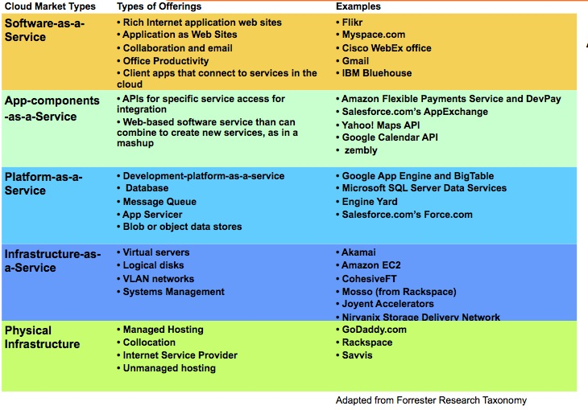
Details and Examples of Cloud

Slide 77
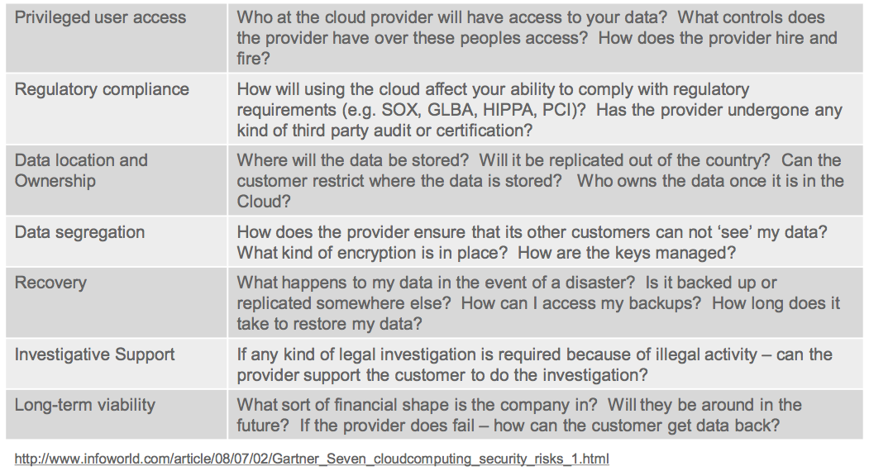
Considerations & Risks

Slide 78
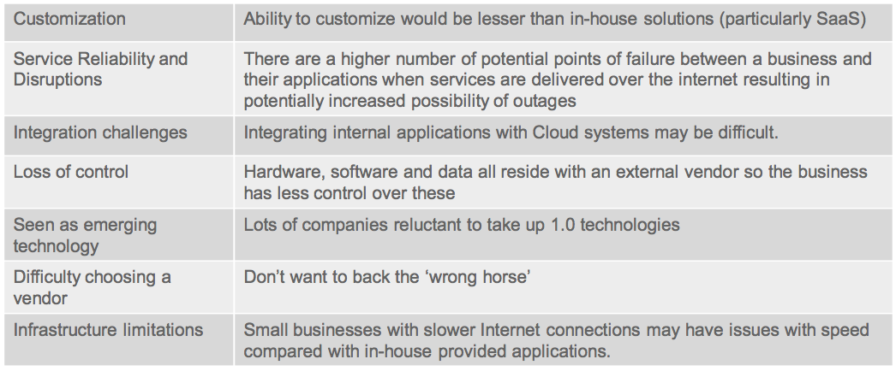
Considerations & Risks - Other

Slide 79
Considerations – Confidentiality & Privacy
Risk Factors:
  Data stored, transmitted and processed outside the organization
  Shared computing environments
  Loss of physical control of data
  Physical and logical access managed by provider
  Limited information about provider personnel
Mitigation Techniques:
  Separation of user directories and access control
  Encryption
  Key Management
  Define standards
  Procedural reviews
  Access Control reviews

Slide 80
Considerations – Data Segregation
Risk Factors:
  Shared computing environments
  Lack of segmentation
  Geographical residence of data
  One compromised system could affect another
Mitigation Techniques:
  Encryption
  Key Management
  Logical segregation
  Firewalls, routers, ACLs
  Info Classification
  Isolation of data

Slide 81
Considerations – Data Integrity
Risk Factors:
  Lack of controls to prevent data modification
  Undetected modification of data
  Incorrectly implemented encryption leading to data corruption
Mitigation Techniques:
  File integrity, logging and monitoring
  Digital signatures
  Periodic review of data
  Redundancy and error recovery
  Error checking and correcting codes
  Encryption

Slide 82
Considerations – Availability
Risk Factors:
  Network connectivity required
  Transmission of data over ‘noisy’ channels
  Increased potential points of failure
  Limited ability to control changes
  Reliance on provider DR
  Viability of provider is not assured
Mitigation Techniques:
  RTO’s in SLA
  Network availability in ISP SLA
  Diversify replication
  Formal CCP
  Multiple provider use
  Plan for data retrieval
  Error correction systems
  Caching to address latency

Slide 83
Considerations – Regulatory Compliance
Risk Factors:
  Data transmitted and stored
  Information subject to new laws
  Foreign governments
  Different retention requirements
  Audits of provider
  Increased complexity to comply
Mitigation Techniques:
  Limit storage to specific countries
  Contractual commitment to obey privacy laws
  Security certifications of provider
  External reviews (PCI, SAS70)
  Limit data types / classification

Slide 84
5 key Business Benefits of a User driven Cloud viewpoint
Monetizing cloud services
  It is currently an area of adoption question; “how much do cloud services cost my business?”. Defining a way to show individual services and their common shared service or incremental growth could help accelerate an adoption profile where users understand the cost of service better.
Visualizing the real cloud
  Cloud is already here, we everyday see the email, video feeds, web sites and tweets. Business needs a way of describing this from that perspective so that we can accelerate the meaning full integration and adoption of cloud into everyday experience.
Defining a clear Customer experience
  Probably the biggest affect on everyday lives has been the attention span and impact on people and business through on-demand and real-time exchange of messages and content enabled by an increasing social and dynamic network of services that can be described as “the cloud”. Showing this experience and how this changes in a “mash-up”, on-demand world would greatly improve the real world representation of consumer choice , the self-service “menus” and “portfolios” open to business.
Describing who has ownership of Security Risk in the cloud
  The greatest impediment to cloud is probably the risk and security aspects of the data, location and control of services. Defining a user location perspective of security protection points would greatly enhance the provider conditions to address those critical concerns.
Defining how to monitoring Quality of Service QoS in the cloud
  Overall how the service level performance monitoring and disaster recovery aspects of the cloud service needs to be shown in a heterogeneous context. Many enterprise level SLAs need OLAs that are representative of business level QoS standards, how multiple service monitoring and management systems need to be position on the provider side and the consumers side. A methodology that helps clarify this “ownership of responsibility” would be a great benefit in definition a clear boundary of service trading and exchange.

