Slide 1
Virtualizing Network Functions
Matt Falkner, Distinguished Engineer, Technical Marketing
Cisco
mfalkner@cisco.com
March 27, 2018

Slide 2
Agenda
Introduction & Motivation
Deployment Models and Characteristics
The Building Blocks of Virtualization (today)
Virtualization Trade-offs and Research Topics
Conclusion

Slide 3
Glossary
Abbreviation | Description | Abbreviation | Description | Abbreviation | Description
ACL | Access Control List | CFS | Completely Fair scheduler | DPM | Distributed Power Management
ANCP | Access Node Control Protocol | CFS | Customer Facing Services | DRS | Dynamic Resource Scheduling
ARP | Address Resolution Protocol | CGN | Carrier Grade NAT | DSCP | DiffServe code Point
ASA | Application Security Appliance | CLI | command Line Interface | Eap | Extensible Authentication Protocol
AVC | Application Visibility & Control | CM | Chassis Manager (in IOS XE) | EOAM | Ethernet OAM
BFD | bi-directional Forwarding detection | CoA | RADIUS Change of Authorization | ESA | Email Security Appliance
BPDU | Bridge Protocol Data Unit | COS | Class of Service | ESC | Elastic Services Controller
BRAS | Broadband Remote Access Server | COTS | Common off-the-shelf | ESXi | VMWare hypervisor
BSS | Business support system | CPS | Calls per second | EVC | Ethernet Virtual Circuit
CAPEX | Capital Expenditures | DC | Data Center | F/D/C | Fibre / DSL / Cable
CDP | Cisco Discovery Protocol | DCI | Data Center Interconnect | FFP | Fast Forwarding Plane (data plane in IOS XE)
CE | Carrier Ethernet | DHCP | Dynamic host configuration Protocol | FLR | Frame Loss Rate
CE | Customer Edge | DNS | Domain Name System | FM | Forwarding Manger (in IOS XE)
CEF | Cisco Express Forwarding | DPDK | Data Path Development Kit | FSOL | First Sign of life
CFM | Configuration and Fault Management\ | DPI | Deep Packet Inspection | FT | Fault Tolerance

Slide 4
Glossary
Abbreviation | Description | Abbreviation | Description | Abbreviation | Description
FW | Firewall | IPoE | IP over Ethernet | LRO | Large Receive Offload
GRE | Generic Route Encapsulation | IPS | Intrusion Prevention System | MC | PfR Master Controller
GRT | Global routing table | IRQ | Interrupt Request | MP-BGP | Multiprotocol BGp
GSO | Generic Segmentation Offload | ISG | Intelligent Services Gateway | MPLS EXP | Multi Protocol Label Switching EXP field
GTm | Go-to-market | ISG TC | ISG Traffic class | MS/MR | LISP Map Server / Map Resolver
HA | High Availability | IWAN | Intelligent WAN (Cisco Solution) | MSP | Managed Service Provider
HQF | Hierarchical Queueing Framework | KSM | kernel same-page merging | MST | Multiple Spanning Tree
HQOS | Hierarchical QOS | KVM | Kernel Virtual Machine | NAT | Network Address Translation
HSRP | Hot Standby Routing Protocol | L2TPv2 | Layer 2 Transport Protocl version 2 | NB | Northbound
HT | Hyperthreading | LAC | L2TP Access Concentrator | NE | Network Element
HV | Hypervisor | LAG | Link Aggregation | NF | netflow
I/O | Input / Output | LB | Loadbalancer | NfV | Network Function Virtualization
IDS | Intrusion Detection System | LCM | Life-cycle manager (for VNFs) | NFVI | NFV Infrastructure
IP SLA | IP Service Level Agreements | LNS | L2TP Network Server | NFVO | NFV Orchestrator
IPC | inter-process communication | LR | Loss Rate | NIC | network Interface card

Slide 5
Glossary
Abbreviation | Description | Abbreviation | Description | Abbreviation | Description
NID | Network Interface Device | PnP | Plug and Play | RSO | Receive Segmentation Offload
NSO | Network Services Orchestration | POF | Prime Order Fulfilment | Rx | Receive
NUMA | non-uniform memory access | PoP | Point of presence | SB | Southbound
NVRAM | non-volatile Random Access Memory | PPE | Packet Processing Engine | SBC | Session Border Controller
OAM | Operations, administration and maintenance | PPS | Packets per Second | SC | Service chaining
OPEX | Operational Expenditures | PSC | Prime Services Catalog | SDN | Software Defined Networking
OS | OpenStack | PTA | PPP termination and Aggregation | SF | Service Function (in SFC Architecture)
OSS | Operations support System | PW | Pseudowire | SFC | Service Function Chaining
OVS | Open Virtual Switch | PxTR | Proxy Tunnel Router (LISP) | SFF | Service Function Forwarder (in SFC Architecture)
PBHK | Port Bundle host key (ISG feature) | QFP | Quantum Flow Processor ( | SGT | Security Group Tag
PE | Provider Edge | QOS | Quality of Service | SIP | SPA Interface Processor
PF | Physical Function (in SR-IOV) | RA | Remote Access | SLA | service level agreement
PfR | Performance Routing | REST | Representational State Transfer | SLB | Server Loadbalancing
PMD | Pull mode driver | RFS | Resource Facing Services | SMB | small and medium Business
pNIC | Physical NIC | RR | Route Reflector | SNMP | Simple Network Management Protocol

Slide 6
Glossary
Abbreviation | Description | Abbreviation | Description | Abbreviation | Description
SP | Service Provider | VM | Virtual Machine | WAN | Wide Area Network
SPA | Shared Port Adapter | vMS | Virtual Managed Services | WLAN | Wireless LAN
SR-IOV | single Root I/O virtualization | VNF | Virtual Network Function | WLC | Wireless LAN Controller
TCO | Total Cost of Ownership | VNFM | VNF Manager | WRED | weighted random Early Detection
TOS | Type of Service | vNIC | virtual NIC | ZBFW | Zone-based firewall
TPS | transparent page sharing | VPC | Virtual Private Cloud | ZTP | Zero touch provisioning
TSO | TCP Segmentation Offload | vPE-F | virtual PE Forwarding instance
TTM | Time-to-market | VPLS | Virtual Private LAN service
UC | Unified communication | VPN | Virtual Private Network
vCPE | virtual CPE | VRF | virtual routing and forwarding
vCPU | virtual CPU | vSwitch | virtual Switch
VF | virtual Function (in SR-IOV) | VTC | Virtual Topology controller
vHost | virtual host | VTF | Virtual Topology Forwarder
VIM | Virtual Infrastructure Managers | VTS | Virtual Topology System
VLAN | virtual Local area network | WAAS | Wide Area Application Services

Slide 7
Assumptions
Familiarity with IP-based networking
  Routing, MPLS,
  Switching
  Control plane protocols
  Broadband communication: DSL, Cable
  Data Center architectures
No details on
  Optical network design
  Packet manipulation functions: NAT, Firewalls, Encryption

Slide 8
Introduction and Motivation

Slide 9
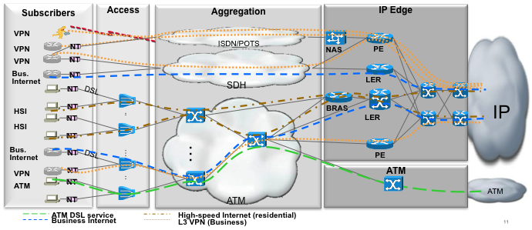
A Typical SP Architecture (back in 2005)
Subscribers | AN | Agg1 | Agg2 | Agg3 | BNG/NAS | LER/PE | P
Locations | 200,000 | 4000 | 500 | 74 | 74 | ~1000 | 296
BW Demand/system | O(100) Mbps | 1-10 Gbps | 10 Gbps | 10 Gbps | 1-5 Gbps | 40 Gbps | 40Gbps
Notes:
9
Initially sparse customer take rates
Faster roll-out in coverage
Subnetting and IP address pool utilization
Reuse of SDH infrastructure
Internet Access “Star Aggregation” traffic dominance
Similar to centralized dial paradigm
Conservative growth assumptions
Availability of IP Operations Expertise

Slide 10
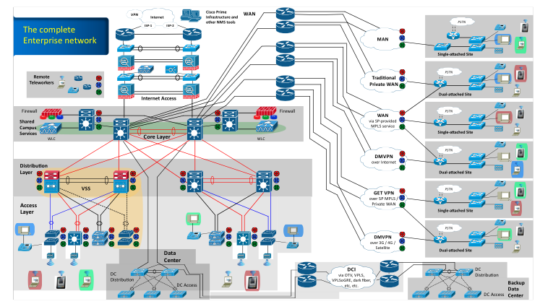

Slide 11
Network Architecture Cost Factors
Goal is to minimize overall Total Cost of Ownership (TCO) related to the deployment and operation of a broadband aggregation network delivering quad-play services
Min Σ CapEx(services, time) + Σ OpEx(services, time)
    s.t. Traffic flows <= Link Capacity
    Traffic flows <= Node capacity
    Node Capacities >= Number of subscribers
    ….
Note: not just minimization of initial CapEx at time t=0!
Also minimization of OpEx and expansion CapEx
  Assumes a timeframe t
  Need to take subscriber and traffic growth into account
CapEx Variables
OpEx Variables
Network equipment
  BNG, DSLAMs, PON…
Servers for each service
  SIP, RACS, RADIUS, Softswitches, Gateways…
Link Costs
Real Estate
Power: network, servers
  SIP, RACS, RADIUS, Softswitches, Gateways…
  BNG, DSLAMs, PON…
Real estate
Labour and Maintenance
  OSS Changes, Cutover
Management Costs

Slide 12







Certification and Operational Expenses
Hardware certification
  Many Vendors
  Different hardware Architectures
  Many modules
Software certification
  Vendor specific software
  Patches
  New Functionalities
Branch
Branch
Branch
Branch
Internet
Branch
WAN
Campus / DC
Cloud

Slide 13
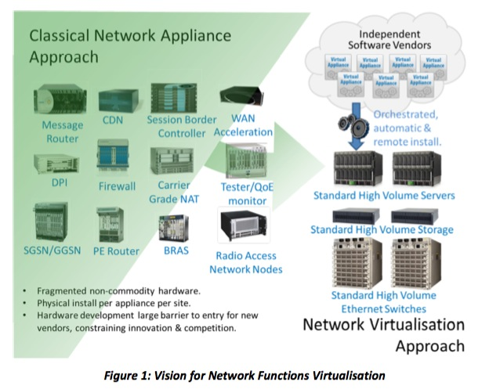
Network Functions Virtualization (NFV)
Announced at SDN World Congress, Oct 2012
AT&T
BT
CenturyLink
China Mobile
Colt
Deutsche Telekom
KDDI
NTT
Orange
Telecom Italia
Telstra
Verizon
Others TBA…

Slide 14
What is NfV? A Definition
…
NFV decouples the network functions such as NAT, Firewall, DPI, IPS/IDS, WAAS, SBC, RR etc. from proprietary hardware appliances, so they can run in software.
…..
It utilizes standard IT virtualization technologies that run on high-volume servers, switch and storage hardware to virtualize network functions..
…..
It involves the implementation of network functions in software that can run on a range of industry standard server hardware, and that can be moved to, or instantiated in, various locations in the network as required, without the need for installation of new equipment.
Service
Orchestration
SDN
X86 compute
NFV
Sources:
https://www.sdncentral.com/which-is-better-sdn-or-nfv/
http://portal.etsi.org/nfv/nfv_white_paper.pdf
Notes:
Network function virtualization
De-couple the network function from the hardware
Its just software, so why does it need to run on a dedicated hardware device
Server resources need to be integrated with AD
Server resources need to be available to the server admins
UCS-E part of Vmware domain?
Don’t mix application server resources with networking function resources
Different requirements
Key Enabler: Cloud technology
Hypervisor & x86 compute hardware
Network Programmability APIs
Network Automation / Orchestration

Slide 15
Enterprise Motivation for Virtualizing Network Functions
CAPEX
Deploy on standard x86 servers
Economies of scale
Service Elasticity – deploy as needed
Simpler architectural paradigm
  HA still needed?
Best-of-breed
OPEX
Reduction of number of network elements
Reduction of on-site visits
  Deployment of standard on-premise hardware
  Simplification of physical network architecture
Leveraging Virtualization benefits
  Hardware oversubscription, vMotion, ..
Increased potential for automated network operations
Re-alignment of organizational boundaries

Slide 16
Deployment Models and Characteristics

Slide 17
The Top 5 use-cases for Enterprise Virtualization

Slide 18





1. Branch Virtualization
FROM
TO
Branch
Branch
Email Sec.
Web Sec.
X86 host
WAAS
UC
FW
Email Sec.
Web Sec.
WAAS
UC
FW
LAN
LAN
Enterprise Fabric
Enterprise Fabric
Branch virtualization attractive due to sheer number of branches
Very different environment to DC!
  Cost sensitive, often no on-site support, ..
Notes:
Example:
Bank Leumi
RBC mobile banking

Slide 19
2. Connecting to Apps in the Cloud!
Enhancing network functionality to
reach cloud-based applications
Support for Amazon AWS,
Microsoft Azure, AliCloud etc.
Notes:
Cisco CSR 1000v for VPC & remote worker connectivity
vWAAS, vIPS/IDS, vASA
Leverage SSLVPN access via Anyconnect, IPSec (e.g. IWAN)

Slide 20


3. Virtualization helps the move to multi-cloud
VPCs
CoLo
AWS
LB
LB
WAAS
WAAS
IPS
Apps
IPS
Enterprise Fabric
NFVIS
Apps
LB
WAAS
Apps increasingly live in multiple clouds
  Cloud provider Independence
  SaaS
CoLo Virtualization facilitates multi-CP connectivity
IPS
Apps
Notes:
Example: BP, Barclays

Slide 21
4. Thin Branches and MSP Virtualization
Thin Branch
SP PoP - vCPE
LB
WAAS
IPS
Thin CPE
NFI/NFVIS
Many MSPs are already offering virtualized CPE services
  AT&T
  NTT-E: https://newsroom.cisco.com/press-release-content?type=webcontent&articleId=1896371&dtid=osscdc000284
Remove complexity (Functions) from the branch
Leverage virtualization in the SP Data Center / PoP to add services
Notes:
Example: NTT-E
Anecdote:
- Layer 2 CPE

Slide 22
5. The obvious place to virtualize - Control Plane Functions
WAN Fabric
 | ASR1001 & ASR1002-X (8GB) | ASR1001 & ASR1002-X (16GB) | CSR1000v (8GB) | CSR1000v (16GB) | RP2 (8GB) | RP2 (16GB)
ipv4 routes | 7M | 13M | 8.5M | 24.8M | 8M | 24M
vpnv4 routes | 6M | 12M | 8.1M | 23.9M | 7M | 18M
ipv6 routes | 6M | 11M | 7.4M | 21.9M | 6M | 17M
vpnv6 routes | 6M | 11M | 7.3M | 21.3M | 6M | 15M
BGP sessions | 4000 | 4000 | 4000 | 4000 | 8000 | 8000
Shared Services
vWLC
vRR
vMS/MR
vMC
Campus Fabric
Route Reflectors, PfR MC, LISP MS/MR, WLC…
Notes:
Can be on-premise or in larger Enterprise WAN PoPs or in the cloud
Assuming VNFs are reachable by IP
CSR 1000v offers functional and operational consistency
Virtualized IOS XE

Slide 23
The Building Blocks of Virtualization (Today)

Slide 24

The 4 Layers of a virtualized System Architecture
4
Automation / Orchestration (DNA Center, NSO)
3
Virtual Router
(ISRv,CSR)
Virtual Firewall
(ASAv, NGFWv)
Virtual WAN Optimization (vWAAS)
Virtual Wireless LAN Controller (vWLC)
3rd Party VNFs
2
Network Functions Virtualization Infrastructure Software (NFVIS)
1
ISR 4000 +
UCS E-Series
CSP-2100 /
UCS C-Series
Enterprise Network Compute System

Slide 25
A System Architecture View with 3 VNFs
X86 Server
VM¹(4vCPU CSR 1000v)
VM²(1vCPU CSR 1000v)
CSR
IOS
Fman / CMan
PPE
PPE
HQF
Rx
IRQ¹
vNIC₁¹
vNIC_{n}¹
VM Linux¹
CSR
Pkt Scheduler
IOS
VM³ (2vCPU CSR 1000v)
Fman / CMan
PPE
HQF
Rx
IRQ²
vNIC₁²
vNIC_{n}²
VM Linux²
Example: 3 CSR VMs scheduled on a 2-socket 8-core x86
  Different CSR footprints shown
Type 1 Hypervisor
  No additional Host OS represented
HV Scheduler algorithm governs how vCPU/IRQ/vNIC/VMKernel processes are allocated to pCPUs
Note the various schedulers
  Running ships-in-the-night
Guest OS Scheduler
Pkt Scheduler
CSR
IOS
Fman / CMan
PPE
HQF
Rx
IRQ³
vNIC₁³
vNIC_{n}³
VM Linux³
Guest OS Scheduler
vCPU₀¹
vCPU₁¹
vCPU₂¹
Pkt Scheduler
vCPU₃¹
Guest OS Scheduler
vCPU₀²
vCPU₀³
vCPU₁³
Process Queue
vSwitch
vCPU₁²
vCPU₀³
Host Linux
vNIC_{n}²
VM Kernel¹
HV Scheduler
Socket₀
Socket₁
pCPU₀
pCPU₁
pCPU₂
pCPU₃
pCPU₀
pCPU₁
pCPU₂
pCPU₃
pCPU₄
pCPU₅
pCPU₆
pCPU₇
pCPU₄
pCPU₅
pCPU₆
pCPU₇
I/O
I/O
Memory
Storage
Memory
I/O
I/O
Notes:
NOT SHOWN: LINUX CONTAINER, WEB SERVER
Thread: schedulable entity
Linux process: one or more threads
CP: group of processes
DP: one process with PPE threads, HQF thread, Rx thread

Slide 26
ETSI NfV Reference Architecture
NFV Management and Orchestration
Management
Os-Ma
Orchestrator
Orchestration
OSS/BSS
Service, VNF and Infrastructure Description
Se-Ma
Or-Vnfm
Virtual Network Functions
EMS 1
EMS 2
EMS 3
Ve-Vnfm
VNF
Manager(s)
VNF 1
VNF 2
VNF 3
Or-Vi
NFVI
Vn-Nf
Vi-Vnfm
Hypervisor
Virtual Computing
Virtual Storage
Virtual Network
Virtualised
Infrastructure
Manager(s)
Virtualisation Layer
Nf-Vi
Vl-Ha
Hardware resources
Compute Hardware
Computing
Hardware
Storage
Hardware
Network
Hardware
Execution reference points
Other reference points
Main NFV reference points
Notes:
THIS IS LOGICAL/FUNCTIONAL ARCHITECTURE! These are just functional blocks, it does not represent any specific implementation.

Slide 27
Hypervisors

Slide 28
CSR 1000v and Hypervisor Processing
X86 Server
VM¹(4vCPU CSR 1000v)
VM²(1vCPU CSR 1000v)
CSR
IOS
Fman / CMan
PPE
PPE
HQF
Rx
IRQ¹
vNIC₁¹
vNIC_{n}¹
VM Kernel¹
VM³ (2vCPU CSR 1000v)
CSR
IOS
Fman / CMan
PPE
Pkt Scheduler
HQF
Rx
IRQ²
vNIC₁²
vNIC_{n}²
VM Kernel²
CSR
Example: 3 CSR VMs scheduled on a 2-socket 8-core x86
  Different CSR footprints shown
Type 1 Hypervisor
  No additional Host OS represented
HV Scheduler algorithm governs how vCPU/IRQ/vNIC/VMKernel processes are allocated to pCPUs
Note the various schedulers
  Running ships-in-the-night
Pkt Scheduler
Guest OS Scheduler
IOS
Fman / CMan
PPE
HQF
Rx
IRQ³
vNIC₁³
vNIC_{n}³
VM Kernel³
Guest OS Scheduler
vCPU₀¹
vCPU₁¹
vCPU₂¹
Pkt Scheduler
vCPU₃¹
Guest OS Scheduler
vCPU₀²
vCPU₀³
vCPU₁³
Process Queue
vSwitch
vCPU₁²
vCPU₀³
HV Kernel
vNIC_{n}²
VM Kernel¹
Linux
HV Scheduler
Socket₀
Socket₁
pCPU₀
pCPU₁
pCPU₂
pCPU₃
pCPU₀
pCPU₁
pCPU₂
pCPU₃
pCPU₄
pCPU₅
pCPU₆
pCPU₇
pCPU₄
pCPU₅
pCPU₆
pCPU₇
Memory
Storage
Memory
Notes:
NOT SHOWN: LINUX CONTAINER, WEB SERVER
Thread: schedulable entity
Linux process: one or more threads
CP: group of processes
DP: one process with PPE threads, HQF thread, Rx thread

Slide 29

Hypervisors vs. Linux Containers
Containers share the OS kernel of the host and thus are lightweight.
However, each container must have the same OS kernel.
Containers are isolated, but share OS and, where appropriate, libs / bins.
Type 1 Hypervisor
Type 2 Hypervisor
Linux Containers (LXC)
Virtual Machine
Virtual Machine
App
App
App
App
Virtual Machine
Virtual Machine
App
App
App
App
Bins / libs
Bins / libs
Container
Container
Operating System
Operating System
App
App
App
App
Bins / libs
Bins / libs
Operating System
Operating System
Bins / libs
Hypervisor
Bins / libs
Hypervisor
Operating System
Operating System
Hardware
Hardware
Hardware

Slide 30
I/O Architecture

Slide 31
Virtualizing I/O – KVM Architecture Example
Hypervisor virtualizes the NIC hardware to the multiple VMs
Hypervisor scheduler responsible for ensuring that I/O processes are served.
There is a single instance of physical NIC hardware, including queues, etc.
  many to one relationship between the VM’s vNIC and the single physical NIC
One vHost/VirtIO thread used per configured interface (vNIC)
May become a bottleneck at high data rates

Slide 32
I/O Optimizations: Single Root IO Virtualization - SR-IOV with PCIe pass-through
Allows a single PCIe devices to appear to be multiple separate PCIe devices
  NIC supports virtualization
Enables network traffic to bypass software switch layers
Creates physical and virtual functions (PF/VF)
  PF: full featured PCIe
    VF: PCIe without configuration resources
    Each PF/VF gets a PCIe requestor ID s.t. IO memory management can be separated between different VFs
    Number of VFs dependent on NIC (O(10))
Ports with the same (e.g. VLAN) encap share the same L2 broadcast domain
Requires support in BIOS/Hypervisor
Notes:
http://www.intel.com/content/dam/doc/application-note/pci-sig-sr-iov-primer-sr-iov-technology-paper.pdf
http://blog.scottlowe.org/2009/12/02/what-is-sr-iov/
http://msdn.microsoft.com/en-us/library/windows/hardware/hh440148(v=vs.85).aspx
VF – Virtual Function ( SR-IOV spec ) – passes packets
PF – Physical Function ( SR-IOV spec ) – controls sorter; typically allows specification of encaps for each VF, under control of e.g. Openstack’s networking functions ( Quantum plugin )
Ports with the same (e.g. VLAN) encap share the same L2 broadcast domain

Slide 33
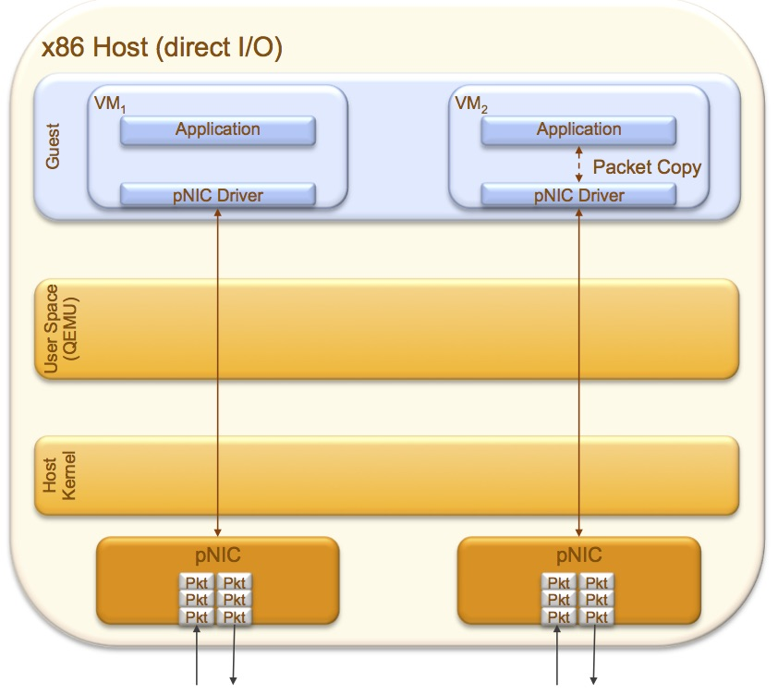
I/O Optimizations: Direct-map PCI (PCI pass-through)
Physical NICs are directly mapped to a VM
  Bypasses the Hypervisor scheduler layer
  PCI device (i.e. NIC) no longer shared among VMs
  Typically, all ports on the NIC are associated with VM
    Unless NIC supports virtualization
Caveats:
  Limits the scale of the number of VMs per blade to ‘number of physical NICs per system’
  Breaks live migration of VMs
Notes:
http://www.ibm.com/developerworks/linux/library/l-pci-passthrough/

Slide 34
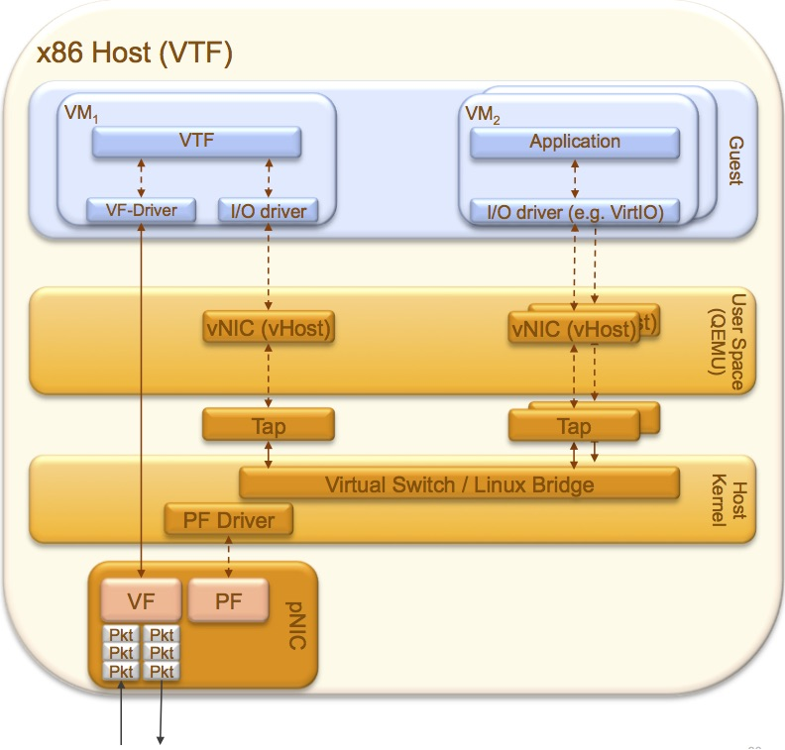
Hypervisor Traversal Tax: Example KVM with OVS
KVM with OVS consumes a vHost thread per configured VM interface
The vHost thread is very CPU intensive, requires dedicated physical core
On 16-core server, can only get 3 CSR1000v (2vCPU, 2 i/f each)
  Cores for CSR: 6
  Cores for vPE-F: 2
  Cores for vHost: 6
  Free: 2
Should be considered when service chaining
May not be fully utilized!
Hypervisor traversal tax = 8/16 = 50%

Slide 35
Packet Path from Physical Interface into VNF
Packet feature processing
x86 Host (FD.io VPP)
Guest User
VM₁
..
VM_{n}
Packet moved to VNF
CSR 1000v
CSR 1000v
Why does this matter?
Illustrates contention of shared resources
Each packet move consumes resources
Packet pointer buffers have limited depth
  can cause drops
VNF interrupted, packet pointer passed to buffer
DPDK-VirtIO
DPDK-VirtIO
Guest Kernel
Host User /Qemu
vHost-user notified
vNIC
(vHost_user)
Shared Pkt Mem
vNIC
(vHost_user)
Pkt
Pkt
Pkt
Pkt
Pkt
Pkt
Pkt
Pkt
VPP kicked, switching packet
FD.io VPP
Host Kernel
pNIC Driver
Ptr
Packet copied into Memory
pNIC
Pkt
Pkt
Pkt
Pkt
Pkt
Pkt
Pkt
Pkt
Pkt
Pkt
Pkt
Pkt
Packet Arrival
Traffic Generator
Pkt
Notes:
Packet arrives on physical interface (Interrupt)
Gets cut through to shared memory (Packet copy)
VPP gets notified about packet arrival
VPP processes packet (e.g. switching)
Related vHost-User gets notified about packet arrival (interrupt)
VNF DPDK-Virtio gets kicked
VNF processes packet (pointer access or packet copy) in order
VNF modifies packet in shared memory
Same process in reverse in egress direction

Slide 36
Virtualization Trade-Offs and Research Topics

Slide 37
Main Trade-off and Research Areas
Cost of Virtualization solution as a function of performance
Trading-off performance for virtualization flexibility
  Tuning performance may impact virtualization elasticity
Architectural Considerations
  Capacity planning Service Function Chains?
  Orchestration solution?
  High-Availability requirements?
CAPEX / OPEX
Performance
Architecture

Slide 38
Cost / Performance Trade-offs
CAPEX Viability for virtualization may require a minimum VM-packing density on a server
  How many VMs can be deployed simultaneously to achieve a certain CAPEX goal?
  Particularly applicable for Cloud deployment architectures
What are cost effective deployment models?
  Mixing of application VMs and VNFs on the same hardware?
  Single-tenant / Multi-tenant?
  Hypervisor type?
  Hyperthreading?
  SLA guarantees and acceptable loss rates?
  High-availability requirements and architectures?
Notes:
STORY:

Slide 39
Performance Aspects for VNF Deployments

Slide 40
Performance Aspects for VNF Deployments
Unconstrained system architecture (emulated with VM-Fex)
Throughput / SLAs for VNFs are determined by a multitude of factors
  System architecture, in particular I/O
  Hypervisor type (VMWare ESXi, KVM, Microsoft HyperV, Citrix XEN..)
Throughput can be increased significantly by hypervisor tuning and the use of direct-I/O techniques
Need to determine
  How many VMs to run on a server blade
  Acceptable frame loss rates
Intra-VM Bottleneck
CSR
Performance
Guest-OS
Guest-OS
CSR
CSR
Virtio-net
Virtio-net
HV Bottleneck
Host-OS
/ KVM
Un-constrained NIC-VM Path
Qemu / vHOST
Qemu / vHOST
vSwitch Bottleneck
tap
tap
Open vSwitch
pNIC Bottleneck
PF driver
NIC
PF
layer-2 sorter / switch / classifier
x86 machine

Slide 41
Physical System Bottlenecks: Interface and Cores
Throughput can never exceed the physical interface capacity
Number of VNFs is constrained by number of cores
  Need to account for CPU cores required for system Linux
  Need to account for CPU cores for switching (I/O tax)
Physical Interface Limit: 4x10GE
  Interesting Region
Max number of VNFs per system:
Number of cores = 2 sockets * 12 cores per socket = 24
Minus: Number of cores for System = 24-2 = 22
Divided by: Number of vCPUs / VNF = 22 / 2 vCPU = 11

Slide 42
Multi-VM System Throughput: KVM CEF IMIX, XE 16.3
2vCPU CSR footprints configured for CEF
SR-IOV, VPP, OVS-DPDK outperform OVS (not shown)
  OVS maxes out below 5 Gbps
    Implies that for each VM addes, average throughput for ALL VMs drops
SR-IOV is near linear up to physical interface bandwidth
x86 Host | Cisco UCS C240 M4 Series: 2 Sockets Intel Xeon E5-2699v3 2.3 GHz with 18 cores each, 262GB RAM
Physical Interfaces | 1 NIC with 2 x 10GE ports; Intel X520-DA2 NIC
Hyperisor | Redhat KVM version 7.2; Linux kernel 3.10.0- 327.18.2.el7.x86 64; Libvirt 1.2.17; QEMU version 2.3.0
I/O Paths | OVS version 2.4.0 , Cisco FD.io VPP release 16.06, configured for 3 cores

Slide 43
Multi-VM System Throughput: KVM CEF 128B, XE 16.3
2vCPU CSR footprints configured for CEF
128B packets -> slope of benchmark shallows
  SR-IOV again near-linear
  VPP linear up to 3 VMs
  VPP, OVS-DPDK always can reach 5 Gbps per server
1500B: very steep benchmark
  Can hit physical limit with 2 VMs
x86 Host | Cisco UCS C240 M4 Series: 2 Sockets Intel Xeon E5-2699v3 2.3 GHz with 18 cores each, 262GB RAM
Physical Interfaces | 1 NIC with 2 x 10GE ports; Intel X520-DA2 NIC
Hyperisor | Redhat KVM version 7.2; Linux kernel 3.10.0- 327.18.2.el7.x86 64; Libvirt 1.2.17; QEMU version 2.3.0
I/O Paths | OVS version 2.4.0 , Cisco FD.io VPP release 16.06, configured for 3 cores

Slide 44
Multi-VM System Throughput: KVM Features IMIX, XE 16.3
2vCPU CSR footprints configured for with NAT, Firewall, QoS and AVC
Slope of benchmark flattens as compared to CEF
  SR-IOV and VPP have nice linearity
  VPP maxes out at 10 Gbps
  OVS-DPDK maxes out at 6.7 VMs
CSR 1000v become bottleneck with feature processing
x86 Host | Cisco UCS C240 M4 Series: 2 Sockets Intel Xeon E5-2699v3 2.3 GHz with 18 cores each, 262GB RAM
Physical Interfaces | 1 NIC with 2 x 10GE ports; Intel X520-DA2 NIC
Hyperisor | Redhat KVM version 7.2; Linux kernel 3.10.0- 327.18.2.el7.x86 64; Libvirt 1.2.17; QEMU version 2.3.0
I/O Paths | OVS version 2.4.0 , Cisco FD.io VPP release 16.06, configured for 3 cores

Slide 45
Multi-VM System Throughput: KVM Features 1500B, XE 16.3
2vCPU CSR footprints configured for with NAT, Firewall, QoS and AVC
Slope of benchmark very steep with large packets
  Reaching physical interface limit with 4VMs for both SR-IOV and VPP
  OVS-DPDK results more erratic
x86 Host | Cisco UCS C240 M4 Series: 2 Sockets Intel Xeon E5-2699v3 2.3 GHz with 18 cores each, 262GB RAM
Physical Interfaces | 1 NIC with 2 x 10GE ports; Intel X520-DA2 NIC
Hyperisor | Redhat KVM version 7.2; Linux kernel 3.10.0- 327.18.2.el7.x86 64; Libvirt 1.2.17; QEMU version 2.3.0
I/O Paths | OVS version 2.4.0 , Cisco FD.io VPP release 16.06, configured for 3 cores

Slide 46
CSR 1000v 10Mbps Oversubscription
Endorsed Number of VMs
10Mbps-licensed CSR 1000v can be oversubscribed up 64 VMs under OVS
  In some cases, even more VMs can be instantiated
Assumptions:
  Sufficient memory & storage & Interfaces
  Ingress traffic <= licensed traffic
  KVM with Redhat and OVS
Holds for 1vCPU and 2vCPU footprints
Tested for stability with IPSec and NAT
  With Hyperthreading
VPP or OVS-DPDK oversubscription to be tested
Hardware: UCS B200 M4 Blade Server, 2x E5-2690 v3 Intel Xeon CPU, 12 cores, 2.6 GHz, 256 GB RAM
  Cisco VIC 1340 adapter
Host OS/Hypervisor: Red Hat Enterprise Linux 6.6 / KVM
I/O Model: VirtIO with OVS version 2.3.1
Hyperthreading turned ON in BIOS

Slide 47
SR-IOV Virtualization Caveats
The following features are not available for virtual machines configured with SR-IOV:
vSphere vMotion
Storage vMotion
vShield
NetFlow
VXLAN Virtual Wire
vSphere High Availability
vSphere Fault Tolerance
vSphere DRS
vSphere DPM
Virtual machine suspend and resu
Virtual machine snapshots
MAC-based VLAN for passthrough virtual functions
Hot addition and removal of virtual devices, memory, and vCPU
Participation in a cluster environment
Network statistics for a virtual machine NIC using SR-IOV passthrough
Notes:
https://pubs.vmware.com/vsphere-55/index.jsp?topic=%2Fcom.vmware.vsphere.networking.doc%2FGUID-E8E8D7B2-FE67-4B4F-921F-C3D6D7223869.html3869.html

Slide 48
Loss Rate Interpretation - Background
Performance results vary depending on what acceptable frame loss is defined. Typical definitions for loss rates (FLR) range from
  Absolutely 0 packets lost -> Non-drop Rate
  5 packets lost
  0.1% of PPS lost
Small relaxation of FLR definition can lead to significant higher throughput
Typically FLR Test data reported for 5 packet loss (to account for warmup) with multiple consecutive 1 minute runs

Slide 49
Number of Packets Lost in Perspective
At high-speed link rates, number of packets that may be lost may be substantial while still meeting the FLR Loss Tolerance
Maximum Throughput at Line Rate | Total Dropped Packets during Trial Duration Allowed by Loss Tolerance of 0.01% | Dropped Packet Rate allowed by Loss Tolerance (PPS)
Physical Media
10 Mbps Ethernet | 179 | 1
100 Mbps | 1,786 | 15
GE | 17,857 | 149
10GE | 178,571 | 1,488
Maximum Throughput at Line Rate | Total Dropped Packets during Trial Duration Allowed by Loss Tolerance of 0.1% | Dropped Packet Rate allowed by Loss Tolerance (PPS)
Physical Media
10 Mbps Ethernet | 1,786 | 15
100 Mbps | 17,857 | 149
GE | 178,571 | 1,488
10GE | 1,785,714 | 14,881
Notes:
2nd Column: number of packets that may be lost to stay within the loss tolerance
3rd column: lost Packet RATE to stay within the loss tolerance

Slide 50
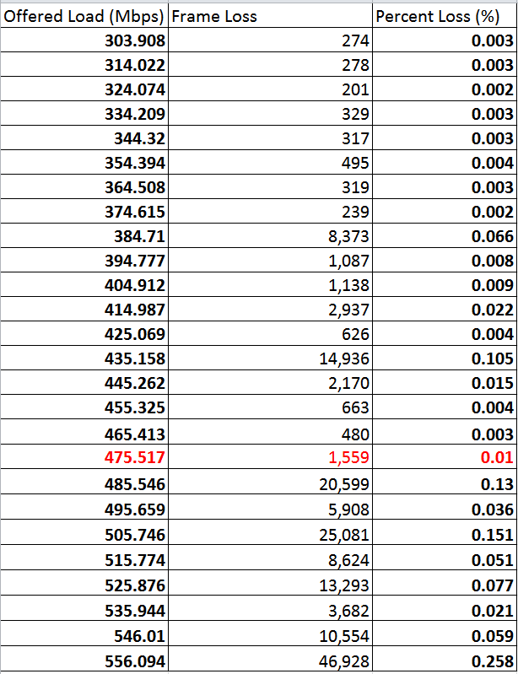
Determination of Desired Frame Loss Rate
Throughput can be affected by definition of acceptable loss rates
Tests measure % of dropped traffic for various traffic loads
  Offer traffic load -> observe loss -> reduce offered load until desired loss rate reached
BUT: Difficult to get consistent data across multiple runs.
How to interpret the right loss-rate?
Example:
  Highest rate at which LR of 0.01% appears -> 475 Mbps
  Lowest rate below which LR of 0.01% is ALWAYS observed -> 374 Mbps
  Loss rate ‘violations’ at {445, 435, 414, 384} Mbps
Sample Data

Slide 51
Architectural Considerations

Slide 52

Single-Branch vs. Multi-Branch VM Deployments
Deployment of multi-tenant VMs can significantly improve the business case
  Leverage multi-tenancy feature set in IOS XE on CSR 1000v
Leverages different footprint sizes of CSR 1000v, for example
  Deploy small footprint for single-branch & large footprint for multi-branch
BUT:
  comes with a different operational model (Need to consider multi-tenancy for on-boarding a new branch)
  Has different failure-radius implications
Branch 1
Branch 1
Branch N
WAN
DC / Cloud
Branch N
WAN
DC / Cloud

Slide 53
VNF / Service Granularity
Multi-Service
Tenancy and feature combinations two different dimensions
Single-tenant service vs. Multi-tenant services
  Different operational model
  Scaling implications
Single-service vs. Multi-feature service
  Implications on service chaining
Requirement for STATE?
  Per-user state?
  Flow state (NAT, Firewall, PPP)?
  Accounting? User-statistics?
Optimum is a f(#users, # services, provisioning, capacity..)
Single-
tenant
Multi-
tenant
Single-Service

Slide 54
Virtualization Architecture Comparison
 | Single-feature/Single-user | Multi-feature/Single-user | Single-feature/Multi-user | Multi-feature/Multi-user
# of VMs | F(#users, #services) Highest | F(# users) Medium | F(#services) Medium | F(VM capacity) Lowest
Provisioning | Orchestrating multiple VNFs for each user and then service chaining | Orchestrating a VM per user | Two-dimensional – need to monitor intra-VM capacities and HW resources | Two-dimensional – need to monitor intra-VM capacities and HW resources
Troubleshooting / Failures | Failures affect only 1 user Per-user-per-service troubleshooting | Failure affects only 1 user Per-user troubleshooting | Failure affects multiple users at the same time, but only for 1 service | Failure affects multiple users and all their services! Troubleshooting difficult
VM Capacity planning | Not required (only need to find free HW resources) | Minimal – need to determine VM size required for the feature combination | Capacity plan a service. May require VNF elasticity / loadbalancing | Difficult – need to test scale of a VNF for feature combination and number of users
Service Chaining | Required | Not required | Required | Not required
Geographic Distribution of VNFs | Yes | No – all services for a user in same VNF | Yes | No – all services for a user in same VNF
QoS / HA | QoS Configured in multiple VNFs. SFC HA costly (Detection / duplicate resources) | Can discriminate for each user within VM & between users outside VM. HA per user (increased resources) | Can discriminate traffic between VMs inside VM. | Can discriminate traffic between users inside VM.

Slide 55
Multi-tenant vCPE - Example
Multi-tenant CSR 1000v deployed for 5 Mbps ‘vanilla’ branches requiring 5 Mbps each
Single-tenant CSR 1000v deployed for high-end branches requiring 50 Mbps each
  Note that the 44 VM scenario (Profile 2) is oversubscribed, however the max bandwidth per VM requirement is only 50Mbps
 | Profile 1 (multi-tenant) 1vCPU CSR – 400 Mbps 200 VRF’s @ 5Mbps/VRF QOS, DHCP Server, Static Route, IP SLA, SNMP | Profile 2 (single-tenant) 1vCPU CSR - 50Mbps QOS, DHCP Server, OSPF, IP SLA, IGMPv2, PIM SM, SNMP, ACL2
Number of VM instances / server chassis | 20 | 44
Number of branches / VNF instance | 40 | 1
Total number of branches / server blade | 800 | 44
Total aggregate bandwidth / server chassis | 8 Gbps | 2.2 Gbps
Notes:
* Price for 1vCPU licenses assumed! Currently do not support 400 Mbps 1vCPU license, so took the price for the 500 Mbps 4vCPU license
8Gbps = 400 Mpbs / instance * 20 instances
2.2 Gbps = 50 Mbps / instance * 44 instances
Hardware: UCS C-series M3 (E5-2697 v2 x2. Each is 2.7 GHz and 12 cores, 24 threads, Memory: 16G x 16 1866 MHz, VIC 1240)
Hypervisor: VMWare 5.0
Hyperthreading turned ON
Software: early IOS XE 3.12 Engineering image

Slide 56
Conclusion

Slide 57
Key Conclusions
Network Function Virtualization is rapidly maturing and enabling first use-cases TODAY for enterprise network functions
  Virtualization of control plane functions
  Cloud-based network services
Virtualization of enterprise network functions enables new architectural approaches leading to potential CAPEX and OPEX savings
  Unclear Benefit from replacement of existing transport infrastructure solutions for the sake of it
  Orchestration and Management put into the spotlight
Architectural details both at the system and network level need to be well understood and examined
  E.g. Service Chaining

Slide 58
References
[1] KVM. Kernel virtual machine. [Online]. Available: http://wiki.qemu. org/KVM
[2] VMWare, “The cpu scheduler in vmware vsphere 5.1,” VMWare, Tech. Rep., 2013. [Online]. Available: https://www.vmware.com/files/ pdf/techpaper/VMware- vSphere- CPU- Sched- Perf.pdf
[3] Non uniform memory access (numa). [Online]. Available: https: //en.wikipedia.org/wiki/Non-uniform memory access#Basic concept
[4] C. Lameter. Numa (non-uniform memory access): An overview. [Online]. Available: https://queue.acm.org/detail.cfm?id=2513149
[5] C. Kim and K. Park, “Credit-based runtime placement of virtual ma- chines on a single numa system for qos of data access performance,” in IEEE Transactions on Computers, vol. 64, no. 6, 2015, pp. 1633 – 1646.
[6] C. Pow. What is cache trashing? [Online]. Available: https://www. quora.com/What- is- cache- thrashing
[7] X. Pu, Y. Mei, Y. Koh, and Y. Cao, “Who is your neighbor: Net i/o performance interference in virtualized clouds,” IEEE Transactions on Services Computing, vol. 6, no. 3, pp. 314–329, July-September 2013.
[8] R. Rojas-Cessa, K. Salehin, and K. Egoh, “Evaluation of switching per- formance of a virtual software router,” in 35th IEEE Sarnoff Symposium (SARNOFF), 2012, pp. 1–5.
[9] Y. Dong, X. Li, T. K., and G. H., “High performance network virtu- alization with sr-iov,” in 16th IEEE International Symposium on High Performance Computer Architecture (HPCA), 2010, pp. 1–10.
[10] Sourceforge. Tuntap overview. [Online]. Available: http://tuntaposx. sourceforge.net

Slide 59
References
[11] J. Halpern and C. Pignataro, “Service function chaining (sfc) architecture,” November 2015, rFC7665. [Online]. Available: https: //datatracker.ietf.org/doc/rfc7665/
[12] P. Quinn and U. Elzur, “Network services header,” draft-ietf-sfc-nsh- 01.txt, July 2015. [Online]. Available: https://datatracker.ietf.org/doc/ draft- ietf- sfc- nsh/
[13] S. Bradner and J. McQuaid, “Benchmarking methodology for network interconnect devices,” 2013, rFC 2544. [Online]. Available: https://www.ietf.org/rfc/rfc2544.txt
[14] p. Emmerich, D. Raumer, F. Wohlfart, and G. Carle, “Performance characteristics of virtual switching,” IEEE 3rd International Conference on Cloud Networking (CloudNet), pp. 120 – 125, 2014.
[15] Open vSwitch. Open vswitch. [Online]. Available: http://openvswitch. org
[16] Intel Corporation, “Intel dpdk vswitch,” https://github.com/01org/dpdk- ovs.
[17] Linuxtopia. isolcpus scheduler options. [Online]. Available: http://www.linuxtopia.org/online books/linux kernel/kernel configuration/re46.html
[18] Cisco. Best practices for setting bios parameters for performance. [Online]. Available: http://www.cisco.com/c/en/us/products/collateral/ servers- unified- computing/ucs- b- series- blade- servers/whitepaper ^{c11- 727827.html}
[19] Fedora Documentation. J.11.cpu model and topology. [Online]. Available: https://docs.fedoraproject.org/en- US/Fedora Draft Documentation/0.1/html/Virtualization Deployment and Administration Guide/sect-libvirt-dom-xml-cpu-model-top.html
[20] GitHub. Irqbalance. [Online]. Available: https://github.com/Irqbalance/ irqbalance

Slide 60
References
[21] A. Mahmood and A. Chandra, “Kvm ubuntu and rhel tuning steps,” cisco Internal Wiki; Available upon demand.
[22] M. Haugh, IXIA. Examining factors of the nfv-I impacting performance and portability. [Online]. Available: http://www.ixiacom.com/sites/default/files/resources/whitepaper/915- 0953- 01- examining- factors- of- the- nfv- i- impacting- performance- and- portability- lt pdf
[23] VMWare. (2013) Deploying extremely latency-sensitive applications in vmware vsphere 5.5. [Online]. Available: http://www.vmware.com/files/ pdf/techpaper/latency- sensitive- perf- vsphere55.pdf
[24] Intel Corporation. Accelerating high-speed networking with intel i/o acceleration technology. [Online]. Available: http://www.intel.com/ content/dam/doc/white-paper/i-o-acceleration-technology-paper.pdf
[25] Lightreading, Ray Le Maistre. (2015, November) Val- idating cisco’s nfv infrastructure part 1. [On- line]. Available: http://www.lightreading.com/nfv/nfv- tests- and- trials/ validating- ciscos- nfv- infrastructure- pt- 1/d/d- id/718684
[26] ——.(2015,November)Validatingcisco’snfvinfrastructurepart2.[On- line]. Available: http://www.lightreading.com/nfv/nfv- tests- and- trials/ validating- ciscos- nfv- infrastructure- pt- 2/d/d- id/718898
[27] Intel Corporation. Pci-sig sr-iov primer. [On- line]. Available: http://www.intel.com/content/dam/doc/application-note/ pci- sig- sr- iov- primer- sr- iov- technology- paper.pdf
[28] VMWare, “Sr-iov support,” 2015, vSphere 5.5 Documentation Center. [29] ——, “Deploying extremely latency-sensitive applications in vmware vsphere 5.5,” Technical Whitepaper, 2013, http://www.vmware.com/files/pdf/techpaper/latency-sensitive-perf- vsphere55.pdf.

