Slide 1
Voice over IP
Carleton University VoIP Overview
Carleton University VoIP lecture
Tony Hutchinson (Cloud Architect/System Engineering)
March 15th, 2018

Slide 2

Biographical Information
Tony Hutchinson
  Expertise:
    VoIP and network design
    PBX Design, TDM, ISDN, Ethernet, PSTN (PRI, BRI and Analogue), EMC, Safety
    Telephony and data, TDM and PDH design
  Current Position - 1998 to Present
    Cloud Architect – Mitel Networks (Canada)
    System Engineer Manager – Mitel Networks (Canada)
    VoIP design, PBX, Hosted (Cloud) Services, Network Design
    Technical interface with RnD and customer facing Sales/System Engineers
  Previous Positions (UK)
    Telecom Sciences – SME PBX System Engineer
    Philips – SME ISDN PBX System Designer (for the global market)
    GEC – Transmission and Multiplex system (analogue and digital design)
  Education
    Birmingham University (UK): Electronic and Computer Engineering (Hons.)

Slide 3
Agenda
Executive Summary
History
Business Case
Services
Convergence
Infrastructure
Challenges
Notes:
In writing up the notes for this presentation I thought I would cover a number of areas. Although the technical area is something I’m involved in on a daily basis, often the underlying background is just as interesting. Often engineers will focus on the technical side, but when dealing with the business world, there is less interest in the ‘toys’ and more in what advantages does this give to the business. Questions such as ‘Why install this?, How much (money) will this make me? What is my Return on Investment?’ are often heard.

Slide 4
Executive Summary
Notes:
Here is a quick summary of the key aspects affecting Voice Over IP. A number of these points are covered in more detail in the following sections and slides.

Slide 5
Agenda
Executive Summary
History
Business Case
Services
Convergence
Infrastructure
Challenges
Notes:
Where did we come from to get to this point. Voice over IP covers two aspects. There is the voice side, and the transport, IP, data side.

Slide 6
History
There has been much experience learnt in 100 years
Some is so common place, it has been forgotten
With IP some of these lessons need to be re-learnt
  Echo was previously just louder side-tone
  Added delays now affect conversation quality
  Network Clocks were previously well defined
  Data path wasn’t lossy, with potential gaps in speech
Notes:
We have come a long way in the Telephony world. Starting with that simple call with Alexander Graham Bell in 1876, much has been learnt since then, such as electronic switching, multiplexing, modulation methods, radio techniques and fibre optics.
But some of the challenges of old were tackled so well and forgotten about, that in the new world of Voice over IP, many of these have re-appeared. Issues such as long delays and echo have resurfaced. Much effort has been put into making the telecom network so robust that some applications don’t even use error correction anymore. But in the data world, applications are different, may not be real-time, and are allowed to throw away data under certain conditions. So, now error correction techniques are needed. In the telecom world, the whole world is transferring data to the same highly accurate clock frequencies. In the data world, devices run to their own local clocks. Data is not synchronous, running in a more asynchronous fashion.
Many challenges!

Slide 7
Agenda
Executive Summary
History
Business Case
Services
Convergence
Infrastructure
Challenges
Notes:
If there are so many challenges, why would people go to all the trouble of trying to get round these. It’s interesting from a technical challenge, but this requires large groups of people, and that costs money.
There must be a good business case for people to install these systems, and also for people to spend time developing them.

Slide 8
Business Case
So why all this interest in IP? Isn’t it just another transport medium?
  Yes
  Connectionless
    Not constrained to a physical location
    Path between two user points is not pre-defined, can change dynamically
    Bandwidth is only consumed when needed
  Cost Alternative
    The long haul carriers (e.g. AT&T) are already carrying data traffic in their large networks (at a lower cost)
    So, send voice as data and pay less!
  Why Now?
    Moore’s Law
    Cheaper Processing
    More readily available
Notes:
Why IP? Well, for one, it is a common and popular data transport mechanism, and covers much of the world. As people become more data aware and connect to the Internet, IP continues to be the protocol of choice.
Moore’s Law means that computing power is less costly and more readily available, making voice transport over packet possible.
Businesses today often have two connections to the outside world:
Telecom connection
Data connection for business and e-mail transactions
Costs are partitioned by interface, but now there is an alternative, less costly path for voice - the data connection!
Business phones, today, are physically constrained to stay within the building. Their location is pre-determined by the physical wiring to the line card. IP is ‘connectionless’. The connection paths are not physically defined. With a global network, an IP phone could be located anywhere. For a mobile business, sales people, call centres, that’s a big cost saving. Many countries and regions now stipulate that people must be able to work from home, e.g. California has such a requirement. With an IP phone, they can, and it appears as though they are still in the office! Maybe, it’s time to spread that globally...

Slide 9
Business Case
So why deploy IP rather than TDM?
  Easier and cheaper maintenance: Integration of data and voice onto one network
  Consolidation of trunk access to a central SIP gateway (IP) across the business
  Lower operating costs: Integration of remote offices over a common corporate data network, rather than through PSTN. Single Dial Plan.
  Access from anywhere: Power users such as Teleworker and sales ‘Road Warrior’. Global Access
  Lower product costs: Integration of a voice application onto a central server, e.g. voice mail, means reduced number of devices. The remote sites no longer need their own local VM.
  Security, Resiliency and Availability: In NY (September 11th) the IP infrastructure kept running; the PSTN didn’t
  Unified Communications and Integration with other (mobile) services
  Displacement of older (non-IP) phone systems
Notes:
Many new and older businesses already include two networks within the building, and likely two departments and two groups of people. With VoIP a single network can be used.
Maintenance is reduced, only one network, although it might be bigger. Merging of skill sets also makes maintenance more flexible (and transferable).
Power users, such as sales people and Remote Office worker (Teleworker) can work from anywhere, but still present an external corporate view.
Using the data network, resources and features can be centralized, or can equally be distributed, depending upon business needs. With the TDM PBX, it’s all central, there is no choice.
A business needs contacts to customers. It needs connection to the PSTN. Now there is an alternative, via the data connections, for both voice and e-commerce. With this second alternative connection also comes alternative pricing and competition.
On another note: The data network is also self healing (although the telecom core is as well). In NY (September 11th) the local IP infrastructure was still working, despite a large part having been removed. None of the PSTN lines were working. Worth thinking about. Distributed systems provide a much higher level of system availability compared to a centralized single system. This is much more achievable through IP rather than dedicated TDM connections.
And, future data integrated applications are much easier to develop and deploy (I.e. cheaper) with IP, for example Presence and links to other services, such as mobile phones.

Slide 10
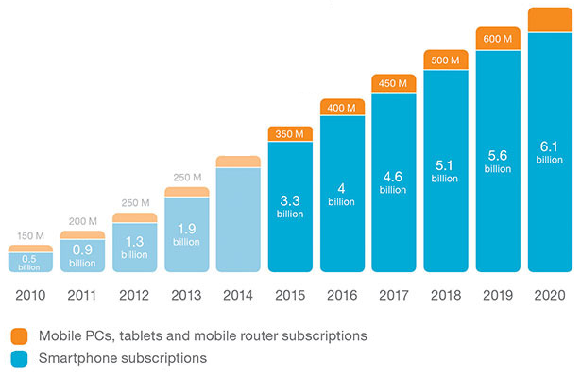
Business Case
There are still reasons for both IP and TDM to live together
  Legacy devices are still going to be around (for some time) and people will still use these, e.g. FAX, remote MODEM
  TDM and IP are now equally important – transition to IP is occurring
  Many businesses are IP only, home subscribers are mixed.
Mobile and 4G/LTE is increasing VoIP uptake. 5G will continue to drive this forwards
4G/LTE is IP only
Wikipedia (2017)
  7.0B mobile phones
  7.3B people
Country Ranking
  China (+1)
  India (-1)
  USA (=)
  Canada (=)
%LTE Subscriptions
Courtesy: Ericsson
Notes:
But, there is still a lot of telephony equipment out in the world. And, an infrastructure that took 100 years to build isn’t going to go away overnight. The world’s biggest computer is the PSTN.
Businesses are also looking for ways to migrate and enhance their networks for better performance. IP provides alternative paths and new modes of operation, e.g. remote workers outside the office.
4G wireless will introduce full VoIP and as this continues to roll out there will be increased IP connectivity between the different global networks.
There comes a critical tipping point where more calls are made on IP compared to TDM. At this point TDM networks and gateways start to become less of a requirement. That critical point is usually the point where there are equal number of subscribers on both TDM and IP, i.e. 50%.
Increased IP usage will also see new service providers appearing and a good percentage of these are expected to come from existing IP application providers that have a global presence, i.e. Google, Facebook, Yahoo, Skype, etc.
Whereas traditionally market growth was focussed on the Americas and Europe, in the past years India and China now dominate the market in terms of quantity of phones. As a pointer, Canada has slipped in the rankings and also now holds less phones per person than it did a couple of years ago, suggesting a trend away from mobile phones to other wireless connected devices, e.g. Wifi connected PC and tablets and use of Skype.

Slide 11
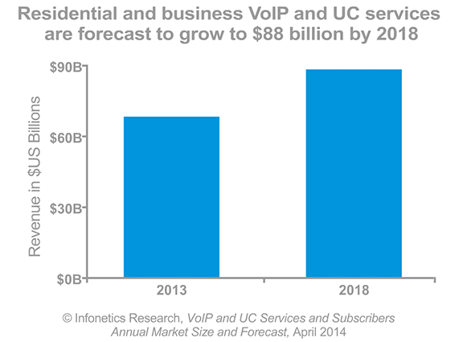
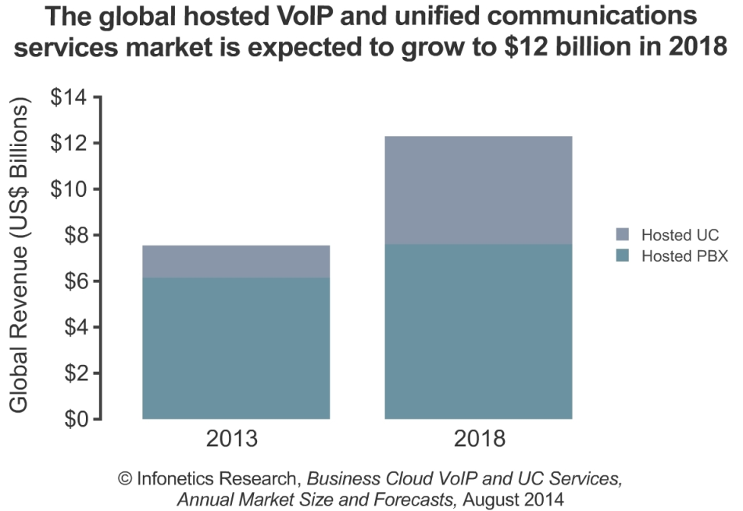
Business Case
In the Business PBX space two main tiers are emerging:
  On-Premise & Private Hosted
  Public Cloud Hosted
For 2018 expected revenues are:
  $88B for overall VoIP and UC, including
  $12B for Public Cloud Hosted
Cloud Hosting offers opportunity for VoIP without local “boxes”.
  OPEX, rental model
  Increasing Integration of services (UC) with other (mobile) data devices.
Mobility - anywhere
  Wireless connections and new data modes allow IP connections to be provisioned much easier in countries where it has traditionally been difficult to provide standard telephone cables and wires.
Notes:
Much publicized information suggests that of all the Small/Medium Enterprise (SME) market, there was a potential for over $3Billion in the year 2007. In 2012 the market forecast was over $16Billion. It recorded $33Billion on 2013. 2018 is expected to reach $88Billion! This is for premise based deployments
So, there is potential for big money, from a vendor view!
IP is also less restricted to country boundaries. It provides the opportunity for Service Providers to provide voice, and other services outside the normal country boundaries. Effectively the carriers now have potential to grow to a global market space, rather than a fixed national boundary. Security and Privacy issues are now appearing on the scene. Technology was the enabler, but other factors are now dictating where connections can and cannot be made.
Traditionally PBX sales are focussed around supplying equipment to the end customer. With IP, it is now possible to host this same service from a remote location, even a different country, so installation into new areas only requires an IP connection. Wireless and new data modes are providing IP into countries and regions of the world previously unable to run telephone lines.

Slide 12
Agenda
Executive Summary
History
Business Case
Services/Content
Convergence
Infrastructure
Challenges
Notes:
The business case suggests that there is a big market and demand for Voice over IP. But what are people actually buying? From a business view, it has to be more than just copper wires.
What people are buying are services (or content); features that enhance the business operation.

Slide 13
Services/Content
What services are people looking for?
  Basic hook-switch and dial tone
  Call handling features, transfer, etc.
  Advance features such as call centres, agents, skill based routing
  Remote location, e.g. Teleworker, Remote Agent
  Networking between sites and Virtual Private Networks
  Voice recognition
  Business Process Improvements and integration, e.g. Google, SalesForce
  Unified Communications and Collaboration (UCC), Business to Business (B2B)
  Improved mobility, BYOD and use of Smart Phones anywhere (in/out of office)
Notes:
With the standard telephone, there are already services that we take for granted. The humble hook-switch (still keeps its name from operator switch board days) and dial tone.
Especially with business systems, there are other call handling features that we take for granted, such as transfer, divert, voice mail, caller display.
IP services include more advanced features. Integration with databases for call centres, and hotel registration are a couple of examples.
IP can provide global networking, so an office in Melbourne can work with an office in London, or San Francisco, as though it was a local call.
New features, such as ‘Presence’, allow a user to profile how calls are handled based on time, and also on who is calling. For example an urgent phone call might get re-routed from the business to a cell phone, but the call centre call gets dropped to voice mail.
Unified communications allow the call to be handled by different and multiple routes, e.g. desk phone, mobile phone, remote worker phone, PC phone, or voice mail. Collaboration allows these devices to used for multiple services, and may include conference calls and presentations, and may include multi-media connections including video and web presentations.
The ability to link the user’s smart phone into the system with ‘Bring Your Own Device’ (BYOD) offers the ability to allow the user to use a common interface for business and personal calls. It also allows additional services to be provided to customers that may not be available to traditional desk phones. Such examples could be in hospitality where a customer’s phone is linked to the room number. Having full use of Fixed Mobile Convergence will then allow the customer to use the phone on the internal WiFi network as well as being contactable when on external mobile data networks.

Slide 14
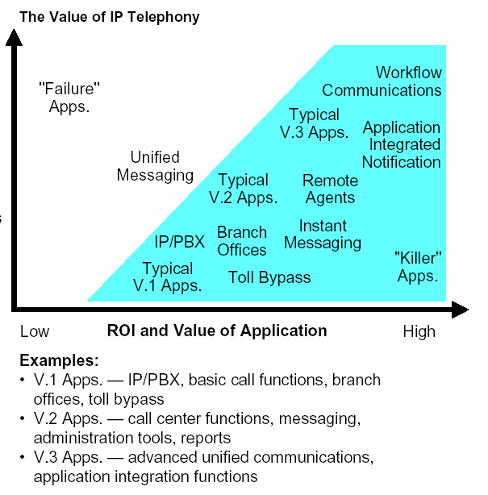
Services/Content
We started circa 2000 with V1 applications
  Biggest features were Toll Bypass and Networking
Today, V2 and V3 applications are normal practice.
  Remote workers and Applications that don’t require access to the office
  Remote ACD, help desks, etc
  “Road Warriors” - Sales
  Service Personnel
  Mobility integration
  Common access number for all connections
  Unified Communications: Voice, Video, Application collaboration
  Business workflow and collaboration
2018
Affect on business
2000
Notes:
When originally conceived the main driver for VoIP was to link in network branch offices and to do Toll Bypass. They may be doing Toll bypass as the primary link, or as a secondary backup. Reduced costs of SIP trunks are also driving replacement of PSTN trunks. Today, the linkage into the data arena allows much more integration with other applications and business practices.
More forward looking companies are using remote agents, softphones for sales people, teleworkers / remote office workers. In some places this is being mandated to cut down traffic and pollution, an example of this being California.
For agents in a call centre, this is a great application. Agents can log in for a few hours from home and may be located in different time zones, providing 24/7 coverage. Agents in different countries can provide support in different languages for a multi-national business. All with minimal office space being needed. Such integration with TDM is possible, but technically challenging, and also expensive when compared to an IP solution.
New features that allow users to make and take calls based on their current location, are also becoming popular. A highly mobile worker may need to take a call in the office, on a mobile phone, or at a customer location. Mobility provides the capability to do this and present a common business number to the outside world. The worker can take the call in multiple locations and also dynamically switch between networks.
Workflow communications allow more efficient handling of agent calls, for example a help desk might present information in advance of the customer being asked a question so current information is immediately available rather than the customer waiting while files are searched. Use of IVR can also help direct calls and in some cases allow operation without reliance on a human operator – e.g. ordering a taxi, or enabling a charge card.

Slide 15
Services/Content
Unified Communications (UCC)
  Globally Accessible
  E-mail, V-Mail, video, chat, collaboration
Presence and call routing
  Redirection of calls based on time, availability and caller to different end points
  Integration with multiple call routing applications, Microsoft, e.g. Skype™ and Active Directory
Fixed Mobile Convergence
  One number - able to pick up calls at desk and mobile, or alternative number
  Switchover between mobile carrier and in-house Wireless LAN
ACD and workflow call routing
  Service is handled by same agent to give more personalized service
  Agents located globally - full language support
Speech Recognition
  Redirection of calls based on spoken words
E-Business
  Workforce is distributed, and mobile.
  Customer Relationship Management tools
  On phone Advertising, e.g. hotel
  B2B collaboration, e.g. presence sharing
Business Process Improvement
Notes:
There are many new technologies and applications that are becoming common place within the the telecom industry. A number of ago many of these were being talked about. Today, these are available.
The overall effect is to improve the process of doing business. If a business is more effective and more efficient than the competition then they survive and grow. These technologies allow business to deal with customers in a more service oriented fashion as well as responding more quickly to their needs.
Business Process Improvement Example:
A well known Pizza Parlour will take repeat orders totally handled through voice recognition, without human interaction. The incoming call is recognized, previous information recovered, call transactions and billing are all handled without need of a local human operator. This includes Speech Recognition, ACD handling and Electronic Business transactions.
The ability to link in all these services through an existing TDM telephony system would be quite difficult, but with IP it’s possible to link all these components and provide a much more useful service to the end user, other than a basic phone system.

Slide 16
Agenda
Executive Summary
History
Business Case
Services
Convergence
Infrastructure
Challenges
Notes:
Often we’ll hear the word ‘Convergence’ and it gets interpreted in different ways. From a network view it may mean one thing, to a user something different.
However, what can safely be said is that the major disciplines of data and voice will be merging, and with that will come many of the integrated services mentioned earlier.

Slide 17
Convergence
What do we mean by convergence?
  Combining of different worlds
  Different mindsets and cultures
  Different set of standards
  Use of personal devices (Smart phone) for both business and personal use – “Bring Your Own Device (BYOD)”
And why now?
  Processing power is cheaper - Moore’s law!
    Phones have more power today than early PCs
    PCs and phones are standard desktop tools
  Voice and data networks can be combined to ONE
  Phones can now interact directly with data devices and applications
Notes:
What do we mean by convergence? It means a number of things in the network infrastructure, but it also means a merging of two different mindsets, that of Telecoms and that of Data.
The two mindsets have also developed networks along different lines and to different standards. Voice is passed over a fixed connection where bandwidth is guaranteed. Data is passed over a less dedicated shared infrastructure.
The data infrastructure is evolving. Bandwidth is becoming plentiful, label switching is used to guarantee connections, service level agreements on delivery are being offered. The data world is quick to evolve and invoke new requirements. Slowly, but surely, voice is migrating to IP.
For a number of years the core parts of the voice and data networks have been combining resources and reducing costs. Common fibre links exist between major sites. ATM was an early protocol to merge different requirements onto a common infrastructure. SONET/SDH agreements also led to common transport mechanisms.
From a user’s view, PCs and phones are now considered as standard desktop tools. Phones now have more processing power than early PCs. With the advent of cheaper processing power, it is possible to use the data networks to provide large amounts of bandwidth and combine functionality with other data devices.

Slide 18

Convergence
Convergence at the network level is unseen by the user.
What does the user see at the access point?
  Two line jacks into ONE?
Add in a wireless connection
  Wifi
  Bluetooth
  3G, 4G, LTE – 5G?
IP Multimedia System (IMS) Converged infrastructure
  Connection from anywhere
  From wired or wireless, mobile phones, internet
  Common IP infrastructure
  Location tracking, routing and billing
?
Access from anywhere
Notes:
As an office worker sitting at a desk, what differences are you likely to see? You’ll still see a PC and a phone, but won’t necessarily know which network the phone is connected to.
Probably now you only use a single line jack, rather than the previous two.
But is this convergence? In practice the second line jack will still be present because building wiring isn’t removed when not used. And, there’s always spare installed in a new building because adding wiring once a building is completed is even more expensive.
So, contrary to popular beliefs, saving costs by removing line jacks is NOT convergence.
Convergence is the provision of multiple services onto a common network infrastructure. Convergence offers the opportunity for additional services, and ‘triple play’ now also brings IPTV and TV on Demand services into the fray as well. Convergence at the network level is the ability to access the services from anywhere. The mobile network IMS infrastructure offers one such converged network, although still geared around phone services, it now interoperates with VoIP devices, mobile devices and Internet services.

Slide 19
Convergence
Four main business areas are converging
  Voice, TV/Video, VPN and Data
  Triple Play
    Broadcast TV - 100% users
    Telephony - 100% users
    Internet - 80% users+ (NA)
Voice is still the biggest revenue earner
Incumbents need to grow and expand
Many Cable TV providers now offer IP connectivity, many also voice.
New IP providers: Hosted VoIP, SIP Trunks, Video on Demand (e.g. NetFlix)
Courtesy: ATM Forum
Integration of Services
Notes:
There are a number of players in the ‘convergence’ arena, not just voice. And data covers a number of aspects:
‘Triple Play’ is the level of convergence combining broadcast TV, Telephony and Internet data access.
Cable TV companies are offering direct digital TV, and now Internet access. Many now offer Internet access and also voice. In the UK, for example, the biggest selling aspect of cable TV is the telephony services, not the TV!
Internet access will continue to grow, especially as more countries become involved and consumers demand access.
Current network providers providing data links to businesses through services such as Frame Relay, ATM, MPLS, dedicated lines, are also expanding.
Voice is by far the biggest revenue earner, and a lot of the other service providers see this as their goal. Bandwidth is reaching commodity price levels, so it won’t go much cheaper.
Costs are increasing at a higher rate, so unless they provide additional services, many will go out of business.
But some of the incumbent Telcos are now aware their market share is being taken. They now provide DSL and VoDSL, and some run their own ISP.
Convergence not only provides technical challenges, but with it are also market and business challenges.

Slide 20




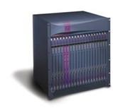
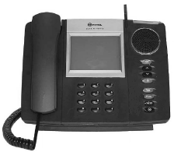
Convergence
Long Distance PSTN
e.g. AT&T
CO,
e.g. Verizon
SIP Trunk Gateway
CO,
e.g. Bell
SIP Trunk Gateway
SIP Trunk Gateway
Existing TDM
IP Network 1
Existing IP
IP Network 2
Usage Migration
Peer2Peer BGP Router
LAN
Hosted SoftSwitch
LAN
Business A
Business B
Merging of business functions to common IP network
Notes:
As the data network service providers grow and want to get into the telecom business, they need to provide connections between different users and businesses. A Softswitch can effectively provide the voice switching capability as well as policing access and bill charging.
New service providers can provide Telecom and voice services via the data connection. This can effectively bypass the local PSTN network provider. Trunk and PSTN access is provided by SIP gateways connected to other networks. This allows the larger network providers more access to the customer and bypassing the local networks. It also allows the businesses to have global presence but provided by a common service provider, effectively cutting costs. Use of the data network for inter business communications also allows toll bypass, further removing costs.
Peering agreements between network provider also allows data (and voice) to transition between networks without hitting “The Internet”, and therefore allowing service level agreements to be honoured. These peering arrangements further enhance the reach from one location to another without need to cross onto the TDM network and again maintaining cost reductions for longer distance connections.

Slide 21
Agenda
Executive Summary
History
Business Case
Services
Convergence
Infrastructure
Challenges
Notes:
Having covered some of the business aspects we now dig down into some of the more technical issues. What do some of these networks look like, and is this important? What are the building blocks of a system and how do they communicate?

Slide 22
Infrastructure
What are the building blocks of the system and how are these connected?
  Deployment Architectures and voice media paths
  Signalling Protocols
  Network Interconnections
Notes:
The are a number of aspects to infrastructure and how this is all connected.
The system infrastructure consists of a number of building blocks that communicate with each other through different sets of signalling protocols. All these building blocks are connected across a network consisting of one or many networks introducing local and global issues.

Slide 23
Infrastructure
The voice media paths and switching define the type of system. Three main types are defined:
  IP Enabled PBX
    Here a line card is simply replaced by an Ethernet card. Voice switching is done in TDM. This is not scalable and adds unnecessary delay.
  Hybrid PBX
    TDM and IP are handled equally, only traversing a gateway when IP and TDM devices need to connect.
    Typical in a SME (on-premise) environment
  IP-PBX (Hosted – Private and Public Cloud Services)
    All switching is done in IP. TDM connections are generally only to the PSTN via external gateway, which is typically off-site.
    Model used for Hosted services, both Private (e.g. single business) and Public (e.g. Skype)
Notes:
There are 3 distinct variations on VoIP telephone systems. These have been described as:
The IP-Enabled PBX, the
Hybrid PBX and
The IP-PBX (Hosted).
The IP Enabled PBX is very much based on current TDM technology. The line card is simply replaced with an Ethernet interface. Thus two IP phones talking will have their voice ‘back-hauled’ and switched in TDM. This adds unnecessary delay as well as using valuable network bandwidth. The system is still basically the same a centralized TDM PBX.
The Hybrid PBX, provides local switching for TDM devices, but understands that IP devices can talk directly. The gateway function is only required when IP and TDM devices need to converse. Such a system can be centralized or distributed as required, for example where local TDM devices need connection, e.g. PSTN, FAX, etc.
The IP-PBX, is a more pure IP solution. SIP Trunks are provided for connections to the TDM PSTN or to other SIP Trunks and businesses. Local TDM devices, such as POTS, have to go through a local TDM/IP SIP gateway.
This model is typical of a Hosted solution, where the trunks and call control are off-site and often maintained by another party. This model works well for smaller businesses that don’t necessarily want, or can budget, to run their own telephony equipment or data infrastructure.

Slide 24
Infrastructure
Basic VoIP system building blocks
  Gateway between IP and TDM
  Media Gateway Controller
  Call Control
  Features and Services
  End users
Different protocols use different names, but functions are essentially the same
Peer to Peer or Central Control?
  Central is good at resolving resource conflicts
  Peer to peer is resilient to network failure
  SIP can handle both aspects
Notes:
There are a number of essential building blocks to any VoIP system.
These may be called different things in different protocols, but essentially they are similar in function. It is also possible that some of these functions may be combined within a particular unit, or may be kept geographically separate. This is the advantage of using IP in that these logical functions may be physically separated, or combined onto common units.
The main functions include:
A Media Gateway between the IP and existing TDM world
Some controller for the Media Gateway, sometimes call a Gatekeeper, or Gateway Controller
Call Control, or some device to monitor the state of certain calls. For example it might be important to know is someone is present before completing a call. If not, then the call can be diverted to voice mail
Features and Services. This can include a whole list of features. Some of the more obvious could be call centre handling, voice mail, Interactive Voice Response (press 1 for, etc.), conference capabilities, etc.

Slide 25
Infrastructure
Signalling Protocols are numerous and include:
  H.323
  MGCP/Megaco
  SIP
  Proprietary
Why so many Signalling protocols?
  Different starting perspectives of the requirements
  They all offer some advantage for different users
  Most are evolving as new features start to roll out
Notes:
A number of signalling protocols have been proposed, including new ones and some based on known working standards. Based on Open Standards, the three main ones that seem to be in favour are H.323, MGCP/Megaco and SIP.
Proprietary signalling is still prevalent, simply because it can provide more features and ease of use quickly and simply. And, it’s services that VoIP is providing.
The different protocols derive from different groups with different perspectives and levels of understanding trying to solve slightly different communications problem. There were ‘Bell Heads’ and ‘Bit Heads’ for instance. There were different visions of how communications should evolve. The ‘Bell Heads’ saw things from the traditional TDM perspective and extended the centralised control view of the world. The ‘Bit Heads’ looked at a decentralised model, and envisaging multimedia communication among mobile and nomadic users.
Of these protocols, H.323 and MGCP/Megaco are still in use for gateways and more central control functions.
The SIP protocol is generally accepted as the main protocol of choice. There are emerging standards for different variations including SIP Users and SIP Trunks, but essentially the same base functions. Globally, SIP is recognised across the Internet and many applications now include SIP interfaces. Firewalls that are SIP aware (Application Level Gateways) now also allow connection to SIP devices that are within and outside of the business, making this a much more universal protocol.

Slide 26
Infrastructure
H.323
  Overview specification and includes:
    H.225 - Signalling
    H.245 - Media streaming
    TCP/IP and RTP/UDP/IP
  One of the early protocols
  Standards based, uses current ISDN technology, works well for interoperability between vendors
  Features are basic, but well proven
  Well proven ground rules about interoperability
  Centralised call control, based on known proven techniques, call state aware
  Slow to evolve
  Difficult to scale to millions of users
  Central call control = single point of failure
  Telephone routing biased rather than at application level
Notes:
H.323 is a collection of current working standards through ITU-T. These have been well proved in the world of ISDN, so feature interactions and availability are known.
But, the features are basic to allow different vendors to inter-operate.
H.323 is based on current TDM technology, so sharing between telephony servers is not easy to achieve. The ITU-T are not known for being rapid in changing specifications, although recently this has changed.
That being said, this was one of the earliest standards available and has become well established, especially with the gateway functions where interworking with the PSTN requires little protocol conversion. Despite projections of this being replaced, it continues to be in use and have new releases. The most recent update was posted in December 2009.

Slide 27
Infrastructure
MGCP/MEGACO
  MGCP was initially a proposal to IETF for a stateless gateway protocol, it has similarities to H.323, and has the ability to evolve
  Combined forces with ITU to create MEdia GAteway COntrol
  Similar to H.323 in content, but reduced messaging
  New standard and evolving
  Allows central and distributed call control access to a gateway
  Was thought to be the front runner with Enterprise business but little is heard
  Difficulties again in scaling from a global view. Different gateways need different controllers which need to intercommunicate.
Notes:
MGCP and Megaco (Media Gateway Control Protocol) is a merging of minds from the telecom and data worlds. It was seen as being more flexible and likely to evolve, not being directly linked with ITU-T.
However, as time moved on, it was recognized that similarities exist with H.323 and doing this work twice was wasteful.
Because it involves a level of functions common with telecom operation, but with the ability to evolve quickly, it was thought likely to be the front runner with a number of Enterprise and PBX vendors.
Having said that, evolution in SIP and the ability to add SIP extensions has taken away some the of the requirements for these protocols, so these may become ‘merged’.

Slide 28
Infrastructure
SIP (Session Initiation Protocol), RFC2543
  More Client/Server based and allowing Peer to Peer interaction.
  Call control can be distributed
  End devices need to be more intelligent than simple phones
  Has the ability to evolve quickly, and scale to large numbers
  Simple protocol, but lacks certain PBX capabilities
  Vendor specific options provide features
  Inter-vendor working is usually determined through “bake-off” but improving as more vendors implement agreed solutions
  Networking features low, but improving
  Open Standards through IETF, agreed by many established industry leaders
  Continual proposal of new features and extensions
  SIP Extensions to include “proprietary” features to make them more mainstream
  SIP is the Internet Phone signalling protocol of choice
Notes:
SIP (Session Initiation Protocol) is the control mechanism from the data world. It is based more on the Client-Server model and allows peer to peer communication. The previous protocols need to be passed via some central control.
The phone devices should really be considered more like PCs, where each can have its own personality based on which features are downloaded. It allows for rapid development of features, but also potential confusion.
Standards are available. However, the only real way to guarantee inter-working with different vendors is to do a ‘bake-off’. This is analogous to the older telecom testing regime, but done on a ‘peer-peer’ basis rather than a central authority.
The other potential disadvantage is that this is almost a clean slate. All the previous knowledge of feature operation needs to be re-learnt. An established business is unlikely to step backwards in time, so new features are needed to make this a compelling solution. Many of these are now being provided through extensions to SIP.
The client-server model is, however, well suited to the Internet, and to make a point of this, Microsoft includes SIP as part of Windows XP. General availability of SIP phones is also driving this protocol use. SIP based services such as International connections over IP with the Skype service is also driving public demand and awareness of SIP. In effect it is now a defacto standard.

Slide 29


Infrastructure
Private Enterprise
Private Cloud
Infrastructure as a Service (IaaS)
Public Cloud
Software as a Service (SaaS)
Cloud Network
Cloud Network
Cloud (Hosted)
PBX
PBX
Customer Network
Customer Network
Customer Network
PBX
Migration
Premise
Local Management
PBX on premise
Traditional deployment
Local Management
PBX on rented servers in cloud. VPN connected
Cloud Management Portal
Unknown infrastructure in cloud. Public IP connected
Notes:
Traditionally, the PBX was deployed and managed on the customer premise. This meant it could only be in one location, and so could the users. There would a cost to installing the equipment, as well as on-going maintenance and training of IT staff.
Increasingly there is a trend to migration of services to the cloud, with a view to reducing costs. What exactly is the cloud? It’s a data-centre that’s deployed and managed by a third party. The data-centre service providers offer infrastructure for many customers and so the deployments are very efficient and cost effective. The data-centres also provide high bandwidth network connections, either as dedicated VPNs or as local Internet Service Provider access points.
Cloud deployments take multiple forms, but the two most common are Infrastructure as a Service (IaaS) and Software as a Service (SaaS). The differences between these are the network connectivity and how, or rather who, manages the service.
For IaaS deployments, the customer is renting some server capacity. Service providers such as Amazon Web Services, or Microsoft Azure offer this capability. However, these service providers only offer infrastructure, and it’s up to the customer to install the software, configure and manage it. This likely still involves an IT team, but the equipment is now off-premise, but connected via a dedicated VPN connection. This is privately managed and therefore a Private Cloud deployment.
For smaller deployments, it’s quite likely that the customer simply wants a service, and this is offered by the Software as a Service deployment, and often as a subscription cost model, e.g. monthly payments, rather than a capital outlay. The infrastructure is managed by the service provider and the customer has little knowledge of where or how this is implemented. Day to day management is handled by the service provider. The customer may/often has access to limited configuration settings through a web based management portal. The only requirement is to connect the phones. Since this is over a public network, the customer’s phones could be deployed anywhere in the world. Such an infrastructure will also be shared with many other customers. This is a Public Cloud deployment. Due to economies of scale, the service provider can offer this at a competitive price for much smaller customers that would not be able to afford on-premise equipment. It’s also easily scalable.
Increasingly, on-premise based customers are migrating to cloud based deployments, be it Private or Public Cloud.

Slide 30
Infrastructure
Edge Firewalls
  Used to keep out unwanted access
  Restricts flow of data both ways, including voice
Network Address Translation (NAT)
  Maps many internal private addresses to limited number of public IP addresses
  NAT is typically not application aware
  VoIP media and signalling may include private IP addresses in messages which will be confusing externally in public IP space
Application Level Gateway (ALG)
  Stateful and knowledgeable of protocol, e.g. SIP
  Can translate private/public addresses within messages
  SIP ALG also known as Session Border Controller (SBC)
NAT and IPv6
  NAT and ALG will not be needed
  Any device can access any other device in both public and private address space
  Truly global access- one large address space
NAT
ALG
Internal:
Private IP Address Space
External:
Public IP Address Space
Notes:
A connection to the IP Service provider is often through a firewall and also Network Address Translation (NAT). NAT allows a few public Internet addresses to be dynamically mapped to hundreds, or even thousands, of internal private users.
The main advantage with NAT is that it can change IP addresses. The main disadvantage is that unless NAT is fully aware of the application it won’t be able to change IP addresses that are buried within messages.
For voice connections, these NAT devices cause some issue. Firewalls are unlikely to allow lots of openings for lots of voice channels, and NAT units don’t know about voice applications, so instructions may get incorrectly translated.
The solution is often a proxy server, or Application Level Gateway that provides a dedicated and very secure access around these functions. The gateway pretends to be an end user internally, externally appearing as a gatekeeper, or controller, and provides translation of messages passing through it. This may often also be referred to as a Back-to-Back User Agent (B2BUA). The ALG may provide its own local firewall functions, or may live within the DMZ behind a pre-configure firewall.

Slide 31

Infrastructure
SoftSwitch
Private IP
SIP Trunk Gateway
Private IP
VoIP
Hosted
SIP ALG
PSTN
LAN
Carrier/SP
Public IP
LAN
SIP ALG
Internet
Public IP
Border Gateway
Carrier2
LAN
Public IP
Private IP
Architecture of SIP in a large carrier deployment
SIP ALG provides IPv4 NAT and firewall functions for SIP Service Provider (a.k.a. Session Border Controller (SBC))
Notes:
SIP is not just limited to the Internet, although that is probably the primary view of home subscribers.
SIP is becoming a major force for carriers, such as cable TV providers, to get into the telecom market and provide interconnections to local subscribers, thereby bypassing the CO ‘last mile of copper’.
In IPv4 there are address space issues between business private address space, carrier private address space and Internet public address space. With IPv4 deployments, SIP NAT is usually handled with a SIP ALG around the firewall/NAT, or it may be integrated. Being an open standard, SIP ALG devices are becoming prevalent. For larger carriers this functions is also known as a Session Border Controller (SBC).
However, while North America and Europe struggle with IPv4 address spaces, the rest of the world is implementing IPv6 where address space isn’t an issue, where ALGs are not needed and where the address space really is global. So the diagram shows today’s picture, but in the future it may be a lot simpler. But, a global address space means that the Softswitch supplier may not be local either!

Slide 32
Infrastructure
With IPv6 all devices can be addressed globally
  Removes need for NAT and SIP Proxies (ALG), making global connections possible
  For example: call control in NA, gateway in Asia, IP phone in Europe!
  Uptake of IPv6 is currently slow. Internet of Things (IoT) and more 4G LTE phones will drive change.
  But today we’re still stuck with a lot of IPv4
SIP is the accepted global standard for IP media device signalling
SIP and IPv6 have the potential to become disruptive technologies in displacing the current (TDM) telephone network systems
Industry Trends
IPv6 provides everyone with a global address
SPs compete on a global scale
SIP Trunks
SIP User
Network SP provides phones
Network SP provides end-end IP
Today
Notes:
From a physical infrastructure view, what benefits can be gained from IP?
Once the end-points are defined, then these can be located anywhere on the global network. There is no need to restrict the location of the device to within a single building because that’s where the line cards are located.
Deployment of IPv6 will allow all devices to be uniquely identified, and there will be no need to deploy NAT devices. Therefore any device will be able to talk to any device. With SIP becoming a globally accepted signalling standard it also provides opportunities for Service Providers to provide connection from anywhere in the world and compete on a global rather than local scale.
IPv6 and SIP therefore have the potential to become disruptive technologies in the displacement of existing TDM infrastructure.
Despite IPv6 being the future direction, the uptake globally has been slow, especially in places where IPv4 is well established, i.e. NA and Europe. This is primarily because many other techniques, such as NAT, have allowed the IP addresses to be used more efficiently. However the explosion of Internet of Things (IoT) and increasing 4G/LTE penetration cannot be covered with remaining IPv4 addresses and will force wider uptake of IPv6 globally.

Slide 33
Agenda
Executive Summary
History
Business Case
Services
Convergence
Infrastructure
Technical Challenges
Notes:
Having looked at the business aspects and some of the overlying questions with Voice over IP, we now get into some of the more local engineering challenges that have to be faced. Assuming that we have our business customer willing to implement Voice over IP, we now have to make it work.

Slide 34
Technical Challenges: Many!
There are many…
  Voice Quality
    Delay, packet loss, echo, delay, jitter, clock slip,
  Tones
    In-band DTMF, FAX, MODEMS
  Packet Size
  Voice CODEC
  Bandwidth
  Security
  Rules and Regulations, including E911
  IP address space
Notes:
There are a number of fundamental challenges to tackle. Simply put:
The customer won’t accept less service quality (signalling delays or voice quality) than they have today.
Some of the areas that are particularly important include:
Voice Quality
How are delays handled, what about jitter and echo?
In TDM, the network is well behaved, not so in IP, how is this handled?
In TDM, bandwidth is guaranteed, not so in IP, and IP uses more
In TDM, the endpoint are frequency locked, so no data is lost, not so in IP
In TDM it’s not easy to listen in to some-one’s call, but in IP this is possible
Multiple networks require address and application level translations
The connections need to be secure from eavesdroppers, the public network is just that, public!
When a problem exists, how is this located when the device may be 1000s of miles away?

Slide 35
Technical Challenges: Voice Quality Metrics
To a User - It’s a Phone!
Voice Quality Metrics
  Toll Quality
  Mean Opinion Score (MOS) of 4.0 or better
  E-Model with R=80 or better
  Output based on many inputs:
    Delay
    Levels
    Echo
    Background noise
    CODEC
R=88
Continued Voice Quality is expected
Notes:
The MOS (Mean Opinion Score) value can be derived from various acoustic measurements in a call, and is based on subjective tests with live people on real calls.
The R-Value is derived from a tool based on these subjective tests that allows call quality to be predicted. So, it becomes a useful tool in VoIP, where impairments will affect the perceived quality.
The slide shows a number of these inputs, but of these the most important are:
Delay, end to end, mouthpiece to earpiece,
The signal levels,
Echo and where this is located,
Typical environment, such as background noise, and
What CODEC is in use.
The chart shows an IP Phone with end-to-end delay of 150ms, with good echo suppression and using a G.711 CODEC. A value greater than 80 is considered acceptable or Toll Quality, which this one is.
Note that in a real system increased end-to-end delay affects the ability to hold a conversation. It will impair the R-value, but have little effect to the MOS score. In this sense the two measurements are not identical and so both are important. The R-Score includes a level of perception of conversation as well as voice quality.

Slide 36
Technical Challenges: VQ - Delay and Loss
Voice Quality
  End to end delays of ~150ms are tolerable with good echo cancellation techniques
  1% packet loss with good Packet Loss Concealment is also tolerable
  Jitter only becomes significant when it results in packet loss
  Jitter buffer balance between adding delay and introducing packet loss
Note: Above 200ms an additional 20ms delay is worse than 1% packet loss with PLC.
Some Delay is tolerable
Notes:
How does voice quality change with different parameters?
One of the biggest impacts is noticed with increasing delay. With good echo suppression, or cancellation, it is possible to increase the end to end delay to about 150ms before there is a marked degradation in conversation and speech quality. As delay increases the conversation degrades into a radio style rather than a normal conversation. At around 400ms the conversation has degraded to radio style quality.
Packet loss also affects the voice quality. Straight packet loss of even 1% has a significant effect on the results, as can be seen in the curves above. A call that has a good R-Value of nearly 90 drops below 70, which is not acceptable. However, if some form of Packet Loss Concealment (PLC) is used then the effect can be reduced. In this case the degradation keeps the R-Value above the 80 value.
Network jitter typically has little effect on the signal quality, except when it results in packet loss, or discard due to late arrival. Thus to minimize any effect, a good jitter buffer scheme is required, and this must balance the issues of packet loss against increased conversation delay.

Slide 37

Technical Challenges: Voice Quality - Echo
ECHO
IP
Echo is always present, even in TDM. Delays in IP makes this more noticeable
ECHO
IP
Control of Echo is important
Notes:
Echo is generated at the far end device, and so not heard by the person listening, but by the person talking. To provide a good connection it is the far end device that must cancel any generated echo. For example, when caller A talks to caller B, the echo is generated at caller B and caller A will hear this; caller B will not. Echo cancellation at caller B will ensure that caller A does not hear echo.
Echo cancellation (or suppression) is needed at all IP end devices or gateways. This is specifically true where there is the possibility of coupling between the send and receive signals. In an analogue trunk, for instance, this condition can occur in the 4-Wire to 2-Wire converter. The efficiency of the converter is defined by how well the line is matched at all frequencies. This results in a compromise for best voice quality and some of the source signal is fed back. In an IP end device, there is also the possibility of coupling between the earpiece and mouthpiece of a handset. This might occur if the user cradles the handset on their shoulder, rather than directly on the ear, or if the handset is placed on a hard surface, such as a desktop.
Fundamentally an echo canceller consist of a dynamic filter with delay to simulate the returned echo, a summing junction and a Non-Linear Processing switch. A feedback loop exists from the summing junction output back to echo predictor filter to continuously improve performance.

Slide 38
Technical Challenges: Voice Quality - Delay
Let’s look at where delay occurs
  Fixed Delays in CODECs and filters
  Packet size delays to build a packet
  Jitter Buffer
  Network (which also introduces jitter)
End to End Delay = 79ms, but with 10ms jitter (router)
Control of Delay is important
Notes:
Delay is an issue in a conversation, but where does this come from?
There are a number of areas, and these are shown in the diagram above and described below:
The CODEC filters introduce phase shift which appears as delay, albeit small by comparison to the rest of the connection (9 pole ~ 1ms delay @ 1kHz)
The data to be sent is collected up to a certain size. This minimizes the overhead on the network, but a 20ms packet size means a 20ms delay.
The network devices introduce delays. They have multiple queues to handle data arriving from multiple ports. The Layer 2 switch devices tend to be fairly fast at handling this data.
A router has a similar task to the Layer 2 switches. However it must read further into the packet before deciding where to send it. It is also limited by the access speed of the ports. A slower port means a longer serialization delay and a potential congestion point. Congestion occurs when a packet cannot be sent until a previous packet is sent. This is where the most significant jitter is added.
On the receive side, a jitter buffer is used to handle the variable packet arrival rate. Typically this will hold data for a short period, maybe 2 packets worth, just in case a packet is lost and concealment is needed.
Thus, a simple connection could easily add up to nearly 80ms of delay.

Slide 39
Technical Challenges: Network Jitter
Where does jitter come from?
  Serialization delay: Waiting for larger packets to transfer
  Lack of Priority means all data is treated equally - First in First out
Apply priority queues for voice and set MTU to cut large packets
Priority mechanism to get voice into gap first
MTU Breaks up large packets
Use QoS settings to prioritize voice and minimize jitter
Notes:
This diagram illustrates the previous points.
The voice1 packet must wait until all of the large data packet is sent. This introduces significant delay to the signal. It might also require a bigger jitter buffer, and introducing more voice delay, if this packet is not to be lost.
By fragmenting the data packet and using priority, there are now more opportunities for the voice data to be interleaved. This reduces the time added to the voice data, and hence reduces the jitter on the signal.
This mechanism works surprisingly well, especially on congested or near congested links. The difference can be between having a normal conversation, with this scheme, to hearing virtually no voice, due to high levels of jitter and packet loss.
Adjusting how the interface handles voice data is a means of providing the end user with a guaranteed delivery, or Service Level Agreement. Within an Enterprise business, controlling the network performance is directly under control of the business. With the Internet, this is not true. However, a number of Service providers are now guaranteeing performance, in order to get some of this WAN and VPN business.

Slide 40
Technical Challenges: Network Jitter
Removal of jitter
  Voice CODECs run at a constant rate
  Too much or too little will result in a gap
  Small gaps in voice are not discernable <60ms
  Small gaps in tones are discernable
  Jitter Buffer needed = Leaky Bucket
Packet Loss Concealment hides loss
  Fill gaps with noise, silence
  Remove data in fixed size, during silence
Jitter Buffer = ‘Leaky Bucket’
PLC Hides lost packets
Notes:
Jitter is obviously something that is always present. However, the voice CODECs operate at a constant input rate and produce a constant output rate. If they are starved of data, or receive too much, then a gap in the information will result.
To get round this variation, a jitter buffer is needed. This is effectively like a low pass filter and smoothes out the input variations in an attempt to produce a constant output flow of data.
Small gaps in voice are not noticeable, typically less than 60ms, due to the random nature of voice. Gaps will be noticed with tones, however, and some of these need to be treated in a different manner, e.g. DTMF dialling tones.
Part of the jitter buffer is also linked to the PLC (Packet Loss Concealment) function such that data can be added, or removed, in a controlled manner. For example data can be removed during a silence period of speech, or similarly added.

Slide 41
Technical Challenges: Clock Slip
Clock Slip
  The CODEC at each end may run at 64kbits/s, but they have a tolerance
  No clock synchronization, therefore need to add or drop data
  Example of packet drop due to slip
    Suppose two device, each at 50ppm (TDM tolerance)
    That’s 100 bits drift in 1 million bits, or
    8 bits in 80,000 bits which = 1 bit every 1.25 seconds @ 64kbits/s, or
    1 packet (160 bytes) every 3 minutes, 20 seconds
  Clock slip buffer needs to consider this drift up and down
    Often, slip correction is included with jitter buffer control to minimize media delays and complexity of multiple buffers
Clock Slip needs to be considered
Notes:
In the TDM world every part of the network is synchronized in some form. This is often referred to as plesiochronous, not being synchronous, but locked. In effect the network is frequency locked, but not phase locked. Thus there is no real data loss in the network as everything runs at the same speed.
In the IP world, a central clock with sufficient accuracy isn’t always readily available. The effect is that two end devices might be running at the same nominal frequency, but there are always tolerances between two free running devices. Thus one clock will be running faster than the other, so one device will overflow with data and the other will underflow.
Suppose we have two devices running at 50ppm each. That’s 100pm worst case between them. If the data is corrected on a per packet basis (20ms), then this condition will occur every 3, or so, minutes. If done on a byte basis then this occurs roughly every second.
The jitter buffer needs to consider these effects, otherwise it will just keep filling and the delays will get progressively longer, or in the other case it will simply run out of data. An additional correction (slip) mechanism is needed to keep the buffer centralized.

Slide 42


Technical Challenges: Transmitting Tones
Transferring tones is problematic if the jitter buffer discards
  A DTMF tone need only be 75ms long.
  A packet loss of 20ms is significant, results in misdialed digits.
  Convert tones to signalling packet (RFC4733) and regenerate at edge (if needed)
DTMF
IP Network
RFC4733
RFC4733 ensures DTMF tones are transferred correctly
Notes:
Transferring tones between end devices is also problematic. A packet loss in voice might amount to 20ms of lost information and might not be noticed. However with a continuous tone this will definitely be heard. For example such a gap will be noticed if dial tone is being listened to.
In the outgoing direction, signalling is often carried using DTMF. For an automatic dialler, this tone signal burst might only be 75ms in duration. Losing 20ms in the middle is likely to cause the receiver to incorrectly detect the signal. It might not detect anything, or might interpret the signal as two dialled digits. So, if this occurs only occasionally, what’s the problem? Well, in NA normal access to a trunk line from a PBX starts with ‘9’, then ‘1’ for long distance. If these digits are double detected then this could become 9911, which is the external emergency service.
RFC4733 (supercedes RFC2833) details how tone information can be passed between end devices and reproduced locally.

Slide 43
Technical Challenges: FAX and Modem
In band tone transmission
  Other devices use in band tones, such as:
    FAX and MODEM
  FAX will work, but only under very controlled network conditions, such as packet loss
  MODEMs will work, but again under controlled conditions such as echo cancellation
Alternative CODEC for FAX is T.38 (and less often T.37)
Alternative CODEC for MODEM is V.150
  V.150 complexity has resulted in little enthusiasm to include this in gateways.
  Limited (proprietary) solutions are available.
  IoT are likely to replace current slow speed telemetry MODEMs
FAX and MODEM need alternative CODECs
Notes:
Phone lines are used to carry information other than voice. They are also used to carry data (ironic when we are looking at using data to carry voice). This data is usually in the form of MODEM tones. Devices such as FAX, Point of Sales terminals, etc.
Although these will work over a well managed IP network, issues can arise from clock slip and echo cancellation. To cater for this, some new standards are being proposed for new types of CODEC function.
For FAX, the T.38 standard seems to be gaining favour over the previous T.37.
The standard for MODEMs is still under debate, but it is known that echo cancellation must be removed for this to work. Echo devices include a MODEM tone detector to auto-disable themselves for this type of connection. The ITU-T V.150 standard has been proposed for MODEMS, but appears to be gaining little ground in terms of being implemented.

Slide 44
Technical Challenges: Packet Size
How big a packet should be used?
Packet Rate | Use | Advantages | Disadvantages
10ms | High speed network | Low latency | High Bandwidth and packet rate, not all CODECs work
20ms | Mixed network, including WAN | Acceptable latency, minimum rate for more complex codecs | Reasonable bandwidth usage
30ms | Wireless access | Reduced packet rate | Increased latency, not all CODECs work
40-60ms | Lower speed links, satellite | Reduced bandwidth | Increased latency, reduced end user quality of use experience
20ms Packets - Good Compromise
Notes:
So, what is a good packet size to use. Up to now 20ms has been used in the examples. Is this a good value? Actually, yes.
Ideally a sample rate between 10ms and 50ms gives a good end-to-end delay.
Samples in multiples of 10ms are preferred for low bit-rate CODECs
Below 10ms the packet overhead becomes very significant.
A good compromise appears to be 20ms to 30ms. Many vendors are choosing 20 ms to reduce delays, although some, notably wireless, are choosing 30ms to reduce packet rate and processing issues. Some carriers are suggesting 10ms to reduce delay, where bandwidth issues are not an issue.

Slide 45
Technical Challenges: CODEC
So many CODECs, which one to choose?
CODEC Type | Voice Quality | Network Impact
G.711 “The Standard” | Base CODEC. Good voice quality. PSTN compatible | High Bandwidth, for voice.
G.726 (Delta Modulation) | Good Voice Quality | Limited bandwidth reduction. Poor return on processing investment
G.729, G.729a (Compression) | Acceptable voice quality | Much reduced bandwidth. Good for WAN access and wireless. Good return on processing investment
G.729b (Compression + Silence suppression) | Reduced voice quality. Silence detection and switching causes issues | Potential for further reduced bandwidth doesn’t materialize. Bandwidth must still be provisioned, even if not used.
G.722, G.722.1 (Wideband) | Much improved voice quality (8kHz) over G.711. Good user experience | Reduced bandwidth compared to G.711. Good return on processing investment.
Others.. | Improved voice quality | Bandwidth uncertainty
Balance of Voice Quality and Bandwidth usage
Notes:
Which CODEC should be used?
From H.323 one of the requirements is that G.711 in both A-Law and u-Law should be supported, irrespective of which other CODECs are supported. Even in a non-H.323 environment this principle still seems to hold and accepted as ‘standard’. G.711 uses 64kbits/s.
G.726 is often used by voice mail, but offers little network bandwidth reduction. The payload is typically set to 32kbits/s. It is often used as data compression onto hard disk drives, but with the size of disk drives today, this is becoming unnecessary.
G.729, G.729a, G.729ab all provide 8kbits/s compression.
The ‘a’ version is a reduced processing version, and much favoured
The ‘ab’ version uses the reduced algorithm and also voice activity detection. This reduces bandwidth when there is no speech, but can clip voice on activation.
Newer CODECs such as G.722 and G.722.1 include wideband audio, up to 8kHz, and also stereo. Both provide surprisingly good results in conference situations. The possibility to provide this added function is a lot simpler to provide in an IP environment, and may not be supported across TDM connections which is inherently based around G.711 CODECs.

Slide 46
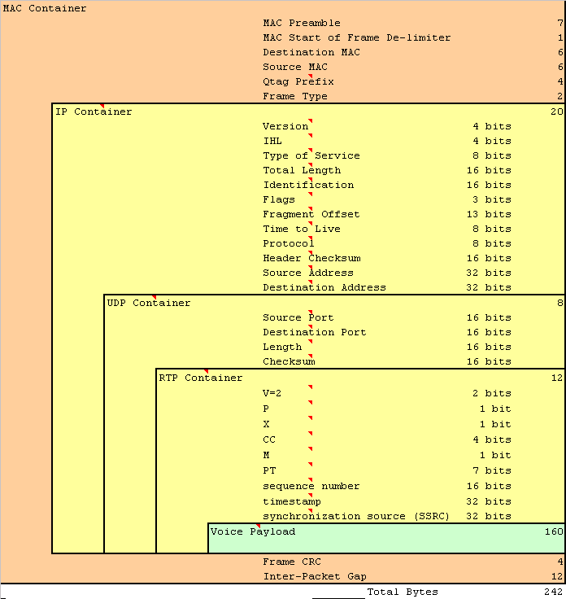
Technical Challenges: Bandwidth
How much bandwidth needed?
  Payload
    G.711: 160 Bytes (64kbps)
    G.722.1: 80 Bytes (32kbps)
    G.729: 20 Bytes (8kbps)
  Plus Overhead:
    RTP, UDP, IP, MAC and Ethernet + inter-packet gaps
LAN Bandwidth (Ethernet)
G.711 ~ 100kbits/s
G.722.1 ~ 65kbits/s
G.729 ~ 40kbits/s
Notes:
Different results are often quoted for bandwidth needs. But, we need to consider what a packet is made up from, as it consists of a number of layers:
The payload at G.711 64kbits/s or 160 bytes per packet at 20ms packet rate
This is included into an RTP wrapper
further wrapped inside an IP layer
further wrapped in a MAC layer
encoded in a physical layer that also includes unsent data such as inter-packet gaps.
The inter-packet gaps are included because they affect every packet, and data cannot be sent during these periods. However, in a dedicated link, these gaps still need to be paid for, so it counts in the overall bandwidth calculation.
Network bandwidth consumption is increased over TDM, and payload compression doesn’t always give equal benefit when compared to TDM. However, TDM uses dedicated physical links (layer 1), whereas IP does not (layer 3). The advantage of IP is the location independence, but the cost is more routing information and hence more bandwidth. “There is no free lunch!”

Slide 47
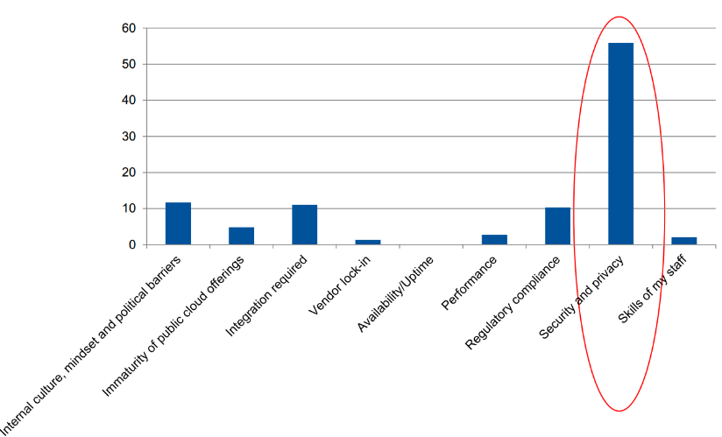
The Challenges: Security
Security:
  Becoming more important, especially for hosted deployments
  Becoming regulated with heavy fines for failures
  An attack can disrupt or even destroy a business
  Ever changing attack theatre
  Firewalls are no longer enough
    DDoS, floods, etc.
    Intrusion Detections Systems
    Intrusion Prevention System
    Application Specific firewalls
    Zero Day Malware attacks
    Sandboxes
    Ransomware
  Security Incident and Event Manager (SIEM) to look for trends and patterns of attack and raise alarms, as well as providing signature updates
Notes:
Now that the system is available globally (potentially) it can be accessed from anywhere. That’s good for the business, but also good for potential miscreants that may wish to use the system for other purposes.
Malicious attacks can occur anywhere in a network, although it is well known that most attacks on systems come from within the operation, maybe through some backdoor access.
Some simple starts can be made to secure the system. Don’t give unauthorized use to the maintenance ports. Put the system in a separate room and lock the door! Protect the access, physically and logically. Encrypt the data, check the connected user is who they claim to be, etc.
But the system may be subject to external ‘denial of service’ attacks, trying to disrupt communications. Phreakers may wish to use the system to set up long distance calls at the business’ expense.
The whole area of security is a subject unto itself. The field is becoming increasingly complex as attackers refine and improve their methods of attack. Increasing use of more intelligent tracking devices looking for trends and patterns of attack are becoming more common, with the firewall almost becoming relegated to another add-on component. Cloud based attacks from Malware components can result in Gbytes of attack data on the networks, bringing many to a grinding halt. Detection of these attack sources is increasingly important to prevent a PC, or a user, or a business unwittingly becoming part of the attack. Anti-Virus software on PCs is a good starting example.

Slide 48
The Challenges: Rules and Regulations
Emergency Location (E911)
  Emergency Location (E911) requires that a person making an emergency call can be physically located within a pre-defined area
  IP phones can move and be located globally
  These requirements are potentially in conflict
  New global standards and regulations are evolving to maintain this capability
    IETF-ECRIT : “Framework for Emergency Calling using Internet Multimedia”
CALEA
  Call Tracing, Malicious call handling
  Wire-tapping
Charging for services
  Who pays? The Internet is ‘free’ But, is it?
Local and Global rules need to be applied
Notes:
E911, in North America, requires that a person making an emergency 911 call be located within a certain physical area. This enables the emergency services to correctly locate the caller, even if the caller is unavailable or can’t describe the location. Other countries are investigating using similar techniques. The IETF Standards Organisation is currently investigating a framework for use in multiple regions.
With TDM phones, the phone is physically located on a defined wire connected to a defined line card and circuit. Thus, it is easy for a system to identify the device and pass this to the Emergency Service Access Provider via special signalling (MODEM based).
With IP phones this is more difficult, since there are no real line cards and IP phones are intended to be more mobile.
A consortium of telecom and data manufacturers are in discussion with the regulators to come up with a solution. Yet another sign of convergence!
With increased security and the threat of terrorism, there is increasing need to be able to monitor calls legally. This is potentially in conflict with other areas noted earlier where security is added to stop this very practice. Providing this capability adds further complications.
And, we talk about the Internet being free, but is it? Who really pays for all the networks and equipment that make up the Internet? Today the networks are cheap, but as more traffic is carried, the more bandwidth will be needed, and the systems will need to be upgraded. This all comes at a price.

Slide 49
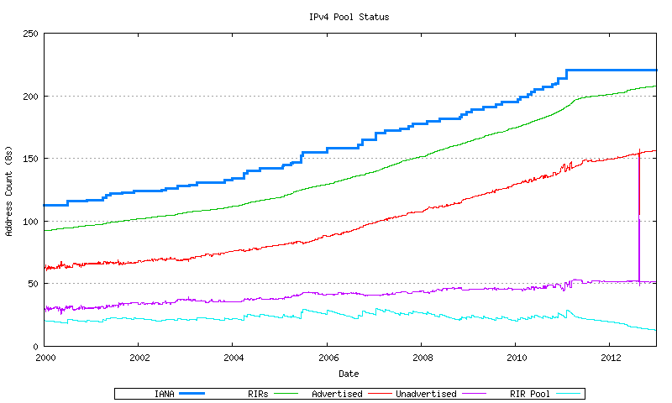
The Challenges: IPv6
IPv4 Public Address
  The current public address range has run out!
  Main users are NA and Europe
  Insufficient for ROW
  Exhaustion
    IANA Jan 2011
    Regional Internet Regions: April 2011
  Increasing IPv4 NAT complexity
IPv6 Public Address
  Driver: 3G/4G wireless, internet connected appliances
  Already being deployed in a number of countries
IPv4 Sold
IPv6 is here! IPv4 has run out
Notes:
Currently a lot of VoIP technology is based around IPv4 address space. Since the major deployments have so far been mainly in North America and Europe, as well as within Enterprise private address space, this has been of little issue.
As more hosted services come on line, there is a need to work across a number of businesses, potentially with common addresses. Businesses are also global and cross international boundaries. The address range of the service provider may use public addresses. Service providers need to communicate directly rather than through a TDM intermediary. Incumbent PSTN suppliers are migrating their current TDM networks towards IP.
The main consumers of IPv4 address space are mainly North America and Europe. Having consumed 85% of the address space with potentially 20% of the world population, there is no chance that the remaining 15% of addresses, or less, will satisfy the remaining 80% of the world. New devices such as 3G/4G mobile phones and home appliances are also consuming IP addresses, so a single person may consume multiple IP addresses.
IPv6 is being rolled-out in a number of regions of the world, in order to meet this growing demand. IP phones will need to work in this infrastructure, so new technologies and techniques need to be learnt.

Slide 50
Finale
VoIP is mainstream
  Mobility and Unified Communications and Collaboration
  Business Process Improvements
Technical challenges for voice quality are being overcome and improved upon
The large Telecos are changing to embrace the IP changes. IMS and 4G/LTE mobile networks are extending “connection from anywhere”.
IP network access is becoming ubiquitous, especially with wireless hotspots, e.g. WiFi
SIP is the preferred communication method, and feature interaction between vendors is improving
Many new service providers are appearing in the market place and consolidations are taking place
Integration with other cloud services is increasing along with improved business workflow improvements.
IPv6 is being implemented to provide truly global communications
Thank You
Notes:
That is the end of the presentation, and I hope that you found it informative.
The Open Standard approach of SIP means that this will work across different vendor products and different countries. The introduction of IPv6 will also remove the need for NAT and provide access to every device on a global basis.
Many businesses will seize on this opportunity to provide services both locally and also out-of-country.
Together SIP and IPv6 are disruptive technologies and have the ability to provide global access from anyone to anyone without firewalls and NAT. The current incumbents are waking up to this and many out-of-country telcos are aware of the opportunities that come with this. Competition will become global in the new communications global-village.
Thank You.

