Slide 1
Recent Trends in Wi-Fi Evolution and Unlicensed Bands
Osama Aboul-Magd
Huawei Technologies

Slide 2
About the Speaker
Dr. Osama Aboul-Magd is working at Huawei Technologies, Canada Research Center.
He led the task group (TG) in IEEE 802.11 leading to the design of the IEEE02.11ac.
He is currently chairing the TG in IEEE 802.11 designing AX enhancements to WLAN.
He taught courses on communication systems and computer networks at Carleton University from 2005-2009.

Slide 3
Introduction
This lecture focuses on the evolution of the wireless LAN (WLAN) technology and new trends.

Slide 4
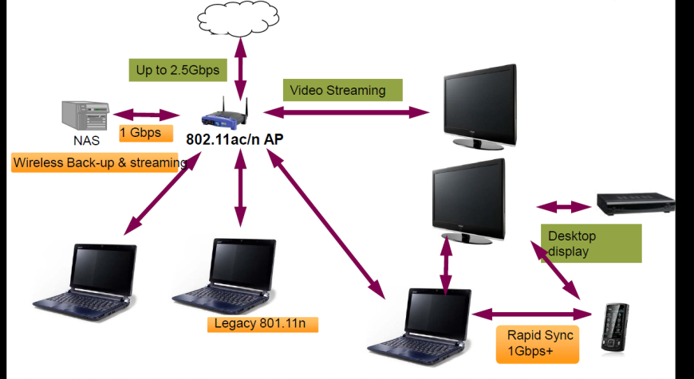
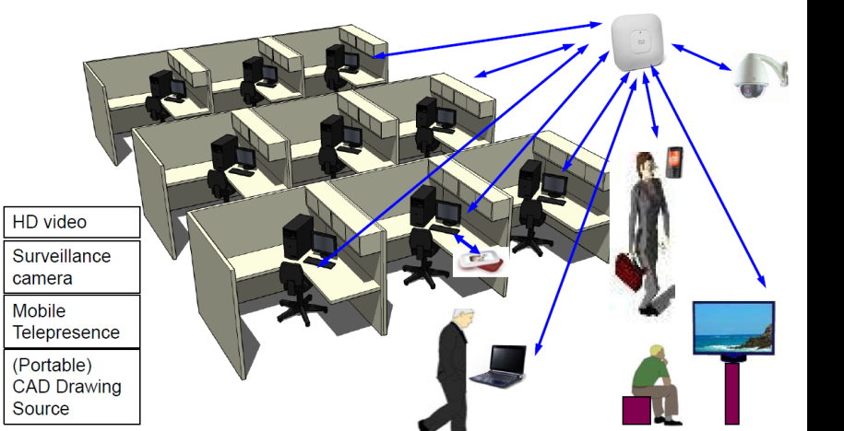
Traditional WLAN Markets
Home Networking
(Fast Synch and Video Distribution)
Enterprise Networking

Slide 5
WLAN Evolution - Drivers
The evolution of WLAN technology has always been in response to the needs of its key markets
The need for speed by traditional WLAN enterprise and consumer electronics markets
Advances in communication systems and signal processing technologies
The main focus has always been on increasing the data rate.

Slide 6
WLAN Evolution – Layered Approach
Over the years, WLAN technology has evolved both at the PHY and the MAC layers.
MAC evolution has centered around QoS and reducing MAC overhead including overhead related to acknowledgemnts.
PHY layer is considered to be the engine that enables the increase in the data rates.
Traditionally PHY enhancements are more celebrated than those of the MAC.

Slide 7
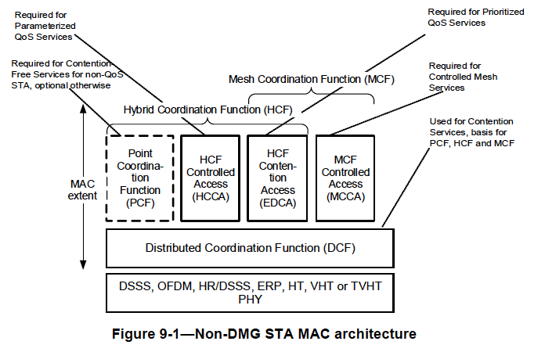
A Second View of WLAN Architecture

Slide 8
IEEE 802.11 PHY Layers (2014 view)
IEEE 802.11
Legacy
A/B/G
HT, VHT, HEW
N
White Spaces
AF
IoT
AC
mmWave
AD
IEEE 802.11b is not the first WLAN PHY layer, but it is the one that have seen much popularity
IEEE 802.11a/g increased the data rates up to 54 Mbps
IEEE 802.11n was an inflection point where MIMO was first introduced WLAN.

Slide 9
PHY Evolution: The Holy Grail
OFDM
MIMO
MU-MIMO
Mainly driven by technological advances in communication systems and signal processing
802.11ac (5GHz)
802.11ad (60GHz)
6.7~6.9Gbps
The main focus has been on increasing throughput – usually by an order of magnitude
802.11n
600Mbps
802.11a (5GHz),
802.11g (2.4GHz)
54Mbps
802.11
2Mbps
802.11b
11Mbps
1997
2000’s
We are here!
9

Slide 10
From IEEE 802.11n to IEEE 802.11ac
Feature | IEEE 802.11n | IEEE 802.11ac
Frequency Band | 2.4 and 5 GHz | 5GHz
Channel Width | 20 MHz 40 MHz (optional) | 20/40/80 MHz 160 and 80+80 MHz (optional)
Static/Dynamic BW | X | √
Backward Compatibility | 802.11b/g 802.11a | 802.11a/n
OFDM | √ | √
MIMO | SU MIMO Up to 4 antennas | SU and DL MU MIMO Up to 8 antennas
Preamble | Mixed Format (MF) Green Field (GF) | Mixed Format (MF) only.
Modulation and Coding Schemes | 76 MCS | 9 MCS 256 QAM and r=5/6
Beamforming (optional) | Staggered and NDP | NDP
Coding | BCC/LDPC (optional) | BCC/LDPC (optional)

Slide 11
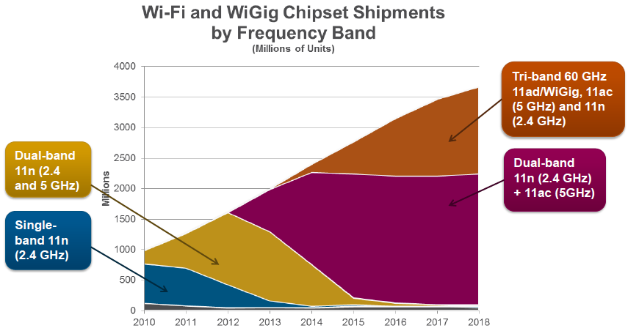
Dual/Tri-band Chipsets Coming!

Slide 12
A Victim of its Own Success
Wi-Fi technology is being used everywhere
Its traditional consumer and enterprise markets
Carrier market for data offloading and hot spots
Dense deployments including sporting events, airport terminals, and shopping centers.
Emerging IoT applications including low-power devices such as battery-operated sensors.

Slide 13
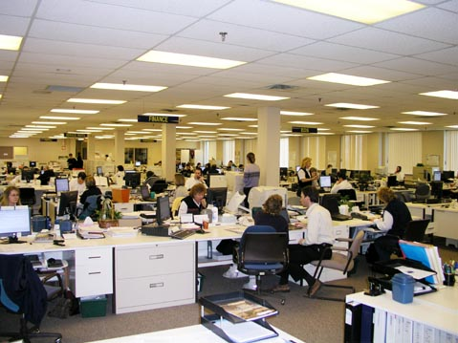
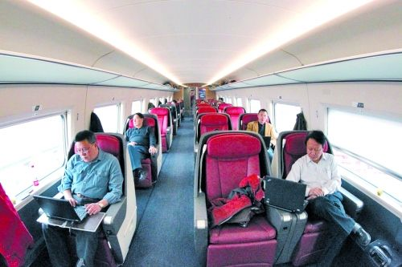
New Usage Cases
Wireless Office
Public Transportation
Lecture
Hall
Airport Concourse
Stadium
Carrier
Wi-Fi

Slide 14
New Usage Cases = New Requirements
Improved user experience in carrier off-loading
Per user throughput rather than aggregate data rate is now the measure of interest.
Explosive growth in traffic due to video uploading and downloading
Video traffic represents over 60% of the total traffic and QoS requirements.
Ability to support low-power devices with limited battery life.
Capture the emerging IoT markt
New usage cases are mainly characterized by:
Dense environment with many Aps and many stations associated to a single AP.
Low-power devices for IoT applications.

Slide 15
IEEE 802.11 PHY Layers
IEEE 802.11
Legacy
A/B/G
HT, VHT, HEW
N
White Spaces
AF
IoT
AH
AC
mmWave
AD
AY
AX
BA
Wake-up
Receiver
High Efficiency
WLAN
IEEE 802.11b is not the first WLAN PHY layer, but it is the one that have seen much popularity
IEEE 802.11a/g increased the data rates up to 54 Mbps
IEEE 802.11n was an inflection point where MIMO was first introduced WLAN
Two PHY amendments are currently under development.

Slide 16
The Scope of the 802.11AX Project
This amendment defines standardized modifications to both the IEEE 802.11 physical layers (PHY) and the IEEE 802.11 Medium Access Control layer (MAC) that enable at least one mode of operation capable of supporting at least four times improvement in the average throughput per station (measured at the MAC data service access point) in a dense deployment scenario, while maintaining or improving the power efficiency per station.
This amendment defines operations in frequency bands between 1 GHz and 6 GHz. The new amendment shall enable backward compatibility and coexistence with legacy IEEE 802.11 devices operating in the same band.

Slide 17
Purpose
Improve performance of WLAN deployments in dense scenarios
Targeting at least 4x improvement in the per-STA throughput compared to 802.11n and 802.11ac.
Improved efficiency through spatial (MU MIMO) and frequency (OFDMA) multiplexing.
Dense scenarios are characterized by large number of access points and large number of associated STAs deployed in geographical limited region, e.g. a stadium or an airport.
Access to Internet, latest airlines’ announcements, and digital media such as movies and sport events

Slide 18
IEEE 802.11ax Design Trends
Backward compatibility requires the use of the same frame format as in other existing IEEE 802.11 PHYs (i.e. Legacy Preamble)
Employing OFDMA to allow the multiplexing of multiple users in a single transmission.
Groups of subcarriers (or resource units) are allocated to different users
Allow for clients to request resources based on their buffer status.
Allow the AP to allocate resources to clients as needed.
Main PHY features includes:
Support of OFDMA Layer (DL and UP) – first 802.11 amendment to support OFDMA
Support for MU MIMO (DL and UL) – Adds UL MU MIMO
Support for 1024 QAM – goes beyond 256 QAM introduced in 11ac
LDPC (Low Density Parity Check) code is mandatory for certain sizes of the resource units – usually an optional feature

Slide 19
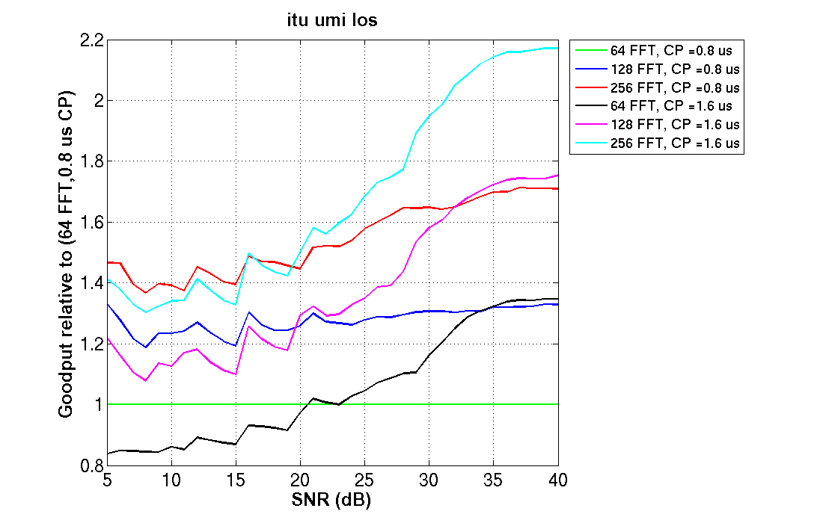
802.11ax Overview
The use of Orthogonal Frequency Division Multiple Access (OFDMA)
Allows the multiplexing of multiple users in the frequency domain.
A departure from the use of the OFDM where all resources are assigned to a single user as in previous IEEE 802.11 amendments.
Support of OFDMA is both for the Uplink (UL) and the Downlink (DL)
Supporting UL MU MIMO
DL MU MIMO support is already in IEEE 802.11ac.
Allows multiplexing of multiple users in the spatial domain
Supports spatial reuse among neighboring BSS
1024 QAM
Source: https://mentor.ieee.org/802.11/dcn/15/11-15-0099-04-00ax-payload-symbol-size-for-11ax.pptx

Slide 20
OFDMA and MU MIMO
Frequency
STA
STA-1
STA-2
PHY
Header
STA-3
STA
AP
STA-4
STA-5
Time
STA
OFDMA resource allocation based on buffer status at the STA for better user experience.
MU MIMO allows a high capability device to simultaneously transmit or receive from a multiple of low capability devices.

Slide 21
802.11ax Chip Availability
Major Chip vendors have already announced their chip availability.
Example: Broadcom Announcement
BCM 43684
Support for 4-streams of 802.11ax
4.8 Gbps PHY Rate
160 MHz Channel Bandwidth
1024 QAM Modulation
Uplink & Downlink OFDMA
MU-MIMO
ZeroWait DFS
AirIQ Interference Identification
BCM4375
Support for 2-streams of 802.11ax
Bluetooth 5.0+ including Low-Energy Long Range (LELR)
Real Simultaneous Dual-Band (RSDB)
1.429 Gbps PHY Rate
1024 QAM Modulation
OFDMA
MU-MIMO

Slide 22
IEEE 802.11ba – Wake-Up receiver
Low Power Wakeup
Signal (Frame)
1
WuRx
2
Wakeup
ACK
3
Wi-Fi
Receiver
4
Information
Exchange
TX
RX
The operation steps of the WUR receiver is as follows:
When the TX has information for the RX, the TX sends an wake-up signal (frame) to the RX.
The RX receives the wake-up signal and wakes up the main Wi-Fi receiver. This step is perceived to be an implementation issue and is not subject to standard.
When the main Wi-Fi Receiver wakes up it responds with an ACK (other frame types are also possible) informing the TX of its transition to the active state.
information exchange between RX and TX proceeds as normal

Slide 23
IEEE 802.11ba Project Scope
This amendment defines a physical (PHY) layer specification and defines modifications to the medium access control (MAC) layer specification that enables operation of a wake-up radio (WUR). The wake-up frames carry only control information. The reception of the wake-up frame by the WUR can trigger a transition of the primary connectivity radio out of sleep. The WUR is a companion radio to the primary connectivity radio and meets the same range requirement as the primary connectivity radio. The WUR devices coexist with legacy IEEE 802.11 devices in the same band. The WUR has an expected active receiver power consumption of less than one milliwatt.

Slide 24
What does the Future Hold?
Clearly Wi-Fi technology will no longer enjoy the exclusive use of the unlicensed spectrum
LTE-U (LTE-unlicensed), LAA (licensed assisted access), and MuLteFire are emerging as new technologies sharing the spectrum with Wi-Fi devices.
All are promoted and pushed by cellular vendors
Concerns relate to co-existence with the billion of Wi-Fi devices already deployed.
As usual market forces will decide winners and losers.

Slide 25
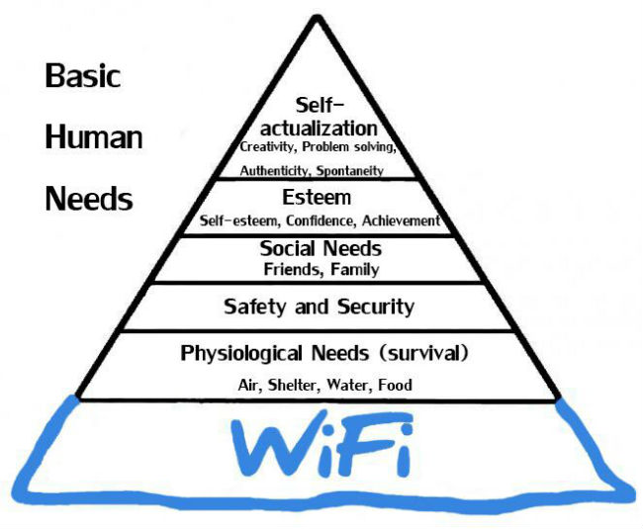
Closing Note
The advance of technology is based on making it fit in so that you don’t really notice it, so it becomes part of everyday life- Bill Gates

