Slide 1
5G and Beyond Wireless Networks:
Emerging Concepts and Technologies
Halim Yanıkömeroğlu
Carleton University
Ottawa, Canada

Slide 2



Carleton University
Ottawa, Canada
Est. in 1946
30,000 students
Engineering
Notes:
2

Slide 3
5G Discussions – Everywhere…
Globecom 2017 Industry Seminars
5G & Beyond Research through Industry-University Collaboration
V2X for Automated Driving in 4G, 5G and beyond
5G Heterogeneous and Small Cell Networks (HetSNets)
Towards 5G Internet-of-Things – URLLC in Automotive and Industrial IoT Applications
Globecom 2017 Industry Panels
5G Use Cases, Services and Applications: Reality, Prospects and Challenges
Multi SDOs/For a Industry Harmonization … and 5G SW PoCs
Accelerate 5G Adoption in Enterprises and Verticals: Learnings, Pitfalls, and Controversies
5G Vision to Reality: 5G Commercialization – New Services and Business Opportunities
5G Vision to Reality: Technical Challenges in Early 5G Commercialization and Advanced Technologies for 5G Evolution
Role of Licensed and Unlicensed Millimeter Wave in Delivering the Promise of 5G
5G Today and 5G Tomorrow: Technology Trends Shaping the Evolution of 5G
Future Indoor Communications: Requirements and Challenges on the Path towards 5G
Abundant material online

Slide 4
Why this Tutorial? – What to Expect / What not to Expect

Slide 5
Why this Tutorial? – What to Expect / What not to Expect
Not about the standards details
Not a marketing pitch
Not wild predictions

Slide 6
Why this Tutorial? – What to Expect / What not to Expect
Not about the standards details
Not a marketing pitch
Not wild predictions
An academic’s perspective
partly factual, partly opinionated, partly guesswork
Diverse set of topics: Systems view (no one knows all of it)
Relevance to 4G/5G/6G and even beyond

Slide 7
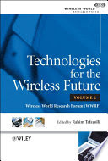
It is Difficult to Guess the Future
Technologies for the Wireless Future
Wireless World Research Forum (WWRF), 2006
The key technological vision from WWRF is
“7 trillion wireless devices serving 7 billion people

Slide 8
It is Difficult to Guess the Future
Technologies for the Wireless Future
Wireless World Research Forum (WWRF), 2006
The key technological vision from WWRF is
“7 trillion wireless devices serving 7 billion people by 2017”

Slide 9
Engineering Design Methodology
Use cases (5G)
Part I
Technical requirements (5G)
Part II
Architecture, enablers, technologies
(5G and beyond)
Part III

Slide 10
Part I: Use Cases (~80 slides)
Generations of cellular technologies (1G → 4G)
3GPP
5G: A game changer
ICT
Concluding remarks

Slide 11
Part II: Technical Requirements (~70 slides)
From 4G to 5G
Rate: Fundamental enablers
Near-term enabling technologies
Public safety networks
Radio security: Threats and vulnerabilities
WLANs
Concluding remarks

Slide 12
Part III: Ultra-Agile Networks for Wireless Ultra-Connectivity (~250 slides)
Problem Statement and Solution Guidelines
HetHetNets: 5G+ Traffic Models
Ultra-Agile Networks for Wireless Ultra-Connectivity
  Spectrum
  Aerial BSs (Non-Terrestrial Networks
  User-in-the-Loop (UIL: Demand Shaping in Space & Time)
  Advanced PHY
    Optimized PHY with Massive Look-Up Tables
    Non-Coherent Communications
    Faster-Than-Nyquist Signaling
Concluding Remarks

Slide 13
Part I: Use Cases
Generations of cellular technologies (1G → 4G)
3GPP
5G: A game changer
ICT
Concluding remarks

Slide 14
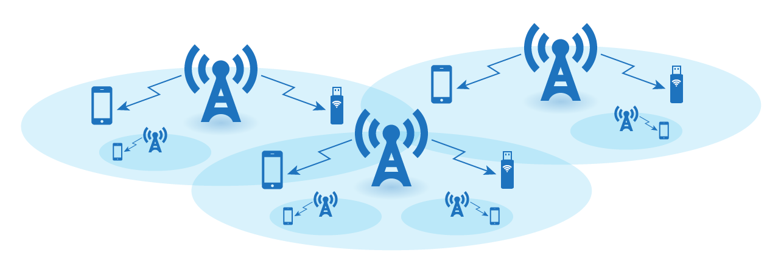
Wireless Cellular Networks

Slide 15
Wireless Cellular Networks
Handoff → Seamless roaming
Network-wide frequency (channel) planning → Quality-of-Service (QoS) guarantee

Slide 16
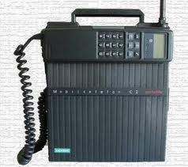
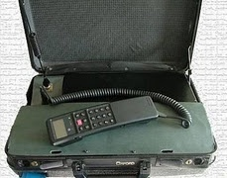
Mobile phone (1946)

Slide 17
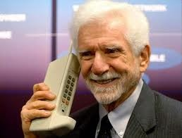
Mobile phone → Cell phone

Slide 18
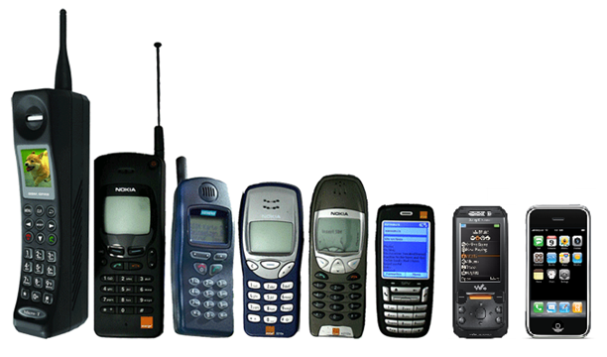
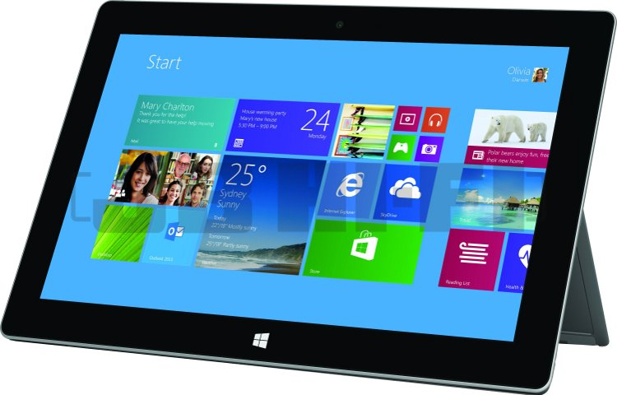
Mobile phone → Cell phone → Smart phone → Tablets

Slide 19
Evolution of Use-Cases in Cellular from 1G to 4G
voice
video
text, email, browsing

Slide 20
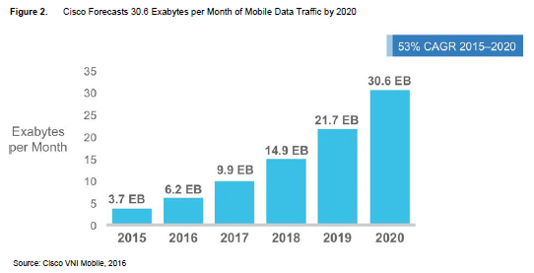
Cisco Visual Networking Index: Global Mobile Data Traffic Forecast

Slide 21
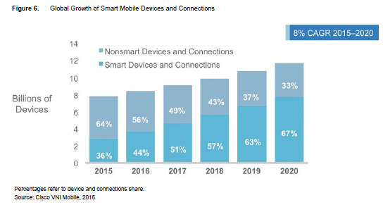
Cisco Visual Networking Index: Global Mobile Data Traffic Forecast

Slide 22
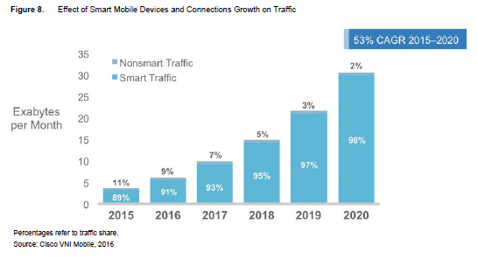
Cisco Visual Networking Index: Global Mobile Data Traffic Forecast

Slide 23
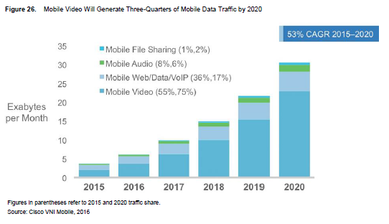
Cisco Visual Networking Index: Global Mobile Data Traffic Forecast

Slide 24




Near Future: More Video

Slide 25
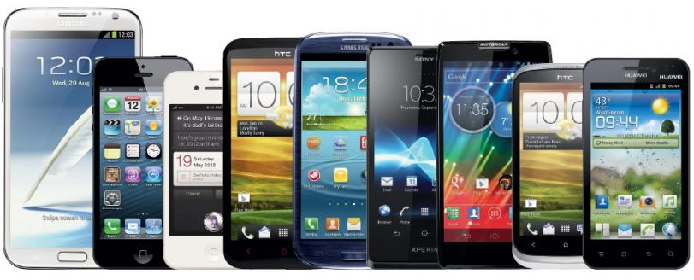
What is 5G?
5G is not about only smart phones
Notes:
25

Slide 26
What is 5G?
5G is not about only smart phones
5G is about novel use cases
Notes:
26

Slide 27
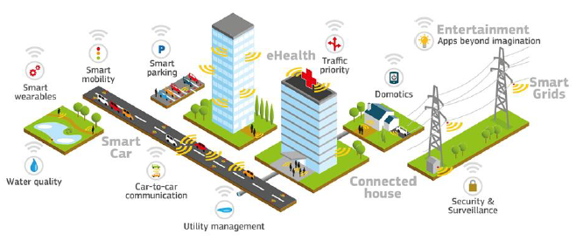
5G Use Cases
A. Dutta, AT&T
Notes:
27

Slide 28
Problem with 5G Discussions
1G– 4G discussions: All around phone
5G: Too many very different use cases with one discussion
Challenges, required technologies, and market demand are very different

Slide 29
Part I: Use Cases
Generations of cellular technologies (1G → 4G)
3GPP
5G: A game changer
ICT
Concluding remarks

Slide 30
Patents are Important
Qualcomm royalty fee: $16.25 per 5G smart phone
2.275% → 5% of the selling price (up to $500)
Ericsson royalty fee: $5 per 5G smart phone

Slide 31
Patents are Important
Nortel’s patents were sold in June 2011 to a consortium consisting of Apple, Ericsson, Microsoft, Blackberry and Sony.
6,000 patents for $4.5 B → $750,000 per patent

Slide 32
Companies with the Highest Number of Issued US Patents in 2014
IBM USA 7,534
Samsung S. Korea 4,952
Canon Japan 4,055
Sony Japan 3,224
Microsoft USA 2,829
Toshiba Japan 2,608
Qualcomm USA 2,590
Google USA 2,566

Slide 33
Generations of Cellular Networks
0G: Non-cellular mobile 1G: AMPS, 1983 2G: GSM, 1991

Slide 34
Generations of Cellular Networks
0G: Non-cellular mobile 1G: AMPS, 1983 2G: GSM, 1991
3GPP Platform: [Est. 1998] “unites 6 telecom standard development organizations (ARIB, ATIS, CCSA, ETSI, TTA, TTC), and provides their members with a stable environment to produce the highly successful Reports and Specifications that define 3GPP technologies”. (Other platforms and organizations: 3GPP2, IEEE, …)

Slide 35
Generations of Cellular Networks
0G: Non-cellular mobile 1G: AMPS, 1983 2G: GSM, 1991
R99
R4
R5
R6
R7
R8
R9
R10
R11
R12
2000
2001
2002
2003
2004
2005
2006
2007
2008
2009
2010
2011
2012
2013
2014
2015
Release 13: Mar 2016
Release 14: Jun 2017
3GPP Platform

Slide 36
Generations of Cellular Networks
0G: Non-cellular mobile 1G: AMPS, 1983 2G: GSM, 1991
2 Mbps mobile
1 Gbps hotspot / 100 Mbps mobile
ITU-R IMT-2000 circular letter ITU-R IMT-Advanced circular letter
R99
R4
R5
R6
R7
R8
R9
R10
R11
R12
2000
2001
2002
2003
2004
2005
2006
2007
2008
2009
2010
2011
2012
2013
2014
2015
Release 13: Mar 2016
Release 14: Jun 2017
3GPP Platform

Slide 37
Generations of Cellular Networks
0G: Non-cellular mobile 1G: AMPS, 1983 2G: GSM, 1991
2 Mbps mobile
1 Gbps hotspot / 100 Mbps mobile
ITU-R IMT-2000 circular letter ITU-R IMT-Advanced circular letter
R99
R4
R5
R6
R7
R8
R9
R10
R11
R12
2000
2001
2002
2003
2004
2005
2006
2007
2008
2009
2010
2011
2012
2013
2014
2015
HSPA
DL
HSPA
UL
HSPA+
LTE
LTE
Adv
UMTS
Release 13: Mar 2016
Release 14: Jun 2017
3GPP Platform

Slide 38
Generations of Cellular Networks
0G: Non-cellular mobile 1G: AMPS, 1983 2G: GSM, 1991
2 Mbps mobile
1 Gbps hotspot / 100 Mbps mobile
ITU-R IMT-2000 circular letter ITU-R IMT-Advanced circular letter
3G: IMT-2000 compliant 4G: IMT-Advanced compliant
R99
R4
R5
R6
R7
R8
R9
R10
R11
R12
2000
2001
2002
2003
2004
2005
2006
2007
2008
2009
2010
2011
2012
2013
2014
2015
HSPA
DL
HSPA
UL
HSPA+
LTE
LTE
Adv
UMTS
Release 13: Mar 2016
Release 14: Jun 2017
3GPP Platform

Slide 39
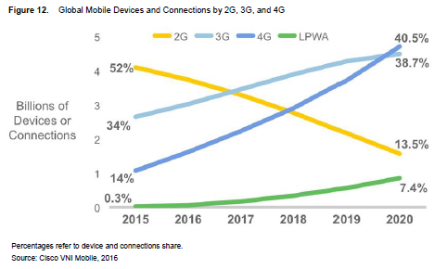
Cisco Visual Networking Index: Global Mobile Data Traffic Forecast
LPWA (Low-Power Wide-Area):
Utility meters, street lights, pet or personal asset trackers, etc.

Slide 40
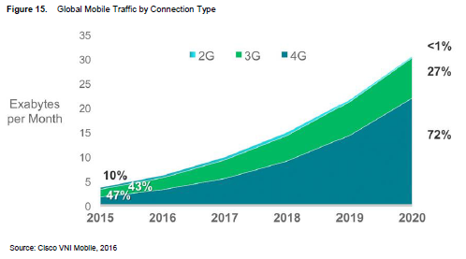
Cisco Visual Networking Index: Global Mobile Data Traffic Forecast

Slide 41
Part I: Use Cases
Generations of cellular technologies (1G → 4G)
3GPP
5G: A game changer
ICT
Concluding remarks

Slide 42


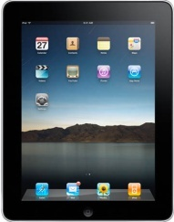






Cellular Generations – 1G, 2G, 3G, 4G
4G
Mobile device for everyone
Gbps
3G
data
Mbps
2G
Mbps
data
kbps
1G
kbps
data
AMPS
bps
AMPS
bps
1980
1990
2000
2010
2020
Time
Notes:
42
2010 – 20 - will be the decade of LTE
2020 -> - will be 5th G what will it hold?
Not entirely sure but – what is sure is that Between Now and then-
Cell size will definitely shrink – and consequently
Cell count will increase
All in an order of magnitude
Devices will undoubtedly expand exponentially
Data M2M will explode – And this will inevitably lead to a concatenation of growth trends
The growing need for information and interaction will spur a number of Mega-trends ……

Slide 43
Cellular Generations – 2010 View
5G
?
data
4G
?
Mobile device for everyone
Gbps
3G
data
Mbps
2G
Mbps
data
kbps
1G
kbps
data
AMPS
bps
AMPS
bps
1980
1990
2000
2010
2020
Time
Notes:
43
2010 – 20 - will be the decade of LTE
2020 -> - will be 5th G what will it hold?
Not entirely sure but – what is sure is that Between Now and then-
Cell size will definitely shrink – and consequently
Cell count will increase
All in an order of magnitude
Devices will undoubtedly expand exponentially
Data M2M will explode – And this will inevitably lead to a concatenation of growth trends
The growing need for information and interaction will spur a number of Mega-trends ……

Slide 44
Cellular Generations – Current View
5G
?
data
4G
?
Mobile device for everyone
Gbps
3G
data
Mbps
2G
Mbps
data
kbps
1G
kbps
data
AMPS
bps
AMPS
bps
1980
1990
2000
2010
2020
Time
Notes:
44
2010 – 20 - will be the decade of LTE
2020 -> - will be 5th G what will it hold?
Not entirely sure but – what is sure is that Between Now and then-
Cell size will definitely shrink – and consequently
Cell count will increase
All in an order of magnitude
Devices will undoubtedly expand exponentially
Data M2M will explode – And this will inevitably lead to a concatenation of growth trends
The growing need for information and interaction will spur a number of Mega-trends ……

Slide 45
Cellular Generations: Use-Cases & Timeline
1980
1985
1990
1995
2000
2005
2010
2015
2020
1G
2G
2.5G
3G
3.5G
4G
4.5G
5G
voice

Slide 46
Cellular Generations: Use-Cases & Timeline
1980
1985
1990
1995
2000
2005
2010
2015
2020
1G
2G
2.5G
3G
3.5G
4G
4.5G
5G
voice
data (video)

Slide 47
Cellular Generations: Use-Cases & Timeline
1980
1985
1990
1995
2000
2005
2010
2015
2020
1G
2G
2.5G
3G
3.5G
4G
4.5G
5G
voice
data (video)
novel use-cases

Slide 48
Cellular Generations: Use-Cases & Timeline
1980
1985
1990
1995
2000
2005
2010
2015
2020
1G
2G
2.5G
3G
3.5G
4G
4.5G
5G
voice
data (video)
novel use-cases
novel use-cases:
autonomous & connected vehicles,
IoT, smart grid, smart cities,
smart homes, health care,
remote robotics, tactile internet, …
very many, difficult to list

Slide 49
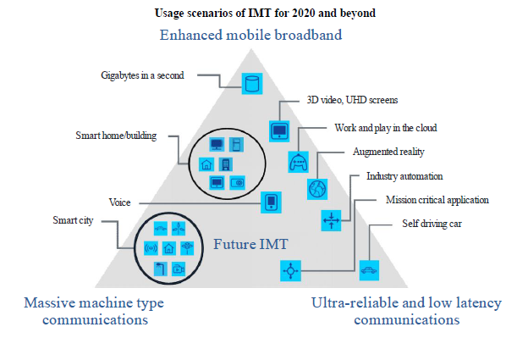
Cellular Generations: Use-Cases & Timeline
1980
1985
1990
1995
2000
2005
2010
2015
2020
1G
2G
2.5G
3G
3.5G
4G
4.5G
5G
voice
data (video)
novel use-cases
novel use-cases:
autonomous & connected vehicles,
IoT, smart grid, smart cities,
smart homes, health care,
remote robotics, tactile internet, …
very many, difficult to list

Slide 50
Cellular Generations: Use-Cases & Timeline
1980
1985
1990
1995
2000
2005
2010
2015
2020
1G
2G
2.5G
3G
3.5G
4G
4.5G
5G
voice
data (video)
novel use-cases
novel use-cases:
autonomous & connected vehicles,
IoT, smart grid, smart cities,
smart homes, health care,
remote robotics, tactile internet, …
very many, difficult to list
Some of the envisioned use cases will have to wait for the 5G evolution,
or even 6G, or even beyond!

Slide 51

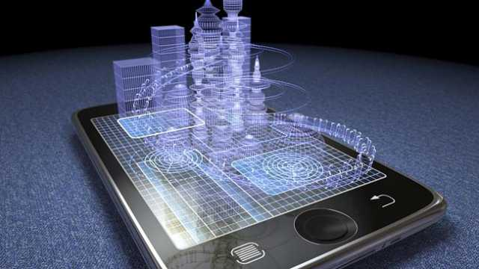
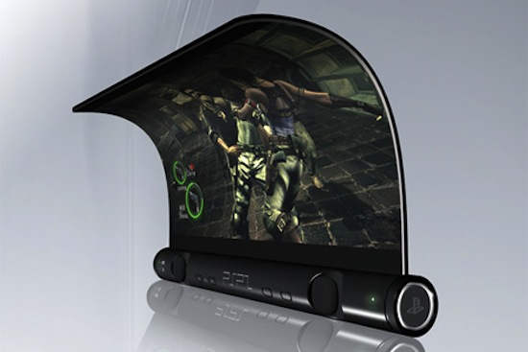

Direction 1: Enhanced Mobile Broadband (EMBB)

Slide 52

Direction 2: Massive Machine-Type Communications (MMTC)
IoT
Internet
of Things
IoE
Internet
of Everything
Notes:
ITU-T Rec. Y.2221 (www.itu.int/rec/T-REC-Y.2221-201001-I): Requirements for support of Ubiquitous Sensor Network* applications and services.
* This is the ITU-T term for MTC systems and applications involving possible large numbers of sensors potentially spread over a large area
Sensor Networks monitor physical or environmental conditions, (e.g., temperature, sound, vibration, pressure, motion or pollutants) at various locations. These sensors need to communicate with a server.
Early sensor networks operate in isolation. Networked sensor applications enable new possibilities for consumers, public organizations, enterprises, government, etc.
Applications integrate data from sensor networks to achieve industrial or home automation control, agricultural monitoring, healthcare, environment and pollution monitoring, and disaster surveillance, security, etc.

Slide 53
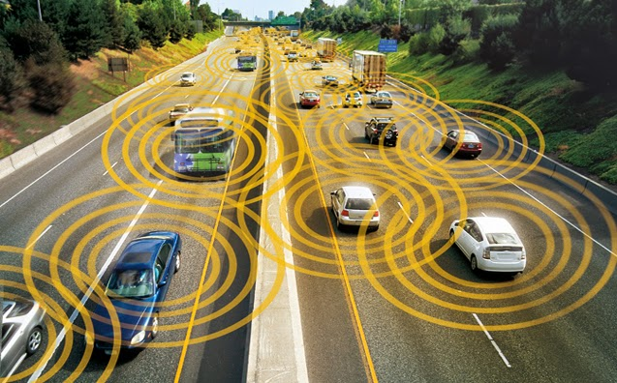



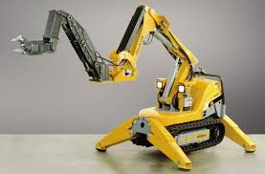
Direction 3: Mission Critical /
Ultra-Reliable Low-Latency Communications (URLLC)
The Ultras

Slide 54
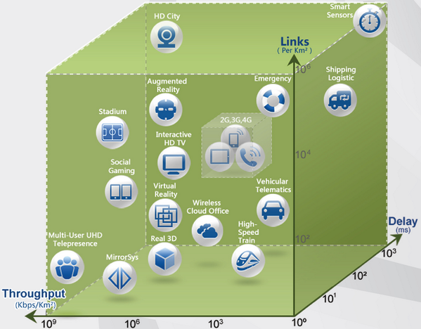
5G Requirements
5G hypercube
Notes:
54

Slide 55
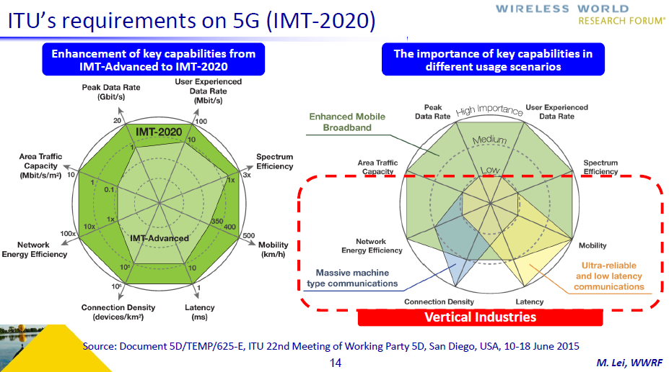

Slide 56
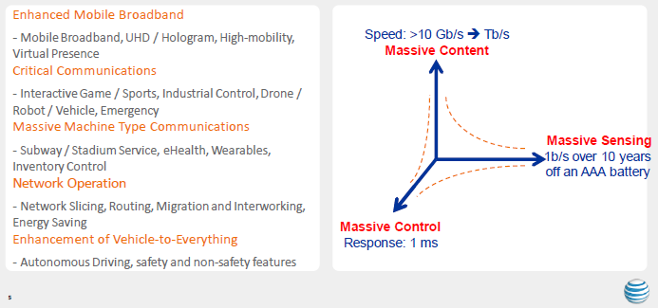
5G Use Cases Taxonomy
A. Dutta, AT&T

Slide 57
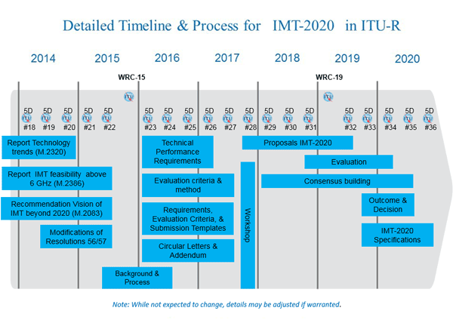
Detailed Timeline & Process for IMT-2020 in ITU-R
In early 2012, ITU-R embarked on a programme (lead by Working Party 5D) to develop “IMT for 2020 and beyond”, setting the stage for “5G” research activities.

Slide 58
Detailed Timeline & Process for IMT-2020 in ITU-R
In early 2012, ITU-R embarked on a programme (lead by Working Party 5D) to develop “IMT for 2020 and beyond”, setting the stage for “5G” research activities.
Will a similar process start in 2021 for 6G?

Slide 59
Detailed Timeline & Process for IMT-2020 in ITU-R
ITU-R IMT.2020 Contribution 2
29 June 2016
WP 5D meetings
2016
2017
2018
2019
2020
No.23
No.24
No.25
No.26
No.27
No.28
No.29
No.30
No.31
No.32
No.33
No.34
No.35
No.36
Step1 and 2
(0)
(40 months: #23 - #32)
Step 3
(20 months: #28 - #32)
(1)
Step 4
(16 months: #31 - #34)
(2)
Steps 5, 6, and 7
(28 months: #29 - #35)
(3)
Steps 8
(12 months: #33 - #36)
(4)
Steps in radio interface development process:
Step 1: Issuance of the circular letter
Step 5:
Review and coordination of outside evaluation activities
Step 2: Development of candidate RITs and SRITs
Step 6:
Review to assess compliance with minimum requirements
Step 3:
Submission/Reception of the RIT and SRIT proposals and acknowledgement of receipt
Step 7:
Consideration of evaluation results, consensus building and decision
Step 4:
Evaluation of candidate RITs and SRITs by Independent Evaluation Groups
Step 8:
Development of radio interface Recommendation(s)
Critical milestones in radio interface development process:
(0): Issue an invitation to propose RITs
March 2016
(2): Cut off for evaluation report to ITU
February 2020
(1): ITU proposed cut off for submission
July 2019
(3): WP 5D decides framework and key
June 2020
of candidate RIT and SRIT proposals
characteristics of IMT-2020 RIT and SRIT
-
(4): WP 5D completes development of radio
October 2020
interface specification Recommendations
IMT-2020 2-01

Slide 60
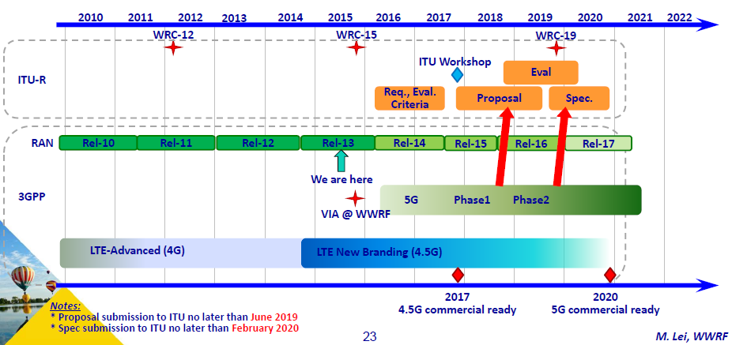
3GPP Timeline

Slide 61
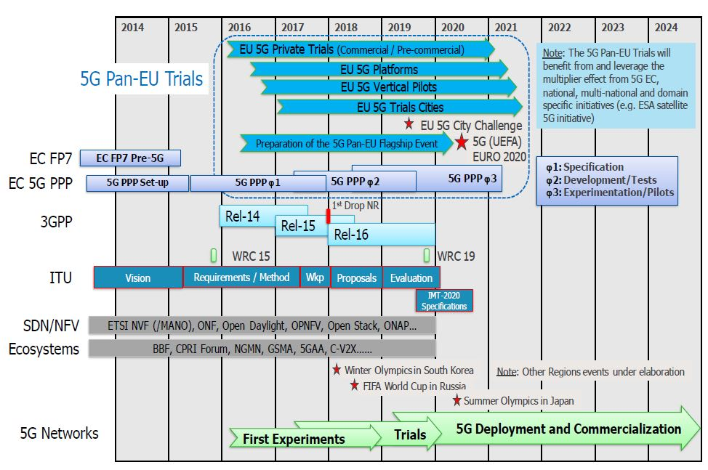
5G Eco-system Timeline
Notes:
61

Slide 62
Current Situation
MMTC: Release-13 NB-IoT (Narrowband IoT)
EMBB: Release-15 NR (New Radio)
URLLC: Release-16 and 5G+

Slide 63
Cellular/Wireless Generations: Use-Cases & Timeline
1980
1985
1990
1995
2000
2005
2010
2015
2020
2025
2030
2035
2040
2045
4G

Slide 64
Cellular/Wireless Generations: Use-Cases & Timeline
1980
1985
1990
1995
2000
2005
2010
2015
2020
2025
2030
2035
2040
2045
1G
2G
3G
4G
5G
6G

Slide 65
Cellular/Wireless Generations: Use-Cases & Timeline
1980
1985
1990
1995
2000
2005
2010
2015
2020
2025
2030
2035
2040
2045
1G
2G
3G
4G
5G
6G
mobile phone
novel use-cases

Slide 66
Cellular/Wireless Generations: Use-Cases & Timeline
1980
1985
1990
1995
2000
2005
2010
2015
2020
2025
2030
2035
2040
2045
1G
2G
3G
4G
5G
6G
mobile phone
novel use-cases
Wireless 2.0
Wireless ultra-connectivity

Slide 67
Part I: Use Cases
Generations of cellular technologies (1G → 4G)
3GPP
5G: A game changer
ICT
Concluding remarks

Slide 68
Access to Information
Books
Brick library
Notes:
68

Slide 69
Access to Information
Books
Brick library
Internet library
Notes:
69

Slide 70

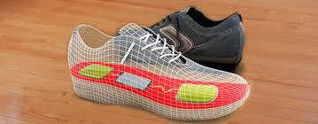
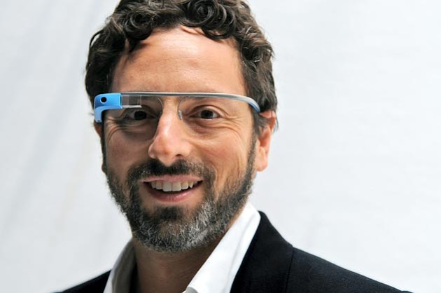
Access to Information
Books
Brick library
Internet library
Data of all sorts
Notes:
70

Slide 71
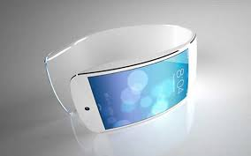
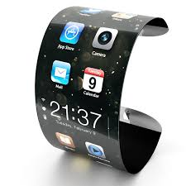

Access to Information
Books
Brick library
Internet library
Data of all sorts
Easy access (I/F)
Notes:
71

Slide 72


Access to Information
Books
Brick library
Internet library
Data of all sorts
Easy access (I/F)
Available before you ask/think
Notes:
72

Slide 73

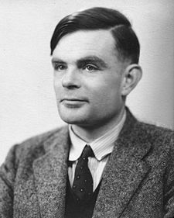
ICT – Information and Communication Technologies
Communications
Computing
Claude Shannon
1916 – 2001
Alan Turing
1912 – 1954
ICT

Slide 74

ICT – Information and Communication Technologies
Communications
Computing
Content
Claude Shannon
1916 – 2001
Alan Turing
1912 – 1954
ICT

Slide 75
ICT – Information and Communication Technologies
Communications
Computing
S. Andreev, O. Galinina, A. Pyattaev, J. Hosek,
P. Masek, H. Yanikomeroglu, Y. Koucheryavy,
“Exploring synergy between communications,
caching, and computing in 5G-grade
deployments”, IEEE Commun. Magazine, August 2016.
Content
Claude Shannon
1916 – 2001
Alan Turing
1912 – 1954
ICT

Slide 76
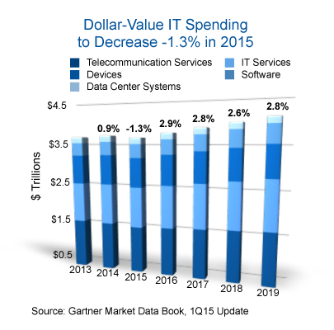
ICT: Becoming World’s Biggest Industry
ICT: Already ~5% of the global GDP

Slide 77


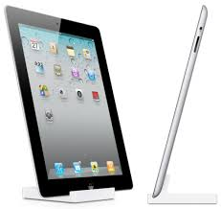
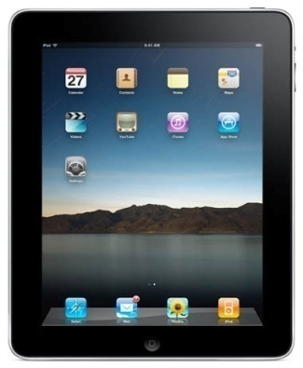
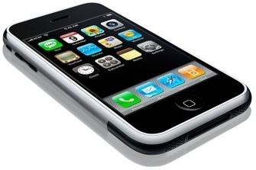

360
300
Number of Days to Reach 1 Million Units Sold
3
iPod
28
Blackberry
74
180
iPad2 (2011)
iPad (2010)
iPhone
Netbook

Slide 78
360
300
Number of Days to Reach 1 Million Units Sold
3
iPod
28
Blackberry
74
180
iPad2 (2011)
iPad (2010)
iPhone
Netbook
iPhone 5: 9 M during launch weekend (20-22 Sept 2013)

Slide 79
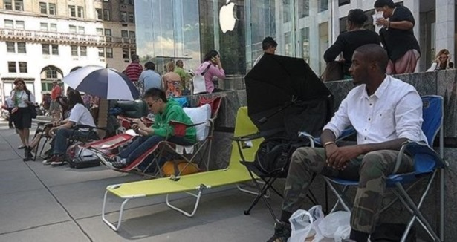
Number of Days to Reach 1 Million Units Sold
Apple Store, 59th Street & 5th Avenue, New York, 05 Sept 2014
iPhone 6: 10 M during launch weekend (19-21 Sept 2014)

Slide 80
Number of Days to Reach 1 Million Units Sold
Apple Store, 59th Street & 5th Avenue, New York, 05 Sept 2014
iPhone 6s & Plus: 13M during launch weekend (25-27 Sept 2015)

Slide 81
ICT: Becoming World’s Biggest Industry
ICT: Already ~5% of the global GDP
Cisco Consulting Services 2014 white paper:
IoT: $19 trillion opportunity over the next decade
Will soon become world’s largest industry sector – by far!

Slide 82
ICT Sector – Unprecedented Value
Market cap Employees Value/employee
Apple $878 B 116,000 $7.6 M 1976
Alphabet $707 B 79,000 $8.9 M 1998
Microsoft $650 B 124,000 $5.2 M 1975
Amazon $560 B 542,000 $1.0 M 1994
Facebook $509 B 21,000 $24.2 M 2004

Slide 83
ICT Sector – Unprecedented Value
Market cap Employees Value/employee
Apple $878 B 116,000 $7.6 M 1976
Alphabet $707 B 79,000 $8.9 M 1998
Microsoft $650 B 124,000 $5.2 M 1975
Amazon $560 B 542,000 $1.0 M 1994
Facebook $509 B 21,000 $24.2 M 2004
WhatsApp $22 B 55 $400 M 2009

Slide 84
ICT Sector – Unprecedented Value
Market cap Employees Value/employee
Apple $878 B 116,000 $7.6 M 1976
Alphabet $707 B 79,000 $8.9 M 1998
Microsoft $650 B 124,000 $5.2 M 1975
Amazon $560 B 542,000 $1.0 M 1994
Facebook $509 B 21,000 $24.2 M 2004
WhatsApp $22 B 55 $400 M 2009
S. Aramco ~$2 T

Slide 85
ICT Sector – Unprecedented Value
Market cap Employees Value/employee
Apple $878 B 116,000 $7.6 M 1976
Alphabet $707 B 79,000 $8.9 M 1998
Microsoft $650 B 124,000 $5.2 M 1975
Amazon $560 B 542,000 $1.0 M 1994
Facebook $509 B 21,000 $24.2 M 2004
WhatsApp $22 B 55 $400 M 2009
S. Aramco ~$2 T
Several ICT companies will be more
valuable than S. Aramco in the next decade

Slide 86
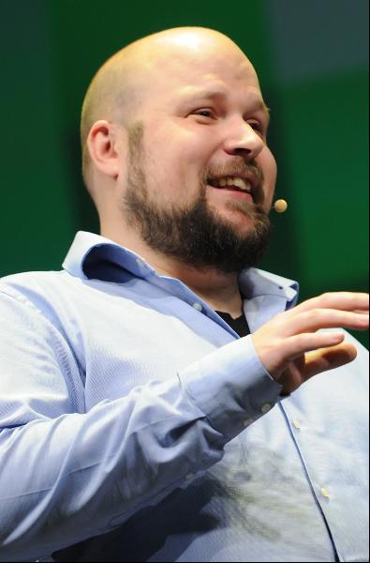



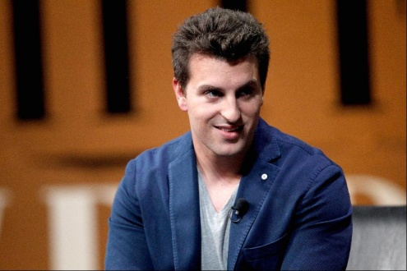
Forbes 2015 Newcomers
Evan Spiegel and Bobby Murphy
Net worth: $1.5 B each
Source of wealth: Snapchat
Markus "Notch" Persson
Net worth: $1.3 B
Source of wealth: Minecraft
(video game)
Travis Kalanick
Net worth: $5.3 B
Source of wealth: Uber
(car service)
Kim Bum-Soo
Net worth: $2.9 B
Source of wealth: KakaoTalk
(mobile chat service)
Brian Chesky
Net worth: $1.9 B
Source of wealth: Airbnb
Notes:
86

Slide 87
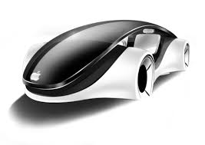
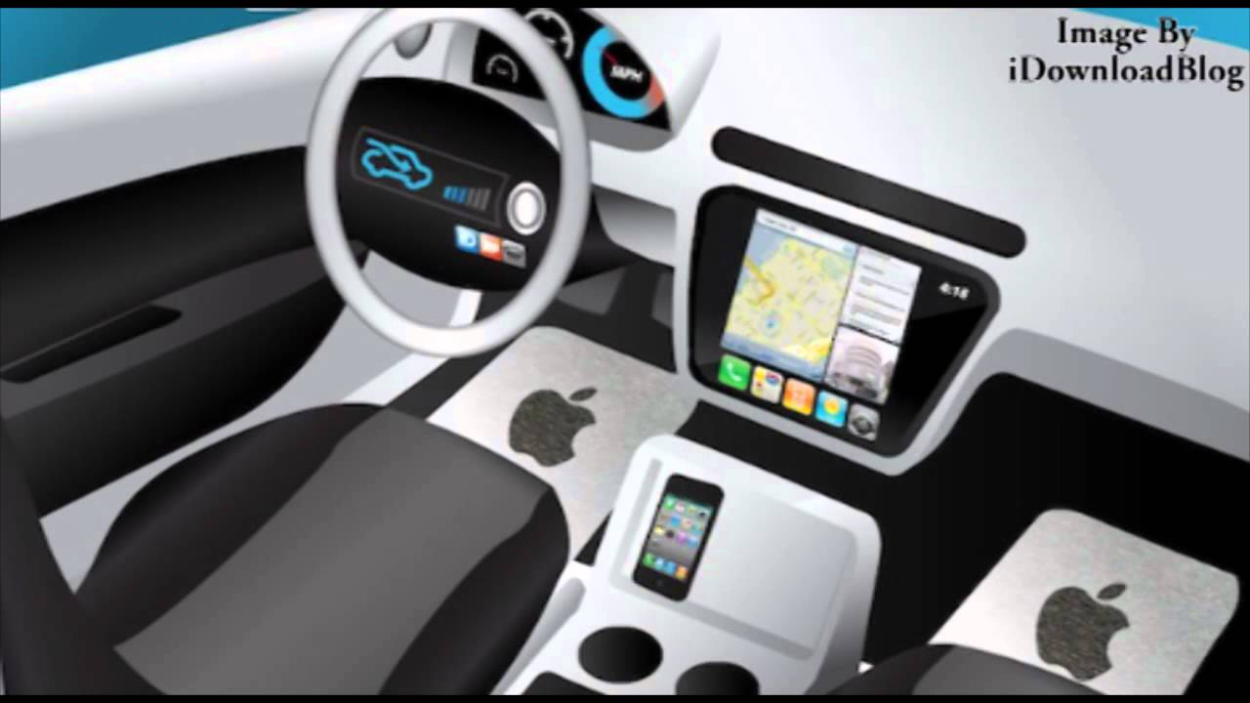
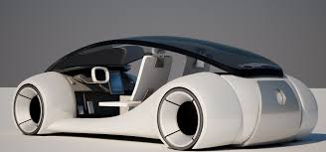
iCar → What is Next?
Nothing will be the same again

Slide 88
Part I: Use Cases
Generations of cellular technologies (1G → 4G)
3GPP
5G: A game changer
ICT
Concluding remarks

Slide 89
5G Ecosystem: Big!
Standards, Fora
Vendors
Operators
Research
Vertical Industries
New Players
Research
Policy

Slide 90
Today: ICT is an Important Sector
Energy
Health
Entertainment
Transportation
Automotive
Agriculture
ICT (4G,…)
Education
Hospitality
Municipalities
Defence
Public Safety

Slide 91
Tomorrow: ICT is the Most Important Sector in Digital Economy
Energy
Health
Entertainment
Transportation
Automotive
Agriculture
ICT (5G,…)
Education
Hospitality
Municipalities
Telecom
→ ICT
→ Vertical Industries
Defence
Public Safety

Slide 92
Eventually: ICT is the Only Sector in Digital Economy
Energy
Health
Entertainment
Transportation
Automotive
Agriculture
ICT (W2.0,…)
Education
Municipalities
Defence
Public Safety
W2.0: Wireless
ultra-connectivity
is at the heart of ICT

Slide 93
Part II: Technical Requirements
From 4G to 5G
Rate: Fundamental enablers
Near-term enabling technologies
Public safety networks
Radio security: Threats and vulnerabilities
WLANs
Concluding remarks

Slide 94
From 4G to 5G (1/8)
1) 4G: R8 LTE (2009), R9 (2010), R10 LTE-A (2011)

Slide 95
Key Technologies for LTE/LTE-Advanced (R8, R9, R10)
OFDM
MIMO
Spectrum aggregation
HetNet, Relay [to be matured]
CoMP (coordinated multipoint) [moved to R11]
→ A number of LTE/LTE-A technologies were ahead of their time
DL: 1 Gbps hotspot / 100 Mbps mobile

Slide 96
From 4G to 5G (2/8)
1) 4G: R8 LTE (2009), R9 (2010), R10 LTE-A (2011)
2) 4G clean-up + new use-cases: R11 (2013), R12 (2015), R13 (2016)

Slide 97
R12 Enhancements (June 2011 – March 2015)
Public safety and critical communications, D2D
Group communications
MTC
UE power consumption, small data
Optimized offloading to WLAN

Slide 98
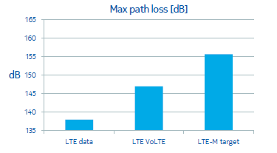
R13 Enhancements (Sep 2012 – Mar 2016)
LTE in Unlicensed (U-LTE) [LAA (Licensed-Assisted Aggregation)]
Carrier aggregation enhancements (up to 32 CCs)
Enhancements for MTC (high path-loss tolerance)
Enhanced multiuser transmission techniques
Elevation beamforming / Full-dimension MIMO
8 → 64 antenna ports
Enhancements for D2D
Indoor positioning
Single-cell point-to-multipoint
http://www.3gpp.org/news-events/3gpp-news/1628-rel13
Nokia white paper

Slide 99
From 4G to 5G (3/8)
1) 4G: R8 LTE (2009), R9 (2010), R10 LTE-A (2011)
2) 4G clean-up + new use-cases: R11 (2013), R12 (2015), R13 (2016)
3) 5G brainstorming (2012 – 2015)

Slide 100
5G Brainstorming in EU
EU Framework Program 7 Call 8 projects (2012 – 2015)
METIS (2012 – 2015): https://www.metis2020.com/documents
EU Framework Program 8, Horizon 2020 (2014 – 2020)
METIS II (July 2015 – June 2017)
5G PPP – The 5G Infrastructure Public Private Partnership (2014)

Slide 101
From 4G to 5G (4/8)
1) 4G: R8 LTE (2009), R9 (2010), R10 LTE-A (2011)
2) 4G clean-up + new use-cases: R11 (2013), R12 (2015), R13 (2016)
3) 5G brainstorming (2012 – 2015)
4) 5G spectrum: ITU WRC-15 (Nov 2015, Geneva); ITU WRC-19

Slide 102
5G Spectrum
WRC 2019
“Study additional bands above 6 GHz for expanded mobile broadband capacity, setting the stage for the next generation of wireless networks”.
“Will also consider spectrum allocations for High-Altitude Platform Systems, which will enable lower-cost delivery of bandwidth for developing economies and remote areas around the globe”.

Slide 103
From 4G to 5G (5/8)
1) 4G: R8 LTE (2009), R9 (2010), R10 LTE-A (2011)
2) 4G clean-up + new use-cases: R11 (2013), R12 (2015), R13 (2016)
3) 5G brainstorming (2012 – 2015)
4) 5G spectrum: ITU WRC-15 (Nov 2015, Geneva); ITU WRC-19
5) 5G definition: ITU circular letter, IMT-2020 (2016)

Slide 104
From 4G to 5G (6/8)
1) 4G: R8 LTE (2009), R9 (2010), R10 LTE-A (2011)
2) 4G clean-up + new use-cases: R11 (2013), R12 (2015), R13 (2016)
3) 5G brainstorming (2012 – 2015)
4) 5G spectrum: ITU WRC-15 (Nov 2015, Geneva); ITU WRC-19
5) 5G definition: ITU circular letter, IMT-2020 (2016)
6) 5G standard development: R14 (2017), R15 (2018), R16 (2019)

Slide 105
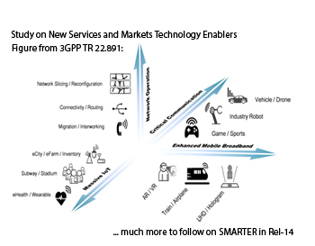
R14 Enhancements (March 2016 – June 2017)
Mission critical enhancements
V2x support
eLAA
4 band carrier aggregation
http://www.3gpp.org/release-14

Slide 106
5G Standard Development
R14: June 2017
R15: H2 2018
R16: Dec 2019
RAN 5G Workshop , 18-19 Sep 2015 – “The Start of Something”
Enhanced Mobile Broadband
Massive Machine Type Communications
Ultra-reliable and Low-Latency Communications

Slide 107
From 4G to 5G (7/8)
1) 4G: R8 LTE (2009), R9 (2010), R10 LTE-A (2011)
2) 4G clean-up + new use-cases: R11 (2013), R12 (2015), R13 (2016)
3) 5G brainstorming (2012 – 2015)
4) 5G spectrum: ITU WRC-15 (Nov 2015, Geneva); ITU WRC-19
5) 5G definition: ITU circular letter, IMT-2020 (2016)
6) 5G standard development: R14 (2017), R15 (2018), R16 (2019)
7) 5G standard approval (~2020)

Slide 108
From 4G to 5G (8/8)
1) 4G: R8 LTE (2009), R9 (2010), R10 LTE-A (2011)
2) 4G clean-up + new use-cases: R11 (2013), R12 (2015), R13 (2016)
3) 5G brainstorming (2012 – 2015)
4) 5G spectrum: ITU WRC-15 (Nov 2015, Geneva); ITU WRC-19
5) 5G definition: ITU circular letter, IMT-2020 (2016)
6) 5G standard development: R14 (2017), R15 (2018), R16 (2019)
7) 5G standard approval (~2020)
8) 5G evolution (2020–2030): R17, …

Slide 109
Part II: Technical Requirements
From 4G to 5G
Rate: Fundamental enablers
Near-term enabling technologies
Public safety networks
Radio security: Threats and vulnerabilities
WLANs
Concluding remarks

Slide 110
Peak Data Rates in the Next 30 Years
1990 – 2020: Kbps → Gbps
2020 – 2050: Gbps → Pbps ?

Slide 111
Gbps Wireless → Tbps (10¹²) Wireless → Pbps (10¹⁵) Wireless ?
Fundamental dynamics: 3 + 1 rule
BS capacity
  Bandwidth: W
  Received power: P_{s}
  Min # of antennas: n
}
R_{BS} = n x W x log(1+SNR) = n x W x log(1+P_{s} /nWN₀)
Notes:
111

Slide 112
Gbps Wireless → Tbps (10¹²) Wireless → Pbps (10¹⁵) Wireless ?
Fundamental dynamics: 3 + 1 rule
BS capacity
  Bandwidth: W
  Received power: P_{s}
  Min # of antennas: n
None of the three variables scales well!
}
R_{BS} = n x W x log(1+SNR) = n x W x log(1+P_{s} /nWN₀)
Notes:
112

Slide 113
Gbps Wireless → Tbps (10¹²) Wireless → Pbps (10¹⁵) Wireless ?
Fundamental dynamics: 3 + 1 rule
BS capacity
  Bandwidth: W
  Received power: P_{s}
  Min # of antennas: n
None of the three variables scales well!
Ex 1: n = 16, W = 250 MHz, log(SNR) = 10 → 40 Gbps
}
R_{BS} = n x W x log(1+SNR) = n x W x log(1+P_{s} /nWN₀)
Notes:
113

Slide 114
Gbps Wireless → Tbps (10¹²) Wireless → Pbps (10¹⁵) Wireless ?
Fundamental dynamics: 3 + 1 rule
BS capacity
  Bandwidth: W
  Received power: P_{s}
  Min # of antennas: n
None of the three variables scales well!
Ex 1: n = 16, W = 250 MHz, log(SNR) = 10 → 40 Gbps
Ex 2: n = 100, W = 7 GHz, log(SNR) = 15 → 10.5 Tbps
}
R_{BS} = n x W x log(1+SNR) = n x W x log(1+P_{s} /nWN₀)
Notes:
114

Slide 115
Gbps Wireless → Tbps (10¹²) Wireless → Pbps (10¹⁵) Wireless ?
Fundamental dynamics: 3 + 1 rule
Network capacity
  # of BSs: K
}
R_{network} = K x n x W x log(SNR)
Notes:
115

Slide 116
Gbps Wireless → Tbps (10¹²) Wireless → Pbps (10¹⁵) Wireless ?
Fundamental dynamics: 3 + 1 rule
Network capacity
  # of BSs: K
Increasing BS capacity: Relatively difficult!
Increasing network capacity: Relatively easy!
}
R_{network} = K x n x W x log(SNR)
Notes:
116

Slide 117
Peak Rates
More bandwidth, more MIMO, more spectral efficiency (received power)
Notes:
117

Slide 118
Peak Rates
More bandwidth, more MIMO, more spectral efficiency (received power)
Outdoors: More difficult to increase beyond tens of Gbps
Notes:
118

Slide 119
Peak Rates
More bandwidth, more MIMO, more spectral efficiency (received power)
Outdoors: More difficult to increase beyond tens of Gbps
Indoors: Can increase towards Tbps
Ex 1: n = 16, W = 250 MHz, log(SNR) = 10 → 40 Gbps
Ex 2: n = 100, W = 7 GHz, log(SNR) = 15 → 10.5 Tbps
Enablers:
Higher frequencies, millimeter wave, THz, light → huge bandwidth
Short wavelength → massive MIMO
Pencil beams → interference rejection, high spectral efficiency
Notes:
119

Slide 120
Peak Rates
More bandwidth, more MIMO, more spectral efficiency (received power)
Outdoors: More difficult to increase beyond tens of Gbps
Indoors: Can increase towards Tbps
Ex 1: n = 16, W = 250 MHz, log(SNR) = 10 → 40 Gbps
Ex 2: n = 100, W = 7 GHz, log(SNR) = 15 → 10.5 Tbps
Enablers:
Higher frequencies, millimeter wave, THz, light → huge bandwidth
Short wavelength → massive MIMO
Pencil beams → interference rejection, high spectral efficiency
More APs (small cells)
Network Capacity
Notes:
120

Slide 121
Part II: Technical Requirements
From 4G to 5G
Rate: Fundamental enablers
Near-term enabling technologies
Public safety networks
Radio security: Threats and vulnerabilities
WLANs
Concluding remarks

Slide 122
Some Enabling Technologies in LTE-A Evolution
Carrier aggregation (licensed and unlicensed)
Advanced MIMO (multi-layer, adaptive beamforming)
D2D, terminal relaying (cellular-assisted multihop)
Advanced CoMP (cloud-RAN)
HetNet (heterogeneous networks)
SON+ (self-organizing, self-configuring, self-healing networks)
FeICIC (further enhanced intercell interference coordination)
Interference rejection (beamforming @ terminal)

Slide 123
The Three Major Enabling 5G Technologies
Massive MIMO
Millimeter-wave
Small Cell

Slide 124
The Three Major Enabling 5G Technologies
Massive MIMO
Millimeter-wave
Small Cell
Not available anytime soon…

Slide 125
The Three Major Enabling 5G Technologies
Massive MIMO
Millimeter-wave
Small Cell
Not available anytime soon…
Cost…

Slide 126
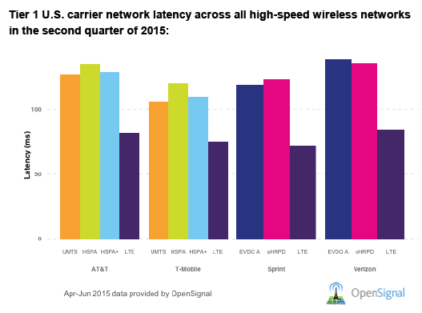
Latency
A. Sharifian, R. Schoenen, H. Yanikomeroglu, “Joint realtime and non-realtime flows packet scheduling and resource block allocation in wireless OFDMA networks”, IEEE Trans.Vehicular Tech, April 2016.
Notes:
126

Slide 127
Latency
Is 1 ms round-trip delay possible?
Transmission at the speed of light:
(10⁻³ s) x (3x10⁸ m/s) /2 = 150 km
Add buffering delay + queuing delay + scheduling delay + all types of protocol-induced delay
Notes:
127

Slide 128
Latency
Is 1 ms round-trip delay possible?
Transmission at the speed of light:
(10⁻³ s) x (3x10⁸ m/s) /2 = 150 km
Add buffering delay + queuing delay + scheduling delay + all types of protocol-induced delay
1 ms latency:
  D2D
  Edge-catching
  AI-based advanced prediction
Notes:
128

Slide 129
Latency
Is 1 ms round-trip delay possible?
Transmission at the speed of light:
(10⁻³ s) x (3x10⁸ m/s) /2 = 150 km
Add buffering delay + queuing delay + scheduling delay + all types of protocol-induced delay
1 ms latency:
  D2D
  Edge-catching
  AI-based advanced prediction
Latency is the new rate
Notes:
129

Slide 130
Part II: Technical Requirements
From 4G to 5G
Rate: Fundamental enablers
Near-term enabling technologies
Public safety networks
Radio security: Threats and vulnerabilities
WLANs
Concluding remarks

Slide 131
Public Safety Networks
Terrestrial Trunked Radio (TETRA)
ETSI (European Telecommunications Standards Institute) standard
APCO-25
Association of Public-Safety Communications Officials – International (APCO)

Slide 132
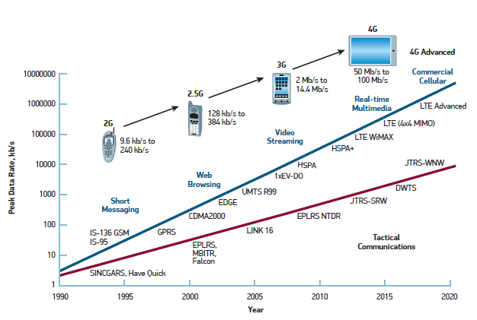
Commercial vs Public Safety & Tactical Communications
LTE Infrastructure for Command and Control Networks
Radisys While Paper, June 2013

Slide 133
Recent Developments in USA
700 MHz spectrum for public safety
First Responder Network Authority (FirstNet) [22 Feb 2012]
  “FirstNet will provide a single interoperable platform for emergency and daily public safety communications”
  $100B
  LTE based
AT&T won the bid (2017)

Slide 134
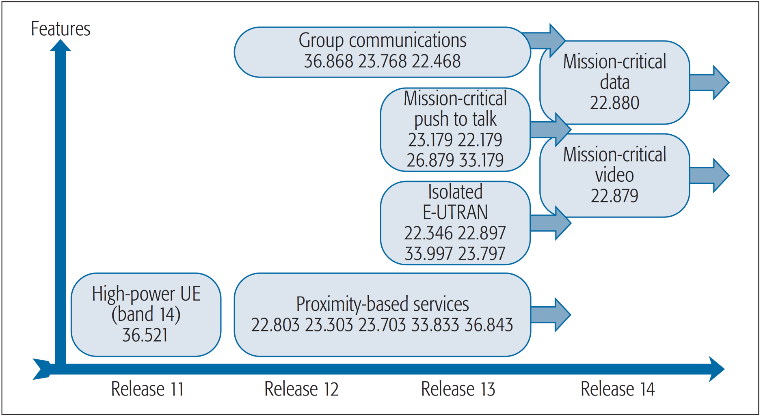
Public Safety in LTE-A

Slide 135
Part II: Technical Requirements
From 4G to 5G
Near-term enabling technologies
Rate: Fundamental enablers
Public safety networks
Radio security: Threats and vulnerabilities
WLANs
Concluding remarks

Slide 136
Radio Security: Threats and Vulnerabilities
New threats
Precision / targeted jamming
Solutions: Expensive

Slide 137
Part II: Technical Requirements
From 4G to 5G
Rate: Fundamental enablers
Near-term enabling technologies
Public safety networks
Radio security: Threats and vulnerabilities
WLANs
Concluding remarks

Slide 138
WLAN: Renewed Momentum
802.11ad – 60 GHz, 6.8 Gbps
WiGig Alliance (subsumed by WiFi Alliance, Mar 2013)
802.11ac – 5 GHz, Gigabit WiFi (Feb 2014)
802.11af – TV whitespace (Jun 2014)
802.11ah – Sub 1 GHz, sensor networks (Jan 2016)
802.11ai – Fast initial link set-up (Feb 2015)
802.11p – DSRC (dedicated short-range communications)

Slide 139
WLAN: Renewed Momentum
802.11ad – 60 GHz, 6.8 Gbps
WiGig Alliance (subsumed by WiFi Alliance, Mar 2013)
802.11ac – 5 GHz, Gigabit WiFi (Feb 2014)
802.11af – TV whitespace (Jun 2014)
802.11ah – Sub 1 GHz, sensor networks (Jan 2016)
802.11ai – Fast initial link set-up (Feb 2015)
802.11p – DSRC (dedicated short-range communications)
HEW: Highly Efficient WLAN
(study group: Mar 2013, task group: Jul 2014)
“dense network environments with large numbers of access points and stations”
802.11ax – 160 MHz @ 5 GHz, 10+ Gbps (2018-2019)

Slide 140
Difference between Cellular and WLAN
WLAN: No coordination between APs, no interference management
  High peak rates
  Low edge rates
  Dense APs: Low rates
  Many users: Low rates
Test in Japan by NTT DoCoMo (2013)
Downlink speeds: LTE: 10 Mbps, WiFi: 1 Mbps

Slide 141
Part II: Technical Requirements
From 4G to 5G
Rate: Fundamental enablers
Near-term enabling technologies
Public safety networks
Radio security: Threats and vulnerabilities
WLANs
Concluding remarks

Slide 142
From Research to Deployment – A Long Journey
Research
Conceptualization
Standardization
Deployment

Slide 143
From Research to Deployment – A Long Journey
Research
Conceptualization
Standardization
Deployment
4G, 4G+, 5G,
5G+, 6G, …
5G+
4G+, 5G
4G

Slide 144
From Research to Deployment – A Long Journey
Research
Conceptualization
Standardization
Deployment
4G, 4G+, 5G,
5G+, 6G, …
5G+
4G+, 5G
4G
From Invention/Envision to Standards:

Slide 145
From Research to Deployment – A Long Journey
Research
Conceptualization
Standardization
Deployment
4G, 4G+, 5G,
5G+, 6G, …
5G+
4G+, 5G
4G
From Invention/Envision to Standards:
Invention (tangible subsystem, algorithm): 10 years
Ex: Polar codes: 2008 → 2018 (3GPP release 15)

Slide 146
From Research to Deployment – A Long Journey
Research
Conceptualization
Standardization
Deployment
4G, 4G+, 5G,
5G+, 6G, …
5G+
4G+, 5G
4G
From Invention/Envision to Standards:
Invention (tangible subsystem, algorithm): 10 years
Ex: Polar codes: 2008 → 2018 (3GPP release 15)
Envision (system, architecture): Decades
Ex: Cooperative communications: 1971 → 5G/5G+ (?)
Ex: Totally autonomous vehicle: 1960s → 2050 (?)

Slide 147
5G → 6G
Will 5G → 6G roadmap be similar to 4G → 5G roadmap?
  Near-term: Towards 2020 (5G standardization)
  Middle-term: early 2020s (5G evolution)
  Long-term: mid/late 2020s (6G discussions)
Notes:
147

Slide 148
5G → 6G
Will 5G → 6G roadmap be similar to 4G → 5G roadmap?
  Near-term: Towards 2020 (5G standardization)
  Middle-term: early 2020s (5G evolution)
  Long-term: mid/late 2020s (6G discussions)
Many of the articulated scenarios, use cases, and technologies for 5G:
Will continue during 5G → 6G era with a more mature market
Notes:
148

Slide 149
5G → 6G
Will 5G → 6G roadmap be similar to 4G → 5G roadmap?
  Near-term: Towards 2020 (5G standardization)
  Middle-term: early 2020s (5G evolution)
  Long-term: mid/late 2020s (6G discussions)
Many of the articulated scenarios, use cases, and technologies for 5G:
Will continue during 5G → 6G era with a more mature market
Ecosystem will likely be driven by new players
Notes:
149

Slide 150
5G → 6G will be very interesting
Looking forward to collaboration towards
6G wireless
http://www.sce.carleton.ca/faculty/yanikomeroglu/cv/publications.shtml
http://www.sce.carleton.ca/faculty/yanikomeroglu/cv/patents.shtml
http://www.sce.carleton.ca/faculty/yanikomeroglu/cv/theses.shtml

Slide 151
Part III: Ultra-Agile Networks for Wireless Ultra-Connectivity (~250 slides)
Problem Statement and Solution Guidelines
HetHetNets: 5G+ Traffic Models
Ultra-Agile Networks for Wireless Ultra-Connectivity
  Spectrum
  Aerial BSs (Non-Terrestrial Networks
  User-in-the-Loop (UIL: Demand Shaping in Space & Time)
  Advanced PHY
    Optimized PHY with Massive Look-Up Tables
    Non-Coherent Communications
    Faster-Than-Nyquist Signaling
Concluding Remarks

Slide 152
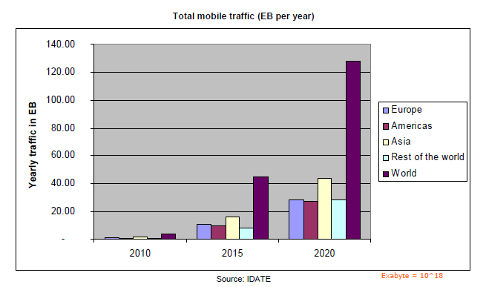
Challenge 1:
Extremely high traffic

Slide 153
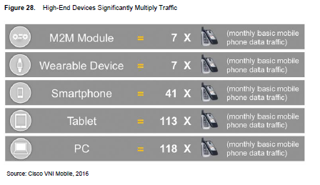
Challenge 2:
Extremely variable traffic
Challenge 1:
Extremely high traffic

Slide 154
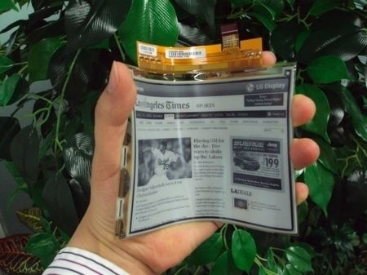


Challenge 2:
Extremely variable traffic
Challenge 1:
Extremely high traffic

Slide 155



Challenge 2:
Extremely variable traffic
Challenge 1:
Extremely high traffic

Slide 156

Challenge 2:
Extremely variable traffic
Challenge 1:
Extremely high traffic
Challenge 3:
Nobody wants to pay for it!

Slide 157
Challenge 2:
Extremely variable traffic
Challenge 1:
Extremely high traffic
Challenge 3:
Nobody wants to pay for it!
Challenge 4:
Novel services and applications

Slide 158

Challenge 2:
Extremely variable traffic
Challenge 1:
Extremely high traffic
Challenge 3:
Nobody wants to pay for it!
rate
Challenge 4:
Novel services and applications
new QoS requirements
more differentiation
latency
reliability

Slide 159
Challenge 2:
Extremely variable traffic
Challenge 1:
Extremely high traffic
Challenge 3:
Nobody wants to pay for it!
rate
energy efficiency
security
Challenge 4:
Novel services and applications
new QoS requirements
more differentiation
latency
cost
reliability

Slide 160



Challenge 2:
Extremely variable traffic
Challenge 1:
Extremely high traffic
Challenge 3:
Nobody wants to pay for it!
Challenge 4:
Novel services and applications
new QoS requirements
more differentiation
Challenge 5:
Complex user

Slide 161
Part III: Ultra-Agile Networks for Wireless Ultra-Connectivity (~250 slides)
Problem Statement and Solution Guidelines
HetHetNets: 5G+ Traffic Models
Ultra-Agile Networks for Wireless Ultra-Connectivity
  Spectrum
  Aerial BSs (Non-Terrestrial Networks
  User-in-the-Loop (UIL: Demand Shaping in Space & Time)
  Advanced PHY
    Optimized PHY with Massive Look-Up Tables
    Non-Coherent Communications
    Faster-Than-Nyquist Signaling
Concluding Remarks

Slide 162
Problem Formulation
Vertical industries & novel use cases → Ultra demanding

Slide 163
Problem Formulation
Vertical industries & novel use cases → Ultra demanding
Ultra-high speed
Ultra-high reliability
Ultra-low latency
Ultra-high # of connections
Ultra-high energy efficiency
Ultra-high security
Ultra availability
Ultra …

Slide 164
Problem Formulation
Vertical industries & novel use cases → Ultra demanding
Ultra-high speed
Ultra-high reliability
Ultra-low latency
Ultra-high # of connections
Ultra-high energy efficiency
Ultra-high security
Ultra availability
Ultra …
Unpredictable and heavy-tail demand

Slide 165
Problem Formulation
Vertical industries & novel use cases → Ultra demanding
Ultra-high speed
Ultra-high reliability
Ultra-low latency
Ultra-high # of connections
Ultra-high energy efficiency
Ultra-high security
Ultra availability
Ultra …
Unpredictable and heavy-tail demand
Cost efficient / Affordable

Slide 166
Problem Formulation
Vertical industries & novel use cases → Ultra demanding
Ultra-high speed
Ultra-high reliability
Ultra-low latency
Ultra-high # of connections
Ultra-high energy efficiency
Ultra-high security
Ultra availability
Ultra …
Unpredictable and heavy-tail demand
Cost efficient / Affordable
Design the Network
?

Slide 167
Problem Formulation
Vertical industries & novel use cases → Ultra demanding
Ultra-high speed
Ultra-high reliability
Ultra-low latency
Ultra-high # of connections
Ultra-high energy efficiency
Ultra-high security
Ultra availability
Ultra …
Unpredictable and heavy-tail demand
Cost efficient / Affordable
Ultra-Agile Network
for
Wireless-Ultra Connectivity

Slide 168
Part III: Ultra-Agile Networks for Wireless Ultra-Connectivity (~250 slides)
Problem Statement and Solution Guidelines
HetHetNets: 5G+ Traffic Models
Ultra-Agile Networks for Wireless Ultra-Connectivity
  Spectrum
  Aerial BSs (Non-Terrestrial Networks
  User-in-the-Loop (UIL: Demand Shaping in Space & Time)
  Advanced PHY
    Optimized PHY with Massive Look-Up Tables
    Non-Coherent Communications
    Faster-Than-Nyquist Signaling
Concluding Remarks

Slide 169
Concluding Remarks
5G: Start of the ultra-connectivity era (W2.0)

Slide 170
Concluding Remarks
5G: Start of the ultra-connectivity era (W2.0)
Brute-force approaches result in over-engineering → not feasible
An ultra-agile network is essential for efficient super-connectivity
Micromanage: Dynamic & adaptive from A-to-Z (opportunistically)

Slide 171
Concluding Remarks
5G: Start of the ultra-connectivity era (W2.0)
Brute-force approaches result in over-engineering → not feasible
An ultra-agile network is essential for efficient super-connectivity
Micromanage: Dynamic & adaptive from A-to-Z (opportunistically)
Operator-user (client-server) distinction will get fuzzy
Novel architecture, novel enablers, novel business models, …

Slide 172
Concluding Remarks
5G: Start of the ultra-connectivity era (W2.0)
Brute-force approaches result in over-engineering → not feasible
An ultra-agile network is essential for efficient super-connectivity
Micromanage: Dynamic & adaptive from A-to-Z (opportunistically)
Operator-user (client-server) distinction will get fuzzy
Novel architecture, novel enablers, novel business models, …
Need for a lot of exciting research and out-of-the-box thinking!

Slide 173
Looking forward to collaboration towards
6G wireless
THANK YOU
http://www.sce.carleton.ca/faculty/yanikomeroglu/cv/publications.shtml
http://www.sce.carleton.ca/faculty/yanikomeroglu/cv/patents.shtml
http://www.sce.carleton.ca/faculty/yanikomeroglu/cv/theses.shtml

