Slide 1
Fundamentals of Cellular Communications and Networks
Halim Yanikomeroglu
SYSC 4700
Lectures 15 (March 06) & 16 (March 08)

Slide 2
Objectives
To learn some fundamental concepts in cellular communications such as
Multiple access
Channel reuse
Clustering
Cell-splitting
Sectoring
Interference
Duplexing
Heterogeneous cellular network

Slide 3
Multiple Access Schemes
Dedicated medium vs shared medium
Shared Medium
Random access (minimal protocol, no or minimal coordination)
No or limited QoS guarantee
Suitable for unlicensed bands
ALOHA
CSMA (carrier sense multiple access), aka listen-before-talk – used in WiFi (802.11)

Slide 4
Multiple Access Schemes
Dedicated medium vs shared medium
Shared Medium
Random access (minimal protocol, no or minimal coordination)
No or limited QoS guarantee
Suitable for unlicensed bands
ALOHA
CSMA (carrier sense multiple access), aka listen-before-talk – used in WiFi (802.11)
Scheduled access (protocol for coordination → overhead)
QoS quarantee
Suitable for licensed bands
TDMA (time-division multiple access)
FDMA (frequency-division multiple access), OFDMA – used in 4G cellular
CDMA (code-division multiple access) – used in 3G cellular

Slide 5
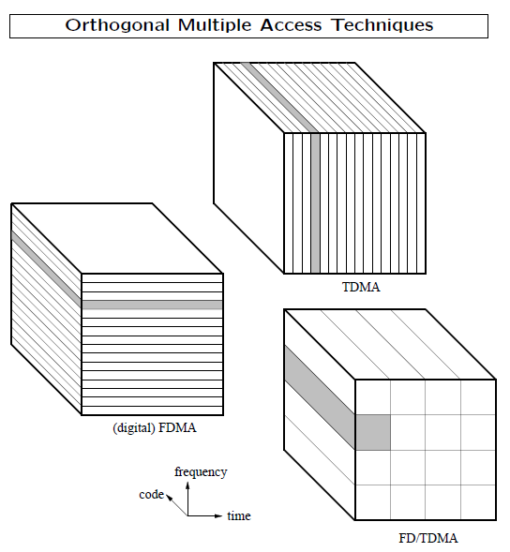

Slide 6
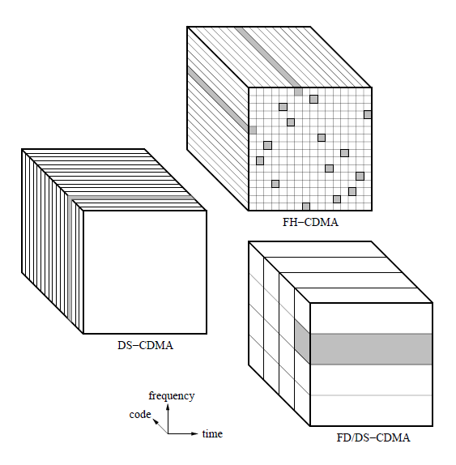

Slide 7
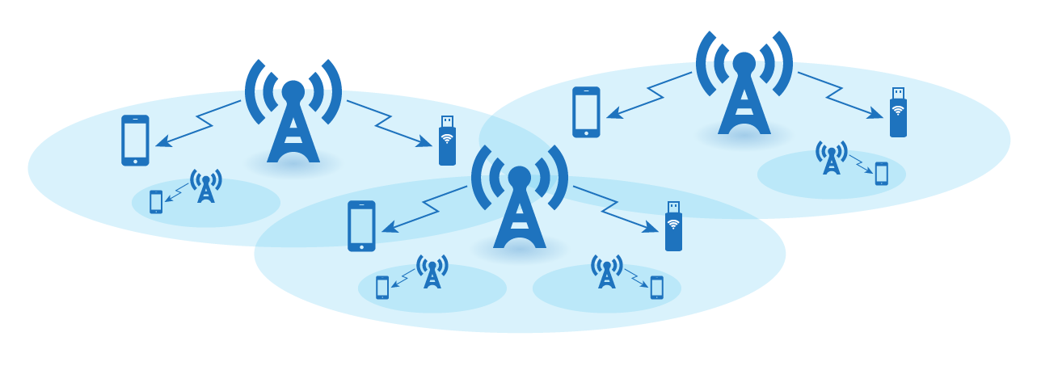
Wireless Cellular Networks

Slide 8
Wireless Cellular Networks
Handoff → Seamless roaming
Network-wide managing channel reuse
through network-wide frequency (channel) planning
→ Quality-of-Service (QoS) guarantee

Slide 9
Wireless access
Through access points (base stations), coupled to the wired (core) network
Attain coverage with minimum infrastructure cost
Put as few base stations as possible

Slide 10
Channel Reuse (1/3)
Problem: Number of channels << number of active users!
Ex: # of users (subscribers) = 200,000 Percentage of active users = 5% # number of active users = 10,000 BW leased = 10 MHz BW required per user = 25 KHz
400 << 10,000 !!!
How can you service 10,000 users with only 400 channels?
Answer: Reuse the channels (radio resources)
# available channels = 10 MHz/ 25 KHz = 400

Slide 11
Channel Reuse (2/3)
A naïve approach in RAN (Radio Access Network) design:
1 BS (1 cell) gives service to all 10,000 active users
Each of the 400 channels is reused 25 times in the one-cell network (400 x 25 = 10,000)
SIR = (1 good signal)/(24 interfering signals) = 1/24 = -14 dB!
Extremely unreliable channel → No application will run…
Refine RAN (i.e., more infrastructure + protocol + complexity for enhanced performance)

Slide 12
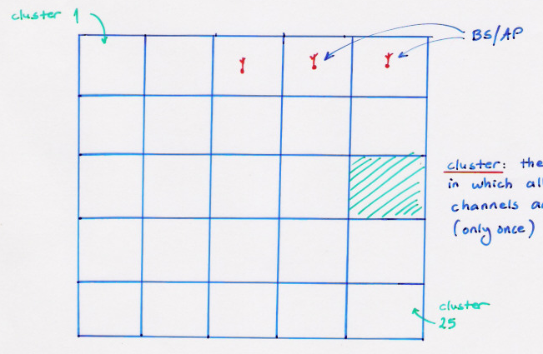
Channel Reuse (3/3)
Channel (frequency, time, code, hybrid) reuse in a coordinated manner → cellular concept
Ex: 25 reuses in non-overlapping areas (clusters). Each cluster is given service by 1 BS (cell)
Cluster: The area in which all the channels are used only once.

Slide 13
Interference due to Channel Reuse
Problem: If two users in adjacent clusters are served through the same channel i (one channel out of 400), then there will be excessive multiple access interference!
SIR = 1/1 = 0 dB (very low)
Multiple access interference: Inevitable in cellular systems, but can be regulated
Control and management of multiple access interference:
Radio resource management (RRM)
Optimization of assignment problems
BS/AP assignment
Power assignment
Channel assignment

Slide 14
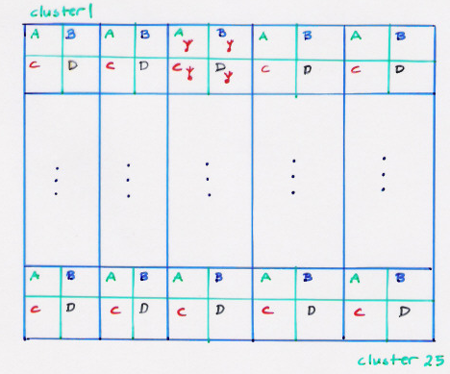
Regulating Channel Assignment (1/2)
Divide each cluster into cells (cell: area served by one base station)
4 cells/cluster
Cluster size: N=4
Reuse factor = 1/N = 1/4
A: ch 1 to 100
B: ch 101 to 200
C: ch 201 to 300
D: ch 301 to 400

Slide 15
Regulating Channel Assignment (2/2)
Cluster size N
N↑ → co-channel interference (CCI) ↓ → SIR ↓
N↑ → capacity/cell decreases (inefficient utilization of the infrastructure, this, the investment)
Example (400 channels per cluster):
A | B | A | B
C | D | C | D
A | B | A | B
C | D | C | D
A | B | A | B
A | B | A | B
A | B | A | B
A | B | A | B
Cluster size: N=4
# channels per cell = 100
Cluster size: N=2
# channels per cell = 200

Slide 16
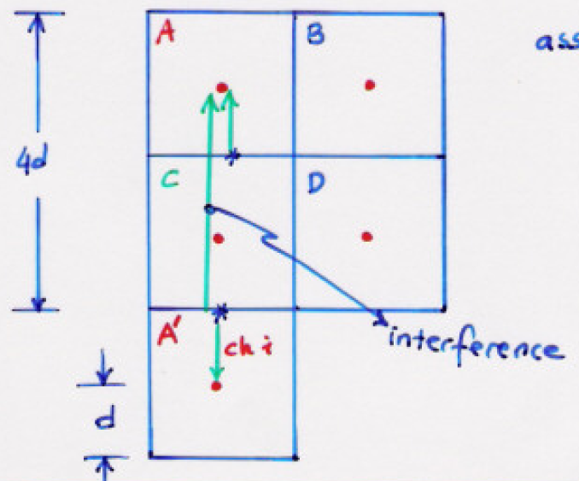
Cluster size and Quality of Service (1/2)
Ex: Signal-to-Interference Ratio (SIR) calculation with N=4
Uplink with
The marked two users in Cell A and Cell A’ use the same transmit power Pt

Slide 17
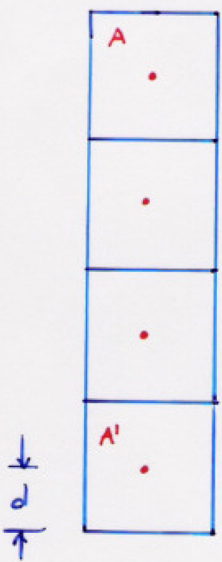
Cluster size and Quality of Service (2/2)
Ex: SIR calculation with N=9
- Example: # cells = 100, # channels = k
N=4 → Network capacity = # clusters * k = (100/4) k = 25k
N=5 → Network capacity = # clusters * k = (100/5) k = 20k
N↑ → co-channel interference↓ → QoS (SIR) ↑
But, for the same number of Base Stations,
N↑ → # clusters ↓ → network capacity ↓

Slide 18
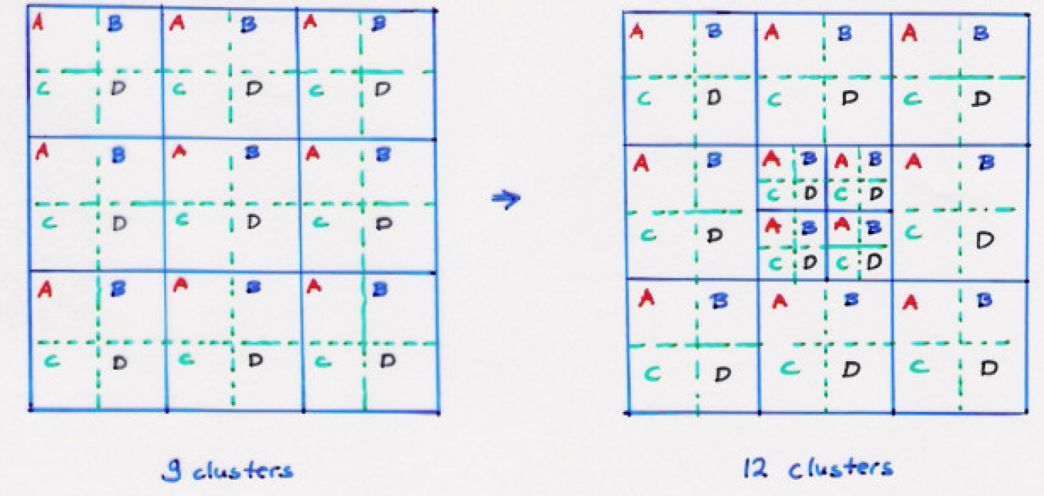
Increased user demand
Demand ↑ → more reuse → # clusters ↑
If cluster size remains the same → more cells in the same area → Cell splitting

Slide 19
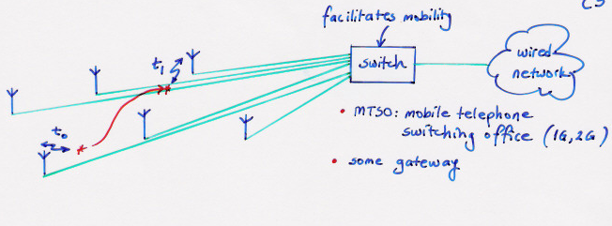
Mobility
Handoff (handover): Seamless transition

Slide 20
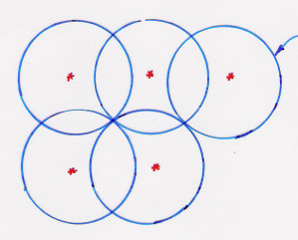
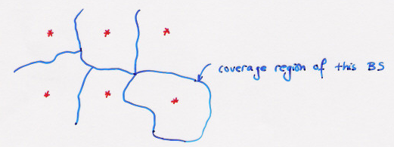
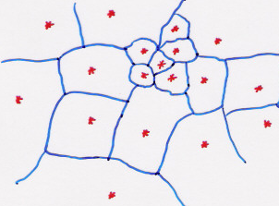
Coverage region of a base station
Propagation on a flat terrain (no shadowing)
With shadowing
Non-uniform demand

Slide 21
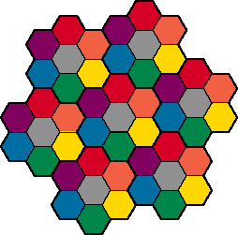
Hexagonal Layout

Slide 22
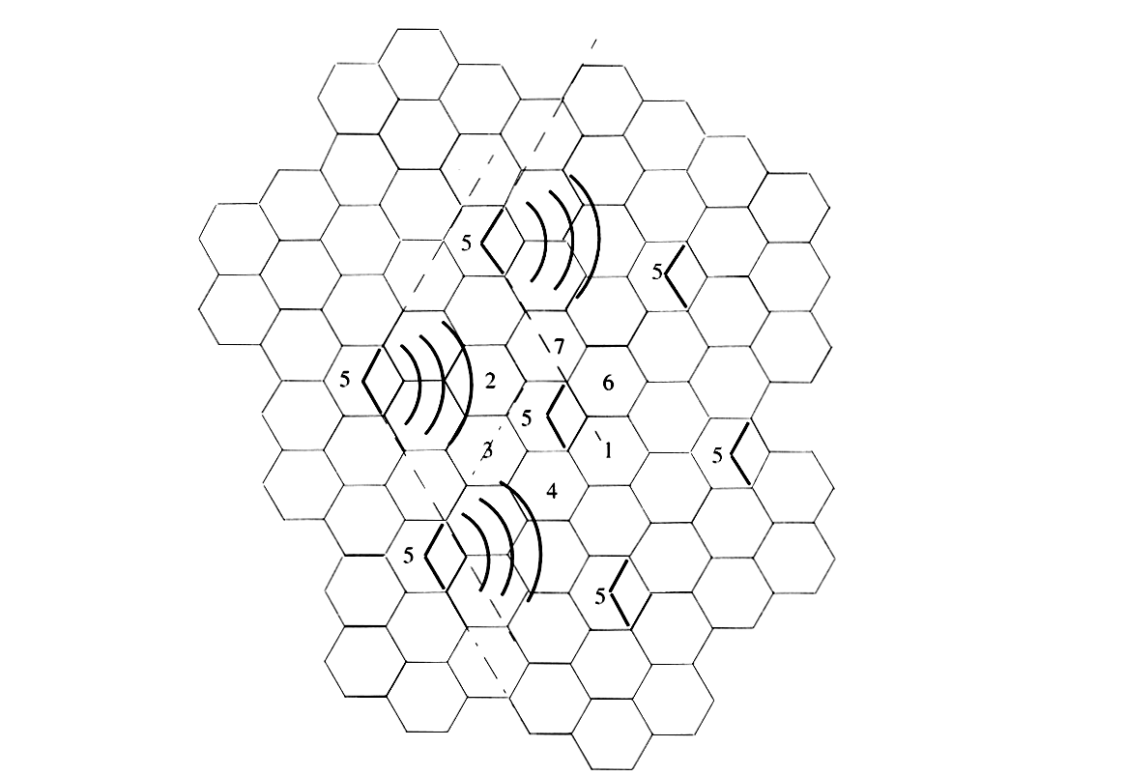
Sectoring
Use directional antenna to reduce co-channel interference, thus we can use small cluster size → increase capacity
Wireless Communications: Principles and Practice, 2nd Edition by T.S. Rappaport
120 degree antennas
are the most popular
Better SIR,
More capacity
But
More handoff
More antennas and their RF’s parts

Slide 23
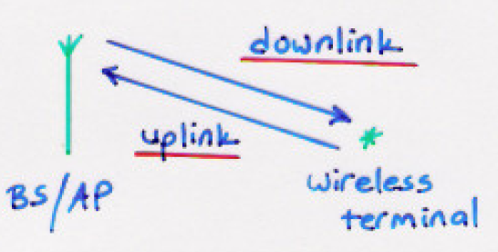
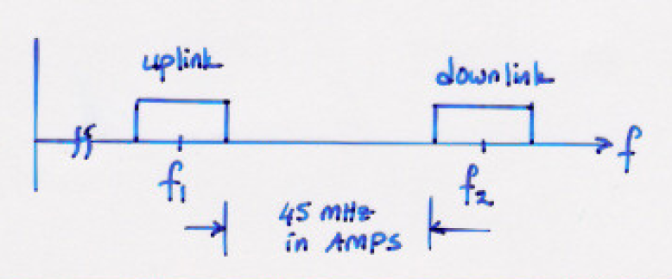
Duplexing
Duplexing: Decoupling the uplink and downlink
Frequency division duplexing (FDD): requires paired spectrum
Time division duplexing (TDD): a single block of spectrum is sufficient

Slide 24
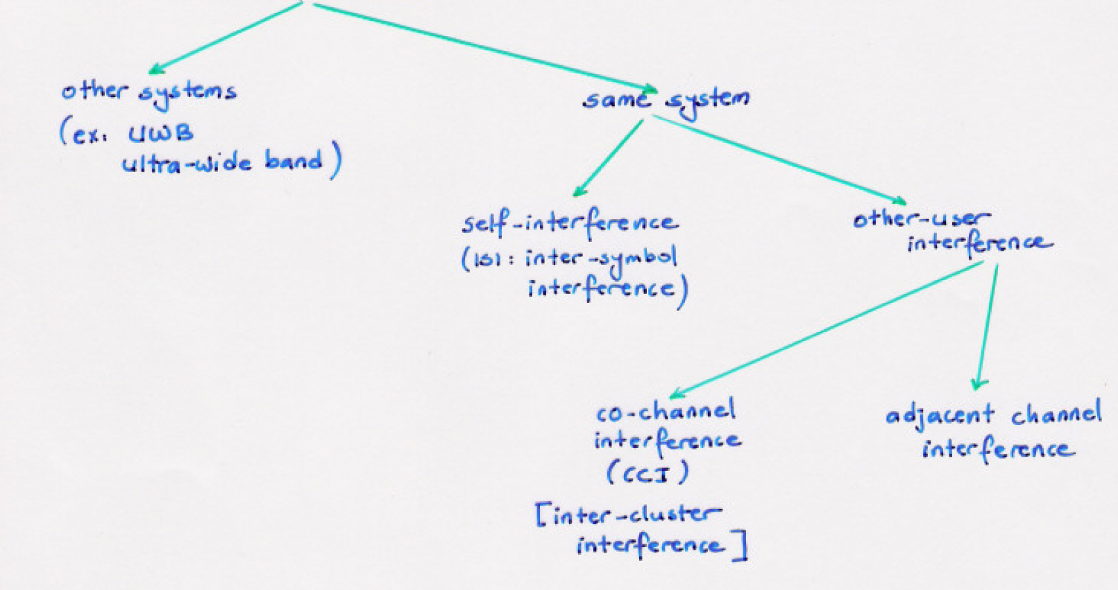
Types of Interference

Slide 25
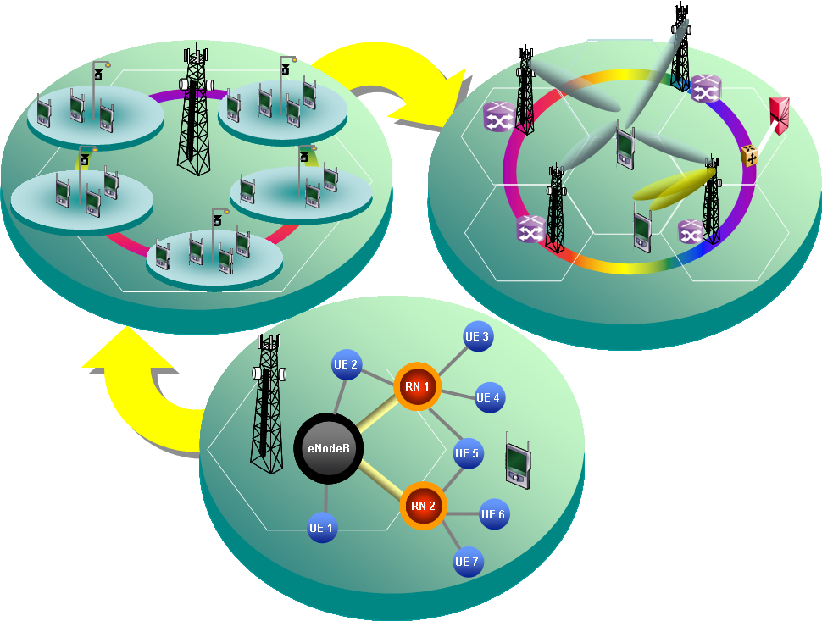
HetNet: Heterogeneous Wireless Network
CoMP
CoMP
Relay
Relay
HetNet

Slide 26
Question
Goal: To provide a cellular voice service to a town using 20 MHz of bandwidth; each user requires 20 kHz of bandwidth for voice communications.
How many users can be supported concurrently, using a single high power transmitter to cover the whole town?
20 MHz / 20 KHz = 1,000 users
How many users can be supported concurrently, using a cellular topology with 20 base stations and a cluster size of 4?
Divide the 20 MHz BW into 4 sets and assign one set to each cell
Each cell has a BW of 20 (MHz/cluster) / 4 (cells/cluster) = 5 MHz/cell
# of users per cell = 5 (MHz/cell) / 20 (kHz/user) = 250 users/cell
The total number of users = 250 users/cell * 20 cells = 5,000 users

