Slide 1
Telecommunications Standards
Business-led, Business-like
jimacfie@microsoft.com
Phone: 613 940 3351

Slide 2
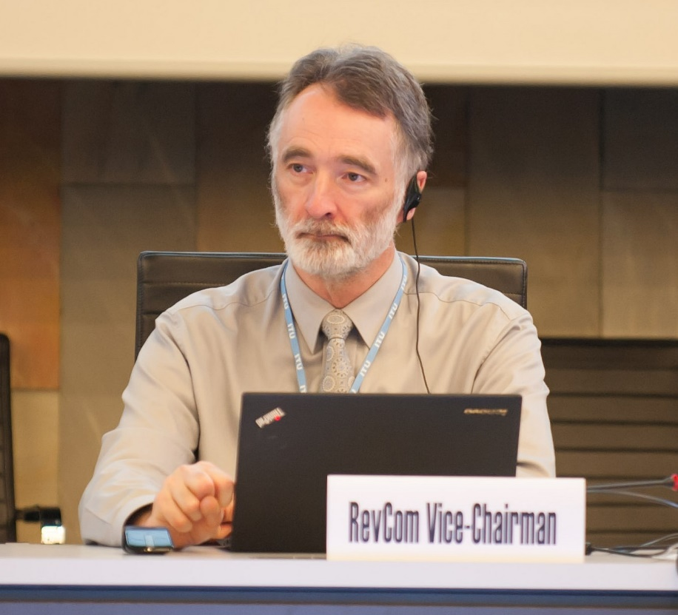
Jim MacFie
Chair of Canadian Mirror Committee for JTC 1
Head of Delegation for Canada to JTC 1

Slide 3
Outline
Intro, Business value
Standards bodies, Standards development
Canadian scene
Standards policy issues

Slide 4
What is a standard?
Typically a document in English. May include a reference implementation and/or a test specification. May include software, possibly open source.
s/w could be a reference implementation or test specification
s/w could be normatively referenced
Part of the standard could be s/w code
Standards are typically specifications that leave room for product differentiation in implementation
Standards from standards development organizations (SDOs) are voluntary
Mandatory standards are called regulations
De facto standards are standards set entirely by market forces without the involvement of a standards development organization

Slide 5
Why standards? In the beginning (1865)…
The telecom industry used to be made up of monolithic national networks (one operator and one supplier)
The International Telecommunication Union developed network standards to enable international connections and service interoperability
International border
National network
National network

Slide 6
Why standards? More recently…
In the era of deregulation, telecom nets are characterized by many network operators, each utilizing many equipment vendors
A further consequence of deregulation is that telecom systems are being subdivided into smaller and smaller components, and the number of interfaces subject to standardization increases
Access nets, previously a national concern, are now the subject of global standardization
Data traffic exceeds voice traffic, enabled by a set of Internet standards

Slide 7
Globalization
Successful companies seek to extend their markets – national, regional, global
The telecoms market is rapidly becoming a global market
Global standards enable a global market
The standards development process is becoming global – national bodies decrease in significance; regional bodies extend their influence outside their region

Slide 8
Standards Benefits: Interoperability
Network operators:
Multiple sources of supply (decrease risk of sole supplier
dependencies/lock-in, improve choice at competitive prices)
Interoperability e.g. multi-vendor networks, service interop
Assurance that investment in technology should not abruptly
change or fail
Vendors / developers:
Network vendors can sell to all service operators, freed from vendor
specific R&D
Reduce customization
Build reputation / customer confidence - strong standards brand
Larger markets from wide adoption, greater economies of scale

Slide 9
Interoperability
Interoperability can be enhanced by developing software engineered to be interoperable
Standards do not ensure interoperability on their own
A product can be compliant with a standard but still not interoperate with other compliant products
or by voluntary publication and/or direct licensing of proprietary technologies
Standards often contain options and variants, and sometimes ambiguities or errors
Some SDOs offer conformance testing services or interoperability testing services
Several approaches must be used together to be most effective
Some SDOs derive profiles to agree options among a set of implementers
Complimentary
actions
Standards

Slide 10
Outline
Intro, Business value
Standards bodies, Standards development
Canadian scene
Standards policy issues

Slide 11
Standards Development Process:
Parties negotiate within an established SDO or a purpose-built new one to agree upon selection of technologies that best meet requirements for the standard
Who participates depends on the standard
To promote efficient coordination and good behaviour, SDOs establish operational processes to agree work items, working methods, approval processes, appeals, policies for example how to include patented technologies
Rules can have an impact on your objectives/costs in participation, or in the selection of proposals
All of the committee members make contributions and edit the standard until finalized

Slide 12
Types of Standards Bodies
Accredited
National accreditation is granted by National Standards Organizations
Treaty-based
Established by treaty agreements among member states
Partnerships
Multiple accredited bodies working jointly to develop standards
Forums and Consortia
Typically not-for-profit corporations
Some develop standards, others promote a specific technology
Industry Associations
Often include a business advocacy function along with standards development
Government Advisory Councils
Make recommendations on regulations
Open source community

Slide 13
Types of Standards Bodies – orthogonal view
Global
Develop globally applicable standards
Regional
Develop regionally applicable standards and often prepare regional positions for the global bodies
National
Develop or adopt (from the global or regional bodies) national standards and often prepare national positions for the regional or the global bodies

Slide 14
In successful standards processes. . .
Decisions are reached through consensus among those affected
Participation is open to all affected interests
Balance is maintained among competing interests
The process is transparent – information on the process and progress is directly available
Due process assures that all views will be considered and that appeals are possible
The process is flexible, allowing the use of different methodologies to meet the needs of different technology and product sectors
The process is timely; purely administrative matters do not slow down the work
Standards activities are coherent, avoiding overlap or conflict
Source:
In addition, successful standards processes must lead to quality standards (implementable, error-free, testable)

Slide 15
International Orgs
International Telecommunication Union (1865)
Founded in 1865, the ITU is now a specialized agency of the UN. The Telecom Standardization sector, ITU-T, has developed extensive standards for the telecom industry
International Organization for Standardization (1947)
Huge range of industrial standards, including management standards
International Electrotechnical Commission (1906)
Publishes standards for the electrical and electronic industries
ISO/IEC Joint Technical Committee 1 (1987)
Founded by ISO and IEC to develop IT standards
Convergence of technology has brought the SDOs closer together.
Popular topics like Internet of Things and Big Data show up everywhere.
February 13, 2018

Slide 16
Institute of Electrical and Electronics Engineers
The IEEE 802 LAN/MAN Standards Committee is a standards project under the auspices of the IEEE Computer Society, and under the supervision of the IEEE Standards Association
IEEE 802 develops Local Area Network standards and Metropolitan Area Network standards. The most widely used standards are for the Ethernet family, Token Ring, Wireless LAN, Bridging and Virtual Bridged LANs. An individual Working Group provides the focus for each area.
Contribution to draft standards in Working Groups and determination of WG consensus is by individual IEEE members (as opposed to corporate members). Individuals vote.

Slide 17
Forums and Consortia - General Description
Anyone can start one
Membership open to all who pay fees
Provide a legal (no antitrust) context for deal-making
“Develop” and endorse specifications typically by vote (not consensus)
Contributions often required to be based on product (present or planned)
Usually a complementary Marketing/Publicity committee to promote the body and its ‘products’
Forums and Consortia have come from nowhere to be
a significant part of the global standards community

Slide 18
Internet Engineering Task Force (IETF)
The primary standards body for the Internet
Develops most (but not all) IP-related protocol standards
A ‘culture of individuals’
No memberships; meeting participation fees only
Work extensively by email; three meetings per year
> 100 Working Groups, structured in eight “Areas”
New WGs initiated following ‘Birds of a Feather’ (BOF) sessions which determine interest level, scope of activity, etc.
Decisions/approvals by “Rough consensus and running code”
No formal voting; “show of hands” recently replaced by “hums”
Disputes resolved by discussion and demonstration
Demonstrate operational stability/interoperability prior to ‘Standard’ level approval
IETF meets three times a year, attracting over 1,000 people to each Plenary

Slide 19
Involvement Levels in Standards Topics
Lead
Defines the standards question, picks the venue (may start a new body); promotes the success of the chosen venue over others; desires one outcome when several are possible; attends regularly, contributes; requires premium membership, fair-share and strategic hosting; senior office holders or technical gurus are essential
Big step up from Participate
Participate
Participants desire one standards outcome when several are possible; attend regularly and contribute to achieve a position; requires membership in the relevant bodies and fair-share hosting; office holders or technical gurus are important
Monitor
Lets others do the work and accepts their result, but knows developments as they happen; requires membership in the relevant bodies, frequent attendance and fair-share hosting
Can move up to Participate quickly if we are no longer prepared to accept the result (e.g. if a competitor attempts to re-open a stable standard)
Ignore
Accepts any result whenever the standards process completes; doesn’t attend or contribute; doesn’t belong to the relevant bodies
Difficult to quickly spool up to Monitor or any higher level

Slide 20
Outline
Intro, Business value
Standards bodies, Standards development
Canadian scene
Standards policy issues

Slide 21
Standards Council of Canada
The Standards Council of Canada (SCC) is a federal Crown corporation founded in 1970
SCC is the National Body for ISO, IEC and JTC 1. SCC also accredits eight domestic standards development organizations, the largest of which is the Canadian Standards Association
The Council has up to 13 members and a permanent staff of approximately 90
The organization reports to Parliament through the Minister of Innovation, Science and Economic Development and is funded by a Parliamentary appropriation
The CEO is John Walter (until June, 2018) who is also President of ISO

Slide 22
Innovation, Science and Economic Development (was Industry Canada)
Innovation, Science and Economic Development represents the federal government in the International Telecommunication Union, The Organization of American States, the Asia Pacific Telecommunity, Asia Pacific Economic Cooperation and the Organization for Economic Cooperation and Development
Innovation, Science and Economic Development broadly manages the Canadian private sector participation
February 13, 2018

Slide 23
Outline
Intro, Business value
Standards bodies, Standards development
Canadian scene
Standards policy issues

Slide 24
How many standards ?
When to have one standard and when to have more than one?
AC power plugs and sockets on Wikipedia
http://en.wikipedia.org/wiki/Domestic_AC_power_plugs_and_sockets#Proliferation_of_standards
In a stable technology, one standard is preferable
If technology is advancing, an established standard should not preclude the adoption of a newer, better standard
Backwards compatibility is desirable, but not always achievable
Should contending standards battle in the marketplace?

Slide 25
What are Intellectual Property Rights?
Premise is to create incentives to invest in developing new inventions or creative works
Copyrights – expression of ideas (but not the ideas themselves)
Patents
Trade Marks, Trade secrets, etc.
February 13, 2018

Slide 26
Copyright in Standards – Yours, Mine and Ours
Committee of technical experts get together to develop a standard
Each contribution may be protected by its own copyright and owned by the participating expert or that person’s employer
Often the contributor wants to retain copyright ownership and wants to use the contribution for other internal and external purposes
At the same time, the SDO often wants/needs explicit permission to include it in the standard
February 13, 2018

Slide 27
Transfer of Copyright
Outright transfer of any of the copyright interests must be in writing (assignment)
One practice is for the participants (in a manner that binds their employers) to license the SDO to use the material in the standard
Further provide that the SDO can do all of the usual things with the standard (such as making and distributing copies, granting rights to make derivative works of the standard, rights to sublicense, etc.)
Mechanisms for accomplishing this vary
SDOs then usually assert copyright in the final standard
February 13, 2018

Slide 28
Patent Policies
Most seek licensing assurances from the holders of essential patents (those patents that contain essential claims) to the effect that they will offer licenses to all implementers on “Fair/Reasonable and Non-Discriminatory” terms and conditions
Sometimes the patent holder is willing to provide licenses free of charge (royalty-free) but on other F/RAND terms and conditions
Wording and approach of IPR policies are negotiated among the SDO’s stakeholders
Almost no two are identical
SDOs do not engage in license negotiations
February 13, 2018

Slide 29
Future Direction
Trends:
Innovation is out-pacing traditional legal and regulatory frameworks
ICT is being recognized as critical infrastructure globally
Geopolitical dynamics point to more fragmentation; standards community is less vulnerable
Open source collaborative development methodology is supplanting the consortia
Maturation of the ICT industry is leading to a receptiveness for regulatory oversight
Consequences:
Modern mechanisms of trust are needed by both industry and consumers; international standards are a unique solution for this challenge.
ISO, IEC and ISO/IEC JTC 1 are well-positioned to offer societal and industrial value for ICT through facilitation of standards-setting and publication of documents targeting collaborative regulation outcomes.
ICT Regulation
Pace of Innovation
Geopolitical Dynamics
Collaborative Development
Universal Impact of ICT

Slide 30
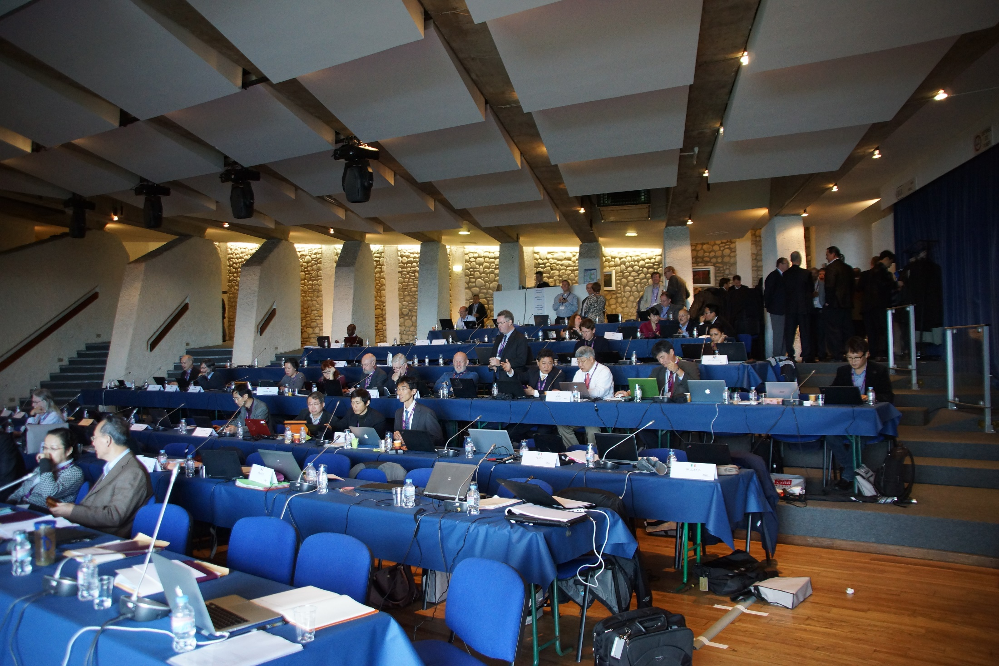

Slide 31
