Slide 1
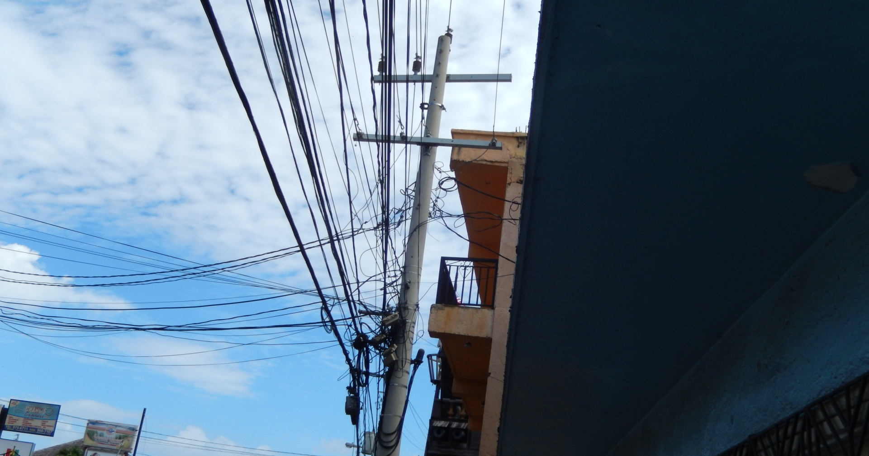
Broadband Access Technologies xDSL and FTTx
Chuck Storry
February 2018

Slide 2

Chuck Storry
Nokia Fixed Networks Business Line Product Manager
Distinguished Member of Technical Staff
Ottawa U Bachelor of Computer Science
Algonquin College Electronics Technologist
8 patents granted + additional applications pending
Broadband Forum, ITU-T Q4-15, ATIS
  contributor, editor, associate rapporteur

Slide 3
Objectives
Statistics, Terminology & Trends
Access network topology
ADSL - some details
Evolution from copper to fiber
Fiber deployment models
GPON – some details
Fiber evolution
Summary

Slide 4
Access Terminology
“Telco” Access = Subscriber Loop
  Legacy -> twisted copper pair (pt-pt); POTS -> DSL
  Greenfield -> optical fiber (pt-pt or pt-mp); PON
Multiple System Operator (MSO) Access = Cable Network
  Hybrid Fiber/COAX -> DOCSIS/EuroDOCSIS (pt-mp);
Fixed Wireless Access (typically ISP or specialty provider)
  Wireless -> WiMAX (pt-mp), millimeter wave;
But what about smart phones, tablets (4G/5G, LTE, etc) ???

Slide 5
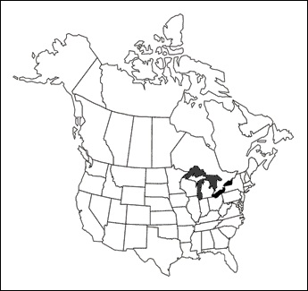


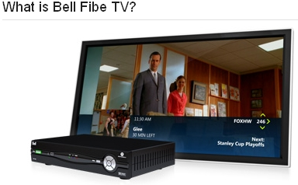
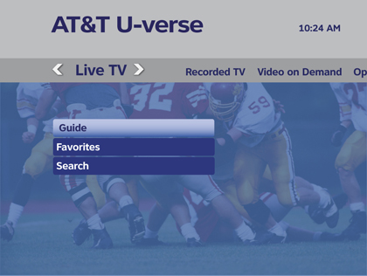
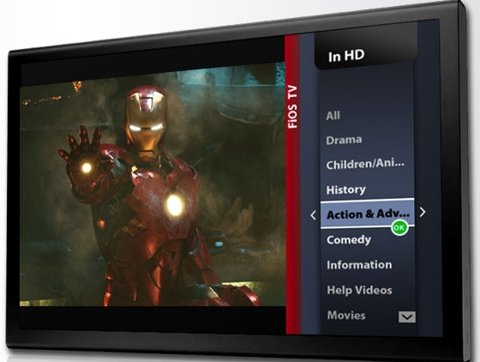
Broadband = High Speed Internet and more cablecos – TV + internet & voice telcos – phone + internet & TV

Slide 6
Long Term Bandwidth Trends
Chattanooga / Hong Kong BB (ALU GPON)
Verizon FiOS
(ALU GPON)
PON
DSL
NTT
Google
target
Korea
target
Offered Data Rates
DOCSIS
Bezeq
Available DSL line rates
Bell Fibe
(ALU VDSL)
Available PON rates (peak)
AT&T
U-verse
(ALU VDSL)
Actual fiber service offers
Cutting Edge Users
Actual DSL service offers
Trailing Edge Users
DOCSIS 2.0 / 3.0
NTT DSL

Slide 7
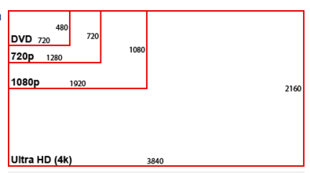
Long Term Demand Forecast
But internet killer app
is probably speedtest
15% YoY
(5-year doubling)
2011 (Conservative)
SD | 2.2 Mb/s
HD 720p | 8.0 Mb/s
HD 1080p | 13.6 Mb/s
3D | 1.4 x 2D
30 Mb/s + 15% YoY bounds a high-end early adopting subscriber
To appear in IEEE Communications Magazine
Notes:
First let’s forecast residential bandwidth demand
Let’s recognize that it’s hard to forecast bandwidth demand, but it’s easier to create an upper bound.
Focusing on the streaming video which drives bandwidth demand
Starting with what it takes to be a successful triple play provider today,
Then, to forecast an upper bound to future demand, this stream mix will evolve. We assume
Content providers move very quickly to convert most programming to 3D and UHD formats
A service provider moves aggressively to deliver ever increasing video quality
The subscriber is an early adopter making aggressive and sustained investments in consumer electronics upgrades
We assume UHD content becomes available in 2015, so that by the end of this decade we are mostl streaming all UHD and or 3D including so-called 8k video which requires enormous screens that you must sit very close to to appreciate the resolution.
We arrive at a 15% YoY increase.

Slide 8
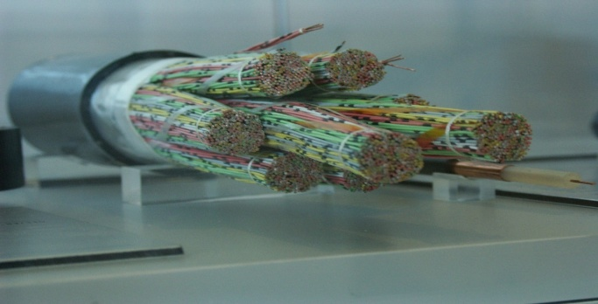


Copper Access Network - Telephone Wire
Telephone plant composed of unshielded twisted pairs
  2 or 3 pairs per home [drop]
  25, 50 or 100 pairs per cable [distribution]
  100’s (maybe up to 1200) pairs per cable [feeder]
Twists (pairs and sometimes quads)
  Reduce EMI ingress (external) noise
    Differential mode transmission
    Reduces noise egress as well
  Reduce crosstalk (internal) noise
    Near end xtalk = NEXT
    Far end xtalk = FEXT
  Xtalk noise is frequency dependant ! Increases with frequency
    Important – can limit data rate on copper as loop lengths decrease
25 pair binders
Crosstalk
downstream
upstream

Slide 9





Segmented distribution area (DA)
Central office (CO) or DLC (COT + RT)
ADSL served from central office DSLAM - CSA
Incumbent access provider ADSL DSLAM
Neighborhood cross-connect (JWI/SAI)
VDSL street cabinet (FTTN DSLAM)
Self-contained VDSL DSLAM
MDF
Feeder cable
(avg 1.1 pairs per hh)
Distribution cable
(avg 2 pairs per hh)
Drop wire
Terminal
(8-12 homes)
Competitive access provider ADSL DSLAM
ADSL—Asymmetric digital subscriber line
CSA – Carrier serving area
DA – Distribution area
DLC – Digital loop carrier
DSL—Digital subscriber line
DSLAM—Digital subscriber line access multiplexer
FTTN—Fiber to the node
HH - household
JWI – Junction wire interface
MDF – Main distribution frame
NID – Network interface device
SAI – Serving area interface
VDSL—Very high speed digital subscriber line
NID & splitter
VDSL served from FTTN DSLAM - DA
VDSL served from neighborhood DSLAM
FTTH topology is
generally the same
* There are usually 2 to 5 DAs in a carrier serving area (CSA), the limits of which can extend 9-12 Kft beyond the RT
Notes:
Since the early 1980s, the most popular plant configuration for DLC has been the Carrier Serving Area (CSA) design where an RT serves up to 9 Kft of 26 gauge or 12 Kft of 24 and coarser gauge in “developed and soon-to-be developed areas.” They normally contain two to five distribution areas, each of which has a Serving Area Interface and serves 200 to 400 homes and business lines. All of the distribution plant within a DA and CSA is supposed to be non-loaded (with no more than 2.5 Kft of bridged tap) to support digital services.
A CSA can contain a single DA, but that is usually limited to remote, low density rural areas. Few RT installations have been made for single DAs in urban and suburban areas, an application also referred to as fiber-to-the-node (FTTN). At one time it was assumed this configuration would become popular to support VDSL deployment, since over 90% of the customers in DAs are within 3-4 Kft of the SAI. This is not happening with RTs but rather with broadband DSLAMs.

Slide 10
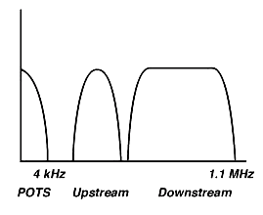
ADSL - Three Information Channels *
Power
Received signal
noise + margin
Background noise
Frequency (Tone Number)
Analog POTS
  0 - 4 KHz
  Low pass filters required to split POTS at each end
Medium Speed Upstream (64 - 640 kbps)
  Uses low end of loop spectrum
  Most reliable
High Speed Downstream (1.5 - 12 Mbps)
  Uses upper end of loop spectral bandwidth
  Bandwidth drops off quickest on long loops
FDD vs TDD
- legacy DSLs typically
used FDD as shown here
- G.fast will use TDD to offer more flexibility in managing different upstream and downstream usage requirements
Notes:
The above diagram shows FDM full-rate ADSL. Echo cancelled ADSL would have the downstream extended to overlap the upstream. This yields additional bandwidth in the downstream direction. Unfortunately it also produces “number of disturbers” dependant near end crosstalk. Receivers can effectively cancel their transmitter’s signal however they are less able to cancel the crosstalk from adjacent transmitters. As the number of adjacent transmitters grows the amount of gain from the overlapped spectrum reduces to the point where performance may be less than that of an FDM design. FDM designs typically use analog filtering to assist in adjacent band rejection.
VDSL bandwidth looks similar except that additional bands are specified for upstream and downstream which extend up to 12 Mhz.

Slide 11
DSL Spectrum
256 “tones” of 4.3125 kHz across 1.104 MHz
138 kHz or 276 kHz
138 kHz or 276 kHz
G.Fast spectrum up to
106MHz and 212MHz
(TDD and FDD)
Comprised of:
ADSL
0.138 to 1.1 MHz
Up
Down
ADSL2⁺
0.138 to 2.2 MHz
0.138 to 1.1 MHz
30a
17a
8 (a,b,c,d)
12 (a,b)
VDSL2
(E.g., ANSI-30a)
3.75
5.2
8.5
12
17.664
23
30
MHz
MHz
MHz
MHz
MHz
MHz
MHz
D1
U1
D2
U2
D3
Upstream.
U3
Downstream
Notes:
DMT very effectively allows maximal channel bandwidth to be used. Where narrow frequency disturbers are experienced individual frequency bins can be disabled or less heavily bit loaded. When longer loops are encountered and the attenuation at the band edge is significant these bins can also be disabled.
By monitoring the channel capacity in this way DMT ADSL adapts, both at start-up and in showtime (once trained and passing data) to the highest capacity for each given line condition.
VDSL standards extends this approach to 4096 bins, some upstream and more downstream.

Slide 12

Delivering more with copper
Claude Shannon
Bell Labs researcher
  Ways to maximize copper networks
      Shorten Loops
      Add Pairs
      Add Spectrum
      Lower Noise
  Deploying DSL deeper in the network will allow copper to deliver 100Mbps
1
2
Shannon’s channel capacity formula (1948)
R = W log₂ (1+SNR) bits/s
3
4
  Goal: increase bitrate R
    Need to: increase W (spectrum) and/or
    increase SNR (reduce noise)
(Note: increasing signal increases noise – to non-DSL services as well)
2005
2010
2012 ->
FTTx
25Mbps 50Mbps 100Mbps
Notes:
12

Slide 13
Noise Reduction Opportunity
Crosstalk reduction - far-end receiver view
Power
Rate proportional to shaded region
Longer line: e.g. 1 km
High frequencies attenuated, rate limited by background noise.
Received signal
Background noise
noise + margin
Crosstalk interference
Shorter line: e.g. 500 m
Stronger rx signal opens new frequencies, but stronger crosstalk limits the rate.
Xtalk is dependant upon cable construction and number of other users in cable
Power
Frequency (Tone Number)
Received signal
Crosstalk interference
noise + margin
Background noise
Power
Frequency (Tone Number)
Received signal
Shorter line: 500 m with vectoring.
Vectoring suppresses Crosstalk interference
“Vectored” rates approach single user rate – reduce usage-based variability !
Residual crosstalk interference
noise + margin
Background noise
Frequency (Tone Number)

Slide 14
DSL Performance vs Loop topology *
Simulations using Shannon’s channel capacity formula
75% of DA loops < 1 km
Downstream rate of 30 Mbps is achievable with either VDSL or pair bonded ADSL2+
Note: sustained rate = peak rate
Notes:
The CO and RT loop distributions are based on the last Bellcore loop survey. The FDI loop distribution is from a contribution to committee T1.
RT loops are contained in a CSA served by a DLC RT
DA loops are a DA served by the SAI (see earlier slide)
The performance values are based on simulations with 10 self disturbers (crosstalk)

Slide 15
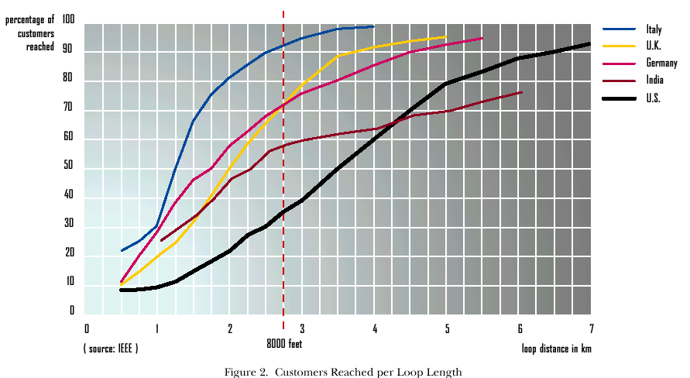
Loop Length distribution in some countries *
1 Km (VDSL reach)
4.5 Km (ADSL reach)
Fiber
Subscribers that require higher speeds
need DSLs that have shorter reach
so fiber is deployed to push
the DSL modem closer to the customer
Notes:
Since loops are longest in the US it seems logical that interest in moving from copper to fiber may be led from the USA

Slide 16
Evolution from copper to fiber *
Bandwith / Service Capability
FTTx
P-P Optics
FTTNode – Electronics at the Copper Cross Connect (DA)
CO
FTTArea – Electronics at Centralized Remote Location (CSA)
FTTExchange – Electronics at CO
VDSL
CO
RU
PON
VDSL
CO
VDSL
CO
RT
ADSL2+
CO
CO
RU
ADSL2+
FTTCurb / FTTdp (distribution point) - Electronics at the terminal (curb-side)
What fiber feeder (pt-pt vs pon) ?
What copper PHY ?
E.g. G.fast – up to 1Gbps aggregate rate
CO
RT
ADSL2+
CO
ADSL
CO
RT
ADSL
CO
$
$$
$$$
$$$$
Notes:
FTTExchange – today virtually all COs are interconnected by fiber (first mile is copper)
FTTArea – outside plant electronics centralized in a Remote serving area typically connected by fiber (CSA deployed DLC or remote DSLAM - Digital Subscriber Line Access Multiplexer)
FTTNode – further push of electronics towards the customer (fiber-fed DA deployment)
Is the next step to take fiber all the way to the business and home ?
4GBB – 4th Generation BroadBand http://www.celticplus.eu/pub/Project-leaflets/Webquality/4GBB-lq.pdf

Slide 17

FTTU – PON Deployment Model *
Splits
Span
Central Office
PON
Passive Optical Network
CPE
Customer Premises Equipment
1490 nm
OLT
1310 nm
Single mode fiber
1:4 splitters
ONU
Data / voice
Video Overlay
WDM
RF Video
DIPLEXER
TRIPLEXER
1550 nm
Video overlay being discouraged in favor of IPTV
Notes:
ONT – Optical Network Termination (historically used to refer to device
ONU – Optical Network Unit (industry agreement to call these things ONUs now !)
OLT – Optical Line Termination
Diplexer and Triplexer include active terminations (transceivers and/or receivers)
WDM – wavelength division multiplexer is an optical device to combine multiple wavelengths

Slide 18
GPON an example
Described by ITU G.984.1- G.984.4 (G.984.x series)
  High re-use of G.983 (* trend at standards)
Single fiber with 2 wavelengths (can use 2 fibers)
Typically deployed as 2.4/1.2 Gbps (symmetrical rates allowed)
Up to 64 ONUs per PON (addressing for 128) -> usually 32
  2.5 Gbps / 32 = 78 Mbps average per ONU (burst up to 2.5 Gbps)
Downstream encryption
Multiple native transport options GEM “GPON Encapsulation Mode” (TDM, Ethernet or ATM) -> usually Ethernet
OMCI “ONU Management and Control Interface” for easy (interoperable) ONU management
*note EPON does not use OMCI

Slide 19
PON Data Transport *
C B A
ONT - A
1490 nm
A
C B A
C B A
OLT
ONT - B
A B C
B
C B A
1310 nm
ONT - C
C
TDM downstream (point to multipoint)
  Downstream needs security
    ONUs process only cells with their GEM ID “address”
    “churning” used to ensure privacy
TDMA upstream (4 Kbps increments) (multipoint to point)
  Who can talk next ? Upstream needs access mechanism
  DBA (dynamic bandwidth allocation makes TDMA “work- conserving”)
Note: sustained rate < peak rate
Notes:
TDM – time division multiplexing
TDMA – time division multiple access
TDMA requires that the ONUs be “synchronized” to have their signals arrive at the OLT at the same time. Ranging is used each time the PON topology is changed (elements added).
Upstream bandwidth can be allocated to individual ONTs with as little as 4 Kbps granularity
Churning – each ONT sends an encryption key to the OLT to use in the churning process. This secures the data destined to one ONT from all others

Slide 20
xPON comparison *
Passive Optical Network
  Standardized at ITU, IEEE (requirements from FSAN)
  Multiple span length options depending upon optics category, topology, number of splits, optical loss, etc.
  Multiple split configurations 1:n
  Single fiber used bidirectionally (multiple light wavelengths)
 | Standard | Bandwidth (Mbps) | Splits | Span | Transport
APON | ITU G.983.1 | 155, 622, 1244 dn 155, 622 up | 32 | 20 km | ATM
BPON | ITU G.983.3 | 155, 622, 1244 dn 155, 622 up | 32 | 20 km | ATM + analog lambda for video
EPON | IEEE 802.3ah | 1000 dn 1000 up | 32 / 64 | 20 km (split 32) | Ethernet
GPON | ITU G.984.1 | 155, 622, 1244, 2488 dn 155, 622, 1244, 2488 up | 64 / 128 | 20, 40 km | Ethernet, TDM, ATM,
XG-PON1 | ITU G.987 | 10/2.5Gbps | 128 | 20 km (split ?) | Ethernet
XGS-PON | ITU G.9807 | 10/10 and 10/2.5 fixed lambdas | 256 | 20km (split ?) | Ethernet
NG-PON-2 | ITU G.989 | 10/10 Gbps (x 4 lambdas) with lambda mobility (40/40 Gpbs) | 256 | 20 km (split ?) | Ethernet
10GEPON | IEEE 802.3av | 10/10 & 10/1Gbps dn/up | 64 | 20 km (split 32) | Ethernet
Notes:
APON: ATM-based Passive Optical Network
BPON: Broadband Passive Optical Network
EPON: Ethernet Passive Optical Network
GPON: Gigabit-capable Passive Optical Network

Slide 21

NG PON Evolution
GPON
XGS-PON
NGPON2
2.5 Gb/s
1.25 Gb/s
10 Gb/s
10 or 2.5 Gb/s
4x 10 Gb/s
4x 10 or 2.5Gb/s
PON technology being deployed today - Fiber is split to serve multiple users.
Same principle as GPON, but higher downstream & upstream.
Dual rate: supports 10/10 Gb/s XGS ONUs and 10/2.5 XG-PON1 ONUs
Adds more wavelengths on fiber cable: 4 in US, 4 in DS (more in the future). Multiple users share a wavelength. ONUs have tuneable optics.

Slide 22
XGS-PON and Co Existence
(passive) Power Splitter
OTDR
ONT GPON
2.5/1.25
Co-Existence element
(passive)
ONT GPON
2.5/1.25
GPON LT card
2.5/1.25
CEx
PON feeder
1:N
XGS-PON ONT
10/10
10/10
(XGS)
XGS-PON ONT
10/2.5
Universal 10G-PON
XGS & NGPON2
XGS-PON
up
GPON
up
GPON
down
NGPON2
up
CATV
XGS-PON
down
NGPON2
down
λ
(in nm)
1260
1280
1290
1300
1310
1320
1330
1480
1490
1500
1524
1540
1550
1560
1575
1580
1596
1603

Slide 23
NG PON and Co Existence
Overlay GPON PON with XGS-PON and NGPON2
(passive) Power Splitter
OTDR
ONT GPON
2.5/1.25
Co-Existence element
(passive)
ONT GPON
2.5/1.25
GPON LT card
2.5/1.25
CEx
PON feeder
1:N
XGS-PON ONT
10/10
10/10
(XGS)
XGS-PON ONT
10/10
Universal 10G-PON
XGS & NGPON2
NGPON2 ONT
10/10
10/10
(NGPON2)
WM
NGPON2 ONT
10/10
Universal 10G-PON
XGS & NGPON2
Wavelength
Multiplexer for NGPON2
NGPON2 ONT
10/10
NGPON2 ONT
10/10
XGS-PON
up
GPON
up
GPON
down
NGPON2
up
CATV
XGS-PON
down
NGPON2
down
λ
(in nm)
1260
1280
1290
1300
1310
1320
1330
1480
1490
1500
1524
1540
1550
1560
1575
1580
1596
1603

Slide 24
Summary - Access Technologies
Both copper and fiber support triple-play and offer bandwidth growth options
Copper will typically be used in buried brownfields (existing installations)
  Fiber is used to feed the copper access nodes however it is often difficult/costly/irritating to dig up people’s yards to bring fiber to the home
Fiber is typically used in aerial brownfields (and many greenfields)
  Some new construction subsidized by someone other than ILECs (e.g. Google Fiber)
Fiber will enhance the bandwidth capabilities of copper
  Allow DSL technology to be deployed closer to customer
Next generation copper technology could more closely integrate with fiber leading to hybrid fiber/copper access networks
Today operators are largely deploying a single access technology in an area (fiber OR copper)
In the future neighbors will likely have access to the same services but the access media may vary dependant upon deployment issues (one side of the street may be fiber and the other copper)

Slide 26
References
Walter Goralski, “ADSL and DSL Technologies”, McGraw-Hill, ISBN 0-07-024679-3, 1998
Charles K. Summers, “ADSL Standards, Implementation, and Architecture”, CRC Press, ISBN 0-8493-9595-X, 1999
… and more
Tom Starr, et al, “Understanding Digital Subscriber Line Technology”, Prentice Hall, ISBN 0137805454, 1998
Tom Starr, et al, “DSL Advances”, Prentice Hall, ISBN 0130938106, 2002
Michael Beck, “Ethernet in the First Mile”, Mcgraw-Hill, ISBN 0071469915 , 2005
Note: EFM encompasses Ethernet over both GPON and VDSL

Slide 27
Backup !

Slide 28
A Taxonomy of DSLs *
DSL is Digital Subscriber Line
A .. Z DSL
  How many are there really ?
  Aren’t they really all the same ?
  How do I decide which to use ?
Notes:
DSL - Digital Subscriber Line
Digital - DSLs use digital transmissions methods to carry digital information (including digitized analog information such as voice).
Subscriber Line - refers to the typical use of this technology on what is often called the “last mile” (now the “first mile” by IEEE).
How many DSLs are there ?
Not every letter of the alphabet is used yet but new DSLs are popping up every day. There’s more than 10 different flavors of DSL and many more transmission technologies like T1/E1that perform similar jobs to DSL.
Are they all the same ?
Each DSL is optimized for a particular purpose. At this point some of the newer DSLs are certainly superceding older ones. They fall into several different categories typically based on their rate and reach. Rate and reach characteristics are largely based on physics i.e. greater rates require more bandwidth and greater coding density. Since useable bandwidth is inversely proportional to loop length higher rate DSLs typically only work on short loop lengths. Greater coding density has only been practical with the increase in processor and hardware speeds. The unique capability first used by ADSL was the concept of partitioning bandwidth asymetrically rather than symmetrically yielding long reach with relatively high rates.
How do I decide which to use ?
Today most business applications call for similar upstream and downstream data throughputs. Although the symmetric DSLs typically support shorter loop reaches they can usually be extended using repeaters. Since the cost of individually repeatering loops is expensive both in capital and on-going costs this can usually only be justified for business services.
Many residential applications are now demanding more bandwidth. When the copper plant bandwidth is used asymmetrically, relatively high throughput and long reach can be achieved.

Slide 29
DSLs and their characteristics *
Becoming widely deployed as FTTN 25/5, 50/10 and soon 100/20 Mbps but on shorter loops
Notes:
T1 - not really a DSL
- 1.554 Mbps up to 6000 ft (may be repeatered)
- 0 - 1.5 Mhz bandwidth (spectrally a bad neighbor)
- 1 circuit per 50 pair cable
- no longer being deployed (being proactively replaced in some instances)
HDSL - Bellcore standardized
- 0-250 khz (may be repeatered) (“bonded” 2 or 3 pairs of 768kbps fdux xvcrs)
- originally designed to be “repeater-less” T1(not good interoperability)
- hundreds of thousands of lines installed (now superceded by HDSL-2 and SHDSL)
IDSL - evolved from ISDN
- uses physical layer from ISDN so good interoperability at physical layer
- limited interop above physical layer (56/64, 128, 144 kbps issues, framing issues, etc)
- 0 - 80 Khz (120 khz for 4B3T Germany) (may be repeatered)
- no longer widely used (shdsl for business and adsl for residential)
SDSL - no standards - proprietary implementations
- typically was implemented as 1/2 of the HDSL transceiver or later with HDSL-2 xcvrs
- like IDSL since operation was not standardized, interoperability suffered
HDSL-2
- 0 - 500 Khz (may be repeatered)
- designed specifically for transmission applications therefore only supports STM interface and lacks rate adaptability

Slide 30
DSLs deJour *
Today’s most popular DSLs include
  ADSL/ADSL2/ADSL2plus and Reach-extended ADSL primarily for residential high speed Internet => disappearing becoming legacy
  ESHDSL (typically from same ADSL DSLAMs) mainly for business => never really caught on (ADSL and VDSL can do it and easier to deal with single technology)
  VDSL2 focused on residential triple play (voice – video – data) Majority of DSL shipments today typically deployed in the outside plant
All moving to Ethernet for Transmission Convergence (TC) layer
Notes:
ADSL - widely used for residential applications
40khz to 1.1Mhz ADSL full-rate (to 2.2 Mhz for ADSL2plus)
40khz to 512khz ADSL-lite
baseband is available for POTS/ISDN
spectrally friendly, designed to coexist with other DSLs
Full-rate
>10 Mbps on short loops, rate adapts to loop capacity, ATM qos
Lite
supposed to be cheaper via softmodem implementations, customer install
unrealized cost savings and microfilter requirement has limited success of ADSL-lite
SHDSL - expected to be widely used for business applications (replaces T1, HDSL & HDSL-2)
Fully standardized
baseband not available for POTS (POTS or ISDN to be carried digitally)
VDSL
0 - 12 Mhz
both symmetrical and asymmetrical implementations exist
spectrally friendly, both symmetric and asymmetric uses can coexist
supports baseband POTS/ISDN like ADSL

Slide 31
ADSL - an example *
Described by ITU G.992.1 (G.99x series)
Single pair – All digital loop, over POTS or ISDN (start frequency)
works like 256 V.34¹ modems spread apart every 4.3 kHz (frequency separation)
total bandwidth to 1.1 Mhz (or 2.2 for ADSL2plus) (end frequency)
variable bit rate, up to 10 Mbps (24 Mbps) , based on loop conditions (startup)
can adapt to changing line conditions (showtime)
forward error correction
multiple latency paths – interleaved path used for improved error protection
ATM transport (although single PVC is predominant, Ethernet transport is an option but not popular til VDSL)
VDSL by comparison is :
  4096 carriers up to 17 (30)Mhz (16 x complexity of ADSL but remember Moore’s law)
  Variable bit rate, >= 50 Mbps, dependant upon loop length
Note 1: V.34 modems achieved up to 33.6 kbps over 4kHz analog phone lines -> near shannon limit of ~ 35kbps
Notes:
ADSL has already achieved mass market status that no other DSL has achieved to date. It is used increasingly as the method of choice to satisfy the need for speed for internet access. Its multiservice capabilities are just starting to be explored for voice and video applications. ATM is used to transport the user data. Multiple independent streams can therefore readily be created which route traffic to the appropriate destination; voice gateway, BRAS or video server. While ATM is the underlying layer that provides these services, IP is typically used above it to carry data and video and increasingly also Voice (although baseband voice is still the most predominant).
From wikipedia: Moore's Law describes an important trend in the history of computer hardware: that the number of transistors that can be inexpensively placed on an integrated circuit is increasing exponentially, doubling approximately every two years.

Slide 32
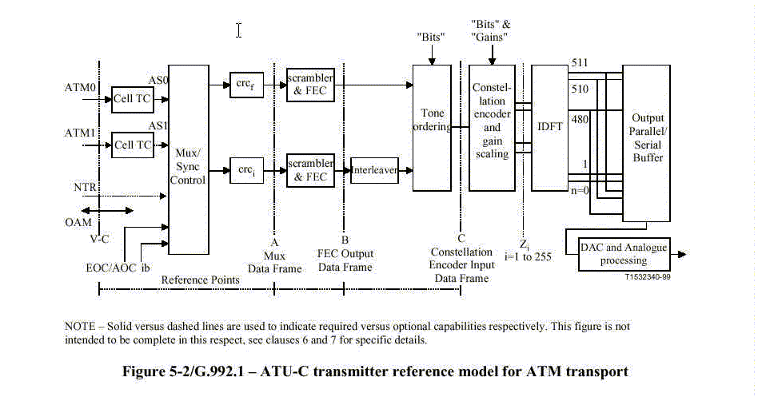
Conceptual ADSL Modem *
Notes:
This conceptual drawing of an ADSL transmitter is taken from an early public version of the ITU standard for ADSL.
Payload data and overhead information are fed into the mux control block where it is built into a framed and superframe structure.
The overhead consists of timing, OAM and ADSL specific control information. The AOC supports the run-time reallocation of data bits across the various carriers.
Customer data may be carried over a higher latency error protected path or a low latency path; interleaved and fast path respectively. This payload data is received via the appropriate ATM utopia interface dependant upon the destined path.
Error detection is provided across a superframe independantly on each path by a CRC. This completed frame is then scrambled for data randomization. If so provisioned the data would have Reed-Solomon parity bytes added and the interleaved path would be convolutionally interleaved. Interleaving spreads the data from individual frames across multiple DMT symbols so that corruption of individual symbols appear as small amounts of corrupted data in multiple frames rather than large amounts of corrupted data in a single frame. This maximizes the effectiveness of the Reed-Solomon forward error correction coding.
Tone ordering is then applied where data from the interleaved path (better error protected) are populated on the denser constellations. Denser constellations are more likely to be corrupted by noise on the line. Further forward error correction may then be applied in the form of Trellis coding. Finally these data symbols are modulated onto the relevant carrier and transmitted onto the line.

Slide 33
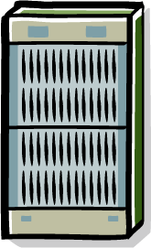

Short loop performance limited by crosstalk noise
Crosstalk Cancellation: Signals on all the lines of the DSLAM are generated jointly or processed jointly.
-
+
H
H
-
+
Downstream Xtalk Precompensation
  Transmit signal is modified with “pre-compensated crosstalk signal”
  Feedback from CPE necessary, but processing performed at transmitter (CO)
Upstream Xtalk Cancellation
  Transmit signal on the line does NOT need to be changed - crosstalk is cancelled after it has coupled via the line
  All processing at the receiver (CO)
Need to sample transmission ‘channels’, evaluate crosstalk, calculate ‘inverse’ function and then apply to each line, in concert

Slide 34
Fiber Access Network
FTTU - Fiber to the User (residential ONU)
  FTTPremises
  FTTHome
  FTTSuite
FTTB – Fiber to the Business (business ONU)
  FTTBuilding
  FTTCampus
Usually shared access

Slide 35
FTTx Topology/Technology Options
Shared Fiber
  PON (Passive Optical Network) :
    Passive and flexible cable plant
    Optimum sharing of bandwidth
    Low cost
    Security
  WDM (Wavelength Division Multiplexing) :
    High sharing of bandwidth over single fiber
    High cost (WDM/DWDM components)
Dedicated Fiber
  Point to point :
    High bandwidth flexibility
    High cost (fiber and equipment)
  Active Star :
    Flexible in feeder range
    Ethernet widely accepted technology
    Active node in the field (high Cost of Ownership)
NG-PON2 is TWDM PON
combination of PON and WDM
OLT – Optical Line Termination
ONU – Optical Network Unit

Slide 36
Why PON
Higher bit rates (than copper)
  Careful splitter placement allows reduced split ratios in the future (even to reducing PON to pt-pt)
  option to use additional wavelengths in the future (even to wavelength per household i.e. essentially pt-pt)
Longer reach (than copper)
  Up to 20 times longer spans possible (20 km vs 1 km)
Lower cost (than point to point fiber)
  Shared feeder fiber and termination in the CO
  Low cost passive splitters in the field (not active electronics)
Retains reliability (of fiber rings)
  Optional ring feeder support (including fast protection switching)
No question it is the long term goal (for Telcos and MSOs) but cost and (slow) speed of deployment are holding it back

Slide 37
Transport (con’t)
Downstream
  Data is visible by all ONUs
  Scrambling or churning of data is employed (Advanced Encryption Standard (AES) encryption is mandatory in GPON)
Upstream
  access mechanism (Dynamic Bandwidth Allocation – DBA)
    Downstream grants assign “slots” for ONU upstream (see PON frame)
  synchronization
    Ranging ensures ONU US bursts are aligned to US frame (accounts for differences in propagation delay between ONUs to OLT)
    Each ONU applies equalization delay as defined by OLT via Ranging protocol
    During Ranging, ONU is assigned ONU-ID

Slide 38
GPON Frame Format *
Downstream Frame Format
PCBd n
Payload n
PCBd n+1
Payload n + 1
- SYNC
- PLOAM
US B/W MAP
(“slot”pointers)
ATM
TDM + Frame (over GEM)
ATM
ATM
ATM
GEM hdr
Frame data
GEM hdr
Frame data
OLT assigns slots to ONUs to allocate bandwidth (see DBA)
Uses pointers to allocate upstream bandwidth
Notes:
TDMA is deployed in the upstream such that data is only sent by the ONT upon receiving a grant message from the OLT (identifying the assigned number of timeslots)
Due to the wide range of distances that need to be supported a process called ranging is used to determine the distance between the OLT and ONT for adjustment of the time slot allocation to maximize efficiency

Slide 39
DBA
ONT
OLT
request
data
User data + report
Report updates b/w
request
data
User data + report
B/W continues to be allocated
request
report
B/W updated
ONU indicates need for upstream b/w
OLT assign’s “slot” as available

Slide 40
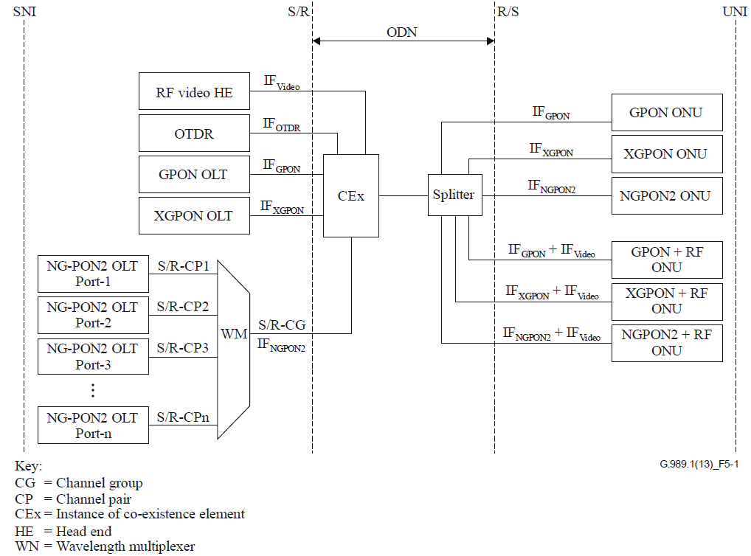
ODN Reference Architecture for NGPON2 (G.989.2)
Co-existence device
(combines different PON technologies onto the same ODN)
Wavelength multiplexer (combined different lambdas onto same fiber)

