Slide 1
A brief History of Telecommunications
(very brief … and incomplete!)
Henry Starzynski
Henry.starzynski@sympatico.ca

Slide 2
A bit about me …
Graduated University of Waterloo BMath/Computer Science – 1982
In my 4th year there was ONE class on data communications!
Worked at Bell Canada for 33+ years
Developed design tools
Managed major Canadian frame relay network
Interface with major US and world carriers for out-of-Canada data circuits
Formerly did course lecture on Network Management
“I’ve been very fortunate in my career. I’ve rode a wave a change in communications: Packet switching, ATM, Frame Relay, Internet, introduction of PCs into the workplace, laptops, cell phones, Blackberry and smartphones, globalization, fibre optics, an explosion in connectivity …”
What does the future hold??

Slide 3
Why the History of Telecommunications?
Who said the following???
“You can't connect the dots looking forward; you can only connect them looking backwards. So you have to trust that the dots will somehow connect in your future. You have to trust in something - your gut, destiny, life, karma, whatever. “
“Study the past, if you would divine the future “
“In this bright future you can't forget your past.”
Steve Jobs
Confucius
Bob Marley

Slide 4
We could do a complete course on telecommunications history!
Emphasis will be on major developments in telecommunications
PLUS a Canadian focus
Lots of great websites for more information – just do a search!
Along the way .. Will add some interesting stories and facts to amaze you!

Slide 5
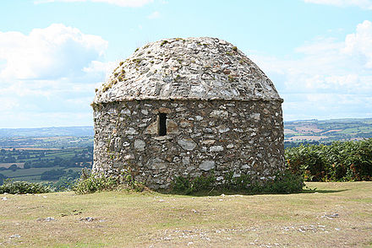
Early Communications Systems
Greeks, Persians and Romans used smoke and fire signals for sending messages
Not very secure! (no encryption!)
Signals could easily be misinterpreted.
Distance and weather would be factors as well
Beacon systems were another method of transmitting information
Some traditions never die … the signalling that a new Pope has been
elected is indicated by the colour of smoke from the Vatican (although this
‘tradition’ is only about 150 years old!)

Slide 6
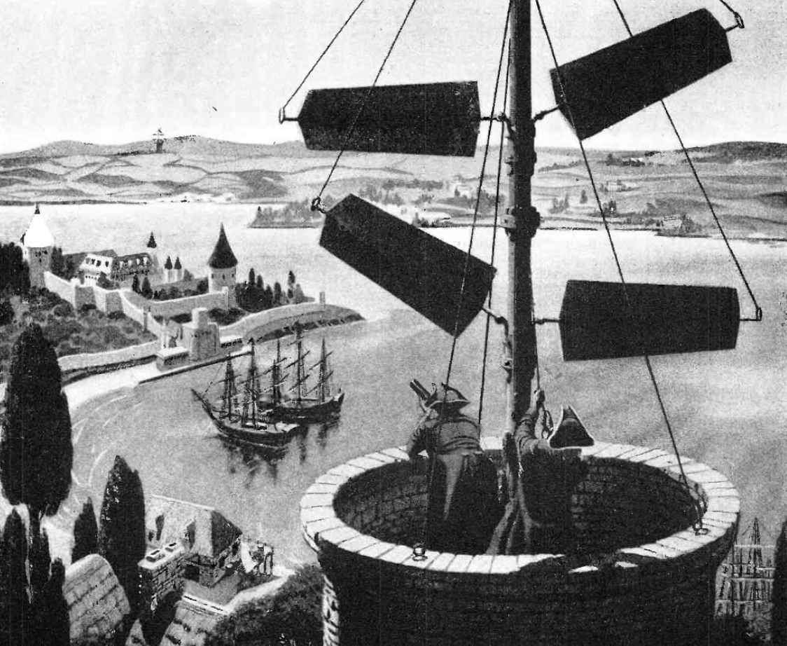
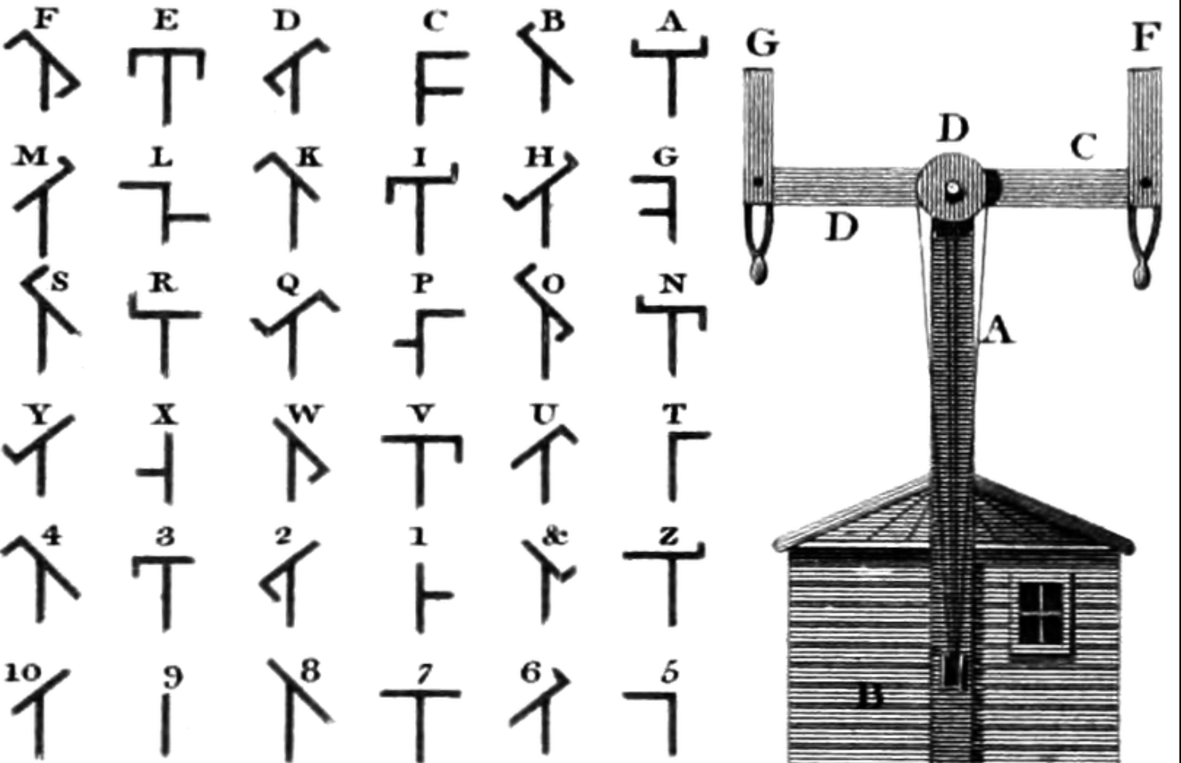
Optical Telegraphy
The Optical telegraph was first functional telecommunications device to be used
successfully
Tachygraphe of Claude Chappe – who is sometimes referred to as
‘the father of telecommunications’
First official message was passed over a line Paris-Lille, August 15, 1794
It took one hour to transmit a message that French troops had
recaptured a town in a battle
Chappe was convinced the relay exchange could be used to send news
and even stock exchange information. The leader of France, Napoleon
thought it was impractical – all he would consent to was a weekly
transmission of the numbers of the winners in the national lottery! Times
never seem to change!

Slide 7
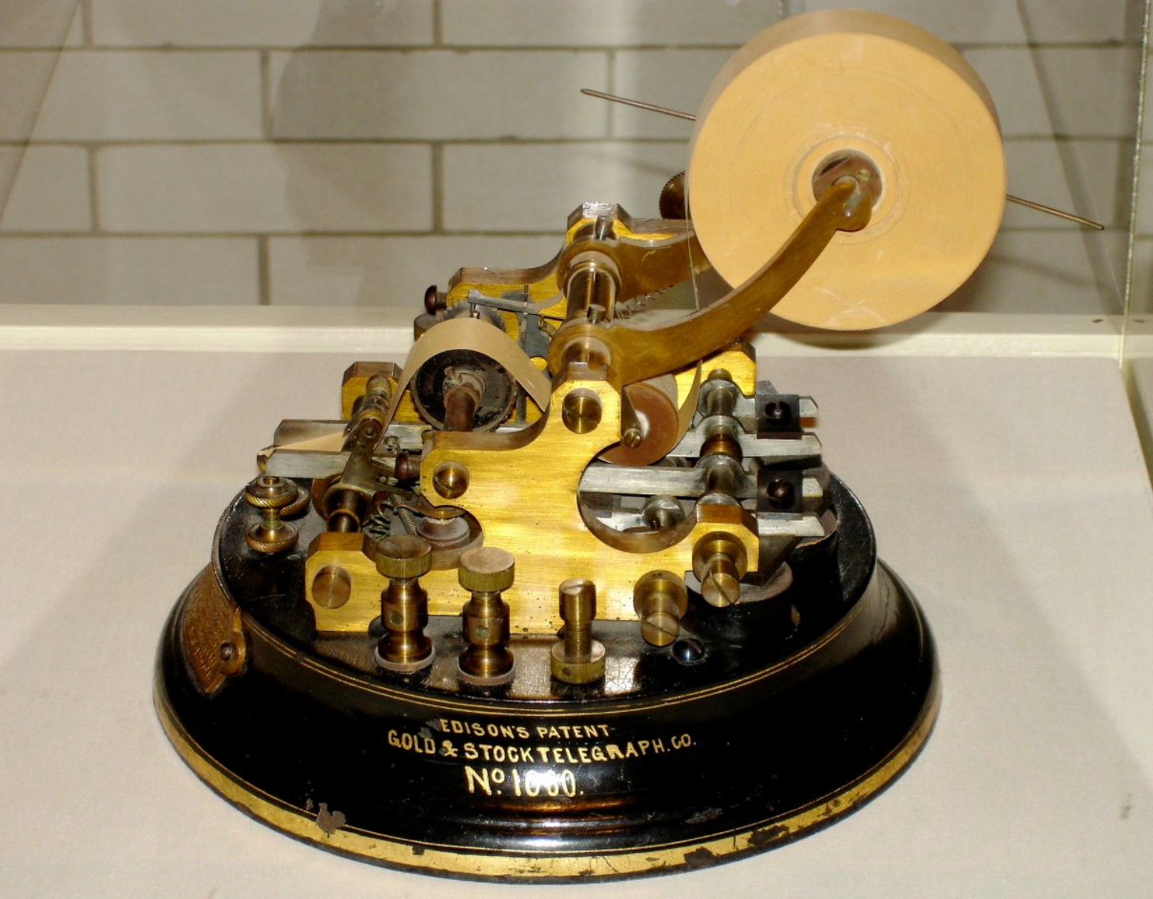
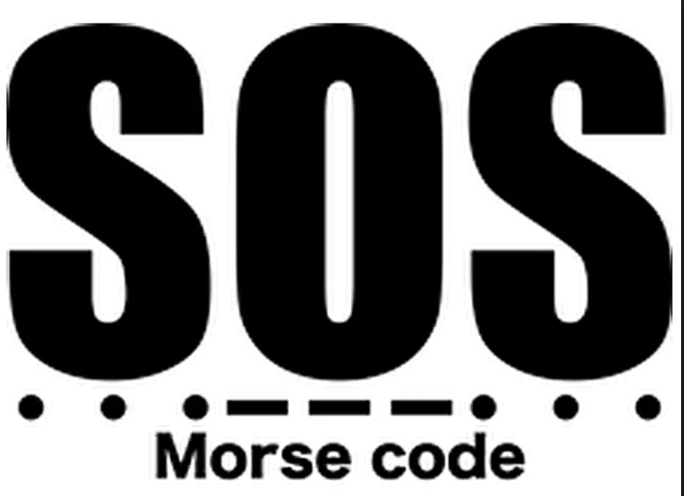
Electrical Telegraphy
February 17, 1753 – start of the history of electrical telegraphy
Letter published in Scots’ Magazine proposed the idea of electrical telegraphy
1833 – Gauss and Wilhelm Weber constructed a mirror-galvanometer
September 4 1837 – Samuel Morse demonstrates the sending of messages
via a wire 550 m long “Successful experiment with telegraph September 4 1837”
Work on telegraph was occurring in the US, and in Europe
Telegraph service started in Canada in 1844 in the Toronto-Hamilton-Niagara area
Many competing companies sprang up in the US
Morse’s system was the simplest and became the standard
July 27 1866 – first transatlantic cable was completed!
Morse code is also called the Victorian Internet. It is due to the fact that the code
can be applied in most areas in the world
Andrei Bindasov from Belarus has the record of the fastest Morse code speed.
He transmitted 216 Morse codes for in minute on 6 May 2003.

Slide 8
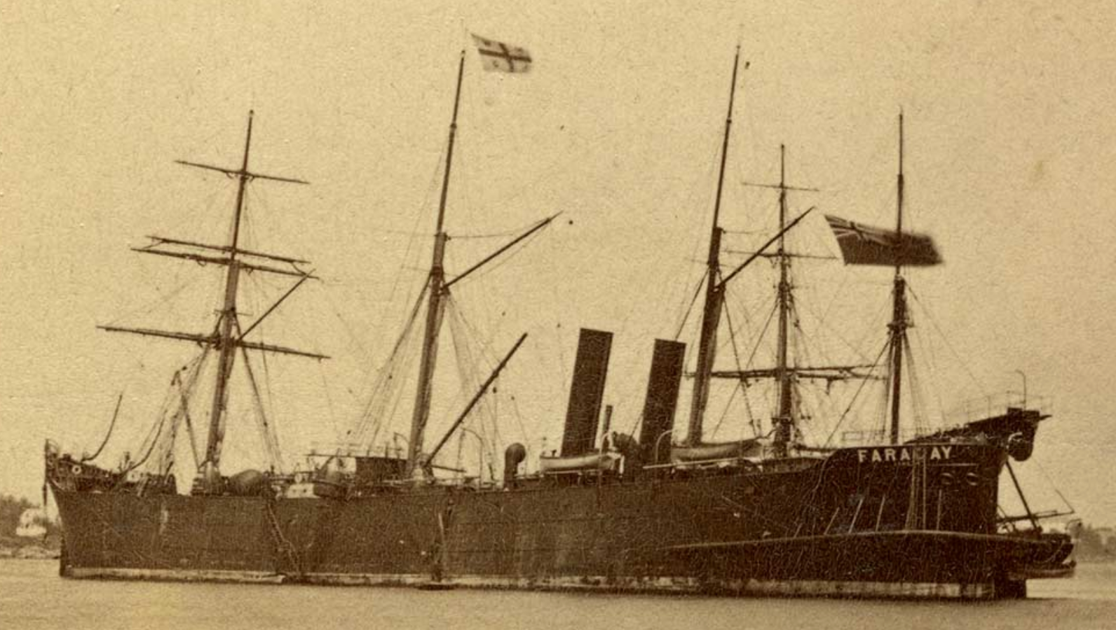
C.S. Faraday – 1874 – was the first ship build specifically for laying
Undersea cable!

Slide 9
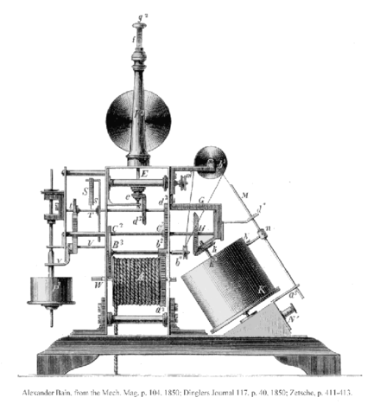
Image Telegraphy
Telefax (facsimile) is as old as the telegraph
Alexander Bain developed a chemical telegraph in 1843
The 1st successful telefax transmission was made in Great Britain in 1847
The first photograph to be sent via fax was in 1904
These were the beginnings of ‘fax’ service which was very popular in the later
half of the last century

Slide 10
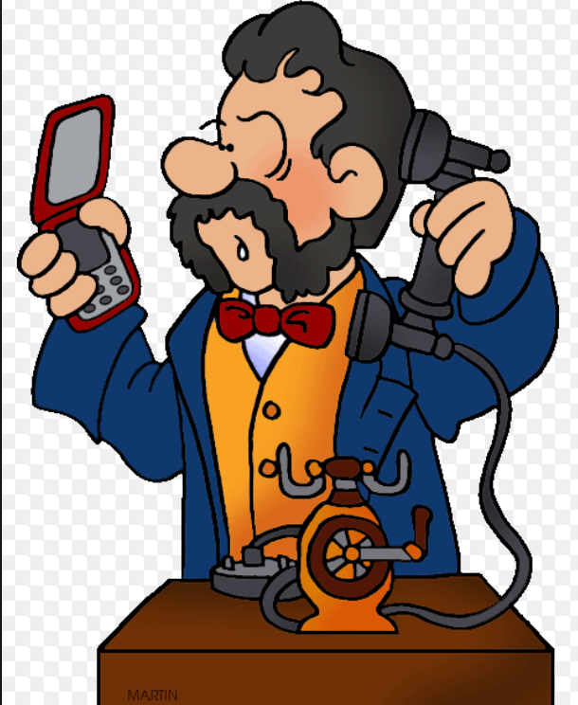
Telephony
We all know – the inventor of the telephone is Alexander Graham Bell
Patent was granted April 6, 1875
But … the public and investors were skeptical!
First demonstrated May 1876 at MIT
At Philadelphia Centennial Exhibition, Bell was given a small table
near a stairwell. Judges virtually ignored Bell, and made jokes about his
invention. But when the Emperor of Brazil, Dom Pedro II, arrived and
recognized Bell (after having visited his school for deaf-mutes), judges
took notice. Bell demonstrated his invention to Dom Pedro, talking to
the emperor across the room. The emperor’s reply?
“My God! It talks!”
As a result, the judges took notice and Bell became
the instant star of the exhibition!

Slide 11
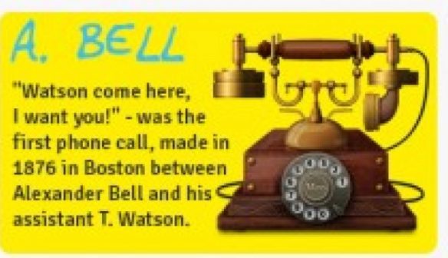
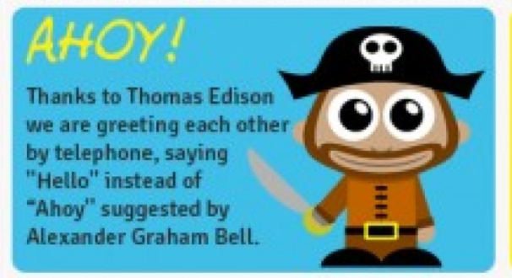
Italian inventor Antonio Meucci had filed his own patent caveat for a telephone device... in December of 1871. But, Antonio Meucci did not renew his caveat after 1874 and Alexander Graham Bell was granted the patent for in March of 1876. Still, some scholars consider Meucci the real inventor of the telephone.
In 1876, a cash-strapped Alexander Graham Bell, inventor of the first successful
telephone offered to sell his telephone patent to Western Union for $100,000.
They declined

Slide 12
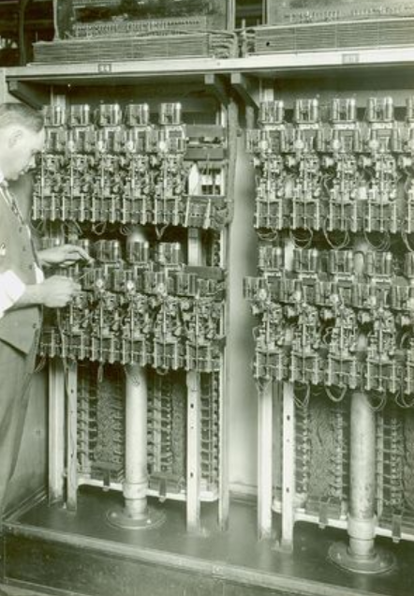
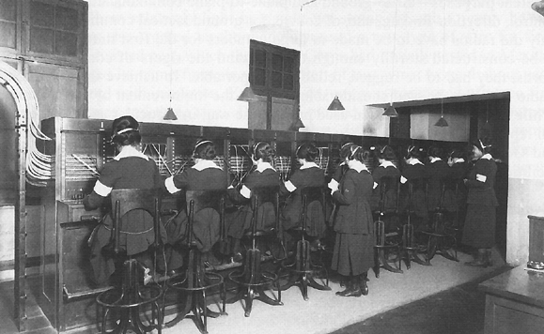
Switching
Initially ‘switching’ of calls was done manually. The first telephone exchange
was in New Haven in 1878 serving 21 subscribers
Operators were called ‘hello’ girls who would patch calls through
System worked, but not very scaleable!
Almon Brown Strowger, and undertaker, invented a switching exchange to
circumvent ‘hello’ girls. He was losing business because a rival undertaker had his
girlfriend as the local ‘hello’ girl and the rival was thus getting all the business!
Strowger decided to get out of the funeral business, and build a switch!
Strowger’s switch was commonly referred to as the ‘step by step’ switch

Slide 13
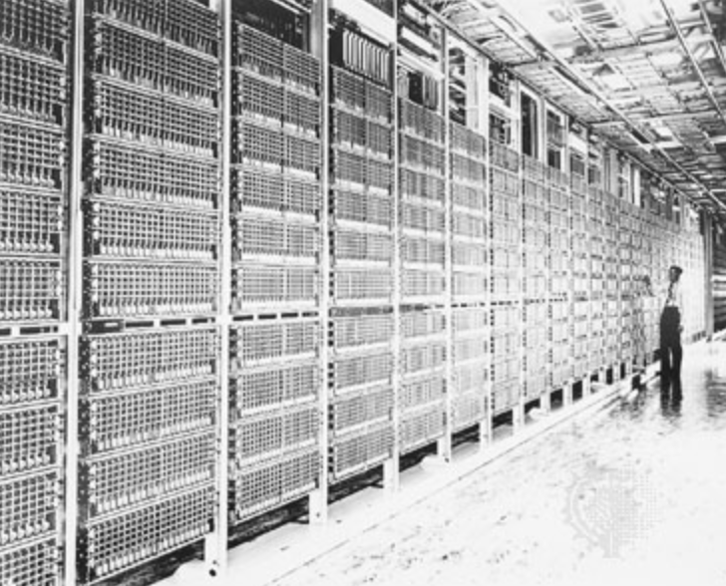
Further enhancement to the electro-mechanical switches continued
AT&T developed the crossbar switch in the early 1900s and various
versions of this existed until the early 1970s
It was not until 1951 though, when subscribers could direct dial long distance!
In the 1960s LD was very expensive, and phone ‘phreaks’ found they could
fool the switching system sending a 26 Hz tone – thus began a cottage industry
of making ‘blue boxes’ to get LD free. 2 of the most famous phone ‘phreaks’
are well known to us today … Steve Jobs and Steve Wozniak!
In the 1960s, Digital switching development began
Alcatel developed a switch in France
In Canada Bell Northern Research, the development arm of Bell Canada
developed the SP1 switch, then the DMS phone
switch. (Bell Canada still has
LOTS of DMS but they will be replaced!

Slide 14
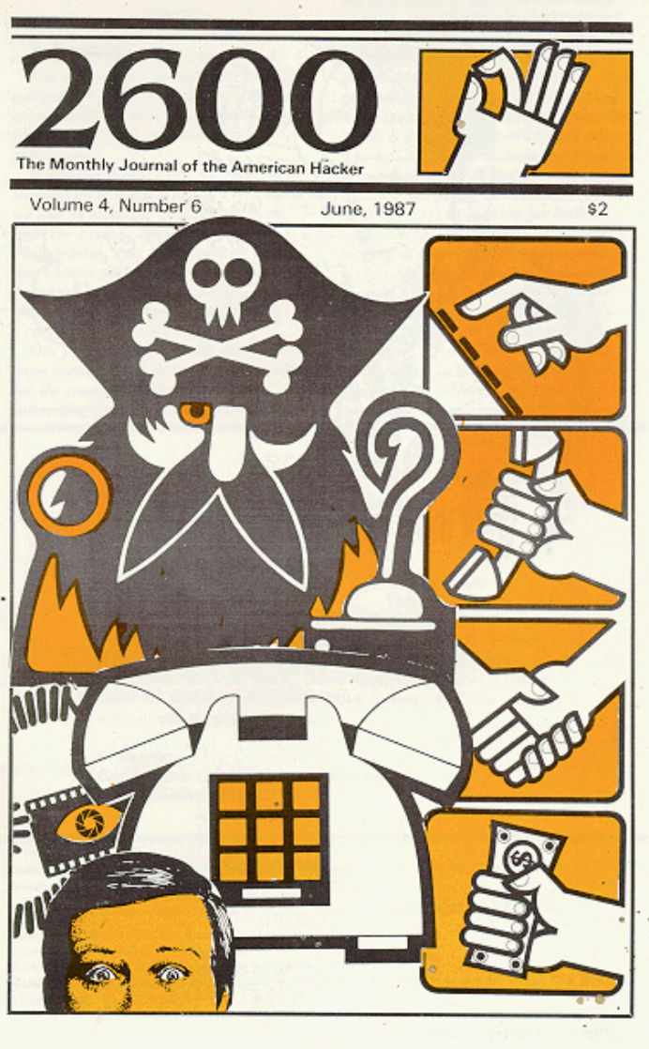
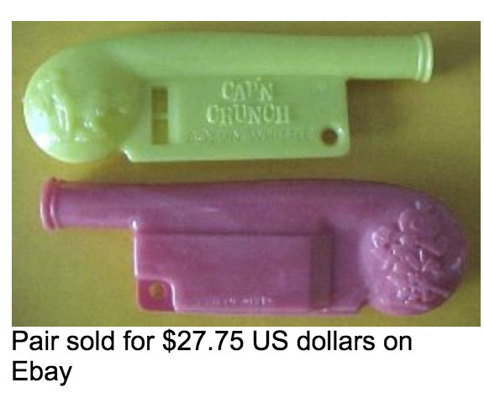
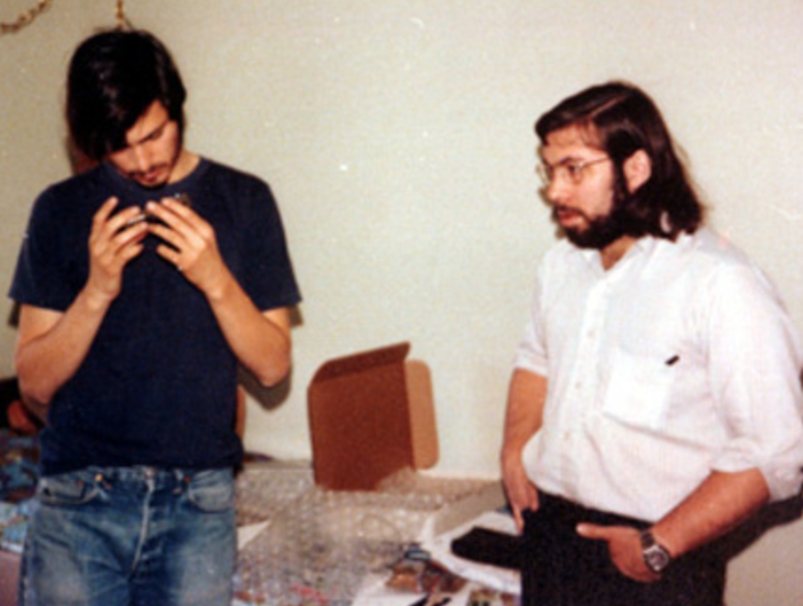

Slide 15
Some more interesting facts!
A number of well known people used to work for Bell Northern Research
Whitfield Diffie (think Cryptogrpahy!)
Robert Gaskins – the person who invented .. POWERPPOINT!
J.W.J. Williams – inventor of Heapsort!
1951 – Ralph Baer suggests adding an interactive game to TV. His
management was not impressed and rejected the idea!
1954 – a company called Service Games starts making coin operated games
Service Games later becomes … SEGA
Where does the word spam come from? One urban legend traces it back to
the Multi User Dungeons of the 1980’s – primitive multiplayer adventure
games where players explored and performed actions using text only.
One new user felt the MUD community and experience was particularly
boring, and programmed a keyboard macro to type the words
SPAM SPAM SPAM SPAM SPAM
repeatedly every few seconds, presumably imitating the famous Monty
Python sketch about spam-loving Vikings.

Slide 16
Canadian Telecommunication Highlights
These are a number of significant highlights in Canada telecommunications
1880 – Canada’s first female operator is hired
1892 – Gov’t of Canada passes legislation banning rate increases without gov’t approval
1948 - First commercial microwave link in the world established between
Prince Edward Island and Nova Scotia
1956 – the first tropospheric scatter transmission system in the world,
linking eastern Arctic with lower Canada, is completed
1958 – Trans-Canada microwave is launched, making coast-coast TV possible!
1962 – PHONE-FAX is introduced. Allouette 1 experimental satellite is launched
1969 – Telesat Canada is incorporated, develops the worlds first
geostationary satellite system, Anik A1 (launched 1972)
1973 – Dataroute, the world’s first public nationwide digital transmission network
is introduced
1976 – Datapac, the worlds first commercial packet-switched digital network
is introduced
1978 – Anik-B is launched, carries world’s first commercial TV service
1978 – World’s first fibre optic trial begins in Toronto

Slide 17
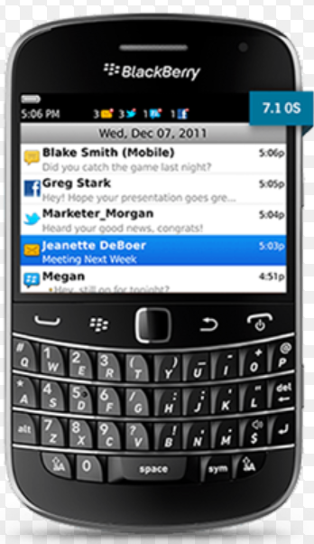
Canadian Perspective
1977 - Nortel (Bell Northern Research) release DMS 100 digital phone switch
1981 – Before the internet, Envoy 100 email service was launched in Canada
1986 – Canada and US become first two countries to offer international
electronic messaging services!
1989 – First coast-coast CELLULAR telephone call made in Canada
1990 – Coast-Coast fibre optic network is completed
1991 – High Performance routing and CCS7 are deployed in the switching network
1992 – CRTC allows LD competition in Canada
1992 – World’s first digital cellular network launched
1995 – Consumer Internet is made available
1996 – RIM (aka Blackberry) releases its first model!
1996 – 56K modem invented!
2010 – Death of Nortel
These are only a few of the Canadian telecommunication innovations!
Major Canadian companies such as Mitel, Nortel (BNR), Blackberry (RIM), Gandalf,
Newbridge, JDI Uniphase, have changed the communications world!

Slide 18
Internet Timeline
1840s – The ‘Victorian’ Internet, aka the Telegraph, was introduced
1964 – Packet switched invented
1965 – Hypertext invented
1968 – Defence Advanced Research Projects Agency creates ARPAnet (to provide
redundant communications in the event of a nuclear hit)
1970 – First 5 network nodes are established
1972 – Email introduced
1973 – FTP introduced
1974 – TCP specification is released (and is still in use today!)
First ISP (Telenet) is established
1983 – DNS established
1984 – Internet with 1000 hosts used TCP/IP for messaging
1989 – WWW created
1990 – First browser invented
1991 – WWW introduced to the public
1995 – The ‘Age of Communications’ begins
1997 – Netflix is founded (they send CDs and DVDs by .. Snail-mail!)
1998 – Google search engine is born

Slide 19
Internet Timeline
1974 – Network voice Protocol tested over ARPANET
1991 – First VOIP application released to the public
1996 – Internet phones catch the attention of the US gov’t .. They want to ban the them!
2000 – Internet bubble bursts – first DoS attack!
2004 – Facebook goes online
2005 – YouTube launches
2006 – Twitter launches

Slide 20
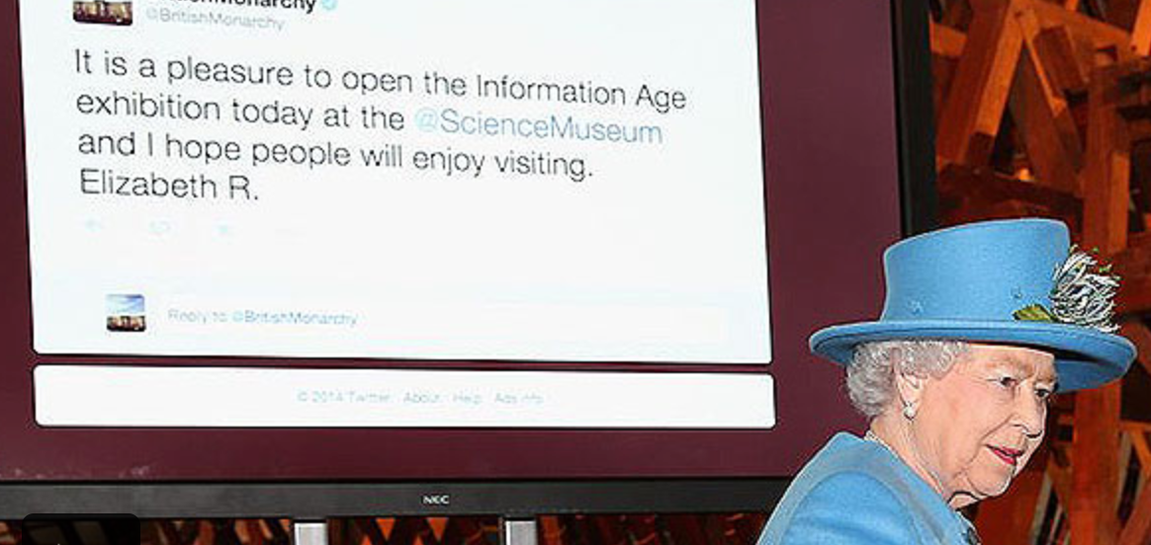
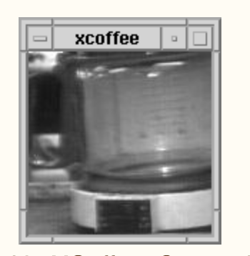
Amazing Internet & Telecom Facts!
1976 - Queen Elizabeth II sends her first email!
1985 – First registered domain established for Symbolics Computer Corp
1988 – the first ‘worm’ is sent through the internet (by the son of a major
internet developer!)
The first webcam was developed to monitor .. A coffee pot!
The first banner ad appeared in 1994 (by AT&T!)
The first spam email was sent in 1978 in error – and the reaction from
recipients is similar as it is today .. GRRRR
Guesses on the busiest day EVER for Long Distance phone calls??
What is the most common ‘application’ on a mobile phone?
The world’s first cell phone was released by IBM .. Called Simon .. In 1993
and had a calendar, fax and touch screen!

Slide 21
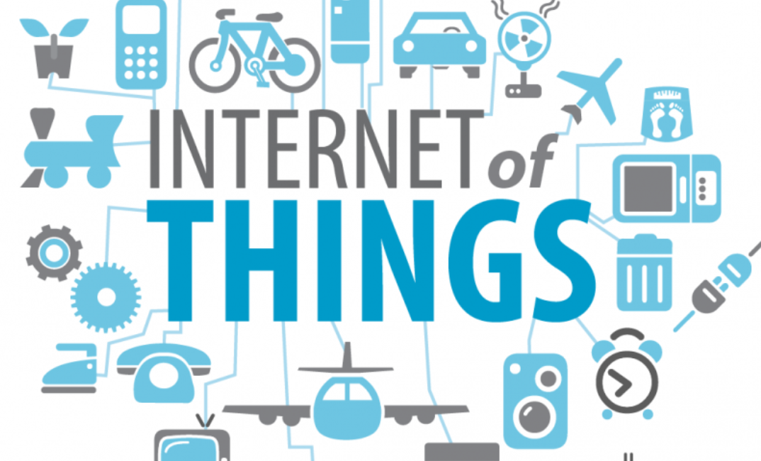
The Future in Telecommunications
Integration of content and service providers
The ‘internet of things’ – explosion in number of devices will see exponential growth in
data volumes … zettabytes per year
Mobility and the death of land lines & copper
Cyber-wars?
Big-Brother society?
Apps .. Apps .. And more Apps
???

Slide 22
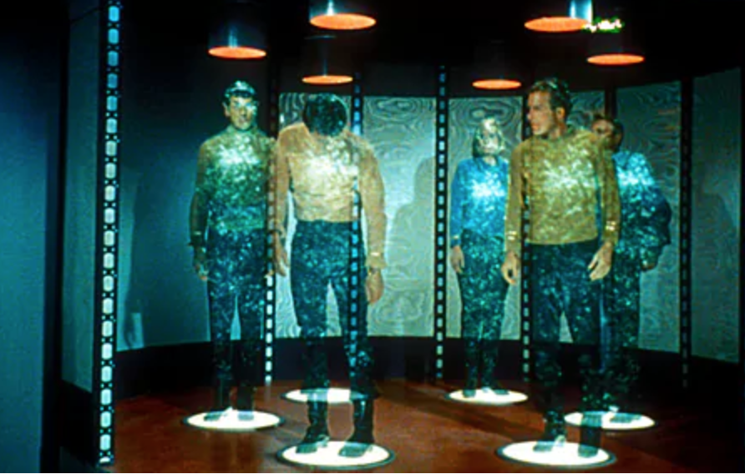
The Future in Telecommunications
What else will the future bring?? Teleportation??
And who will be leading the future developments?
Take a look in the mirror!!!
That you be … YOU!

Slide 23
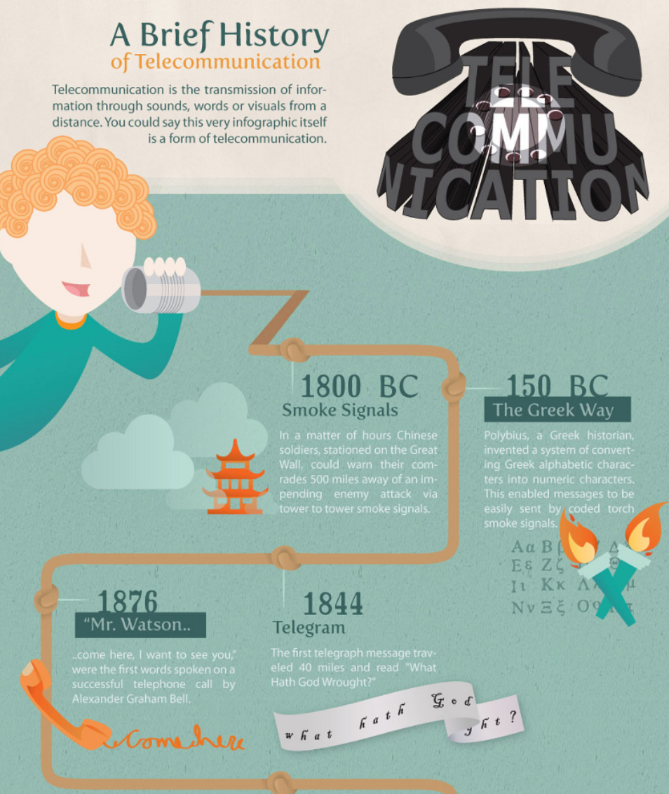

Slide 24
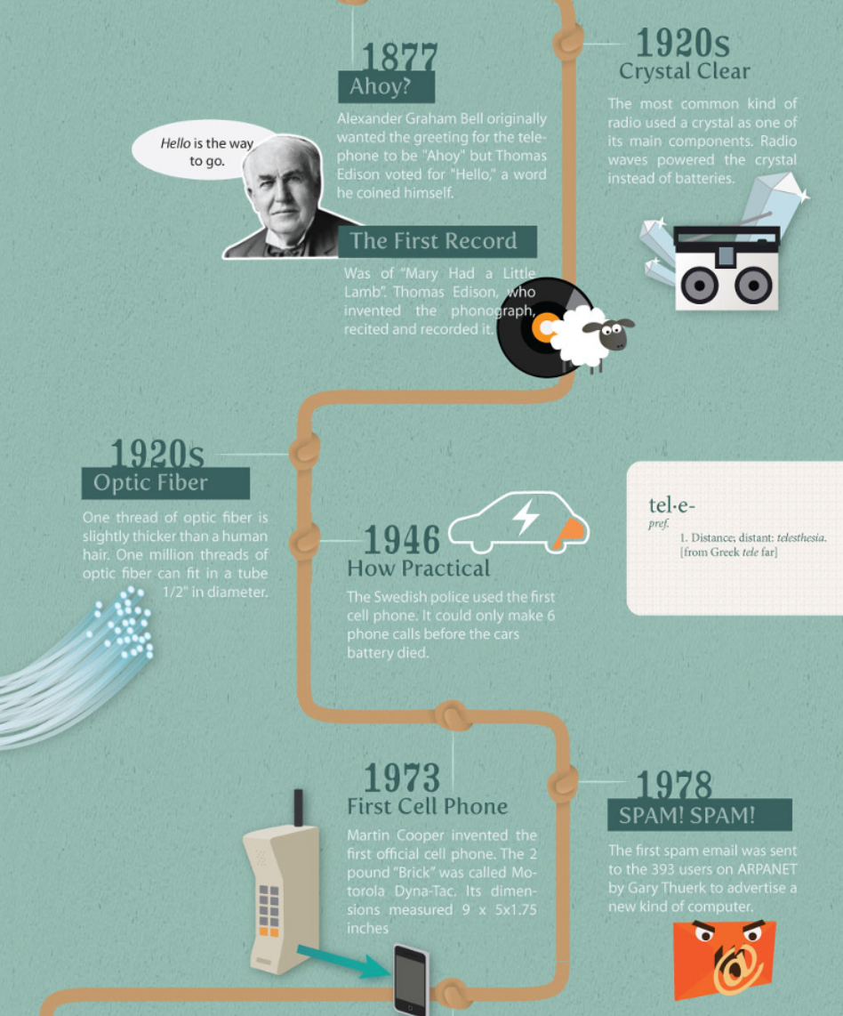

Slide 25
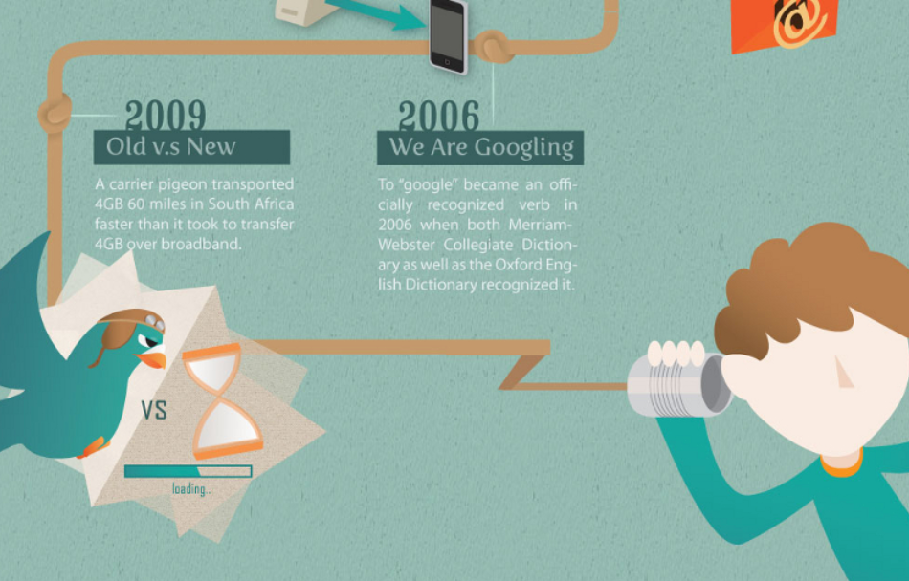

Slide 26
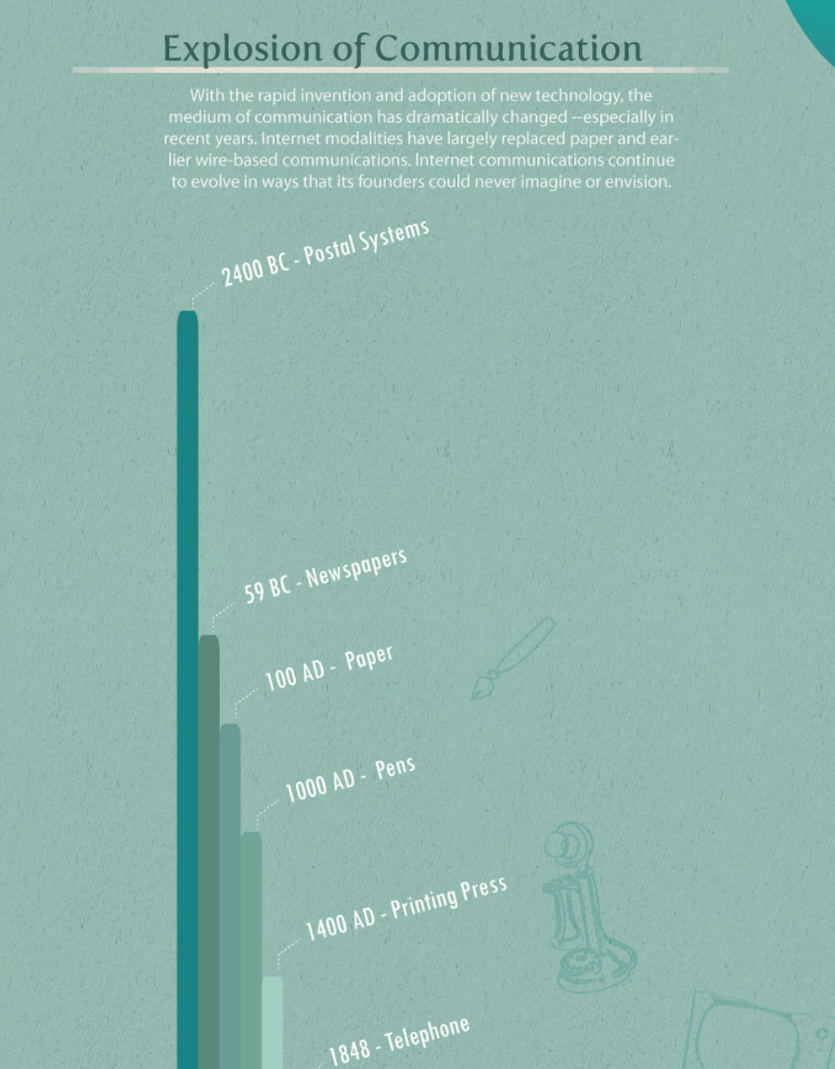

Slide 27
