Slide 1
ICT and 5G+ Wireless Networks
Halim Yanıkömeroğlu
Carleton University
Ottawa, Canada

Slide 2
Part I: Use Cases
Generations of cellular technologies (1G → 4G)
3GPP
5G: A game changer
ICT
Concluding remarks

Slide 3
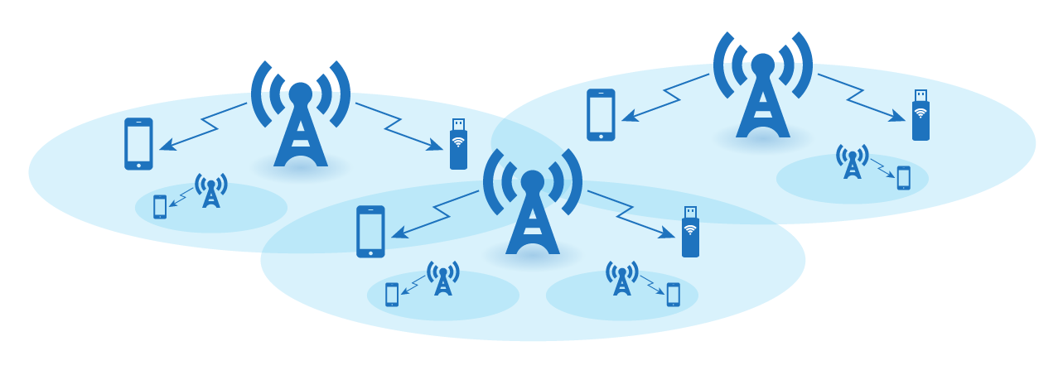
Wireless Cellular Networks

Slide 4
Wireless Cellular Networks
Handoff → Seamless roaming
Network-wide frequency (channel) planning → Quality-of-Service (QoS) guarantee

Slide 5
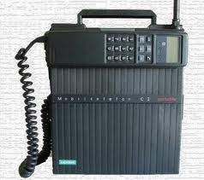
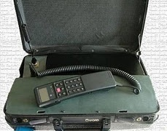
Mobile phone (1946)

Slide 6
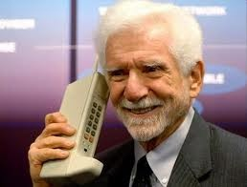
Mobile phone → Cell phone

Slide 7
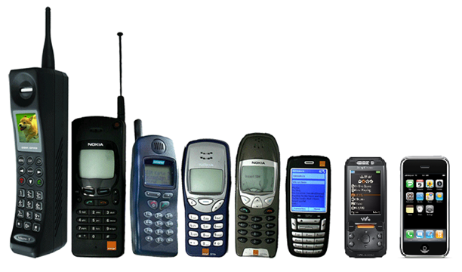
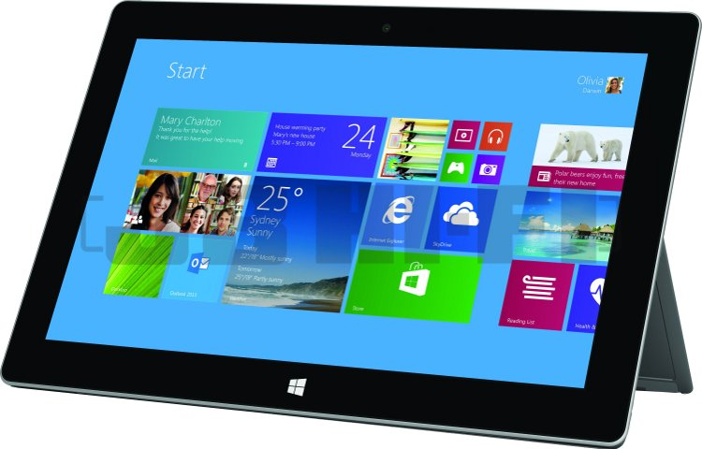
Mobile phone → Cell phone → Smart phone → Tablets

Slide 8
Evolution of Use-Cases in Cellular from 1G to 4G
voice
video
text, email, browsing

Slide 9
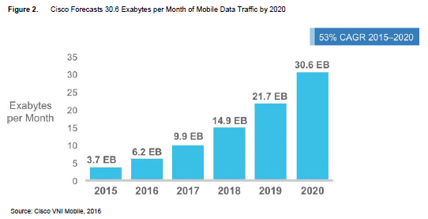
Cisco Visual Networking Index: Global Mobile Data Traffic Forecast

Slide 10
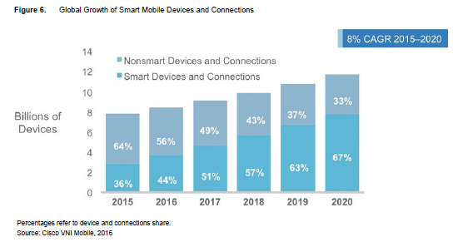
Cisco Visual Networking Index: Global Mobile Data Traffic Forecast

Slide 11
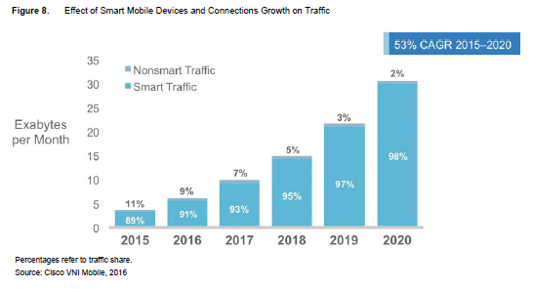
Cisco Visual Networking Index: Global Mobile Data Traffic Forecast

Slide 12
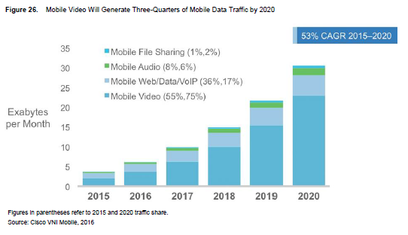
Cisco Visual Networking Index: Global Mobile Data Traffic Forecast

Slide 13
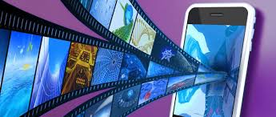

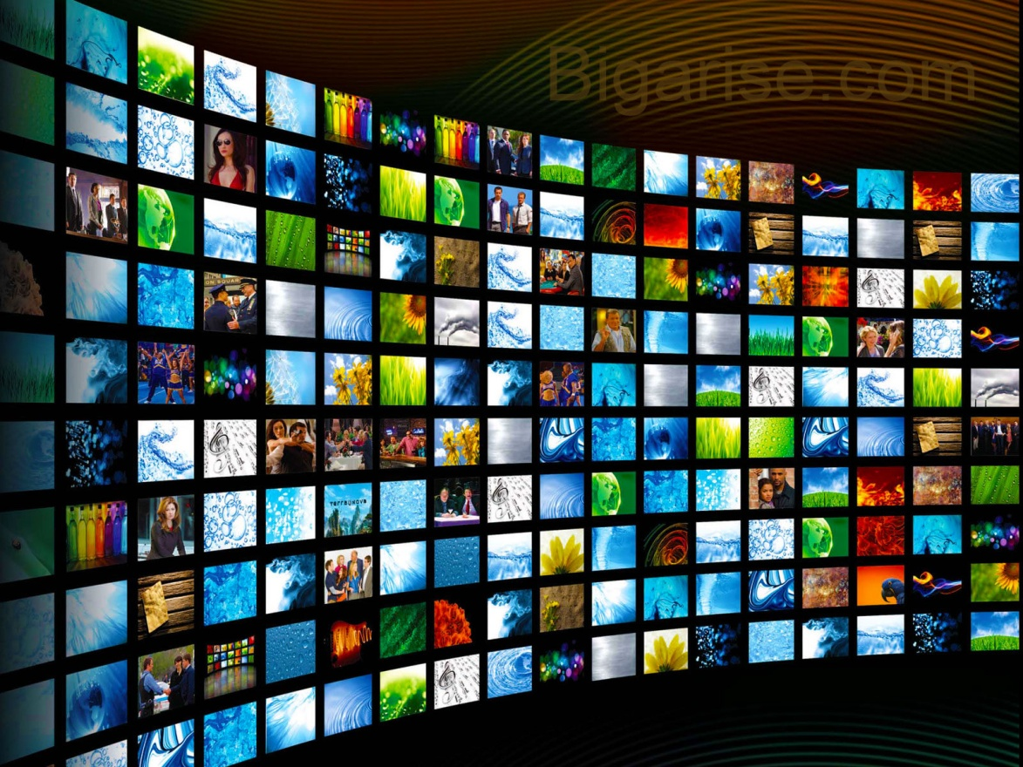
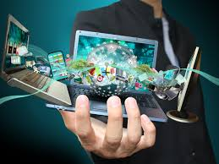
Near Future: More Video

Slide 14
What is 5G?
Notes:
14

Slide 15
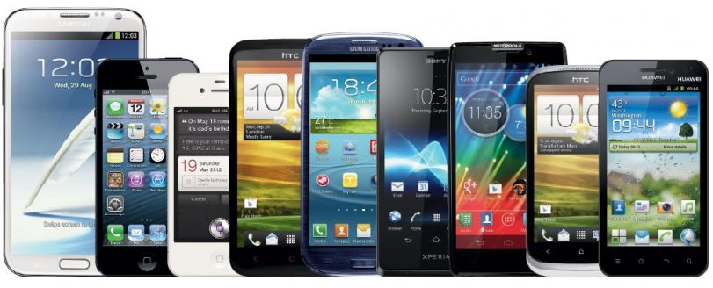
What is 5G?
5G is not about only smart phones
Notes:
15

Slide 16
What is 5G?
5G is not about only smart phones
5G is about novel use cases
Notes:
16

Slide 17
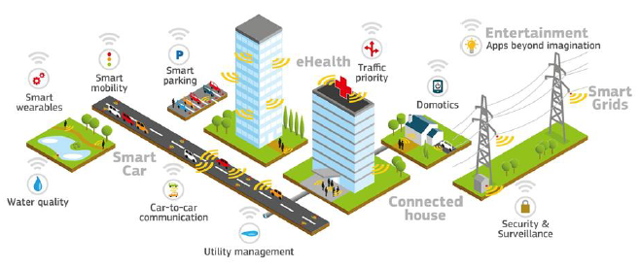
5G Use Cases
A. Dutta, AT&T
Notes:
17

Slide 18
Problem with 5G Discussions
1G– 4G discussions: All around phone
5G: Too many very different use cases with one discussion
Challenges, required technologies, and market demand are very different

Slide 19
Part I: Use Cases
Generations of cellular technologies (1G → 4G)
3GPP
5G: A game changer
ICT
Concluding remarks

Slide 20
Patents are Important
Qualcomm royalty fee: $16.25 per 5G smart phone
2.275% → 5% of the selling price (up to $500)
Ericsson royalty fee: $5 per 5G smart phone

Slide 21
Patents are Important
Nortel’s patents were sold in June 2011 to a consortium consisting of Apple, Ericsson, Microsoft, Blackberry and Sony.
6,000 patents for $4.5 B → $750,000 per patent

Slide 22
Companies with the Highest Number of Issued US Patents in 2014
IBM USA 7,534
Samsung S. Korea 4,952
Canon Japan 4,055
Sony Japan 3,224
Microsoft USA 2,829
Toshiba Japan 2,608
Qualcomm USA 2,590
Google USA 2,566

Slide 23
Generations of Cellular Networks
0G: Non-cellular mobile 1G: AMPS, 1983 2G: GSM, 1991

Slide 24
Generations of Cellular Networks
0G: Non-cellular mobile 1G: AMPS, 1983 2G: GSM, 1991
3GPP Platform: [Est. 1998] “unites 6 telecom standard development organizations (ARIB, ATIS, CCSA, ETSI, TTA, TTC), and provides their members with a stable environment to produce the highly successful Reports and Specifications that define 3GPP technologies”. (Other platforms and organizations: 3GPP2, IEEE, …)

Slide 25
Generations of Cellular Networks
0G: Non-cellular mobile 1G: AMPS, 1983 2G: GSM, 1991
R99
R4
R5
R6
R7
R8
R9
R10
R11
R12
2000
2001
2002
2003
2004
2005
2006
2007
2008
2009
2010
2011
2012
2013
2014
2015
Release 13: Mar 2016
Release 14: Jun 2017
3GPP Platform

Slide 26
Generations of Cellular Networks
0G: Non-cellular mobile 1G: AMPS, 1983 2G: GSM, 1991
2 Mbps mobile
1 Gbps hotspot / 100 Mbps mobile
ITU-R IMT-2000 circular letter ITU-R IMT-Advanced circular letter
R99
R4
R5
R6
R7
R8
R9
R10
R11
R12
2000
2001
2002
2003
2004
2005
2006
2007
2008
2009
2010
2011
2012
2013
2014
2015
Release 13: Mar 2016
Release 14: Jun 2017
3GPP Platform

Slide 27
Generations of Cellular Networks
0G: Non-cellular mobile 1G: AMPS, 1983 2G: GSM, 1991
2 Mbps mobile
1 Gbps hotspot / 100 Mbps mobile
ITU-R IMT-2000 circular letter ITU-R IMT-Advanced circular letter
R99
R4
R5
R6
R7
R8
R9
R10
R11
R12
2000
2001
2002
2003
2004
2005
2006
2007
2008
2009
2010
2011
2012
2013
2014
2015
HSPA
DL
HSPA
UL
HSPA+
LTE
LTE
Adv
UMTS
Release 13: Mar 2016
Release 14: Jun 2017
3GPP Platform

Slide 28
Generations of Cellular Networks
0G: Non-cellular mobile 1G: AMPS, 1983 2G: GSM, 1991
2 Mbps mobile
1 Gbps hotspot / 100 Mbps mobile
ITU-R IMT-2000 circular letter ITU-R IMT-Advanced circular letter
3G: IMT-2000 compliant 4G: IMT-Advanced compliant
R99
R4
R5
R6
R7
R8
R9
R10
R11
R12
2000
2001
2002
2003
2004
2005
2006
2007
2008
2009
2010
2011
2012
2013
2014
2015
HSPA
DL
HSPA
UL
HSPA+
LTE
LTE
Adv
UMTS
Release 13: Mar 2016
Release 14: Jun 2017
3GPP Platform

Slide 29
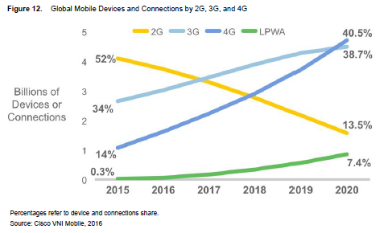
Cisco Visual Networking Index: Global Mobile Data Traffic Forecast
LPWA (Low-Power Wide-Area):
Utility meters, street lights, pet or personal asset trackers, etc.

Slide 30
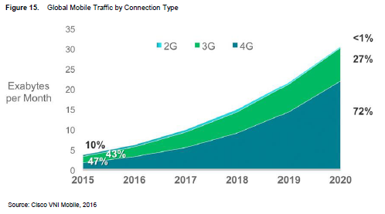
Cisco Visual Networking Index: Global Mobile Data Traffic Forecast

Slide 31
Part I: Use Cases
Generations of cellular technologies (1G → 4G)
3GPP
5G: A game changer
ICT
Concluding remarks

Slide 32


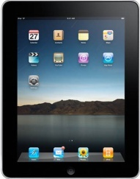






Cellular Generations – 1G, 2G, 3G, 4G
4G
Mobile device for everyone
Gbps
3G
data
Mbps
2G
Mbps
data
kbps
1G
kbps
data
AMPS
bps
AMPS
bps
1980
1990
2000
2010
2020
Time
Notes:
32
2010 – 20 - will be the decade of LTE
2020 -> - will be 5th G what will it hold?
Not entirely sure but – what is sure is that Between Now and then-
Cell size will definitely shrink – and consequently
Cell count will increase
All in an order of magnitude
Devices will undoubtedly expand exponentially
Data M2M will explode – And this will inevitably lead to a concatenation of growth trends
The growing need for information and interaction will spur a number of Mega-trends ……

Slide 33
Cellular Generations – 2010 View
5G
?
data
4G
?
Mobile device for everyone
Gbps
3G
data
Mbps
2G
Mbps
data
kbps
1G
kbps
data
AMPS
bps
AMPS
bps
1980
1990
2000
2010
2020
Time
Notes:
33
2010 – 20 - will be the decade of LTE
2020 -> - will be 5th G what will it hold?
Not entirely sure but – what is sure is that Between Now and then-
Cell size will definitely shrink – and consequently
Cell count will increase
All in an order of magnitude
Devices will undoubtedly expand exponentially
Data M2M will explode – And this will inevitably lead to a concatenation of growth trends
The growing need for information and interaction will spur a number of Mega-trends ……

Slide 34
Cellular Generations – Current View
5G
?
data
4G
?
Mobile device for everyone
Gbps
3G
data
Mbps
2G
Mbps
data
kbps
1G
kbps
data
AMPS
bps
AMPS
bps
1980
1990
2000
2010
2020
Time
Notes:
34
2010 – 20 - will be the decade of LTE
2020 -> - will be 5th G what will it hold?
Not entirely sure but – what is sure is that Between Now and then-
Cell size will definitely shrink – and consequently
Cell count will increase
All in an order of magnitude
Devices will undoubtedly expand exponentially
Data M2M will explode – And this will inevitably lead to a concatenation of growth trends
The growing need for information and interaction will spur a number of Mega-trends ……

Slide 35
Cellular Generations: Use-Cases & Timeline
1980
1985
1990
1995
2000
2005
2010
2015
2020
1G
2G
2.5G
3G
3.5G
4G
4.5G
5G
voice

Slide 36
Cellular Generations: Use-Cases & Timeline
1980
1985
1990
1995
2000
2005
2010
2015
2020
1G
2G
2.5G
3G
3.5G
4G
4.5G
5G
voice
data (video)

Slide 37
Cellular Generations: Use-Cases & Timeline
1980
1985
1990
1995
2000
2005
2010
2015
2020
1G
2G
2.5G
3G
3.5G
4G
4.5G
5G
voice
data (video)
novel use-cases

Slide 38
Cellular Generations: Use-Cases & Timeline
1980
1985
1990
1995
2000
2005
2010
2015
2020
1G
2G
2.5G
3G
3.5G
4G
4.5G
5G
voice
data (video)
novel use-cases
novel use-cases:
autonomous & connected vehicles,
IoT, smart grid, smart cities,
smart homes, health care,
remote robotics, tactile internet, …
very many, difficult to list

Slide 39
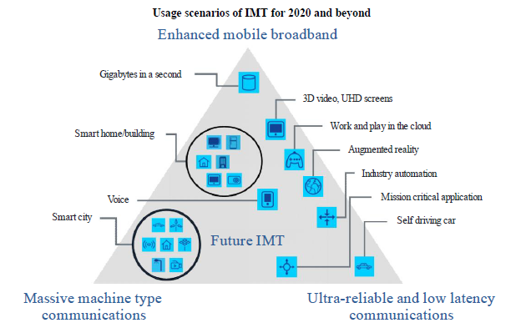
Cellular Generations: Use-Cases & Timeline
1980
1985
1990
1995
2000
2005
2010
2015
2020
1G
2G
2.5G
3G
3.5G
4G
4.5G
5G
voice
data (video)
novel use-cases
novel use-cases:
autonomous & connected vehicles,
IoT, smart grid, smart cities,
smart homes, health care,
remote robotics, tactile internet, …
very many, difficult to list

Slide 40
Cellular Generations: Use-Cases & Timeline
1980
1985
1990
1995
2000
2005
2010
2015
2020
1G
2G
2.5G
3G
3.5G
4G
4.5G
5G
voice
data (video)
novel use-cases
novel use-cases:
autonomous & connected vehicles,
IoT, smart grid, smart cities,
smart homes, health care,
remote robotics, tactile internet, …
very many, difficult to list
Some of the envisioned use cases will have to wait for the 5G evolution,
or even 6G, or even beyond!

Slide 41

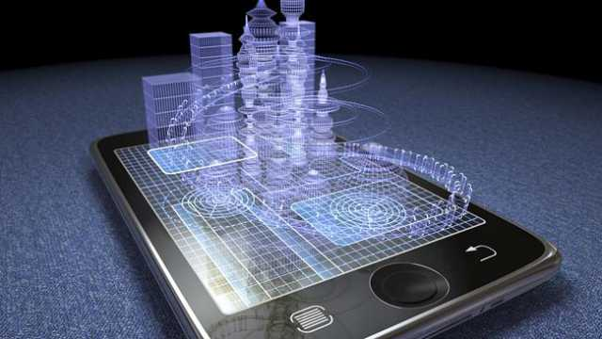
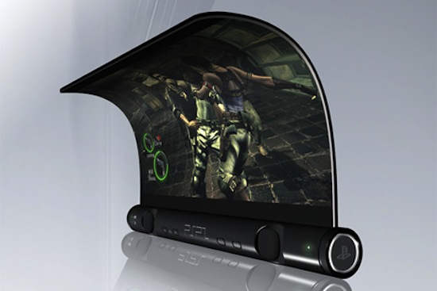
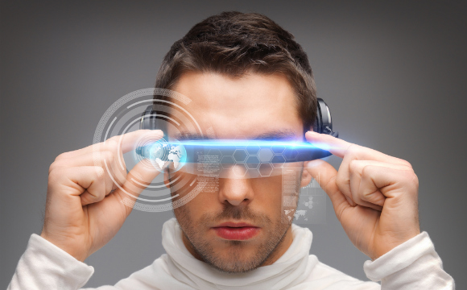
Direction 1: Enhanced Mobile Broadband (EMBB)

Slide 42

Direction 2: Massive Machine-Type Communications (MMTC)
IoT
Internet
of Things
IoE
Internet
of Everything
Notes:
ITU-T Rec. Y.2221 (www.itu.int/rec/T-REC-Y.2221-201001-I): Requirements for support of Ubiquitous Sensor Network* applications and services.
* This is the ITU-T term for MTC systems and applications involving possible large numbers of sensors potentially spread over a large area
Sensor Networks monitor physical or environmental conditions, (e.g., temperature, sound, vibration, pressure, motion or pollutants) at various locations. These sensors need to communicate with a server.
Early sensor networks operate in isolation. Networked sensor applications enable new possibilities for consumers, public organizations, enterprises, government, etc.
Applications integrate data from sensor networks to achieve industrial or home automation control, agricultural monitoring, healthcare, environment and pollution monitoring, and disaster surveillance, security, etc.

Slide 43
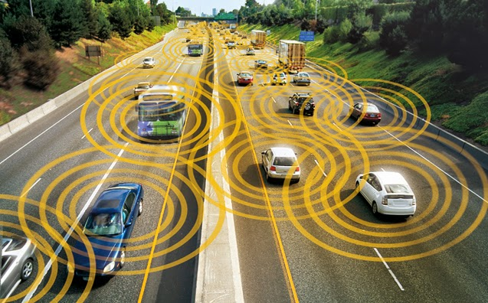
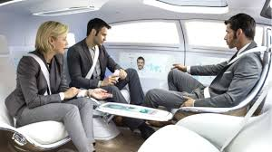


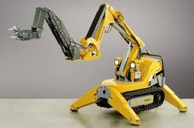
Direction 3: Mission Critical /
Ultra-Reliable Low-Latency Communications (URLLC)
The Ultras

Slide 44
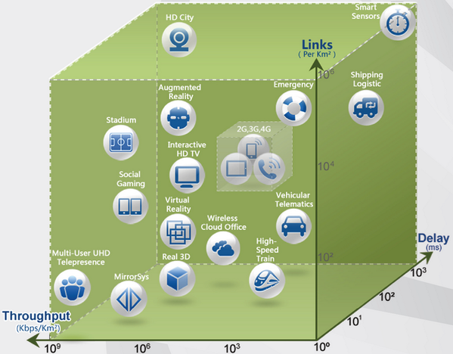
5G Requirements
5G hypercube
Notes:
44

Slide 45
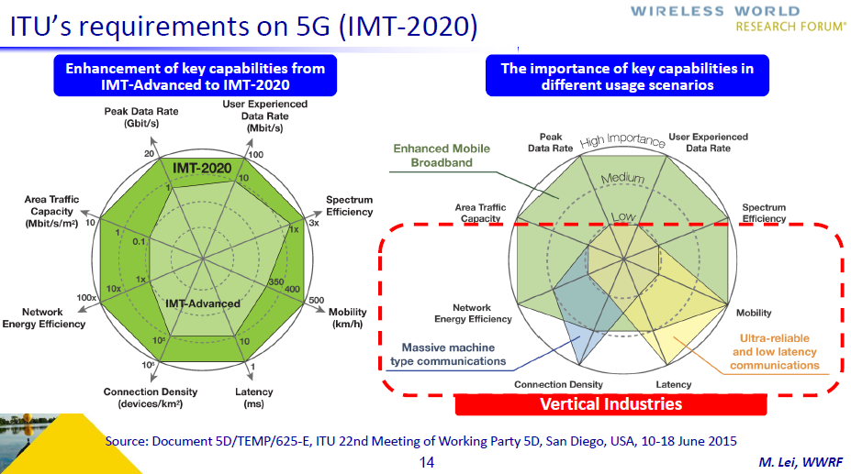

Slide 46
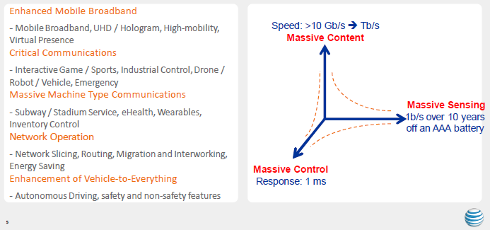
5G Use Cases Taxonomy
A. Dutta, AT&T

Slide 47
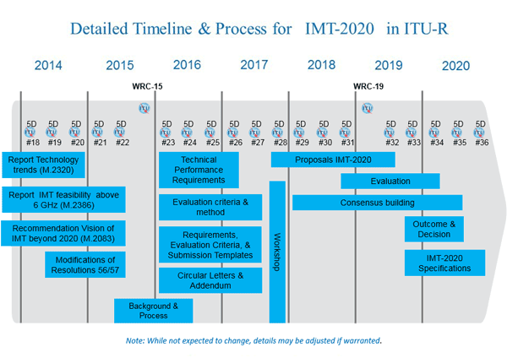
Detailed Timeline & Process for IMT-2020 in ITU-R
In early 2012, ITU-R embarked on a programme (lead by Working Party 5D) to develop “IMT for 2020 and beyond”, setting the stage for “5G” research activities.

Slide 48
Detailed Timeline & Process for IMT-2020 in ITU-R
In early 2012, ITU-R embarked on a programme (lead by Working Party 5D) to develop “IMT for 2020 and beyond”, setting the stage for “5G” research activities.
Will a similar process start in 2021 for 6G?

Slide 49
Detailed Timeline & Process for IMT-2020 in ITU-R
ITU-R IMT.2020 Contribution 2
29 June 2016
WP 5D meetings
2016
2017
2018
2019
2020
No.23
No.24
No.25
No.26
No.27
No.28
No.29
No.30
No.31
No.32
No.33
No.34
No.35
No.36
Step1 and 2
(0)
(40 months: #23 - #32)
Step 3
(20 months: #28 - #32)
(1)
Step 4
(16 months: #31 - #34)
(2)
Steps 5, 6, and 7
(28 months: #29 - #35)
(3)
Steps 8
(12 months: #33 - #36)
(4)
Steps in radio interface development process:
Step 1: Issuance of the circular letter
Step 5:
Review and coordination of outside evaluation activities
Step 2: Development of candidate RITs and SRITs
Step 6:
Review to assess compliance with minimum requirements
Step 3:
Submission/Reception of the RIT and SRIT proposals and acknowledgement of receipt
Step 7:
Consideration of evaluation results, consensus building and decision
Step 4:
Evaluation of candidate RITs and SRITs by Independent Evaluation Groups
Step 8:
Development of radio interface Recommendation(s)
Critical milestones in radio interface development process:
(0): Issue an invitation to propose RITs
March 2016
(2): Cut off for evaluation report to ITU
February 2020
(1): ITU proposed cut off for submission
July 2019
(3): WP 5D decides framework and key
June 2020
of candidate RIT and SRIT proposals
characteristics of IMT-2020 RIT and SRIT
-
(4): WP 5D completes development of radio
October 2020
interface specification Recommendations
IMT-2020 2-01

Slide 50
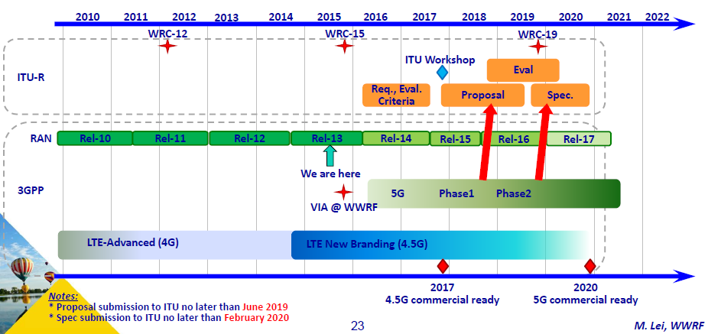
3GPP Timeline

Slide 51
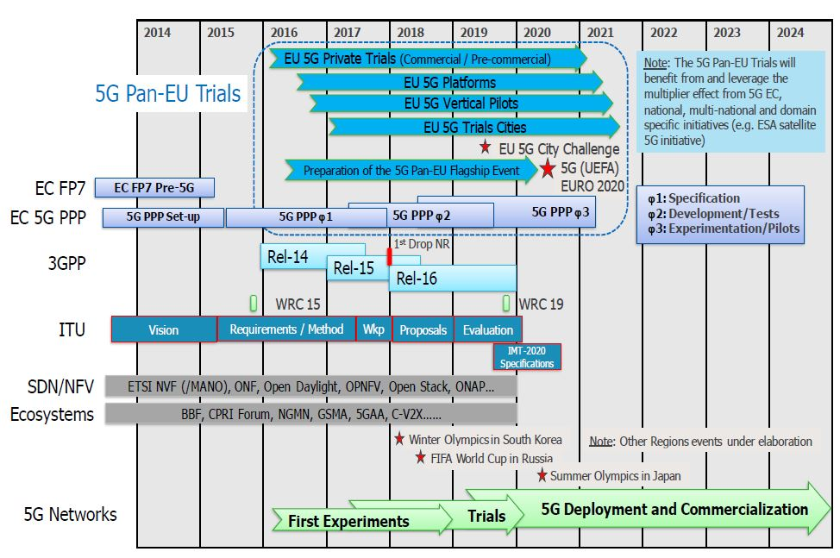
5G Eco-system Timeline
Notes:
51

Slide 52
Current Situation
MMTC: Release-13 NB-IoT (Narrowband IoT)
EMBB: Release-15 NR (New Radio)
URLLC: Release-16 and 5G+

Slide 53
Cellular/Wireless Generations: Use-Cases & Timeline
1980
1985
1990
1995
2000
2005
2010
2015
2020
2025
2030
2035
2040
2045
4G

Slide 54
Cellular/Wireless Generations: Use-Cases & Timeline
1980
1985
1990
1995
2000
2005
2010
2015
2020
2025
2030
2035
2040
2045
1G
2G
3G
4G
5G
6G

Slide 55
Cellular/Wireless Generations: Use-Cases & Timeline
1980
1985
1990
1995
2000
2005
2010
2015
2020
2025
2030
2035
2040
2045
1G
2G
3G
4G
5G
6G
mobile phone
novel use-cases

Slide 56
Cellular/Wireless Generations: Use-Cases & Timeline
1980
1985
1990
1995
2000
2005
2010
2015
2020
2025
2030
2035
2040
2045
1G
2G
3G
4G
5G
6G
mobile phone
novel use-cases
Wireless 2.0
Wireless ultra-connectivity

Slide 57
Part I: Use Cases
Generations of cellular technologies (1G → 4G)
3GPP
5G: A game changer
ICT
Concluding remarks

Slide 58
Access to Information
Books
Brick library
Notes:
58

Slide 59
Access to Information
Books
Brick library
Internet library
Notes:
59

Slide 60

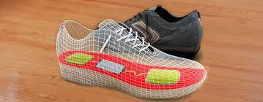
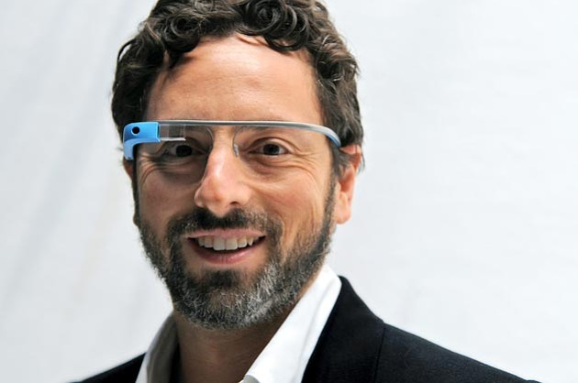
Access to Information
Books
Brick library
Internet library
Data of all sorts
Notes:
60

Slide 61
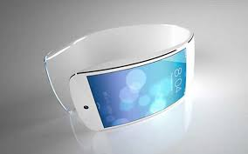
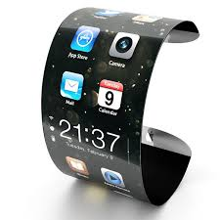
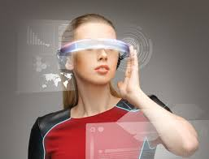
Access to Information
Books
Brick library
Internet library
Data of all sorts
Easy access (I/F)
Notes:
61

Slide 62


Access to Information
Books
Brick library
Internet library
Data of all sorts
Easy access (I/F)
Available before you ask/think
Notes:
62

Slide 63

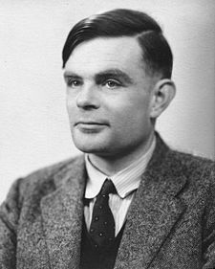
ICT – Information and Communication Technologies
Communications
Computing
Claude Shannon
1916 – 2001
Alan Turing
1912 – 1954
ICT

Slide 64

ICT – Information and Communication Technologies
Communications
Computing
Content
Claude Shannon
1916 – 2001
Alan Turing
1912 – 1954
ICT

Slide 65
ICT – Information and Communication Technologies
Communications
Computing
S. Andreev, O. Galinina, A. Pyattaev, J. Hosek,
P. Masek, H. Yanikomeroglu, Y. Koucheryavy,
“Exploring synergy between communications,
caching, and computing in 5G-grade
deployments”, IEEE Commun. Magazine, August 2016.
Content
Claude Shannon
1916 – 2001
Alan Turing
1912 – 1954
ICT

Slide 66
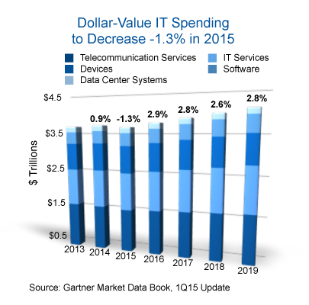
ICT: Becoming World’s Biggest Industry
ICT: Already ~5% of the global GDP

Slide 67


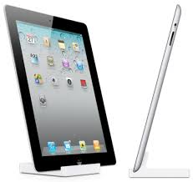
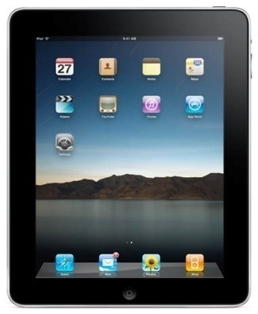
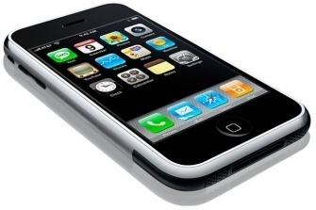

360
300
Number of Days to Reach 1 Million Units Sold
3
iPod
28
Blackberry
74
180
iPad2 (2011)
iPad (2010)
iPhone
Netbook

Slide 68
360
300
Number of Days to Reach 1 Million Units Sold
3
iPod
28
Blackberry
74
180
iPad2 (2011)
iPad (2010)
iPhone
Netbook
iPhone 5: 9 M during launch weekend (20-22 Sept 2013)

Slide 69
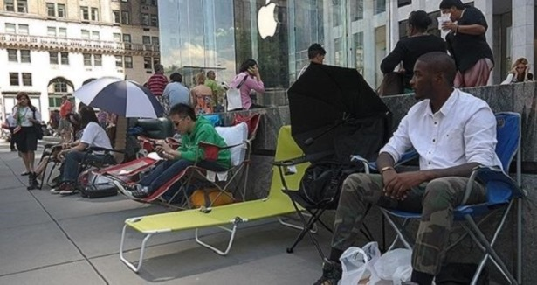
Number of Days to Reach 1 Million Units Sold
Apple Store, 59th Street & 5th Avenue, New York, 05 Sept 2014
iPhone 6: 10 M during launch weekend (19-21 Sept 2014)

Slide 70
Number of Days to Reach 1 Million Units Sold
Apple Store, 59th Street & 5th Avenue, New York, 05 Sept 2014
iPhone 6s & Plus: 13M during launch weekend (25-27 Sept 2015)

Slide 71
ICT: Becoming World’s Biggest Industry
ICT: Already ~5% of the global GDP
Cisco Consulting Services 2014 white paper:
IoT: $19 trillion opportunity over the next decade
Will soon become world’s largest industry sector – by far!

Slide 72
ICT Sector – Unprecedented Value
Market cap Employees Value/employee
Apple $878 B 116,000 $7.6 M 1976
Alphabet $707 B 79,000 $8.9 M 1998
Microsoft $650 B 124,000 $5.2 M 1975
Amazon $560 B 542,000 $1.0 M 1994
Facebook $509 B 21,000 $24.2 M 2004

Slide 73
ICT Sector – Unprecedented Value
Market cap Employees Value/employee
Apple $878 B 116,000 $7.6 M 1976
Alphabet $707 B 79,000 $8.9 M 1998
Microsoft $650 B 124,000 $5.2 M 1975
Amazon $560 B 542,000 $1.0 M 1994
Facebook $509 B 21,000 $24.2 M 2004
WhatsApp $22 B 55 $400 M 2009

Slide 74
ICT Sector – Unprecedented Value
Market cap Employees Value/employee
Apple $878 B 116,000 $7.6 M 1976
Alphabet $707 B 79,000 $8.9 M 1998
Microsoft $650 B 124,000 $5.2 M 1975
Amazon $560 B 542,000 $1.0 M 1994
Facebook $509 B 21,000 $24.2 M 2004
WhatsApp $22 B 55 $400 M 2009
S. Aramco ~$2 T

Slide 75
ICT Sector – Unprecedented Value
Market cap Employees Value/employee
Apple $878 B 116,000 $7.6 M 1976
Alphabet $707 B 79,000 $8.9 M 1998
Microsoft $650 B 124,000 $5.2 M 1975
Amazon $560 B 542,000 $1.0 M 1994
Facebook $509 B 21,000 $24.2 M 2004
WhatsApp $22 B 55 $400 M 2009
S. Aramco ~$2 T
Several ICT companies will be more
valuable than S. Aramco in the next decade

Slide 76
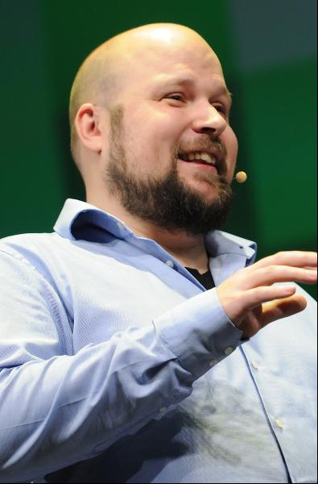



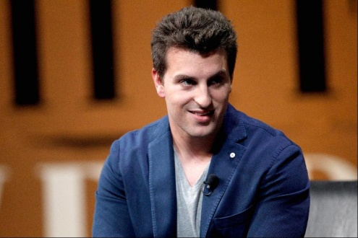
Forbes 2015 Newcomers
Evan Spiegel and Bobby Murphy
Net worth: $1.5 B each
Source of wealth: Snapchat
Markus "Notch" Persson
Net worth: $1.3 B
Source of wealth: Minecraft
(video game)
Travis Kalanick
Net worth: $5.3 B
Source of wealth: Uber
(car service)
Kim Bum-Soo
Net worth: $2.9 B
Source of wealth: KakaoTalk
(mobile chat service)
Brian Chesky
Net worth: $1.9 B
Source of wealth: Airbnb
Notes:
76

Slide 77
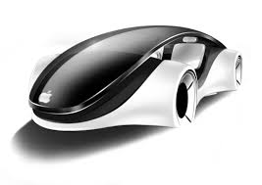
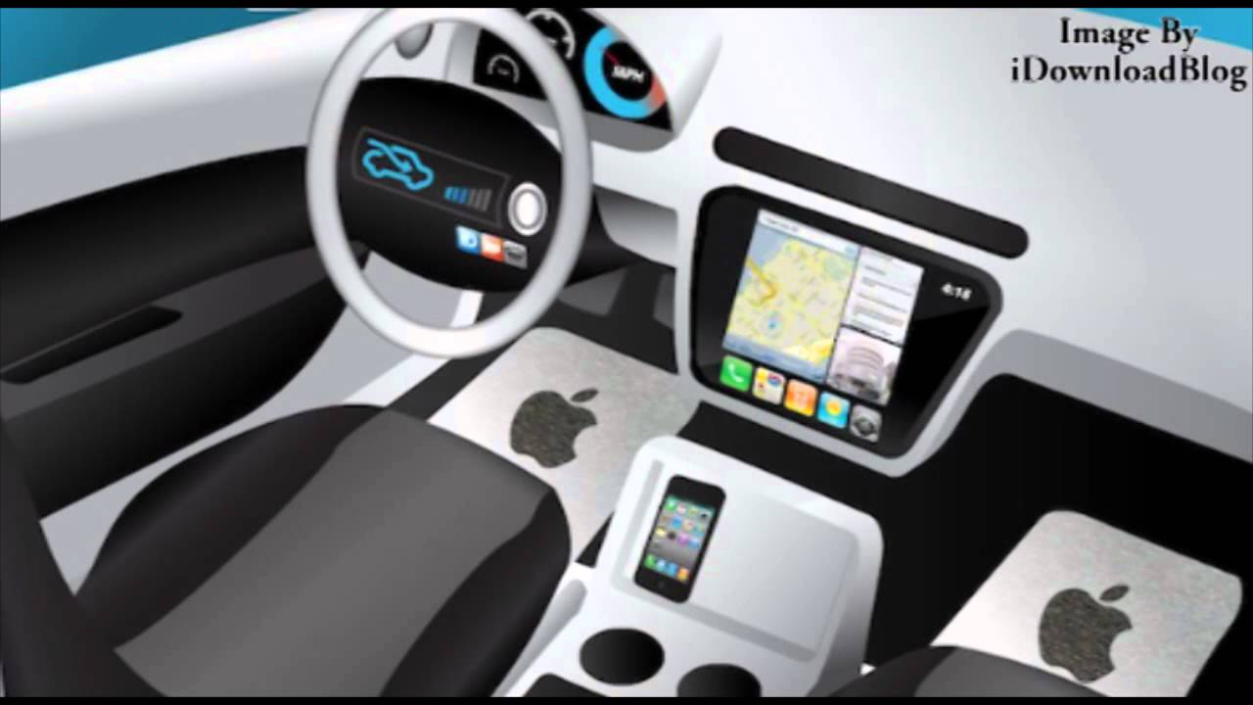
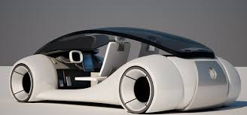
iCar → What is Next?
Nothing will be the same again

Slide 78
Part I: Use Cases
Generations of cellular technologies (1G → 4G)
3GPP
5G: A game changer
ICT
Concluding remarks

Slide 79
5G Ecosystem: Big!
Standards, Fora
Vendors
Operators
Research
Vertical Industries
New Players
Research
Policy

Slide 80
Today: ICT is an Important Sector
Energy
Health
Entertainment
Transportation
Automotive
Agriculture
ICT (4G,…)
Education
Hospitality
Municipalities
Defence
Public Safety

Slide 81
Tomorrow: ICT is the Most Important Sector in Digital Economy
Energy
Health
Entertainment
Transportation
Automotive
Agriculture
ICT (5G,…)
Education
Hospitality
Municipalities
Telecom
→ ICT
→ Vertical Industries
Defence
Public Safety

Slide 82
Eventually: ICT is the Only Sector in Digital Economy
Energy
Health
Entertainment
Transportation
Automotive
Agriculture
ICT (W2.0,…)
Education
Municipalities
Defence
Public Safety
W2.0: Wireless
ultra-connectivity
is at the heart of ICT

Slide 83
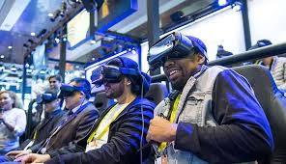
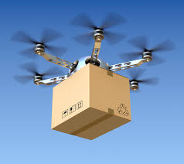
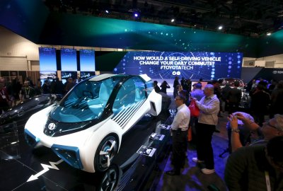



CES 2018

Slide 84
THANK YOU
http://www.sce.carleton.ca/faculty/yanikomeroglu/cv/publications.shtml
http://www.sce.carleton.ca/faculty/yanikomeroglu/cv/patents.shtml
http://www.sce.carleton.ca/faculty/yanikomeroglu/cv/theses.shtml

