Slide 1
A Gentle Introduction to
Information and Communications Technology (ICT)
Halim Yanikomeroglu, PhD, PEng
Professor
Department of Systems & Computer Engineering
Carleton University
Ottawa, Canada

Slide 2
Outline
1. Digital Communications: A Historical Overview
2. Case Study: Wireless Cellular Communications
3. ICT: Information and Communications Technologies

Slide 3
From Research to Innovation
Engineering in contemporary meaning:
A fairly recent branch of knowledge
17th – 19th century: Calculus was developed
19th century, 2nd half: Engineering started being developed
20th century, 1st half: Mathematical principles of engineering got matured
20th century, 2nd half: Explosive growth in engineering applications
21th: Innovation (health care, productivity, environment, communications, education, …)
R&D → R&D&I

Slide 4
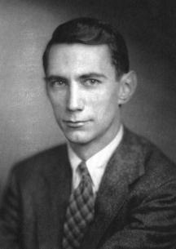
The Great Contributors to Info Theory and Communications Theory
Claude Shannon
1916 – 2001
Bell Labs, MIT

Slide 5
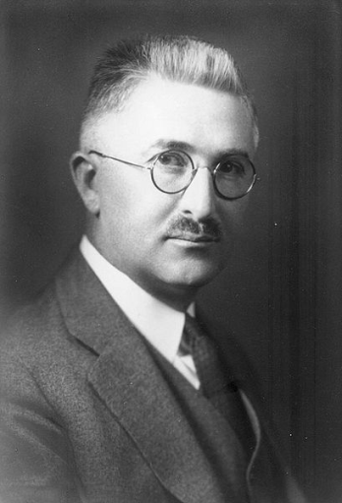
The Great Contributors to Info Theory and Communications Theory
Ralph V.L. Hartley
1888 – 1970
Bell Labs
Claude Shannon
1916 – 2001
Bell Labs, MIT
R.V.L. Hartley, “Transmission of Information”, Bell System Technical J, July 1928.
Formulated the law “that the total amount of information that can be transmitted is proportional
to frequency range transmitted and the time of the transmission.”
Considered as "the single most important prerequisite" for Shannon's theory of information.

Slide 6
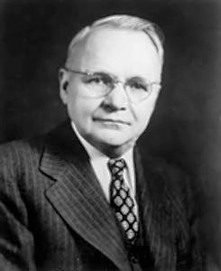
The Great Contributors to Info Theory and Communications Theory
Ralph V.L. Hartley
1888 – 1970
Bell Labs
Harry Nyquist
1889 – 1976
Bell Labs
Claude Shannon
1916 – 2001
Bell Labs, MIT
R.V.L. Hartley, “Transmission of Information”, Bell System Technical J, July 1928.
Formulated the law “that the total amount of information that can be transmitted is proportional
to frequency range transmitted and the time of the transmission.”
Considered as "the single most important prerequisite" for Shannon's theory of information.
H. Nyquist, “Certain factors affecting telegraph speed”, Bell System Technical Journal, 1924.
H. Nyquist, “Certain topics in telegraph transmission theory”, Trans. AIEE, April 1928.

Slide 7
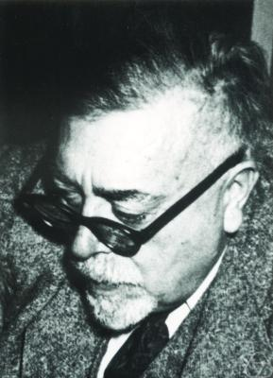
The Great Contributors to Info Theory and Communications Theory
Ralph V.L. Hartley
1888 – 1970
Bell Labs
Harry Nyquist
1889 – 1976
Bell Labs
Norbert Wiener
1894 – 1964
MIT
Claude Shannon
1916 – 2001
Bell Labs, MIT
R.V.L. Hartley, “Transmission of Information”, Bell System Technical J, July 1928.
Formulated the law “that the total amount of information that can be transmitted is proportional
to frequency range transmitted and the time of the transmission.”
Considered as "the single most important prerequisite" for Shannon's theory of information.
H. Nyquist, “Certain factors affecting telegraph speed”, Bell System Technical Journal, 1924.
H. Nyquist, “Certain topics in telegraph transmission theory”, Trans. AIEE, April 1928.

Slide 8
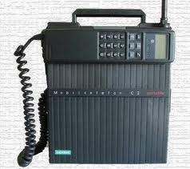
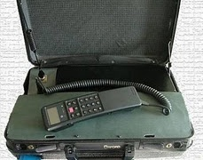
Mobile phone

Slide 9
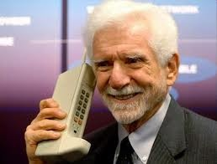
Mobile phone → Cell phone

Slide 10
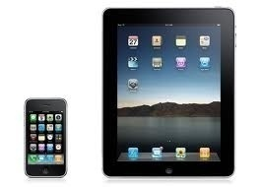
Mobile phone → Cell phone → Smart phone → Tablets

Slide 11
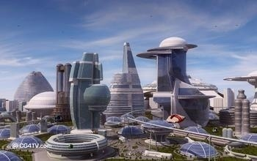
Fast forward… What is 5G?

Slide 12


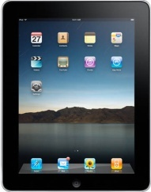






Cellular Generations
4G
Mobile device for everyone
Gbps
3G
data
Mbps
2G
Mbps
data
kbps
1G
kbps
data
AMPS
bps
AMPS
bps
1980
1990
2000
2010
2020
Time
Notes:
12
2010 – 20 - will be the decade of LTE
2020 -> - will be 5th G what will it hold?
Not entirely sure but – what is sure is that Between Now and then-
Cell size will definitely shrink – and consequently
Cell count will increase
All in an order of magnitude
Devices will undoubtedly expand exponentially
Data M2M will explode – And this will inevitably lead to a concatenation of growth trends
The growing need for information and interaction will spur a number of Mega-trends ……

Slide 13
Cellular Generations – 2010 View
5G
?
data
4G
?
Mobile device for everyone
Gbps
3G
data
Mbps
2G
Mbps
data
kbps
1G
kbps
data
AMPS
bps
AMPS
bps
1980
1990
2000
2010
2020
Time
Notes:
13
2010 – 20 - will be the decade of LTE
2020 -> - will be 5th G what will it hold?
Not entirely sure but – what is sure is that Between Now and then-
Cell size will definitely shrink – and consequently
Cell count will increase
All in an order of magnitude
Devices will undoubtedly expand exponentially
Data M2M will explode – And this will inevitably lead to a concatenation of growth trends
The growing need for information and interaction will spur a number of Mega-trends ……

Slide 14
Cellular Generations – 2016 View
5G
?
data
4G
?
Mobile device for everyone
Gbps
3G
data
Mbps
2G
Mbps
data
kbps
1G
kbps
data
AMPS
bps
AMPS
bps
1980
1990
2000
2010
2020
Time
Notes:
14
2010 – 20 - will be the decade of LTE
2020 -> - will be 5th G what will it hold?
Not entirely sure but – what is sure is that Between Now and then-
Cell size will definitely shrink – and consequently
Cell count will increase
All in an order of magnitude
Devices will undoubtedly expand exponentially
Data M2M will explode – And this will inevitably lead to a concatenation of growth trends
The growing need for information and interaction will spur a number of Mega-trends ……

Slide 15
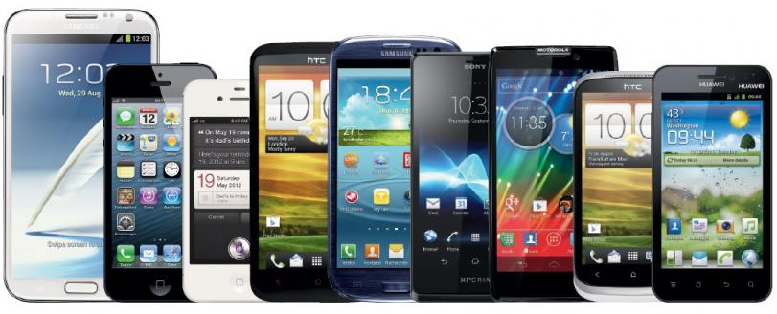
What is 5G?
5G is not about smart phones
Notes:
15

Slide 16
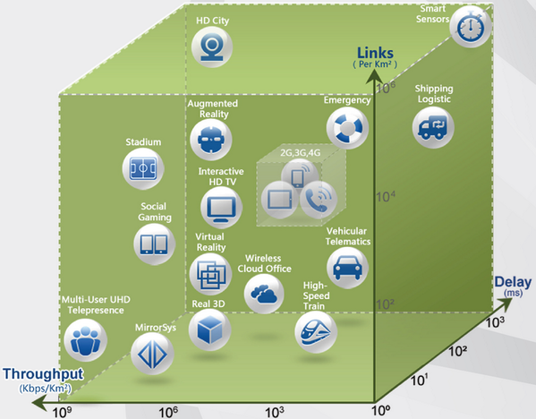
What is 5G?
Notes:
16

Slide 17
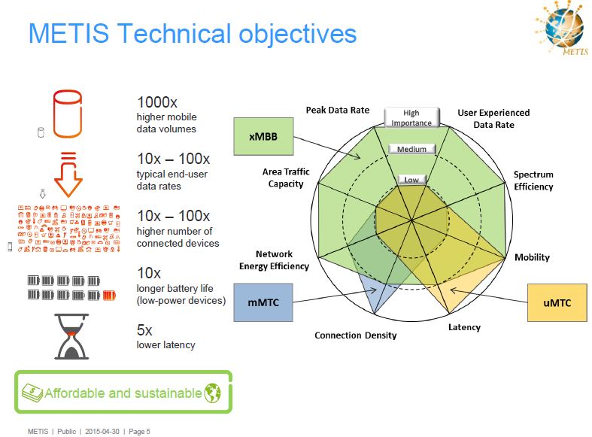
5G Requirements

Slide 18
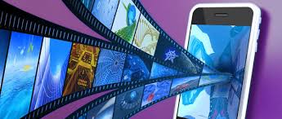
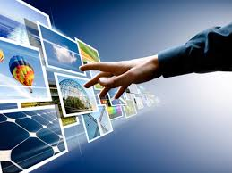
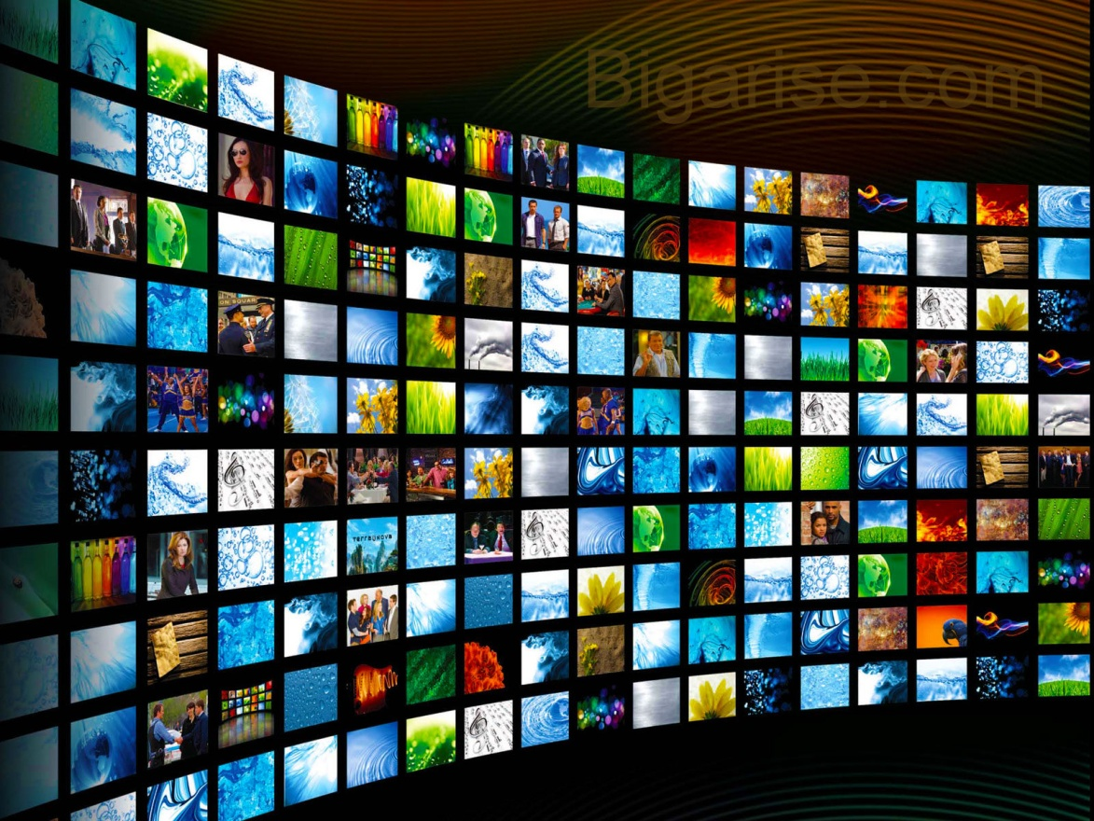
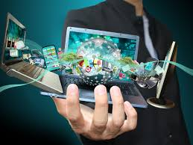
Near Future: More Video

Slide 19
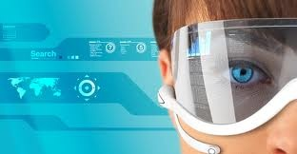
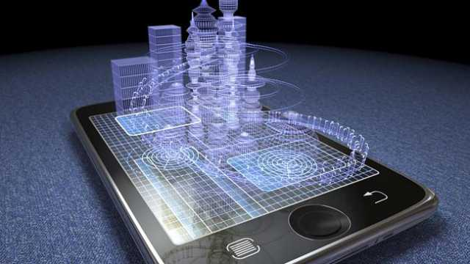
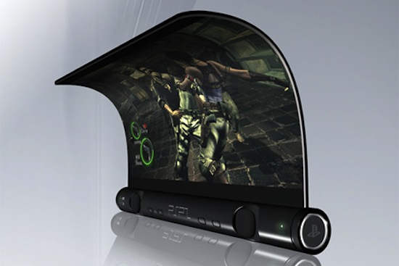
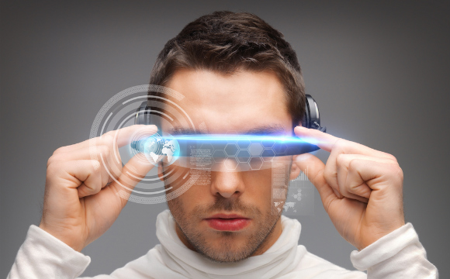
Direction 1: Highly Capable Terminals

Slide 20
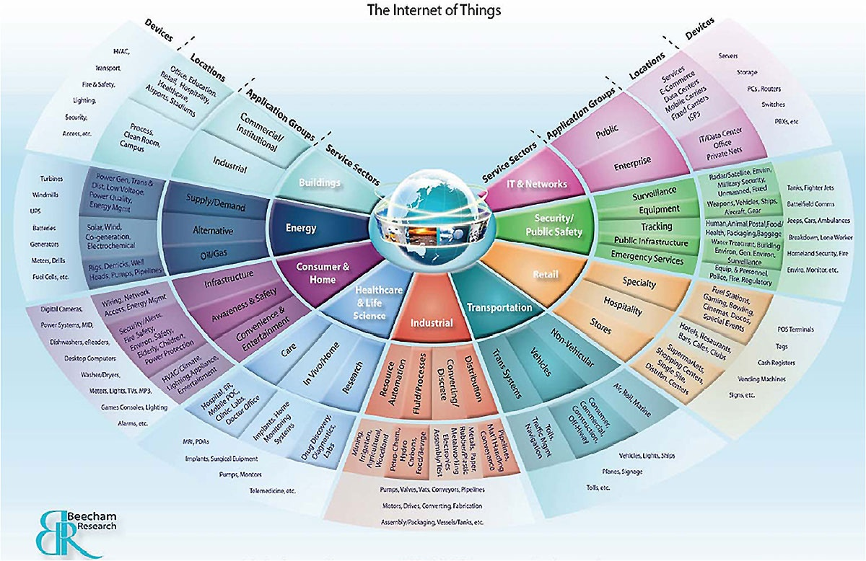
Direction 2: IoT – Integration of Physical and Digital Worlds

Slide 21

Direction 2: IoT – Integration of Physical and Digital Worlds
Notes:
ITU-T Rec. Y.2221 (www.itu.int/rec/T-REC-Y.2221-201001-I): Requirements for support of Ubiquitous Sensor Network* applications and services.
* This is the ITU-T term for MTC systems and applications involving possible large numbers of sensors potentially spread over a large area
Sensor Networks monitor physical or environmental conditions, (e.g., temperature, sound, vibration, pressure, motion or pollutants) at various locations. These sensors need to communicate with a server.
Early sensor networks operate in isolation. Networked sensor applications enable new possibilities for consumers, public organizations, enterprises, government, etc.
Applications integrate data from sensor networks to achieve industrial or home automation control, agricultural monitoring, healthcare, environment and pollution monitoring, and disaster surveillance, security, etc.

Slide 22
Access to Information
Books
Brick library
Notes:
22

Slide 23
Access to Information
Books
Brick library
Internet library
Notes:
23

Slide 24

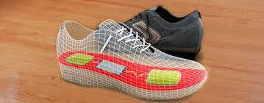
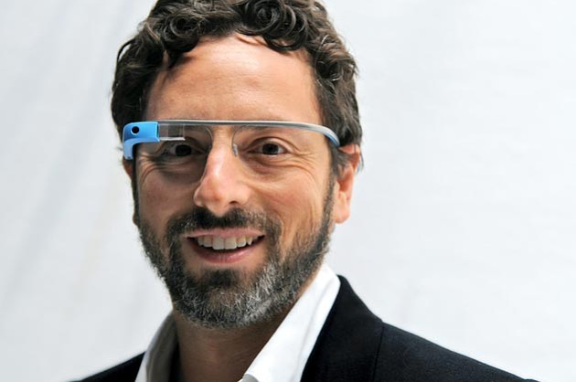
Access to Information
Books
Brick library
Internet library
Data of all sorts
Notes:
24

Slide 25
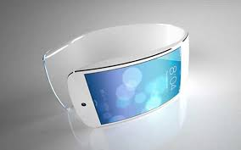
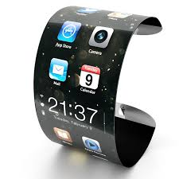
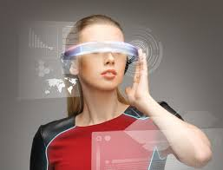
Access to Information
Books
Brick library
Internet library
Data of all sorts
Easy access (I/F)
Notes:
25

Slide 26
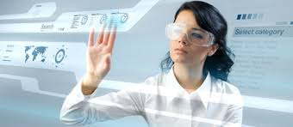
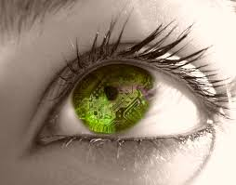
Access to Information
Books
Brick library
Internet library
Data of all sorts
Easy access (I/F)
Available before you ask/think
Notes:
26

Slide 27
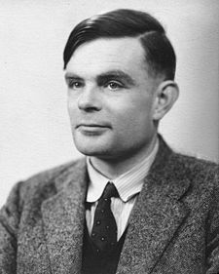
ICT – Information and Communication Technologies
Communications
Computing
Claude Shannon
1916 – 2001
Alan Turing
1912 – 1954
ICT

Slide 28
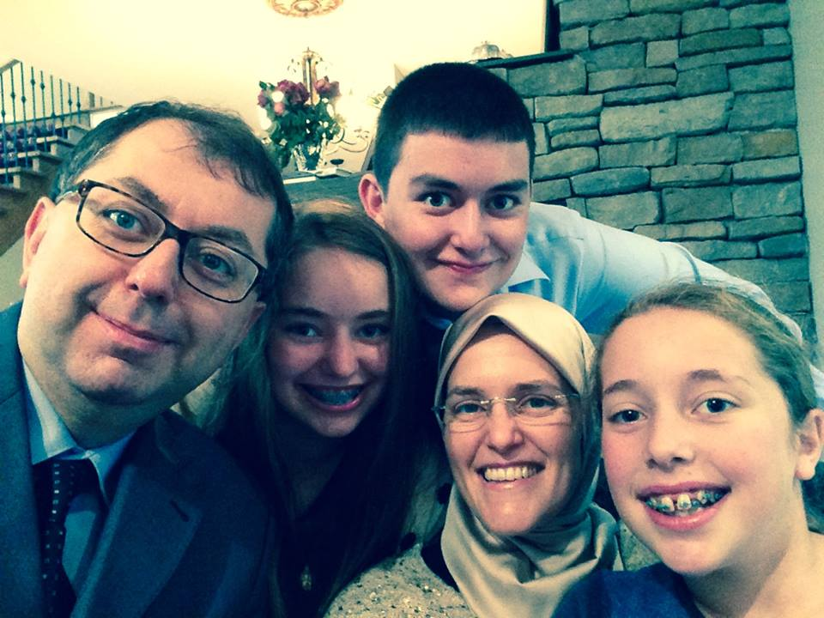
ICT – Information and Communication Technologies
Communications
Computing
Content
Claude Shannon
1916 – 2001
Alan Turing
1912 – 1954
ICT

Slide 29
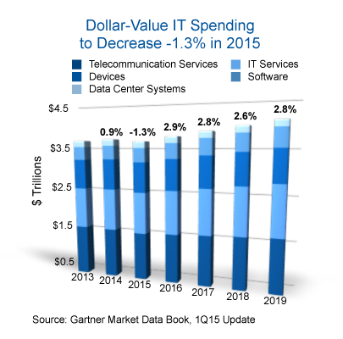
ICT: Becoming World’s Biggest Industry
ICT: Already ~5% of the global GDP

Slide 30


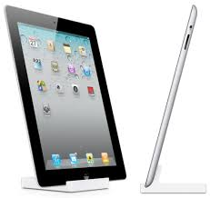
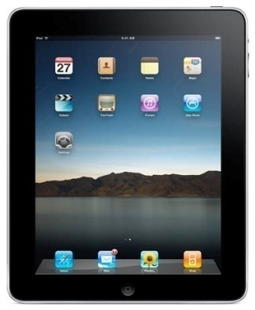
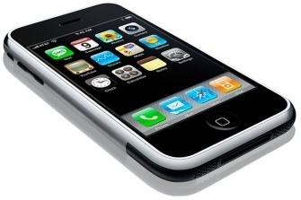

360
300
Number of Days to Reach 1 Million Units Sold
3
iPod
28
Blackberry
74
180
iPad2 (2011)
iPad (2010)
iPhone
Netbook

Slide 31
360
300
Number of Days to Reach 1 Million Units Sold
3
iPod
28
Blackberry
74
180
iPad2 (2011)
iPad (2010)
iPhone
Netbook
iPhone 5: 9 M during launch weekend (20-22 Sept 2013)

Slide 32
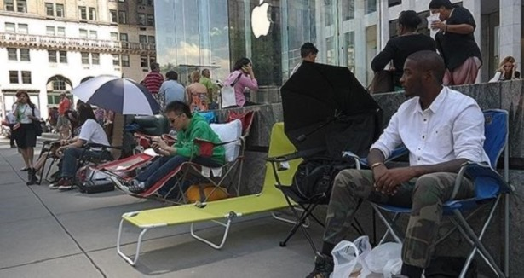
Number of Days to Reach 1 Million Units Sold
Apple Store, 59th Street & 5th Avenue, New York, 05 Sept 2014
iPhone 6: 10 M during launch weekend (19-21 Sept 2014)

Slide 33
Number of Days to Reach 1 Million Units Sold
Apple Store, 59th Street & 5th Avenue, New York, 05 Sept 2014
iPhone 6s & Plus: 13M during launch weekend (25-27 Sept 2015)

Slide 34
ICT: Becoming World’s Biggest Industry
ICT: Already ~5% of the global GDP
Cisco Consulting Services 2014 white paper:
IoT: $19 trillion opportunity over the next decade
Will soon become world’s largest industry sector – by far!

Slide 35
ICT Sector – Unprecedented Value
Market value Employees Value/employee
Google $503 B 57,000 $8.8 M
Apple $496 B 115,000 $4.3 M
Microsoft $405 B 119,000 $3.4 M

Slide 36
ICT Sector – Unprecedented Value
Market value Employees Value/employee
Google $503 B 57,000 $8.8 M
Apple $496 B 115,000 $4.3 M
Microsoft $405 B 119,000 $3.4 M
WhatsApp $22 B 55 $400 M

Slide 37
ICT Sector – Unprecedented Value
Market value Employees Value/employee
Google $503 B 57,000 $8.8 M 1998
Apple $496 B 115,000 $4.3 M 1976
Microsoft $405 B 119,000 $3.4 M 1975
WhatsApp $22 B 55 $400 M 2009

Slide 38
ICT Sector – Unprecedented Value
Market value Employees Value/employee
Google $503 B 57,000 $8.8 M 1998
Apple $496 B 115,000 $4.3 M 1976
Microsoft $405 B 119,000 $3.4 M 1975
WhatsApp $22 B 55 $400 M 2009
Nobody is late in the game

Slide 39
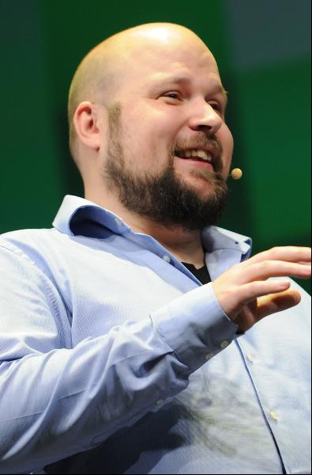
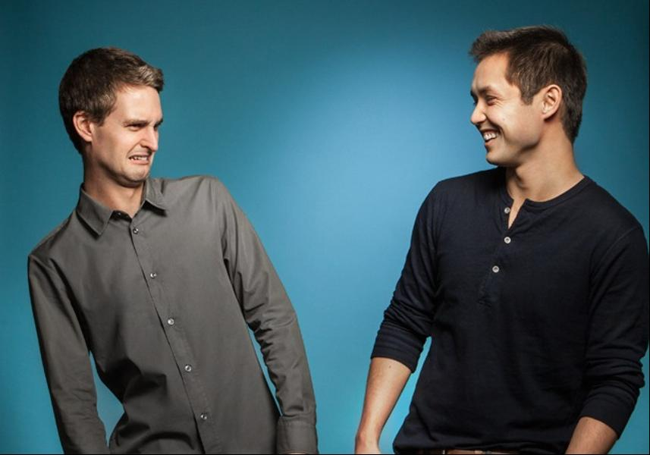
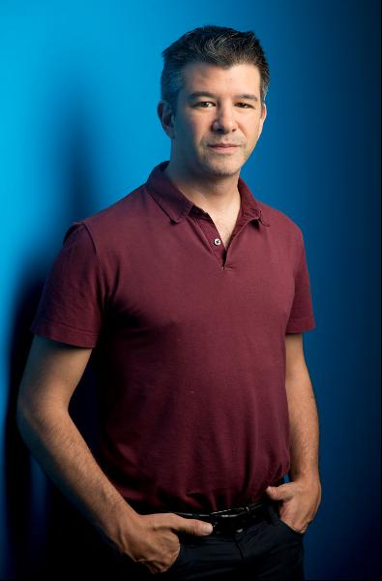
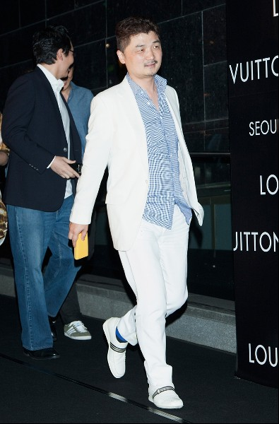
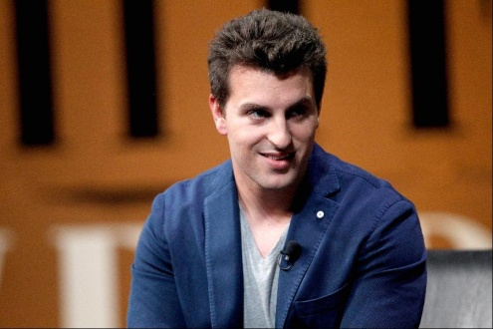
Forbes 2015 Newcomers
Evan Spiegel and Bobby Murphy
Net worth: $1.5 B each
Source of wealth: Snapchat
Markus "Notch" Persson
Net worth: $1.3 B
Source of wealth: Minecraft
(video game)
Travis Kalanick
Net worth: $5.3 B
Source of wealth: Uber
(car service)
Kim Bum-Soo
Net worth: $2.9 B
Source of wealth: KakaoTalk
(mobile chat service)
Brian Chesky
Net worth: $1.9 B
Source of wealth: Airbnb
Notes:
39

Slide 40
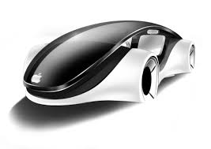
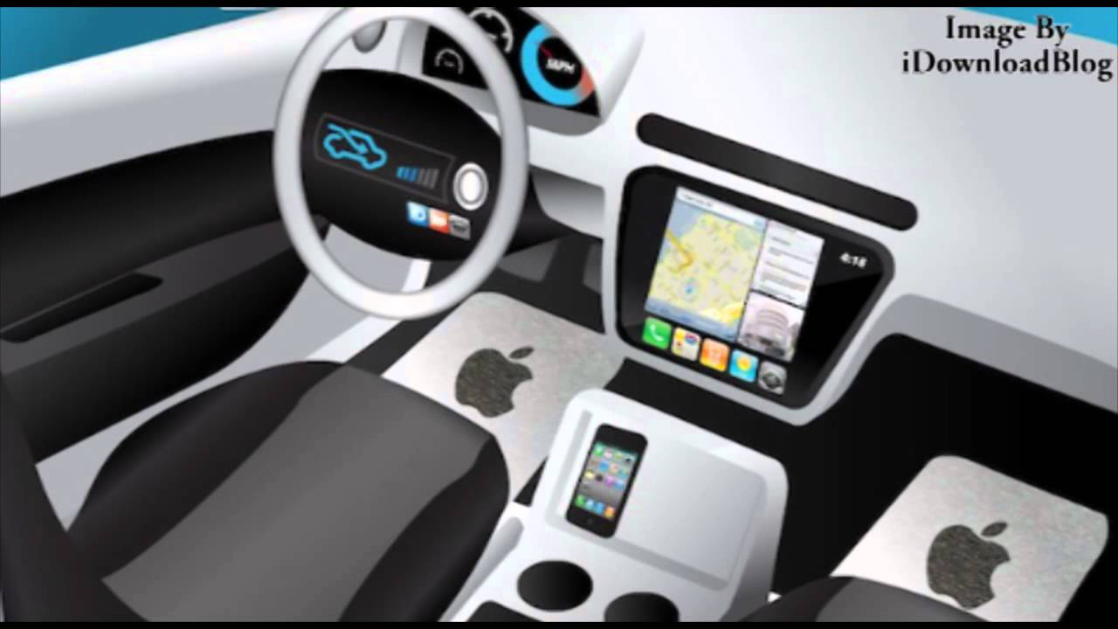
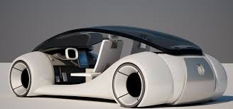
iCar → What is Next?
Nothing will be the same again

Slide 41
Today: ICT is an Important Sector
Energy
Health
Entertainment
Transportation
Automotive
Agriculture
ICT
Education
Hospitality
Municipalities
Defence
Public Safety

Slide 42
Tomorrow: ICT is the Most Important Sector
Energy
Health
Entertainment
Transportation
Automotive
Agriculture
ICT (5G,…)
Education
Hospitality
Municipalities
Defence
Public Safety

Slide 43
Tomorrow: ICT is the Most Important Sector in Digital Economy
Energy
Health
Entertainment
Transportation
Automotive
Agriculture
ICT (5G,…)
Education
Hospitality
Municipalities
Telecom
→ ICT
→ Vertical Industries
Defence
Public Safety

Slide 44
Tomorrow: ICT is the Fundamental Enabler in Digital Economy
Energy
Health
Entertainment
Transportation
Automotive
Agriculture
ICT (5G,…)
Education
Municipalities
Defence
Public Safety

Slide 45
ICT: Great Career Opportunity!
SYSC 4600: Great Course!

