Slide 1
SYSC-3120 —Software Requirements Engineering
Software Engineering Preview

Slide 2
Software Engineering Preview
Definitions
Software Failures
History and Context
Software Development Myths
Principles
Software Development Processes
Software Development Tools
Summary
Notes:
Think back to when you were considering engineering. Did you have trouble deciding between computer science or engineering ? Do people ever ask you ? That’s the question I struggle with the most at the University Open Houses. This is the fundamental question of this course.
What’s the difference between you (when you graduate) and those who have grown up writing programs and/or gone to a technical school ?
Reading from Lethbridge: Not all software development should be called software engineering, in the same way that not all construction is civil engineering. A do-it-yourselfer can build a footbridge spanning a 60cm wide stream in their garden, but it requires a civil engineer to build a bridge across a wider span that PUBLIC vehicles will traverse. Similarly, a self-trained shareware author may write a small program to track a personal stock portfolio, but it requires a software engineer to develop a complete trading and accounting system for a large brokerage company.
[From Braude]: The difference between programming alone and software engineering is like the difference between bringing a patio table into existence and bringing a bridge into existence. These differ greatly in order of magnitude and required professional knowledge. Unlike the building of a patio table, bringing a bridge into existence entails professional and societal responsibilities. This <book> does not attempt to address societal issues, but it does provide the TOOLS TO DO SO in the form of rigorous requirements, analysis and quantified standards of quality.
That’s why we will begin with some definitions of software engineering, but before we go there :
Question: What the key factors of software engineering ? Magnitude, complexity, PUBLIC and SOCIAL RESPONSIBILITY

Slide 3
Definitions of SW Engineering
Software Engineering [IEEE-93]:
  The application of a systematic, disciplined, quantifiable approach to the development, operation, and maintenance of software;
  that is, the application of engineering to software.
  Highlights the difference between programming and software engineering
Canadian Standards Association:
  “The systematic activities involved in the design, implementation and testing of software to optimize its production and support”
Notes:
Huge gap between a piece of SW developed by individual or small team and SW developed by med/large team
Complexity growth is exponential, importance of human factors
n(n-1)/2 potential communication paths between n people

Slide 4
Definitions of SW Engineering (cont.)
Parnas (1987):
  “Multi-person construction of multi-version software”
  Software Engineering means the construction of quality software with a limited budget and a given deadline in the context of constant change
Lethbridge (2004):
  “Software engineering is the process of solving the customers’ problems by the systematic development and evolution of large, high-quality software systems within cost, time and other constraints.”
Notes:
Customer’s problems: Every decision should be reached by asking yourself whether it is what the customer wants.
Systematic : MOST development work involves modifying software that is already written.
Large : The magnitude of projects implies complexity and demands teamwork. Teamwork requires COMMUNICATION (both oral and written)
Constraints: Main economic constraints are (1) resources are finite (2) not worth it unless its benefit outweighs its cost (3) if we can do it faster and cheaper than someone else.

Slide 5
Definitions of SW Engineering: Conclusion
Important notions to remember:
  Systematic, disciplined, quantifiable
  Development, operation, and maintenance (not only construction/coding)
  Quality
  Constraints

Slide 6
The Engineer in SW Engineering
Engineers design products following well-accepted practices which normally involve the application of science, mathematics and economics
As professionals, engineers assume a duty of personal responsibility to the public and society, and a code of ethics.
  The society includes the customer (ie. meeting economic and time constraints)

Slide 7
Scope of SW Engineering
SE is part of a much larger system design activity
  Telephone switching systems, power plants, banking systems, hospital admin systems, aircraft
Doing SE right requires a much larger look at system engineering issues
  entities and activities within the system, its boundary and interface with other systems and users
Understanding the application and user needs is key
  Decide what activity should be supported by the system and how
  Having a technical understanding of the system to be developed is not enough
  Many domains, where very different software systems must be developed, with emphasis on different priorities:
    time-to-market (telecom), safety (aerospace, NASA Shuttle), maintainability (telecom, banking)
Notes:
The focus of this slide is scope --- the key word to notice is “system”.
Software is part of a (large,complex) system.
Dutoit, page 12: Book defines a system as a collection of interconnected parts.
The lessons to be learned here is that
software is omnipresent in our society
software is not always (or even usually) standalone, that the key feature is interaction (ie. interfacing)
this requires us to not only be technically competent but also good in communication with other domains.
Much of the software engineering process is about good, clear, consistent, communication.

Slide 8
Importance of SW Engineering
Software is pervasive in our lives, in most systems surrounding us - we take it for granted!
US $500 Billion world-wide in 1995
This includes critical systems that affect our well-being and our lives
Many reported stories of poor software engineering practices leading to catastrophes
Notes:
- no recent figures on software economics …

Slide 9
Software Quality
External Characteristics (of interest to stakeholders)
  Usability
  Efficiency
  Reliability
  Maintainability
  Reusability
Internal Characteristics (impact maintainability and reliability)
  Comments
  Code Complexity: Nesting depth, branches, complex programming
  Modularity
Short term
Engineering is tradeoffs
Long term
Notes:
Usability: includes ease of learning for new users, efficiency of use for experts, error handling
Efficiency: CPU, memory, network bandwidth
Reliability: Number and type of mistakes. If failure does occur, system should handle or recover.
Maintainability: Easy with which you can change the software. Anticipate change!
Reusability: Reduces long-term costs.
Tradeoffs:
Relative priority of these characteristics will depend on each stakeholder and system.
Characteristics are often counter-effective: Increasing one decreases another.
The goal then is to optimize key qualities, minimizing effect on others.
Example:Improving efficiency may make a design(or code) less easy to understand, decreasing the maintainability, leading to defects that lower reliability.
Example:High reliability demands constant checking, which lowers efficiency.
Internal Characteristics: Those that the stakeholders don’t see and feel, but affect the external

Slide 10
Software Engineering Stakeholders
Developers are only one of the stakeholders in a SE Project
Users: Use the end-product
  Appreciate software that is easy to learn, improves their working conditions
Customers: Order and pay for the software
  Increase profits or run business better
Development Managers: Manage the developers
  Please the customer while spending the least money.
One person may take on multiple roles.
Notes:
Customers: For generic software are only “potential customers” … don’t have concrete people in mind.

Slide 11
Activities Involved in SE
Knowledge acquisition:
  Understand the application domain, the system requirements
  Knowledge acquisition is not sequential, as a single piece of additional information can invalidate complete models
Modeling (the blue-print of the software engineer):
  Way to cope with complexity by raising the level of abstraction, e.g., UML
Problem solving:
  Find an acceptable solution within constraints (budgets and timelines)
  Find -> search -> experiment (i.e., compare alternatives, evaluate)
Documentation:
  The rationale behind decisions need to be captured, in order to be able to deal with change
Notes:
The slide is about the activities involved in software engineering (not the process yet) What do software engineers do (that is different than programmers?). Essentially the required skill set.
Knowledge: I’ve changed this slide: Moved this point from 3rd to 1st. Why? Because before we talk about solutions and models, we need to know the problem! Focus on customer! Key quote: Knowledge acquisition is not sequential, as a single piece of additional data can invalidate complete models. The system is 90% coded; we will be done next week: That 10% can invalidate the previous work, causing us to start from scratch.
We’re going to talk about lifecycles, but one that you should already know is the waterfall (explain if need). The fault is its assumption of linear work lines. Alternatives include “Risk-based development” that works on riskiest functions first and “Issue-based development” where you tackle all aspects (rq/design/impl/test) of an issue in parallel.
Modeling: As is. A model is an abstract representation of one view of the system.
Problem-solving: Find == search == experiment. Constraints include budgets and timelines. Use models to experiment with different solutions. Cannot simply present design. Must establish it by experimenting, comparing, evaluating.
Software engineering is not ad-hoc. It must follow the same scientific method: 1) State the problem 2) State a hypothesis 3) Experiment and (4) Conclude. The only difference is that our problems change (. technology changes, changing our premises; user’s demands/knowledge change)
Documentation: Again, there is no single design. You’ve organized your data, done problem solving…. You need to document the decisions in order to deal with change : Others need to know the history!

Slide 12
Software Engineering Preview
Definitions
Software Failures
History and Context
Software Development Myths
Principles
Software Development Processes
Software Development Tools
Summary

Slide 13
Examples of SE Failures
Patient Protection and Affordable Care Act (a.k.a. ObamaCare, 2013):
  Incorrect functionality, unable to handle the load due to poor specifications, flawed design, poor coding, poor testing, security flaws, time constraints.
Soyuz spacecraft’s descent from the ISS on May 3rd 2003
  Halfway back to Earth, for no apparent reason, the computer had suddenly begun searching for the ISS as if to dock with it.
Ariane 5 Flight 501:
  The space rocket was destroyed. Cause: poor specifications, usage testing, and exception handling.
Therac-25:
  Radiation therapy and X-ray machine killed several patients. Cause: unanticipated, non-standard user inputs.
NASA mission to Mars (Mars Climate Orbiter Spacecraft, 1999):
  Incorrect conversion from imperial→metric leads to loss of Mars satellite
US study (1995):
  81 billion US$ spend per year for failing software development projects
Despite many success stories, there is much room for improvement.
Notes:
See page 4, section 1.1 of your textbook
Yet, the software industry is enormously successful. 6 percent prod increase every year on average
On June 4, 1996, on its maiden flight, the Ariane 5 was launched and performed perfectly for 40 seconds. Then, it began to veer off course.After detection of loss of integgrity, the rocket self-destroyed. The rocket was lost as well as the 4 satellites it contained. The total cost was 500 million dollars and may be much more in reputation …
One subsystem of the flight program, the SRI (the inertial reference system, which provides attitude data about the rocket), was reused from Ariane 4. Reuse was intend to reduce risk, increase productivity, and quality.
But, in general, quality assurance procedures must ensure the reused component works in the next application context. Ariane 5 had much higher accelerations and horizontal speeds than Ariane 4. This led to a catastrophe …

Slide 14
Software Engineering Preview
Definitions
Software Failures
History and Context
Software Development Myths
Principles
Software Development Processes
Software Development Tools
Summary

Slide 15
Historical perspective of SW Engineering
Read the opening sentence in your textbook [Dutoit]
  The term software engineering was coined in 1968 as a response to the desolate state of the art of developing quality software on time and within budget. …. More often that not, the moon was promised, lunar rover built and a pair of square wheels delivered.
[Braude] The production of automobiles was revolutionized by Henry Ford’s observation that parts could be standardized, so that cars of a given model could use any instance of each required part. The reduction in cost … made automobiles more affordable
  We now expect to reuse ideas, architectures, designs or code from one application to build others. …
  Only modular applications have potentially reusable parts.
  Reusability of developer knowledge.
Notes:
Kevin Sczabo : In an interview with CISCO: Is software an art or a science ? What is your answer (He answered : Both)
2nd point: A useful parallel that SW engineering is founded on the idea of re-use and re-use necessitates modules.
Last subpoint: Reusability not only means software components, but tapping into the wealth of experience held by knowledgeable developers to provide formal guidelines and processes for neophytes.

Slide 16
Relationships with other Disciplines
Artificial Intelligence
Operating systems
Compilers
Database management systems …
Computer Science
Customer / System Engineering
Boolean algebra
First order logic
Set theory
Complexity theory
…
Theories
Technologies
Problem
Management science
  Project scheduling, resource planning, people management, project tracking, technology assessment
Software Engineering
Management Science
Quantitative Methods
…
Tools and Techniques
to Solve the Problem
Pfleeger, 1998 (adapted)
Notes:
Computer programming techniques is the object of study for computer scientists
Computer programming techniques are just a set of instruments, among others, to achieve SW development objectives, for the SW engineer (other instruments, not shown on the graph, include management, quantitative quality eng methods, etc.)
Comparison with chemistry and chemical engineering
Theories: Programming languages, computation theory (complexity analysis) …
Technologies: compilers, expert systems, DBMS …

Slide 17
Software Engineering Preview
Definitions
Software Failures
History and Context
Software Development Myths
Principles
Software Development Processes
Software Development Tools
Summary

Slide 18
Management Myths
State-of-the-art tools are the solution
  “A fool with a tool is still a fool”
Falling behind schedule is resolved by hiring additional programmers
  “adding people to a late software project makes it later”
Notes:
Some examples for myths that propagated misinformation

Slide 19
Customer myths
A general statement of objectives is sufficient to begin writing programs - we can fill in the details later.
  Problems:
    Poor up-front definition is a major cause of failed software projects
    Detailed description of function, performance, interfaces, design constraints and validation criteria are essential
  Thorough communication between customer and developer needed
Changes can be easily accommodated because software is flexible
  Problem:
    Impact of change grows throughout the lifecycle -> late changes are expensive
  Changes happen as a fact of life, cannot avoid them
Such myths lead to false expectations by the customer and result in dissatisfaction with the developer.

Slide 20
The impact of change
40-1000 x
1000
100
30-70 x
15-40 x
Cost to change
10 x
10
3 - 6 x
1 x
1
Definition
Design
Code
Test
System Test
Field Operation

Slide 21
Practitioner’s myths
Once we write a program and get it to work, our job is done
  50-70% of all effort after first delivery
Until I get the program “running”, I really have no way in assessing its quality
  inspections & reviews
The only deliverable for a successful project is the working program
  documentation (users, maintenance), e.g., UML Analysis and Design Models
Software engineering will make us create voluminous and unnecessary documentation and will invariably slow us down
  Software engineering is not about creating documents. It is about creating quality. Better quality leads to reduced rework. And reduced rework results in faster delivery times

Slide 22
Software Engineering Preview
Definitions
Software Failures
History and Context
Software Development Myths
Principles
Software Development Processes
Software Development Tools
Summary

Slide 23
Characteristics of today’s software development
Development of large & complex systems
Software systems must fulfill the requirements of many users (or usage conditions)
Number of persons involved in the development >>>> 1
Distributed development is now commonplace
  Same place, same city (Kanata-Downtown)
  Same country (Ottawa-Vancouver), same continent
  Ottawa-Vancouver-England-India-Australia
Software systems are expected to live long and be used by many people.

Slide 24
What are the problems?
Increased quality demands on software products
High cost and time pressure
Shorter time to market
Coordination problems within the projects
Scarce resources (e.g., qualified personnel)

Slide 25
Software Engineering Principles
There are a number of general principles underlying and driving all software engineering techniques
They aim at dealing with the inherent complexity of software and help achieve quality goals, e.g., reliability, evolvability
We will refer to these principles throughout the course.
Rigor and formality
Separation of concerns
Modularity
Abstraction
Anticipation of change
Generality
Incrementality
Notes:
From Ghezzi et al book (1991)
Those principles may sound abstract and general, but they drive everything we do
I will mention them during the remainder of the course

Slide 26
Rigor and Formality
More reliable products, control costs, increase our confidence in the product
Rigor: well-defined, repeatable, technically sound steps (based on method, technique)
Formality, the highest degree of rigor, require the software process to be driven by mathematical laws
No need to be always formal -> tradeoff
  Formality and Rigor have a cost (training, additional time) , so apply as long as the benefits are significantly larger
Rigor and formality apply to both the SW process and product
The UML notation is an example of a (semi-)formal notation. It brings rigor to the way we do analysis and design.
Notes:
Formality/Rigor has a cost (training, additional time) and the benefits it brings must be significantly larger
The UML notation is an example of a (semi-)formal notation. It brings rigor to the way we do analysis and design. It provides a lingua franca.

Slide 27
Separation of Concerns
Decompose a complex problem (or concern) into simpler problems
  Sub-problems (or concerns) should overlap as little as possible
A concern is anything of interest
Concerns may be separated
  in time (e.g., life cycle phases),
  qualities (the “alities”),
  product views (e.g., UML diagrams),
  product parts (subsystems, components)
Notes:
life cycle phases
Correctness vs efficiency
UML diagrams -> different views of the system

Slide 28
Modularity
Software systems are decomposed into simpler pieces: modules, components
High cohesion and low coupling within/among components
Allow reuse, easier understanding, team work, etc.
Ideally, SW development could be based on composing reusable components
Modularity vs. “separation of concerns”
  Separation of concerns (for product parts) is often achieved through modularity

Slide 29
Abstraction
Identify important aspects and ignore non-relevant details for the task at hand
Equations, formalisms are forms of abstractions from reality, in all engineering disciplines
Software specifications and design representations / models: abstract away from programming details
Programming languages: abstract away from hardware details

Slide 30
Anticipation of Change
Software undergoes change constantly
How to account for potential change and limit the side effects?
Impact on design strategy
  Layered architecture
    e.g., user interface, business or application logic, database management system
  Design patterns
Manage versions and revisions (Configuration management)
Process changes, e.g., personnel turnover: Analysis and Design documentation
Notes:
Example layers: user interface, business or application logic, database management system

Slide 31
Generality
General solutions mean more software reuse
General software solutions for a given application domain
Different forms:
  libraries, executable components, frameworks (e.g., JavaCC)
  Database management systems, spreadsheets, text processing and numerical analysis libraries
Overhead, acquisition cost versus reliability, reuse
Large, expanding COTS market (Components/Commercial Off The Shelf) in the software industry
Notes:
JavaCC is a compiler-compiler, that is a framework to build parsers (for various purposes) and possibly compilers (not just for Java)

Slide 32
Incrementality
Stepwise development => early subsets of an application
  build the software in small increments; for example, adding one use case at a time
Early feedback from customers, users
Initial requirements often not stable and fully understood
  start with parts that are clear
Incrementality requires special care for managing documents, programs, test data, etc. of successive versions (configuration management)

Slide 33
Software Engineering Preview
Definitions
Software Failures
History and Context
Software Development Myths
Principles
Software Development Processes
Software Development Tools
Summary

Slide 34
The Software Process
Software Engineering [IEEE-93]:
  The application of a systematic, disciplined, quantifiable approach to the development, operation, and maintenance of software;
  that is, the application of engineering to software.
A Software Process is a series of predictable steps to follow to create a timely, high-quality result.
  Provides stability, control, organization
  Can be adapted to individual process needs (not rigid, can be agile)

Slide 35
Survey of Some Process Models
Waterfall Model
Phased-Release Model
Spiral Model
Unified Process
Agile Process
Model-based Development Process
All have the afore-mentioned activities and principles.

Slide 36
Waterfall Model
In principle, a phase should not start until the previous phase has finished (has been approved).
Problems:
  Real projects rarely follow the sequential flow
  Difficult for stakeholder to state all the requirements once and for all
  Stakeholders must have patience: working version of software comes late in process.
Requirement definition
Specification
Design
Implementation
Integration & deployment
Maintenance

Slide 37
Phased-Release Model
Principle:
  Linear sequences of the waterfall process, with each sequence producing an operational deliverable.
  The incremental model delivers a series of releases, called increments.
  Suggests that all requirements are finalized early in the process.
Phase 1
Design
Implementation
Requirement definition
Integration & deployment
Specification
Planning
Phase 2
Design
Implementation
Integration & deployment

Slide 38
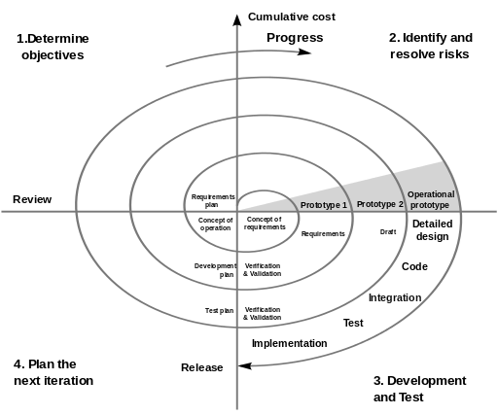
Spiral Model
Incremental and Iterative
Idea:
start by developing a prototype following a mini-waterfall model.
Prototype serves to gather requirements.
Each increment is reviewed and evaluated.
Image from creative commons

Slide 39
Unified Process
Iterative and Incremental, Use-case driven, Architecture centric
Phases:
  Inception: The core idea is developed into a product vision. We review and confirm our understanding of the core business drivers. We want to understand the business case for why the project should be attempted. Product feasibility and project scope.
  Elaboration: The majority of the Use Cases are specified in detail and the system architecture is designed. "Do-Ability" of the project. We identify significant risks and prepare a schedule, staff and cost profile for the entire project.
  Construction: Produces a system complete enough to transition to the user. The design is refined into code.
  Transition: The goal is to ensure that the requirements have been met to the satisfaction of the stakeholders. Other activities include site preparation, manual completion, and defect identification and correction. The transition phase ends with a postmortem devoted to learning and recording lessons for future cycles.

Slide 40
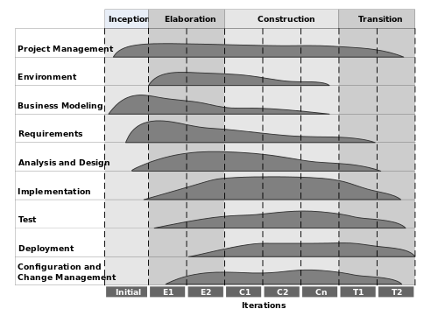
Unified Process (cont.)
Activities
Time
Image from creative commons

Slide 41
Agile Model
Key Assumptions
  Difficult to predict software requirements
  Difficult to predict analysis, design, construction, and testing
  Design and construction should be interleaved
How can we design a process that can manage unpredictability?
  Process adaptability.
Example: Extreme Programming (XP)
  4 phases: Planning (stories), Design (prototype solutions), Coding (pair programming, re-factoring), Test
  The tests are the specification
  Communication paramount (small team, knowledgeable programmers)

Slide 42
Software Lifecycle in Textbook
SYSC-3120
SYSC-4120
SYSC-4101
SYSC-1005…
Requirements
Elicitation
Requirements
Analysis
System
Design
Object
Design
Implemen-
tation
Testing
Implemented
By
Expressed in Terms Of
Structured By
Realized By
Verified
By
class...
class...
class...
?
class....
?
Use Case
Model
Application
Domain
Objects
Implementation Domain
Objects
SubSystems
Source
Code
Test
Cases
Notes:
1) This is how our lectures will proceed, following the chapters in the book.
2) There is going to be some dispute with the book’s terminology, but for now just notice that requirements is broken into two phases : elicitation and analysis: elicitation (from customer’s point of view) and analysis (formal, for developer).

Slide 43
Software Engineering Preview
Definitions
Software Failures
History and Context
Software Development Myths
Principles
Software Development Processes
Software Development Tools
Summary

Slide 44
Some Modeling Tools
Dataflow diagrams
Entity-Relationship diagrams
Finite state machines
Petri nets, queueing networks, fault tree
Descriptive Formal specification languages: Z, B, Alloy, SPIN, TRIO, VDM, LOTOS, RT-LOTOS …
Which notation is used depends on the type of system, familiarity of analysts, organization decisions, etc.
UML combines/adapts many notations into a consistent framework

Slide 45
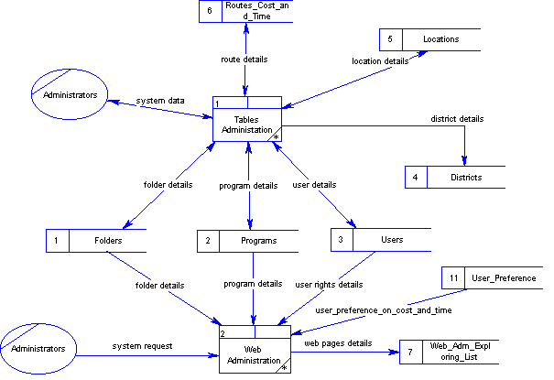
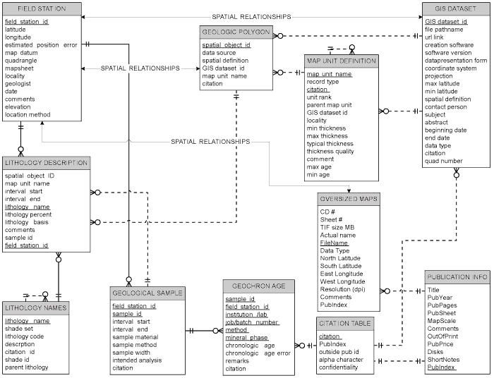
Some Modeling Tools
Data Flow Diagram
Entity Relationship Diagram

Slide 46
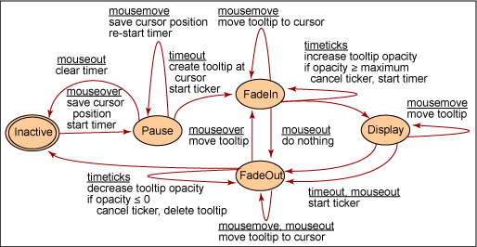
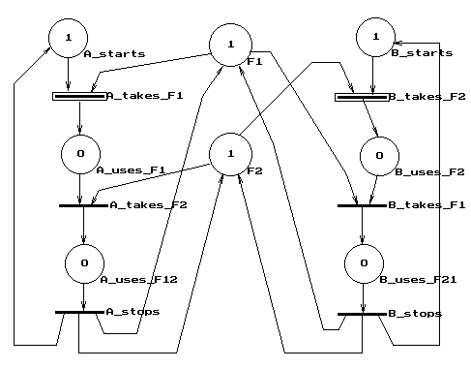
Some Modeling Tools
Finite State Machine
Petri Net

Slide 47
Some Modeling Tools
Synchronous (SCADE) diagram
Z notation

Slide 48
Some Modeling Tools
Unified Modeling Language (UML)
  Now the de-facto standard for OO software development
  70% of IT shops use the UML in one way or another
  90% of the Fortune 500 companies use the UML in one way or another

Slide 49
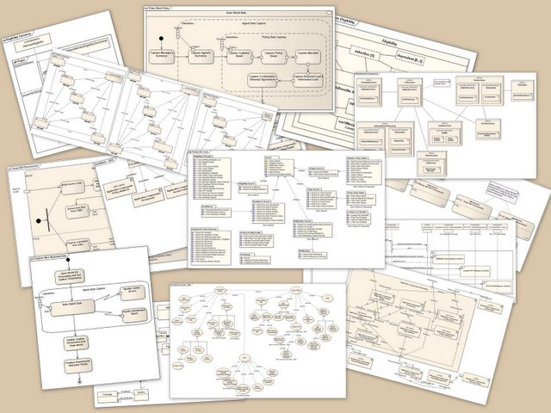
UML diagrams
Two categories of UML diagrams (out of 14 diagrams types)
Structure diagrams
  class, component, composite structure, package, profile, deployment, object
Behaviour diagrams
  use case, state machine, activity, sequence, communication, interaction overview, timing
Image from Creative Commons

Slide 50
UML CASE Tools
CASE = Computer-Aided Software Engineering
  Using automated tools (software) in software engineering
UML CASE tool
  Software to support the use of the UML
  Many, many such tool (incomplete list):
    http://en.wikipedia.org/wiki/List_of_Unified_Modeling_Language_tools
    with varying capabilities
  Software engineering activities supported?
    Drawing Modeling
    Different versions of UML Varying support for notation
    Code generation Documentation generation
    Individual and team work
    Software development phases (analysis, design, …)
    Measurement Simulation
    Forward/Reverse/Round-trip engineering Traceability …

Slide 51
Software Engineering Preview
Definitions
Software Failures
History and Context
Software Development Myths
Principles
Software Development Processes
Software Development Tools
Summary

Slide 52
Summary
Software engineering is
  engineering discipline focused on the development of software systems
  as the solution to a user’s problem
  applying the right techniques / methods / tools
Software engineering is necessary for developing complex but reliable software
A good software engineering practice help to develop software in large teams.

Slide 53
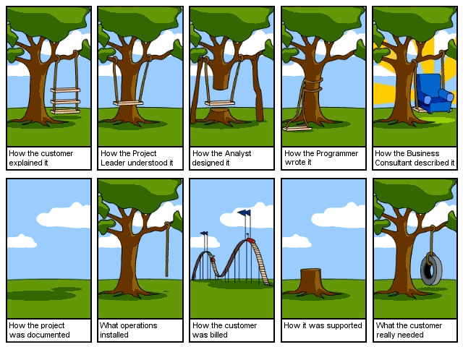
SE goal is to avoid this

