Slide 1
SYSC-3120 —Software Requirements Engineering
ARENA Case Study

Slide 2
ARENA Case Study
Problem statement
Requirement elicitation
Use case model
OO Analysis Model

Slide 3
Initial Problem Statement
1. Problem
The popularity of the Internet and the WWW has enabled the creation of a variety of virtual communities:
groups of people sharing common interests
who have never met each other in person
can be short lived (e.g., a group of people meeting in a chat room or playing a tournament) or long lived (e.g., subscribers to a mailing list).
Many multi-player computer games now include support for the virtual communities of players:
receive news about game upgrades
new game maps and characters
announce and organize matches
compare scores and exchange tips
the game company takes advantage of this infrastructure to generate revenue or to advertise its products.

Slide 4
Initial Problem Statement (2)
Problem (cont.)
Currently, however, each game company develops such community support in each individual game.
Each company uses a different infrastructure, different concepts, and provides different levels of support.
This redundancy and inconsistency results in disadvantages:
learning curve for players when joining each new community,
game companies need to develop the support from scratch
advertisers need to contact each individual community separately
this solution does not provide much opportunity for cross-fertilization among different communities.

Slide 5
Initial Problem Statement (3)
2. Objectives
provide an infrastructure for operating an arena, including registering new games and players,
organizing tournaments, and keeping track of the players scores
provide a framework for league owners to customize the number and sequence of matches and the accumulation of expert rating points.
provide a framework for game developers for developing new games, or for adapting existing games into the ARENA framework.
provide an infrastructure for advertisers.

Slide 6
Initial Problem Statement (4)
3. Functional requirements
ARENA supports five types of users:
The operator should be able to define new games, new tournament styles (e.g., knock-out tournaments, championships, best of series), define new expert rating formulas, and manage users.
League owners should be able to define a new league, organize and announce new tournaments within a league, conduct a tournament, and declare a winner.
Players should be able to register in an arena, apply for a league, play the matches that are assigned to the player, or drop out of the tournament.
Spectators should be able to monitor any match in progress and check scores and statistics of past matches and players. Spectators do not need to register in an arena.
The advertiser should be able to upload new advertisements, select an advertisement scheme (e.g., tournament sponsor, league sponsor), check balance due, and cancel advertisements.

Slide 7
Initial Problem Statement (5)
4. Non-functional requirements
Low operating cost. The operator must be able to install and administer an arena without purchasing additional software components and without the help of a full-time system administrator.
Extensibility. The operator must be able to add new games, new tournament styles, and new expert rating formulas. Such additions may require the system to be temporarily shut down and new modules (e.g., Java classes) to be added to the system. However, no modifications of the existing system should be required.
Scalability. The system must support the kick-off of many parallel tournaments (e.g., 10), each involving up to 64 players and several hundreds of simultaneous spectators.
Low-bandwidth network. Players should be able to play matches via a 56K analog modem or faster.

Slide 8
Initial Problem Statement (6)
5. Target environment
All users should be able to access any arena with a web browser supporting cookies, Javascript, and Java applets.
Administration functions (e.g., adding new games, tournament styles, and users) used by the operator should not be available through the web.
ARENA should run on any Unix operating system (e.g., MacOS X, Linux, Solaris).

Slide 9
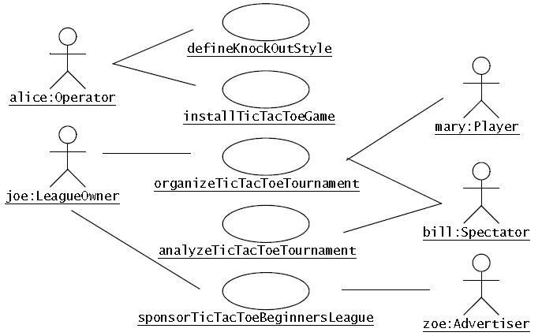
Identifying Actors and high-level Use Cases
Five actors are identified from the problem statement:
Operator, LeagueOwner, Player, Spectator, and Advertiser
High level use cases identified by looking at a narrow vertical slice of the system: TicTacToeTournament (described in text and use-case diagram)

Slide 10
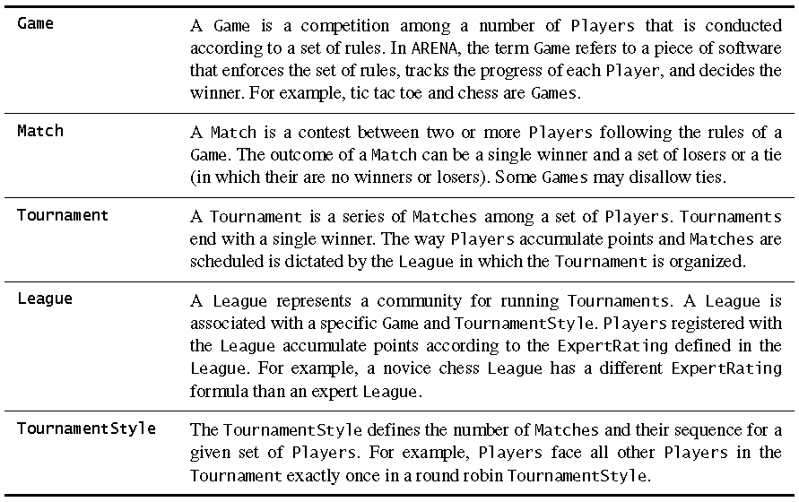
Glossary – define problem domain concepts

Slide 11
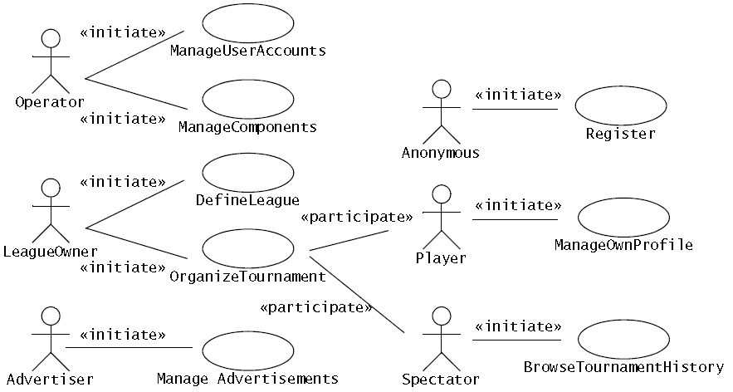
Refine high-level Use Cases

Slide 12
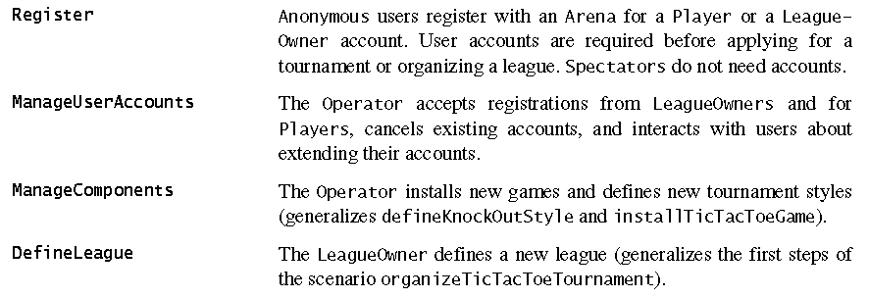
Brief description of Use Cases (1)

Slide 13
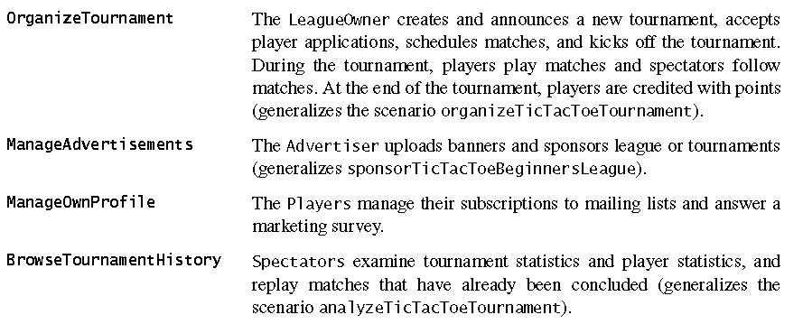
Brief description of Use Cases (2)

Slide 14
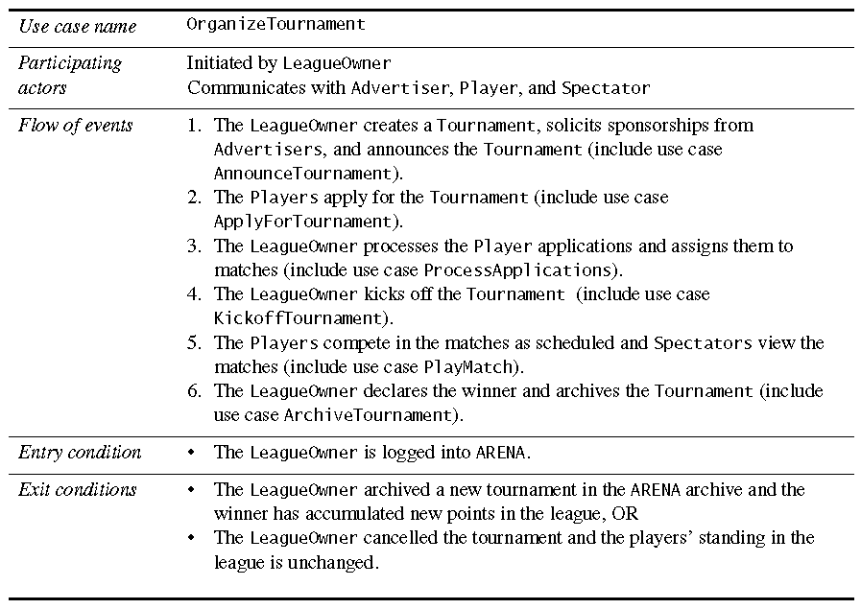
High-level use case OrganizeTournament

Slide 15
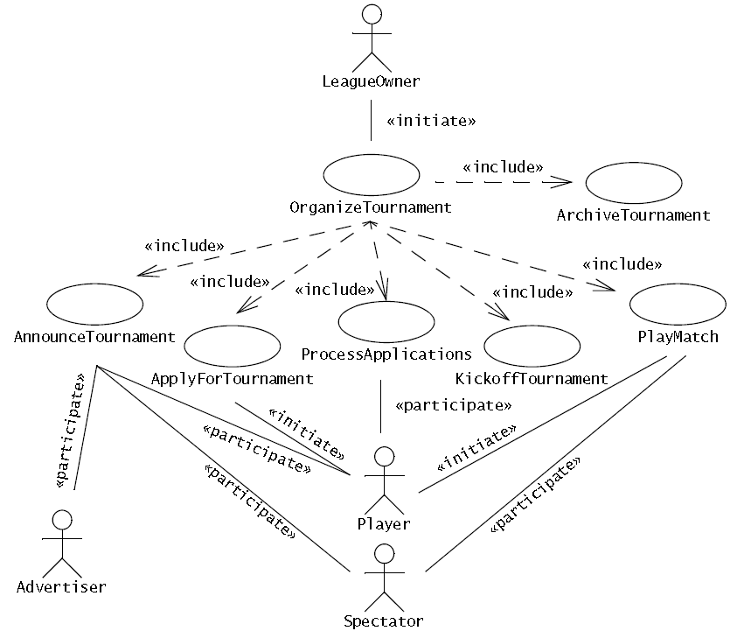
Refine OrganizeTournament

Slide 16
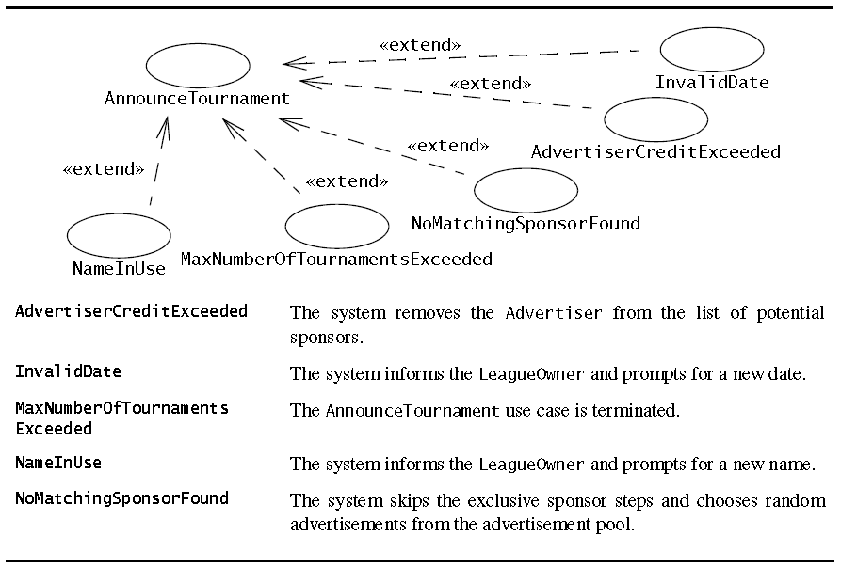
Exceptions occurring in AnnounceTournament

Slide 17
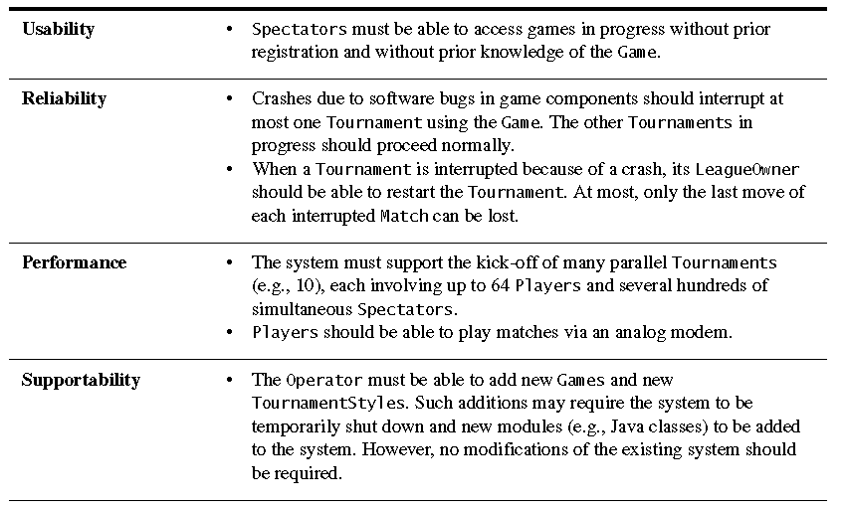
Non-functional requirements (1)

Slide 18
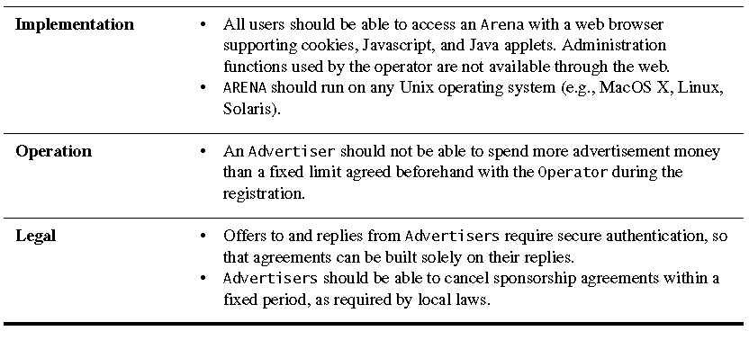
Non-functional requirements (2)

Slide 19
Lessons Learned during Requirements Elicitation
Requirements elicitation involves constant switching between perspectives
high-level vs. detailed,
client vs. developer,
activity vs. entity.
Requirements elicitation requires a substantial involvement from the client.
Developers should not assume that they know what the client wants.
Eliciting non-functional requirements forces stakeholders to make and document trade-offs.

Slide 20
OO Analysis Phase
Develop the part of the analysis object model relevant to the AnnounceTournament use case of ARENA.
Start by identifying entity objects using Abbott’s heuristics
Identify boundary and control objects
Use sequence diagrams to find:
additional associations
objects
attributes.
Finally, consolidate the object model and represented it in a series of class diagrams.

Slide 21
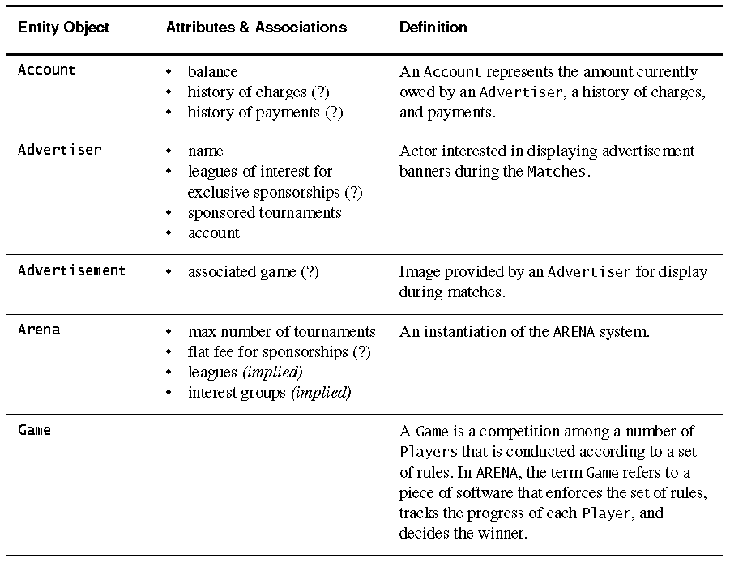
Entity objects (using Abbott’s heuristics)
continue…

Slide 22
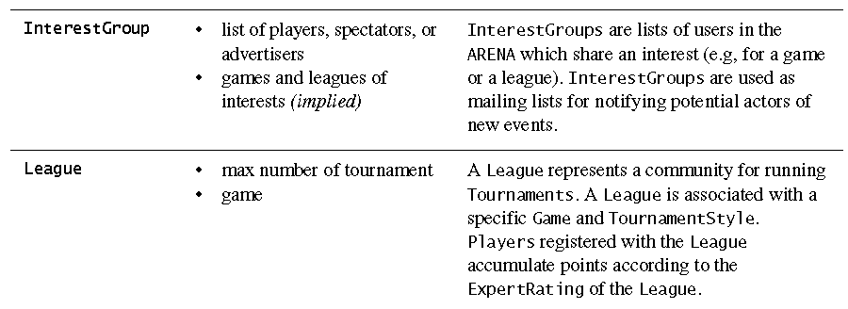
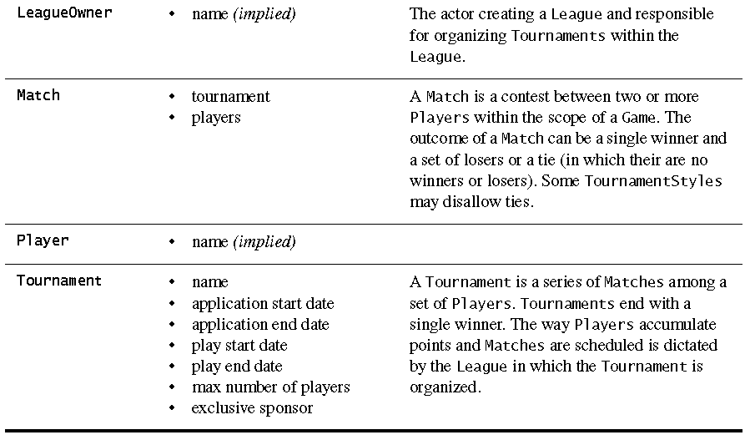
Entity objects (cont)

Slide 23
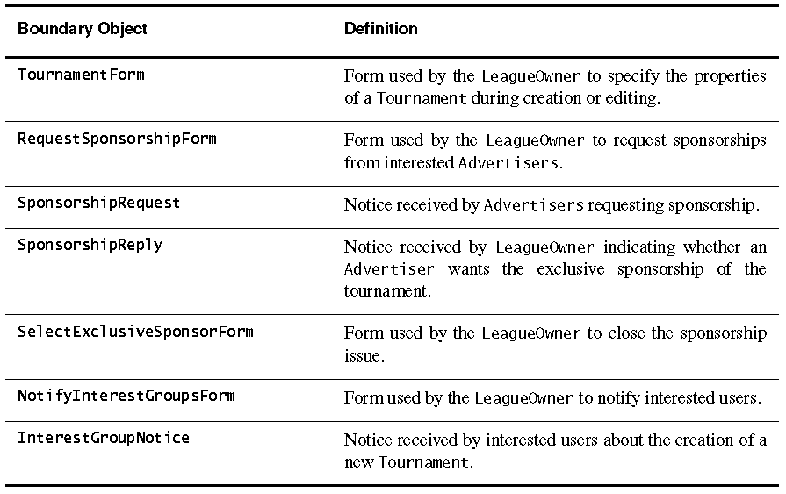
Boundary Objects in Announce Tournament

Slide 24
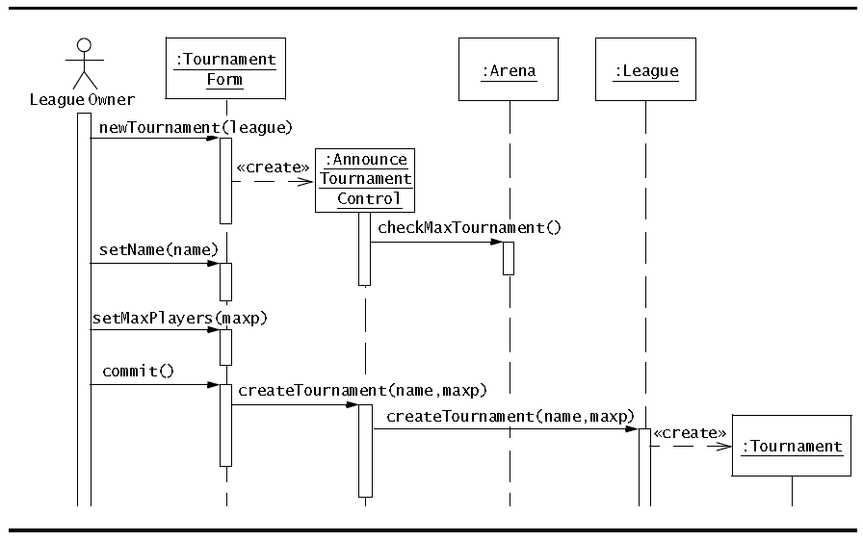
Object interaction: tournament creation workflow

Slide 25
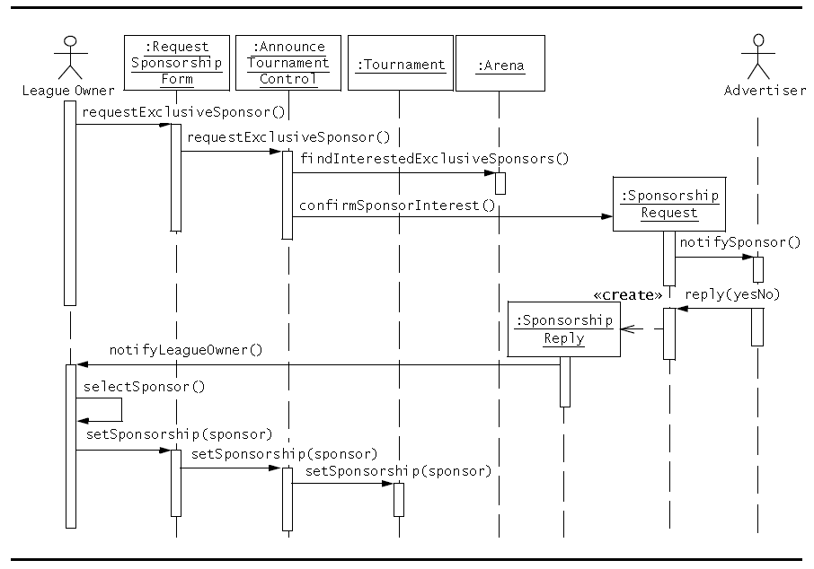
Object interaction: sponsorship workflow

Slide 26
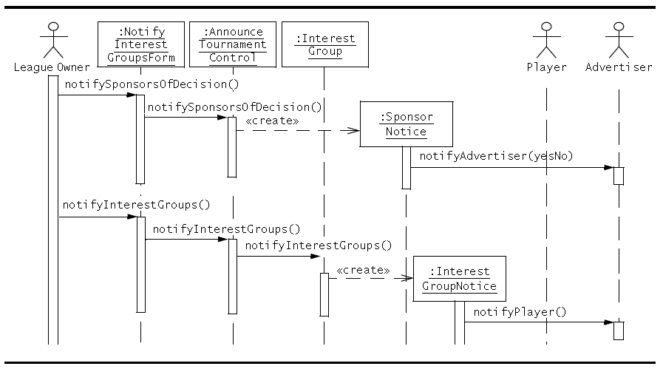
Object interaction: interest group workflow

Slide 27
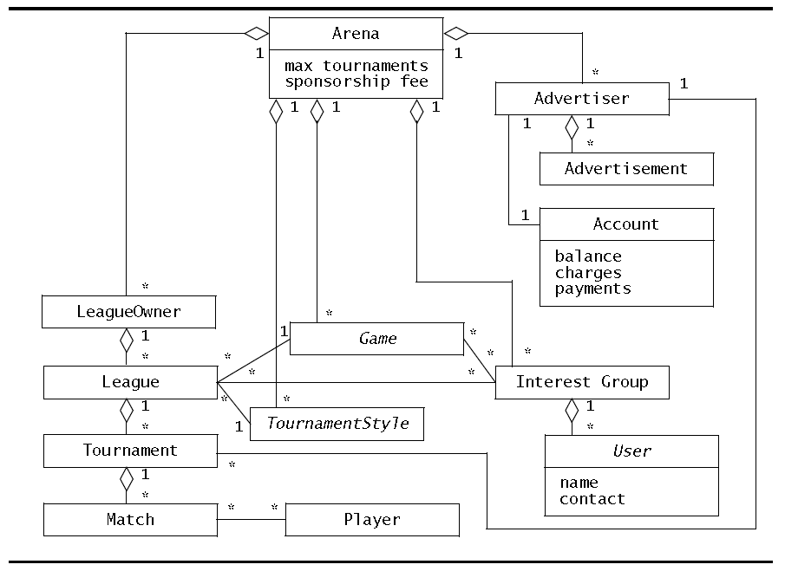
Consolidated class diagram: entity objects

Slide 28
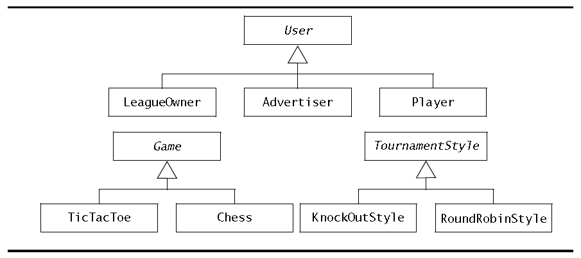
Inheritance hierarchy among entity objects

Slide 29
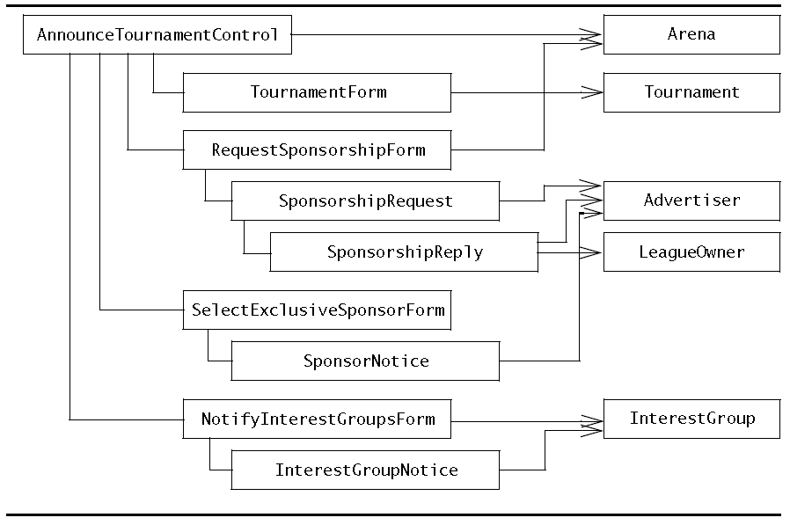
Associations among boundary, control and selected entity objects

Slide 30
Lessons learned during OO Analysis
Identifying objects, their attributes and associations, takes many iterations, often with the client.
Object identification uses many sources, including the problem statement, use case model, the glossary, and the event flows of the use cases.
A nontrivial use case can require many sequence diagrams and several class diagrams.
It is unrealistic to represent all discovered objects in a single diagram. Instead, each diagram serves a specific purpose:
depicting associations among entity objects
depicting associations among participating objects in one use case.
Key deliverables, such as the glossary, should be kept up to date as the analysis model is refined.
others, such as sequence diagrams, can be redone later if necessary.
maintaining consistency at all times, however, is unrealistic.
There are many different ways to model the same application domain or the same system, based on the personal style and experience of the analyst.
This calls for developing style guides and conventions within a project.

