Slide 1
Software Requirements Elicitation and Specifications
-
Fundamentals

Slide 2
How to build a better mousetrap
How do you know what to build?

Slide 3
Objectives
Describe “Requirements Engineering”.
Describe “requirements”.
  User vs System
  Functional vs non-functional.
Determine those things which are not requirements.
Some guidelines for writing requirements.

Slide 4
Requirements engineering
The process of establishing the services that the customer requires from a system and the constraints under which it operates.
The requirements themselves are the descriptions of the system services and constraints that are generated during the requirements engineering process.
We will see one popular way to performing requirements engineering in the next course section.

Slide 5
What is a requirement?
It may range from a high-level abstract statement of a service or of a system constraint to a detailed mathematical functional specification.
This is inevitable as requirements may serve a dual function
  May be the basis for a bid for a contract - therefore must be open to interpretation;
  May be the basis for the contract itself - therefore must be defined in detail;
  Both these statements may be called requirements.

Slide 6
Types of requirement
User requirements
  Statements in natural language plus diagrams of the services the system provides and its operational constraints. Written for customers.
System requirements
  A structured document setting out detailed descriptions of the system’s functions, services and operational constraints. Defines what should be implemented so may be part of a contract between client and contractor.

Slide 7
Definitions and Specifications
User Requirement Definition
  The software must provide a means of representing and accessing external files created by other tools
System Requirements Specification
  The user should be provided with facilities to define the type of external files
  Each external file type may have an associated tool which may be applied to the file
  Each external file type may be represented as a specific icon on the user’s display
  Facilities should be provided for the icon representing an external file type to be defined by the user
  When a user selects an icon representing an external file, the effect of that selection is to apply the tool associated with the type of the external file to the file represented by the selected icons

Slide 8
Informal, High-Level Examples of Functional Requirements
Road De-Icing System
  Product accepts a Scheduling date and district identifier from the engineer
  Product fetches the relevant thermal maps
  Product determines which roads are likely to freeze and when
  Product schedules available trucks from the depot
  Product advises the engineer of the schedule
Notes:
Informal, concise requirements – we will see next how to write good requirements
Product interact with another system producing thermal maps and an engineer (actors in UML)
No specification of how the system is to be designed and implemented, unless demanded by the customer … (we will see examples later on)

Slide 9
Motivations and Goals
Requirements describes the expected behavior of a system and the constraints under which it must operate
Every nontrivial engineering system must be specified, based on user requirements
Requirements need to be explicitly stated and documented for system implementation, e.g., used for design decisions, verification and validation, and a reference point during maintenance
SE is about developing software solutions to problems – Good solutions can only be developed if software engineers understand the problems.
Notes:
Requirements versus specifications
Specifying and implementing a system right based on incorrect/incomplete requirements leads to the wrong system being delivered, though it may be reliable, etc.
Non-functional: time, memory, but also legacy/environment constraints: prog. Lang, reuse, …

Slide 10
Motivations and Goals (II)
Defects are cheaper when detected earlier
For safety-critical systems, requirements problems are more likely to be safety-related
Failure to understand and manage requirements is the biggest single cause of cost and schedule slippage
Requirements documentation treats the software system as a black-box
Separation of concerns: what vs. How

Slide 11
Survey
Standish Group surveyed 350 companies, over 8000 projects, in 1994
31% cancelled before completed, 9-16% were delivered within cost and budget
Causes of failed projects:
  Incomplete requirements (13%)
  Changing requirements and specifications (9%)
  Unrealistic expectations (9%)
  Lack of user involvement (12%) …

Slide 12
Fault Analysis
Source: Lutz, 1993, IEEE Int. Symp. On Requirements Engineering
NASA Voyager (87 faults) and Galileo (122 faults)
Safety-related interface faults overwhelmingly caused by communication errors between development teams (93%, 72%)
Functional faults, especially safety-related ones, primarily caused by misunderstanding requirements (62%, 79%)

Slide 13
Functional vs. Nonfunctional
Functional requirement: interaction between a system and its environment (e.g., UML actors)
Nonfunctional requirement: restriction on the system that limits our choices for constructing a solution, e.g., memory, platform, real-time constraints
Nonfunctional requirements have as much impact on the system cost and development as functional requirements

Slide 14
Types of NF Requirements (I)
Performance – speed, reliability, safety, memory, accuracy
Operational – operating environment
Maintainability, portability – expected changes, time allowed to make them
Look and feel – product appearance
Usability – ease of use, specific needs
Notes:
NF: Non-Functional
Several classifications exist – here is one I like
operating: where is the system to function? One location or several? Temperature, humidity, magnetic interferences …
Sommerville, SE, 2000 provides another classification

Slide 15
Types of NF Requirements (II)
Security – accessibility and confidentiality
Cultural, ethical, and political requirements
Legal requirements – laws and standards
NF requirements have to be prioritized by importance. Some of them need to be met for the system to operate correctly
Notes:
Political, Cultural: system should not include products by **, should only include components made in **, spelling (UK, vs US)

Slide 16
Examples
The product should identify an aircraft within 0.25 seconds
The product should be used with poor lighting conditions and the users will wear gloves
The product should be easy to use with only one hand free
The system shall not disclose any personal information about customers
The product should be readily portable to the Linux operating system
Notes:
Guess the type

Slide 17
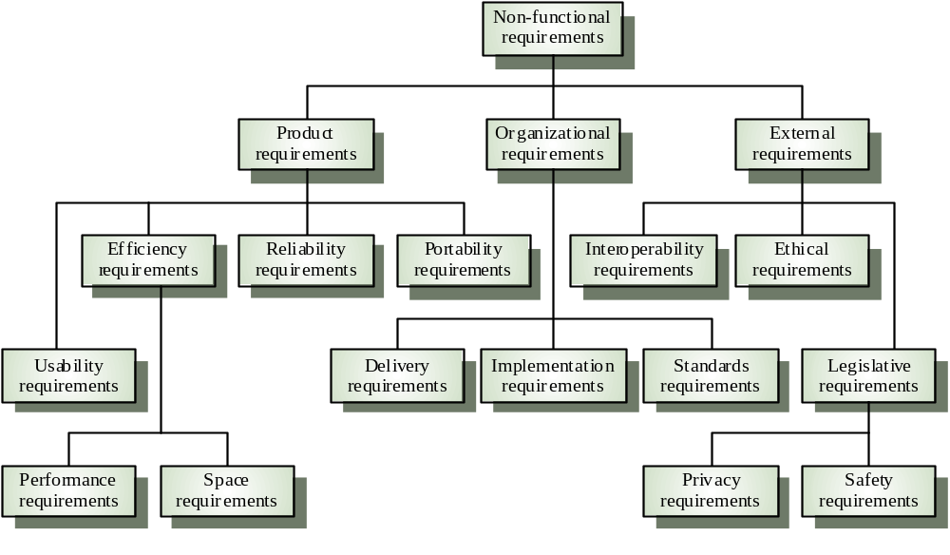
Sommerville’s Classification
Notes:
Sommerville, Software Engineering, 2000

Slide 18
Non-Functional Classification
Product requirements
  Requirements which specify that the delivered product must behave in a particular way e.g. execution speed, reliability, etc.
Organisational requirements
  Requirements which are a consequence of organisational policies and procedures e.g. process standards used, implementation requirements, etc.
External requirements
  Requirements which arise from factors which are external to the system and its development process e.g. interoperability requirements, legislative requirements, etc.

Slide 19
NFR Examples
Product requirement
  The user interface for LIBSYS shall be implemented as simple HTML without frames or Java applets.
Organisational requirement
  The system development process and deliverable documents shall conform to the process and deliverables defined in XYZCo-SP-STAN-95.
External requirement
  The system shall not disclose any personal information about customers apart from their name and reference number to the operators of the system.

Slide 20
Requirements measures

Slide 21
What is usually not in the Requirements?
System structure, implementation technology
Development methodology
Development environment
Implementation language
Reusability (e.g., third-party components, libraries)
It is desirable that none of these be constrained
by the client.
Notes:
But in certain application domains, like airborne systems, military systems, there are (international) standards to follow.

Slide 22
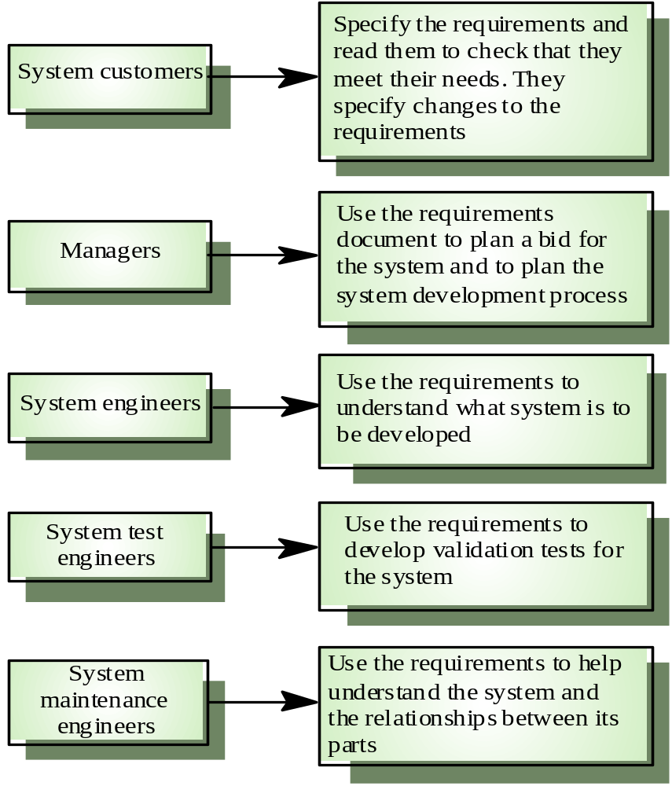
RequirementsUsers
Notes:
Users of the requirements
Sommerville, SE, 2000

Slide 23
User requirements
Should describe functional and non-functional requirements in such a way that they are understandable by system users who don’t have detailed technical knowledge.
User requirements are defined using natural language, tables and diagrams as these can be understood by all users.

Slide 24
Problems with natural language
Lack of clarity
  Precision is difficult without making the document difficult to read.
Requirements confusion
  Functional and non-functional requirements tend to be mixed-up.
Requirements amalgamation
  Several different requirements may be expressed together.

Slide 25
Guidelines for writing requirements
Invent a standard format and use it for all requirements.
Use language in a consistent way. Use “shall” for mandatory requirements, “should” for desirable requirements.
Use text highlighting to identify key parts of the requirement.
Avoid the use of computer jargon.

Slide 26
Sumary
“Requirements Engineering”: determining what the cu$tomer wants.
  Users have requirements, which means the
  System has requirements too.
We usually focus on the functional requirements (make it work!).
Non-functional (“ilities”) are important too.
  They are???

